Slide 1
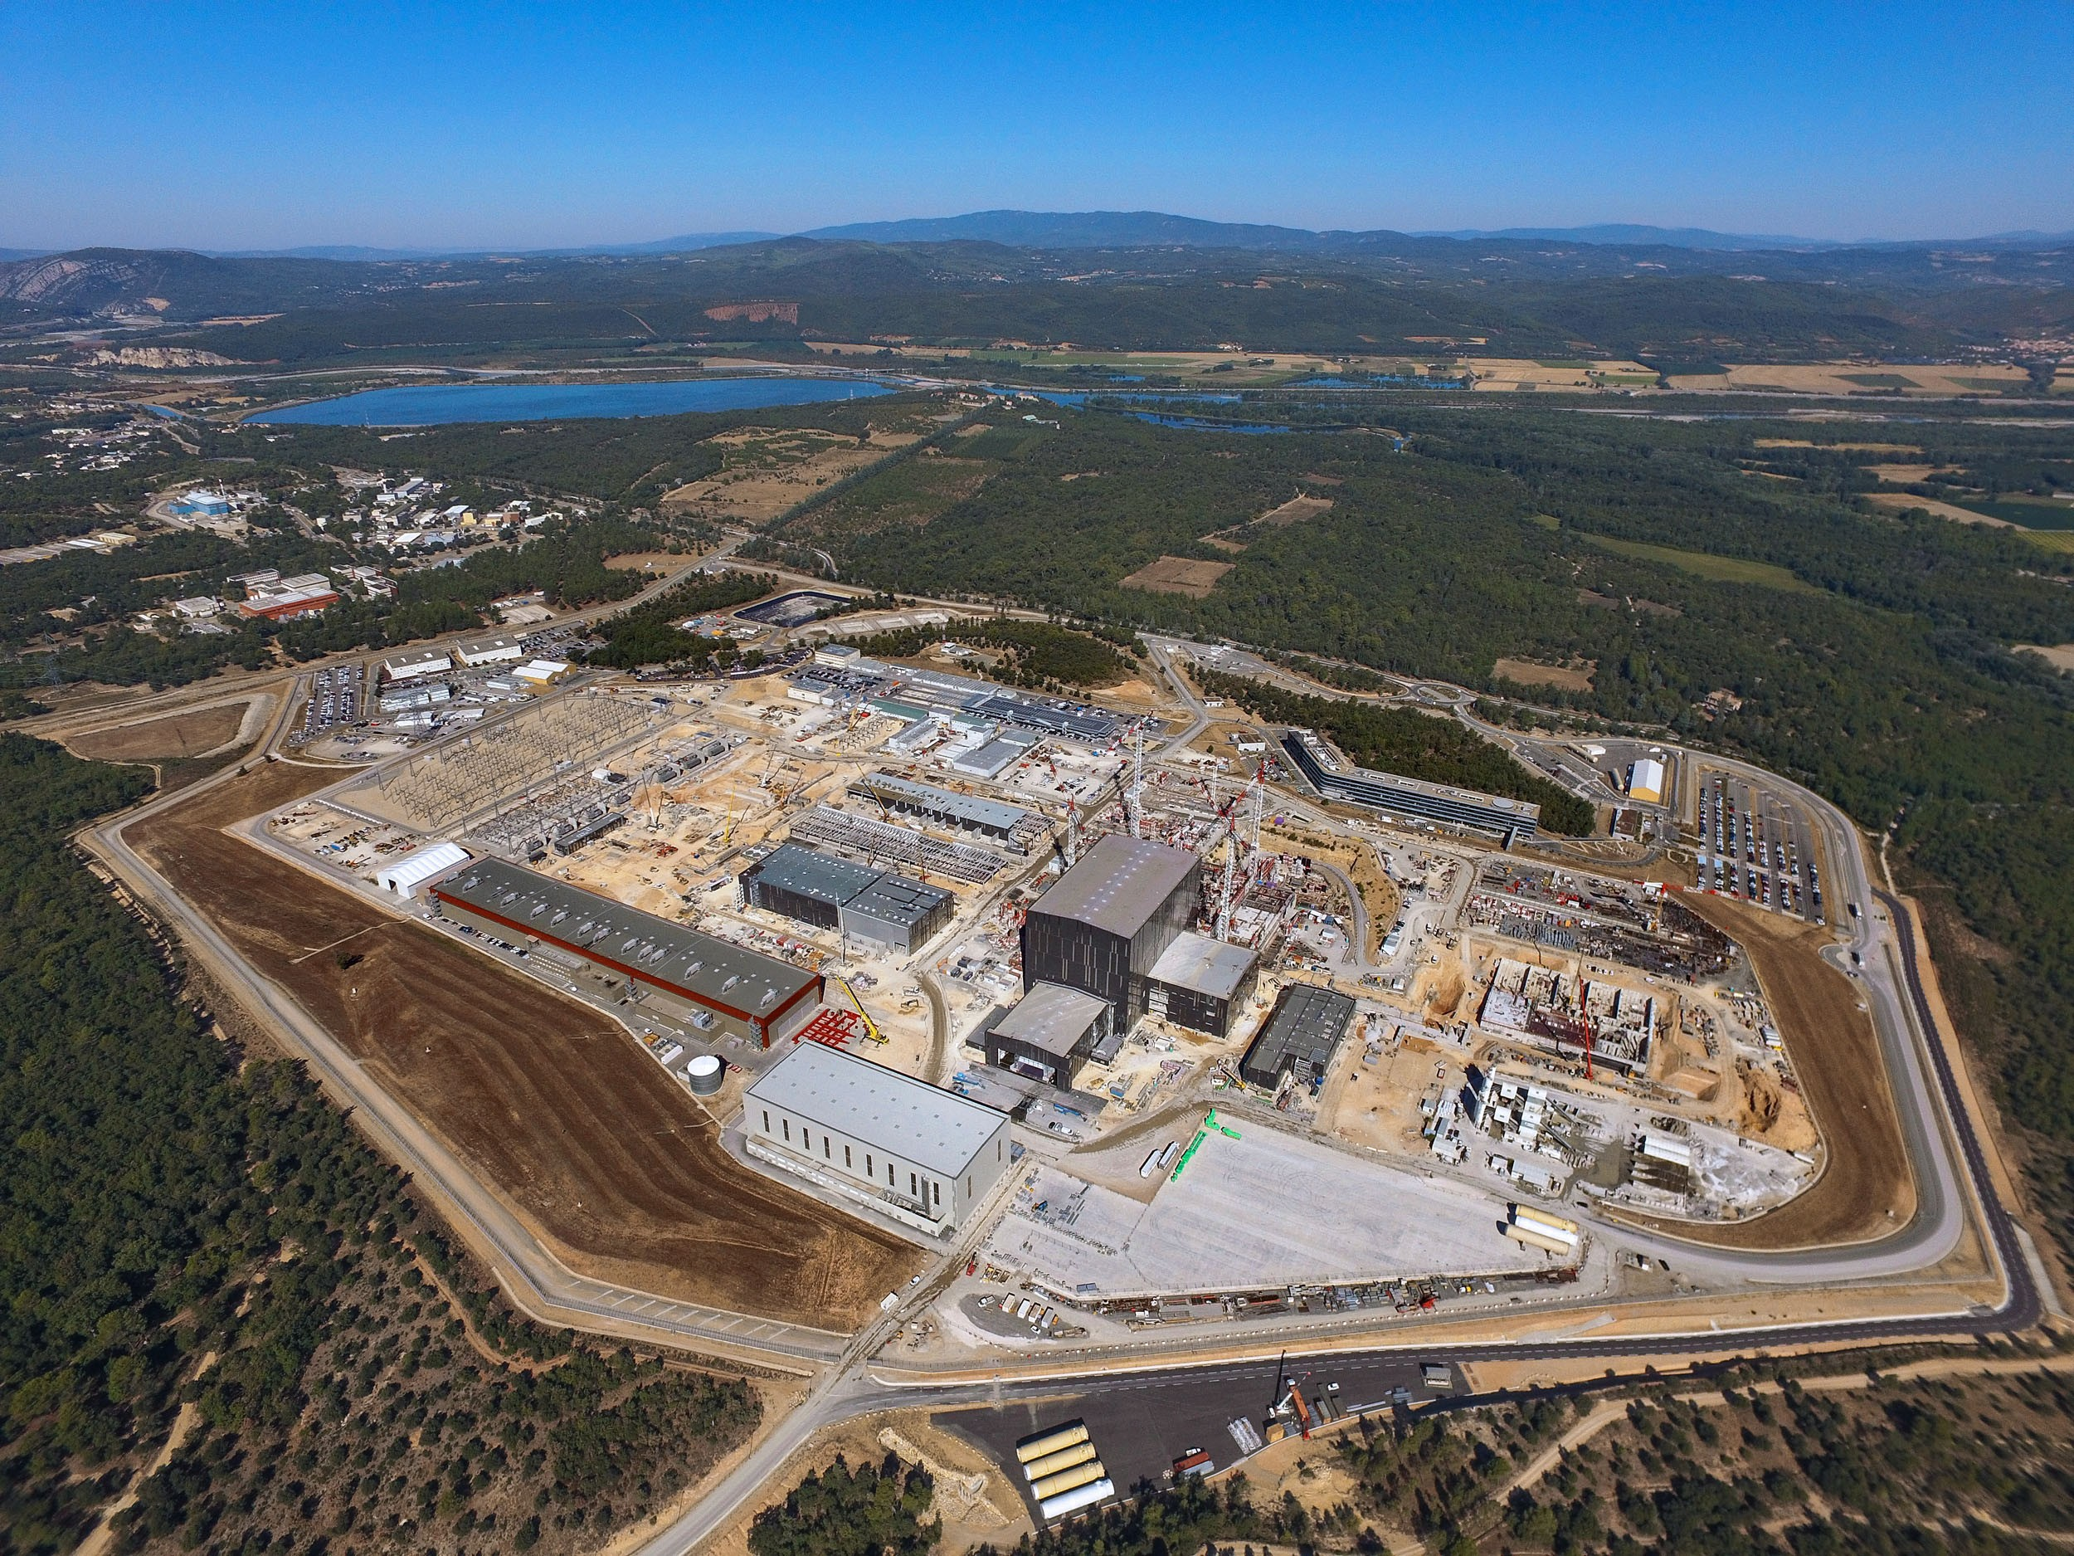
The ITER Research Plan
within the Staged Approach
D J Campbell
Director for Science and Operations. ITER Organization
The views and opinions expressed herein do not necessarily reflect those of the ITER Organization.

Slide 2
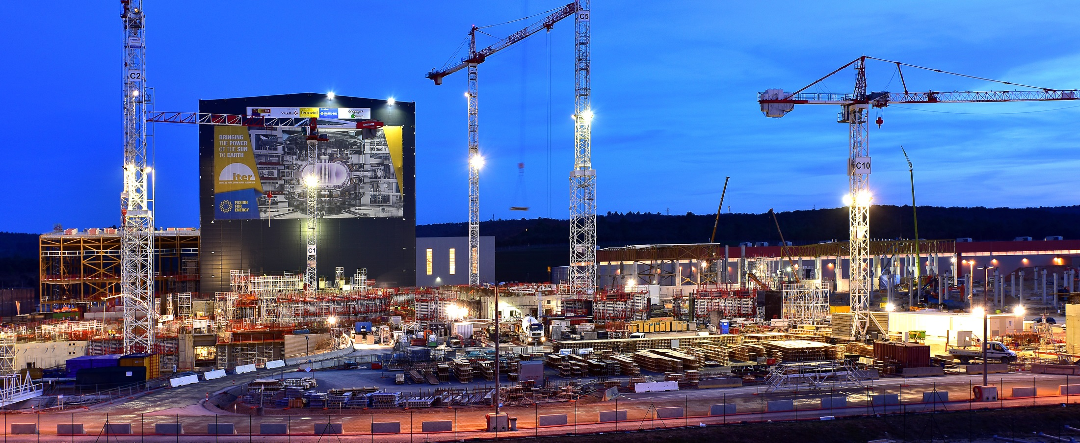
Synopsis
Structure and major activities within the Research Plan
  Schedule and Plant Configuration for present Research Plan analysis
Research Plan: Experimental Programme
  plasma scenarios for the Research Plan
  outline of experimental activities within the 4-stage approach
  extension of 4th stage to long-pulse and burning plasma studies
  estimates of operational time required for major activities

Slide 3
ITER Research Plan:
Structure and Major Elements

Slide 4
Research Plan: Background to Present Analysis
ITER Research Plan Workshop held with participation of experts from Members’ fusion communities:
  Workshop 1: 26 – 28 July 2016
  Workshop 2: 14 – 17 February 2017
  Workshop 3: 14 – 17 March 2017
Workshop participants requested to analyze key activities required to develop the research programme following First Plasma:
  commission all required auxiliary systems with plasma to full performance
  explore options, e.g. H-mode at 1.8 T, PFPO long-pulse scenarios
  programme to achieve initial DT fusion power production at levels of several hundred MW, optimize Q and extend burning plasmas to long duration
⇒ Report to IC-STAC-22, 16 – 18 May 2017

Slide 5
Research Plan: An Important Note
ITER differs in an important way from other devices:
  the experimental programme is determined by the need to reach high current and to demonstrate baseline fusion power as soon as possible
  Disruptions must be absolutely be mastered to reach high I_{p}
  to a large extent the whole of PFPO and a large fraction of the first part of FPO is ‘commissioning with plasma’ of all tokamak and plant systems for to prepare the reliable operation required to reach high Q
  nevertheless, we anticipate that even during the ‘commissioning with plasma’ phase in PFPO, that ITER will give access to many new aspects of fusion plasma research as the programme develops plasmas with parameters well beyond those which can be attained in present experiments

Slide 6
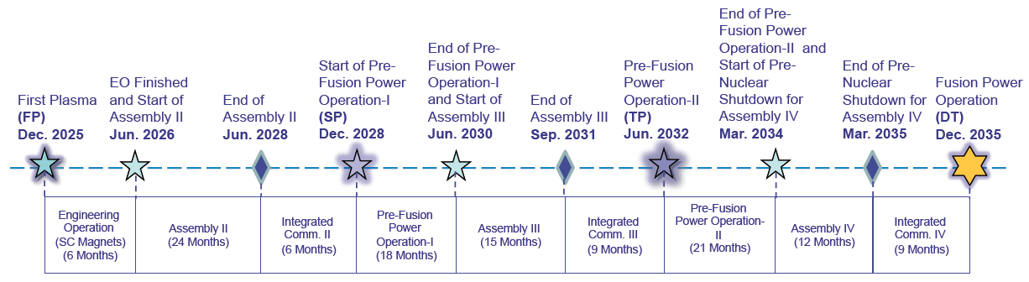
Baseline Schedule - ‘Staged Approach’
During 2015 – 2016, the project has performed a ‘bottom-up’ analysis of the construction and operations schedule to develop a fully consistent programme towards plasma operation and fusion power production:
Schedule and IO-CT resource estimate to First Plasma consistent with Members’ budget constraints
4-stage operations programme developed towards fusion power production in DT, starting in late-2035
DT
Operation
Stage I
Stage II
Stage III
Stage IV

Slide 7
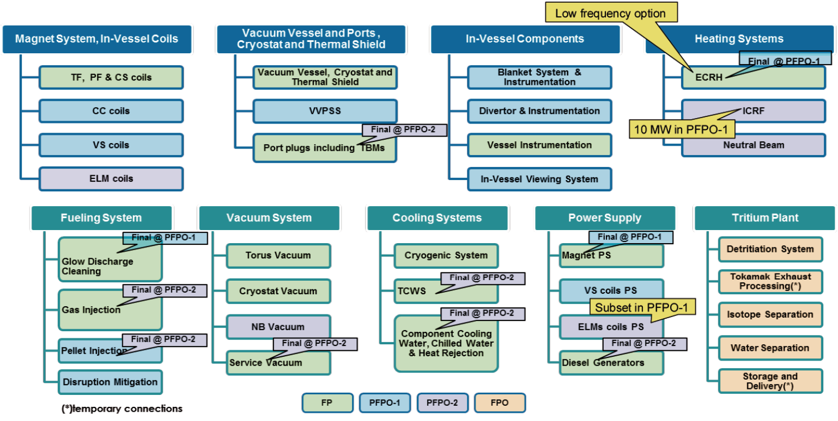
Overview of ITER Plant Configuration I
First tritium introduction possible from early 2033

Slide 8
Overview of ITER Plant Configuration II
Heating and Current Drive systems:
  PFPO-1: 20 MW ECRH (plus 104/110 GHz option), 10 MW ICRF
  PFPO-2: 20 MW ECRH (plus 104/110 GHz option), 20 MW ICRF,
  33 MW HNB
  FPO: 20 MW ECRH, 20 MW ICRF, 33 MW HNB
In-Vessel Coils:
  PFPO-1: VS coils, 9 power supplies for ELM coils
  PFPO-2/ FPO: VS coils, all ELM coils powered
Diagnostic systems:
  Phased approach matching the operational requirements and experimental goals of each stage of IRP – see backup slides

Slide 9
Research Plan Structure and Activities I
Pre-Fusion Power Operation (PFPO):
  First Plasma: nominal 100 kA/100 ms
  plasma operation to ~3.5 MA to establish initial divertor operation
  disruption loads, disruption detection, avoidance and mitigation
  extensive control and protection system commissioning
  development of plasma operation to ~7.5 MA/ 2.65 T (possibly ~10 MA/5.3 T)
  possible option for operation at 5 MA/1.8 T (early H-mode access) with ECRH and ICRF heating systems
  H-mode operation and ELM Control (helium/ hydrogen?)
  options for long pulse operation in L- and H-mode
  demonstration of 15 MA/ 5.3 T operation
  PWI programme: eg, fuel retention/removal, dust, limiter/divertor heat loads

Slide 10
Research Plan Structure and Activities II
Fusion Power Operation (FPO):
  development of deuterium H-modes and preparation of DT scenarios
  trace tritium experiments to initiate transition to full DT operation
  development of 15 MA/5.3 T DT scenario
  initial DT operation to short-pulse (few×10s) several 100 MW fusion power
  optimize Q with target of Q ≥ 10 to few×10s
  develop scenarios for long-pulse operation:
    Inductive: Q ≥ 10 towards ~500 s
    Hybrid: Q ~ 5 (up to 10, if possible) towards ~1000 s
    Non-inductive: Q ~ 5 towards ~3000 s
  PWI programme: Fuel retention/ removal, material migration,
  heat loads/ detachment control

Slide 11
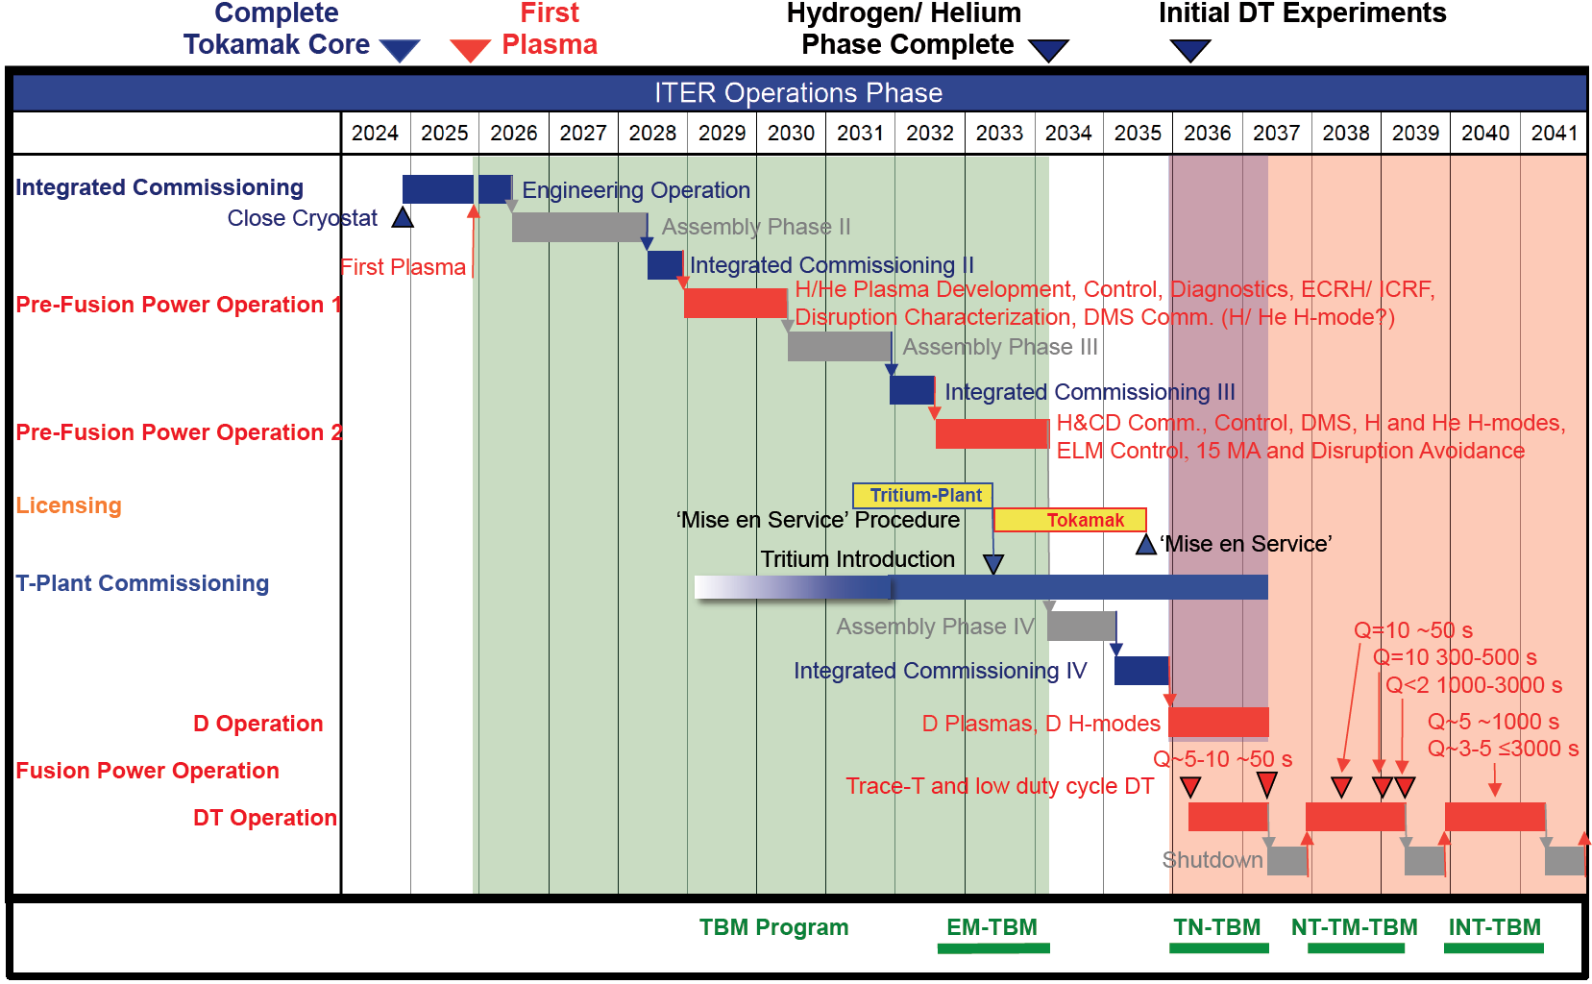
Overview of ITER Experimental Plan
PFPO-1
PFPO-2
FPO-1
FPO-1
FPO-2
FPO-3

Slide 12
Estimate of Available Experimental Time
Two-shift operation:
  two week experimental cycle: 12 days experiments/ 2 days maintenance
  (Nominal) two year experimental campaign cycle ⇒ ~ 415 days of experiments
  incorporating RAMI analysis for Availability and conservative approach to disruption mitigation/recovery ⇒ ~ 13 pulses/ day in 2 shift operation
  New IRP analysis is consistent with Staged Approach

Slide 13
ITER Research Plan:
Experimental Programme

Slide 14
ITER reference plasma scenarios
The set of DT reference scenarios in ITER is specified via illustrative cases in the Project Requirements:
⇒ Design Basis plasma scenarios

Slide 15
Availability of H&CD systems in IRP
2025 | 2026 | 2027 | 2028 | 2029 | 2030 | 2031 | 2032 | 2033 | 2034 | 2035 | 2036
6 m
18 m
21 m
First
Plasma
1st plasma
PFPO-1
PFPO-2
FPO
Full ECRH system,
170 (+104-110?) GHz
20 MW
Full ECRH system,
170 (+104-110?) GHz
20 MW
ECRH available, UL
170 GHz, 6.7 MW
ICRF available,
1 antenna, 10 MW
Full ICRF system,
2 antennas, 20 MW
NBI available,
2 injectors, 33 MW
P_{AUX}
6.7 MW
30 MW
73 MW
73 MW

Slide 16
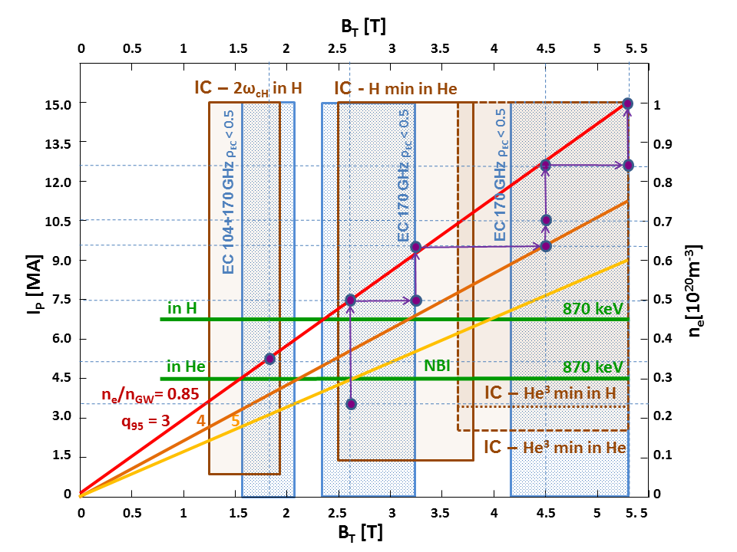
Key plasma scenarios in PFPO-1 and PFPO-2
First plasma
0.1 MA / 2.65 T H plasma
First divertor plasma
3.2 MA / 2.65 T H plasma
First q₉₅=3 plasma
7.5 MA / 2.65 T H plasma
First H-mode plasma
5 MA / 1.8 T He & H plasma
First full current plasma
15 MA / 5.3 T H plasma
First 7.5 MA H-mode plasma
7.5 MA / 2.65 T He & H plasma

Slide 17
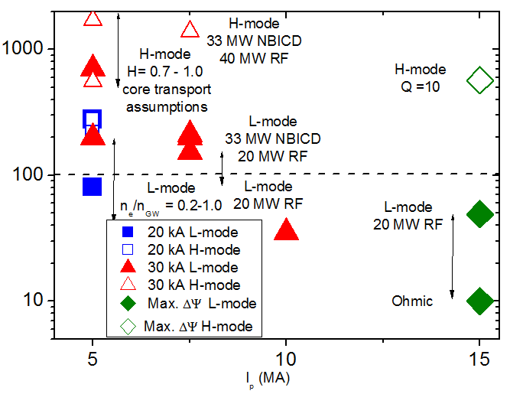
Demonstration of long pulse operation
Goal:
  To assess issues related to processes that evolve on long timescales (changes in current profile, recycling etc.)
Method:
  Built on CS inductive flux at low I_{p} and ITER current drive capabilities (NBCD, ECCD, bootstrap)
Results:
  Possibility to achieve ~1000 s long pulses in 7.5 MA / 2.65 T H-modes even without significant use of CS lifetime (~30 kA, compared to maximum of ~45 kA)
Achievable flat top durations versus pre-magnetization current for a range of plasma conditions
Flattop duration (s)
I_{p} (MA)

Slide 18
1. First Plasma
Integrated Commissioning:
  Integrated commissioning of:
    required plant systems (central control systems, power supplies, cooling/baking, vacuum, cryogenics etc.)
    Magnet systems to level required for FP (nominally 50% maximum current)
    ECRH, diagnostics, fuelling, GDC, PCS systems
  magnetic diagnostic calibration
First Plasma:
  100 kA/ 100 ms milestone
Engineering Commissioning (~6 months):
  performance tests of all Magnet systems to full current
  magnetic axis alignment measurement
  if opportunity arises, 1 MA circular limiter plasma demonstration

Slide 19
2. PFPO-1 Overview
Main elements of experimental programme during PFPO-1:
  development of plasma control capability (PCS), including CIS/CSS plasma-related functions:
    commissioning of plasma magnetic control
    commissioning of core plasma density and impurity control
    commissioning of blanket first wall protection system
    characterization of limiter/ divertor heat loads
  development of diverted plasma scenarios for robust operation to perhaps 10 MA (with B_{t} over range 1.8 – 5.3 T)
  commissioning of disruption prediction, avoidance and disruption/runaway electron mitigation systems
  ECRH commissioning to 20 MW (all launchers); ICRF commissioning to 10 MW
  exploitation of VS coils and Correction Coils; propose early functional tests of ELM coils for ELM mitigation and error field correction

Slide 20
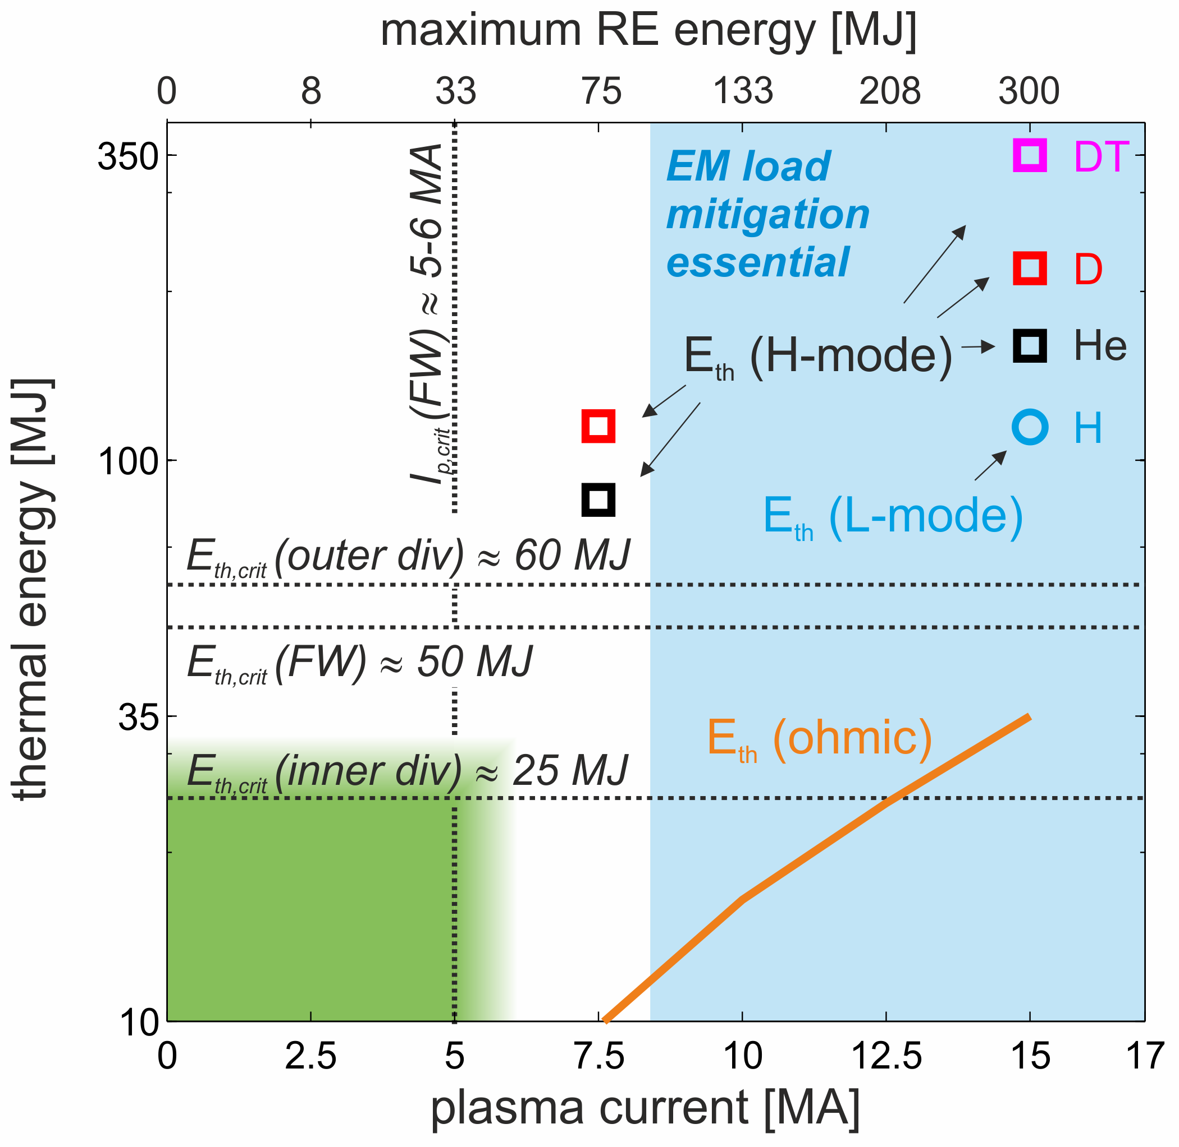
2. PFPO-1 - Disruption Loads and Mitigation
Quantitative analysis of thermal and EM loads for unmitigated disruptions in ITER:
  EM loads imply DMS essential above 8.4 MA
  Green: operational space where no risk of melting of W-divertor
  Orange line: W_{th} for ohmic plasmas
  maximum RE energy is most pessimistic estimate in case of full magnetic energy conversion

Slide 21
2. PFPO-1 – Possible Scenarios at 1.8 T
‘Martin’ scaling
0.4×n_{GW} =
Potential plasma scenario at 5 MA/ 1.8 T (q₉₅ ~ 3):
  this scenario would permit access to H-mode studies if 20 MW of ECRH and 10 MW of ICRF can be coupled efficiently to plasma (especially for H)
  low frequency ECRH and subset of ELM coil power supplies (9) available
  TF ripple of -1.28% is likely to have an impact on H-mode performance

Slide 22
2. PFPO-1 - Options for ICRF exploitation
Installation of one ICRF antenna to couple 10 MW to the plasma, increasing the total auxiliary heating to 30 MW (20 MW ECRH + 10 MW ICRF)
Allow early commissioning of ICRF system for optimization studies (coupling, etc.)
Half-field operation (2.65 T):
  H plasmas → dominant electron absorption (very broad)
  He plasmas → fundamental
  H minority, good absorption
  Third-field operation (1.8 T):
  H plasmas → 2nd harmonic
  H majority, good absorption
  He plasmas → 2nd harmonic
  H minority, good absorption
Main ion | B_{T}(T) | P_{L-H} (MW) | Good IC scenario | H-mode
H | 2.65 | 37 | no | no
He |  | 19-28 | yes | possibly
H | 1.8 | 20 | yes | yes
He |  | 10-15 | yes | yes
Caveat: -1.28% ripple at 1.8T

Slide 23
2. PFPO-1 – Edge Physics & PWI Programme
Wall conditioning and cleaning (GDC/ICWC/ECWC optimization)
  Fuel retention management:
  gas balance in hydrogen, NH₃ formation during N₂ seeding, baking studies, development of ‘raised strike point’ scenario
  Material migration studies:
  including post-mortem analysis of ‘first wall samples’ for model validation
  Limiter heat load characterization:
  dedicated scans for characterization of inboard SOL structure and scaling
  Heat loads and detachment control during divertor operation:
  near-SOL scaling (L-mode, inter-ELM H-mode)
  far-SOL characterization (L-mode, inter-ELM H-mode)
  upper-FWP power handling
  understanding divertor detachment behaviour
  effects of 3-D magnetic fields, ELM transients etc

Slide 24
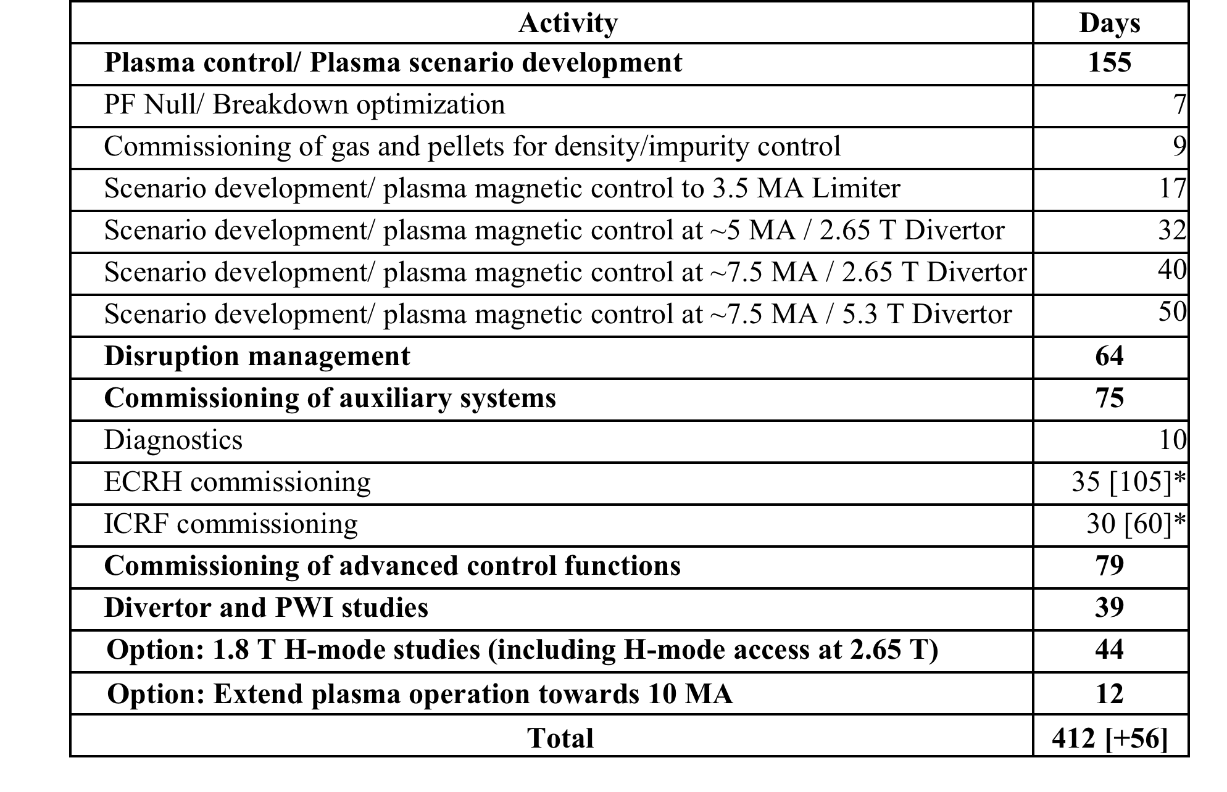
2. PFPO-1: Summary
Estimate of experimental time required:
* The total estimated time for initial commissioning is shown in brackets, with an allocation of fraction of the time to dedicated experiments.

Slide 25
3. Pre-Fusion Power Operation 2 - Overview
Main elements of programme in H/He for study of 7.5 MA H-mode and 15 MA L-mode plasmas:
  commissioning of HNB (33 MW), ICRF (add^{nl} 10 MW) and DNB with plasma
  continued development of plasma control capability:
    feedback control of H&CD systems; non-axisymmetric and profile control
  extend capability for disruption prediction, avoidance and mitigation
  demonstration of divertor heat flux control at higher P_{aux}
  establishment of H-mode plasmas at 7.5 MA/2.65 T (He/H ?)
  and development of ELM suppression as internal coils commissioned
  demonstration of 15 MA/5.3 T L-mode plasmas at highest P_{aux}
  development of long-pulse L- and H-modes
  initial exploration of current drive efficiency, target q-profile control, fast particle confinement in 3-D fields
  characterization of key aspects of PWI in ITER environment

Slide 26
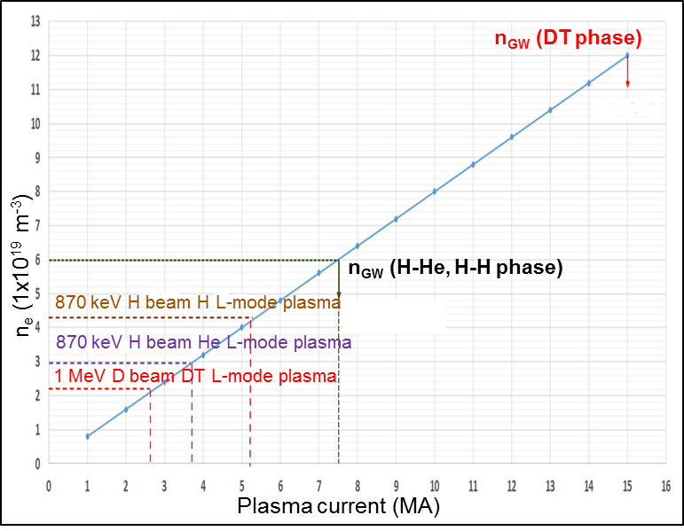
3. PFPO-2 – H&CD Commissioning
Commissioning of H&CD systems to full power/ ~50 s:
  commissioning of HNB
  (33 MW) (and DNB) with plasma:
    following off-line beam-line commissioning during Integrated Commissioning III
    must be adapted to shinethrough limits
    gradual increase in injected pulse length as ducts conditioned/ shinethrough monitored
  commissioning of additional 10 MW ICRF with plasma
    builds on experience gained during PFPO-1
    optimization of coupled power avoiding cross-talk between 2 antennas
    gradual extension of pulse length
HNB shinethrough limits

Slide 27
3. PFPO-2 – H-mode Studies
H-mode operation and ELM control in H/ He plasmas:
  extend studies of H-modes in H/He at 3.5 – 5 MA/1.8 T:
    aim to identify effect of TBMs on H-mode performance, if possible
    expand operation in 5 MA/1.8 T H H-modes if adequate P_{IC} can be coupled
    (P_{LH} ~ 20 MW) – or exploiting low energy NBI possible (note TF ripple)
    commissioning of ELM control coils and demonstration of ELM suppression with magnetic perturbations with n = 2 – 4, q₉₅ = 3 – 4.3
  establishment of H-mode at 7.5 MA/ 2.65 T (in He/ H as P_{LH} allows):
    determination of H-mode access conditions at ITER scale in H and He and develop programme around most favourable scenario (note possible use of Ne seeding)
    extensive characterization of H-mode behaviour: exploring ELM control, density and impurity control etc over range 5 – 7.5 MA
  development of long-pulse H-modes at 7.5 MA/ 2.65 T:
    high non-inductive current fraction (up to 60%) due to I_{NB} + I_{bs} could allow H-mode duration at 7.5 MA to be extended towards 1000 s

Slide 28
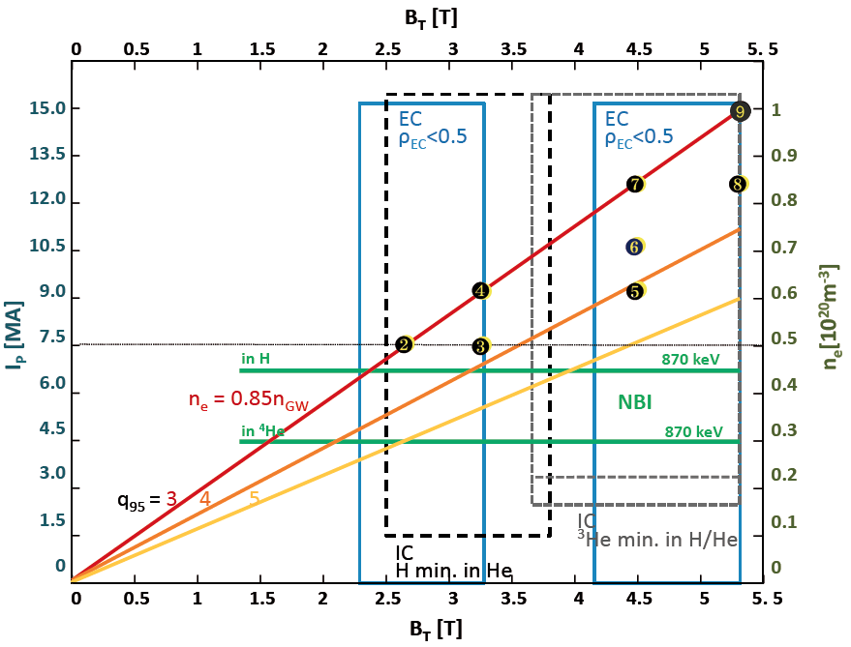
3. PFPO-2 – 15 MA L-mode Development
Strategy for development of 15 MA L-mode scenario revisited with options for expansion of operating space:
  development of favoured set of I_{p}/B_{t} steps in preparation for D/DT phase
  assess impact of fuelling, H&CD mix, ECRH on-/off-axis on L-mode plasma confinement/ transport
  optimization of flux consumption to maximize flat-top duration
  demonstration of integrated 15 MA/5.3 T scenario with ~50 s flat-top
Revised concept for 15 MA scenario development with variable q₉₅

Slide 29
3. PFPO-2 – Long Pulse Operation
Current profiles modelled for 7.5 MA/2.65 T helium H-modes with 73 MW of auxiliary power
Options for long-pulse operation in PFPO-2 phase developed:
  pulse length beyond 100 s in hydrogen plasmas required by PWI studies – probably L-mode
  NBCD in 7.5 MA H-modes offers possibility of very long pulse lengths
  principal limit to exploitation may be system commissioning time to long pulse operation,
  e.g. H&CD, fuelling, PCS etc

Slide 30
3. PFPO-2 – PWI Studies
Plasma-wall interaction studies increasingly significant in PFPO-2:
  Wall conditioning/ fuel removal studies:
    further development of wall conditioning techniques, including divertor baking
    routine monitoring of impurity sources using reference pulse
  Fuel retention and material migration:
    ‘D-spiking’ experiment in long-pulse (~100 s) hydrogen L-modes (see Appendix A)
    NH₃ characterization during N₂ seeding
    Dust generation and characterization (during experiments and post-mortem)
    regular monitoring of wall erosion/ damage by IVVS also essential
    Post-campaign analysis of PFCs via removal of divertor cassette
  Heat loads during divertor operation:
    extension of SOL width studies, PFC power load characterization, 3-D effects
    development of detachment control in L- and H-mode plasmas at high power

Slide 31
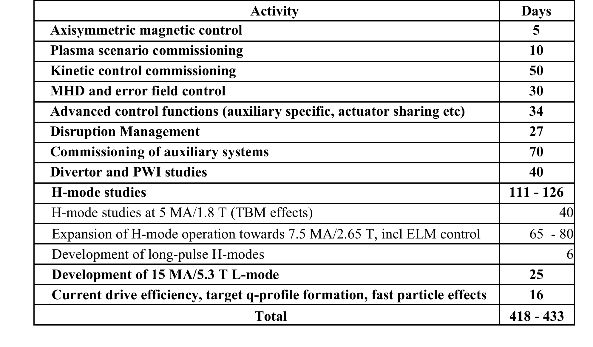
3. PFPO-2 - Summary
Estimate of experimental time required:

Slide 32
4. Fusion Power Operation – D Plasmas
First period of FPO phase centres on machine recommissioning and D H-mode development:
  recommissioning of tokamak operation for D plasmas:
    commissioning of H&CD system in D (HNB at 1 MeV D⁰)
    re-optimize plasma magnetic scenario, if necessary
    development of 15 MA/5.3 T D L-mode scenario
    H-mode access: establishment of D H-modes in range 5 – 7.5 MA/2.65 T
    re-establishment of ELM control techniques in D H-modes
  studies of H-mode plasmas in D:
    integrated 7.5 MA/2.65 T H-mode scenario (long pulse/ high power) with H₉₈~1
    trace-T experiments to initiate DT operation, investigate fuelling and fuel transport
    extension of H-mode operation towards 15 MA/ 5.3 T, preparing DT scenarios
    confirmation of reliable operation of DMS at high current and power
    range of PWI studies on wall conditioning, fuel retention, material migration, heat load characterization and detachment control

Slide 33
4. FPO – High Current D H-Modes
‘Martin’ scaling
Based on ‘Martin’ scaling, H-mode operation at highest currents problematic:
  depends on density control and power margin for high confinement
  could be influenced significantly by
  all-metal PFCs (eg off-axis heating)
  ⇒ gradual transition to DT operation
  advantageous (reduced P_{LH}, central
  heating by α-particles)

Slide 34
4. FPO – D Hybrid/Advanced Scenarios
Hybrid and advanced scenarios would be explored in deuterium with q₉₅ ≥ 4:
  commissioning of auxiliary systems to support development of long-pulse operation
  development of integrated hybrid scenario at q₉₅ = 4 in D with H₉₈ ≥ 1
  optimization of high non-inductive fraction discharges in D with q₉₅ ~ 4 - 5
  studies of current drive efficiency in D over range in q₉₅ and B_{t}
  development/ assessment of β/ j(r)/ p(r) control for performance optimization
  analysis of MHD stability and feedback control (upgrade requirements?)
  assessment of isotope effects on development of hybrid/non-inductive scenarios (H/He/D) and projection to DT operation

Slide 35
4. FPO – DT Inductive Plasmas
Development of fusion power production in DT inductive scenarios:
  development of integrated DT H-mode operation at
  7.5 MA/ 2.65 T:
    development of D H-mode operation with increasing T concentration (10% to >50%)
    characterization of changing H-mode behaviour as T concentration increased
    extension of H-mode operation towards high power and longer pulses (at least several tens of seconds)
    adaptation of control functions to fusion power operation
  development of fusion power production in DT:
    development towards 15 MA/5.3 T DT H-mode operation, varying fuel mix to manage fusion power production and control issues
    confirmation of reliable operation of DMS as fusion power increased
    extension of plasma control capability in DT, including heat exhaust and fusion burn control
    optimization of Q towards short-pulse Q ~ 10 operation at several hundred MW fusion power

Slide 36
4. FPO – DT Long-Pulse Plasmas
Programme towards long-pulse burning plasma studies developed:
  15 MA/5.3 T, Q=10 inductive scenario for 300 – 500 s:
    long-pulse development initiated for Q ~ 5, establishing integrated scenario with feedback control of all key aspects of scenario
    process repeated for Q = 10 scenario, optimizing flux consumption, retuning scenario control as required
    programme of burning plasma studies at long timescales, adapting to discharge evolution as required
    exploration of possibilities for achieving Q > 10 in transient or stationary conditions
  Hybrid scenarios targeting Q ≥ 5 for periods of ~1000 s
    redevelopment of ~5.6 MA/2.65 T hybrid scenario with q₉₅ = 4, H₉₈ ≥ 1 for DT plasmas – retune feedback control, study isotope effects
    extension of q₉₅ = 4 hybrid regime to ~11.2 MA/ 5.3 T, optimizing current drive
    optimizing H₉₈ and Q towards values ≥ 5, extending pulse length towards 1000 s, with high b_{N} and high f_{NI} (>0.6)

Slide 37
4. FPO – DT Long-Pulse Plasmas
Programme towards long-pulse burning plasma studies developed:
  Fully/ quasi-non-inductive scenarios, Q ~ 3 - 5, q₉₅ ≥ 5
    on this timescale, programme can presumably be developed around H&CD upgrades – details will depend on which upgrades available
    initial target would be demonstration of very long, fully non-inductive pulses, ~3000 s, with modest Q ~ 2 (eg 7.9 MA/5.3 T) at H₉₈ ~ 1.2
    optimization of density, current drive, plasma confinement and MHD stability could allow gradual increase in Q to range 3 - 5, if H₉₈ ~ 1.4 - 1.6 can be achieved
    as these scenarios developed, wide range of burning plasma studies and PWI studies would accompany scenario exploration

Slide 38
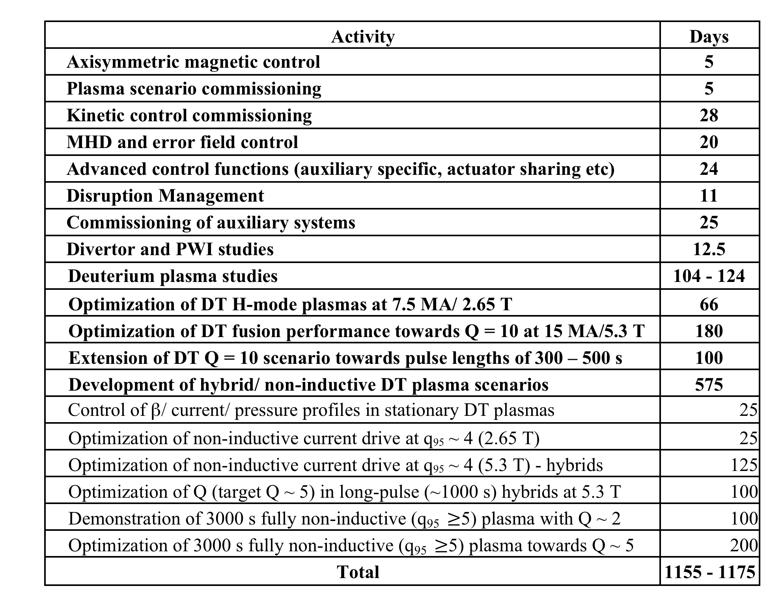
4. FPO - Summary
Estimate of experimental time required:

Slide 39
ITER Research Plan - Summary
Key activities of the ITER Research Plan from First Plasma to the development of long-pulse burning plasma scenarios have been re-analyzed within the framework of the ‘Staged Approach’:
  Major activities adapted to match the staged availability of auxiliary systems
  Options analyzed for early access to H/He H-modes in PFPO-1 and development of long-pulse plasma scenarios during PFPO-2
  Major new PWI programme component added
  Research Plan in FPO phase developed towards long-pulse operation over several experimental campaigns
    initial operation in D plasmas designed to provide robust basis for transition to DT scenarios
    gradual transition to 50:50 DT
    achievement of Q = 10 for ~50 s followed in FPO-2, FPO-3 by extension to Q = 10 for 300-500 s, optimization of hybrid scenarios (q₉₅ = 4) and extension to ~1000 s at Q ≥ 5, optimization of fully non-inductive scenarios towards Q ~ 3 - 5

Slide 40
Backup Slides

Slide 41
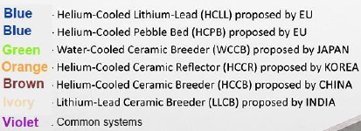
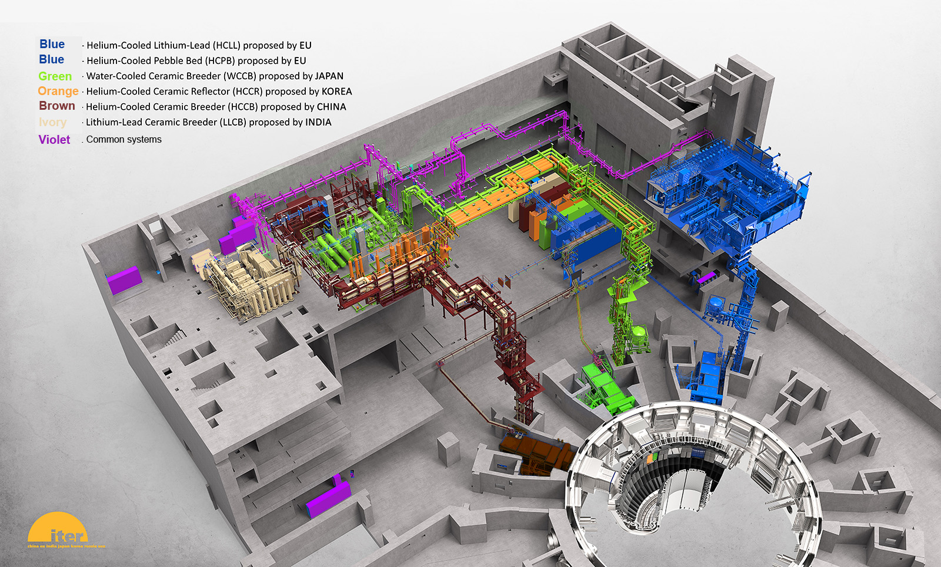
Tritium Breeding – Test Blanket Systems
6 Test Blanket Systems are being developed by the Members TBM teams to test concepts for tritium breeding prototypical of Demo breeding blankets

Slide 42
TBM Testing Program
  TBM testing program is assumed to run in parallel with much of scientific program, with limited direct demands on operation
  4-stages of TBM testing currently foreseen:
    Electro-Magnetic Module – electromagnetic transients, operational function, collect data for licensing process
    Thermal-Neutronic Module – validation of code predictions of TBM nuclear response, including initial tritium production
    Neutronic-Tritium/Thermo-Mechanic Module – TBM structural behaviour at relevant temperature and nuclear response, including tritium production
    INTegral Module – operational behaviour of the blanket module for heat extraction and tritium management
  First installation during Assembly Phase III – might allow possibility of assessing effect of TBM ferromagnetic material on H-mode performance
  6-days of back-to-back long duration (1000 - 3000 s) high power (300 – 400 MW) pulses required for adequate testing of INT-TBM

Slide 43
Diagnostics - Stage I (FP and Engineering Commissioning)
Not all systems indicated will be fully installed, but will fulfill functionality for First Plasma
55.A0 | Magnetics System Electronics & Software
55.A1 | Continuous External Rogowski
55.A3/A4/A9 | Outer Vessel Coils
55.A5/A6 | Steady State Sensors
55.A7/AD/AE/AI | Flux Loops
55.AA/AB/AC | Inner Vessel Coils
55.AF/AG/AH | Diamagnetic Sensors
Background colours represent grouping of diagnostic systems
Note: Infrastructure such as port plugs is not shown here
55.E2 | H-alpha Vis in EPP12
55.E3 | Vacuum UltraViolet Survey
55.E6 | Visible Spectroscopy Reference System (partial)
55.ED | X-Ray Crystal Spectrometer
55.EE | Hard X-ray Monitor
55.G1.E0 | Vis/IR Equatorial in EP16 (temporary)
55.G1 | Vis/IR Equatorial in EPP12 (partial)
55.G3.50 | Pressure Gauges (temporary)
55.GB | Stray ECH detector
55.GF | TF Mapping (one-off activity)
55.GL | In-Vessel Lighting
55.GT | Tokamak Structural Monitoring system
55.FA | Density Interferometer (partial)

Slide 44
Additional Diagnostics for PFPO-1
55.A8 | Fibre Optic Current Sensor
55.AJ | High Frequency Sensors
55.AL/AO | Divertor Coils
55.AM | Divertor Shunts
55.AN/AP | Divertor & Blanket Rogowskis
55.B3 | Microfission Chambers
55.B4 | Neutron Flux Monitor Systems
55.B8 | Neutron Activation System
55.BC | Divertor Neutron Flux Monitors
55.BV | Neutron Calibration (2.5 MeV) [Partial]
55.BT | Neutron Facility Area
55.C1 | Core Plasma Thomson Scattering (partial)
55.C5 | TIP(Density-EQ9)
55.D1 | Bolometry System
55.E2 | H-alpha and Visible Spectroscopy
55.E4 | Divertor Impurity Monitor
55.E5 | Core Imaging X-ray Spectrometer
55.E6 | Visible Spectroscopy Reference System
55.E7 | Radial X-Ray Camera
55.EG | VUV Divertor
55.EH | Vacuum UltraViolet Edge
55.EI | X-Ray Crystal Spectrosopy Edge
55.F1 | Electron Cyclotron Emission
55.FA | DIP(density-EQ8)
55.G1 | Vis/IR Eq Ports (remainder of system)
55.G2 | Thermocouple (divertor)
55.G3 | Pressure Gauges
55.G4 | Residual Gas Analysers
55.G6 | Divertor IR Thermography
55.G7 | Langmuir Probes
55.GA | Vis/IR Upper Ports
55.GD | First Wall Samples
55.GE | Flow Monitor
55.GG | Calorimetry (for testing with aux. heating inputs)
Black = functional
Orange = not functional but partly installed/captive
Blue = “upgrade” but basic system is functional

Slide 45
Additional Diagnostics for PFPO-2
55.BV | Neutron Calibration (2.5 MeV)
55.C1 | Core Plasma Thomson Scattering (full)
55.C2 | Edge Thomson Scattering
55.C4 | Divertor Thomson Scattering
55.C6 | Poloidal Polarimeter
55.C8 | High Temperature Thomson Scattering
55.E1 | Charge Exchange RS Core
55.E8 | Neutral Particle Analysers
55.EA | Laser-Induced Fluorescence
55.EB | Motional Stark Effect
55.EC | Charge Exchange RS Edge
55.EF | Charge Exchange RS Pedestal
Black = functional
Orange = not functional but partly installed/captive
Blue = “upgrade” but basic system is functional
55.F2 | Reflectometry Low Field Side
55.F3 | Plasma Position Reflectometry
55.F9 | Reflectometry High Field Side
55.G8 | Erosion Monitor
55.G9 | Dust Monitor
55.GG | Calorimetry

Slide 46
Additional Diagnostics for FPO
55.B1 | Radial Neutron Camera
55.B2 | Vertical Neutron Camera
55.B7 | Radial Gamma Ray Spectrometer
55.B9 | Lost Alpha Monitor
55.BB | High Resolution Neutron Spectrometer
55.BD | Vertical Gamma Ray Spectrometer
55.BE | Tangential Neutron Spectrometer
55.BV | Neutron Calibration (14 MeV)
55.C7 | Collective Thomson Scattering
55.GC | Tritium Monitor
55.GG | Calorimetry (full measurements)
Black = functional
Orange = not functional but partly installed/captive
Blue = “upgrade” but basic system is functional

