Slide 1
The Status of the Milestone Program
Fusion Power Associates Annual Meeting, Session 6
Wednesday, December 20th, 2023
Colleen Nehl
Office of Fusion Energy Sciences

Slide 2
FES Mission and Strategic Priorities
MISSION
The mission of the Fusion Energy Sciences (FES) program is to expand the fundamental understanding of matter at very high temperatures and densities and to build the scientific foundations needed to develop a fusion energy source. This is accomplished by the study of the plasma state and its interactions with its surroundings.
The Energy Act of 2020 expanded the scientific mission of FES to support “the development of a competitive fusion power industry in the U.S.”
FES PROGRAM PRIORITIES
Accelerate fusion development as a carbon-free energy source via public-private partnerships (“bold decadal vision”)
Support R&D Fusion Centers (“FIRE” centers) to establish S&T basis of a Fusion Pilot Plant (FPP)
U.S. participation in ITER to leverage engineering and study burning plasma science technology at power plant scale while expanding Inertial Fusion Energy (IFE) program
Support discovery plasma science and technology
Broaden participation in fusion and DEIA activities to enable the program
2

Slide 3
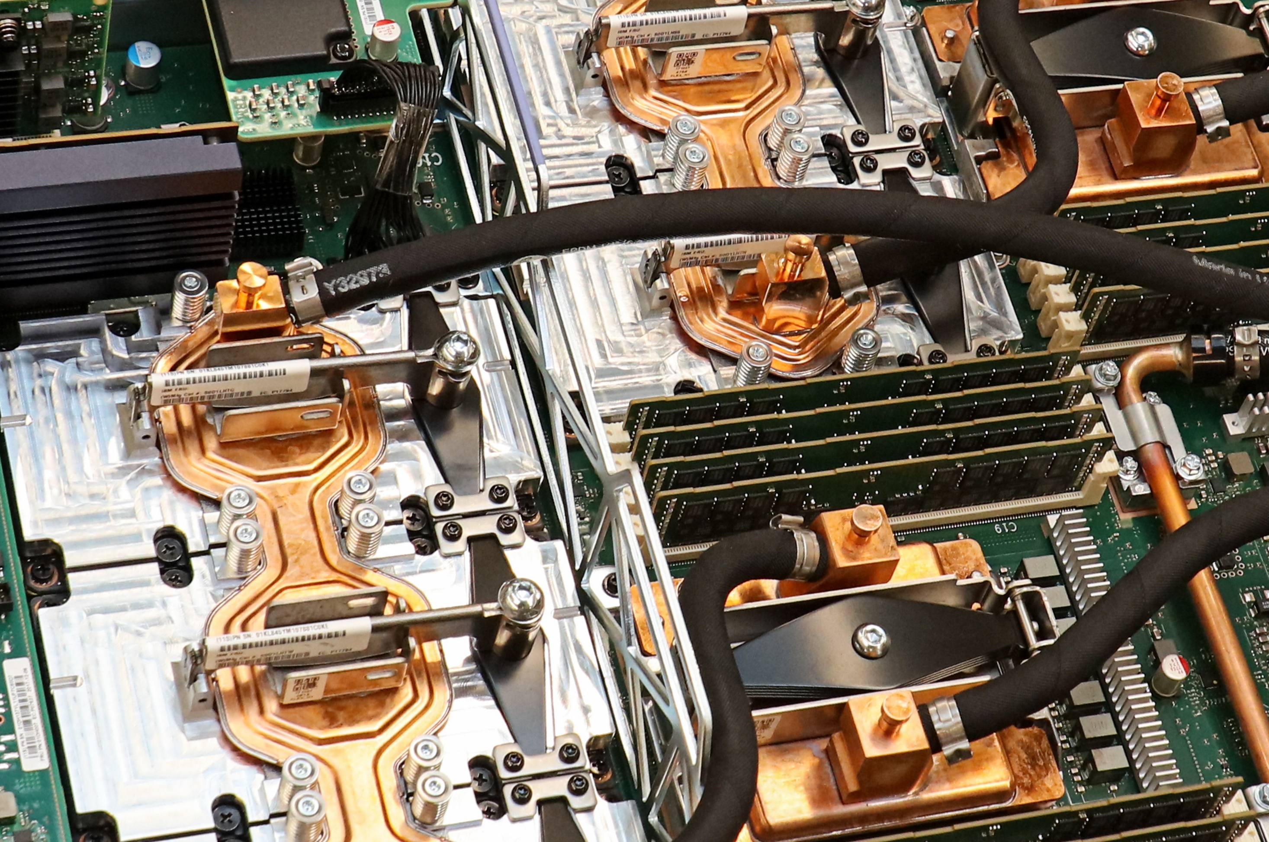
Public-Private Partnerships (PPPs)
Why PPPs?
Leverage decades of public support for fusion R&D and synergy with existing activities
Greater available financial resources (public + private) to achieve objectives and accelerate timelines
Stakeholders are committed & aligned by sharing cost
Research and innovation are pursued in a way that is relevant and valuable for commercialization
Why now?
The private fusion landscape has changed in the last decade. Increased technical readiness & investment, combined with significant market pull.
Fusion is at an inflection point where PPPs can help.
PPP Exemplar:
NASA COTS
NASA COTS (Commercial Orbital Transportation Services) used milestone-based payments to accelerate development of a domestic private space industry, helping companies like SpaceX become viable.
Notes:
The Milestone program is a public-private partnership.

Slide 4













Milestone-Based Fusion Development Program
The purpose of the Milestone Program is to enable a vibrant domestic fusion sector through public-private partnerships to improve the technical maturity (physics basis, enabling materials/technologies) of fusion concepts
Deliverables for the first 18-month phase of the program by the 8 teams:
  Fusion pilot plant preconceptual designs
  Technology roadmaps
The Milestone Program will produce designs & data
The Milestone Program will not build fusion plants.

Slide 5
Milestone Program: 8 Teams selected for award
Tokamaks
Inertial Fusion Energy
Stellarators
Alternates

Slide 6


Milestone Negotiations
Background:
  Technology Investment Agreements (TIAs), the DOE’s implementation of the Other Transactions Authority.
  TIAs enable the maximum flexibility the DOE can extend, but they take time.
  We need to get the terms right so the Milestone program doesn’t have unintended negative consequences.
Individual Negotiations are Underway.
Next:
  Once teams are under contract they can report progress to DOE and request Milestone payments.
  As the end of the first 18-month budget period approaches, we will (depending on available funds and team progress) advance teams to the next budget period.
More PPP Opportunities are Coming
Notes:
With the

Slide 7

INFUSE Topics
Enabling technologies
Materials science
Diagnostics
Modeling and simulation, including but not limited to:
  o Physics, engineering and/or materials modeling/simulation
  o Plant costing (e.g., models focused on cost to build a fusion plant and cost drivers for a fusion plant or essential subcomponents/systems, such as tritium processing)
  o Technoeconomic modeling focused on cost-of-electricity or other products (e.g., process heat) for fusion plants
• Unique fusion experimental capabilities
• Activities to support eventual fusion commercialization including but not limited to:
  o Accident and safety analysis in support of eventual licensing
  o Public engagement, including energy and environmental justice
  o Fuel supplies
  o Advanced manufacturing
  o Waste disposition and recycling
INFUSE awards can be complementary to Milestone (or other) DOE-funded projects, but we cannot fund the same scope twice.
https://science.osti.gov/-/media/fes/fesac/pdf/2023/FES-Vision.pdf

Slide 8
Save-the-Date: February 27-29, 2024 at PPPL
The INFUSE Workshop is scheduled for February 27-28 at PPPL.
Contact: infuse@ornl.gov or colleen.nehl@science.doe.gov
On February 29th, 2024 we plan to hold a complementary workshop for a new Private Facility Research program.
  Specifically, to collect input from private fusion companies, private non-fusion companies, and public sector researchers (i.e., Universities, National Laboratories, and industry partners) to explore a potential FES public-private partnership program focused on scientific research involving privately owned facilities.
Contact: josh.king@science.doe.gov or colleen.nehl@science.doe.gov
NEW!!
We are in the final stages of the SC workshop approval process.
Do not make travel plans yet.
Full announcements for these workshops will be forthcoming
Notes:
https://science.osti.gov/-/media/fes/fesac/pdf/2023/FES-Vision.pdf

Slide 9
Thank you!
Colleen.Nehl@science.doe.gov

Slide 10
Backup Slides

Slide 11
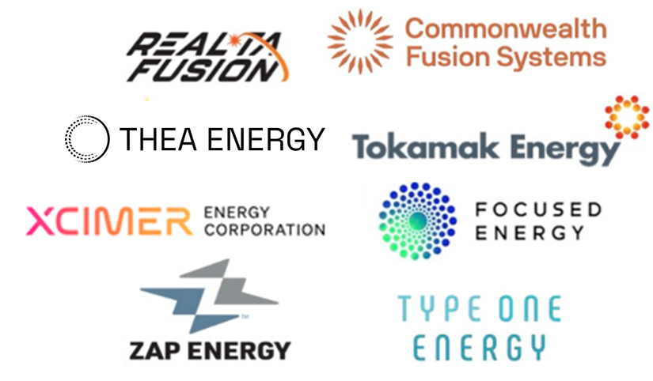
Milestone-Based Fusion Development Program and beyond
Milestone Work Scopes
Building resilient public-private partnerships that are equitable and provides a bridge to our public expertise and know-how in FES
FES PPP portfolio: Milestone, INFUSE, other PPP elements are “seeds” for further development that must be translated to a framework for collaborative participation on fusion FM&T gaps and accelerated development
Enabling materials/technology
Manufacturing Readiness
Community Benefits Plans
Foundational
(concept maturity)
Remote Maintenance
Physics & Hardware demos
Fuel Cycle
Site & Cost Evaluation
FES PPPs
Private-Public Consortium Framework
FPP and FOAK
Milestone
TRL push
TRL pull
Supply chain incubation
Translate from FES to PPP framework
Commercial Fusion Industry
The Milestone Program will produce designs & data
The Milestone Program will not build fusion plants.
Requires LPO, philanthropy, private equity, etc…

Slide 12
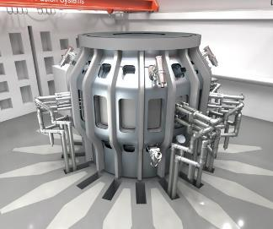

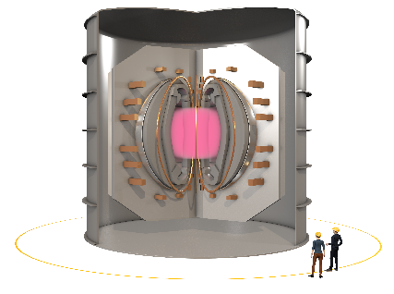
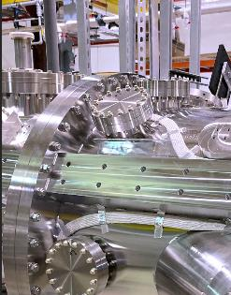
Tokamaks
Alternates
Innovation: Modern, high field superconducting magnets to enable compact, high gain tokamaks
https://cfs.energy/technology/sparc
Innovation: The sheared flow-stabilized (SFS) Z-pinch may offer favorable scaling, simplicity & stability vs. traditional z-pinches.
https://www.zapenergy.com/how-it-works
Innovation: ST40, the world's highest field spherical tokamak (UK) has shown fusion-relevant ion temperatures in a compact spherical tokamak for the first time
https://www.tokamakenergy.co.uk/technology/
Innovation: HTS may help make the physics of a magnetic mirror viable. Team is also considering industrial heat applications, which should help make the mirror economically viable.
https://realtafusion.com/

Slide 13
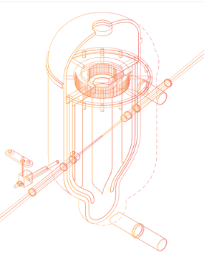
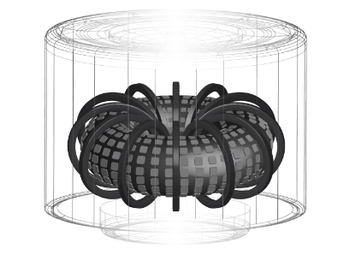
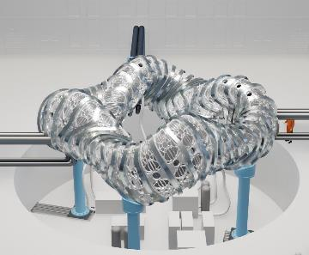

Inertial Fusion Energy
Stellarators
Innovation: Excimer lasers to heat & compress a fuel pellet, which should offer greater efficiency, lower cost, and simpler operation than existing laser facilities.
https://xcimer.energy/index.html
Innovation: Arrays of planar magnets on the surface which should offer a cheaper, lower maintenance pathway to fusion.
https://thea.energy/history/
Innovation: Proton fast ignition (PFI), separates the two stages of fuel compression & heating, with targets that are robust against laser/target imperfections.
https://focused-energy.world/
Innovation: Advanced manufacturing and improved computational design tools + HTS magnets to reduce cost of the stellarator platform
https://typeoneenergy.com/envisioning-a-fusion-future/

Slide 14
Office of Science Statement of Commitment & other Guidance
SC Statement of Commitment – SC is fully and unconditionally committed to fostering safe, diverse, equitable, inclusive, and accessible work, research, and funding environments that value mutual respect and personal integrity. https://science.osti.gov/SW-DEI/SC-Statement-of-Commitment
Expectations for Professional Behaviors –SC’s expectations of all participants to positively contribute to a professional, inclusive meeting that fosters a safe and welcoming environment for conducting scientific business, as well as outlines behaviors that are unacceptable and potential ramifications for unprofessional behavior. https://science.osti.gov/SW-DEI/DOE-Diversity-Equity-and-Inclusion-Policies/Harassment
How to Address or Report Behaviors of Concern– Process on how and who to report issues, including the distinction between reporting on unprofessional, disrespectful, or disruptive behaviors, and behaviors that constitute a violation of Federal civil rights statutes. https://science.osti.gov/SW-DEI/DOE-Diversity-Equity-and-Inclusion-Policies/How-to-Report-a-Complaint
Implicit Bias – Be aware of implicit bias, understand its nature – everyone has them - and implicit bias if not mitigated can negatively impact the quality and inclusiveness of scientific discussions that contribute to a successful meeting. https://kirwaninstitute.osu.edu/article/understanding-implicit-bias

