Slide 1
Elevating Confinement: The Key to Commercial Viability
Fusion- a Quintessential Scientific Pursuit
Swadesh Mitter Mahajan,
Professor, University of Texas| Chief Scientific Advisor ExoFusion
FPA, Dec.19, 2023

Slide 2
Bending the Directives!
This talk is not about a particular FPP design, its technological readiness, costs and schedules—etc.
At this time, ExoFusion does not have a “marked” horse in the race
We will, instead, focus on scientific investigations that have helped us to identify the defining characteristics of a commercially viable FPP.
Science also identifies/defines technologies crucial for the success of a fusion reactor
Boosting confinement will be key for every magnetic fusion approach
our approach is both catholic and agnostic.

Slide 3
Why dwell on Confinement (energy confinement time $τE$)?
Scientifically - Fusion Enterprise must maximize n T $τE$
Commercially speaking, smaller, cheaper reactors are necessary
The higher the $τE$, the smaller and cheaper the fusion relevant machines
ExoFusion’s Defining Philosophy and Key Challenge :
Develop modes of boosting confinement
So that high fusion gain in a small device becomes possible
To do that we’ve designed suitable exhaust systems (divertors, for instance) that are compatible with most high gain configurations

Slide 4
Deeper Look into Confinement- Turbulent Transport
It turns out even if conventionally understood mechanisms (like velocity shear) are strong enough to stabilize MHD and some other vicious modes, they are not adequate to stabilize all fluctuations (like ETG and MTM)
The residual turbulence due to these fluctuations can/does degrade confinement . To push confinement beyond the conventional values, one must investigate the physics of the Residual Turbulent Transport
This twenty first century physics ( developed, in part, by the principals of ExoFusion), in fact, supplies us with enough understanding on how to control the turbulent transport, and in the process, strongly boost confinement.
We have, in fact, found regimes where turbulence suppression takes place without velocity shear.

Slide 5
Modern, Innovative Physics
In magnetically confined plasmas, there is a constraint on gyrokinetic fluctuations that prevents them from accessing free energy in the equilibrium. General physics principles, then, can be invoked to find regimes of strongly suppressed turbulent transport – of boosted confinement (BC).
Via detailed investigations, Exo Fusion has mapped out these regimes. Though demonstrated primarily for tokamaks, BC is accessible to all magnetic configurations.
Equally important is the fact that Theory and Simulations identify the knobs that we must turn to access the BC states.
In systems as complex as magnetically confinement plasmas, it is amazing that High confinement regimes are often accessible when density gradients become large.
Larger density gradients = smaller n_{sep}/n , n_{sep}= separatrix density

Slide 6
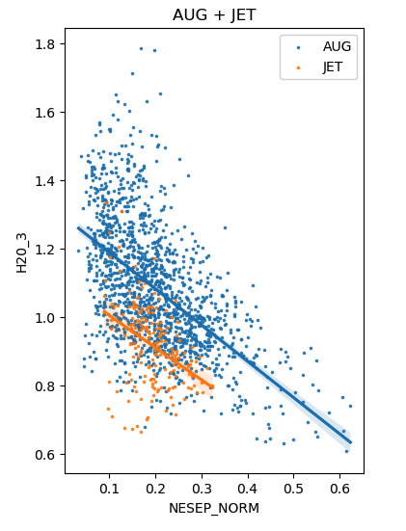
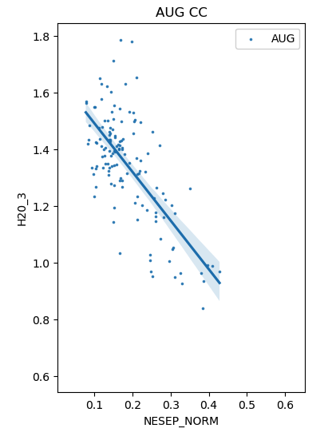
Experiments show the trend expected from gyrokinetic theory: low edge density greatly improves confinement
All H-modes
Shots with higher β_{N} /low Z
From the ITPA database:
Confinement relative to the H-mode scaling law (“H factor”) increases as separatrix density n_{sep} is lowered
Confinement up to 1.8 times higher than normal is possible with low n_{sep}
ASDEX
JET-ILW
H
H
n_{sep}/n
n_{sep}/n
Heating power needed for the same stored energy falls to 1/3- sure signature of suppressed transport

Slide 7
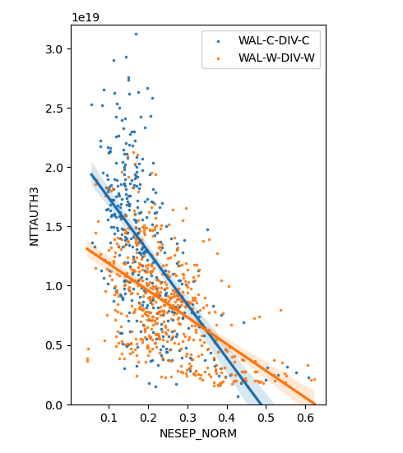
Triple product follows these trends
Triple product vs n_{sep}/n
Maximum fusion performance (n T t) is obtained at low n_{sep}
particularly, for low Z walls
Such low n_{sep} ( and correspondingly high T_{sep} ~hundreds of EVs) edges are rather problematic :
Demand novel divertor solutions
New geometries
New materials
New Kinetic codes to model/analyze the new edge
ExoFusion has patents pending on new geometries, new materials needed to enable exceptional confinement
Low Z wall
High Z wall
n T τ
n_{sep}/n

Slide 8
What must we do to reify high confinement regimes
ExoFusion has been working vigorously to create pathways to access and maintain the high confinement regime implied by the basic structure of the gyrokinetic equations ( epitomizing the physics of turbulent transport)
It is a multidimensional space in which we have to find working solutions- has required innovations on several fronts
The most salient expression of this persistent investigation is what may be called a Liquid Metal SUPER XT divertor (T is for high temperature), a very advanced version of the well-known SuperX divertor ( invented by ExoFusion principals years ago) whose efficacy has been so well demonstrated by MAST-U experiments.
ExoFusion has also been occupied in developing appropriate computational tools to further understand and predict confinement in general, and in the regimes of choice.

Slide 9
Super-XT Divertor: Ultimate Flexibility to Optimize
Integrated solution: Efficiency in handling heat exhaust , Sputtering/erosion, impurity entrainment, alpha pumping---.
Employ self-healing liquid metals creatively + manipulation of divertor magnetic geometry
Originally designed for low recycling conditions- separate the absorbing and the heat handling functions- each becomes more effective ( Lithium not needed at all)
However the exhaust part is applicable to all edge conditions-including the high recycling ones
The best of both worlds- The Miracle Liquid Metal : An alloy with high Z metal with a “segregated” low Z surface- Combining the high heat handling capacity of the high Z with limiting sputtering to only low Z ( Exo Patent Pending) .
This is an important technical solution invented by ExoFusion- likely applicable to most if not all fusion worthy concepts.

Slide 10
How Could ExoFusion enrich the vibrant Fusion Ecosystem
ExoFusion is a relatively small company developing novel solutions to problems of confinement, divertors and Liquid metal PFCs. Creating exploitable intellectual property has been our main pursuit.
Design and analyze SuperX - Super XT divertors for superior quality ETBs and ITBs-Coupled with Miracle Liquid Metal walls, these will handle problems of erosion and limiting impurities to only low Z
Provide novel simulation tools to analyze kinetic divertor regimes. One of the code, necessary for all burning plasma edges, is being developed along with PPPL -- STEP divertor design will be its first application
Our abilities ( theoretical- state of the art computational tools) equip us to do Confinement projections in multiple geometries ( our codes are global – a crucial advance upon local tools like TGLF)
We already have experience in engineering TBs in tokamaks- we designed an ITB for EAST in conjunction with GA - invited talk. All our tools are applicable to other geometries

Slide 11
ExoFusion Ready to Work for advancing fusion Making it cheaper, less risky, nearer term
Even If your system already has good confinement, we can work out ways to enhance it and help you design a system that is smaller and cheaper
For systems struggling towards adequate confinement, we will work out scenarios to boost it to fusion worthy values
More generally, through our well-developed investigative tool kit, we can help avoid costly delays by anticipating and correcting confinement shortfalls
We can always give you the best in PFCs if that is all you need

Slide 12
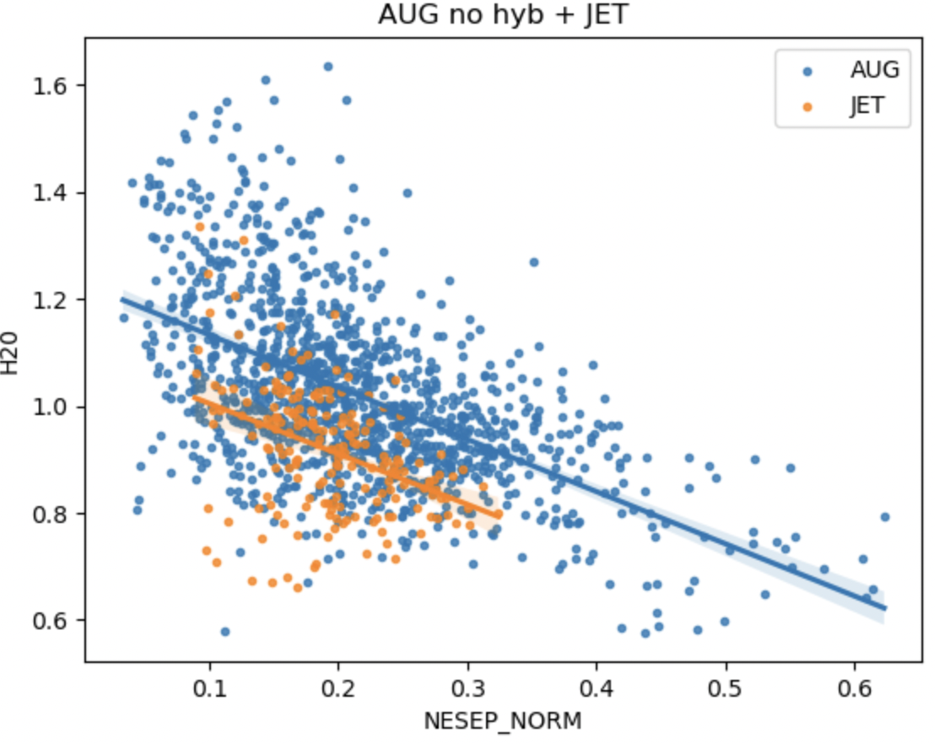
Experimental Evidence -Confinement goes up with lower edge density
Most spectacular effects are seen when both the divertor and wall are low Z
ASDEX-U and JET H-modes
ASDEX-U
JET-ILW
Although the tokamak data is available and clear, the physics is common to gyrokinetic instabilities in diverse geometries. And for a given geometry to all
Variations in plasma properties.
H20

Slide 13
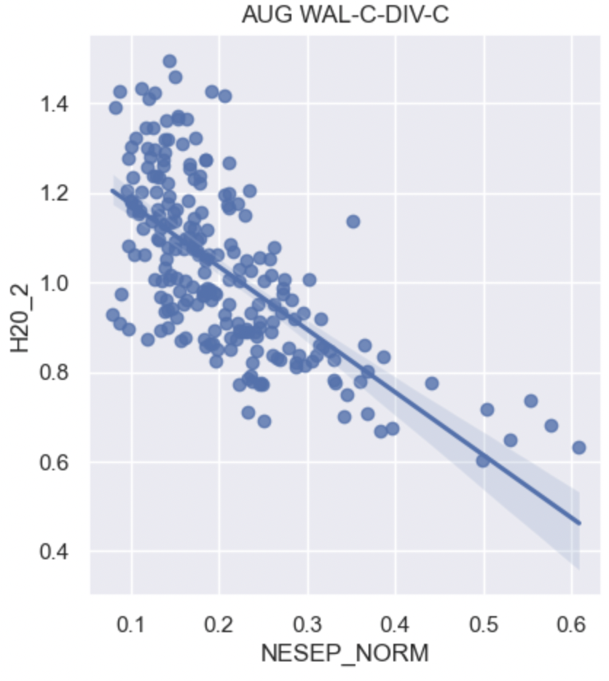
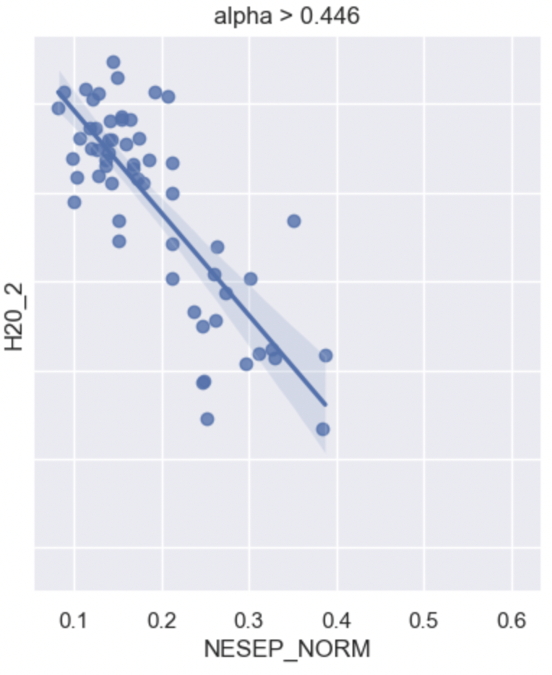
ASDEX-U wall-C div-C
(like DIII-D)
ASDEX-U wall-C div-C:
highest β_{pol} quartile
H20
H20
Holds for both ITBs / pedestals

Slide 14
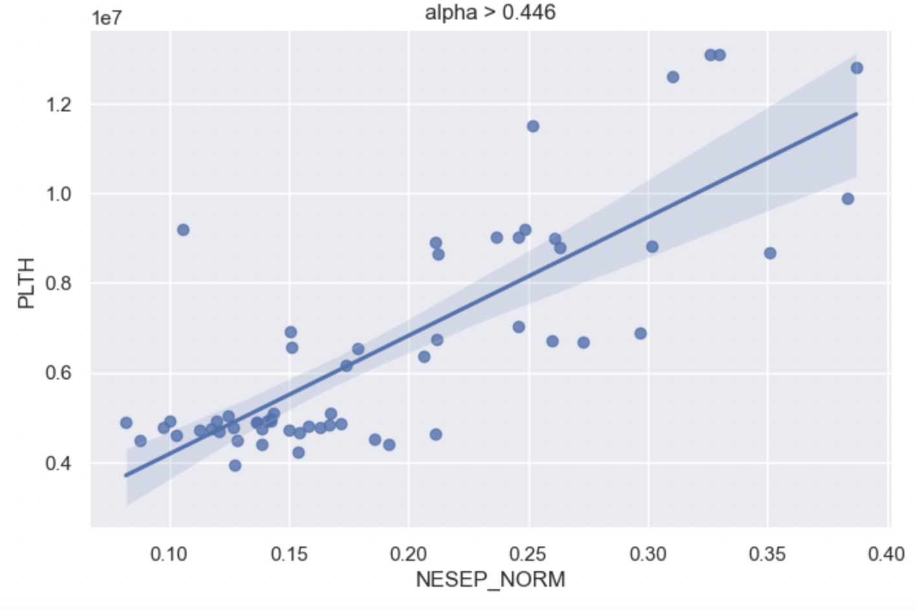
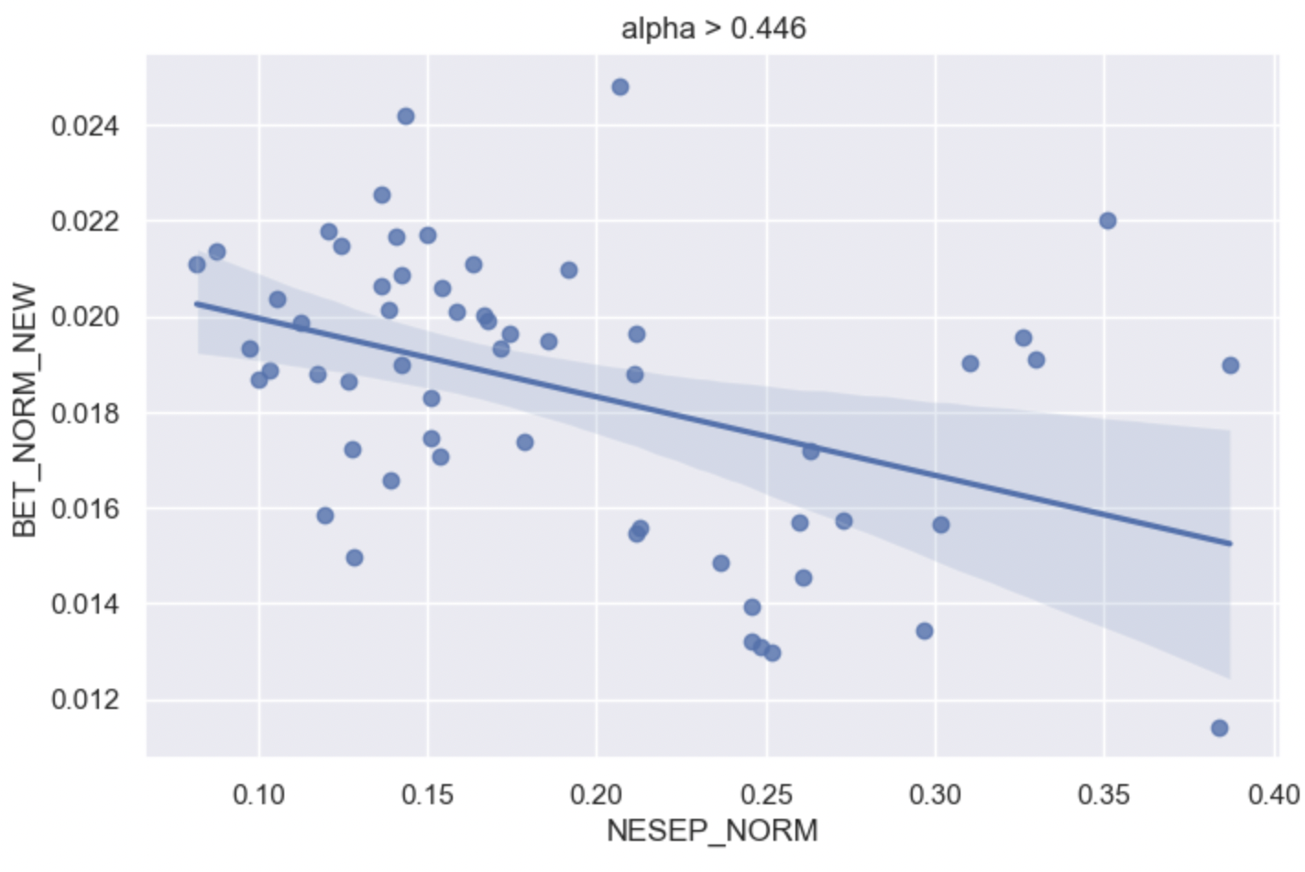
Where does this confinement improvement come from?
Almost factor of 3 reduction in heating to get the same stored energy
NOT from pedestal MHD stability improvement
Further analysis: reduced pedestal transport allows pedestal to get to MHD limit with much less heating
Net heating power
ASDEX-U wall-C div-C:
highest β_{pol} quartile
factor of ~ 3
improvement
H20
β_{N} (thermal)
only ~ 20%
improvement
As the Constraint Dynamics would predict !

Slide 15
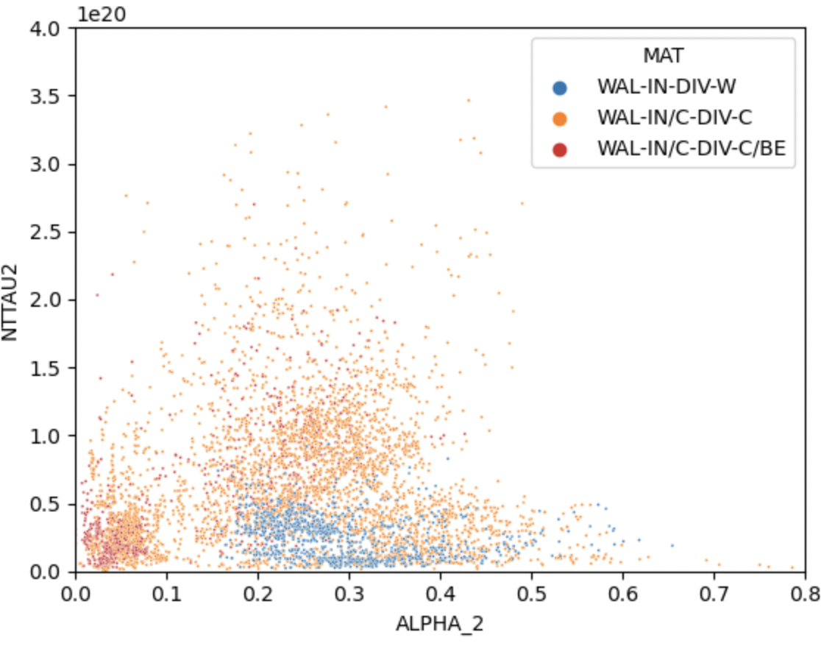
On JET low Z divertor (C and C-Be) much higher nTavgτ than W
At higher β_{pol} C much better than W
This and earlier pictures gives us a
Profound message that plasmas are much more fusion worthy if they are “polluted” by low Z impurities. Exo incorporates this fully into the design of Super XT liquid metal divertors.
nT_{avg} τ
β_{pol} -> (arb units)

