Slide 1
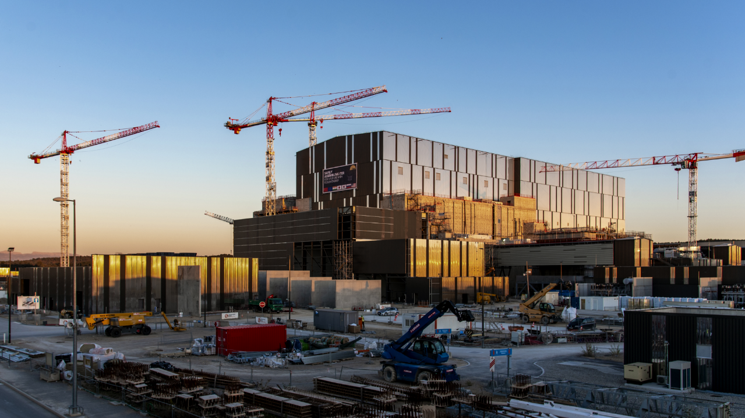

THE ITER PROJECT
PROGRESS AMID CHALLENGES
Laban Coblentz, Head of Communication
Fusion Power Associates, 19-20 December 2023

Slide 2
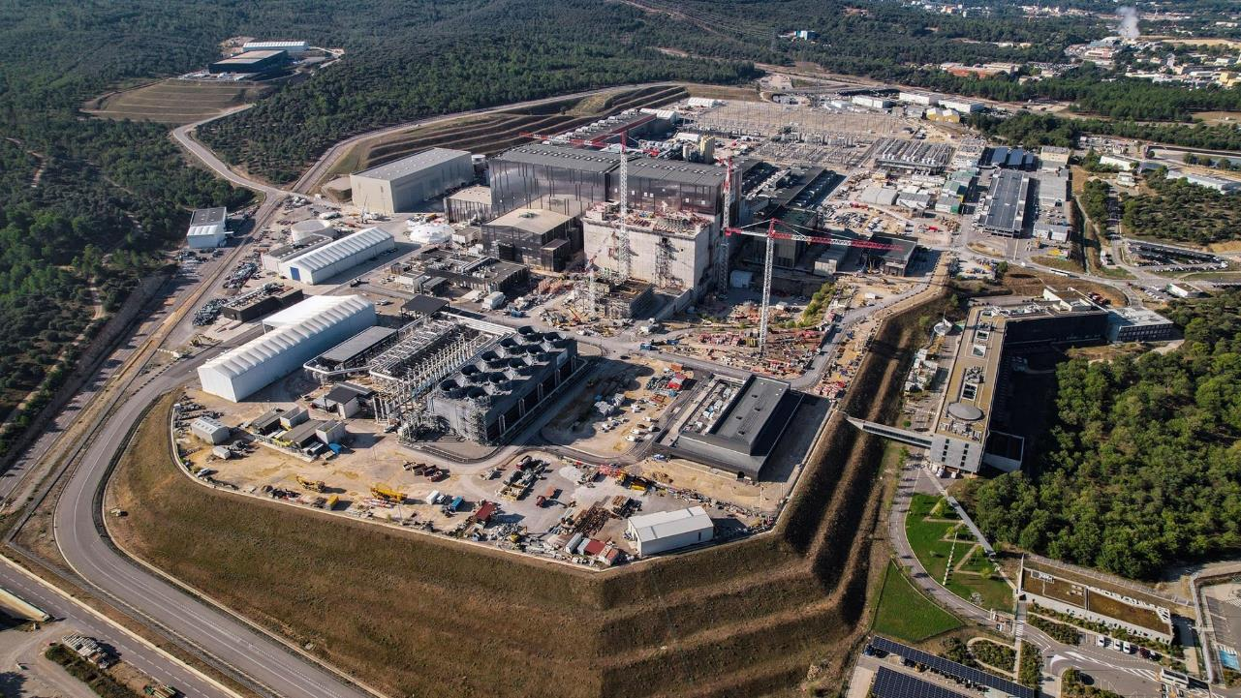

text
text
text
WORKSITE CONSTRUCTION & COMMISSIONING HIGHLIGHTS
Most plant support systems are operational or in commissioning.
Civil works are 80% completed.
text

Slide 3
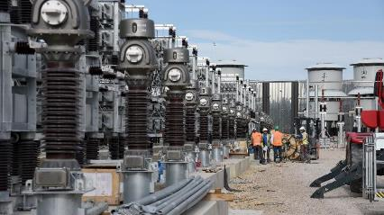
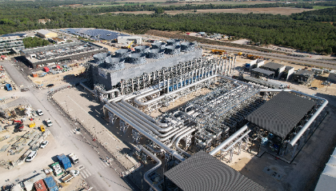
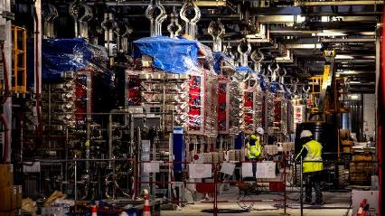
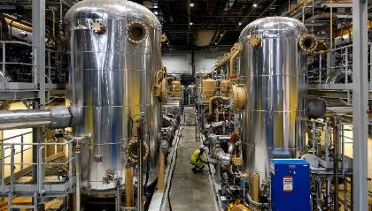
ONSITE PROGRESS IN CONSTRUCTION & INSTALLATION
Reactive power compensation equipment largely installed
Cooling water system fully installed and commissioned
Magnet power conversion equipment largely installed
Cryogenics plant: installation is complete, pre-commissioning underway.

Slide 4
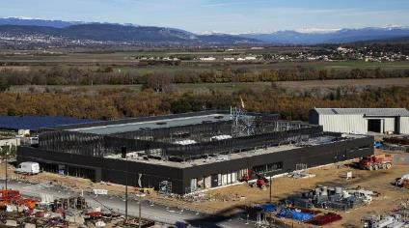
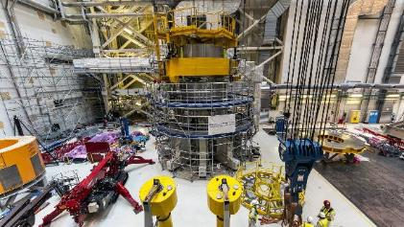
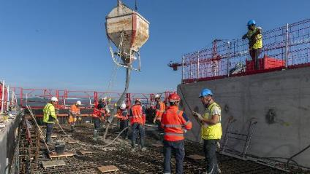
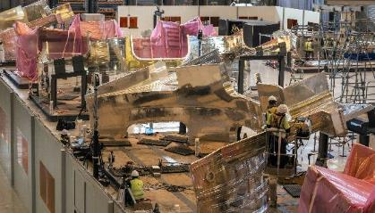
ONSITE PROGRESS IN CONSTRUCTION & INSTALLATION
Control building ready for equipment installation
First two Central Solenoid Modules stacked and are being aligned
Final concrete pour of Tritium Building
October 2023
PF Coils Building being repurposed for component repairs and port plug testing

Slide 5
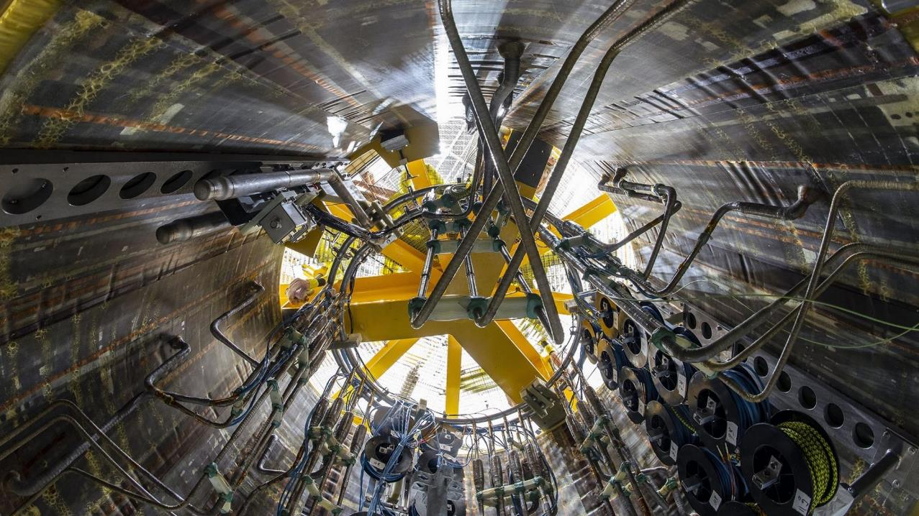

text
text
text
ASSEMBLING THE MACHINE
The first of six cylindrical superconducting magnets for the central solenoid is positioned on a dedicated assembly platform at ITER. Pictured (inside the cylinder): helium input pipes and electrical connections. January 2023
5
text

Slide 6
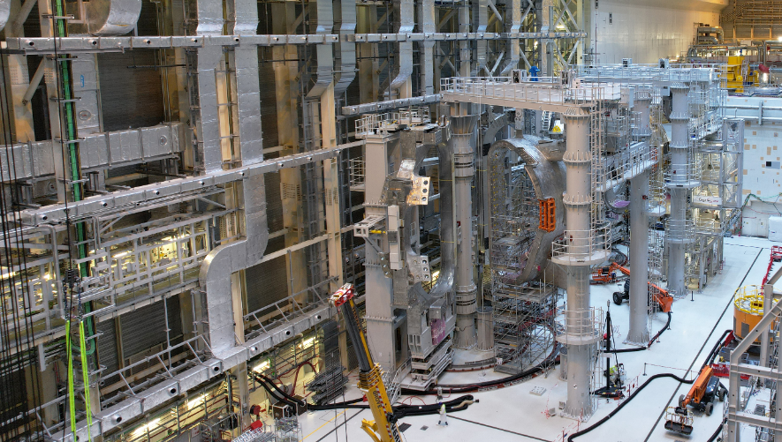

text
ASSEMBLING THE MACHINE: ITER Assembly Hall
September 2023
text
text
6
text

Slide 7
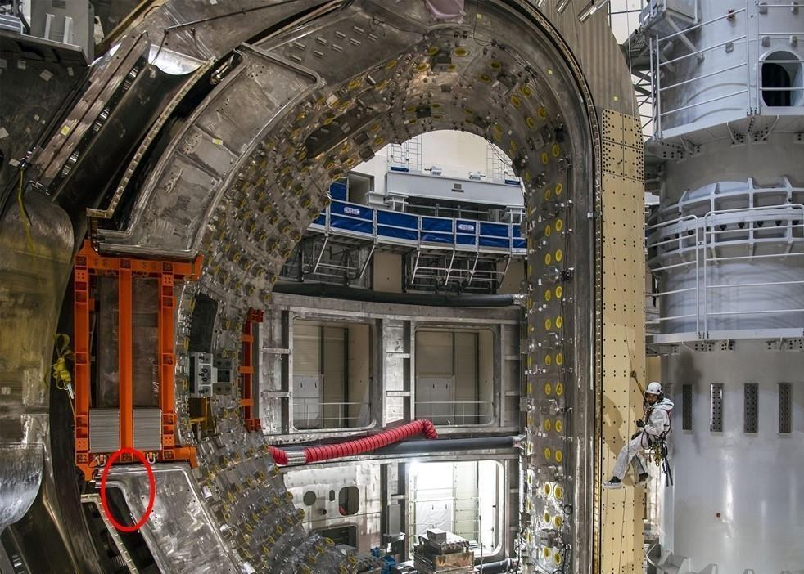

text
CHALLENGES OF
FIRST-OF-A-KIND COMPONENTS
Vacuum Vessel sectors have geometric non-conformities in the field bevel joints.
text
text
7
text

Slide 8
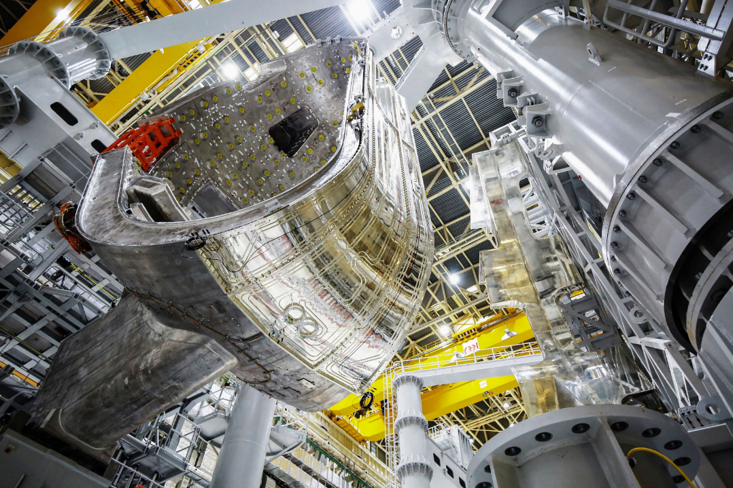
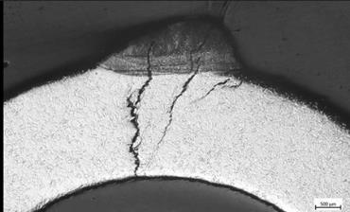
text
CHALLENGES OF FIRST-OF-A-KIND COMPONENTS
Leakage identified in thermal shield cooling piping due to chloride stress corrosion.
a
text
text
8
text

Slide 9
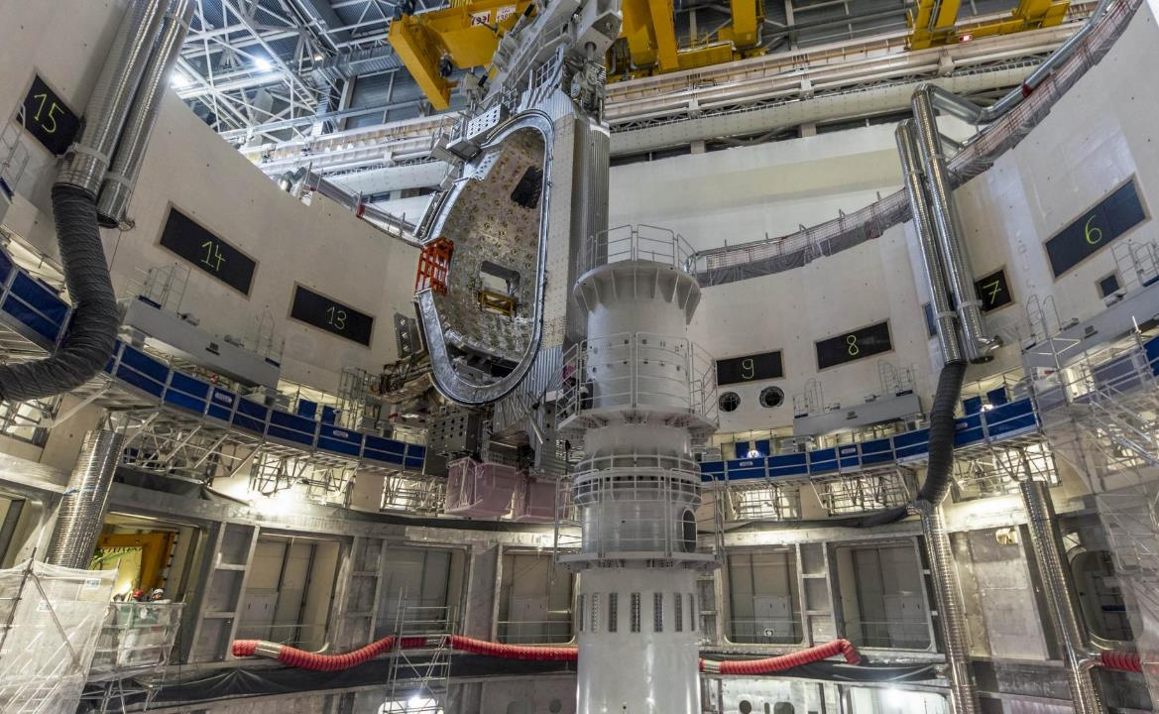
text
CHALLENGES OF FIRST-OF-A-KIND COMPONENTS
Vacuum Vessel Sector Module 6 has now been removed for repairs
July 2023
text
text
9
text

Slide 10
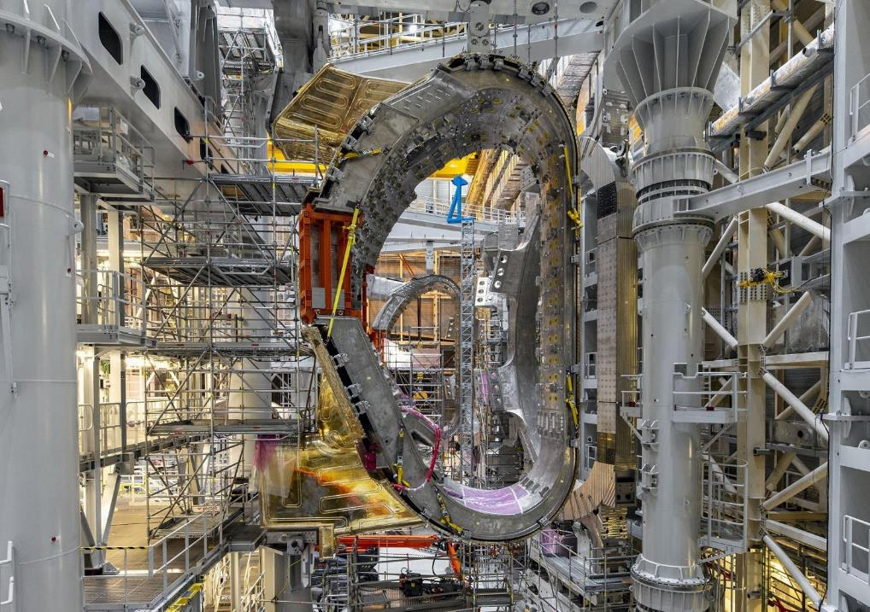
text
STATUS OF REPAIRS TO VV BEVEL JOINTS & THERMAL SHIELD COOLING PIPES
Repairs are well underway according to the defined strategy.
VV Sector 6 removed from the tokamak pit
VV Sectors 6 and 7 have been disassembled
All TS piping has been removed, repairs and replacement underway
text
text
10
text

Slide 11
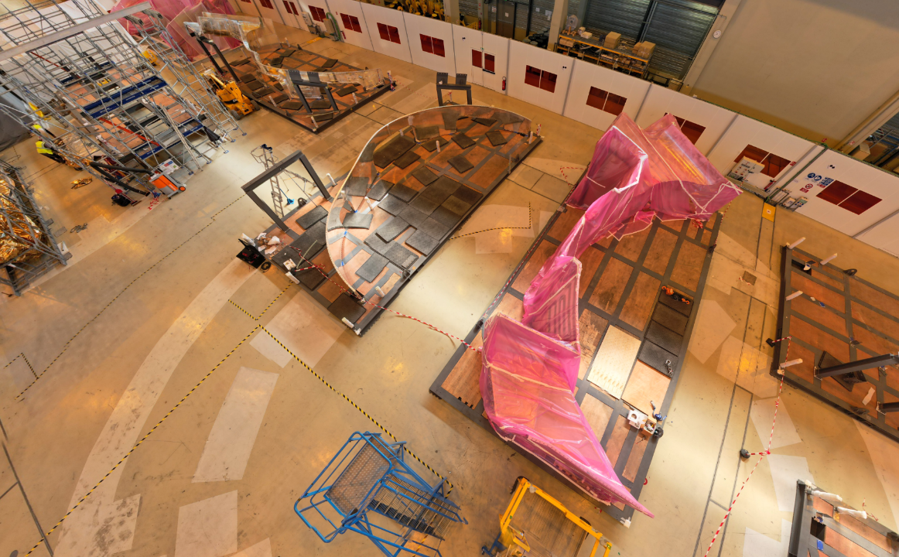
text
REPAIRS TO VV BEVEL JOINTS & THERMAL SHIELD COOLING PIPES
Photo shows thermal shield components in the re-purposed PF Coils building.
Photo from September 2023
text
text
11
text

Slide 12
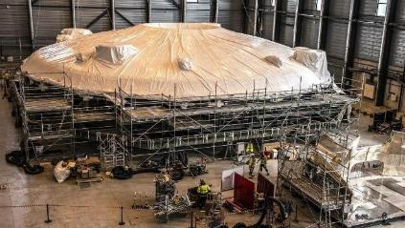
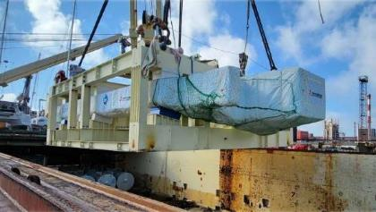
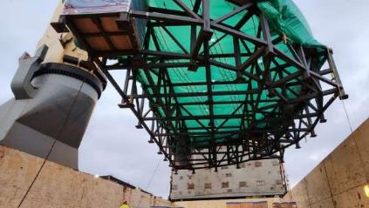
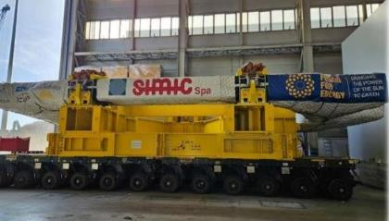
MANUFACTURING AND DELIVERIES CONTINUE
Cryostat lid completed by India and in storage
Last Toroidal Field Coil from Japan arrived onsite
More “in-cryostat” feeder components delivered from China
Last Toroidal Field Coil completed in Europe

Slide 13
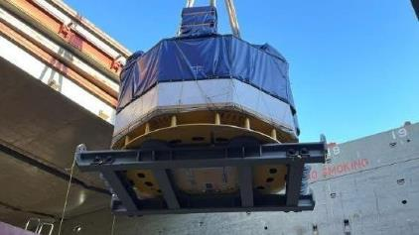
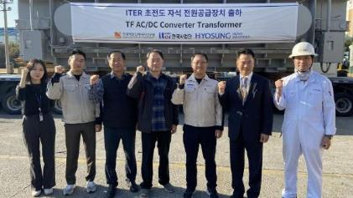
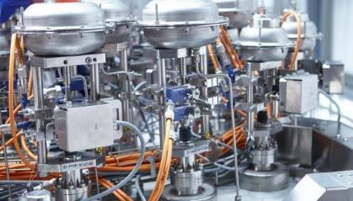
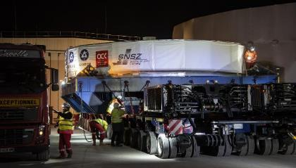
MANUFACTURING AND DELIVERIES CONTINUE
Fourth Central Solenoid module delivered from USA
Last AC/DC converter unit delivered from Korea
Eight cold valve boxes delivered by Europe
Poloidal Field Coil #1 delivered from Russia

Slide 14
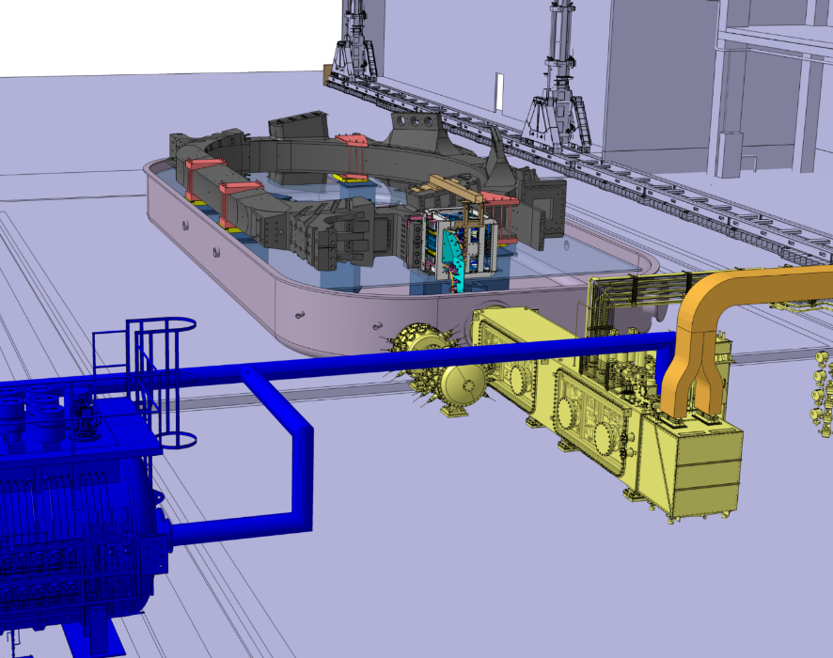
text
TF/PF COLD TESTING
… to mitigate risks of superconducting magnets
Cryostat to accommodate TF coils and PF1 coil.
A complete unit of energization (up to 67kA for TFs) and associated fast discharge unit.
Connection to ITER’s existing Cryogenic plant, using 1 of 3 Helium refrigerators to cool the coils at 4 Kelvin.
a
text
text
14
text

Slide 15

text
CHANGE IN FIRST-WALL MATERIAL
From Beryllium to Tungsten
Logic: Is ITER’s mission to reach Q≥10 and a set of experiments? Or to serve as precursor to DEMO machines?
Answer: both
This is why we are moving to Tungsten.
Precursor to DEMO
W
a
text
text
Be
Best path to Q≥10
15
text

Slide 16
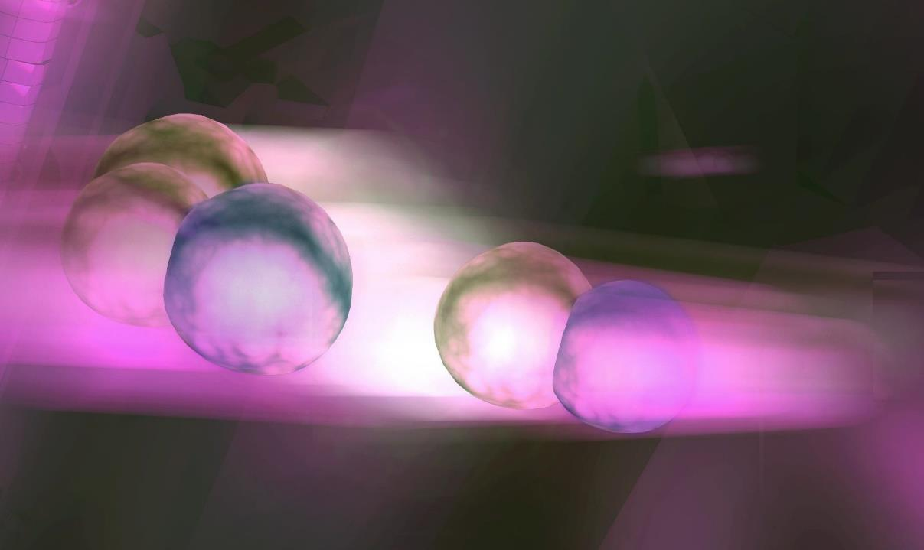
text
MOVE TO TWO-PHASE DT OPERATIONS
Essentially a 2-stage safety demonstration
Goal: early achievement of nuclear operations
a
text
text
16
text

Slide 17
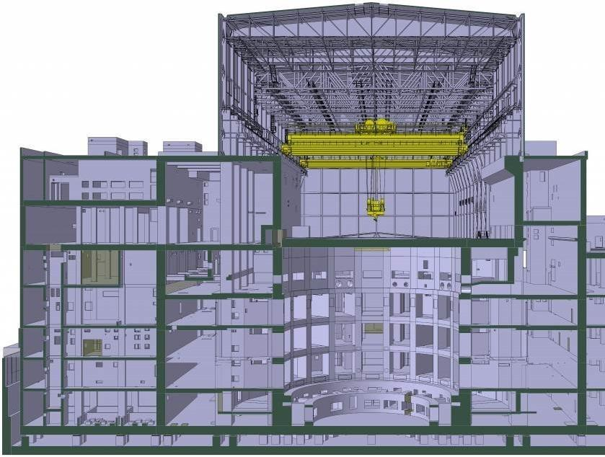
text
UPDATE BASELINE BY MID-2024
Current ITER cost and schedule “baseline” was set in 2016.
Review well-advanced; will present new baseline to ITER Council in June 2024.
Overall objective:
Start of Fusion Operations as soon as possible, with a realistic plan;
Mitigate risks where possible.
Key considerations:
Delays from Covid-19 pandemic and technical challenges.
Ensuring alignment with ASN, the French nuclear safety regulator.
Reconsideration of Vacuum Vessel welding sequence, to control deformations.
4 Kelvin testing of some Toroidal and Poloidal Field coils.
Adjustments to First Plasma campaign, followed by two DT operational phases.
text
text
17
text

Slide 18
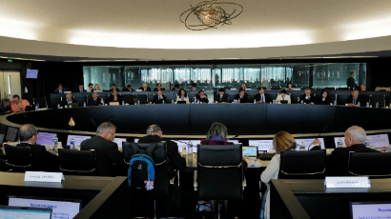
THE “JOINT NARRATIVE”: re-articulating ITER’s mission
…in the context of the global fusion innovation program
Many characterize the current state of fusion as a “competition” between public fusion R&D (e.g., ITER) and the emerging private sector initiatives.
In reality, fusion development is, optimally, a public-private collaboration.
ITER remains the convergent “national lab” for all involved, enabling repeatable experiments, long-term testing.
The private sector offers small scale, agile, initiatives:
  Enabling technologies (e.g., better magnets, control systems)
  New physics (e.g., shape effects, burning plasma)
  New materials resistant to 14 MeV neutron irradiation
  Exploration of new concepts (some with higher risk of failure)
The need: a platform for cross-fertilization, adjustment in mind-set
Ambition: to serve as an “information hub” for global fusion R&D, breaking down “silos” and consolidating knowledge to drive faster fusion success.
The ITER Council: …
(iv) Requested the ITER Organization, in collaboration with Domestic Agencies, to engage with private sector fusion initiatives at a pace that will not compromise its core tasks, and in line with the ITER Agreement, and to do so in close cooperation with the International Atomic Energy Agency (IAEA). It also requested the Members to encourage their national entities (such as government agencies, research institutes, and private sector fusion companies) to support the relevant global efforts;

Slide 19
THE “JOINT NARRATIVE”: re-articulating ITER’s mission
…in the context of the global fusion innovation program
Many characterize the current state of fusion as a “competition” between public fusion R&D (e.g., ITER) and the emerging private sector initiatives.
In reality, fusion development is, optimally, a public-private collaboration.
ITER remains the convergent “national lab” for all involved, enabling repeatable experiments, long-term testing.
The private sector offers small scale, agile, initiatives:
  Enabling technologies (e.g., better magnets, control systems)
  New physics (e.g., shape effects, burning plasma)
  New materials resistant to 14 MeV neutron irradiation
  Exploration of new concepts (some with higher risk of failure)
The need: a platform for cross-fertilization, adjustment in mind-set
Ambition: to serve as an “information hub” for global fusion R&D, breaking down “silos” and consolidating knowledge to drive faster fusion success.
The ITER Council: …
(iv) Requested the ITER Organization, in collaboration with Domestic Agencies, to engage with private sector fusion initiatives at a pace that will not compromise its core tasks, and in line with the ITER Agreement, and to do so in close cooperation with the International Atomic Energy Agency (IAEA). It also requested the Members to encourage their national entities (such as government agencies, research institutes, and private sector fusion companies) to support the relevant global efforts;
Inaugural Workshop @ITER, April 2024 (date tbc)

Slide 20
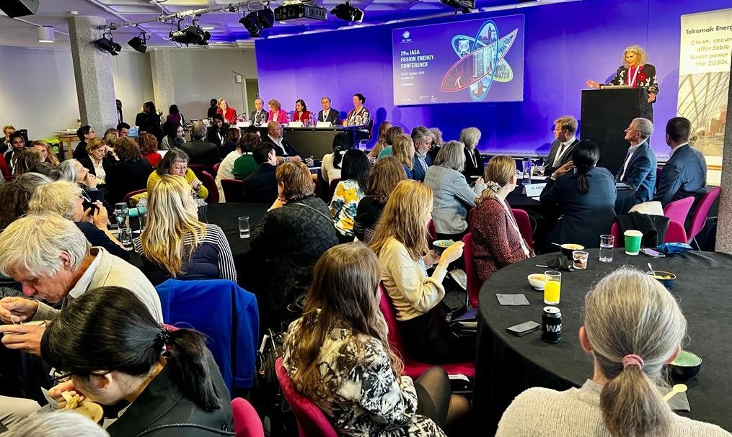
text
DIVERSITY, EQUITY, AND INCLUSION
Three interconnected values to engage and enable different groups of individuals.
We strongly believe that a diversified, equitable, and inclusive workplace is crucial to ITER’s success.
The most innovative team is diversified & inclusive.
[Pictured: Women in Fusion event, Fusion Energy Conference, October 2023]
text
text
20
text

Slide 21
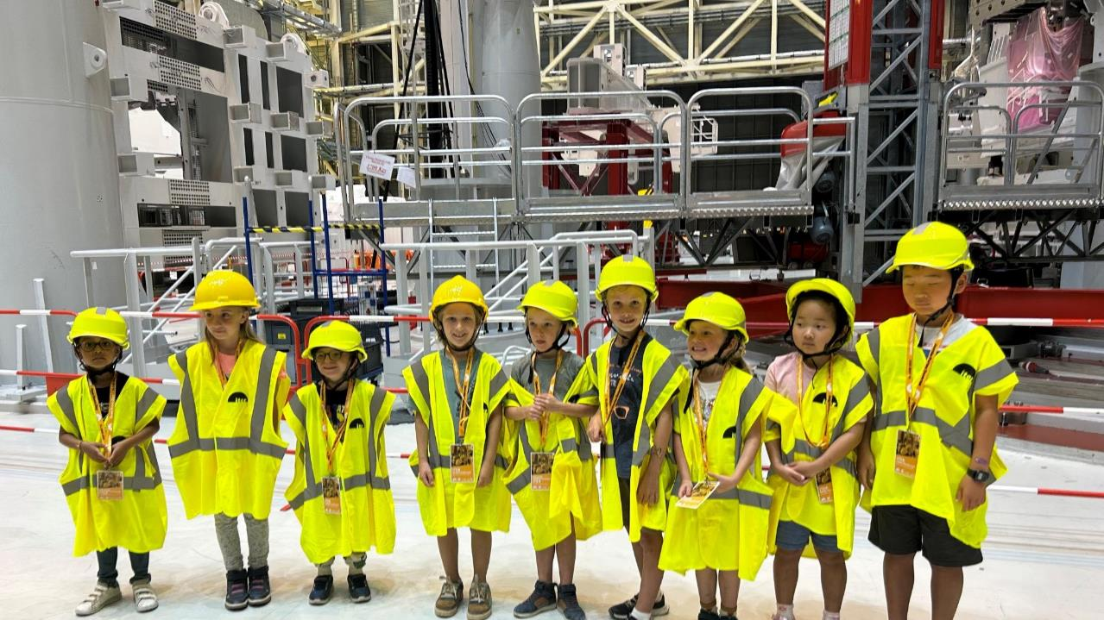

Thank you!
ITER Open Doors Day
June 2023

