Slide 1





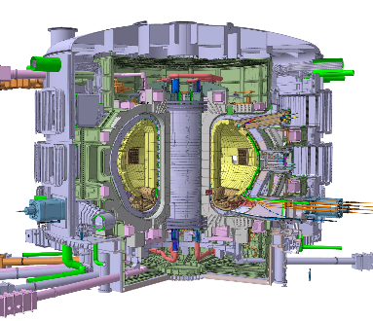




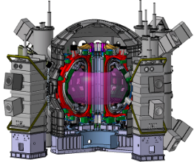
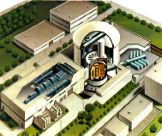
National Institutes for Quantum Science and Technology
Fusion Energy associates, 19th, Dec., 2023
Fusion Energy Development in QST
/
The ITER
（France）
QST：three Directorates
JT-60SA
（Naka）
/
Fusion Energy
○ Rokkasho
○ Naka
DEMO Reactor R&Ds
（Rokkasho）
Beam Science Research
Rokkasho
QST is the ITER Domestic Agency of Japan and the BA Implementing Agency of Japan to promote fusion R&Ds towards the early realization of “Fusion Energy” by utilizing international collaborations at three locations: ITER (Experimental reactor), Naka Fusion Institute (JT-60SA), and Rokkasho Fusion Institute (DEMO reactor R&Ds) .
Naka
Life and Medical Science
Notes:
QST has three directorates. One is Fusion Energy, the second is Beam Science Research and third is Life and Medical Science. The Fusion Energy directorate of QST has two institutes, Naka and Rokkasho.
QST is the ITER Domestic Agency of Japan and the BA Implementing Agency of Japan to promote fusion R&Ds towards the realization of “Fusion Energy” by utilizing international collaborations at three locations: ITER (Experimental reactor), Naka Fusion Institute (JT-60SA), and Rokkasho Fusion Institute (DEMO reactor R&Ds) .

Slide 2








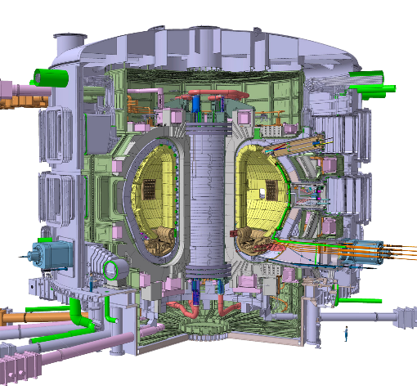
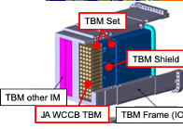
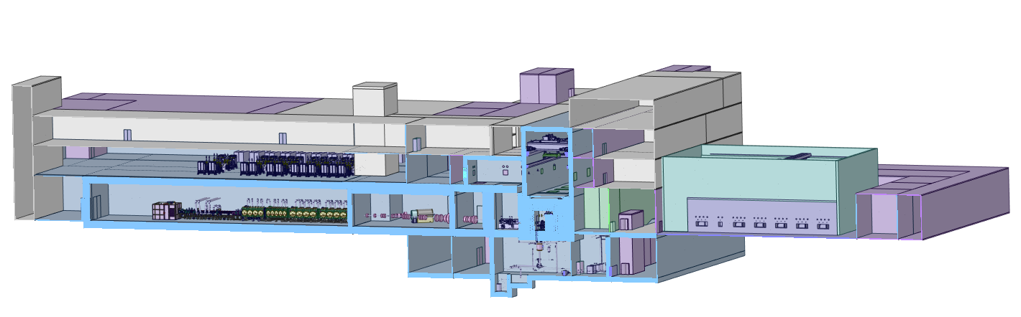
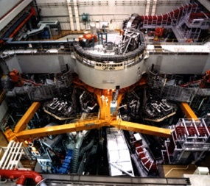
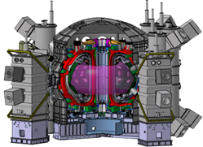
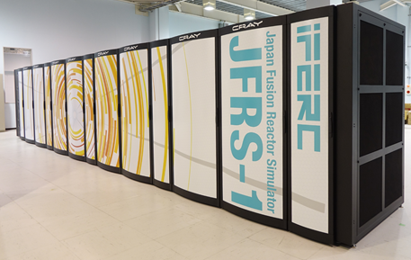
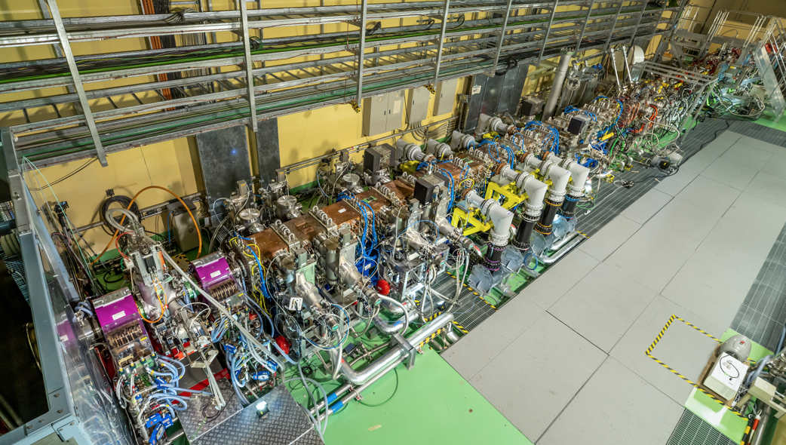
Phased approach
Electricity Production
Fusion Energy Production
Fusion DEMO
ITER
Fusion Plasma
Production
7 Members
Fusion Power
of 0.5GW
TBM
JT-60
Electric Power of
〜0.6 GW
Corresponding Fusion Power of ~10MW
Establish Engineering Basis for DEMO
Support ITER
at France
Broader Approach Activities
Advanced Fusion Neutron Source
【Naka in Ibaraki】
【Rokkasho in Aomori】
IFERC:
International Fusion Energy Research Center
IFMIF/EVEDA:
International Fusion Materials Irradiation Facility/Engineering Validation and Engineering Design Activities
IFERC
DEMO design
Simulation
ITER REC
IFMIF/EVEDA
Prototype accelerator development for fusion materials
JT-60SA
(Joint with National Program)
In Japan
Notes:
This shows the step for realization of fusion reactor in Japan. There are three stages, first is the JT-60 which was terminated in 2008. Second is the ITER to demonstrate the Fusion energy production of 0.5 GW. And then, we will construct the Fusion DEMO reactor to produce the electric power in Japan. In addition to this main route, we have carried out the BA activities under EU-Japan collaboration and the domestic activities to support the ITER and to promote Fusion R&Ds.

Slide 3
Roadmap toward Fusion DEMO Reactor
In Japanese Fusion Strategy, the Japanese DEMO activities are shared in Naka and Rokka institutes.
BA activities to be done are the key framework for Japanese DEMO.
In 2022, 1st C&R was conducted to confirm the progress.
July 24, 2018
Science and Technology Committee on Fusion Energy
Subdivision on R&D Planning and Evaluation
Council for Science and Technology
Judgment of DEMO construction
Mission of Naka Fusion Institute
Mission of Rokkasho Fusion Institute
Notes:
This is the Japanese roadmap toward fusion DEMO reactor established in 2018 by the Science and technology Committee on Fusion Energy in the Education, Culture, Sports, Science and Technology.
In this strategy, three C&Rs are set to decide the transition to Demo Reactor Phase just after a successful DT operation in ITER (2035~). There are eight items to be judged. The first and second items are the main mission of Naka Fusion Institute, the third , fourth and fifth are the main mission of Rokkasho Fusion Institute. BA activities is the key framework for Japanese DEMO in addition to ITER. In this year, the first C&R was conducted to confirm the progress such as the basic conceptual design of DEMO, establishment of manufacturing technologies for key components such as ITER TF coils.

Slide 4
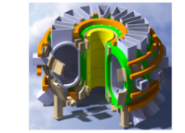


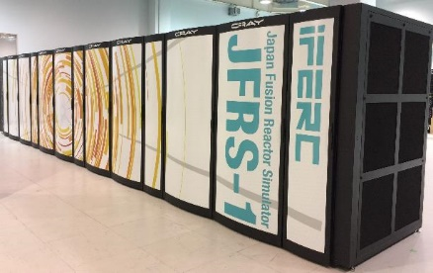
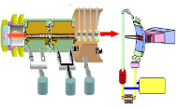

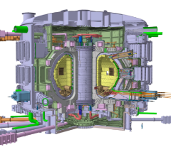


Fusion Technology Innovation Hub
  Based on Japanese Fusion Energy Innovation Strategy, fusion technology innovation hub is established to
  Open Innovation for developing Fusion Industries (Joint research, Joint use of facilities and equipment, and IP strategy)
  Acceleration of DEMO development: Fostering young leaders who are able to take initiatives in the ITER and JT-60SA researches and in the overall integration of furoin plants towards DEMO.
Rokkasho Fusion Institute
〇 Large-scale tritium handling facility
〇 Large remote maintenance development facility
〇 Fusion informatics center (provisionally)
〇 Blanket cold test facility
〇 Fusion Neutron Source irradiation test facility (A-FNS)
Technical Provision
Feedback
Industries
General Incorporated Association Fusion Industry Council of Japan (provisionally)
Office of Fusion DEMO Promotion Strategy
Overall Coordination and Strategy Planning for early realization of DEMO
General Contact for Open Innovation (Technical coodimator)
Linkage・Cooperation
Concentration of Excellence of Intellectual Capital ・
Fostering Human Resources / Promotion of Brain Circulation
Naka Fusion Institute
Research Institutes
〇 Neutral Beam Injection heating system test facility
〇 Radio-frequency Heating System test facility
〇 Plasma-facing component test facility
〇 Superconducting component test facility
〇 Joint Research Building
Universities
  In both Naka and Rokkasyo institutes, existing facilities are opened to fusion development to be done by industry
  Website (https://www.qst.go.jp/site/open-innovation/) has been opened to promote the participation of private company. Some of the Japanese companies are interested and asked to QST.
4

Slide 5
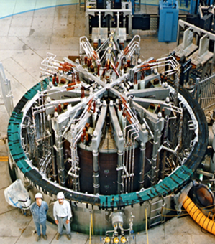
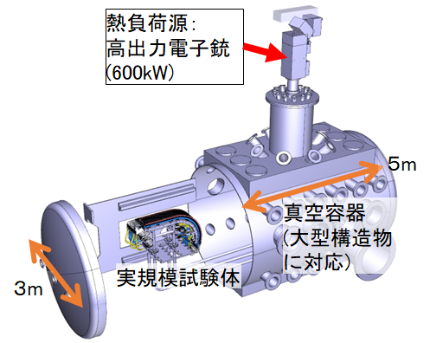


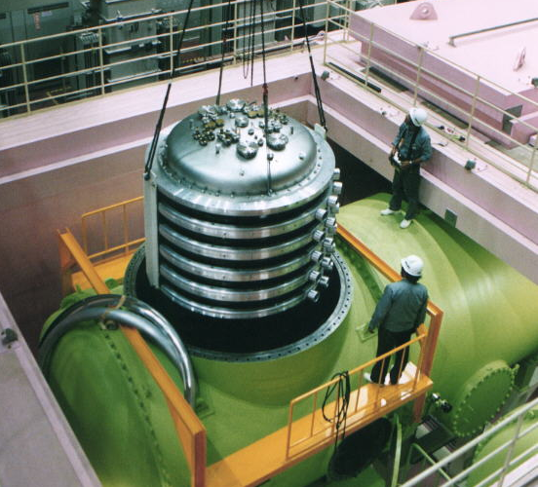
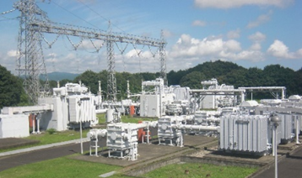
Development of Fusion Technology Innovation Hub
- Naka Fusion Institute -
Open Platform (including joint use of facilities)
Research linkage promotion・Fostering Human Resource
Strengthening the test facilities for development of ITER components, and Promoting joint cooperation and joint use of facilities with industries towards DEMO development
Fostering young leaders who can take initiative in ITER research, by establishing joint research building, to promote technology transfer of the integrated technology of JT-60SA fusion plant to industries, as well as to proceed with JT-60SA research with all JA fusion communities, through friendly competition against foreign researchers mainly from the EU.
Superconducting component test facility
Plasma facing component test facility
High power electron gun
Vacuum Vessel
Full-scale test module
The hub for conductor development facility, by upgrading for higher magnetic field and larger current, which are necessary for the superconducting coils for DEMO.
The DEMO divertor R&D hub, by development of the high heat load test facility which is necessary for the plasma facing component being exposed to high heat load in DEMO.
RF heating system test facility
NBI heating system test facility
RF Waveguide
Strengthening infrastructures of innovation hub
Gyrotron
Enforcing the central electric power substation, which is a basic infrastructure supporting Naka Fusion Institute including JT-60SA that foresees operation for about 20 years.
Enforcing gyrotron test facility, considering the lack of similar facilities necessary before the shipment of JA gyrotrons which are of the best performance in the world.
For development of high-voltage equipment and insultation, by use of the test facility up to 1 MV.
5

Slide 6
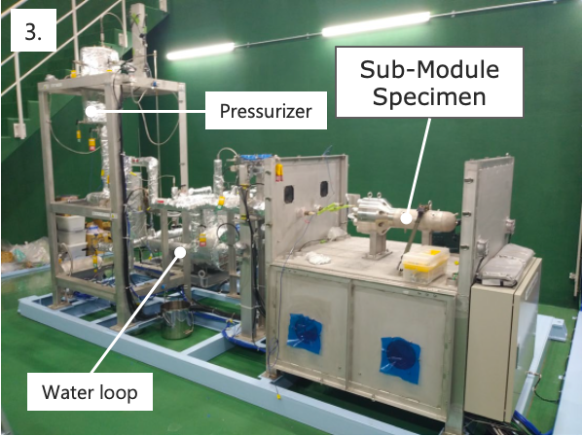
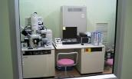
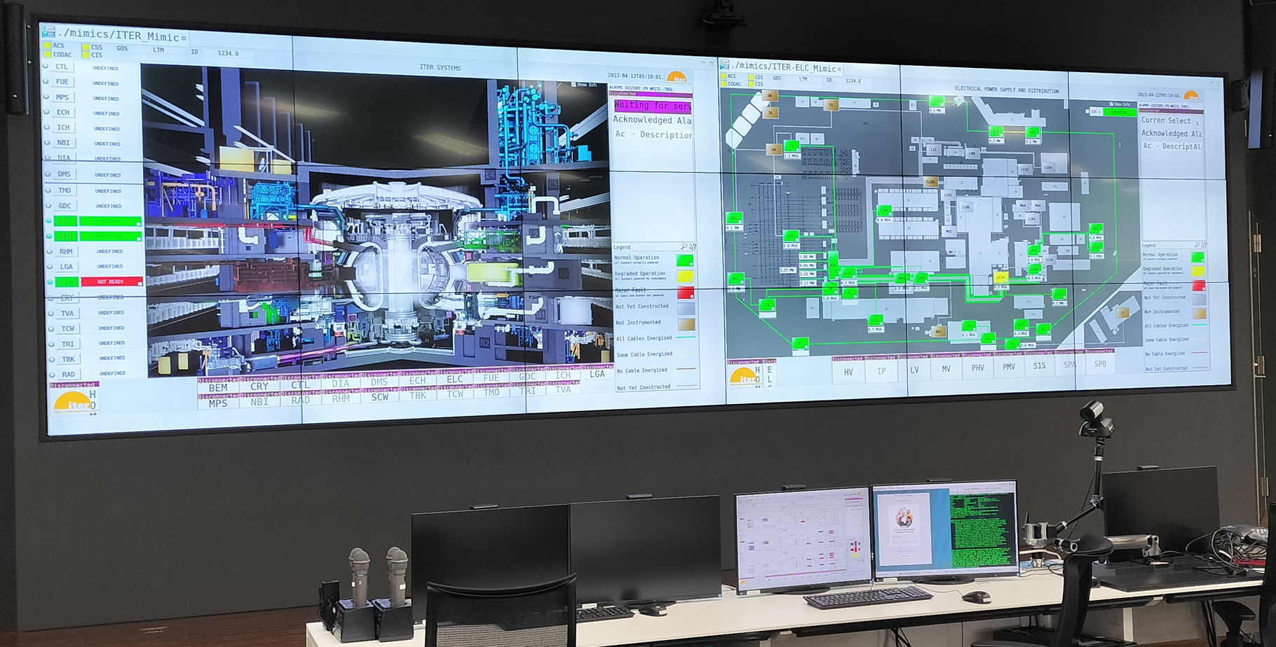
Development of Fusion Technology Innovation Hub
- Rokkasyo Fusion Institute -
Open Platform (including joint use of facilities)
Microstructure analysis equipment.
Blanket safety facilities
High Heat Flux Test
Water Ingress Test
Supercomputer
Flow Assisted Corrosion Test
Beryllium-Water Reaction Rate Measurement
Remote Experiment Control
6

Slide 7
ITER Project

Slide 8
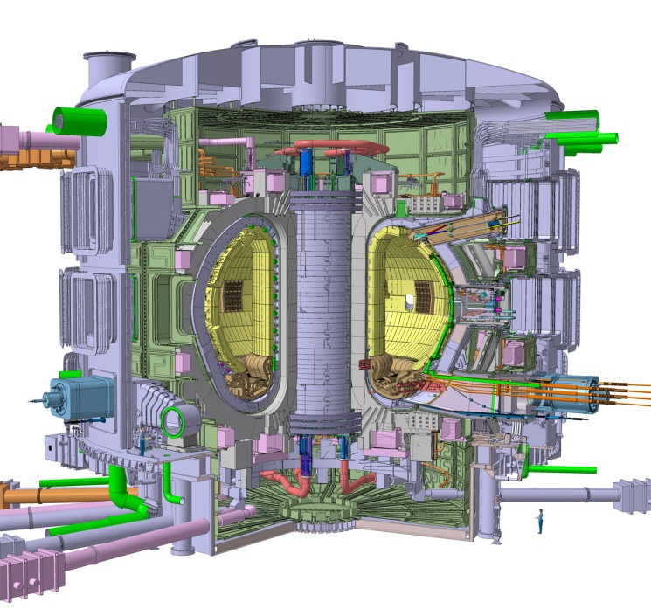
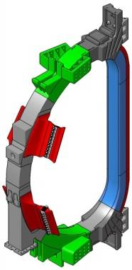

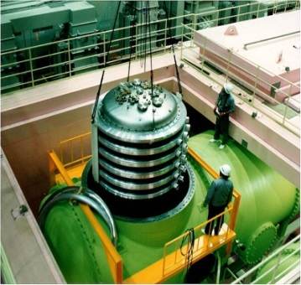
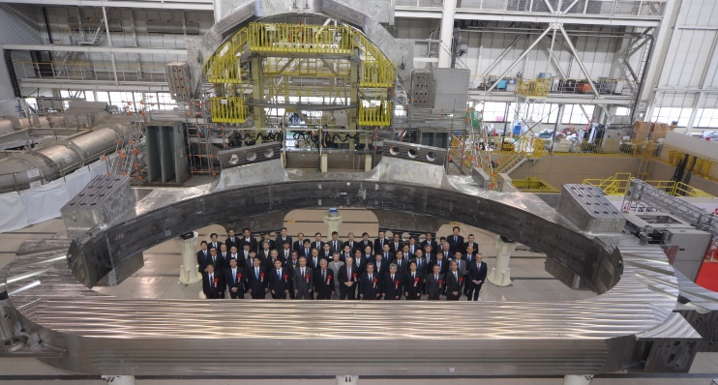
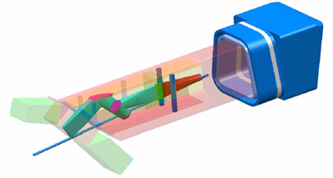
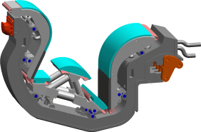
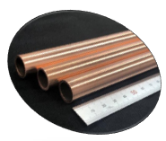
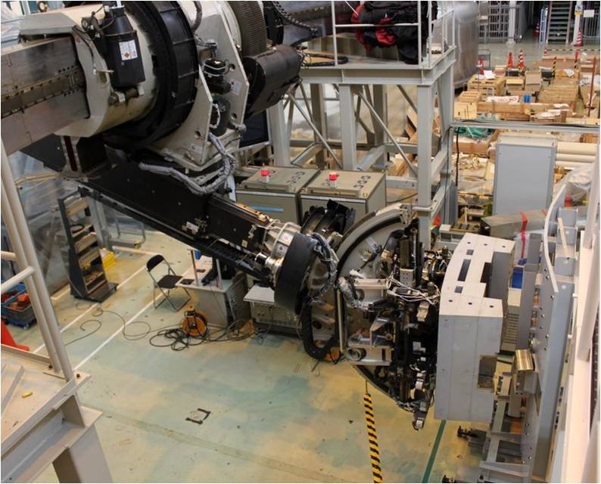
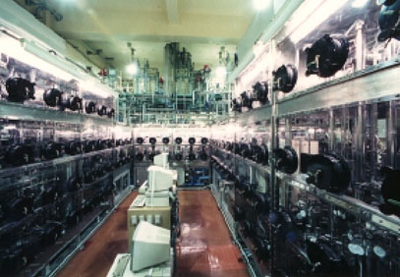
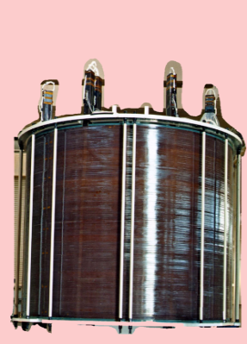
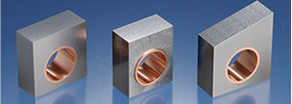
JA contribution to ITER components
First of Kind components
Magnet
Plasma Heating Systems
Superconducting
Magnetic coils
RF
heating
Neutral beam heating
World’s largest coil
World’s highest beam of 1MeV,40A
World highest power of 1 MW
person
Diagnostics
Divertor for heat and ash removal
～20MW/ｍ^{２}
First coil completion
（Jan. 2020）
Remote
maintenance
Tritium handing
Superconductor of CS
Cooling water pipe
Tungsten Monoblock
8
Notes:
This is the Japanese contribution to ITER components. Concerning with magnetic basket, Japan has manufactured several superconducting coils. Japan also will contribute the ignitor systems of RF heating and neutral beam heating systems, and so on. These Japanese components were designed and tested on the Naka Fusion institute.

Slide 9

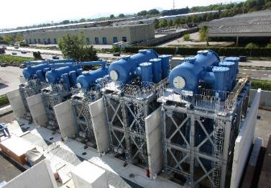
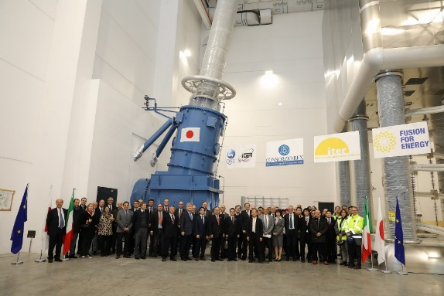
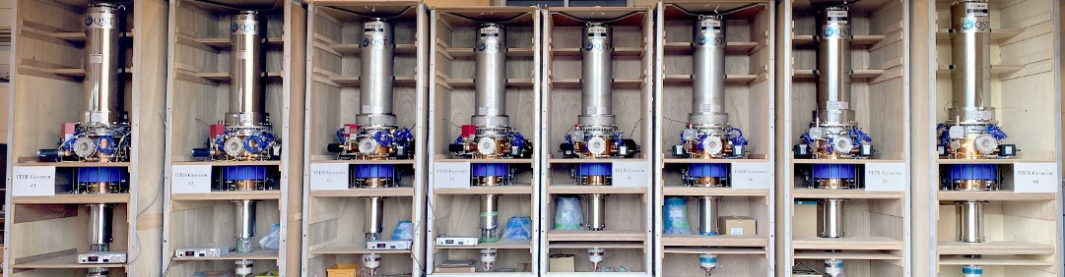
Progress in JA Procurement
Superconducting Toroidal Field coils; all completed, all 9 SC delivered;
Neutral beam heating device: test facility constructed in Padova for Japanese high-voltage power supply equipment passed 1.2 million V withstand voltage test.
Divertor: developed tungsten monoblock that can withstand a high heat load of 20 MW/m² and produced a full-scale prototype
Radio-frequency heating device: all 8 gyrotrons completed. 1 MW/300 s confirmed up to Unit 7.
9

Slide 10
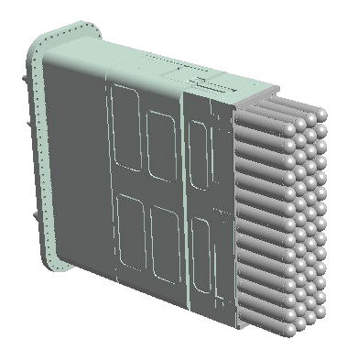
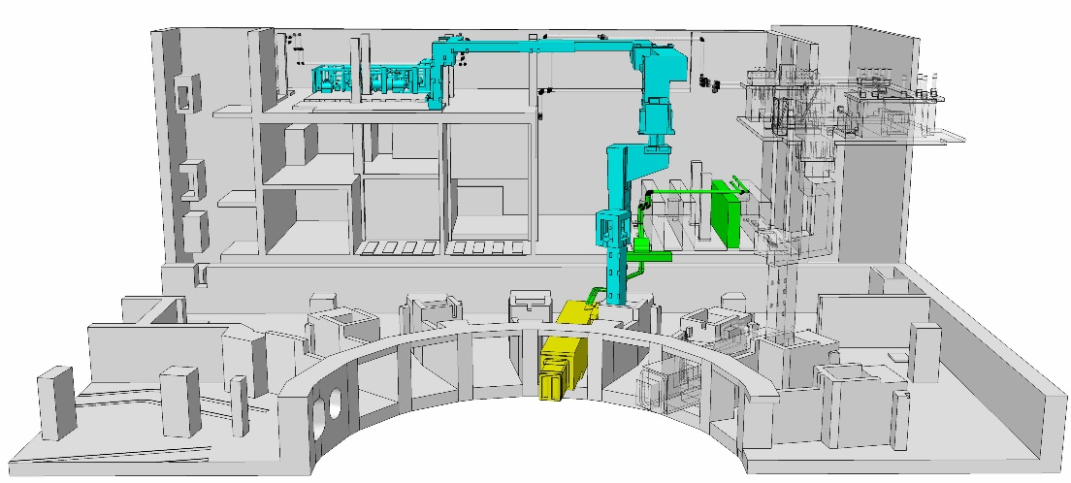
Water Cooling Ceramic Breeder (WCCB)
ITER-TB system
ITER Project
Test Blanket modules
TBM set
4x14 modules
Lithium ceramic (Li₂TiO₃₎
A water-cooled ceramic breeder test blanket module (WCCB-TBM) is proposed.
The preliminary design status assessment meeting was held and were confirmed to be fulfill the requirements.
Chanel of water
at ～300℃～150atm
Beryllium
Test Blanket System
WCCB-TBS consists of
  TBM set (TBM + Shield),
  Water Cooling System (WCS),
  Tritium Extraction System (TES) including Tritium Accountancy System (TAS) function,
  Neutron Activation System (NAS), and
  Their controlling system
Water cooling system
T2 recovery system
Four test stands are newly built.
High Heat Flux test
Flow Assisted Corrosion test
Water Ingress test
Beryllium-Water Reaction Rate Measurement
TBM
Notes:
One of the most important R&D subjects for nuclear technology using ITER is TBM program. A series of tests on the heat and tritium production is carried out in ITER operation.
A water cooled ceramic breeder (WCCB) is proposed by Japan as primary option of TBM, and R&D and design studies have been carried out. The TBM is composed of TBM set (TBM+Shield), a water cooling system (WCS), and a tritium extraction system (TES) . Some analysis systems for neutron and tritium are also needed. The structural materials of TBM is RAFM (Reduced Activated Ferric Martensite: F82 H, Fe-8Cr-2W-V,Ta), and 1.67 m in height, 0.46 m in width, and 0.6 m in tall. The surface heat flux and neutron wall load are expected to be 0.3 MW/m² and 0.78 MW/m², respectively. The coolant water conditions are 15.5 MPa for pressure, 555-600 K for temperature, and 3.59 kg/s for flow rate. The tritium breeder material is Li₂TiO₃ (37 kg), and neutron multiplier is Be metal (200 kg).

Slide 11



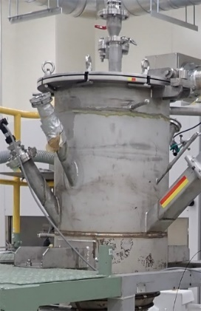
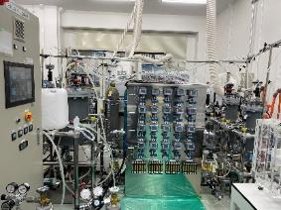

Fusion Startups from Fusion Development
As one of the blanket developments, the refining technology of beryllium (Be) and lithium (Li) is being developed by establishing start-up companies as QST venture.
Low energy consumption process of beryllium with alkali and RF power
Very simple process on lithium with Lithium ionic conductor
Li ＝Lithium
S ＝Sustainable
Tie
Aiming to be a bridge company that connects a decarbonized society to the next generation.
MiRESSO Co. Ltd.
LiSTie Inc.
Date of incorporation: July 6, 2023
Company
MiRESSO Co. Ltd.
Mineral Refining and Recycling System Society
Li Separation Method by Ionic Conductor : LiSMIC
LiSMIC enables for extracting high purity Li as LiOH with one process
Start-up
May 2023
Business Outline
Production and sales of Beryllium
Technical support for energy saving of refinement and recycling processes with high temperatures
Hydrogen is also produced as a byproduct
Microwave device
Mission
Contribution of fusion realization by providing a stable supply of beryllium
Realization of fusion
Achievement of
Carbon Neutrality
by 2050
Li extraction device
Preparation
Stable supply of Be
Energy saving for refinement & recycling processes with high temperatures
Contribute to a sustainable society
Now
2030
2035
2050
Notes:
Some of the fusion technologies are already commercialized. The refining technology of beryllium (Be) and lithium (Li) that are used in the blanket is applied to the product Li and Be that are widely used in the market. Start-up companies are newly established as QST venture.
As for Beryllium, the low energy consumption process of beryllium with alkali and RF power is developed to lower the energy. The startup of miressso is established.
As for Lithium, very simple process on lithium with ionic conduction is developed to increase the production speed. The startup of LISTI is established.

Slide 12
BA Activities

Slide 13
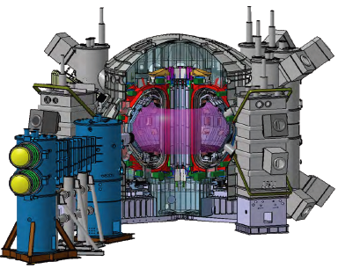
JT-60SA (JT-60 Super Advanced) Project
Mission:
Contribute to the early realization of fusion energy by addressing key physics and engineering issues for ITER and DEMO.
15.5m
Major Objectives:
(1) Supportive Researches for ITER
  address ITER related issues in advance and optimize its operation scenarios under the break-even condition
(2) Complementary Researches for DEMO
  study long sustainment of high integrated performance plasmas with high β_{N} value
  (3) Foster Next Generation
  build up experience of young scientists and technicians who will play leading roles in ITER and DEMO.
Plasma Current | 5.5 MA
Toroidal Field | 2.25 T
Major Radius | 2.96 m
Minor Radius | 1.18 m
Elongation, κ_{X} | 1.87
Triangularity, δ_{X} | 0.50
Safety factor, q₉₅ | 3.0
Plasma Volume | 131 m³
Heating Power | 41 MW
Normalized beta, β_{N} | 3.1
(full I_{p} inductive mode)
JT-60SA is the world largest tokamak fusion experimental reactor and has a half dimensions and 1/10 weight of ITER.
Notes:
JT-60SA is a superconducting tokamak under construction in Naka, Japan.
JT-60SA Project is implemented under the Broader Approach Agreement between EU and Japan as well as the Japanese national fusion programme.
The mission of the JT-60SA Project is to contribute to the early realization of fusion energy by addressing key physics and engineering issues for ITER and DEMO.
There are three major objectives in JT-60SA Project.
The first one is “Supportive Researches for ITER”. JT-60SA starts operation in 2019 and address ITER related issues in advance, and optimize its operation scenarios under the break-even condition.
The second one is “Complementary Researches for DEMO”. From the economical point of view, DEMO should be operated in high b_{N} condition. Therefore JT-60SA will study long sustainment of high integrated performance plasmas with high b_{N} value to promote DEMO.
The third one is to foster next generation by using JT-60SA. Progress of Fusion research and development needs quite a long time. JT-60SA will build up experience of young scientists and technicians who will play leading roles in ITER and DEMO.
This is the plasma parameters of the full current inductive mode. Plasma current is 5.5 MA, toroidal field is 2.25 T, plasma volume is about 130 m³, and heating/current drive power is 41 MW.

Slide 14
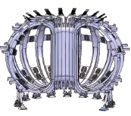
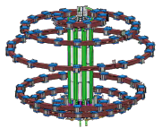
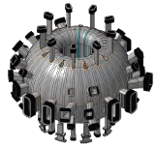
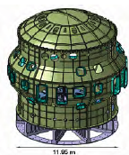







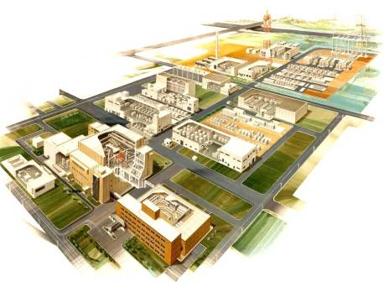


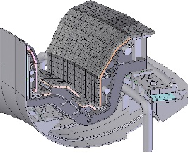

Major components in JT-60SA
175t+45t
Cryostat
vessel body
396t
260t
157t+100t
150t
Toroidal Field Coils
Poloidal Field Coils (EFC&CS)
Vacuum Vessel
Cryostat base
Compressor Building
Radio Frequency Resonance Heating System
Cryogenic System
In-vessel Components
15.5m
Plasma
12m
Naka Site
Divertor
Plasma Diagnostics
Neutral Beam
Injector
Power Supplies
All components to be required for DEMO are being developed through JT-60SA and ITER. Integrated technologies with design, manufacture and operation are also developed.
Notes:
Here is the major components in JT-60SA.
Plasma is produced by these superconducing magnetic field for plasma by these coils and in a vacuum vessel.
The Superconducting mangets is installed in vacuum, which is formed by the cryostat.
Facility of cryogenic system is newly manufactured, power supplies are manufactured.
JT-60SA is about half size of ITER and presently the largest tokamak in the world.
The major size and total weight are > 10 m and 2600 tons, respectively.

Slide 15
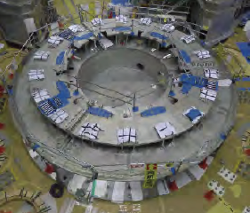
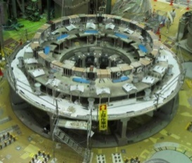
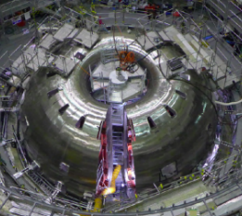
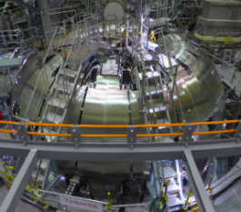







Tokamak Assembly of JT-60SA from 2013 to 2020
2013, Mar
2014, Jan
2015, Aug
2016, Sep
Cryostat Base
Lower EF coils
Vacuum Vessel
VV Thermal Shield
2018, Apr
2018, Aug
2019, May
2019, Dec
TF coils
Upper EF coils
Central Solenoid
Cryostat Body
2020, End of Mar
2020, Jan
2020, Mar
Cryostat Thermal Shield
Cryostat Top Lid
15
Completion of tokamak assembly

Slide 16



First plasma was achieved on 23rd, Oct.
JT-60SA
March, 2020:Integrated commissioning started.
March, 2021:Insulation incident of the feeder joint in Equilibrium Field #1 coil was found.
The insulation improvements were taken with respect to not only EF#1 feeder joint but also similar parts of insulation weakness, nearly 100 locations by developing the in-site measurement and repair. The measures were shared with IO.
May, 2023: Integrated commissioning re-started.
October, 2023: First tokamak plasma was achieved.
December,2023: Diverted tokamak plasma with plasma current of 1 MA. The largest volume plasma of 165 m^{3.}
Tokamak plasma with several ｈａｎｄｒｅｄｓ of plasma current
The JT-60 SA will be upgraded since 2024 by installing NB and in-vessel coils etc..
The participations of the institutes in US are GA&UC Irvine and PPPL with delivering FIDA and XICS, respectively. FIDA: Fast Ion Deuterium Alpha, XCIS:X-ray Crystal Imaging Spectrometer

Slide 17




Demo Design
BA Activities
2015
2020
2025
2030
2035
JA Roadmap
pre-Conceptual Design
Conceptual Design
Engineering design
Manufac. Design
Pre-Conceptual Design of JA DEMO has been developed based on ITER technologies and industry experiences.
  R_{p}=8.5m, P_{fus}=1.5GW, Steady-state operation
  PWR cooling water condition (15.5MPa, ~300℃)
Highlights of the collaboration
For the benchmark of divertor simulation, JA has performed SONIC simulations of the radiation fraction and density scans for EU DEMO divertor.
In addition, He exhaust calculation for EU DEMO by SONIC started in some typical cases.
Further analysis of the He transport between the inner to outer divertors is continued.
36th DDA Task meeting at EUROfusion
DEMO designers from JA and EU had their first face-to-face meeting over the Covid-19 pandemic.

Slide 18



Progress of IFMIF/EVEDA Project
Preparation of CW operation of RFQ and Injector for long pulse D+ beam operation.
160mA CW operation for 6 hours with stable & high-quality beam extraction in Injector.
Trouble shooting for the RFQ RF coupler vacuum leak. A new brazed coupler was tested at full power (200 kW) up to 96% duty cycle.
CW operation of Injector
Notes:
18

