Slide 1
FUSION POWER ASSOCIATES
42ND Annual Meeting and Symposium
Office of Experimental Sciences, Defense Programs
National Nuclear Security Administration
Dr. Sarah L. Nelson
Director, Office of Experimental Sciences (OES)
December 15, 2021

Slide 2
The Department of Energy and National Nuclear Security Administration
Secretary of Energy
Jennifer Granholm
Under Secretary for Nuclear Security & Administrator, NNSA
Jill Hruby
The National Nuclear Security Administration (NNSA) is a semi-autonomous agency within the U.S. Department of Energy responsible for enhancing national security through the military application of nuclear science.
Deputy Administrator for Defense Programs, NNSA
Principal Deputy Stockpile Sustainment Defense Programs, NNSA
Assistant Deputy Administrator for Research, Development, Test and Evaluation
Mark Anderson
Sarah Nelson
Director, Office of Experimental Sciences (Acting)
Charles Verdon
Michael Thompson
Notes:
Introduction
Highlight that national security is the NNSA mission (from https://www.energy.gov/nnsa/about-nnsa)

Slide 3
The NNSA Office of Experimental Science delivers the world-class scientific data, facilities, and expertise required support the modern nuclear stockpile
Science
Computer Simulation
Inertial Confinement Fusion
Technology Maturation
Engineering
RDT&E
For maintaining the effectiveness of the nuclear weapons stockpile, providing a technical basis for the annual assessment, developing modernization options, and quantifying the effects of aging on the stockpile
VISION: A world-class scientific enterprise for stockpile stewardship that creates and applies 21st century science capabilities to anticipate and address existing and emergent stockpile needs, and thwart unforeseen threats
MISSION: Ensure a resilient US nuclear deterrence posture by delivering world-class data, facilities, and expertise required to undergird the effectiveness and responsiveness of the modern stockpile
Office of
Experimental
Sciences
Notes:
OES provides the data needed for the NNSA national security mission described previously.

Slide 4
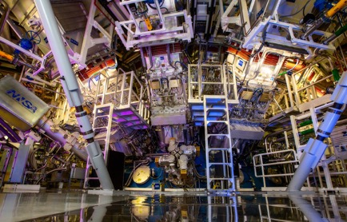
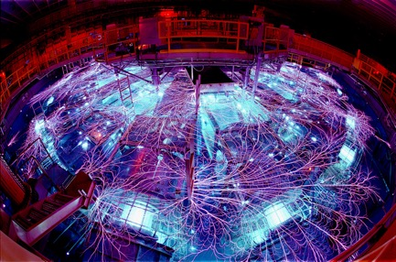
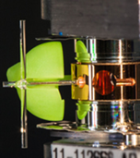
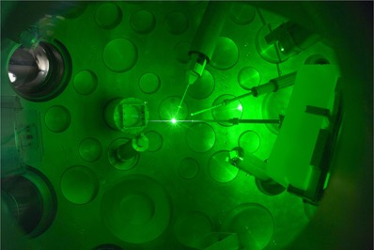
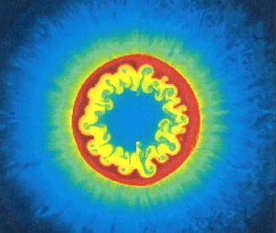
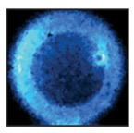
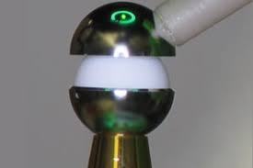
Achieving a burning plasma is a priority for the NNSA
NIF, Laser Indirect Drive
Z, Magnetic Direct Drive
Omega, Laser Direct Drive
LANL, HED and ICF physics investigations
General Atomics, Targets
Notes:
Each of the three NNSA science and engineering national labs are actively working on ICF, as are partners at LLE and GA.
This is a priority activity for the NNSA. We intentionally approach it using different techniques, because each has its own unique benefits and challenges.

Slide 5
Achieving this goal is only possible with sustained support for operations, improvements, and sustainment activities
ICF FY21 ($575 M)
ICF Facility Shot Allocations
150/yr
400/yr
2300/yr
HED & Ignition Science: Advances experimental platforms and understanding toward ignition and MJ fusion yield
ICF Diagnostics: Conducts the R&D for new technologies to execute and interpret HED experiments
Facility Operations: Enables safe and efficient operations of national HED facilities for all applications
Notes:
[A chance to add commentary about the age of facilities, the challenges of workforce and STEM pipeline, etc].
Through this effort, we are closer now than we’ve ever been….

Slide 6
NATIONAL NUCLEAR SECURITY ADMINISTRATION OFFICE OF DEFENSE PROGRAMS
Inertial Fusion in NNSA
Presented to:
Fusion Power Associates
33rd Annual Meeting and Symposium
Washington, DC
Presented by:
Jeff Quintenz, PhD
Director, Office of Inertial Confinement Fusion
December 6, 2012
prior material

Slide 7
Summary
Ignition not yet achieved but remains principal goal of the ICF Program, and our understanding is increasing rapidly
Alternate concepts to the mainline indirect drive approach are advancing
HED facilities are operating well and are oversubscribed (by a lot)
Vibrant HED community is recognized to be critical to the success of SSP
ICF is an exciting grand challenge endeavor and remains a leading attractor for talent and the next generation of stewards
prior material

Slide 8
NIC Key Milestones
 | Short Description | NIC EP Rev 4.0 Approved Title | Due Date
1. | Facility approved for ignition shots | Complete contractor Readiness Assessment for High Yield | Q2 FY 2011
2. | Diagnostics available for ignition shots | Complete Operational Qualification of the First Set of NIC Ignition Diagnostics | Q2 FY 2011
3. | Systems, diagnostics, and experimental capabilities demonstrated | Begin First Integrated Ignition Experiments | Q4 FY 2011
4. | Preparing the fuel for ignition | Conduct first THD Tuning Experimental Campaign to Optimize Ignition Threshold Factor (ITF) | Q4 FY 2011
5. | Demonstrating that we can light the “match” – alpha heating | Conduct First DT Implosion Experimental Campaign to Demonstrate Limited Alpha Heating | Q3 FY 2012
6. | Completing the laser operations to give maximum headroom | Demonstrate 1.8 MJ Operations | Q2 FY 2012
7. | Demonstrating ignition (burn) | Conduct DT Implosion Experimental Campaign to Produce Gain of 1 | Q4 FY 2012
prior material
Completed
Not completed

Slide 9
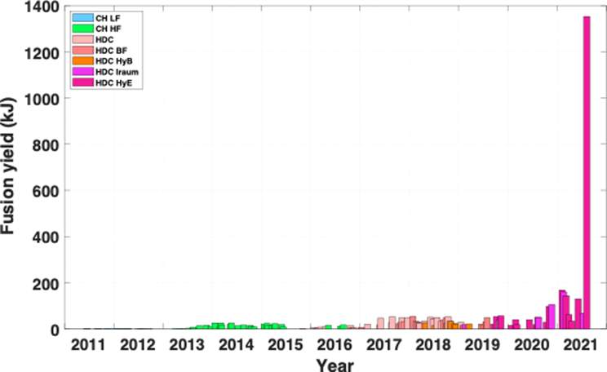
And then there was the shot on August 8, 2021…
HyE/Iraum (1.35 MJ)
Increased coupling
and compression
Understanding
degradations
Better targets
Reduced LPI
Reduced fill tube
Diamond ablator
Improved symmetry
HyE/Iraum
(100+ kJ)
Improved stability
High-foot
(25 kJ)
HDC/BF
(55 kJ)
NIC
(2.5 kJ)
Notes:
I’m not just being optimistic saying that we’re closer than ever before. We have the data to prove it.
We’ll hear more about this from the scientists involved in this shot, so I won’t go into any technical detail here, beyond to say that is a great success made possible by years of hard work and perseverance.

Slide 10
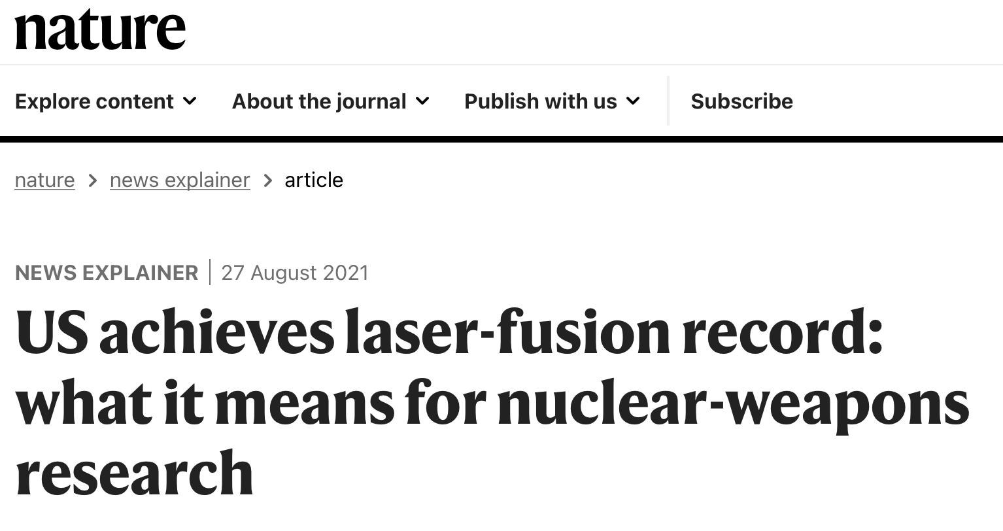
And then there was the shot on August 8, 2021…
HyE/Iraum (1.35 MJ)
Increased coupling
and compression
Understanding
degradations
Better targets
Reduced LPI
Reduced fill tube
Diamond ablator
Improved symmetry
HyE/Iraum
(100+ kJ)
Improved stability
High-foot
(25 kJ)
HDC/BF
(55 kJ)
NIC
(2.5 kJ)
Notes:
I want to acknowledge the fact that this is a milestone, and that both of these headlines are true.
As the director of NA-113, my responsibility is to focus on the Nature headline, and as a program that is where our funding and focus will remain.
However, as a [scientist, American, person who believes in climate change…], I share the excitement of this this community.

Slide 11
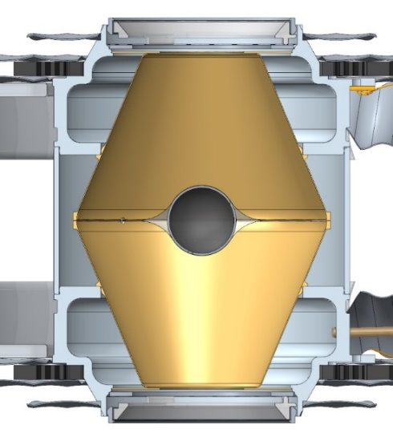
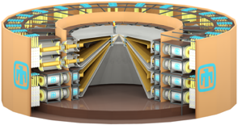
Where is the ICF Program Going?
More Innovation
Better Diagnostics
Next-Gen Technologies
World-Leading Facilities
Broaden the community
ICF workshops
New collaborations
Innovative approaches
Disruptive initiatives
Alternative designs
Mature MDD / LDD
Advance time and energy resolution
Multiple dimensions
High rep rate
Radiochemistry
Time-resolved material properties at high pressure
MDD ICF
Driver technologies
Broadband lasers
Next-generation pulsed power
Probes
Compact accelerators
Light sources
Computational tools
AI, advanced data analysis, routine 3D, predictive models
5-year plan for HED & ICF science
Address key uncertainties in scaling for each approach
2024: Establish modern mission requires for high yield
2025: Assess investments to meet mission requirements
Sustain flagship facilities through 2020s
Notes:
We’ve made great progress in the last year, but we know that additional technological innovation will be needed to reach our goal.

Slide 12
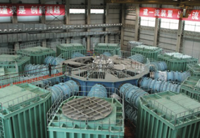
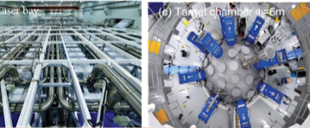
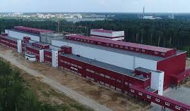
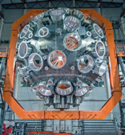
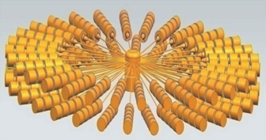
Other nations are actively pursing facilities to rival U.S. capabilities
France: Laser MegaJoule (LMJ)
Comparable capability to NIF
China: 8 MA Primary Test Stand 2nd largest pulsed power facility
China: Shenguang-III Laser Facility
SG-IV being considered to rival/exceed NIF
China:
CAEP designing 50-60 MA facility
NINT designing CZ30, a 30-34 MA facility
Russia: 192-beam UFL-2M Laser
Comparable capability to NIF
Notes:
And, in keeping with the fact that we’re in the “World Perspectives” session, we should note that other countries are pursuing this technology as well.
We must continue to lead the world in this field of science that is so important for national security.

