Slide 1

SPARC, ARC and the high-field path to burning plasmas and commercial fusion energy
Dennis Whyte
Director, MIT Plasma Science & Fusion Center
Representing my colleagues at Commonwealth Fusion Systems, MIT-PFSC and our many collaborators

Slide 2
Burning Plasmas are a necessary but insufficient part of delivering fusion energy to meet decarbonization goals
Net energy gain commensurate with commercialization →
physics tells us we must obtain burning plasma self-heating regime
Yet the urgency for decarbonization has completely modified the context and drive for obtaining burning plasma, which must have
  Timeline commensurate with commercialization
  Approach with obvious and relatively small extrapolation to commercial entity in terms of confinement scheme
  Altered risk assumptions: will accept/require parallel development paths
If these are met, more resources will arrive to support BP mission (not a zero sum game)
This reality has fundamentally changed the BP strategy. A single collective BP experiment that does not meet these criteria is insufficient

Slide 3
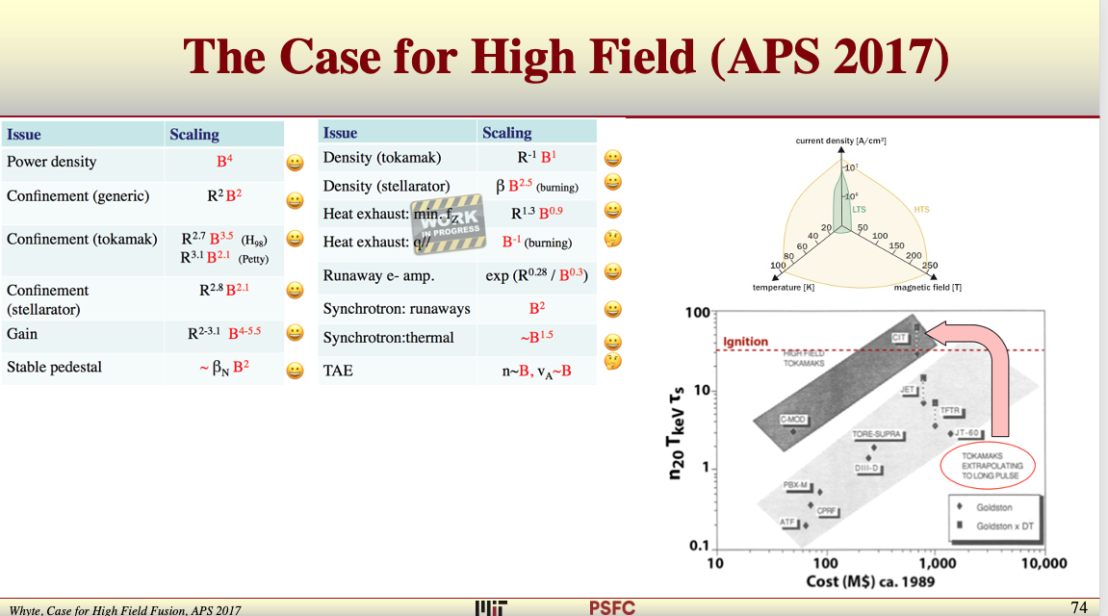

Slide 4
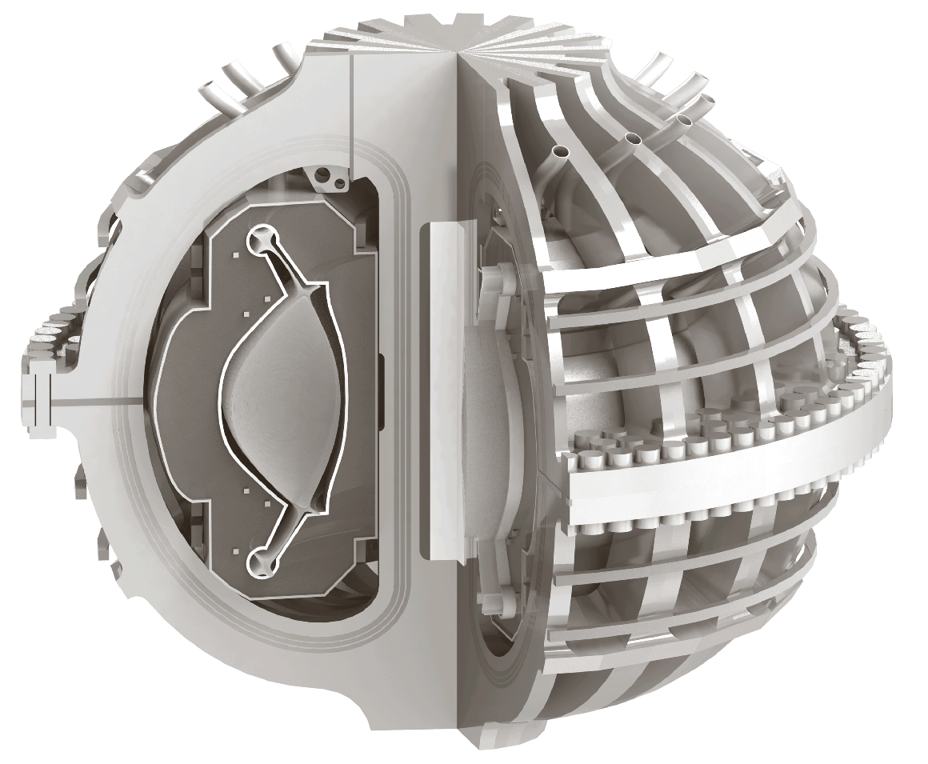
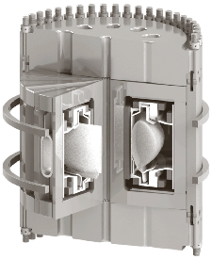
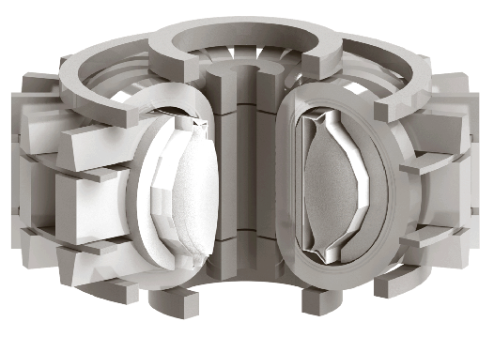


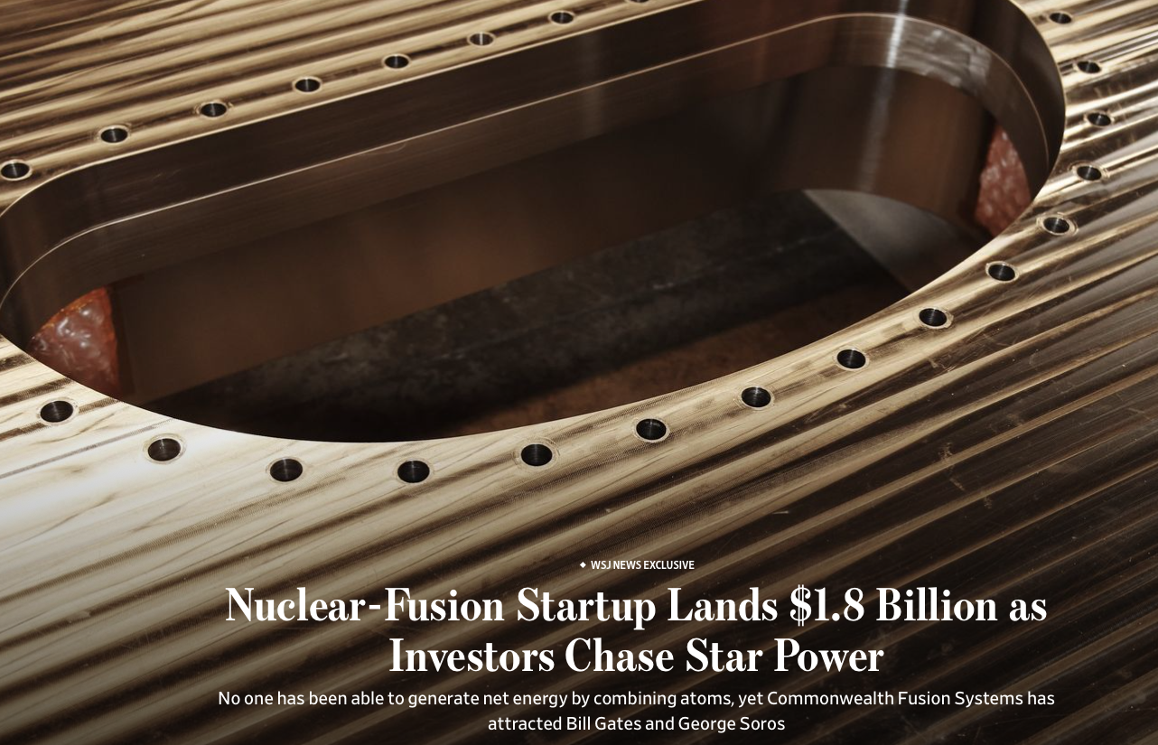
Commercial fusion risk retirement in concrete steps
COMPLETED:
Alcator C-Mod
COMPLETED
TFMC demonstrated September 5, 2021
CONSTRUCTION PLANNING UNDERWAY for 2025 LAUNCH
SPARC achieves net energy
Early 2030s
ARC fusion power on the grid
FUNDED at 1.8 B$
December 1, 2021
Net energy
Carbon-free scalable commercial power
Notes:
Bob

Slide 5
SPARC design and operations are pushed by the need to inform ARC: Q=11, H=1
Get early DT results in L-mode
H-mode confinement data at high field, including power threshold,
Burning plasma physics including alpha interactions
  P. Rodriguez-Fernandez et al APS 2021.
Disruptivity at ARC relevant parameters
  R. Sweeney et al APS 2021
Passive runaway electron mitigation
  D. Garnier et al APS 2021.
Gas fueling efficiency at high opacity
Diagnostics and control for burning plasmas
Heat removal via an X-point target divertor configuration (see right)

Slide 6
SPARC H-mode window will explore a range of burning plasma regimes directly relevant to ARC
B₀ | 12.2 | T
I_{p} | 8.7 | MA
q* | 3.05 | (q₉₅ = 3.4)
𝜅_{a} | 1.75 | (𝜅_{sep} = 2.0)
<T_{e}> | 6 - 13 | keV
<n_{e}> | 1.4 – 5.5 | 10²⁰m⁻³
f_{g} | 0.17 – 0.65
𝛽_{N} | 0.8 – 1.5 | m∙T/MA
P_{sep}B₀/R₀n_{e,20}² | 9 - 126 | MW∙T∙m⁵
P_{fus} | 80 – 150 * | MW
Q | 3.4 - 11.0
* Fusion power limited by magnet heating

Slide 7
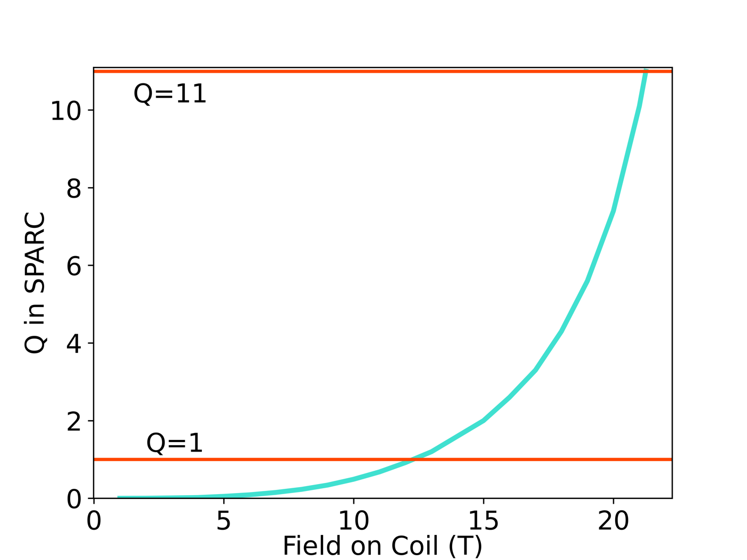
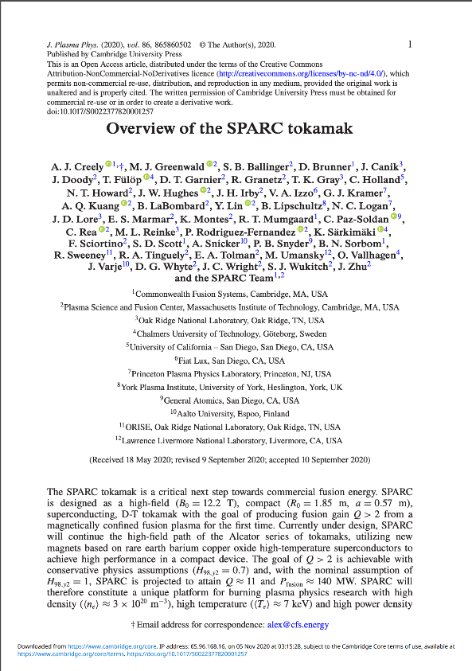
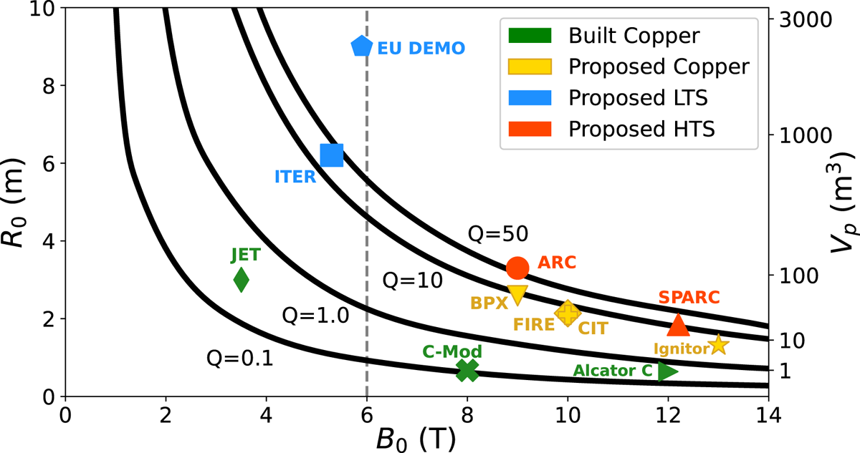
SPARC is an ITER equivalent burning plasma device in a commercially relevant platform
B_{coil} > 20 T ?
Design validated using the ITER tools
Q=11 @ H=1; long-legged divertor
JPP peer-reviewed physics papers
2020’s most downloaded plasma physics paper
Same physics as ITER, FIRE, BPX, CIT….
Notes:
Bob

Slide 8
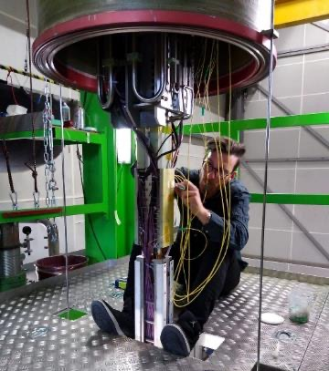
Developing the HTS was part of an integrated strategy that itself informed our magnet development
Must be based on robust science and engineering
Must be eventually manufacturable at scale and economically
Don’t leave innovations on the table, yet know when knowledge was good enough → parallel developments
Build-test-understand cycle as fast as possible

Slide 9
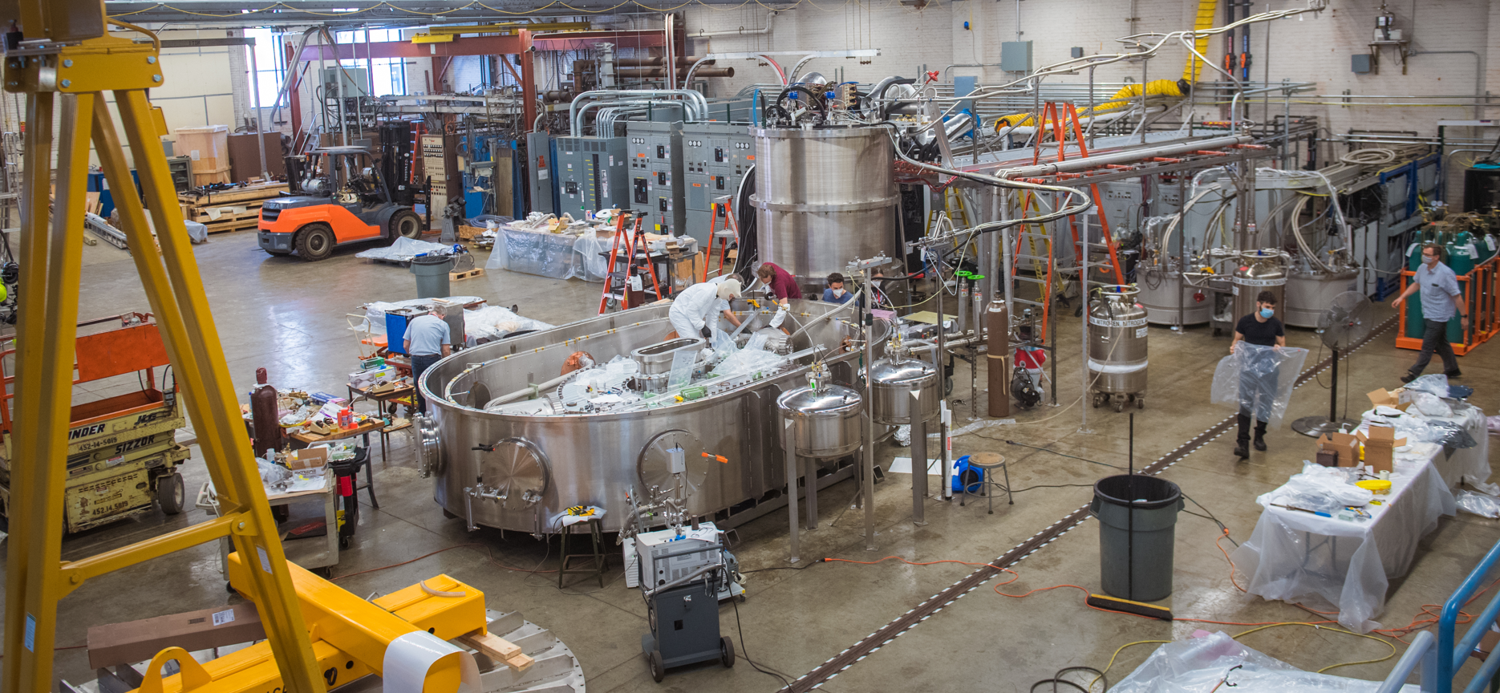
We quickly constructed a large integrated coil test stand in the Alcator C-Mod power room

Slide 10
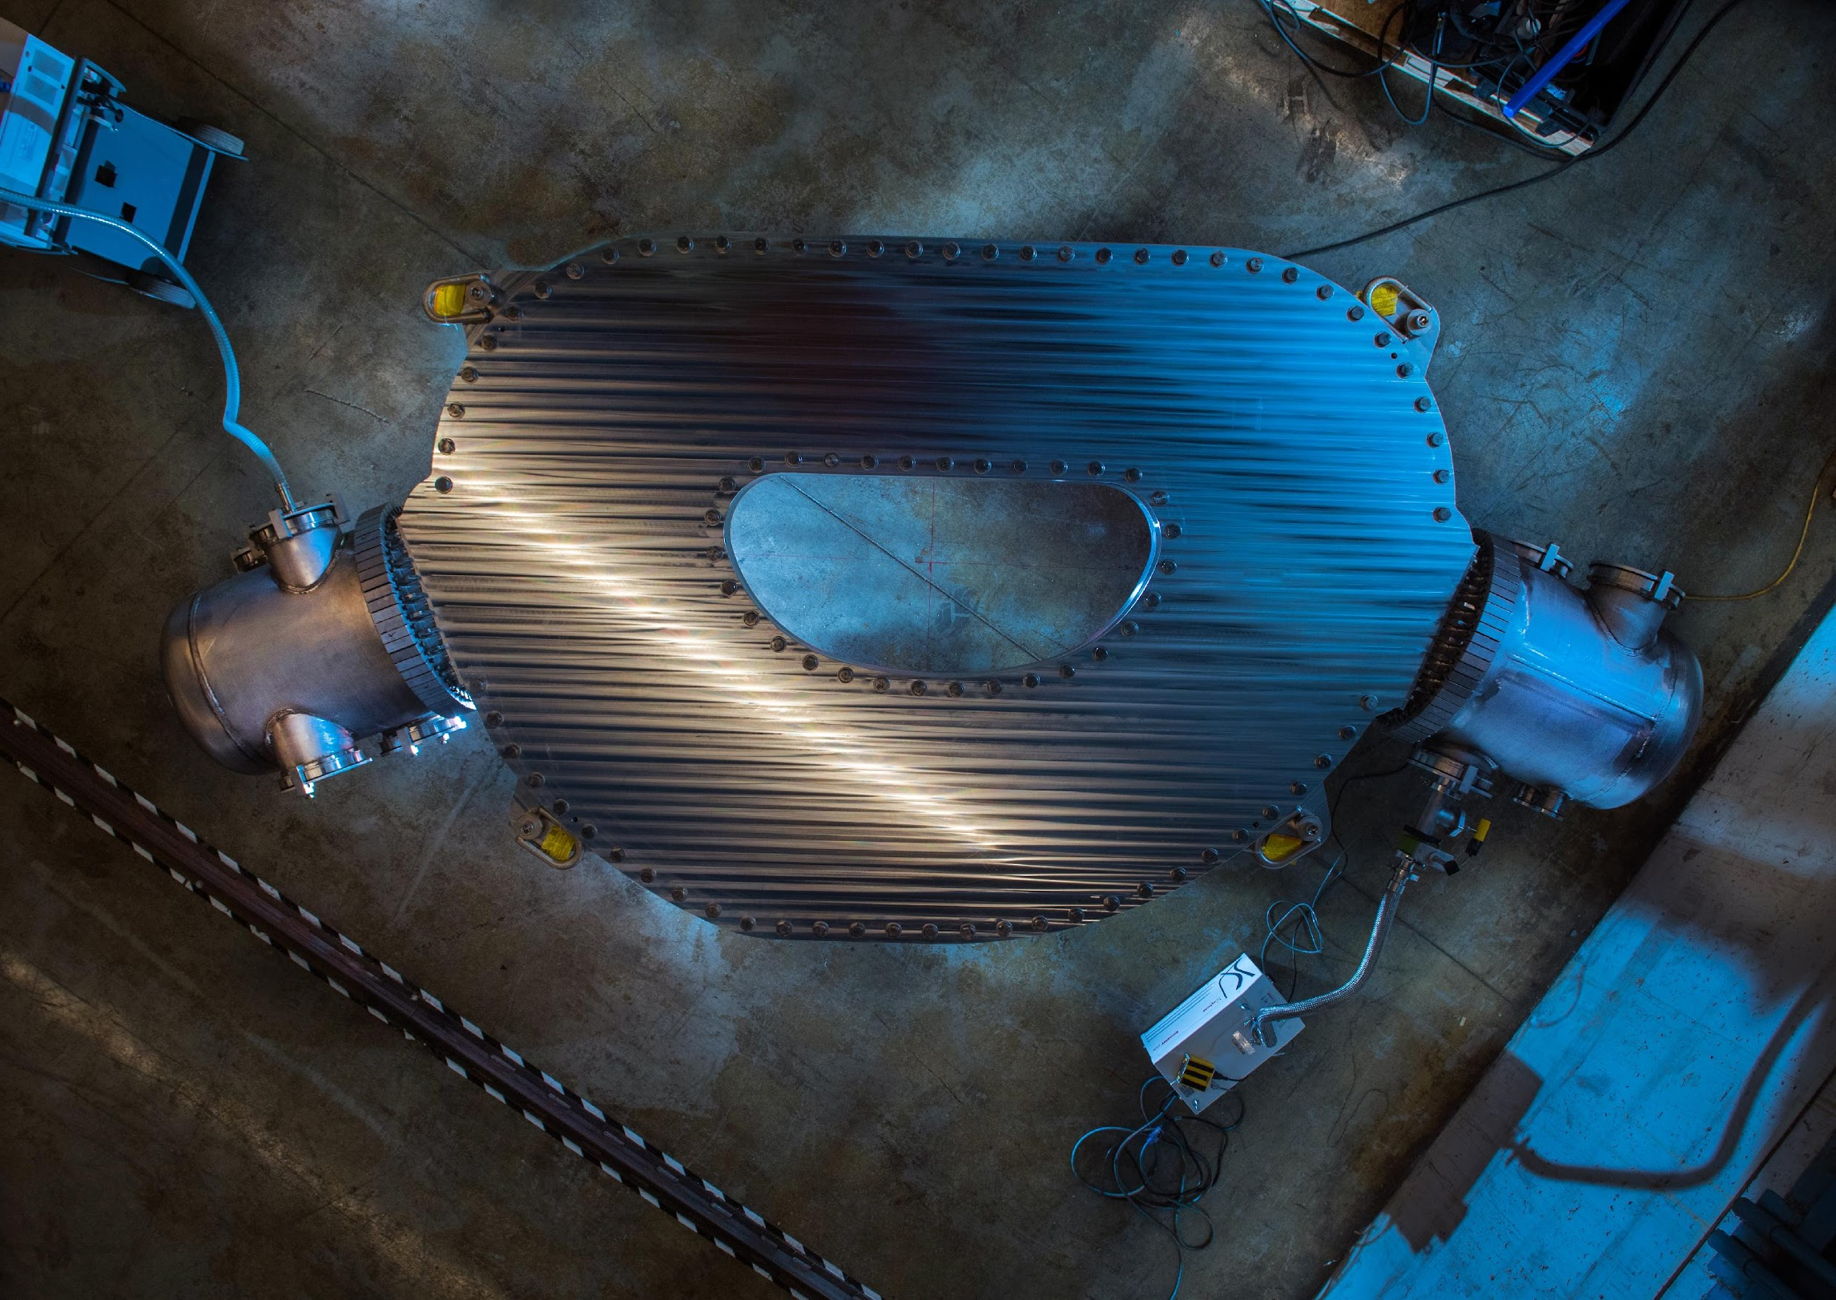
We have built and tested the non-insulated high-field magnet
Fully representative of SPARC coil operation
20T on coil, well beyond what LTS can do
Largest HTS magnet in the world by a factor of 100x
  Stored energy: 110 MJ
  Mass: 9265 kg
  HTS tape in coil: 267 km
  Size: ~ 2 meters tall
Modular: Each of 16 pancake is world’s largest HTS magnet
Successfully tested: September 5, 2021

Slide 11
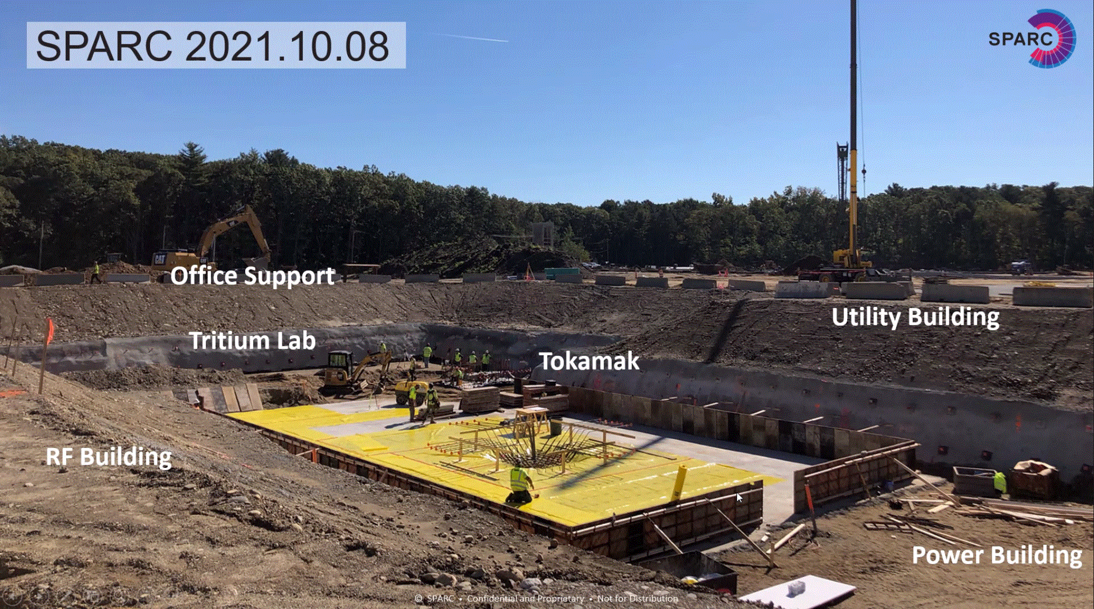
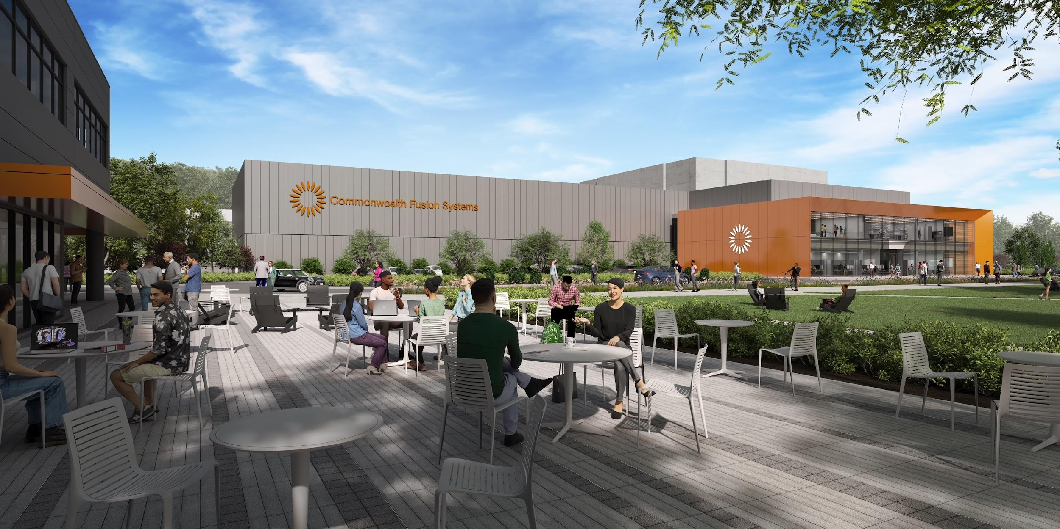
SPARC construction underway
Host magnet manufacturing for both SPARC and ARC
Will be an entire CFS campus eventually housing >1000 people + MIT scientists and students + collaborators
NRC concurs this will be dealt with by state of MA, an agreement state
  State agreed to license similar to a cancer treatment center

Slide 12
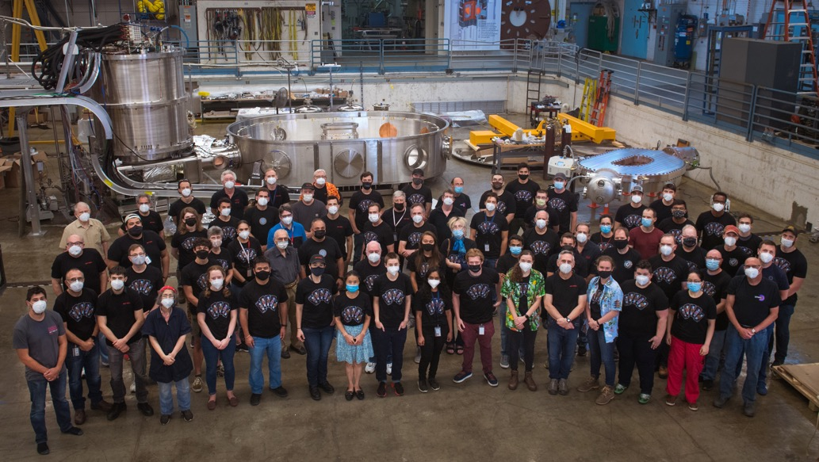
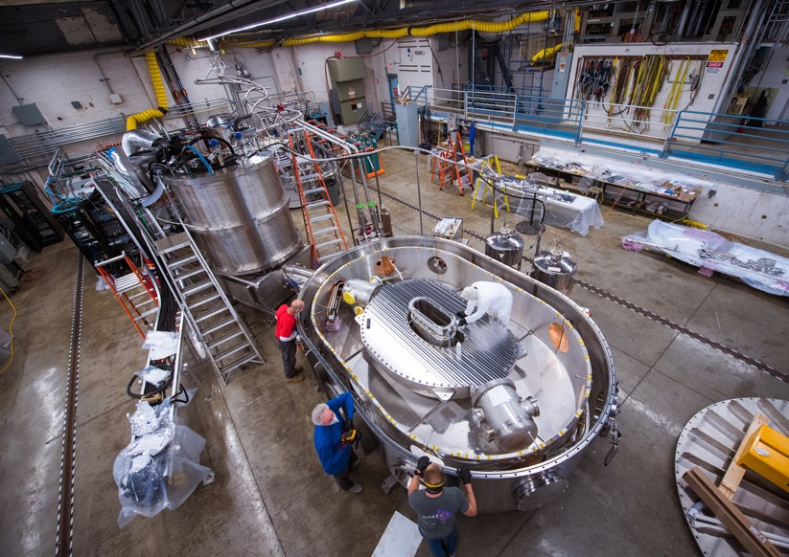
MIT-CFS partnership
Leverages existing MIT infrastructure — people, expertise, space
Leverages CFS expertise in supply chain, finance, manufacturing,
Currently have over 275 people working on this project (CFS+MIT)
The best from both academia and industry working together
Flexible invention and licensing agreement, expedited tech-transfer

Slide 13




















Private fusion is an organizational forcing function
CFS/MIT/SPARC has >50 collaborations, >40 institutions, >10 countries
Includes National Labs, universities, governmental orgs, private companies
10 INFUSE awards, premier FES PPP program, most of any company
ARPA-E awards as prime, sub-recipient, industrial partner
Notes:
Hub; 30+ collaborations; point is to help retire risk but also communicate openness and galvanize the community; key value; dpp standing room only; different collaboration models, including in-kind, government sponsorships, private funding; three tracks: plasma physics, tape, and engineering challenges.

Slide 14
ARC – a platform for fusion energy development
Only a few set boundary conditions
  REBCO-based high B magnets → ~JET size
  Liquid immersion blanket → neutron physics
  Modular design → replaceable thin VV/first wall
Set by market: economics ($/W) and need to have a flexible platform that can provide integrated answers to plant availability
Highly flexible core plasma scenarios because high B allows for ops in huge parameter space…these are tools, not the reason to build ARC!
  Standard H-mode, inductive
  Non-inductive, higher H, high recirculating powe
  Radiative L-mode, higher I_{p} (negative triangularity?)

Slide 15
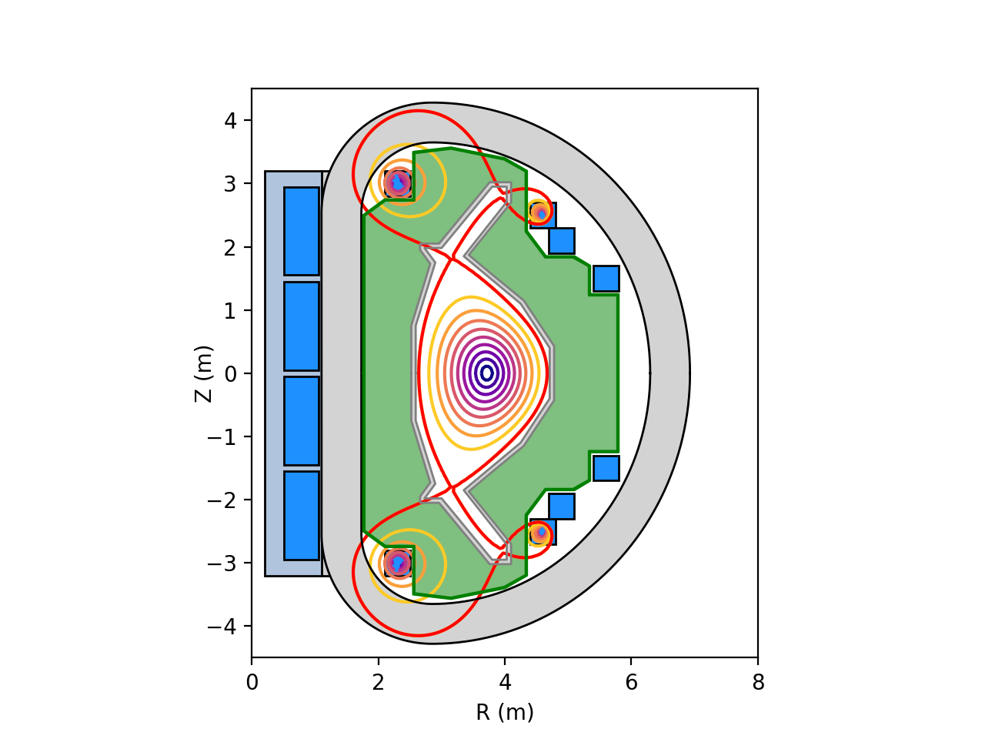
The current ARC design point → Market informed
ARC is a class of machines driven by market needs
Characteristics:
  Nearly ignited
  Pulsed with 30min on/1min off
  Very similar to SPARC
  Very far from plasma limits
  P_{elect} ~200MWe
Reference design is not overly sensitive to assumptions
Parameter | ARC V1
B₀ (T) | 11.5
R₀ (m) | 3.45
a (m) | 0.93
𝜖 | 0.27
V_{p} (m³) | 91
𝜅_{a} | 1.60
𝜅_{sep} | 1.80
𝛿_{sep} | 0.50
I_{p} (MA) | 9.9
q* | 3.05
H_{98,y2} | 1.15
Q | 107
P_{fus} (MW) | 521
P_{rf,coup} (MW) | 4
Parameter | ARC V1
Z_{eff} | 1.5
P_{rad} (MW) | 24
<T_{e}> (keV) | 11.8
<n_{e}> (10²⁰) | 1.7
f_{g} | 0.49
𝛽_{N} | 1.4
f_{bs} | 0.10
PB/R (MW T/m) | 284
Pulse Len. | ~30 min
𝛷_{total} (V-s) | 125

Slide 16
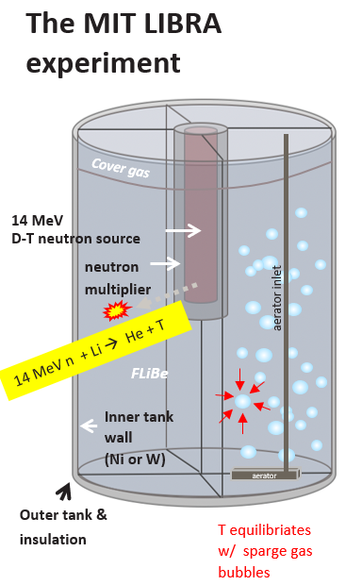
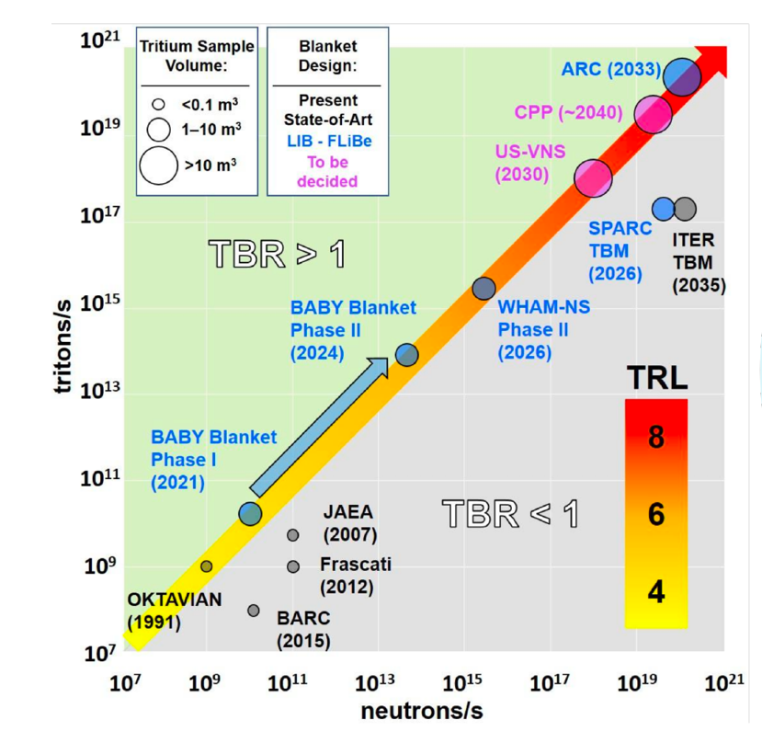
Leveraging technology innovations: liquid immersion blanket
TRL can be greatly advanced without a tokamak!
Proposed “mini” LIB blanket at MIT
Significant milestones:
  TBR>1 at increasing amounts of breeding
  Tritium extraction at rep. rate
  Corrosion control
  FLIBE material handling and sourcing
Collaboration opportunities outside
usual fusion community expertise
  FLiBe impurity control, purification
  Active corrosion monitoring and control
  MHD heat transfer coefficients of FLiBe under fields
  Heat exchange materials, performance
  Tritium accountancy

Slide 17
Commercial fusion risk retirement in concrete steps
COMPLETED:
Alcator C-Mod
COMPLETED
TFMC demonstrated September 5, 2021
CONSTRUCTION PLANNING UNDERWAY for 2025 LAUNCH
SPARC achieves net energy
Early 2030s
ARC fusion power on the grid
FUNDED at 1.8 B$
December 1, 2021
Net energy
Carbon-free scalable commercial power
Notes:
Bob

Slide 18
Thank you
www.psfc.mit.edu
www.cfs.energy

