Slide 1




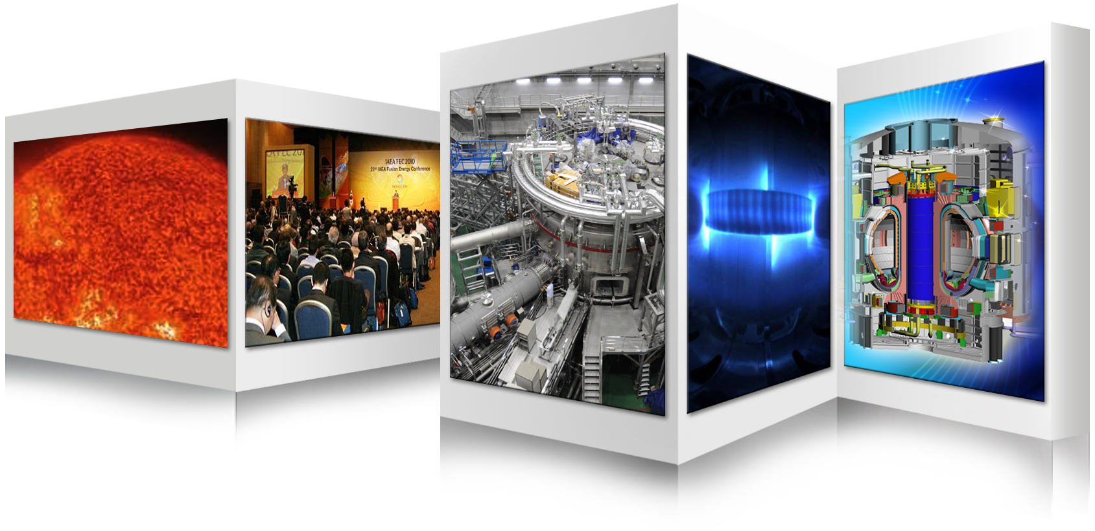

Achievements and Opportunities 2020
on Fusion Energy Development in Korea
Suk Jae YOO
Fusion Power Associates,
41st Annual Meeting and Symposium,
December 16th – 17th , 2020/
Virtual Remote Access Meeting
On behalf of Korea Institute of Fusion Energy and Korea Fusion Research Groups

Slide 2
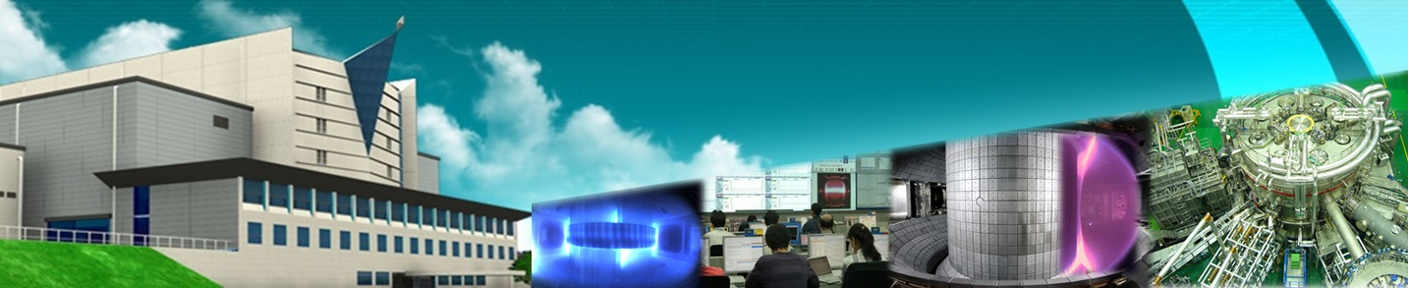
Contents …….
Highlight Achievements 2020
Opportunities 2020
Summary

Slide 3
Highlight Achievements 2020
Notes:
This is important recognition from Korean government of the importance for Fusion

Slide 4
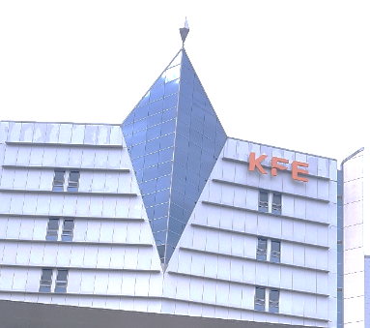

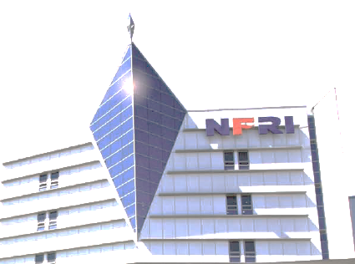
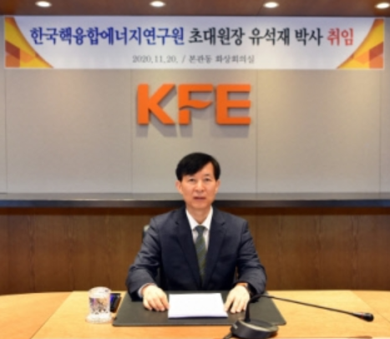
The NFRI was promoted to an independent legal entity as of Nov. 20th, 2020
Independent
Legal Entity
Korea Institute of Fusion Energy (KFE)
National Fusion Research Institute (NFRI)
Suk Jae YOO,
the first president of KFE
Notes:
This is important recognition from Korean government of the importance for Fusion

Slide 5
Governance Framework of Fusion R&D in Korea
MSIT
National Fusion
Energy Committee
Ministry of Science and ICT
KFE
Basic Fusion R&D Programs
ITER Korea
(KO-DA)
KSTAR
Fusion Energy Research Centers
Universities
K-DEMO
Research Institutes
Plasma R&D
Notes:
This is important recognition from Korean government of the importance for Fusion

Slide 6
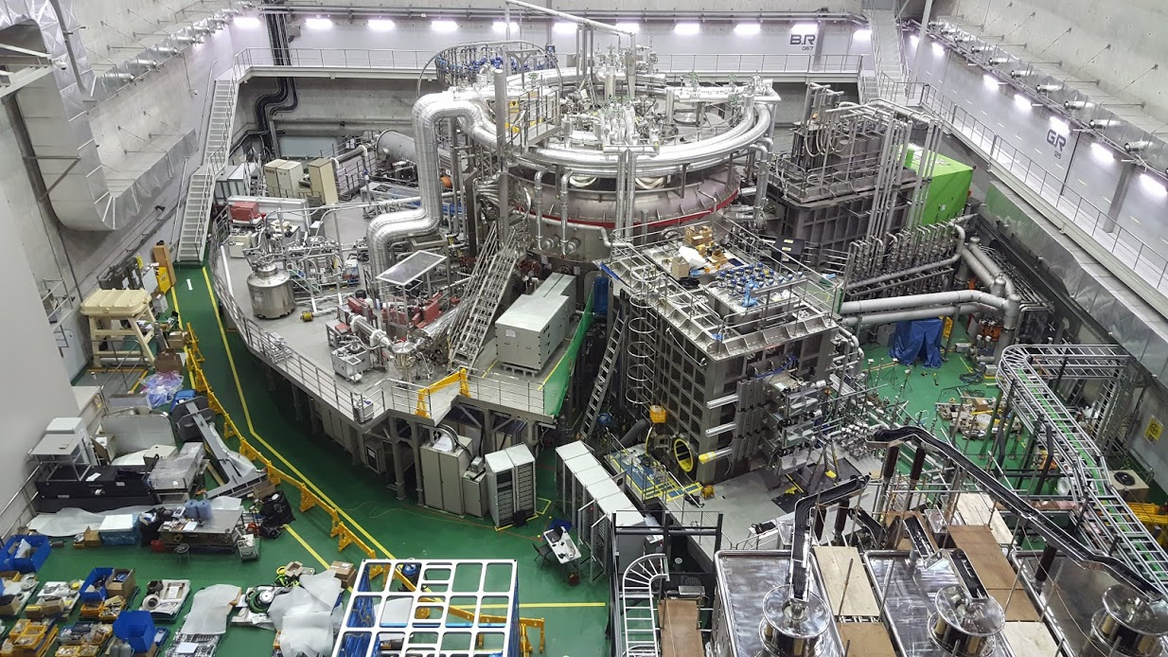
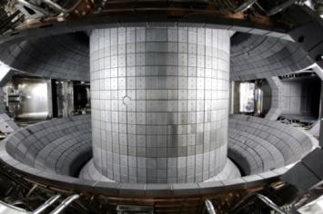
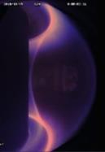
KSTAR
Korea superconducting Tokamak Advanced Research
Parameters | Designed | Achieved (~2020)
Major radius, R₀ Minor radius, a Elongation, κ Triangularity, δ Plasma shape Plasma current, I_{P} Toroidal field, B₀ H-mode duration β_{N} Superconductor Heating /CD PFC | 1.8 m 0.5 m 2.0 0.8 DN, SN 2.0 MA 3.5 T 300 s 5.0 Nb₃Sn, NbTi ~ 28 MW C, W | 1.8 m 0.5 m 2.15 0.8 DN, SN 1.1 MA 3.5 T 89 s 4.3 (~ 0.1 s) 3.4 (~ 4 s) 3.0 ( ~ 10 s) Nb₃Sn, NbTi(Pol.#6,7) ~ 15 MW C, (W)
Main body
Height: ca. 10 m
Diameter: ca. 10 m

Slide 7
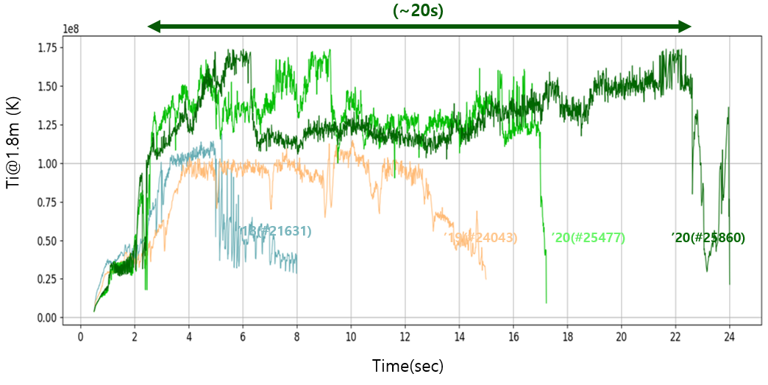
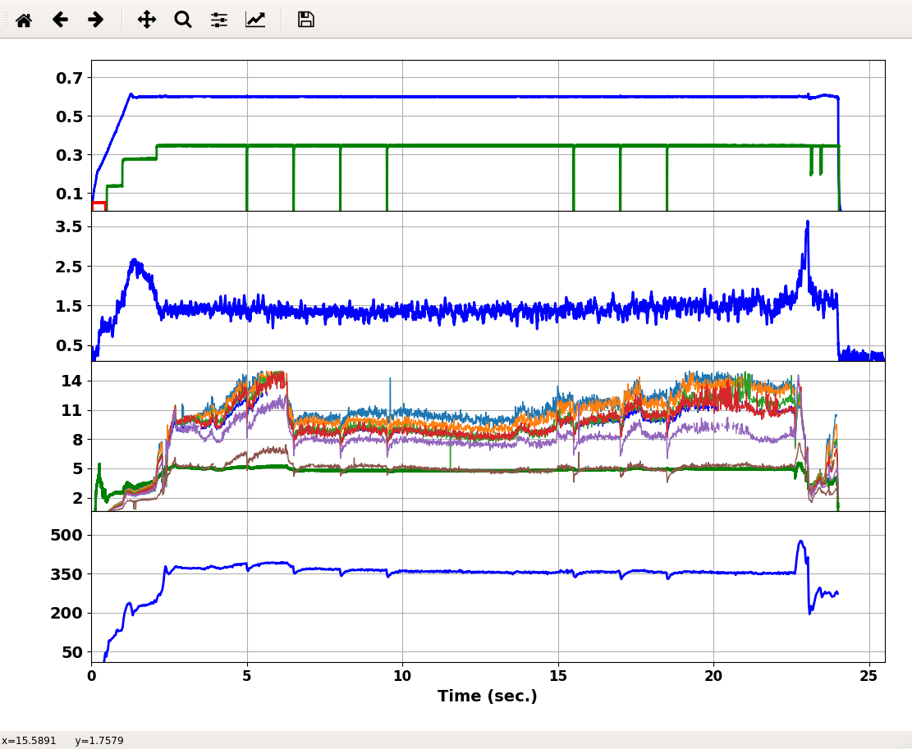
KSTAR Achievements (1): High Temperature Plasmas ( > 20 s)
Plasma current (MA, 0.6MA@flattop)
KSTAR #25860 (2020/10/16), Bt=1.8T
NBI power(x10MW, ~3.4MW total)
Line-averaged electron density by TCI(10¹⁹m⁻³)
Core ion temperature by CES(1.8m≤R<2.0m),keV)
Core electron temperature by ECE(R=1.8m,keV)
Confinement energy(kJ)
Notes:
This is important recognition from Korean government of the importance for Fusion

Slide 8
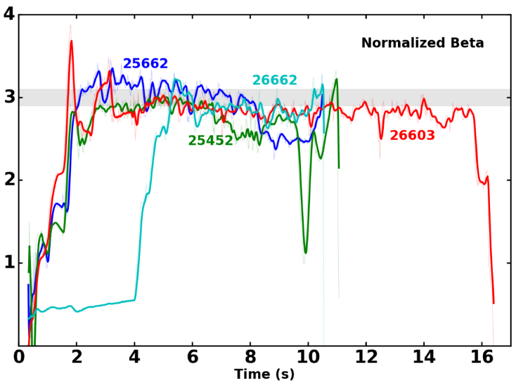
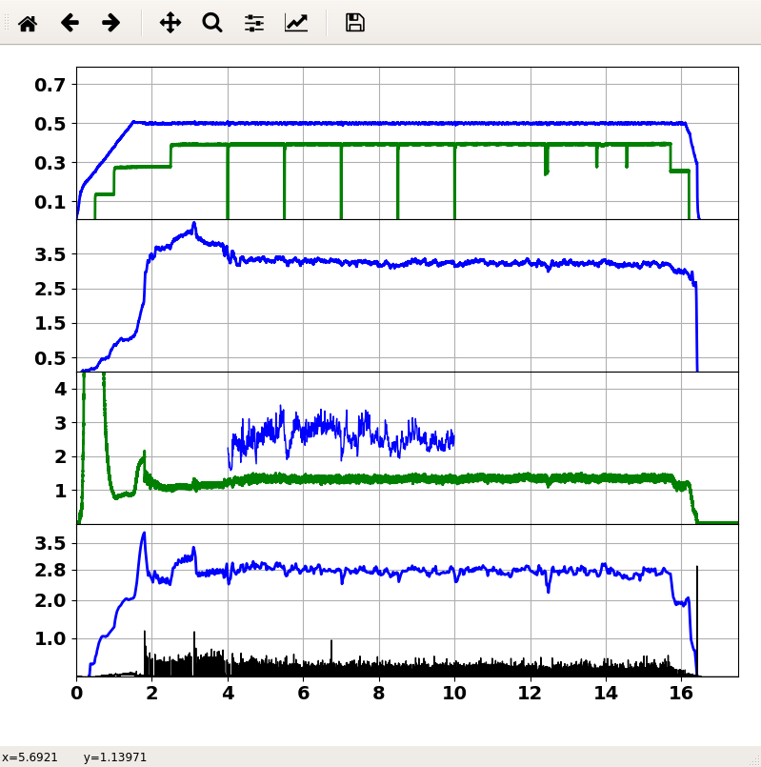
KSTAR Achievements (2): High Beta Plasmas
High beta ( β_{N}<~ 3) operation for longer than 10 sec
KSTAR #26603 (2020/11/10), Bt=1.4T
Plasma current (MA, 0.5MA@flattop)
NBI power(x10MW, ~4MW)
Line-averaged electron density by TCI(10¹⁹m⁻³)
Core ion temperature by CES(1.8m,keV)
Core electron temperature by ECE(R=1.8m,keV)
Normalized beta, β_{N}
D_{α}(A.U.)
Time(sec.)
Notes:
This is important recognition from Korean government of the importance for Fusion

Slide 9
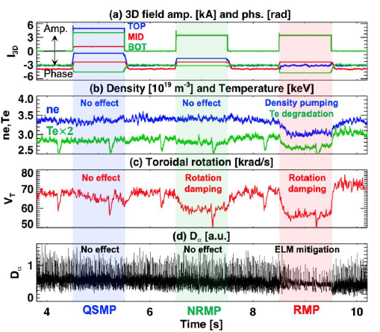
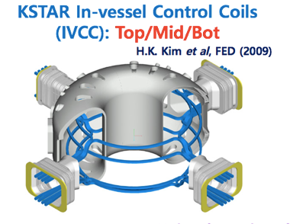
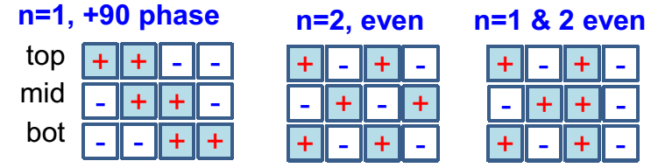
KSTAR Achievements (3): Resolving key physics on 3D field
Verifying the controllability of plasma characteristics by 3D field
Top
Mid
Bot
Notes:
This is important recognition from Korean government of the importance for Fusion

Slide 10
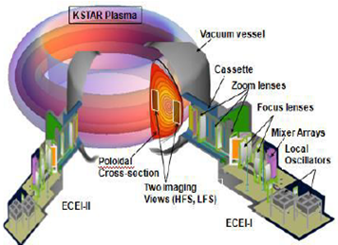
KSTAR Achievements (4): Simulations vs Measurements
Validation of the simulation of plasma turbulence by ECEI measurements
* M. J. Choi, et al. Effects of plasma turbulence on the nonlinear evolution of magnetic island in tokamak,
Accepted at Nature Communications (2020).
Notes:
This is important recognition from Korean government of the importance for Fusion

Slide 11
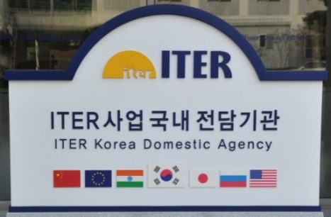
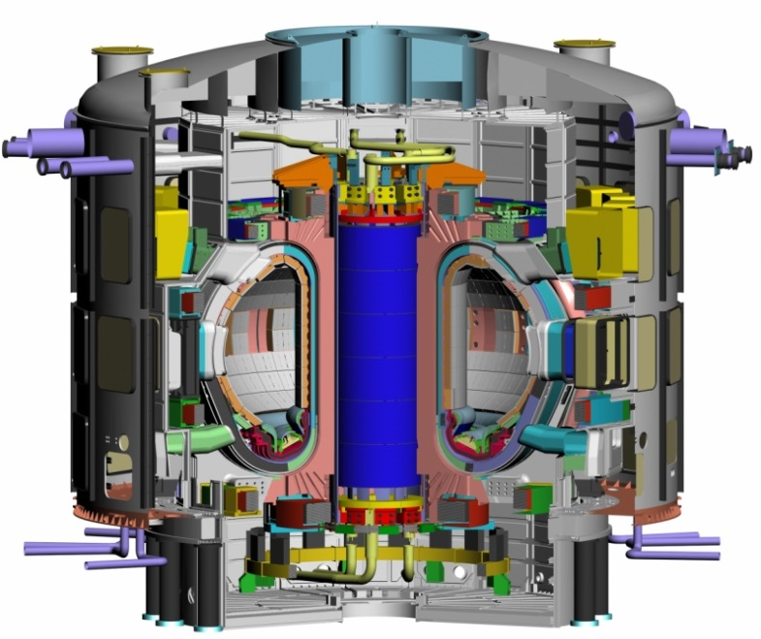
ITER Project
In-kind Contribution of Korea (9 items)
1. TF Conductor (Completed)
Total Value (kIUA) : 215.01
KO Allocation : 20.2%
KO Contribution (kIUA) : 43.39
10. Test Blanket Module*
KO Contribution :
HCCR TBS (TBM System)
kIUA Value : N/A
4. Thermal Shield
Total Value(kIUA) : 26.88
KO Allocation : 100%
KO Contribution(kIUA) : 26.88
2. Vacuum Vessel Main Body
Total Value(kIUA) : 118.51
KO Allocation : 21.3%
KO Contribution (kIUA) : 25.20
5. Blanket Shield Block
Total Value(kIUA) : 56.34
KO Allocation : 49.8%
KO Contribution(kIUA): 28.07
3. Vacuum Vessel Port
Total Value(kIUA) : 76.98
KO Allocation : 72.9%
KO Contribution (kIUA) : 56.13
6. Assembly Tooling
Total Value(kIUA) : 18.45
KO Allocation : 100%
KO Contribution(kIUA): 18.45
7. Tritium SDS
Total Value(kIUA) : 12.51
KO Allocation : 94.2%
KO Contribution(kIUA) : 11.79
8. AC/DC Converters
Total Value(kIUA) : 122.61
KO Allocation : 37.1%
KO Contribution(kIUA): 45.58
9. Diagnostics
Total Value(kIUA) : 205.66
KO Allocation : 2.0%
KO Contribution (kIUA) : 4.11
Total Value : 259.60 kIUA
Leading Items
Tokamak Main
Ancillary
* (TBMA (TBM Agreement) was signed in 2014.)
Notes:
This is important recognition from Korean government of the importance for Fusion

Slide 12
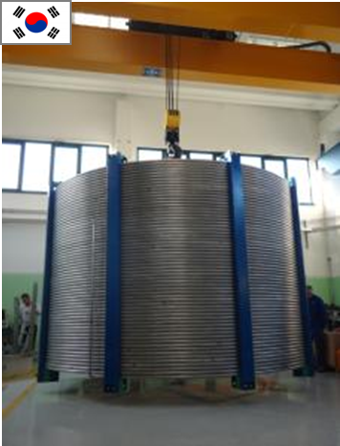
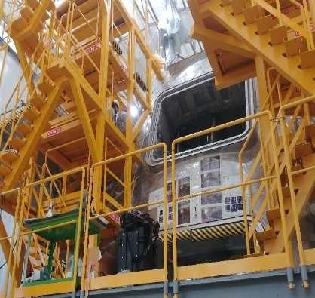
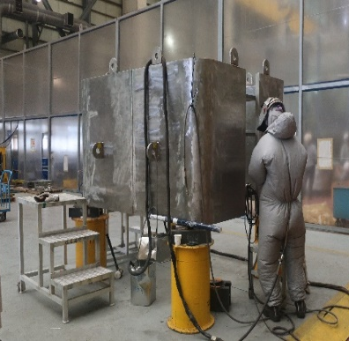
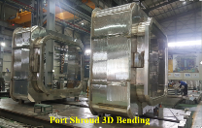
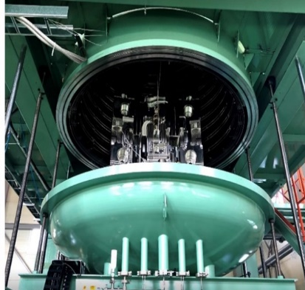
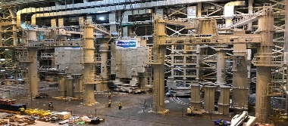
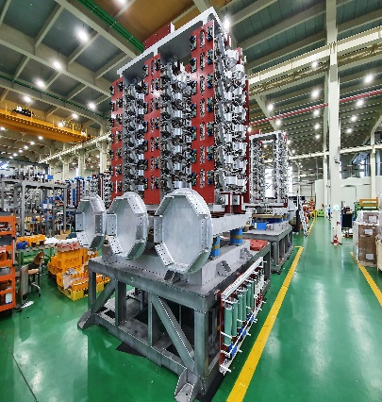
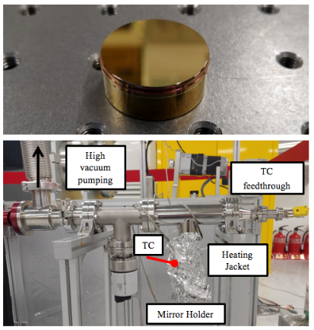
ITER Project: Overall Progress of Procurement
▶ Overall Physical Progress of KODA Procurement Activities (including design) is recorded as about 76.8% in October 2020.
TF Conductors | Vacuum Vessel Sector | Vacuum Vessel Ports | Thermal Shield | Blanket Shield Blocks
100.0% | 99.7% | 52.3% | 93.9% | 41.9%
Assembly Tools | Tritium SDS | AC/DC Converters | Diagnostics | Average 76.8 % (as of October 2020) (Activity Progress as per Item × Weight of its kIUA)
100.0% | 32.1% | 83.2% | 51.5%
Notes:
This is important recognition from Korean government of the importance for Fusion

Slide 13
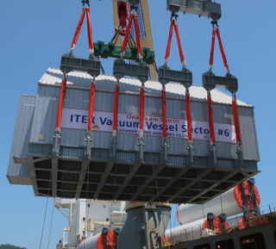
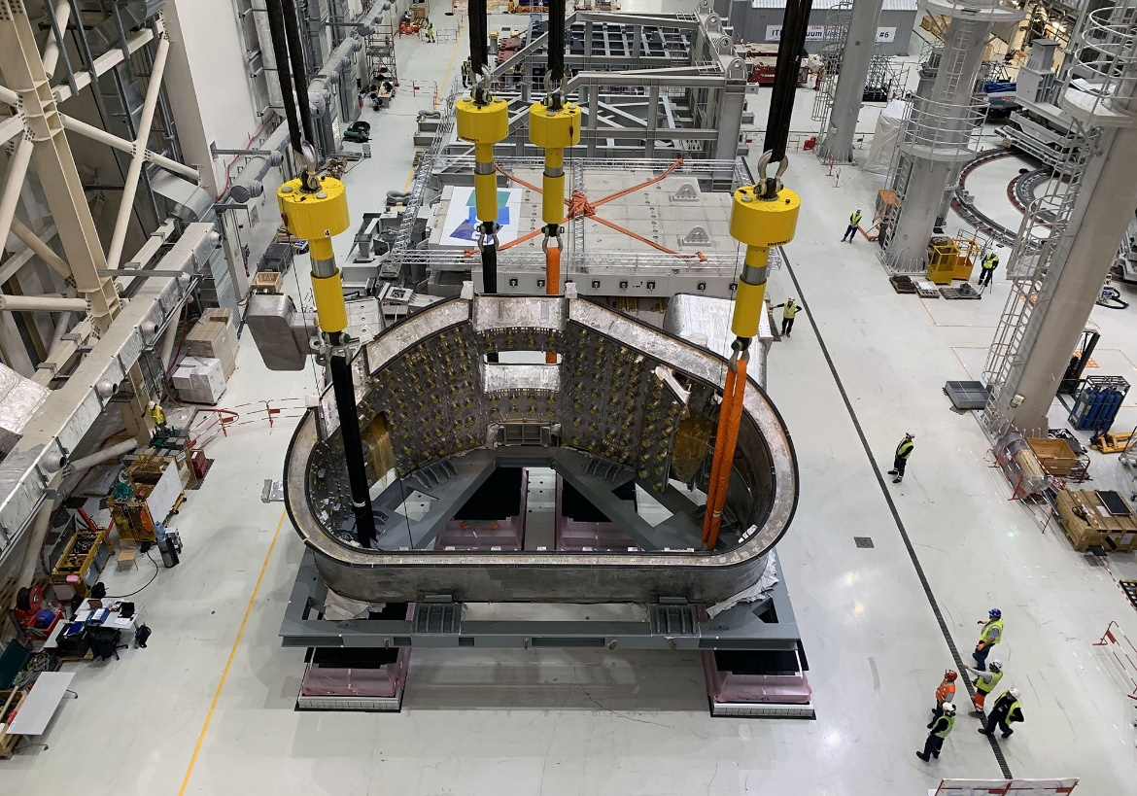
ITER Project: Completion of VV Sector 6
The first VV Sector #6 is now on-site, ready for assembly and installation, after overcoming technical challenges: tight tolerance (accumulated), narrow space & position for final welding, accessibility of NDE (PAUT, RVE), etc.
Manufacturing progress by the HHI about subsequent sectors #7, #8, and #1 is 97.2%, 91.4%, and 84.2%, respectively (as of November 2020).
선적 in Korea
VV Sector #6 at the Assembly Hall of the IO
Notes:
This is important recognition from Korean government of the importance for Fusion

Slide 14
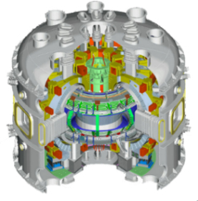
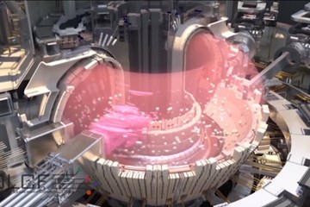
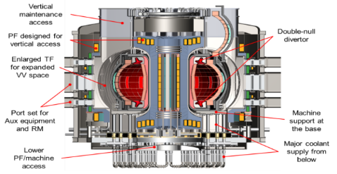
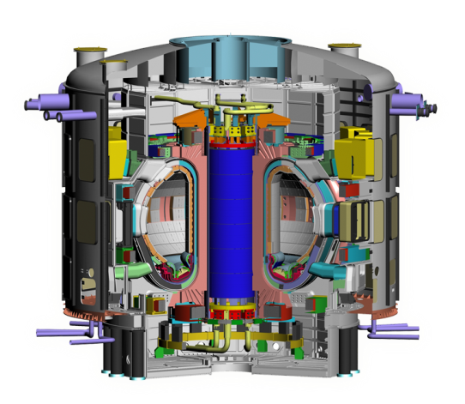
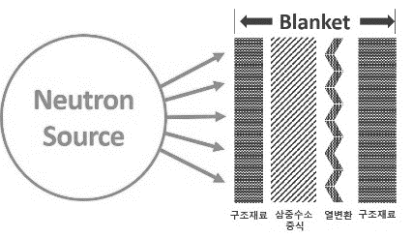
Virtual DEMO: Bridges the present (KSTAR, ITER) and the future (K-DEMO)
  Validated simulations with data provided by KSTAR, ITER and Blanket facilities
  Integrated simulations of engineering components (Blanket, BOP, licensing etc)
  Optimization of K-DEMO simulations, Reduced risks and construction costs
Virtual DEMO
K-DEMO
High Performance
Plasma Data
Optimization
Reduced costs
KSTAR
Burning Plasma Data
Licensing, System integration
Tritium
Heat exchange
Materials
Basic Fusion R&D Program
ITER
Blanket R&D Facility

Slide 15
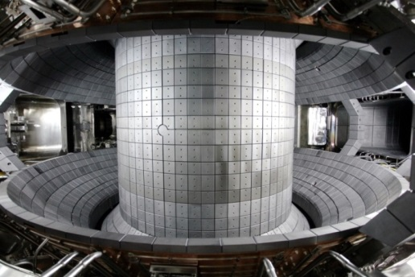
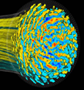


Virtual tokamaks can be going better owing to the digital new deal project
  Virtual DEMO validation can be made well based on KSTAR, ITER data
  ☞ Simulations validated with KSTAR, ITER experiments
  Decreased uncertainties with high fidelity and accuracy of simulations
  ☞ Reduced risks and construction costs by validated simulations
Virtual DEMO
ITER
Fusion
Performance
KSTAR
Validation
Virtual ITER
Validation
Virtual KSTAR
Devices, Operations

Slide 16
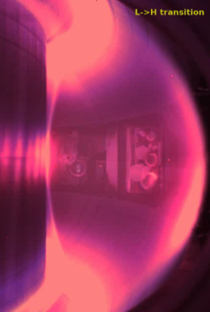
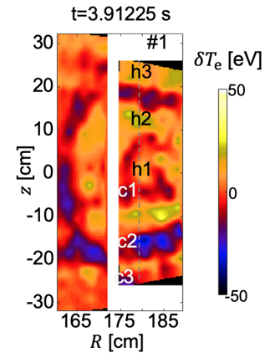
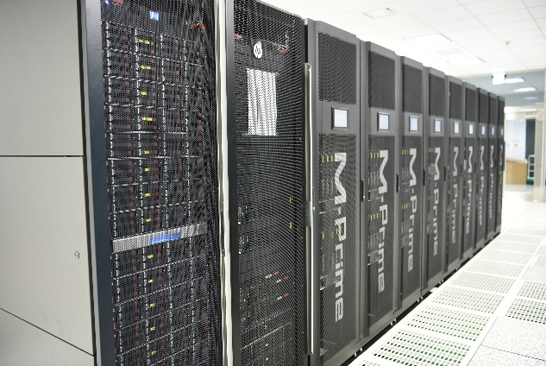
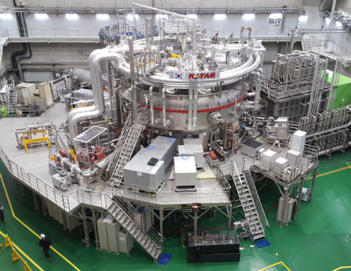
Launching Virtual KSTAR project for Virtual DEMO
Quantitative validation owing to reliable data of the real KSTAR
Precision simulation for quantitative predictive capabilities
  Large-scale high precision simulation development
  Peta-flops Super-parallel supercomputing techniques
  Efficient simulations with reduced models
  Data analysis and validation with big data techniques
Validation
Exploration
Supercomputer
KSTAR

Slide 17
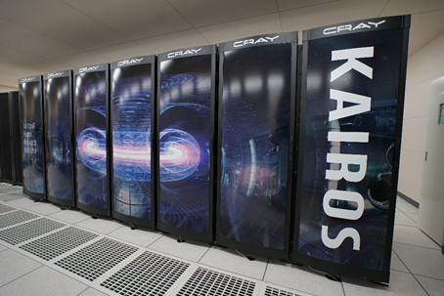
Setup of Supercomputing System
KAIROS
(Korea Advanced Instrument for Realizing the Operation of the Sustainable Fusion Reaction)
Model | Cray XC50
CPU | Intel Xeon Cascade Lake 2.4 GHz 424 x 2x 24 = 20,352 computing cores 1.56 PF (Rpeak, theoretical Max) 1.02 PF (Rmax, measured)
GPU | NVIDA Volta 6 x 5,120 = 30,720 cores 0.78 PF*
Memory | 8 GB per core, Total 162 TB
Notes:
This is important recognition from Korean government of the importance for Fusion

Slide 18
Opportunities 2020
Notes:
This is important recognition from Korean government of the importance for Fusion

Slide 19
Korean New Deal would make a great opportunities
to accelerate the fusion energy development
President Moon Jae-in
at Presentation of Korean New Deal Initiative
“The Korean New Deal
will set the foundation
for Korea’s next 100 years.”
Notes:
This is important recognition from Korean government of the importance for Fusion

Slide 20
Basic Plan of Korea Fusion Energy R&D
Fusion Energy Development Promotion Law (Dec. 2006)
Basic plan for the development and promotion of fusion energy (Aug. 2007)
Phase
Phase 1 (’07~’11)
Phase 2 (’12~’26)
Phase 3 (’27~’41)
Policy Goal
Establishment of a foundation
for fusion energy development
Development of Core Technology for DEMO
Acquirement of construction capability of fusion power plants
Basic Directions
Acquisition of operating technology for the KSTAR
Participation in the international joint construction of ITER
Establishment of a system for the development of fusion reactor engineering technology
High-performance plasma operation in KSTAR for preparations for the ITER Operation
Completion of ITER and acquisition of core technology
Development of core technology for the design of DEMO
DEMO design, construction, and demonstration of electricity production
Undertaking of a key role in ITER operations
Completion of reactor core and system design of the fusion power reactor
Commercialization of fusion technology
Basic Promotion Plan
Basic Promotion Plan 1 (’07~‘11)
Basic promotion plan 2 (‘12~‘16)
Basic promotion plan 3 (‘17~‘21)
Basic promotion plan 4 (‘22~‘26)
Basic promotion plan 5 (‘27~‘31)
Basic promotion plan 6 (‘32~‘36)
Basic promotion plan 7 (‘37~‘41)
We could have a good chance to make the 4th basic promotion plan (2022 ~ 2026)
under frame of the Korean New Deal policy

Slide 21
Summary
Highlight Achievements 2020 of KSTAR
Ion temperature of 100 mil. K with an operation duration longer than 20 s
High beta ( β_{N}<~ 3) operation for longer than 10 sec
Verifying the controllability of plasma characteristics by 3D field
Validation of the simulation of plasma turbulence by ECEI measurements
Highlight Achievements 2020 of ITER
Overall Physical Progress of KODA Procurement Activities (including design) is recorded as about 76.8% in October 2020
The procurement of VV sector 6 was successfully completed
Highlight Achievements 2020 for virtual DEMO
The virtual KSTAR project was launched this year
The setup of supercomputing system was successfully completed.
Opportunities 2020 for fusion energy R&D in Korea
- Korea new deal initiative was presented.
- The fusion energy R&D can be accelerated under the frame of the Korea new deal policies.

Slide 22
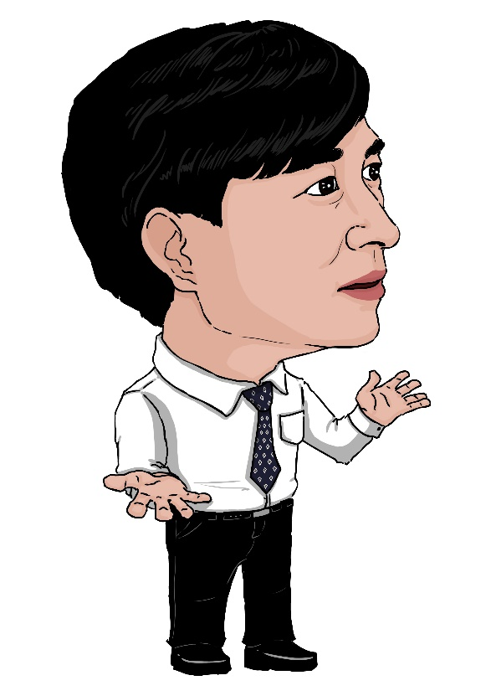

Thank you for your attention !
Around 2035, owing to the success of ITER burning, I hope the recovery of
the honor of fusion energy that has been teased with “the Boy Who Cried Wolf” of Aesop’s Fables
http://pesstevensone.blogspot.com/2013/08/the-boy-who-cried-wolf.html

Slide 23
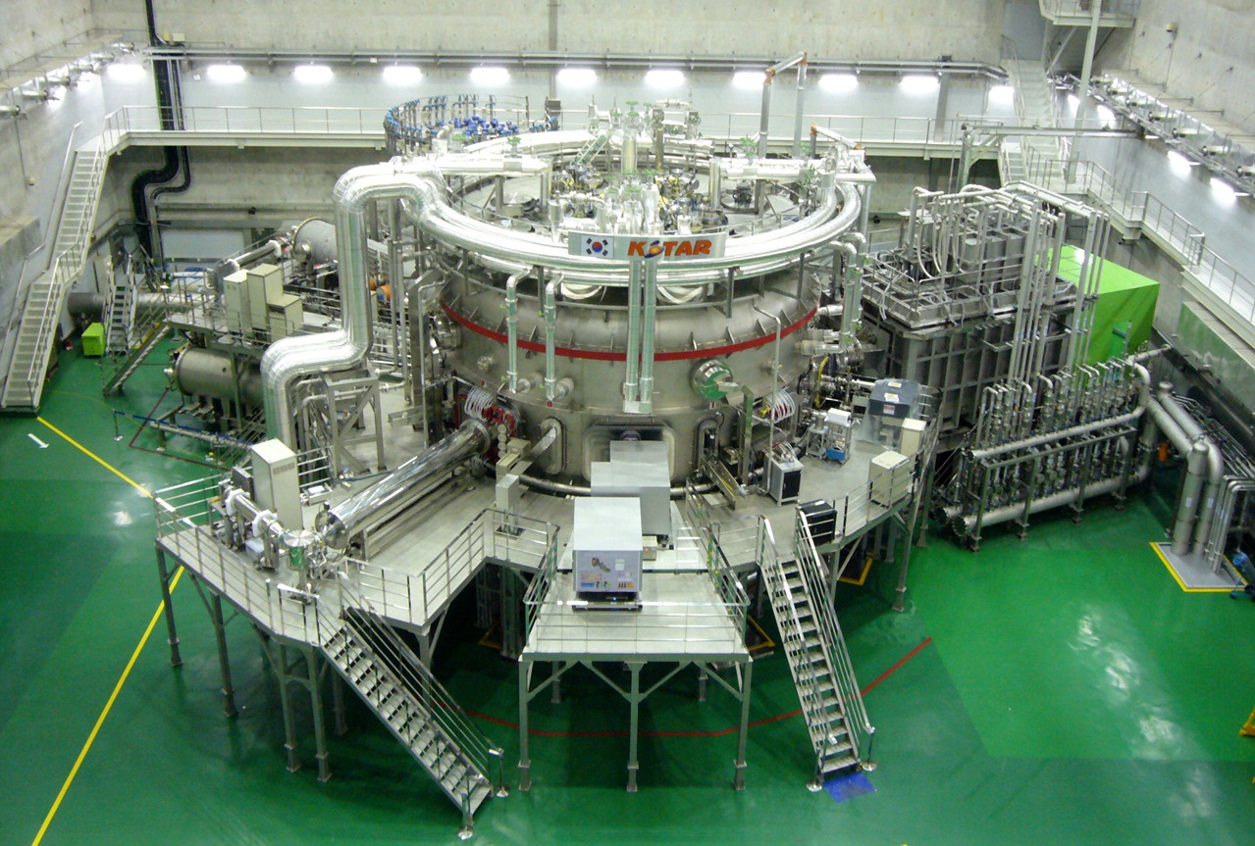
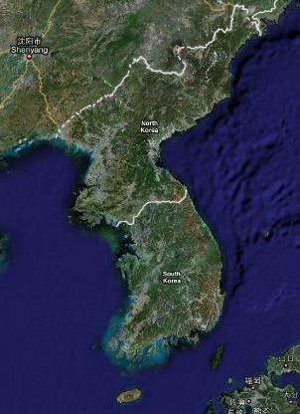
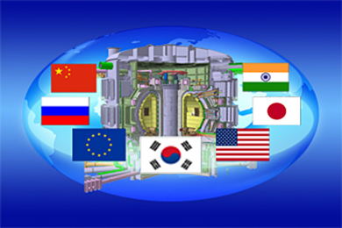
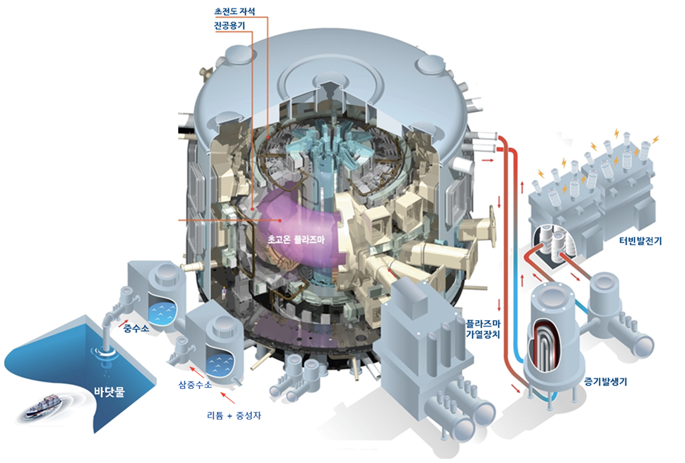
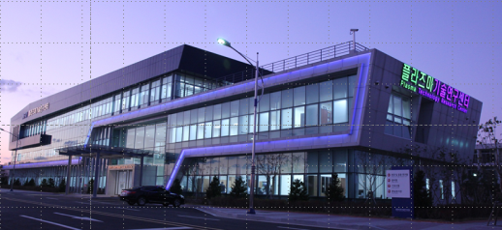
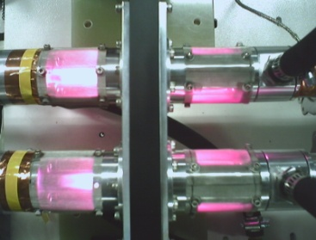
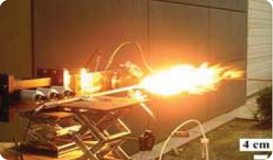
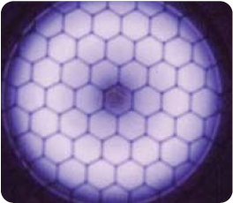
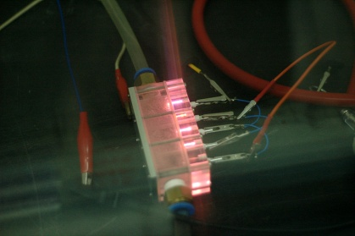

Korea Institute of Fusion Energy (KFE)
KSTAR*
Nuclear Fusion
and Plasma science
ITER**
K-DEMO
Seoul
* Korean Superconducting Tokamak Advanced Research
** International Thermonuclear Experimental Research
Daejeon
Plasma Technology
and Applications
Gunsan
Jeju
Institute of Plasma Technology

Slide 24



KSTAR Collaboration Activities
▶ ASIPP (China)
  W PFC operation (ASIPP)
▶ NIFS and QST (Japan)
  Physics understanding on 3D field and rotation (NIFS)
  Development of VUV & X-ray diagnostics (NIFS)
  EC wall conditioning (QST)
▶ ITER IO
  Resolving uncertainty for ELM suppression
    Magnet operation (quench detection system, controller)
    Disruption Mitigation system with shattered pellets (ITER DMS TF)
▶ CULHAM and IPP (EU)
  Shattered pellet (JET)
  Physics of RMP ELM suppression (IPP)
▶ Department of Energy (US)
  Shattered pellet system development and operation (ORNL)
  Helicon current drive system (PPPL, GA)
  High beta MHD stability (Col. Univ.)
Dual SPI experiment

