Slide 1
ORNL Fusion Energy Program: Accomplishments and Opportunities for the 2020s
Presented at:
Fusion Power Associates 41st Annual Meeting
Mickey Wade
December 16, 2020

Slide 2
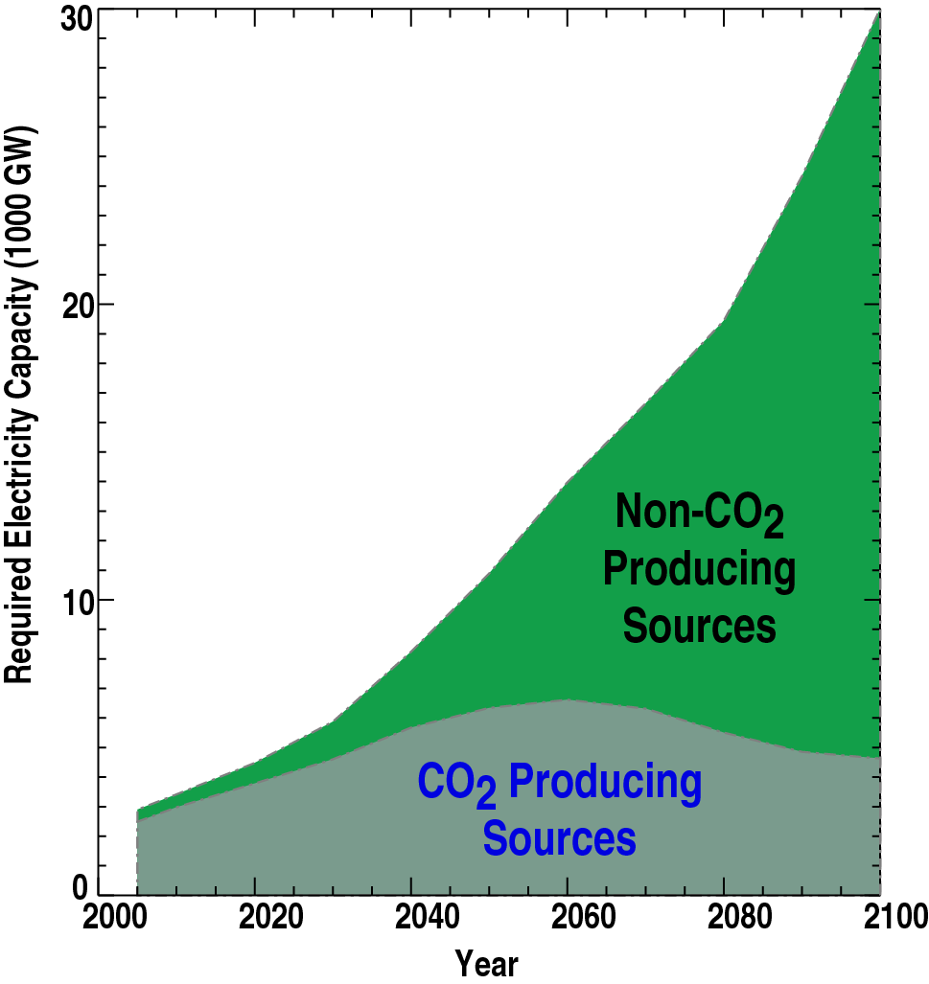
Exploding Energy Demand in Coming Decades
Requires Urgency in Fusion Development
Projected need for ~ 25,000 GW from non-CO2 producing sources
25,000 GW-e plants !!!
*Message AMPERE3-450
from Intergovernmental Panel on Climate Change (IPCC) model

Slide 3
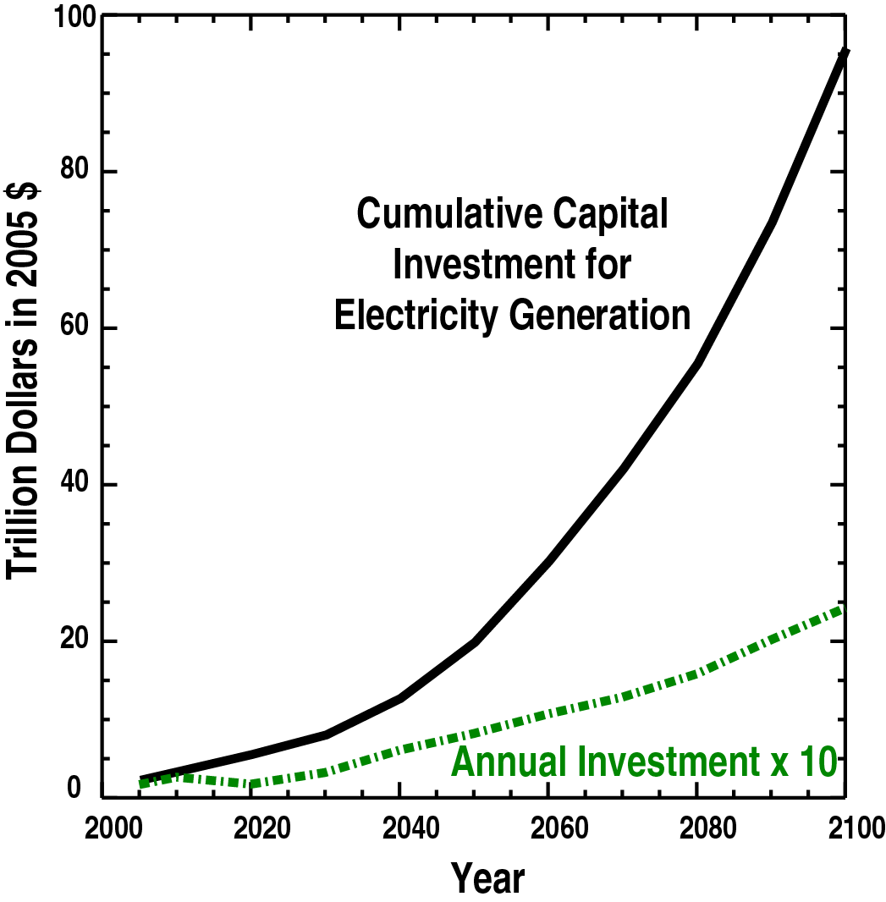
A Tsunami in Energy Investment →
National Economic Security is at Stake
Projected need for ~ 25,000 GW from non-CO2 producing sources
25,000 GW-e plants !!!
Annual investment in energy projected to explode (2005 $)
  $0.8 T by 2050
  $2.5 T by 2100
  GDP of US : $18 T
  GDP of China: $11T
  GDP of UK: $2.8 T
  Global Cell Phone Market (2018): $0.55 T

Slide 4
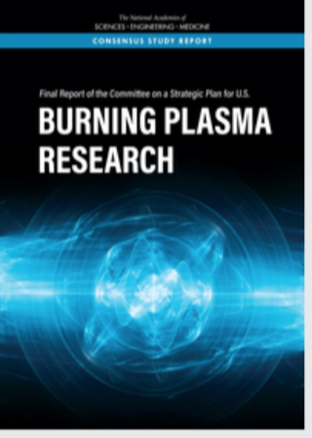
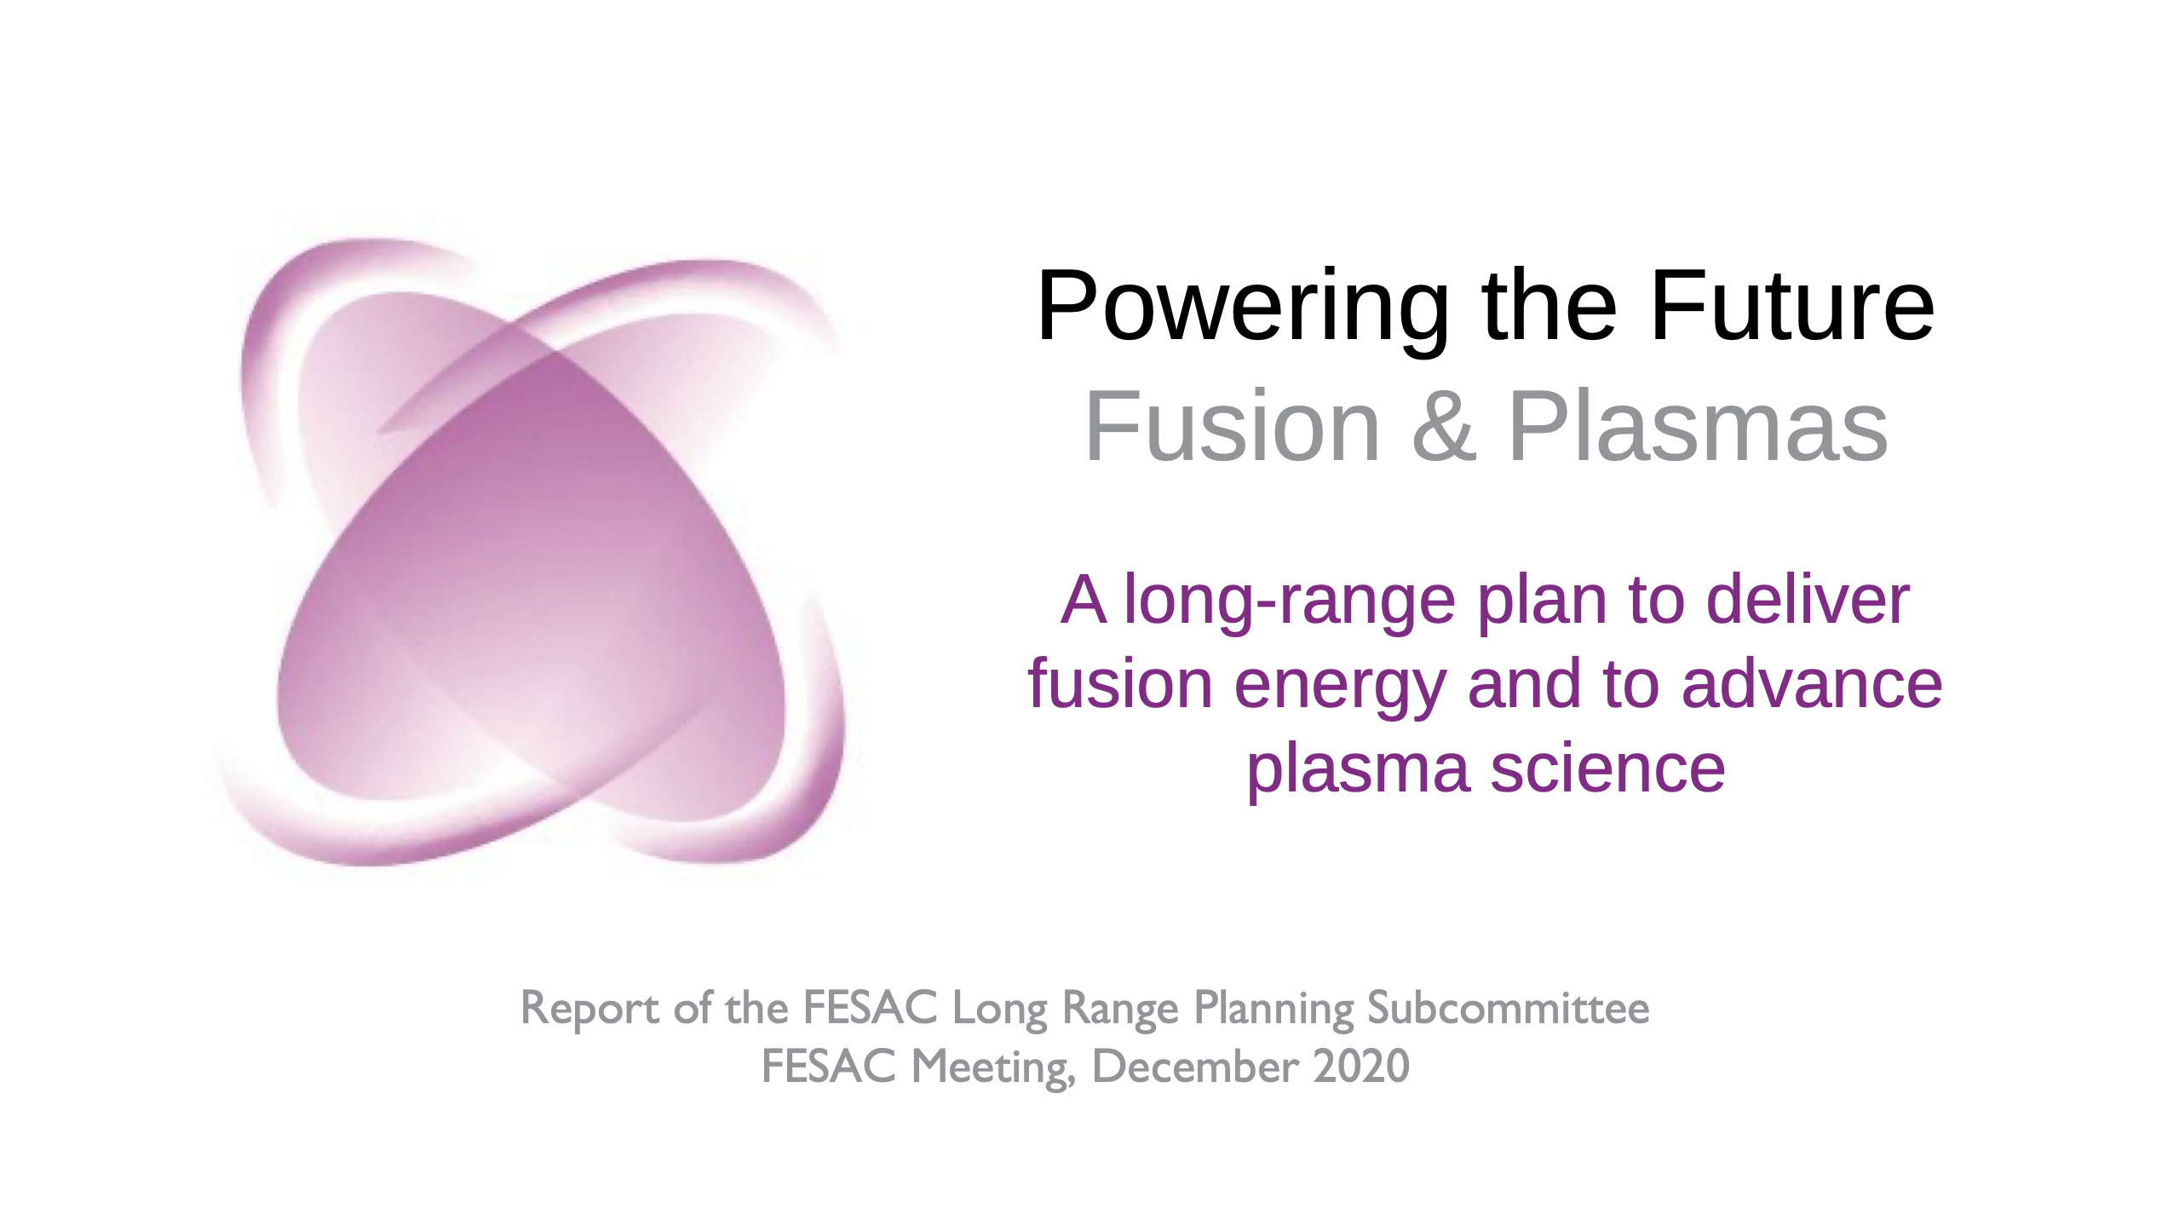
Fusion is at a critical moment – How will we respond?
Recent National Academies and FESAC reports provide impetus for aggressive US fusion program
  Focused on a US Pilot Plant in the 2040s
ITER operation is on the horizon
Fusion industry is rising in US pursuing alternate routes in parallel
Climate change is pressing the urgency of fusion energy
  Will we be ready?

Slide 5
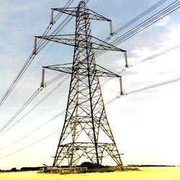
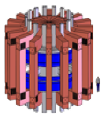
Generating Electricity from Fusion Energy Requires Resolution of Three Scientific/Technological Challenges
Creating and Sustaining a Fusion Power Source
Approximate Technical Readiness Today
Materials to Survive in
the Fusion Environment
Fusion Electricity
Fuel Self-Sufficiency & Harnessing Fusion Power
Technical Readiness Level (TRL)
Imaginable
Plausible
Feasible
Practical
1
2
3
4
5
6
7
8
9

Slide 6
Generating Electricity from Fusion Energy Requires Resolution of Three Scientific/Technological Challenges
Creating and Sustaining a Fusion Power Source
Approximate Technical Readiness Today
ORNL is committed to being a national resource in making fusion energy a viable electricity source for this generation and beyond
Materials to Survive in
the Fusion Environment
Fusion Electricity
Fuel Self-Sufficiency & Harnessing Fusion Power
Technical Readiness Level (TRL)
Imaginable
Plausible
Feasible
Practical
1
2
3
4
5
6
7
8
9

Slide 7

ORNL – A National Resource for …
ITER
Burning Plasma Physics
Fusion Materials
Fusion
Nuclear Science
Public-Private
Partner
Fusion System Design Studies
Fusion Pilot Plant

Slide 8
ORNL – A National Resource for …
ITER
ITER site in Southern France (May 2020)
>70% complete for 1st plasma
ITER project activities covered by Kathy McCarthy in earlier presentation
Self-Heated/Self- Organized Plasmas
Engineering of Components at Fusion Scale
Fusion System Design Studies
Fusion Pilot Plant

Slide 9
ORNL – A National Resource for …
Burning Plasma Physics
Sustained, high performance operation
Validated predictive models
Fusion System Design Studies
Fusion Pilot Plant

Slide 10
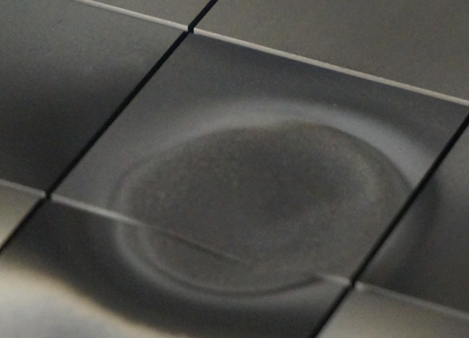
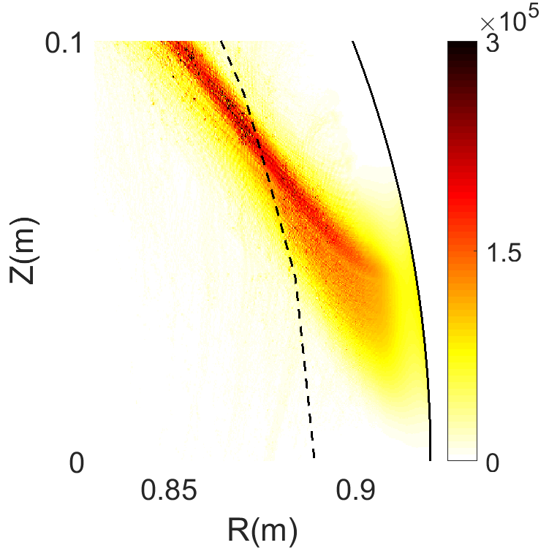
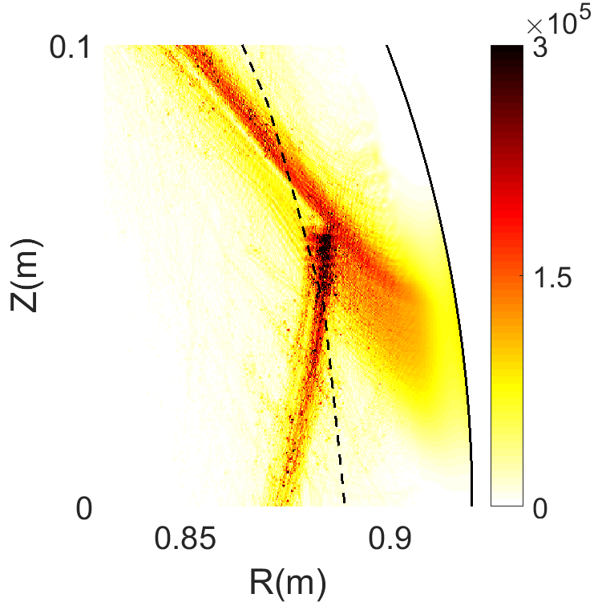
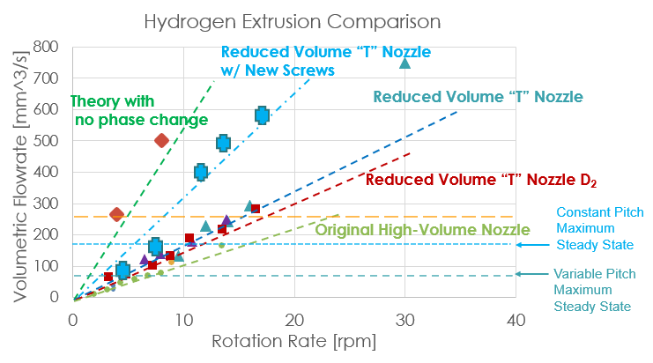
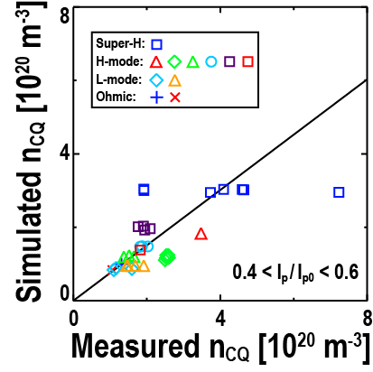
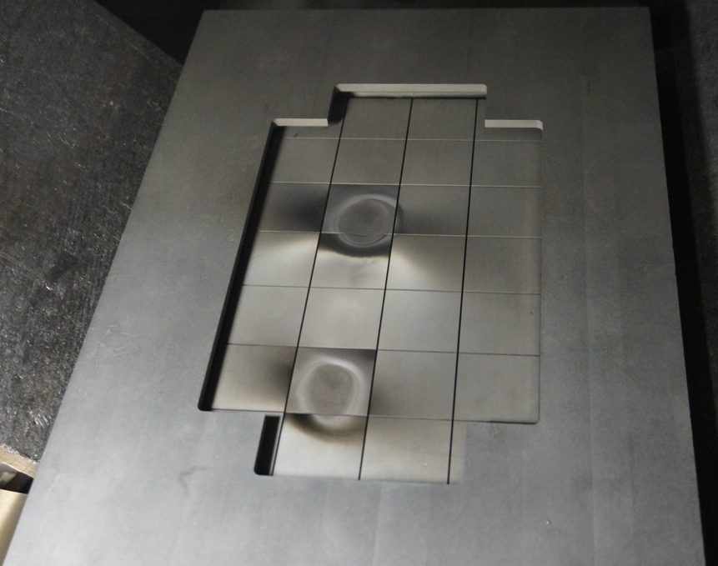
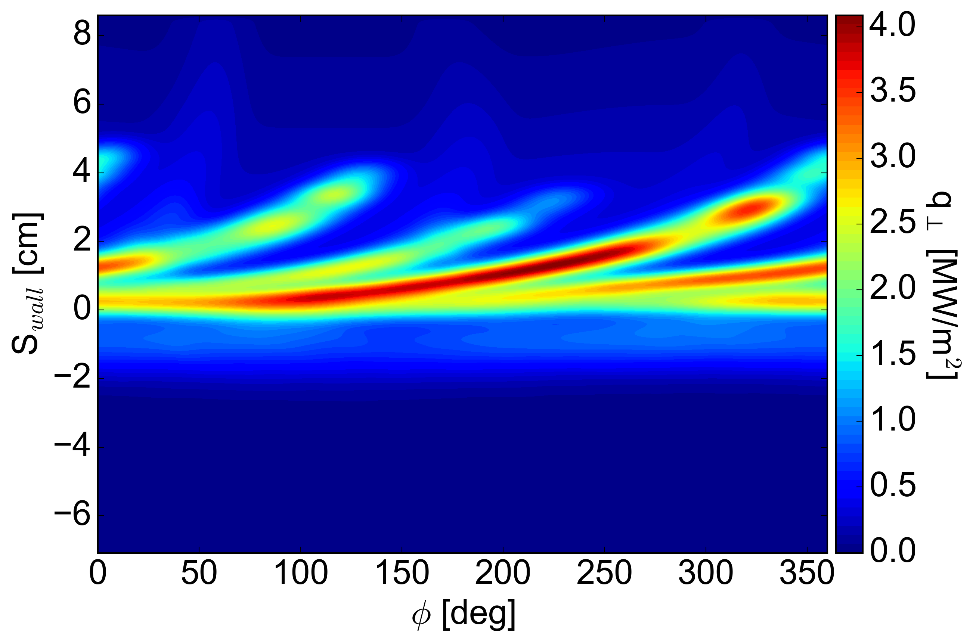
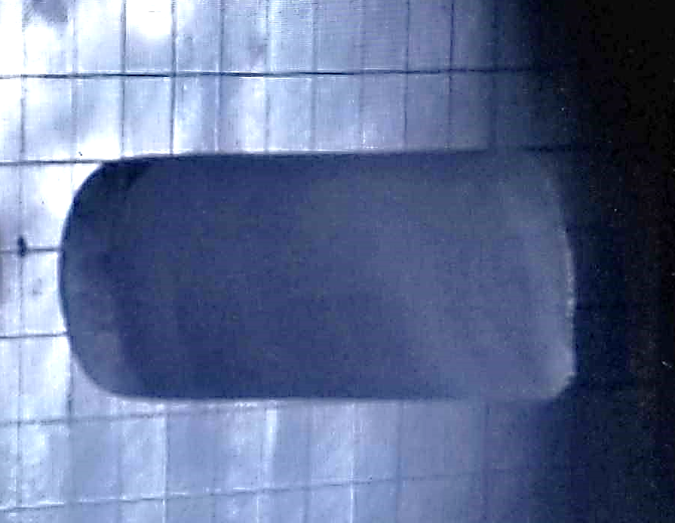
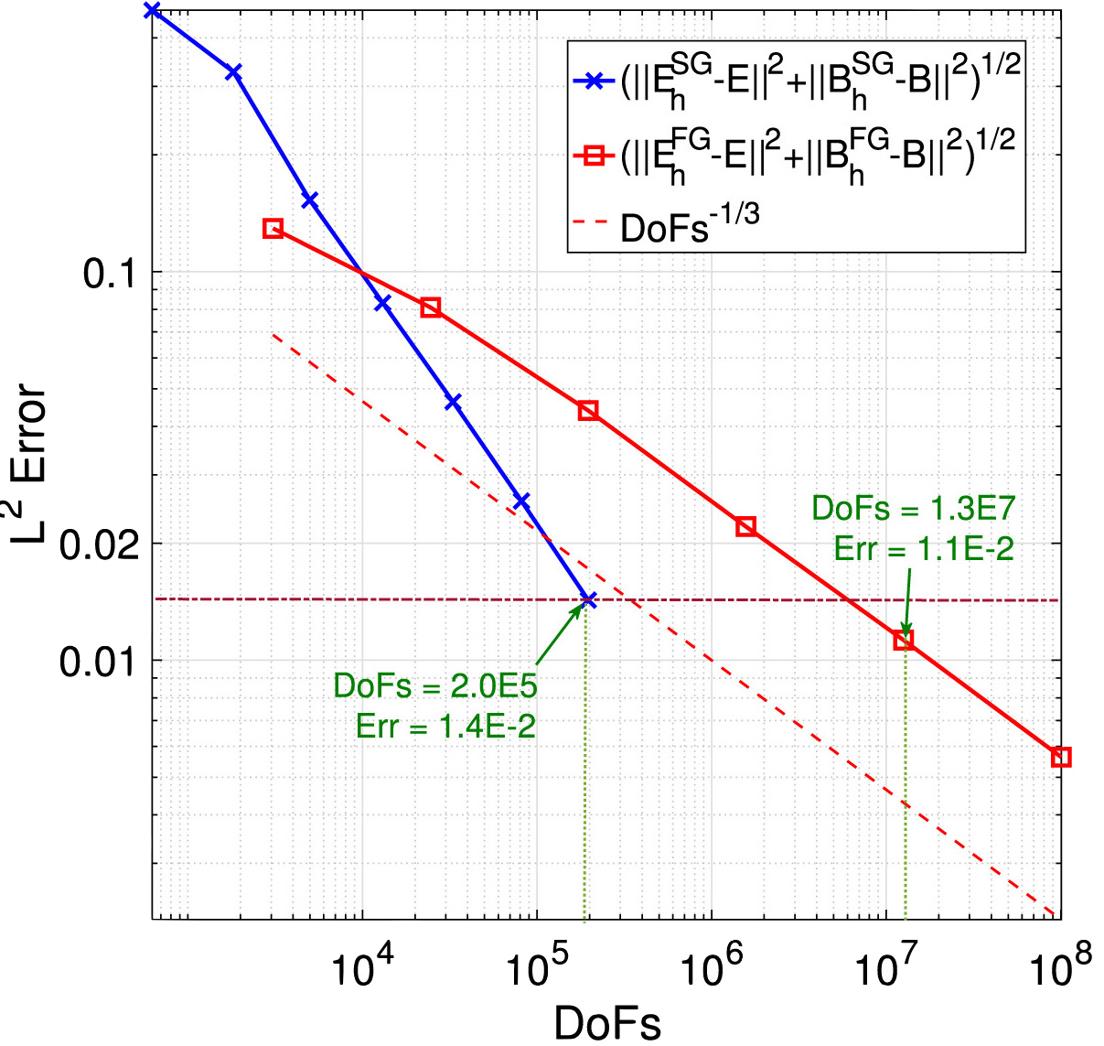
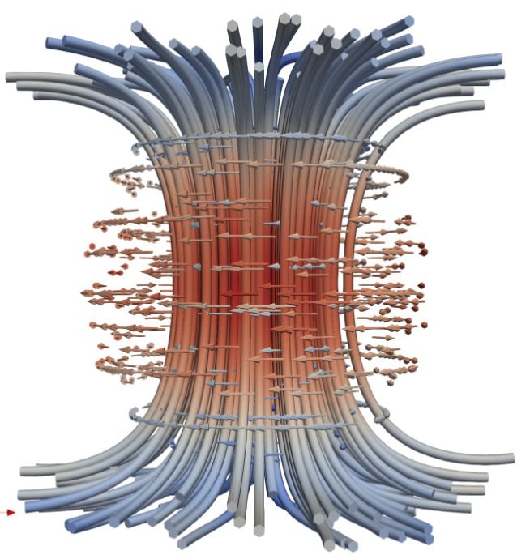
ORNL – Delivering Cutting Edge Tools for Burning Plasma Realization
Disruption Mitigation
Pellet Fueling
Boundary Solutions
Theory & Modeling
Improving the physics basis and technology for Shattered Pellet Injection (SPI) on ITER
Delivering long-duration, high-throughput pellet extrusion (W7-X)
Understanding ELM triggering (DIII-D)
Characterizing effect of high heat flux
…and 3D fields on SOL and divertor
Turbulence → large change in Lower Hybrid propagation
New adaptive grid → ~ 100x less elements for solving Maxwell’s equations (ASGarD)
Castellated graphite
target
Simulated vs Measured Current Quench Density (DIII-D)
LCFS
Vessel
2mm crater due to graphite sublimation/over heating
28 mm D₂ pellet prior
to target impact

Slide 11
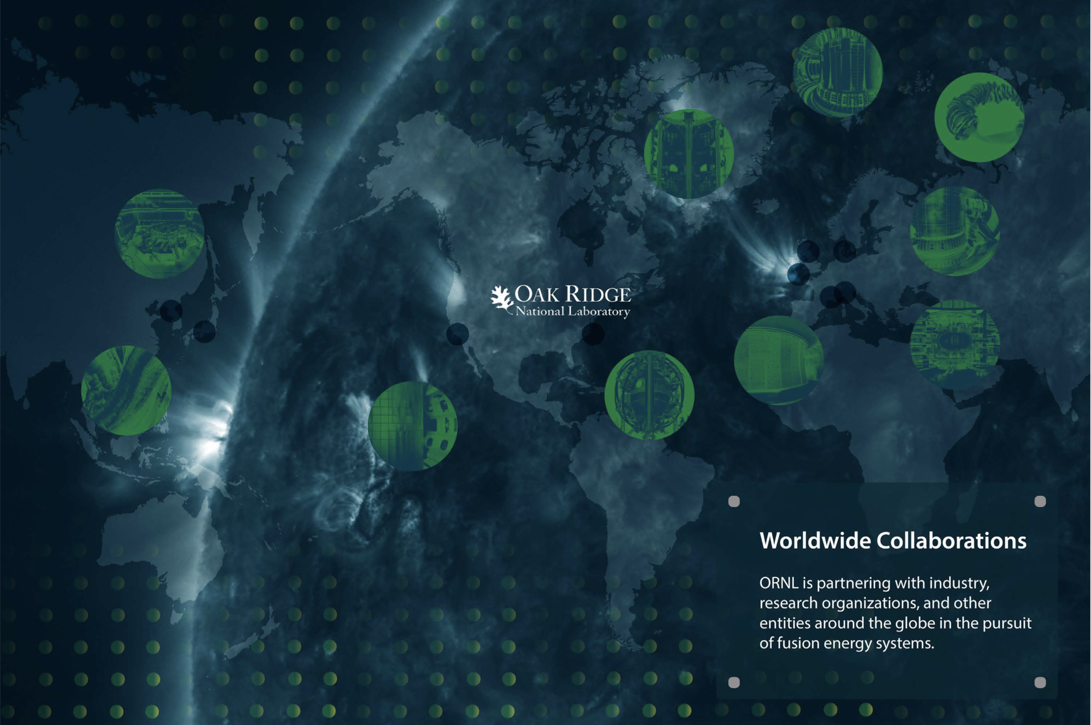
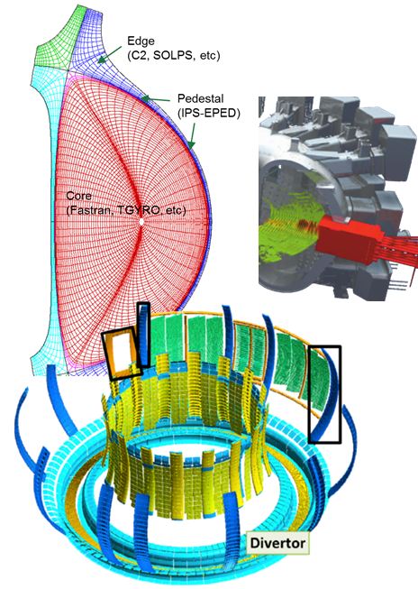
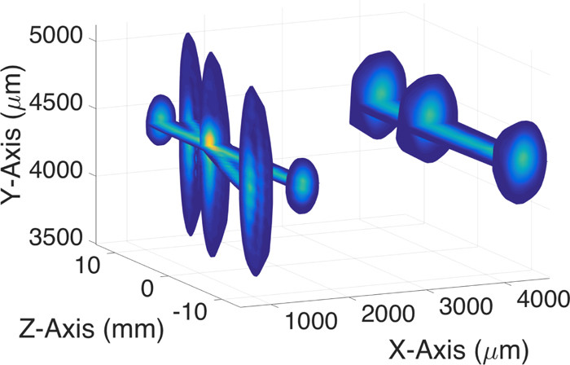
ORNL Vision for the 2020s in Burning Plasma Physics
Utilize DIII-D, NSTX-U, and international collaborations to develop foundational basis and high confidence simulation capabilities of key enabling elements for ITER and future burning plasmas systems
  Disruption mitigation - ELM control
  Heat Flux management - Fueling
  High performance scenarios
Partner in establishing the mission need, design, and construction of EXCITE to resolve gaps between present physics basis and pilot plant
Continue to develop and refine the necessary diagnostics and control capabilities required for burning plasma operation
Doppler Free
Saturation Spectroscopy
[ Divertor image from J. Romazanov et al., “ERO 2.0” (2015)]

Slide 12
ORNL – A National Resource for …
Fusion Materials
Low Erosion Plasma Facing Materials
Long Lifetime Nuclear Structural Materials
Fusion System Design Studies
Fusion Pilot Plant

Slide 13
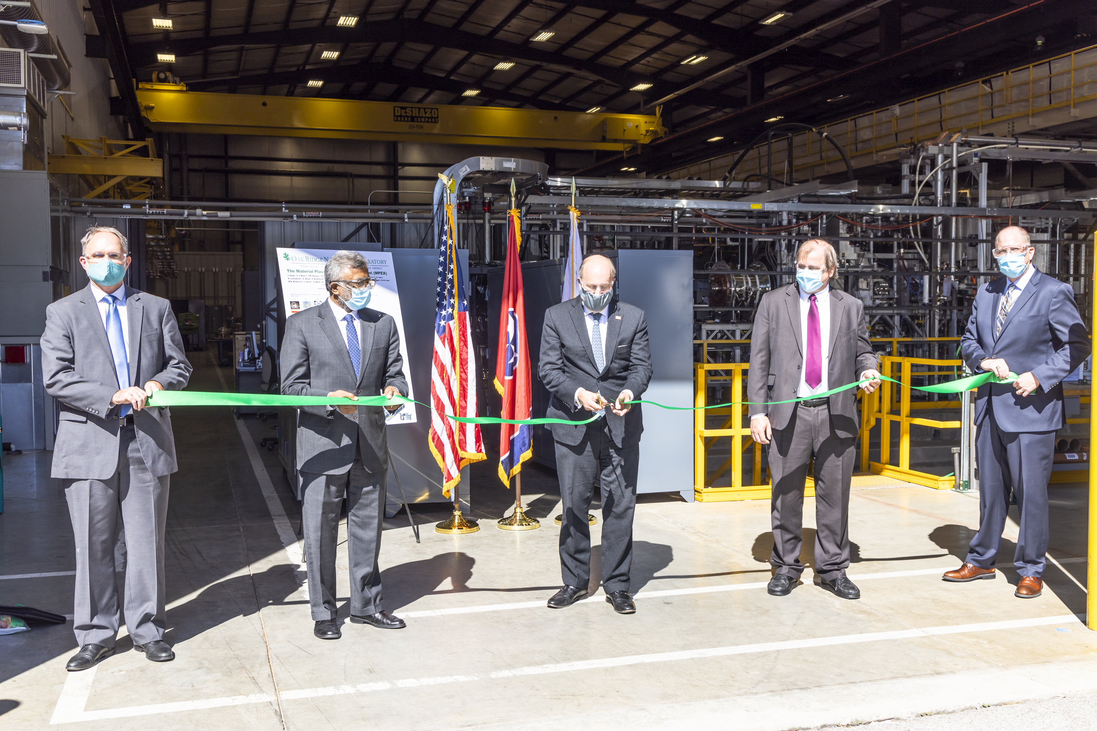
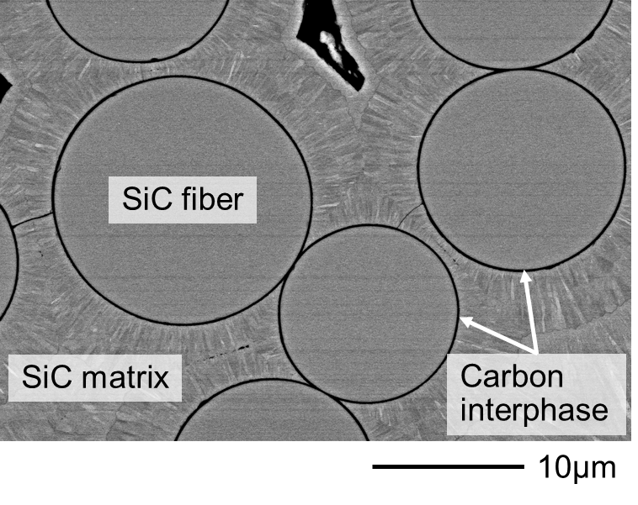
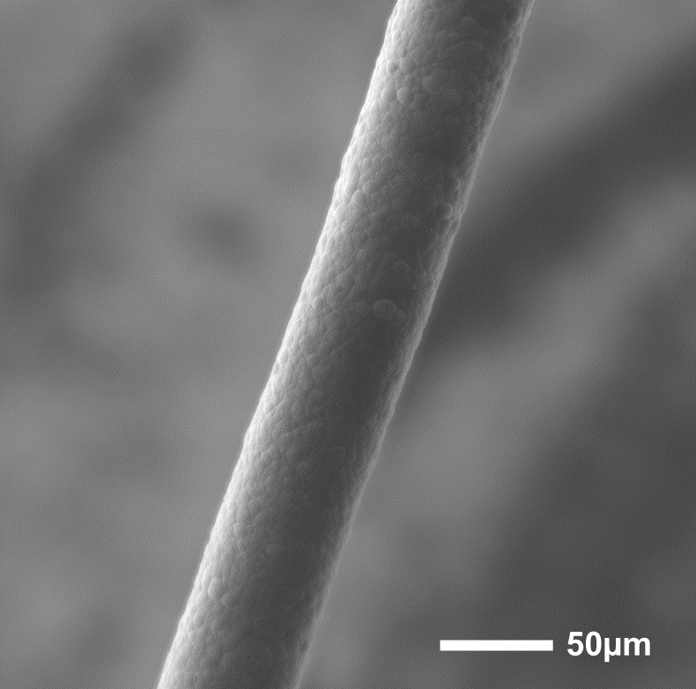
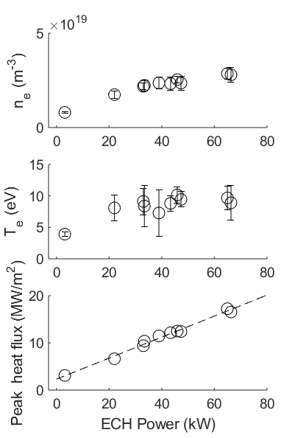
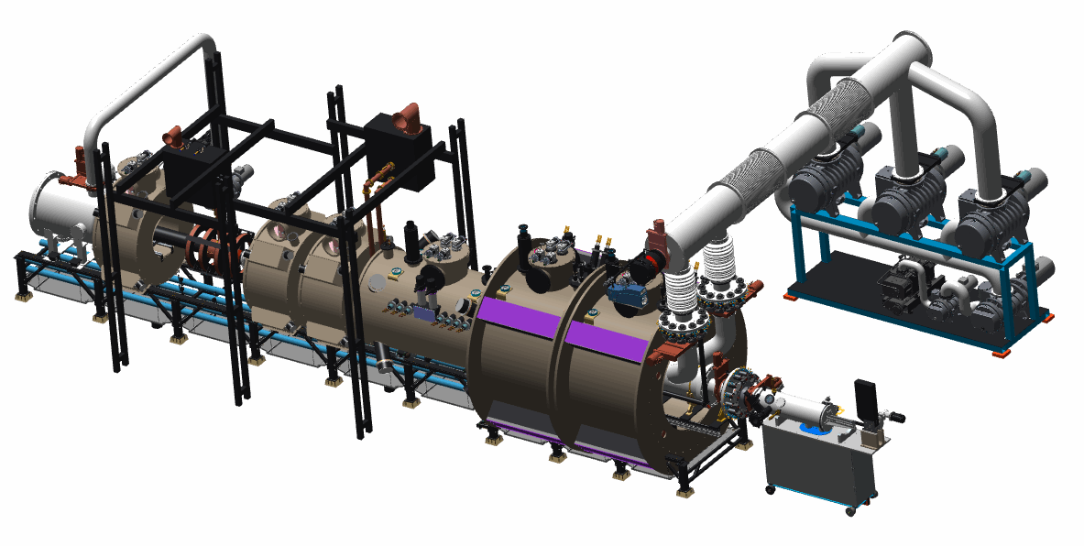
ORNL – Developing the Foundational Basis for Fusion Materials
Proto-MPEX
MPEX Design
Fusion Materials R&D
Demonstrated feasibility of MPEX design achieving reactor relevant conditions
CD-3a approval in Nov. 2020
Developing next-generation silicon carbon composites
Identifying the advantages of carbon nanoprecipitates on high temperature mechanical properties
Paul Dabbar at MPEX Ribbon Cutting
MPEX Configuration Model

Slide 14
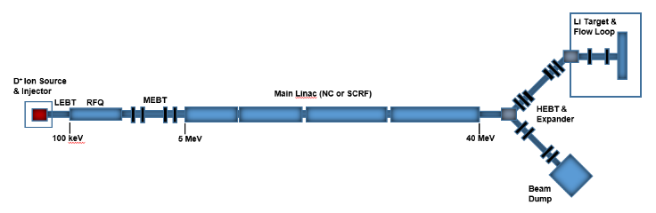
ORNL Vision for the 2020s in Fusion Materials
Deliver MPEX project on time, on schedule, and on spec to support the development of candidate plasma facing materials
  As part of a vibrant fusion materials program in the US
Utilize DIII-D, NSTX-U, and international collaborations to develop foundational basis for in-situ material erosion, migration, and impact
Establish the mission need, identify best approach, design, and construct a Fusion Prototypic Neutron Source
  Fill critical gap in fusion neutron effects
W erosion at 10 eV
Fusion Power Plant
MPEX
C-mod
JT60-SA
ITER
DIII-D
JET
EAST
Multibeam D⁺ into T gas target
fusion neutron source
1 MW spallation source
LANSCE target station
D – Li stripping reaction
~5 MW D accelerator and liquid Li target

Slide 15
ORNL – A National Resource for …
Fusion
Nuclear Science
Blankets for Tritium Breeding/Power Extraction
Closed Tritium Fuel Cycle
Fusion System Design Studies
Fusion Pilot Plant

Slide 16
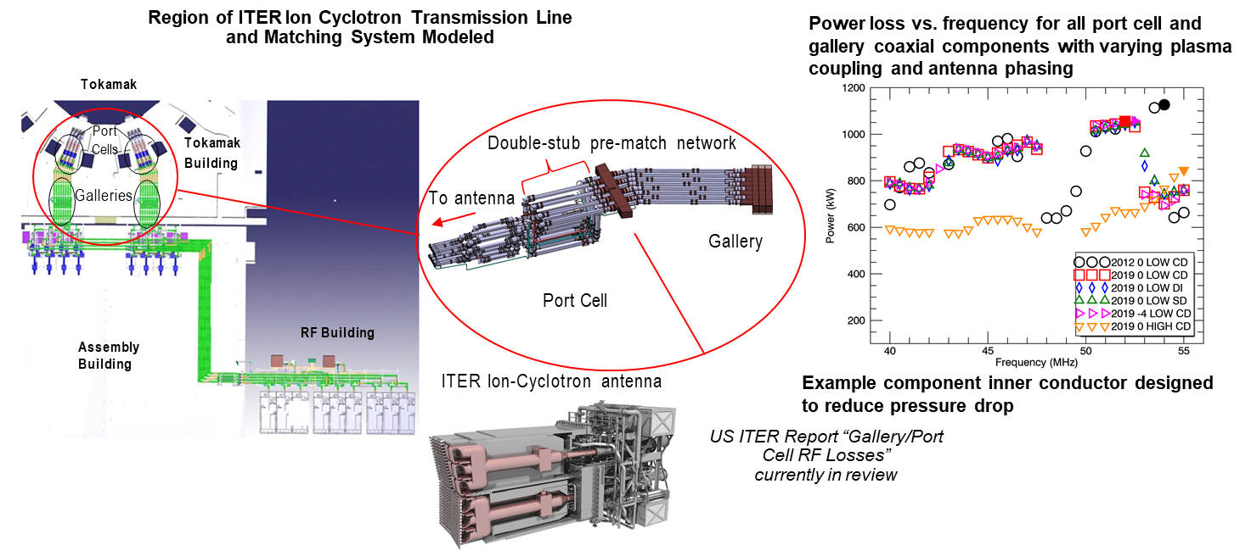
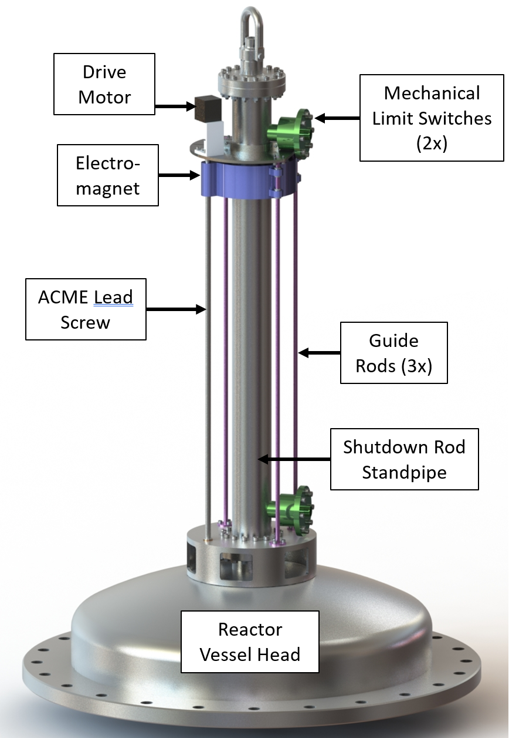
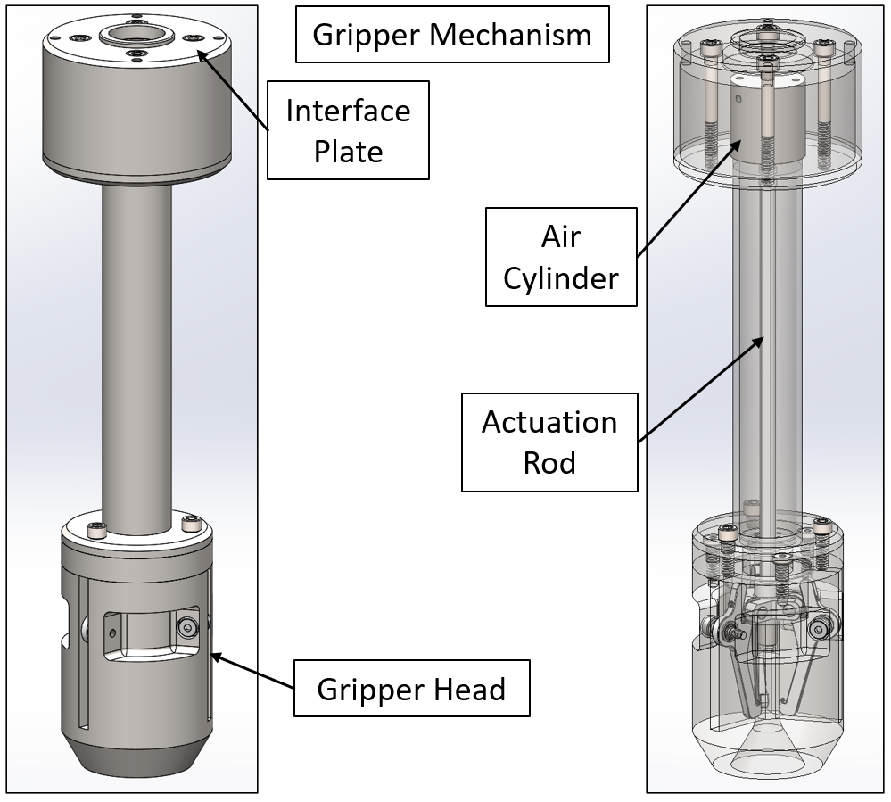
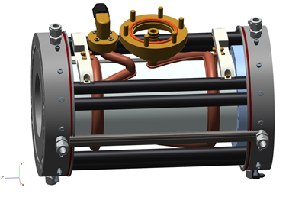
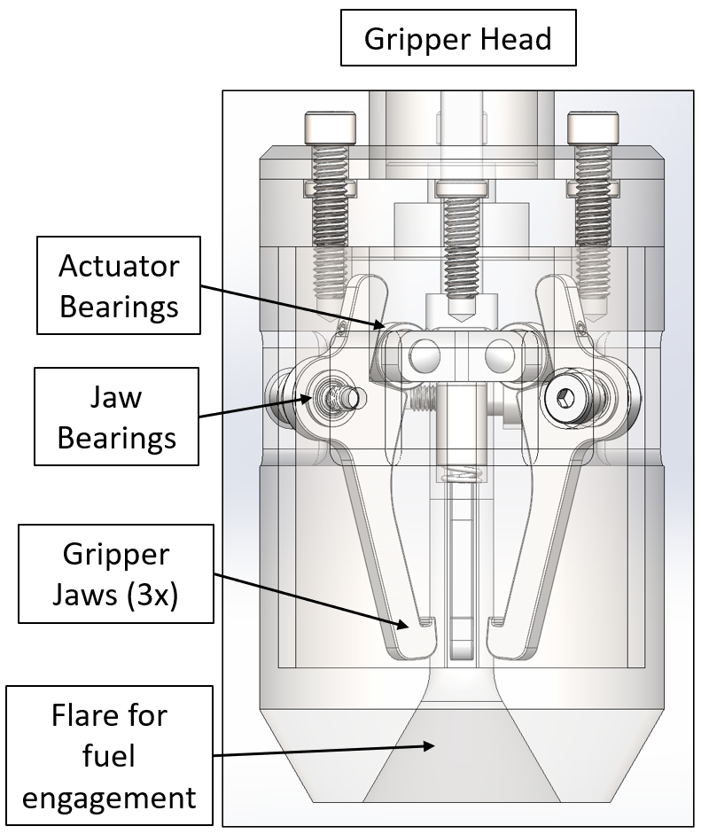
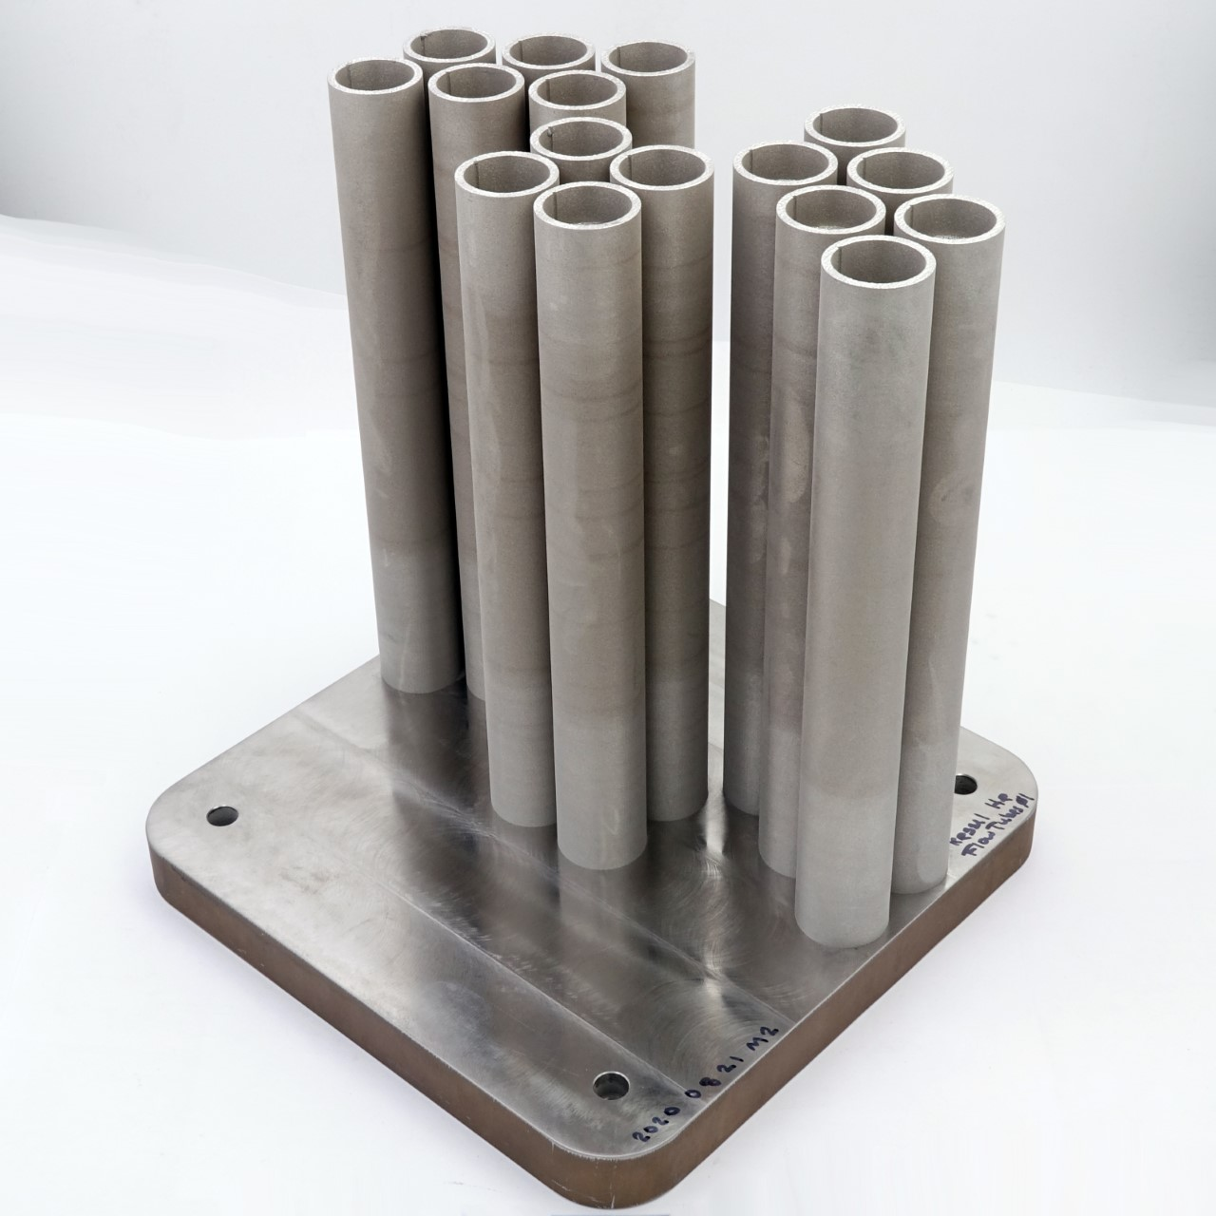
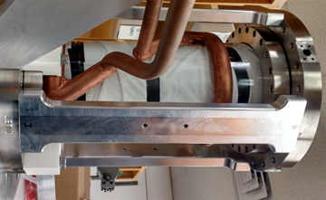
ORNL – Leading US Development of Fusion Technologies
Blanket Development
RF Technology
Remote Systems
Helium Flow Loop approaching completion
Testing complex structures to improve heat transfer
ITER ICH system
evaluation
MPEX Helicon window design
Providing practical solutions to challenging remote handling issues
ORNL Helium Flow Loop
Example: Design of Central Control Rod and Fuel Handling Manipulator for Transformational Challenge Reactor (TCR)
Actual AM produced batch of parts for testing in flow loop
Fuel Handling Manipulator
Central Control Rod

Slide 17
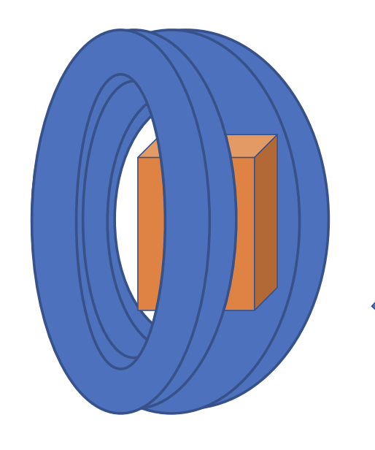
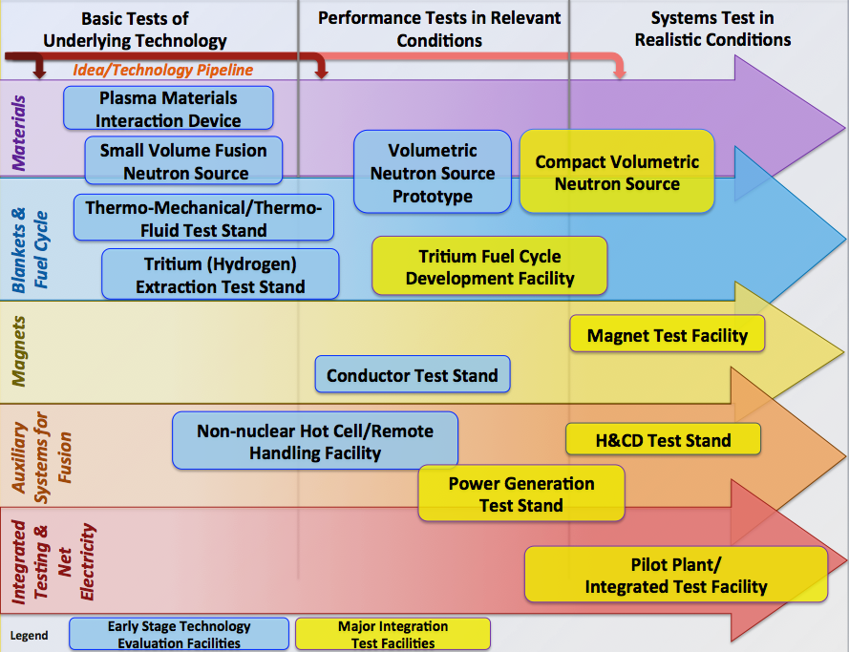
ORNL Vision for the 2020s in Fusion Technology
Establish improved understanding of helium flow in complex structures using the Helium Flow Loop
Continue to develop RF technologies that are relevant to fusion development, including non-tokamak needs
Leverage opportunities in other areas including fission to develop remote handling capabilities
Develop the basis and start design of a blanket component test facility
Start development of infrastructure to
support a fusion technology ecosystem
Blanket component test facility
Fusion Technology Pipeline

Slide 18
ORNL – A National Resource for …
Public-Private
Partner
Engagement in New Approaches
Host Test Beds & Be a Knowledge Resource
Fusion System Design Studies
Fusion Pilot Plant

Slide 19
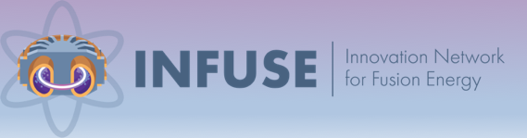
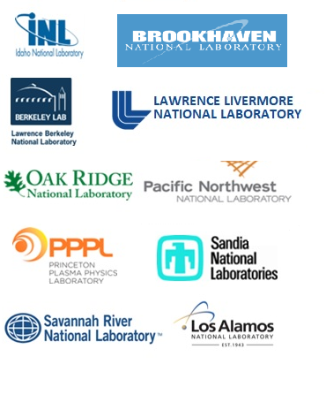
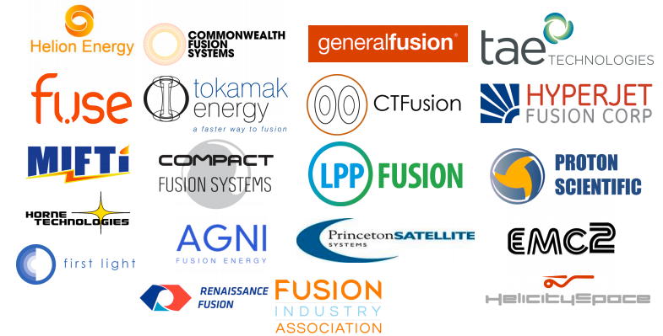
ORNL – Engaging Private Industry in Fusion Development
INFUSE program
ORNL Vision for the 2020s
Enables private firms to tap into national lab resources to address key issues
  Led by ORNL and PPPL
Expand the INFUSE program to larger activities
Engage in much larger cost-share programs targeting demonstration of breakthrough approaches (COTS-like program)
Actively pursue partnerships with private firms interested in leveraging ORNL resources towards technology development or demonstration
  Personnel, siting, and infrastructure
10 Participating
DOE labs
Fusion Industry
Association

Slide 20
ORNL – A National Resource for …
ITER
Burning Plasma Physics
Fusion Materials
Fusion
Nuclear Science
Public-Private
Partner
Self-Heated/Self- Organized Plasmas
Engineering of Components at Fusion Scale
Sustained, high performance operation
Validated predictive models
Low Erosion Plasma Facing Materials
Long Lifetime Nuclear Structural Materials
Blankets for Tritium Breeding/Power Extraction
Closed Tritium Fuel Cycle
Engagement in New Approaches
Test Platforms & Knowledge Resource
Fusion System Design Studies
Fusion Pilot Plant

Slide 21
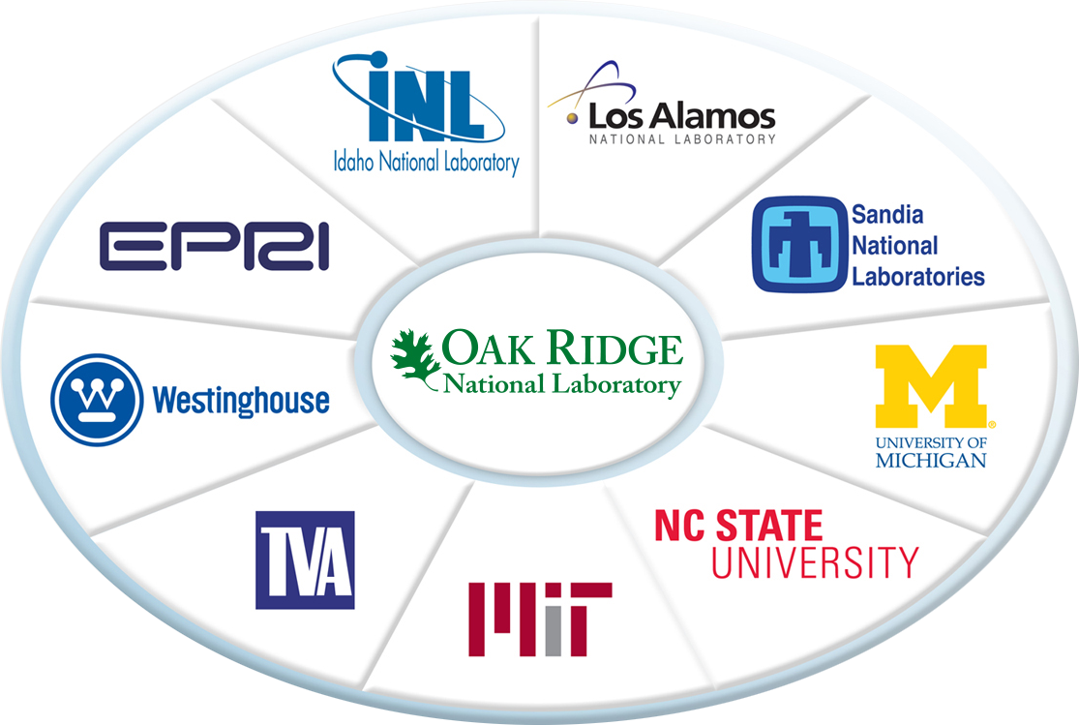
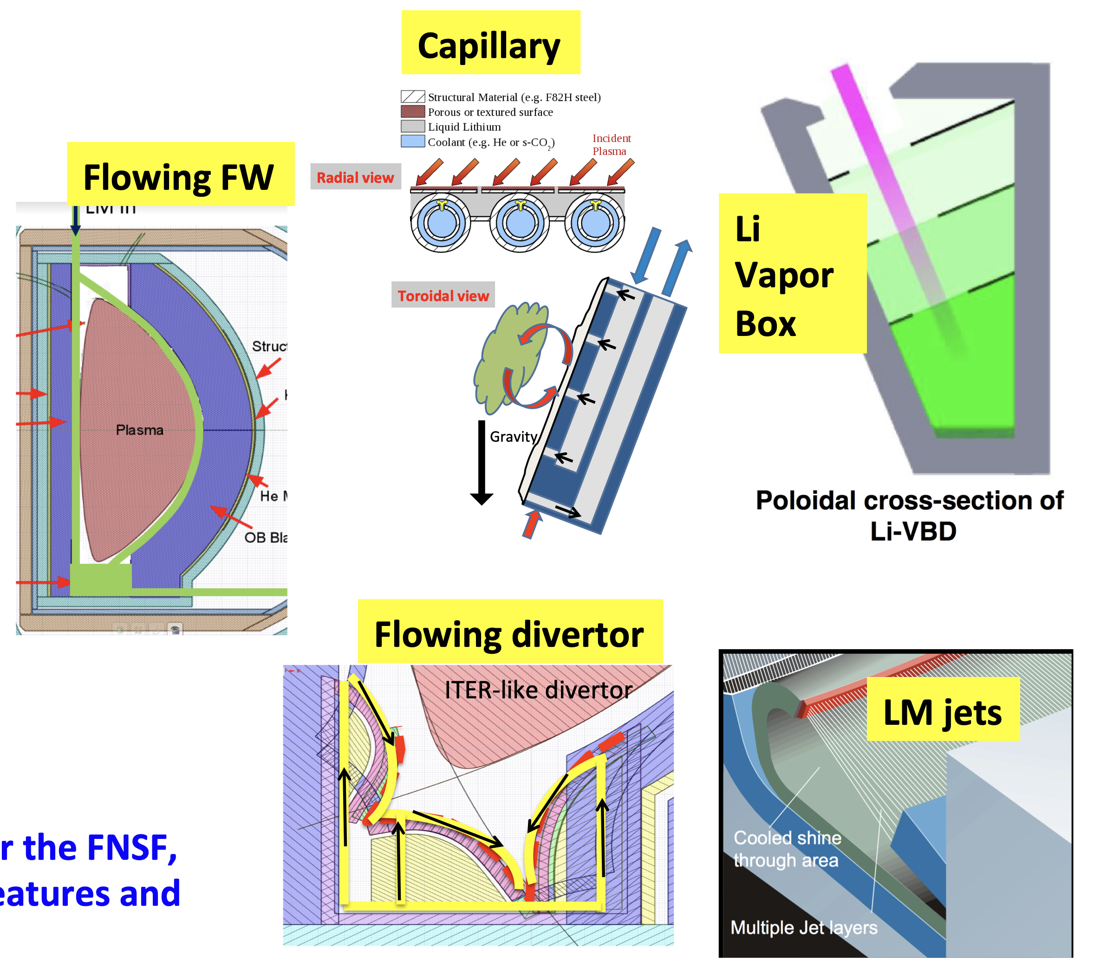
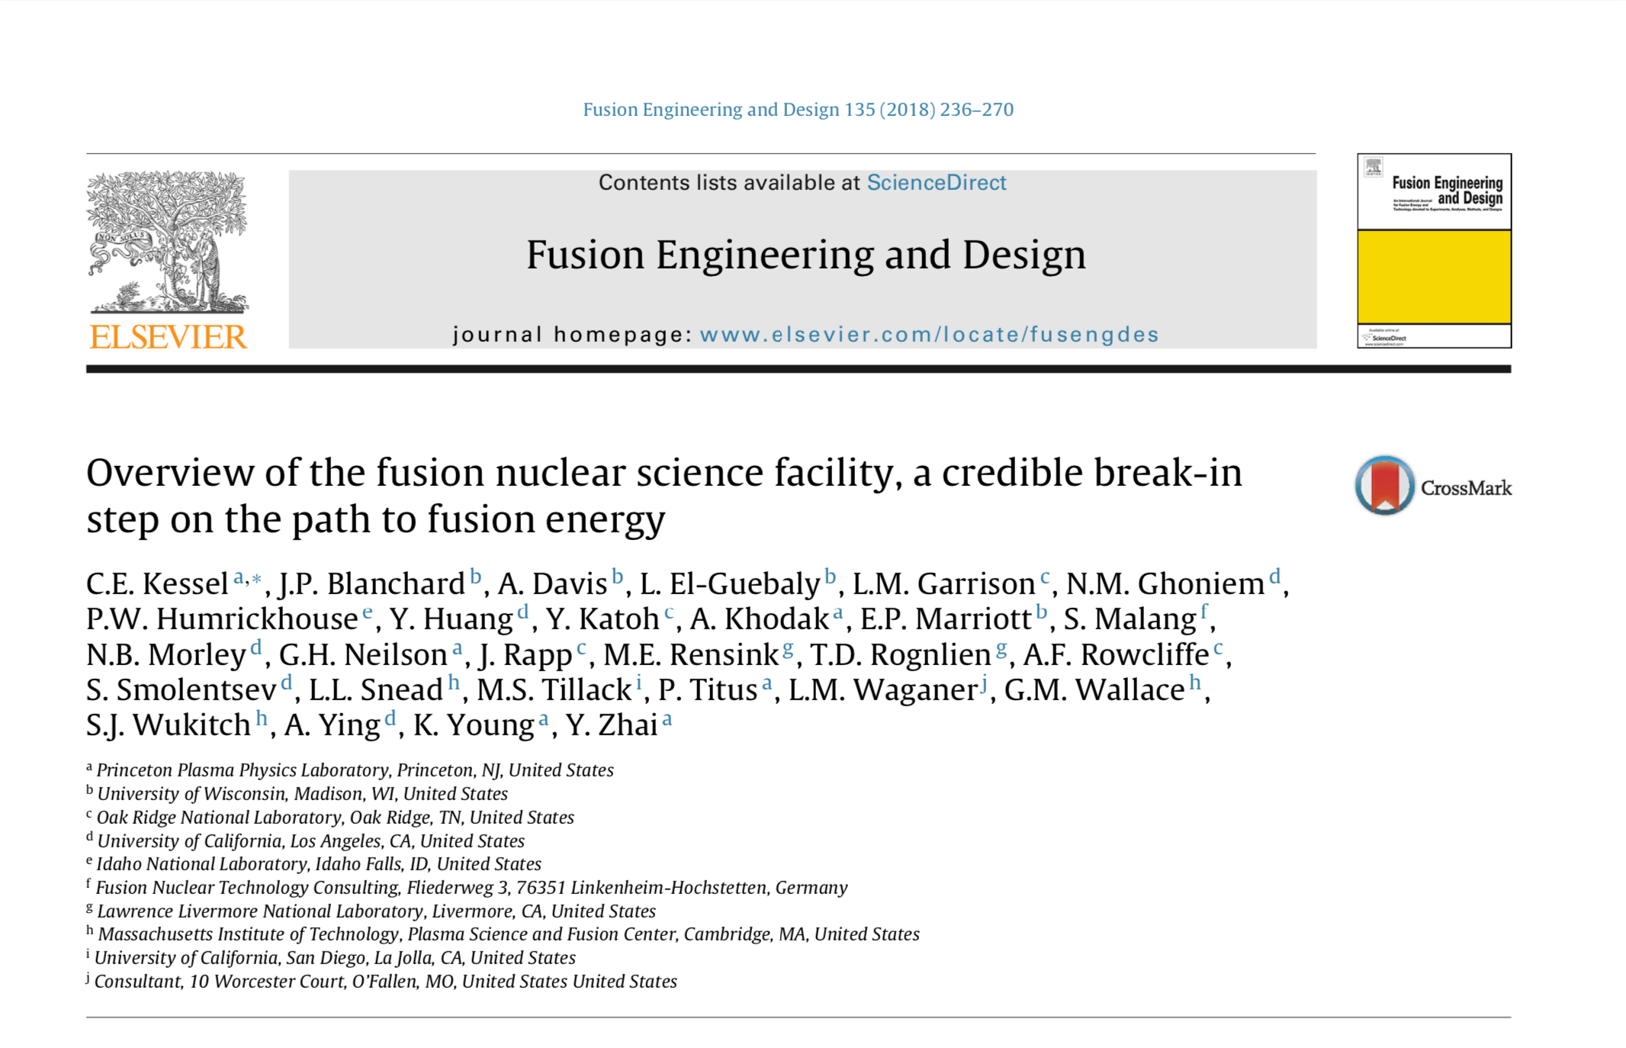
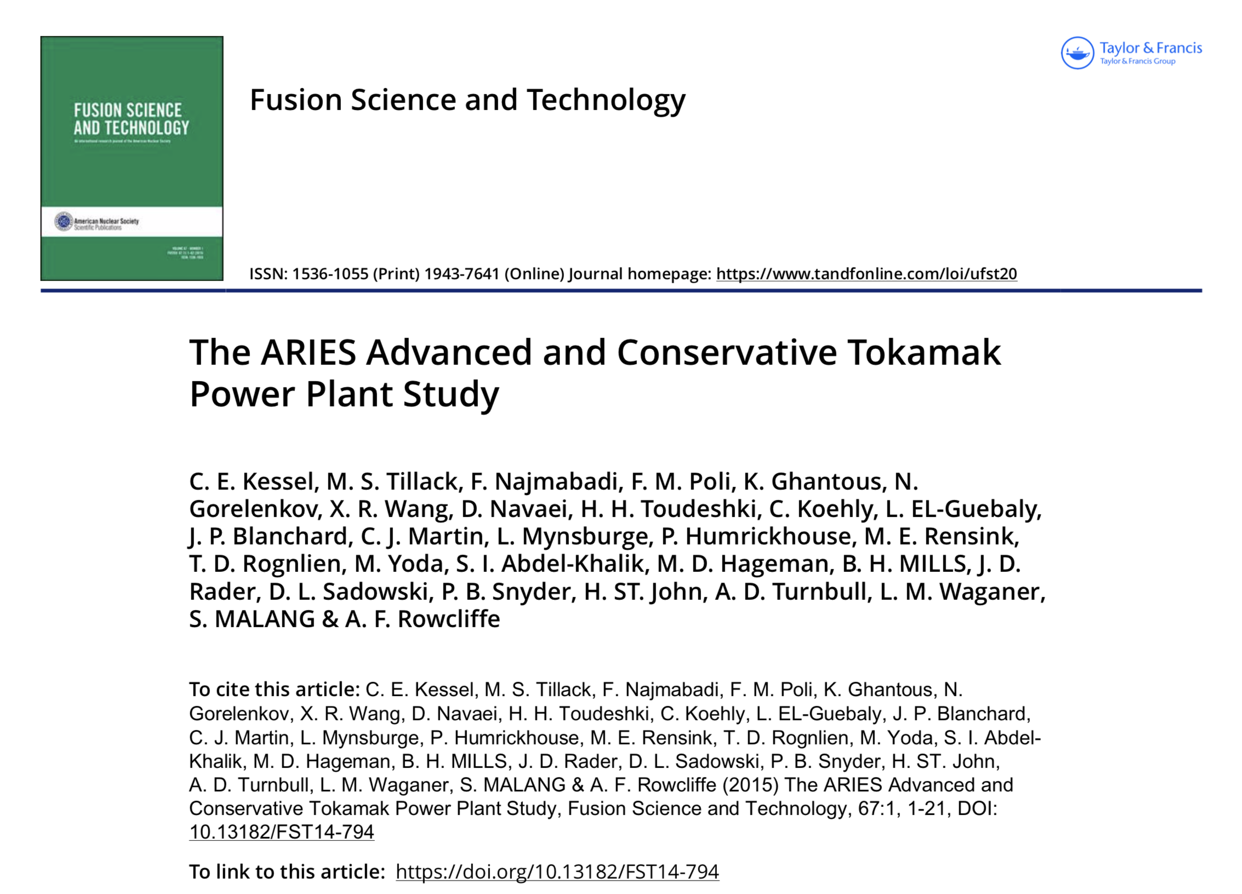
ORNL – Providing the Framework for a National Fusion Design Team
Fusion Energy Systems Studies
ORNL Vision for the 2020s
National effort to develop better understanding of practical considerations of improved capabilities (e.g.)
  Aggressive vs Conservative Tokamak (ACT) physics and technology assumptions and Fusion Nuclear Science Facility
  Liquid plasma facing materials
  How small can a reactor be?
Develop the framework for high-power, adaptive fusion system design, supported by advanced computation incorporating the best available physics, engineering, and technologies
  Lean on experience
  from other fields
Utilize capabilities to design next-generation devices such as EXCITE and Fusion Pilot Plant
Liquid metal study
ACT Power Plant Study
Consortium For Advanced Simulation Of Light Water Reactors (CASL)

Slide 22
ORNL – A National Resource for …
ITER
Burning Plasma Physics
Fusion Materials
Fusion
Nuclear Science
Public-Private
Partner
Self-Heated/Self- Organized Plasmas
Engineering of Components at Fusion Scale
Sustained, high performance operation
Validated predictive models
Low Erosion Plasma Facing Materials
Long Lifetime Nuclear Structural Materials
Blankets for Tritium Breeding/Power Extraction
Closed Tritium Fuel Cycle
Engagement in New Approaches
Test Platforms & Knowledge Resource
Fusion Design Systems Studies
Fusion Pilot Plant

Slide 23
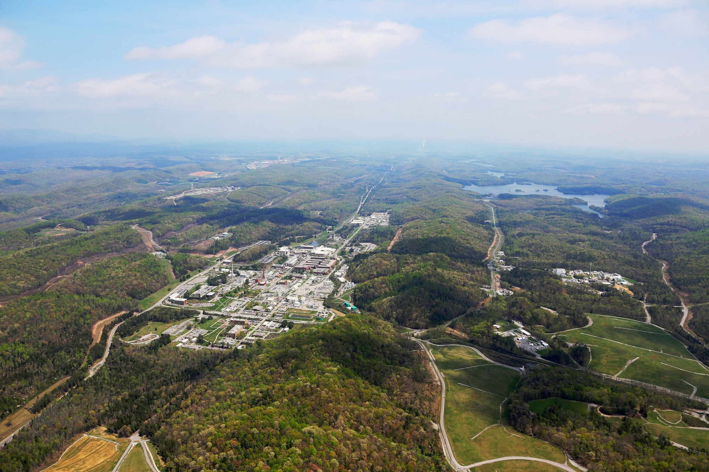
ORNL Has the Capabilities and Interest to Host a Future Fusion Pilot Plant and Demonstration Facilities
Our Vision: Fusion energy – the clean electricity source of choice for this generation and beyond
Our Capabilities:
  Multiple siting options with access to required water and electricity needs
  Demonstrated capability to host major projects
  Broad range of technical capabilities important to pilot plant success
Our Pilot Plant vision: A public-private venture that leverages the capabilities of both sectors to deliver timely completion at acceptable risk
  For 2040s delivery, conceptualization and build out of infrastructure will need to begin in the 2020s
Aerial view of ORNL

Slide 24
ORNL Has the Capabilities and Interest to Host a Future Fusion Pilot Plant and Demonstration Facilities
Our Vision: Fusion energy – the clean electricity source of choice for this generation and beyond
Our Capabilities:
  Multiple siting options with access to required water and electricity needs
  Demonstrated capability to host major projects
  Broad range of technical capabilities important to pilot plant success
Our Pilot Plant vision: A public-private venture that leverages the capabilities of both sectors to deliver timely completion at acceptable risk
  For 2040s delivery, conceptualization and build out of infrastructure will need to begin in the 2020s
Aerial view of ORNL
ORNL is committed to being a national resource in making fusion energy a viable electricity source for this generation and beyond

