Slide 1
Recent Progress on the high-field path to fusion energy
FPA 2020
Dennis Whyte for the
MIT and CFS SPARC Team

Slide 2
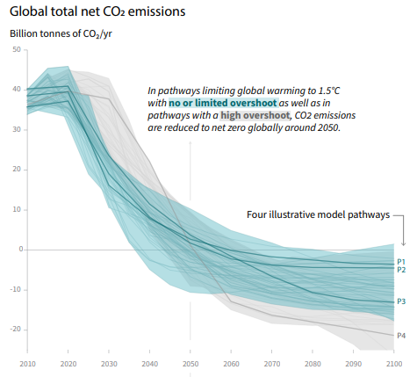
Entire team focused on near-term energy from fusion
Climate change as the driver of the energy transition and our team’s timescale
CFS/SPARC is privately backed, >$200M of private money & <1% public funding
MIT R&D and educational partner
Status: > 240 team members, 10 institutions
    For fusion to make any impact in the world it will need to build ~10,000s power plants (true for all energy technologies)
    This makes fusion an entire standalone industry of large value
    For fusion to make a difference to climate change and the energy transition it needs to start delivering plants no later than 2030s or else it misses the market
2018 IPCC report

Slide 3
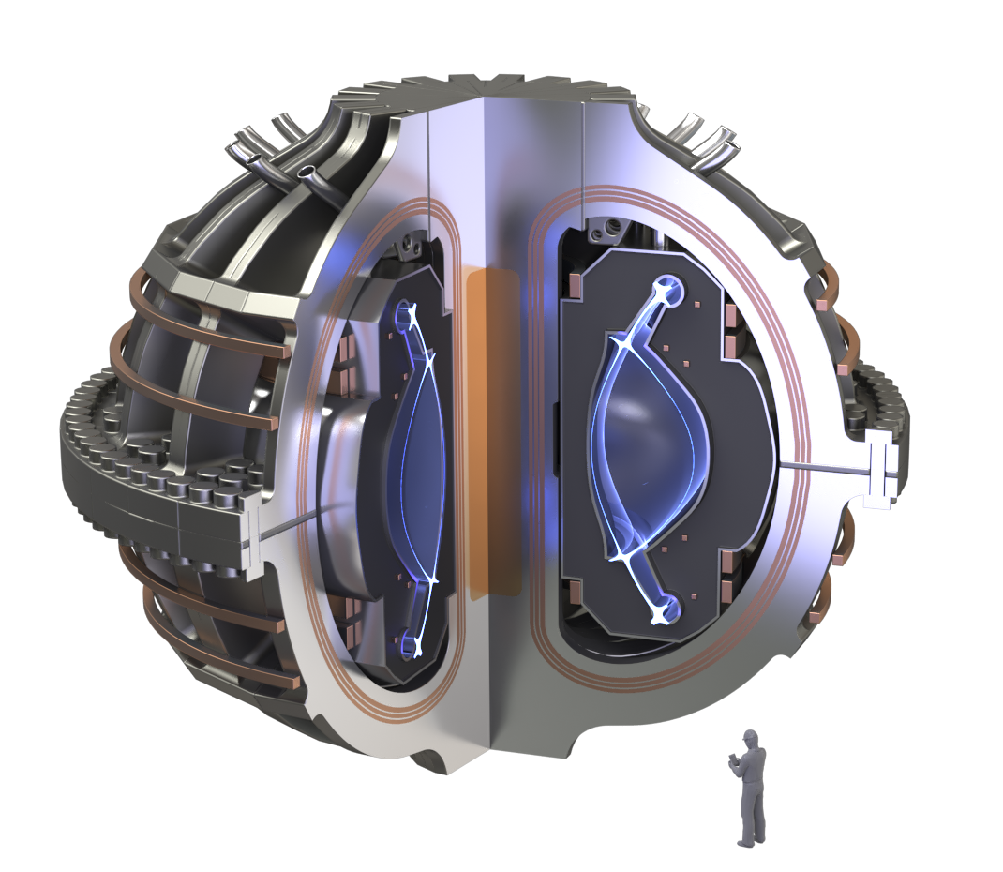
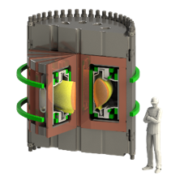
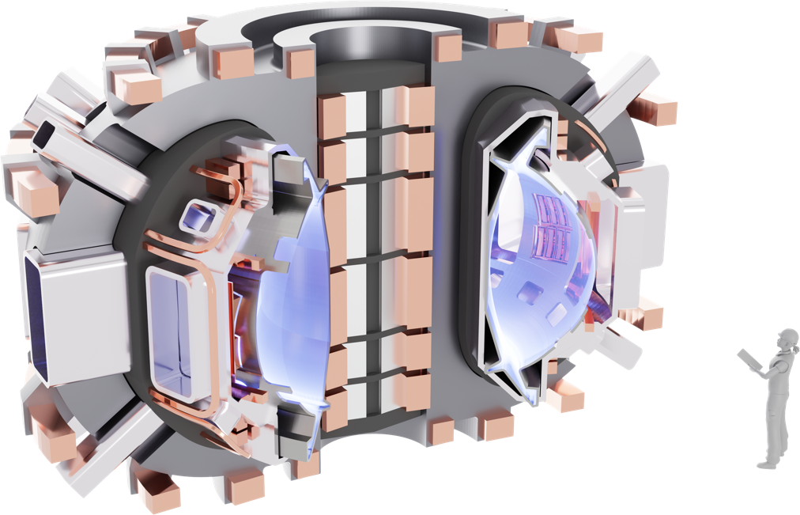
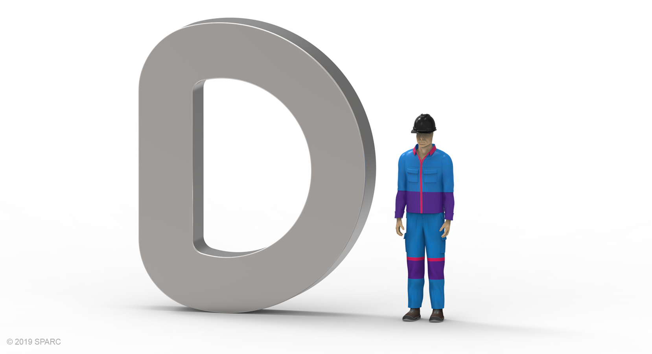
HTS magnets enable the high-field path to fusion energy
High-field
fusion science
Phase 1:
Technology
R&D
Phase 2: Demonstration
Phase 3: Commercialization
Alcator
C-Mod
SPARC
SPARC
HTS magnet R&D
ARC
2016
2021
2025
2030s

Slide 4
HTS magnets enable the high-field path to fusion energy
High-field
fusion science
Phase 1:
Technology
R&D
Phase 2: Demonstration
Phase 3: Commercialization
Confirmation of confinement physics and fusion burn
Plasma power management
High flux, low fluence
Low availability
No balance of plant
Integrated engineering performance and construction
Component supply chain, costs, delivery
Integrated delivery by company
Regulatory foothold
Maintenance scenario
Materials in moderate fluence
Availability increasing across stages
High average power (pulsed or steady state TBD)
Heat extraction
TBR>1
Balance of plant
Operability in an energy system
Costs, build time, delivery channel
Regulation at commercial scale
Power development by company
High-field plasma physics
High power density operation
Plasma prediction workflows
Alcator
C-Mod
Key disruptive component
At scale, field, stress
Integrated manufacturing
Supply chain and costs
SPARC
SPARC
HTS magnet R&D
ARC
2016
2021
2025
2030s

Slide 5
On track for 6/21 start of SPARC construction
2018
2019
2020
2021
2022
2023
2024
2025
2026
Phase 1
Phase 2
Cable R&D
Toroidal field model coil (TFMC)
TF, PF, CS magnet fabrication
7 years from start of
design to first plasma
SPARC 10% design
SPARC 30% design
SPARC 60% design
SPARC 100% design
Site selection
Site prep, licensing
Construction, commissioning
Operations
First
plasma
On schedule for magnet demo
On schedule to start SPARC construction
Budget sufficient to start SPARC construction
DT as soon as possible after startup
Key:
10% = Design concept: 2D poloidal cross section baselined
30% = Ready for construction
60% = Grouped systems
100% = Final design
TFTR: 6 years from start of design to first plasma
JET: 9 years from start of design to first plasma

Slide 6
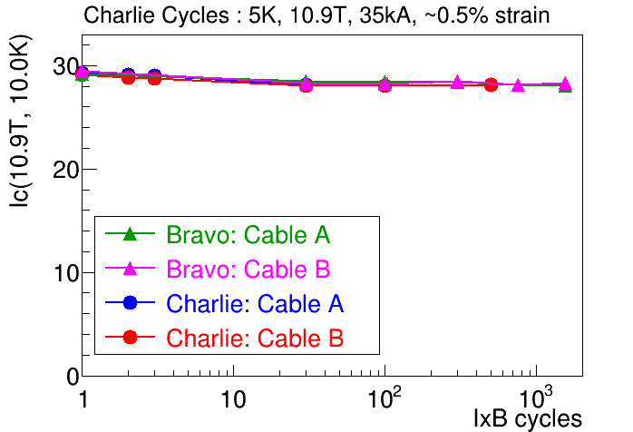
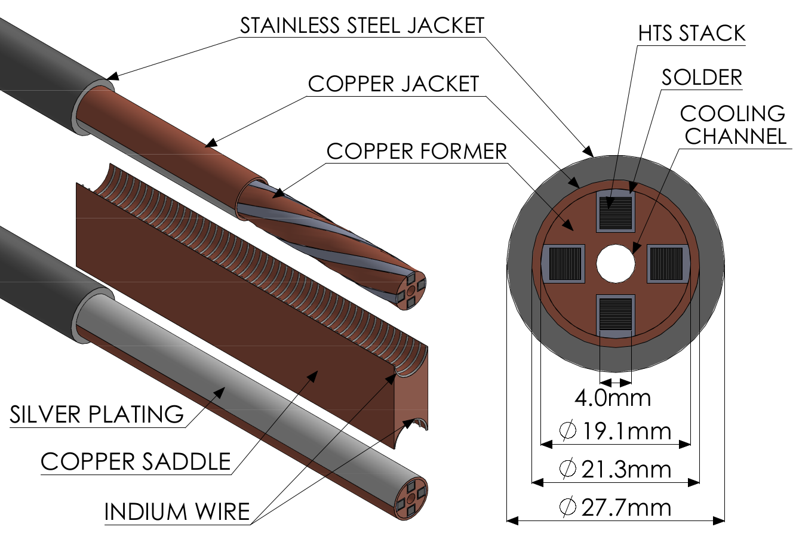
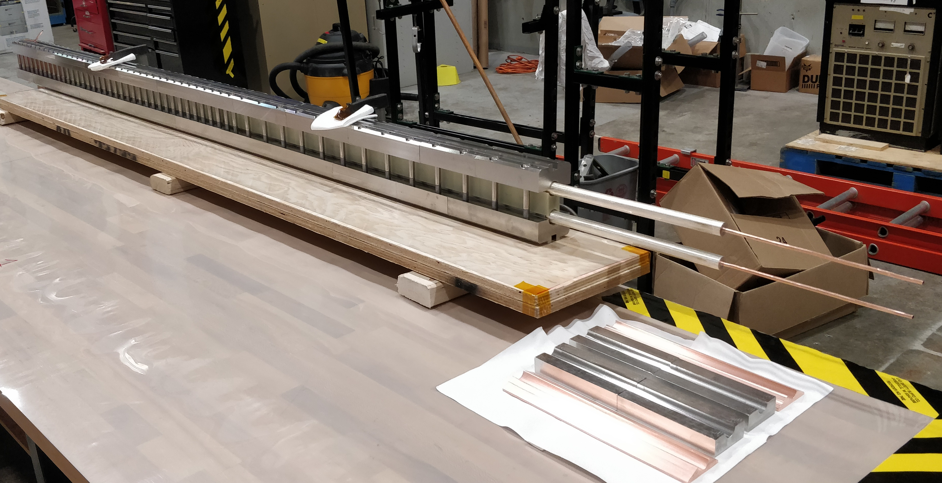
Magnet R&D has de-risked SPARC cables
>20 test cables fabricated as part of VIPER program
3D configurations (now an ARPA-E program)
Proven in SULTAN at SPARC/ARC TF relevant conditions
Adapted to use in the CS/PF under fast ramp rates
[Hartwig et al, SUST 2020 33 11LT01]

Slide 7
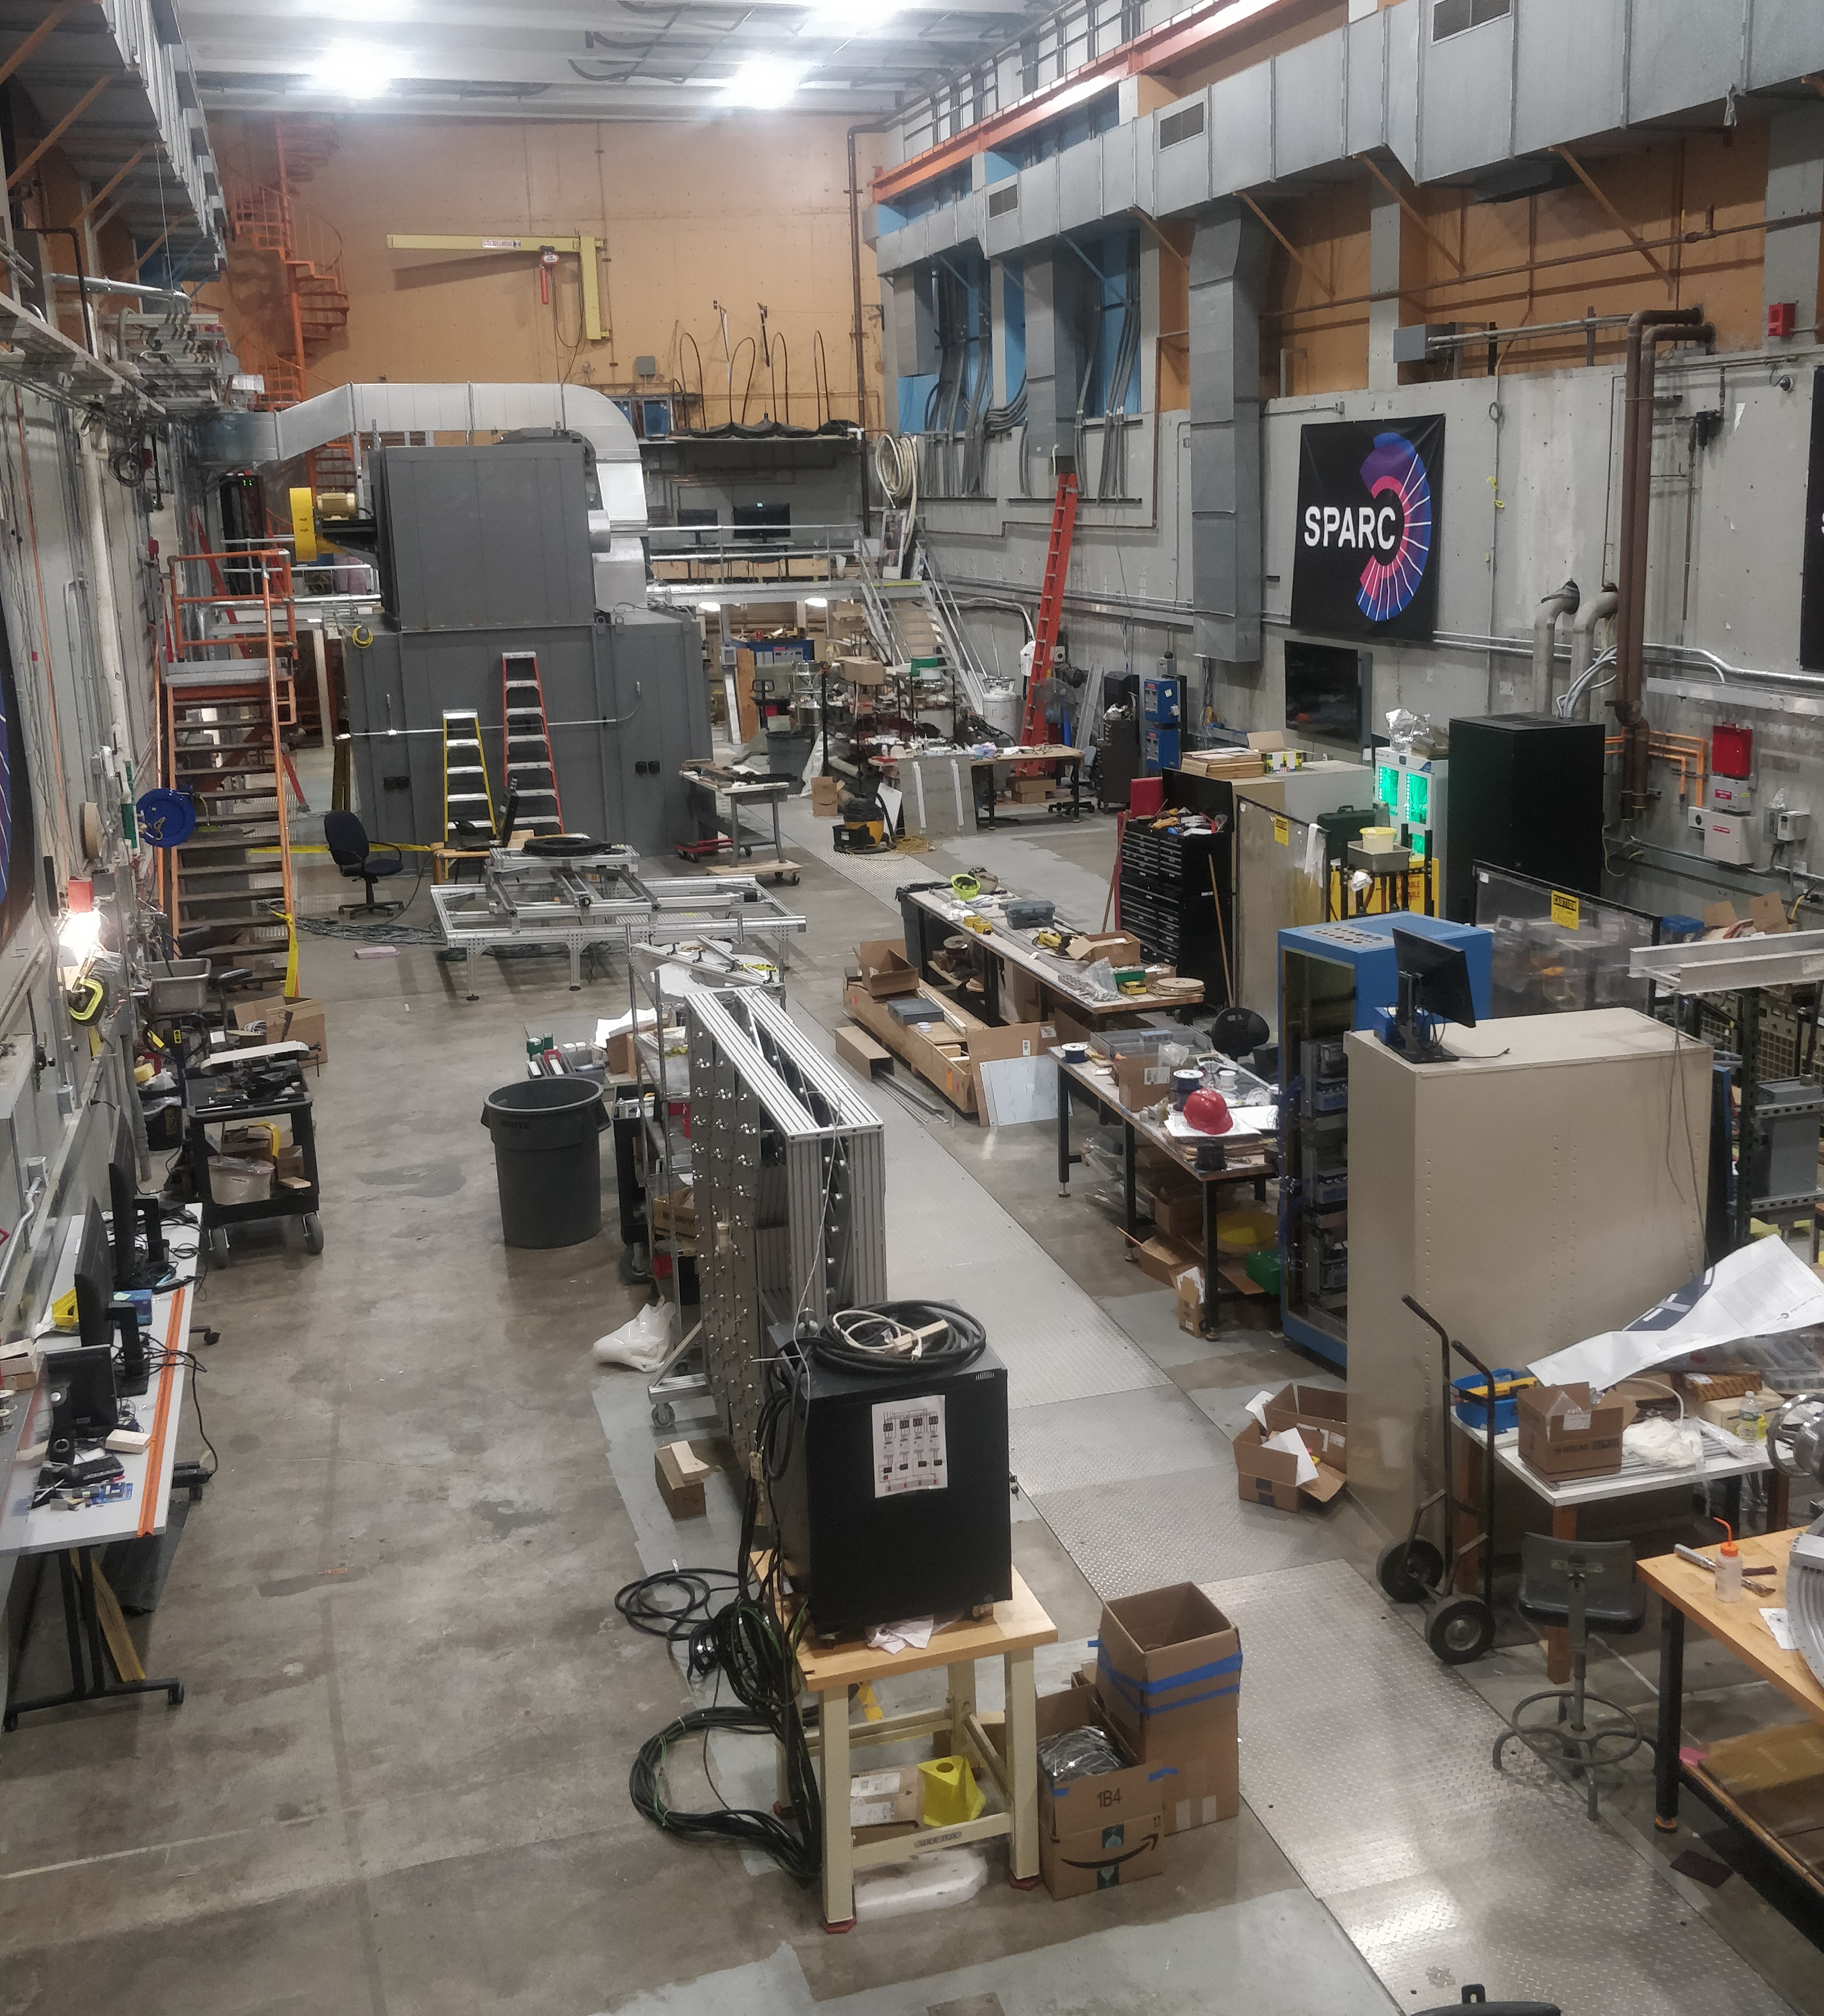
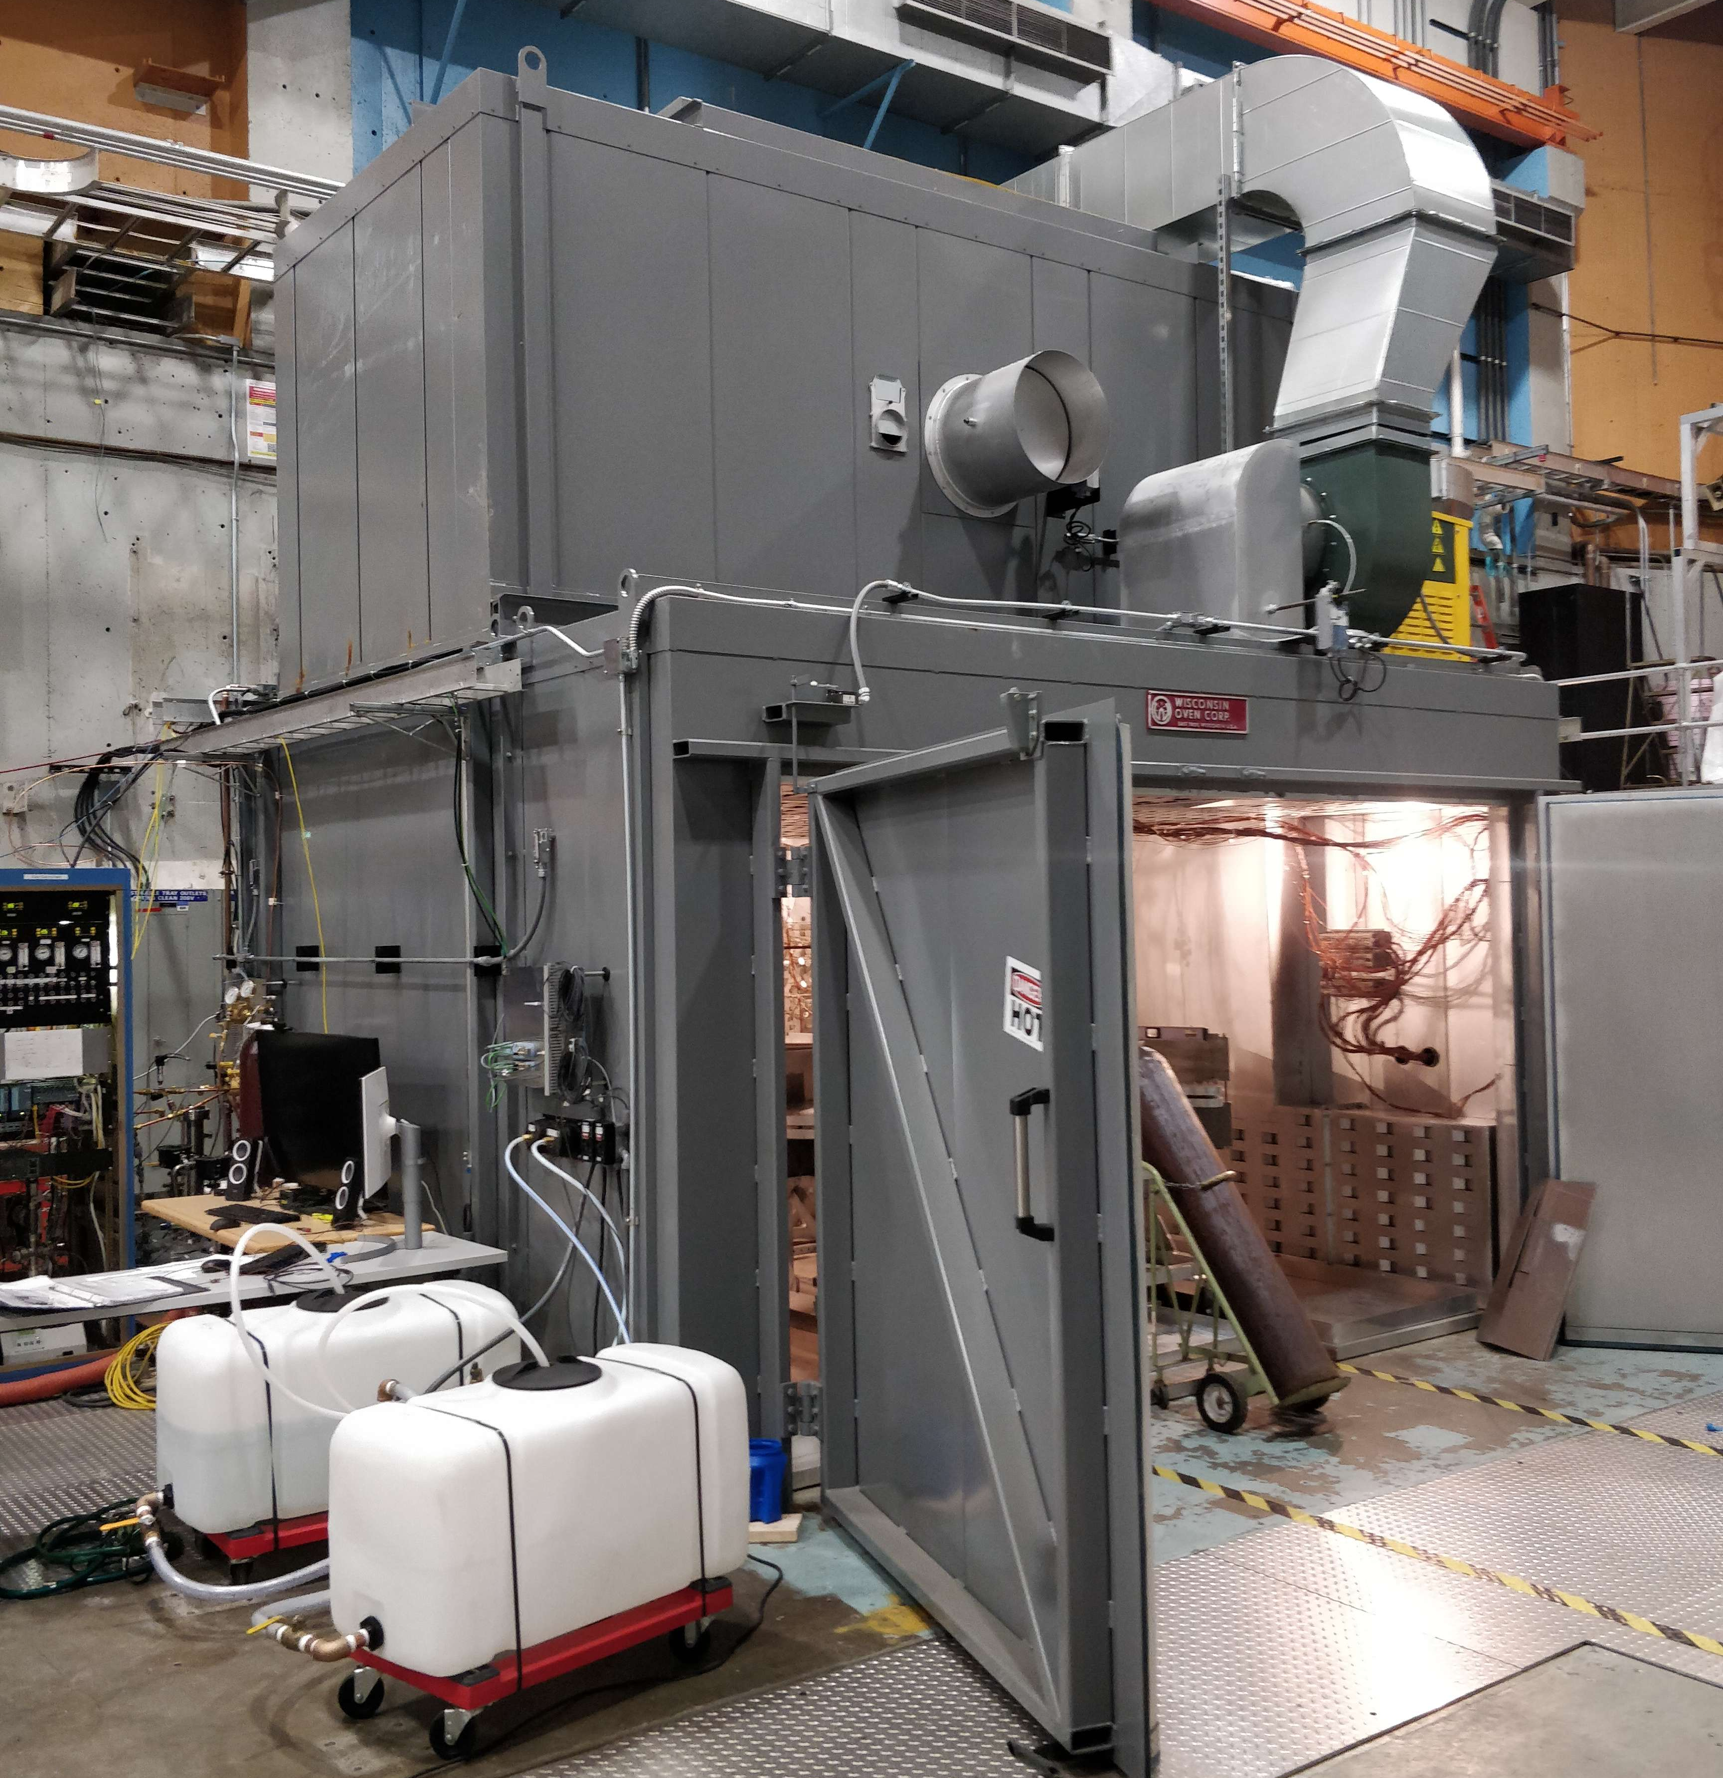
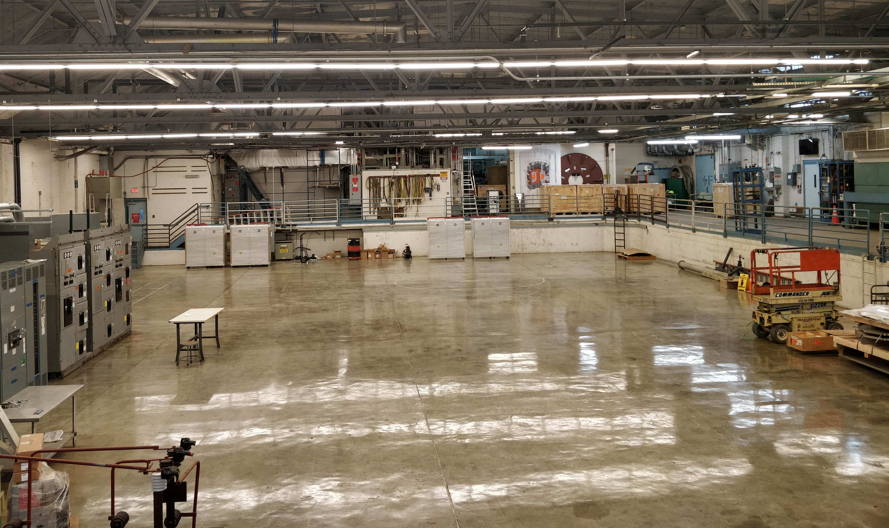
Retiring both technical and manufacturing risks
Developed manufacturing and test facilities
HTS tape supply scaled to sufficient levels to support SPARC construction
  HTS tape industry a factor of 4x, already at spec required for SPARC
  Multiple suppliers under contract and scaling factories another 4x, 100s of km
TFMC made with manufacturing techniques directly transferrable to the SPARC TF
  Supply chain and equipment carries over
  Unique tech transfer model
>100,000 sqft Magnet factory for all SPARC and other coils breaks ground in January ‘21
Magnet winding fabrication facility in operation.
20 K cryogenic
system (received)
50 kA power
supply
(1/2 received)
C-Mod Power room converted to magnet test hall.

Slide 8
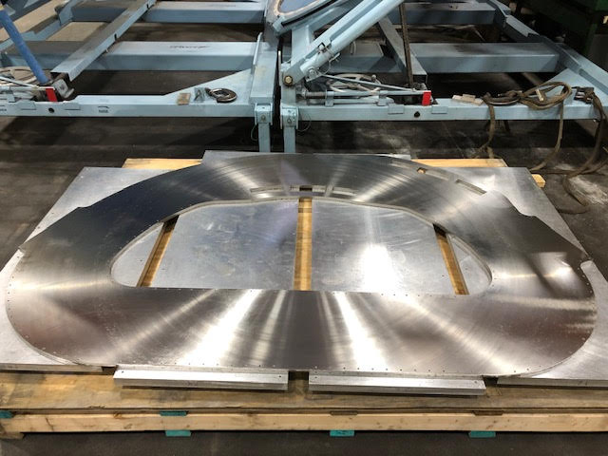
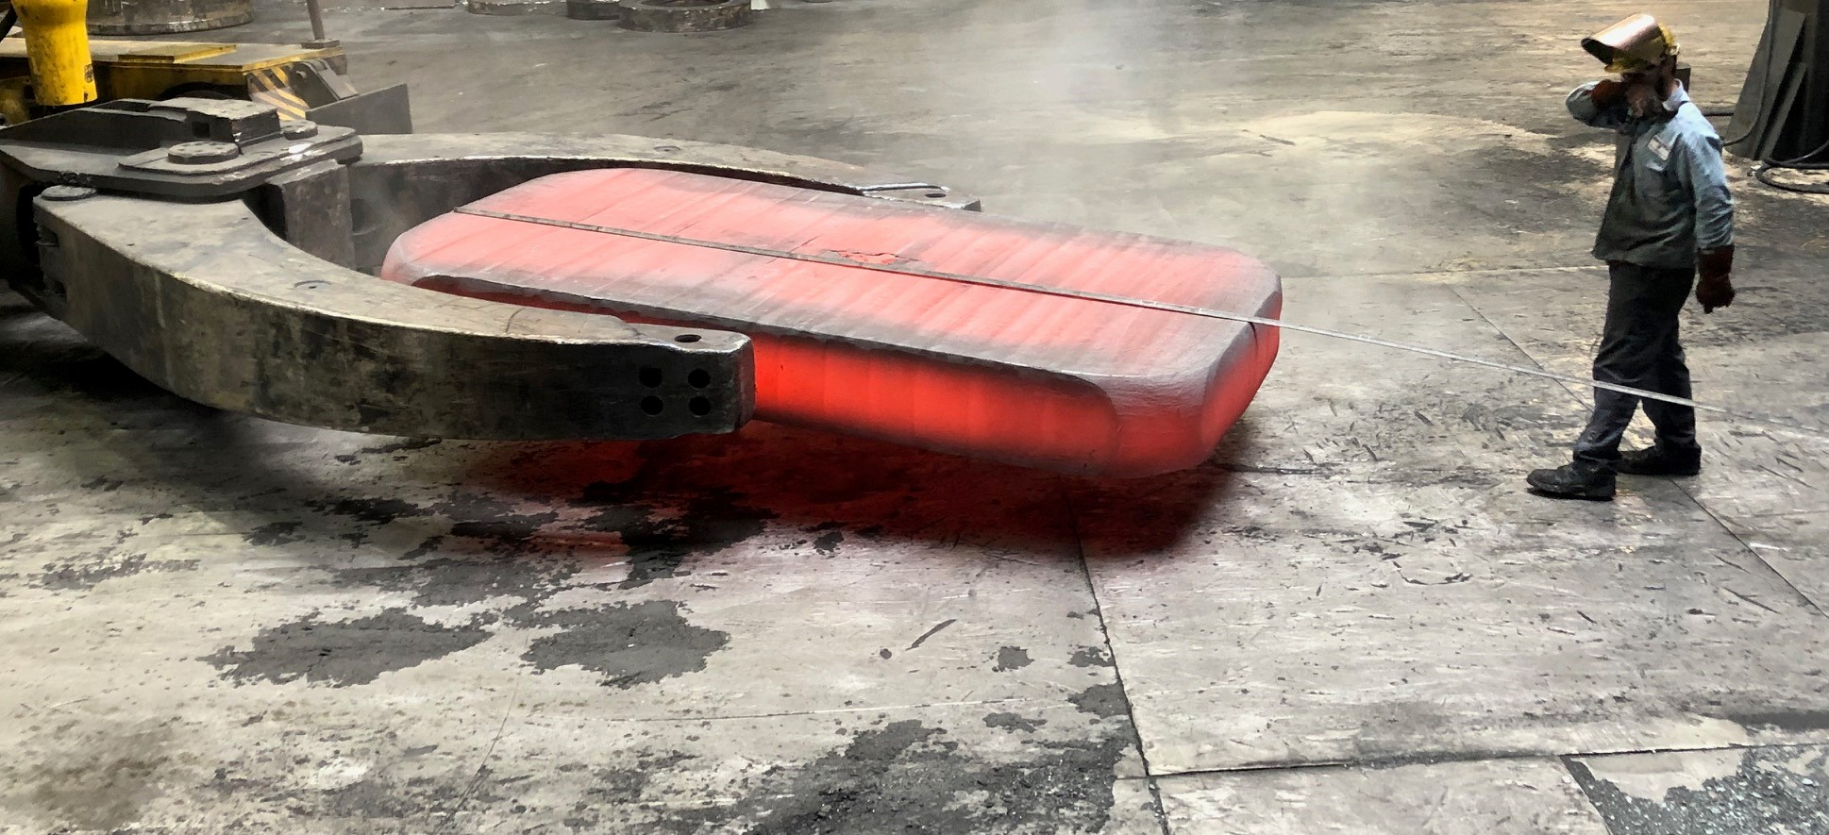
Now fabricating the full-scale model coil
Parameter | Value
Number of pancakes | 16
Total turns | 256
Operating temperature | 20 K
Operating current | 45 kA (max.)
Peak magnetic field | 20 T
Inductance | 0.14 H
Magnetic stored energy | 110 MJ
WP mass | 5100 kg
WP + case mass | 9300 kg
WP current density | 110 A/mm²
Model coil at fully representative of the SPARC coil operation
20T on coil, well beyond what LTS can do
Largest HTS magnet in the world by a factor of 100x
  >100MJ, >500km of HTS, >800MPa, >100A/mm^2, >3m size
On track for comprehensive tests Spring ‘21
SPARC design proceeding at risk assuming success in full scale coil
The first 9’ x 6’ TFMC radial
plate in-work.
Forging of the
structural case

Slide 9
Updates since FPA 2020
Self-consistent design now under formal change control, this is largely the machine we will build
SPARC Physics Basis published in JPP, 7 peer-reviewed papers validating SPARC performance projections
Team deep into conceptual design reviews of engineering systems
Engineering-based SPARC model, Trey Henderson, CFS

Slide 10
SPARC is very similar in size to many tokamaks, but at ITER-level performance
SPARC
ASDEX-U
KSTAR
DIII-D
EAST
Machine | R₀ [m] | a [m] | B₀ [T] | I_{p} [MA]
SPARC | 1.85 | 0.57 | 12.2 | 8.7
ASDEX-U | 1.65 | 0.50 | 3.9 | 1.6
KSTAR | 1.80 | 0.50 | 3.5 | 2.0
DIII-D | 1.66 | 0.67 | 2.2 | 2.0
EAST | 1.70 | 0.40 | 3.5 | 1.0
All devices approximately to scale

Slide 11
SPARC siting nearly complete
Within commuting distance of Boston
Wrapping up due diligence, licensing, and permitting processes; will announce location when complete
Have agreement from NRC on process for materials license
Have tritium source secured
Similar in size to PPPL
Scheduled to break ground in early 2021 and have first people moved-in in early 2022
Architect’s rendering of SPARC Facility, Ken Filar, HDR

Slide 12
SPARC provides burning plasma & divertor physics
SPARC physics mission (promised externally) is Q>2
  A low performance H-mode or high-performance L-mode
Under ITER physics rules (H=1, n_{G}<1) SPARC can obtain Q~11 enabling exploration of burning plasmas
SPARC has ARC-matched divertor physics and can explore high power density divertor plasma solutions at absolute parameters
  Without requiring active cooling of components
  Long leg divertor solutions including X-point target
Access transients at compact power plant conditions
  ELMs and disruptions at timescales and forces relevant to Pilot, NTUF
SPARC can provide learning for ITER in key areas in a domestic machine
SPARC will provide learnings for compact pilot plant in a commercially-minded organization
ARC
SPARC

Slide 13
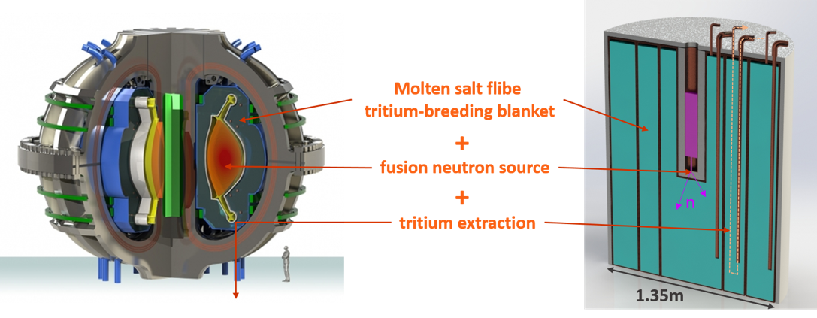
Part of a comprehensive plan to accelerate fusion
ARC is the high-field approach’s fusion pilot plant informed by customers
  Net electric at >200MWe
  Close the fuel cycle
  Establish the supply chains
  Demonstrate operability, regulatory, acceptance
  Path towards economics
Work ramping up in parallel to SPARC
  SO-G: Demountable joints at scale, Replaceable
  vacuum vessel, balance of plant, licensing framework
  SO-B: Materials under irradiation
  SO-C: Liquid immersion blanket
BABY Liquid Immersion Blanket

Slide 14
Thank you.

Slide 15
SPARC Physics Basis peer reviewed
Overview of the SPARC tokamak, A.J. Creely et al,
J. Plasma Phys. 86 (5), 865860502 (2020). http://doi.org/10.1017/S0022377820001257
Predictions of core plasma performance for the SPARC tokamak, P. Rodriguez-Fernandez et al,
J. Plasma Phys. 86 (5), 865860503 (2020). https://doi.org/10.1017/S0022377820001075
Projections of H-mode access and edge pedestal in the SPARC tokamak, J.W. Hughes et al,
J. Plasma Phys. 86 (5), 865860504 (2020). https://doi.org/10.1017/S0022377820001300
Divertor heat flux challenge and mitigation in SPARC, A.Q. Kuang et al,
J. Plasma Phys. 86 (5), 865860505 (2020). https://doi.org/10.1017/S0022377820001117
Physics basis for the ICRF system of the SPARC tokamak, Y. Lin et al,
J. Plasma Phys. 86 (5), 865860506 (2020). https://doi.org/10.1017/S0022377820001269
MHD stability and disruptions in the SPARC tokamak, R. Sweeney et al,
J. Plasma Phys. 86 (5), 865860507 (2020). https://doi.org/10.1017/S0022377820001129
Fast-ion physics in SPARC, S.D. Scott et al,
J. Plasma Phys. 86 (5), 865860508 (2020). https://doi.org/10.1017/S0022377820001087

