Slide 1
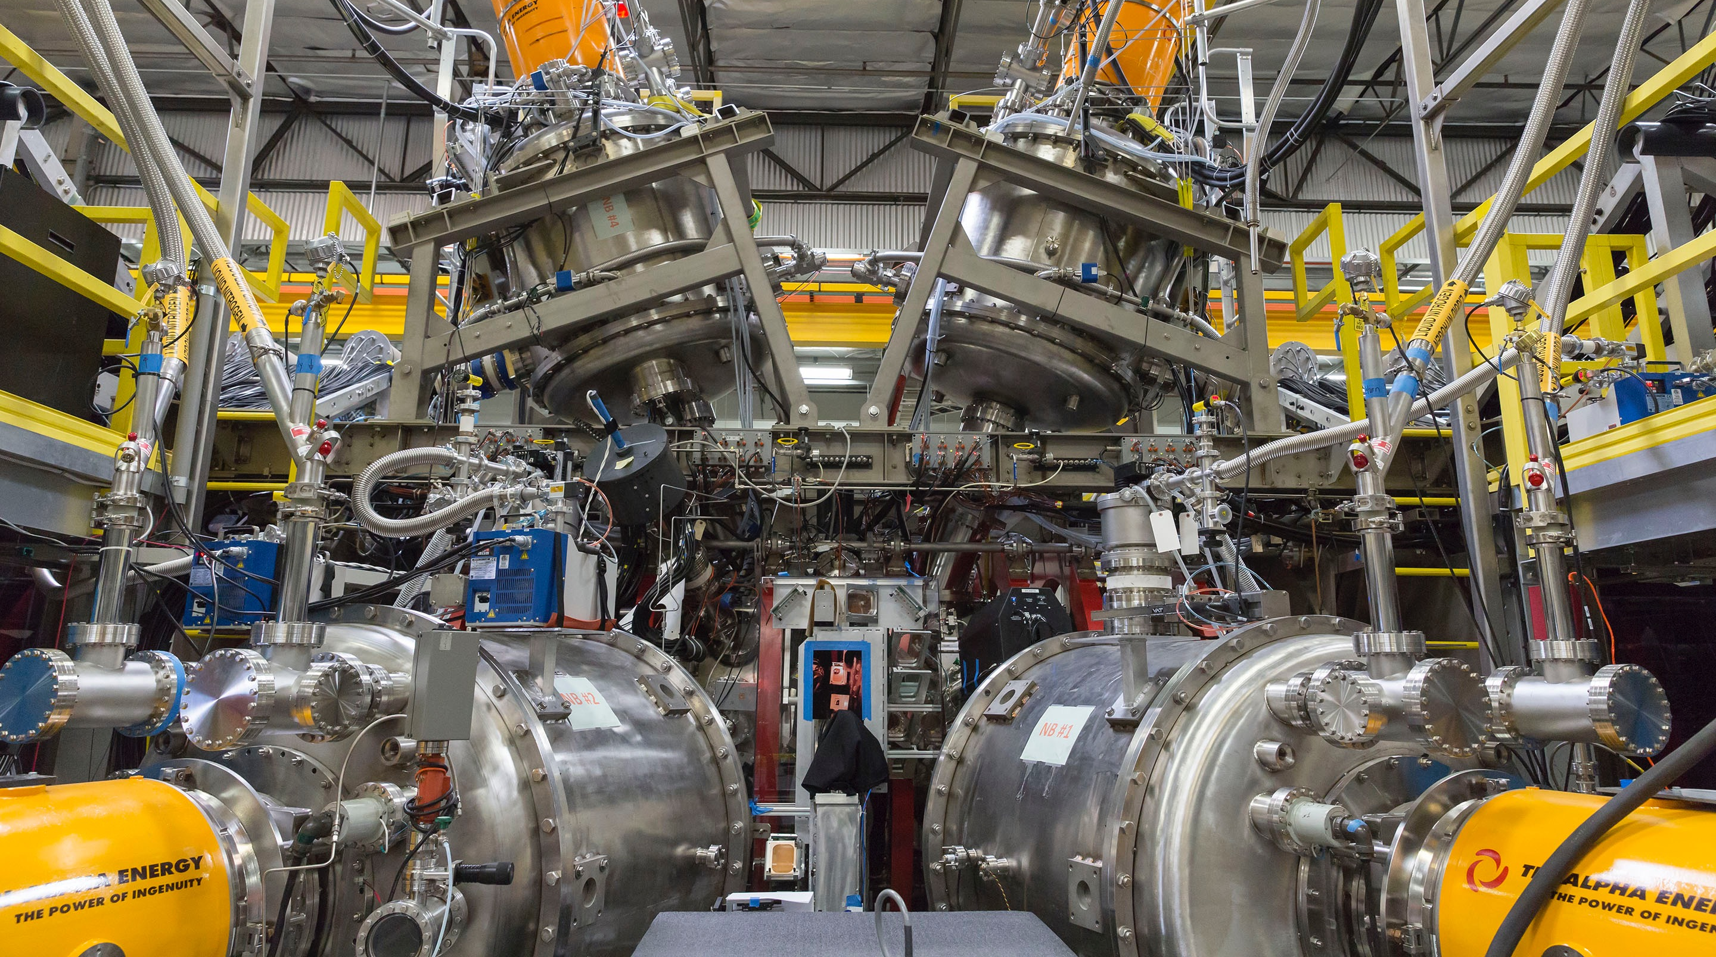
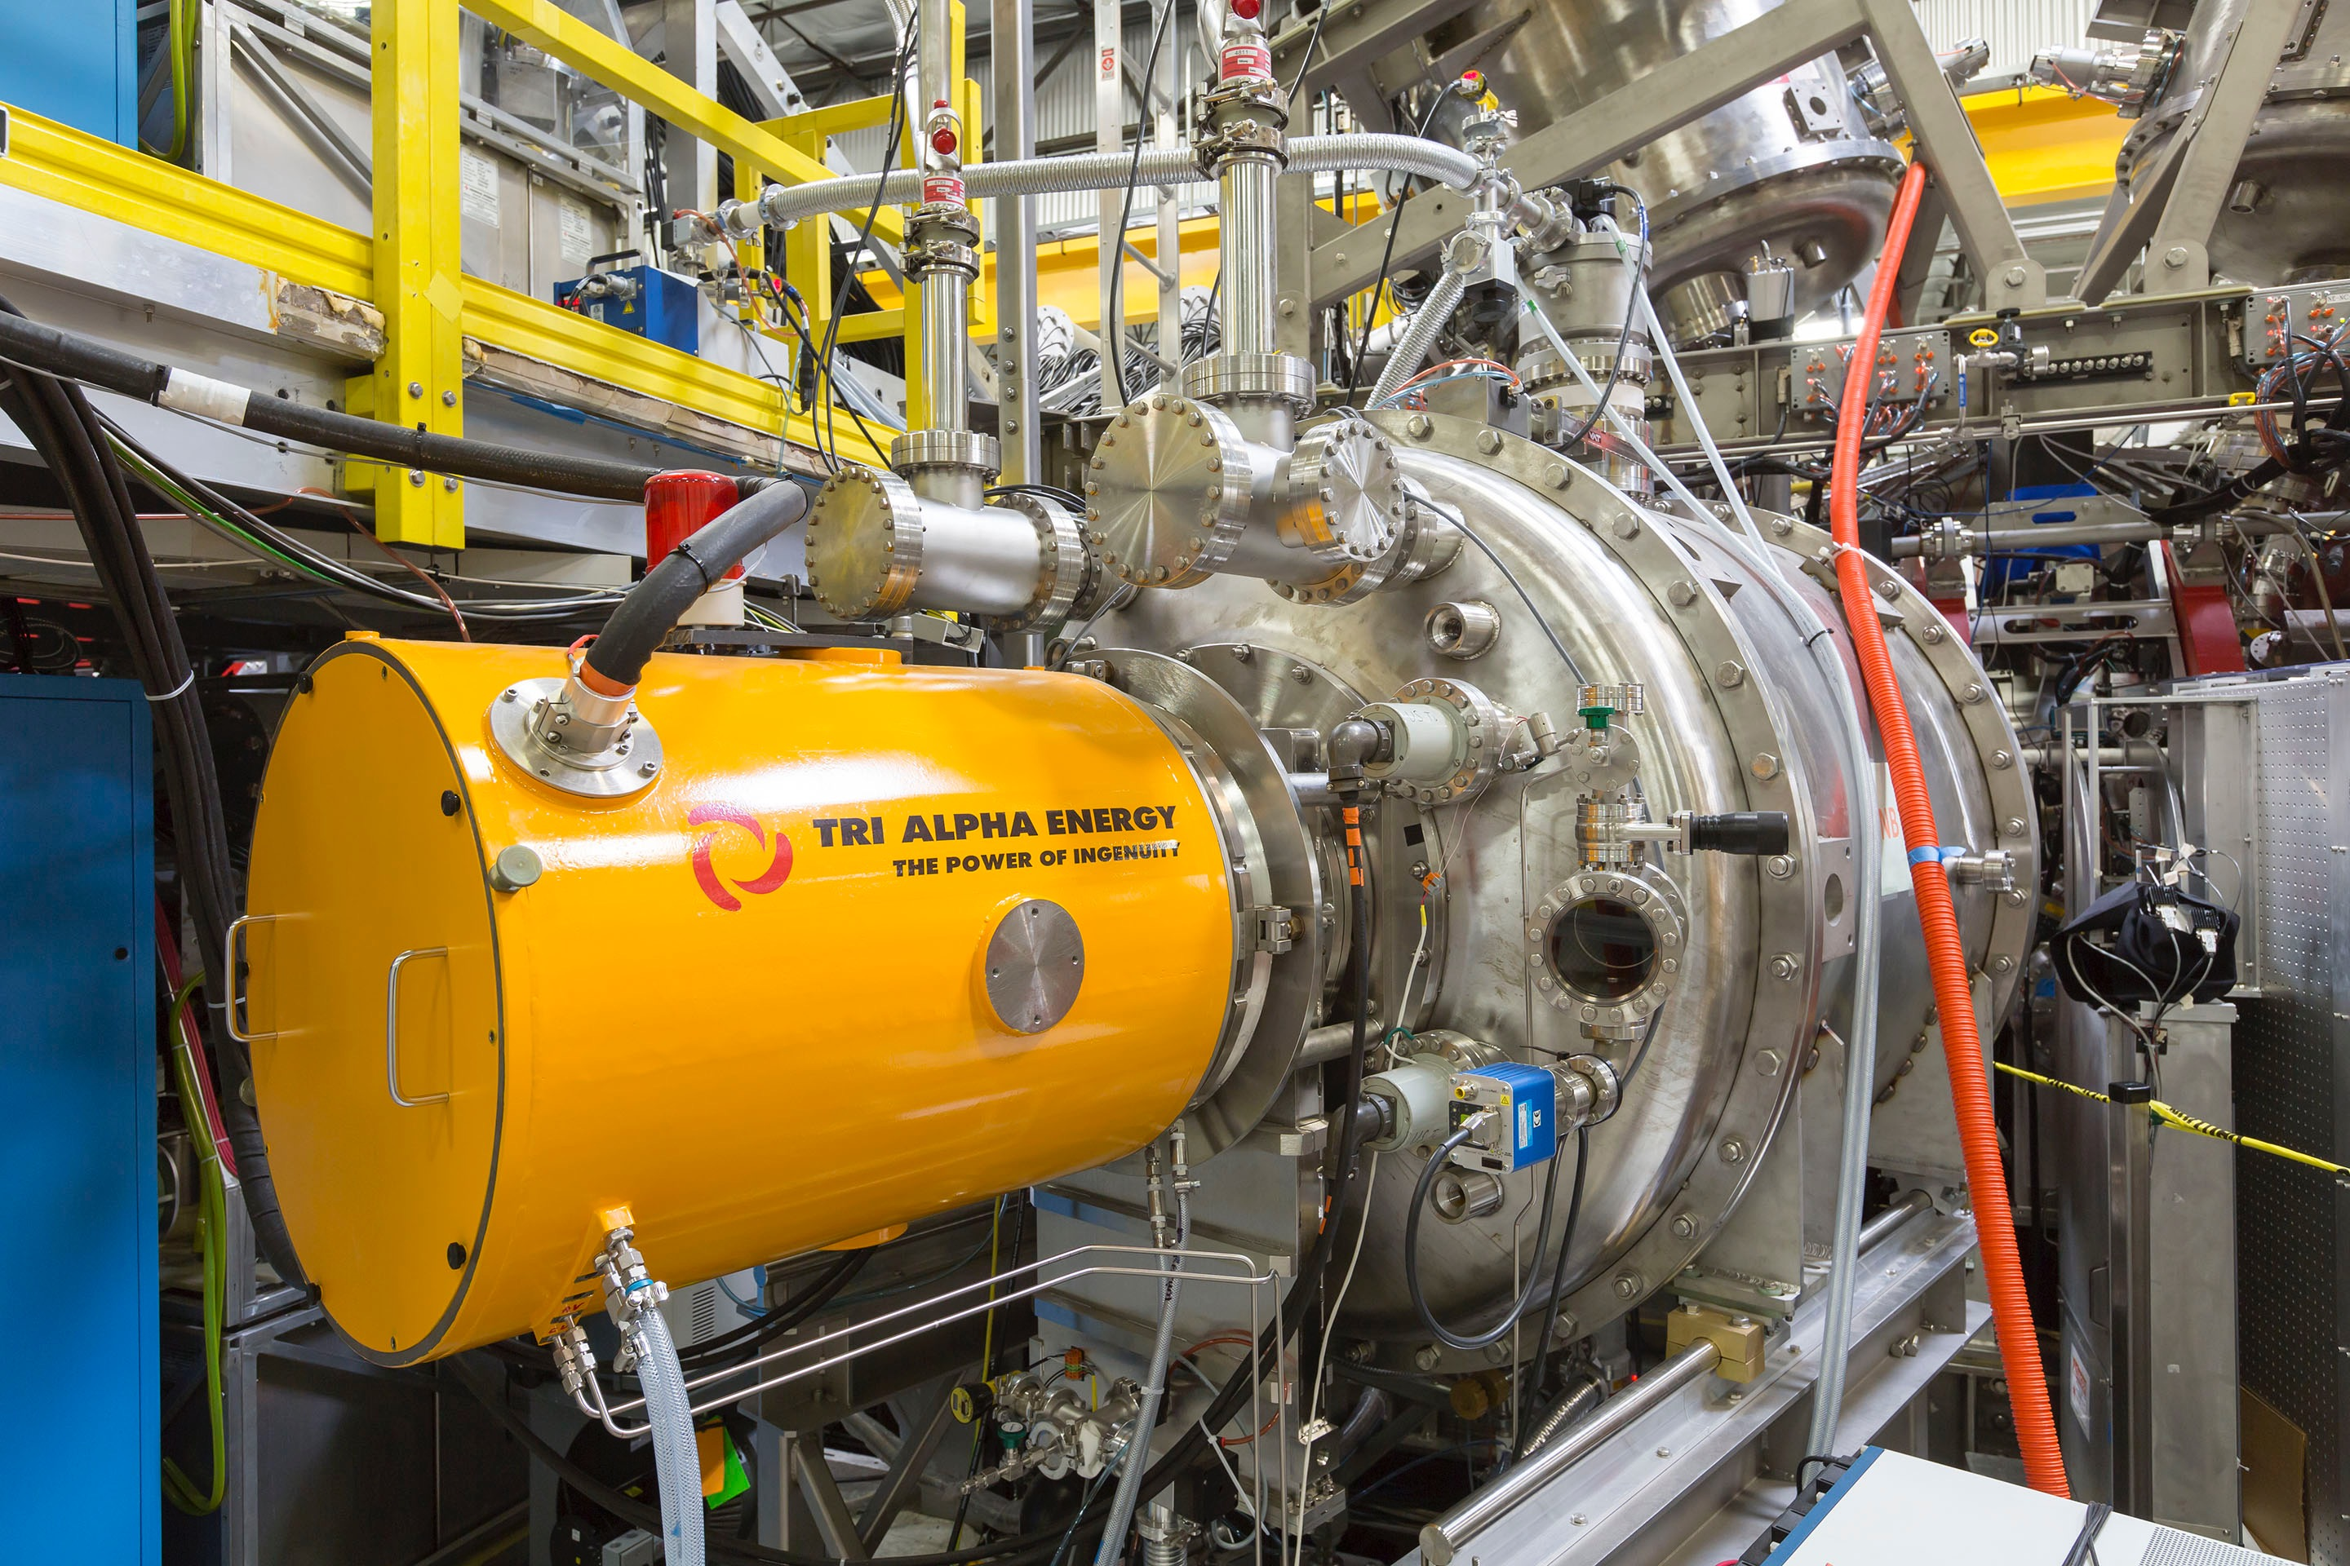
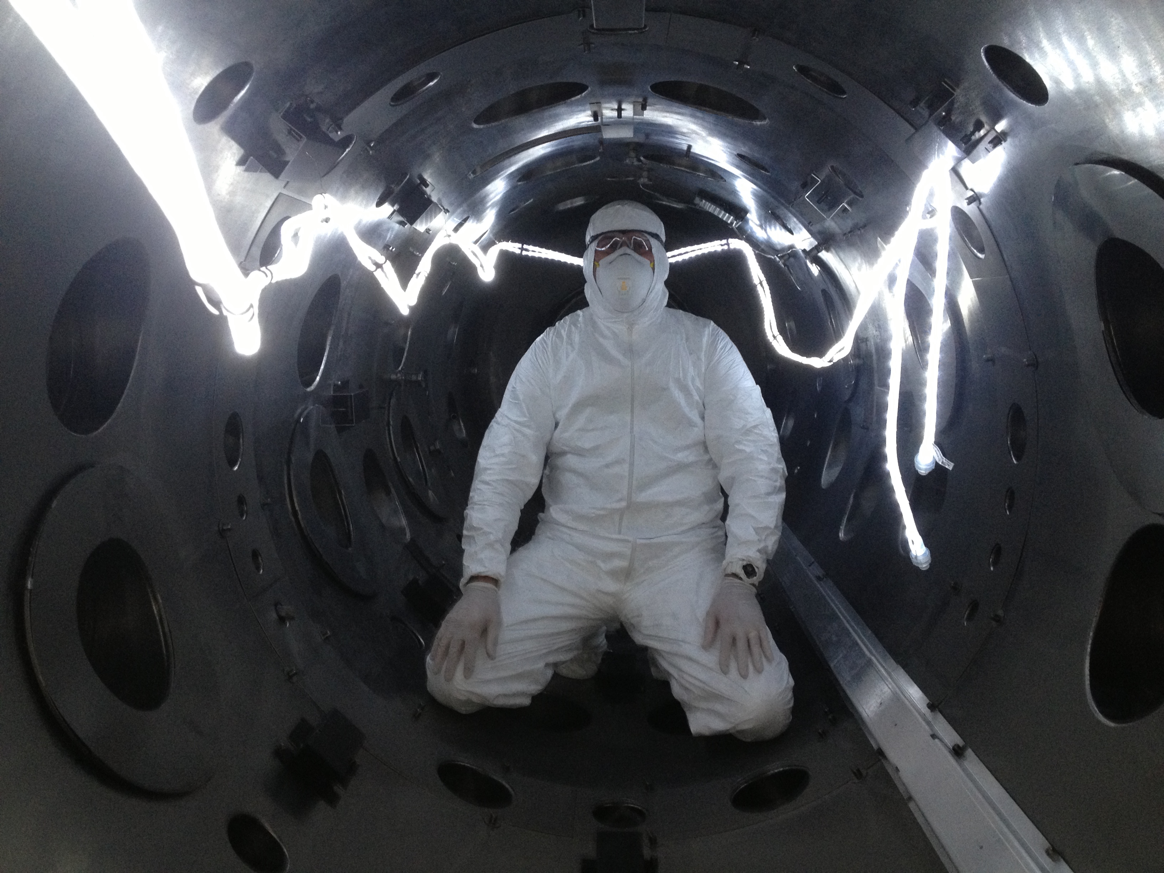
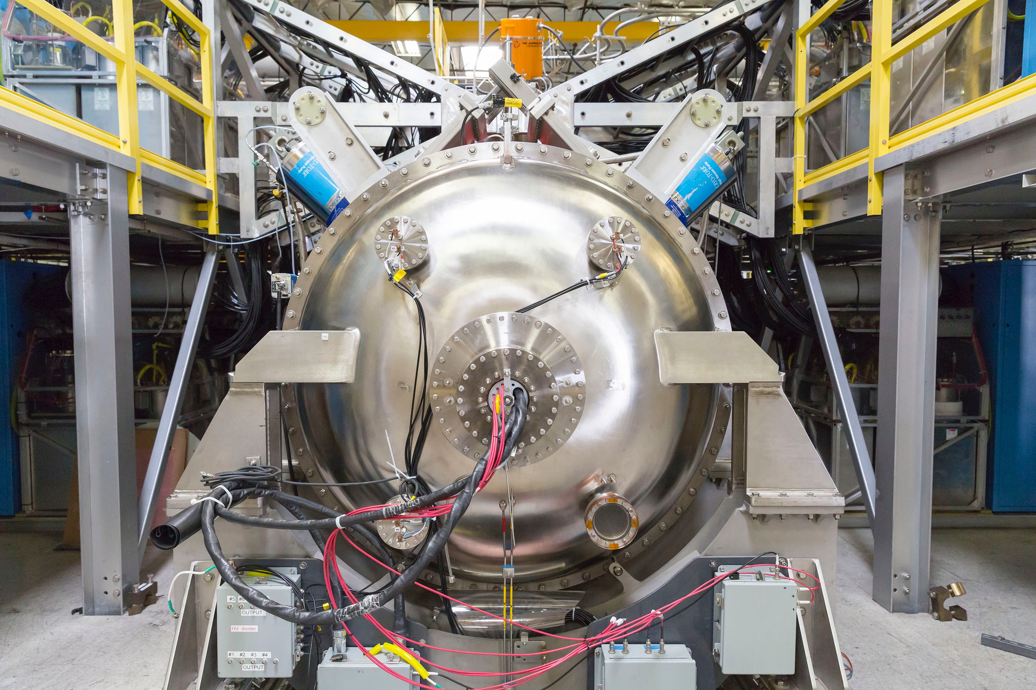
Progress at Tri Alpha Energy
Michl Binderbauer
Tri Alpha Energy
Fusion Power Associates 37th Annual Meeting – Washington, DC
December 13-14, 2016

Slide 2
2016 at Tri Alpha Energy (TAE)
Year of change
Finished last campaign of C-2U in April
Dismantled C-2U in May
On schedule with construction of new C-2W installation
1st plasma on C-2W by early Summer 2017
Launched efforts to commercialize spin-off technologies
Good progress simulation progress – first principle turbulence modeling, transport simulations, divertor modeling
Plans under way to develop community wide whole device modeling of compact tori

Slide 3
Agenda
  Introduction
    Concept and recent efforts
  C-2/C-2U Project Summary
    Results & achievements
  C-2W Project Preview
    Goals
    Construction progress
    Schedule
  Miscellaneous Initiatives
    Technology spin-offs – BNCT, non-destructive testing
    Whole device modeling

Slide 4
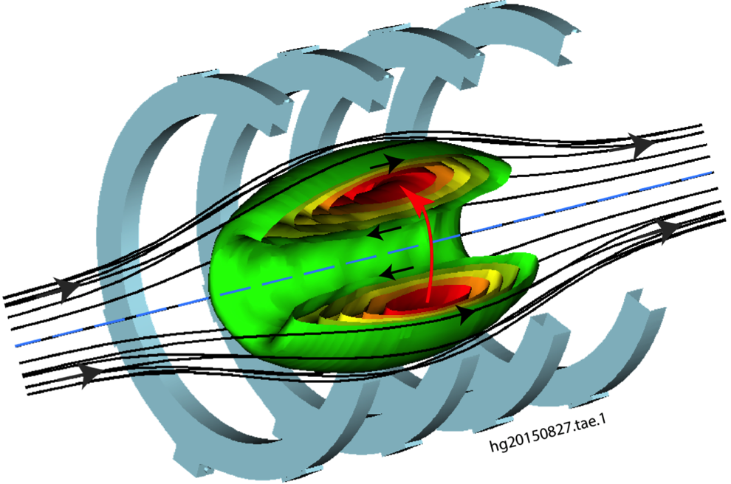
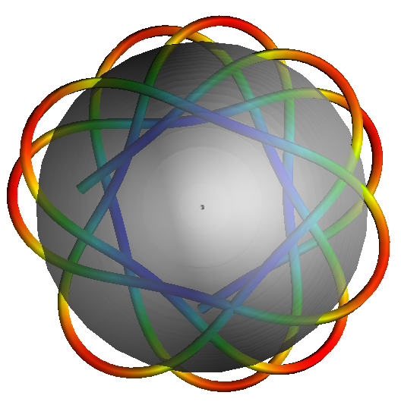
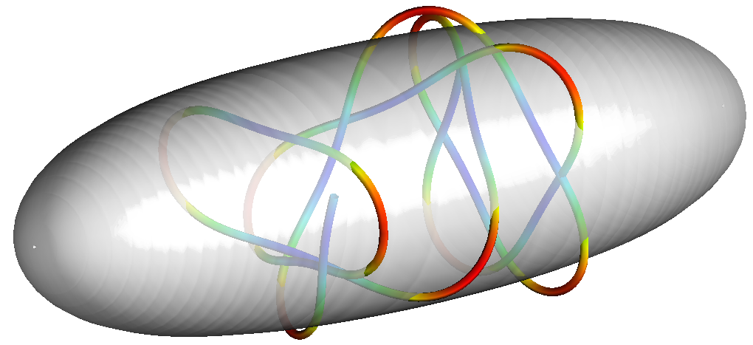
TAE Concept
Advanced beam driven FRCs offer reactor advantages
    High plasma β~1
      compact and high power density
      aneutronic fuel capability
      indigenous large orbit particles
    Tangential beam injection
      large orbit ion population
      better stability and confinement
    Simple geometry
      only diamagnetic currents
      easier design & maintenance
    Linear unrestricted divertor
      facilitates impurity, ash and power removal

Slide 5
TAE’s Efforts to Now
Explore beam driven FRC physics
Test for failure early and at reduced cost while reducing most critical risks
Establish beam driven high-β, large orbit FRC physics test bed to
  provide fast learning cycles and large experimental dataset (~50,000 shots)
  demonstrate sustainment via neutral beam injection (NBI) for >5 ms (longer than critical timescales) with high repeatability
  study tangential NBI and fast particle effects on stability and transport
  measure scaling and study fluctuations and transport
Provide opportunity to
  tightly integrate theory/modeling with experimentation
  develop engineering knowhow and integration
Invite collaboration to accelerate progress
  Budker Institute, PPPL, UCI, UCLA, LLNL, Univ. of Pisa, Univ. of Wisconsin, Nihon Univ., Univ. of Washington, Industrial partners

Slide 6
Agenda
  Introduction
    Concept and recent efforts
  C-2/C-2U Project Summary
    Results & achievements
  C-2W Project Preview
    Goals
    Construction progress
    Schedule
  Miscellaneous Initiatives
    Technology spin-offs – BNCT, non-destructive testing
    Whole device modeling

Slide 7
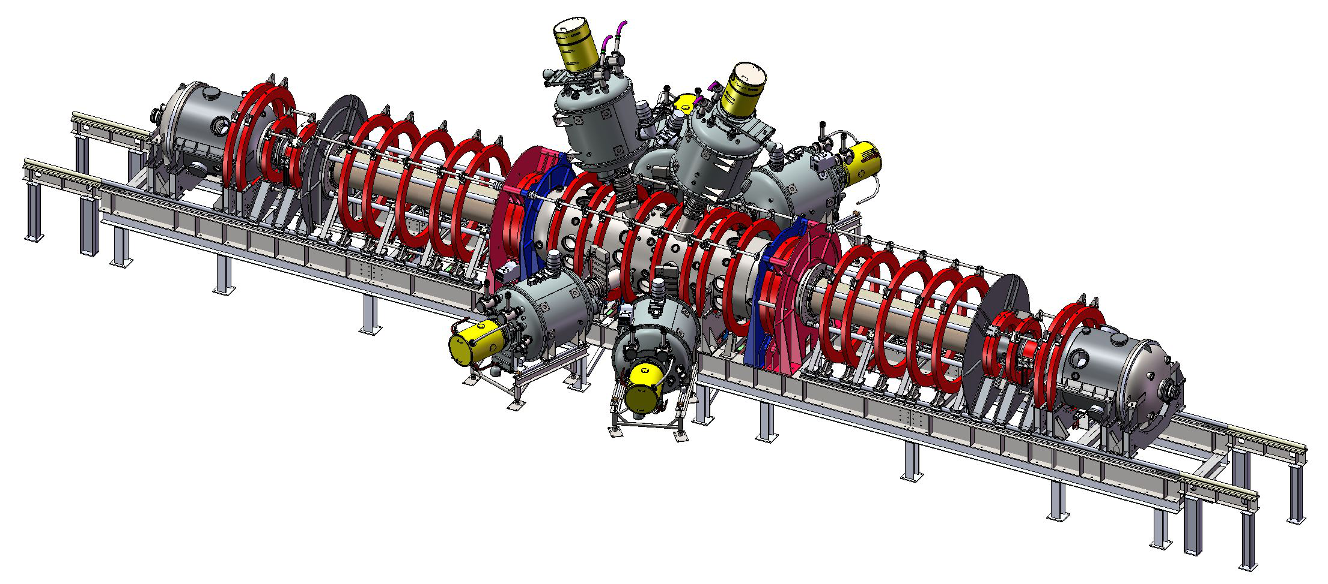
C-2U Research Facility (4th Generation Device)
Hybrid FRC/Mirror Machine
Neutral Beam
Injectors
Mirror plugs
Parameter | Value
B_{ext} , kG | ~ 1
R_{s}, cm | ~ 35
L, m | 2 – 3
P_{NB}, MW | 10
E_{NB}, keV | 15
N_{e}, cm⁻³ | ~ 3×10¹³
T_{i} , eV | 500 – 800
T_{e}, eV | 100 – 150
Wall gettering | Ti or Li
Z_{eff} | < 1.3
Mirror coils
Start-up
coils
Divertor
Plasma guns and biasing electrodes (in divertors)
Central chamber
External field
coils
Plasma formation
sections

Slide 8
C-2/C-2U Summary Performance
Major Program Accomplishments
Discovered High Performance FRC (HPF) Regime – substantial reduction in transport losses up to factor > 10
Perfected edge control and plasma stabilization, achieved stable discharges with diamagnetic lifetimes > 10 ms
Mastered NBI, established fast ion benefits and beam driven state
Demonstrated current drive and FRC sustainment via NBI for 5+ ms, only limited by hardware and stored energy constraints

Slide 9
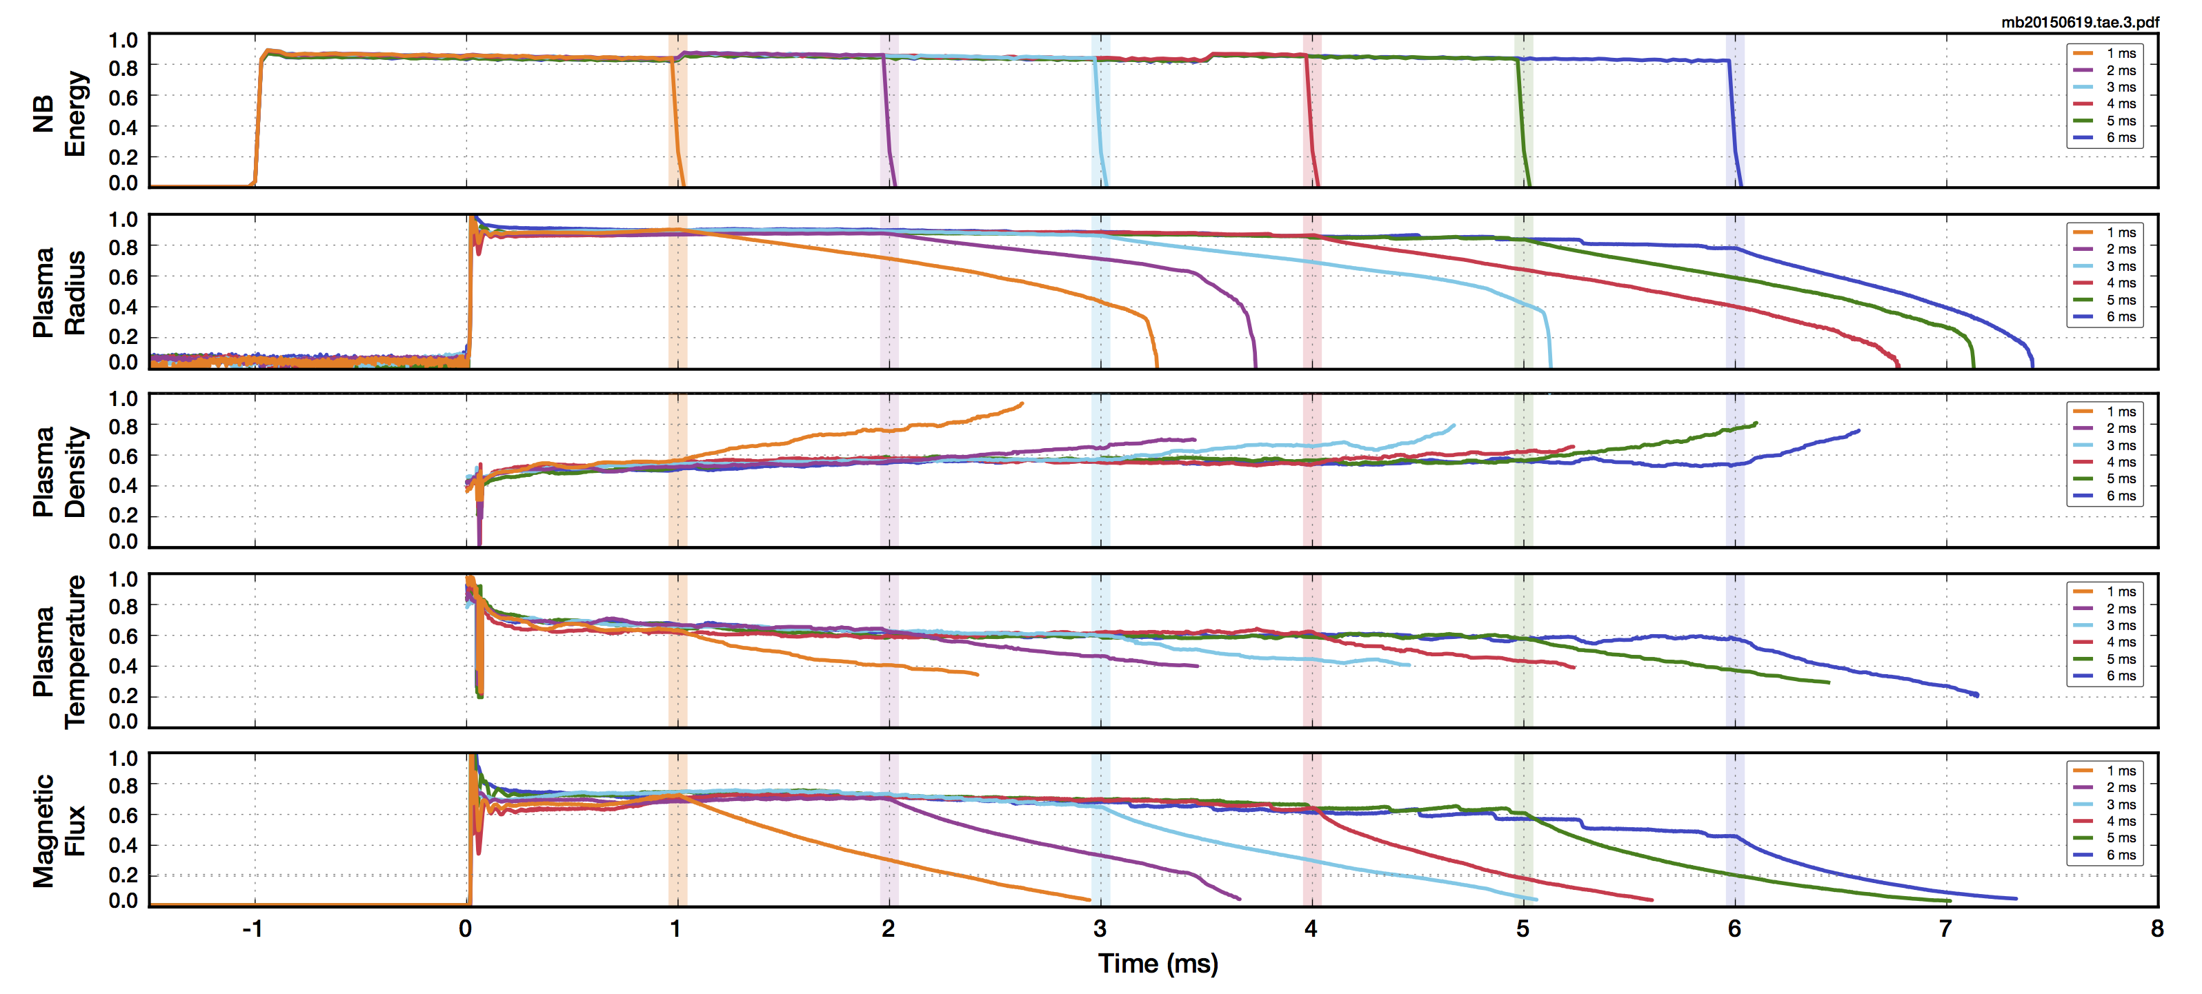
C-2U Sustainment Experiments
Correlation between beam drive and plasma characteristics
* all quantities normalized
  pulse length limited by hardware and stored supply energy (biasing, beams)
  flux maintained (up to 5-5.5 ms) – showcases ability to drive current by beams

Slide 10
Agenda
  Introduction
    Concept and recent efforts
  C-2/C-2U Project Summary
    Results & achievements
  C-2W Project Preview
    Goals
    Construction progress
    Schedule
  Miscellaneous Initiatives
    Technology spin-offs – BNCT, non-destructive testing
    Whole device modeling

Slide 11
C-2W Goals
Explore beam driven FRCs at 10x stored energy
Principal physics focus in C-2W is to study
  scrape off layer and divertor behavior
  ramp-up characteristics
  transport regimes
Specific programmatic goals
  demonstrate ramp-up and sustainment for times well in excess of characteristic confinement and wall times
  explore energy confinement scaling over a broad range of plasma parameters
                core and edge confinement scaling and coupling
      consolidated picture between theory and experiment
  operational goal to develop and demonstrate first order active plasma control

Slide 12
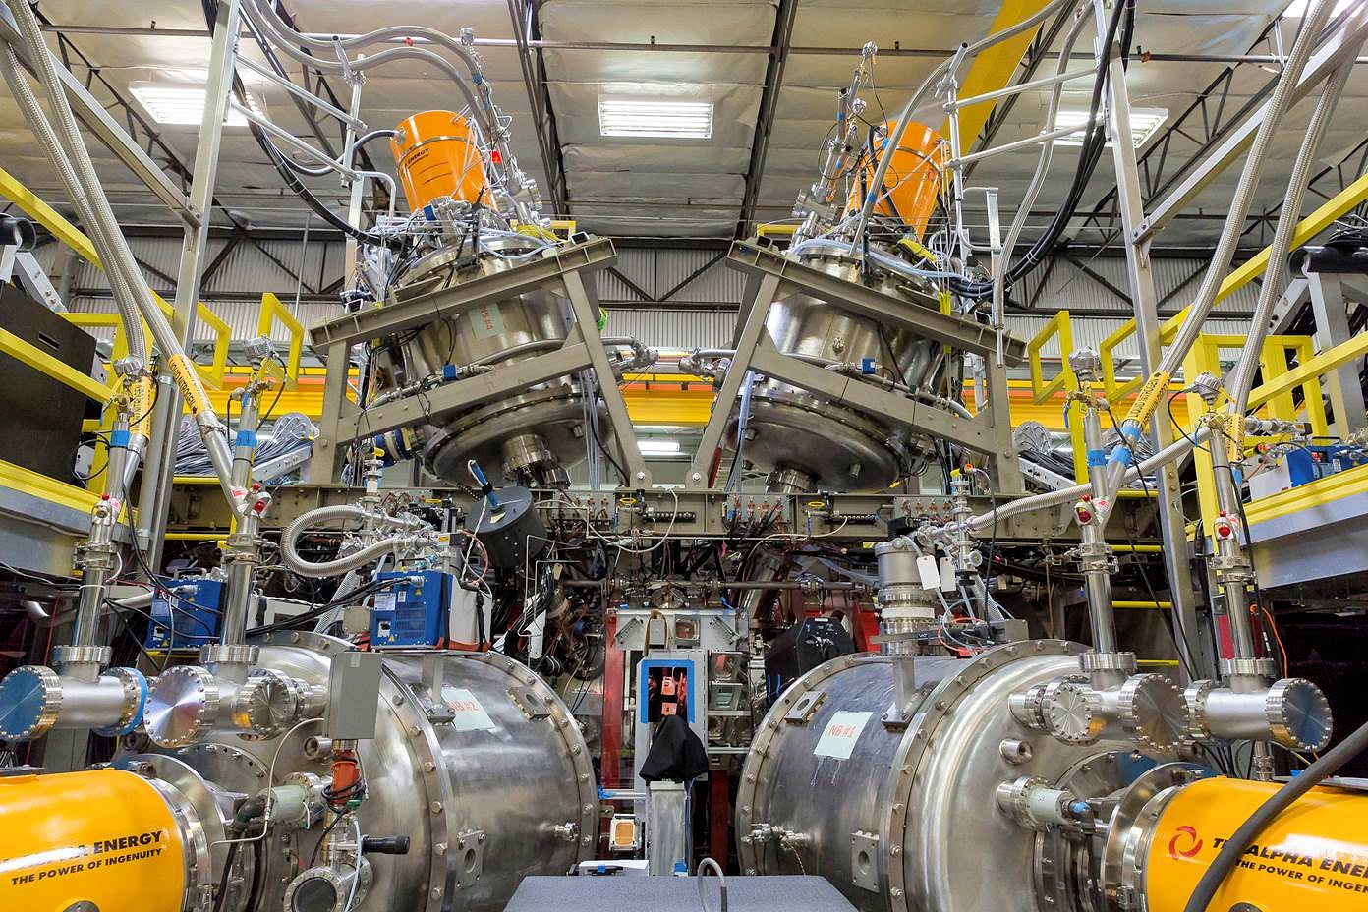
C-2U Operations completed April 2016

Slide 13
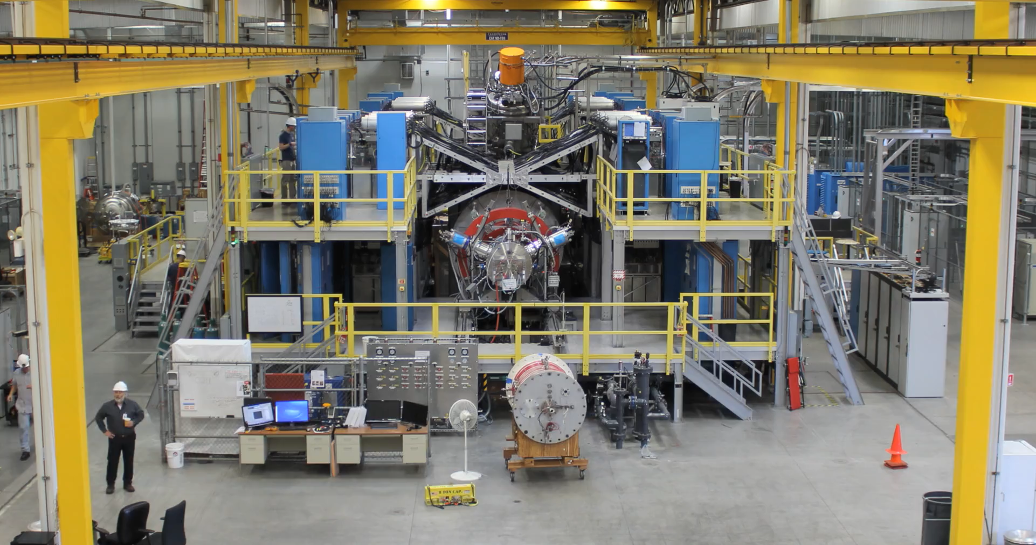
C-2U Dismantlement Time-Lapse
30 days to take “7 years” apart …

Slide 14
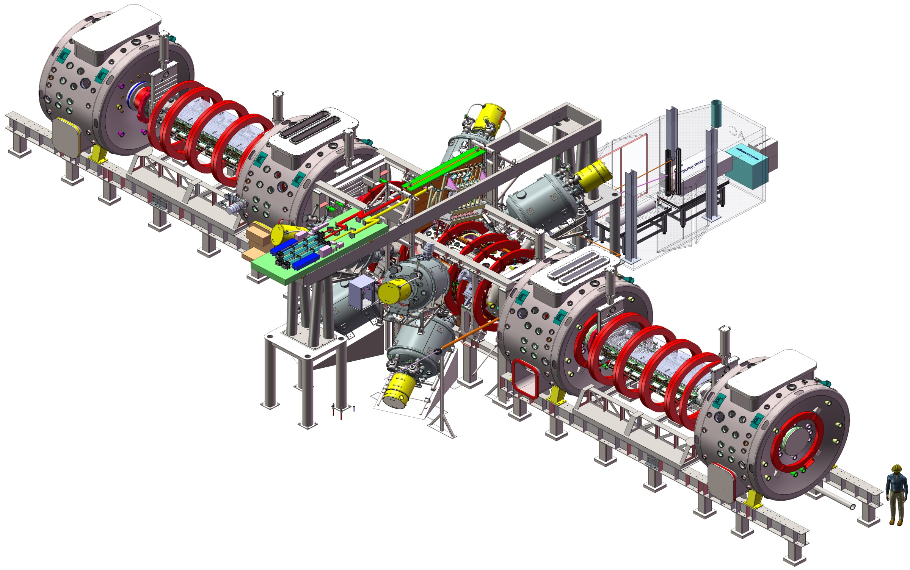
C-2W Under Construction
10x stored energy
C-2W commissioning
May
Upgraded NB’s
Phase 1: 13 MW, 30 ms
Phase 2: 21 MW, 30 ms
Upgraded formation,
15 mWb trapped flux
2017
C-2W construction
Inner divertor
April
Last shot on C-2U
2016
C-2U campaign
End divertor
June
5+ ms sustainment
Plasma-guns and biasing electrodes
(In both inner and end divertors)
March
1st shot on C-2U
2015
C-2U construction
New confinement vessel, skin
time < 3 ms
New magnet
system for field
ramp & active control
August
Last shot on C-2
  worldwide sourcing and procurement effort
2014
14
14

Slide 15
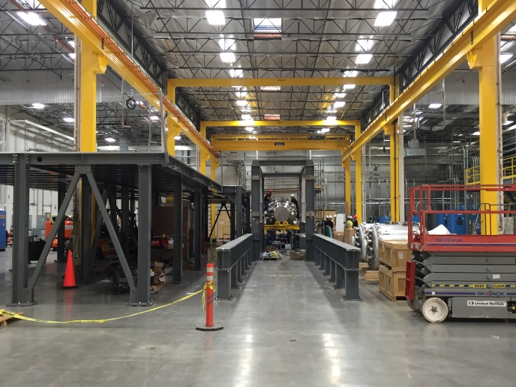
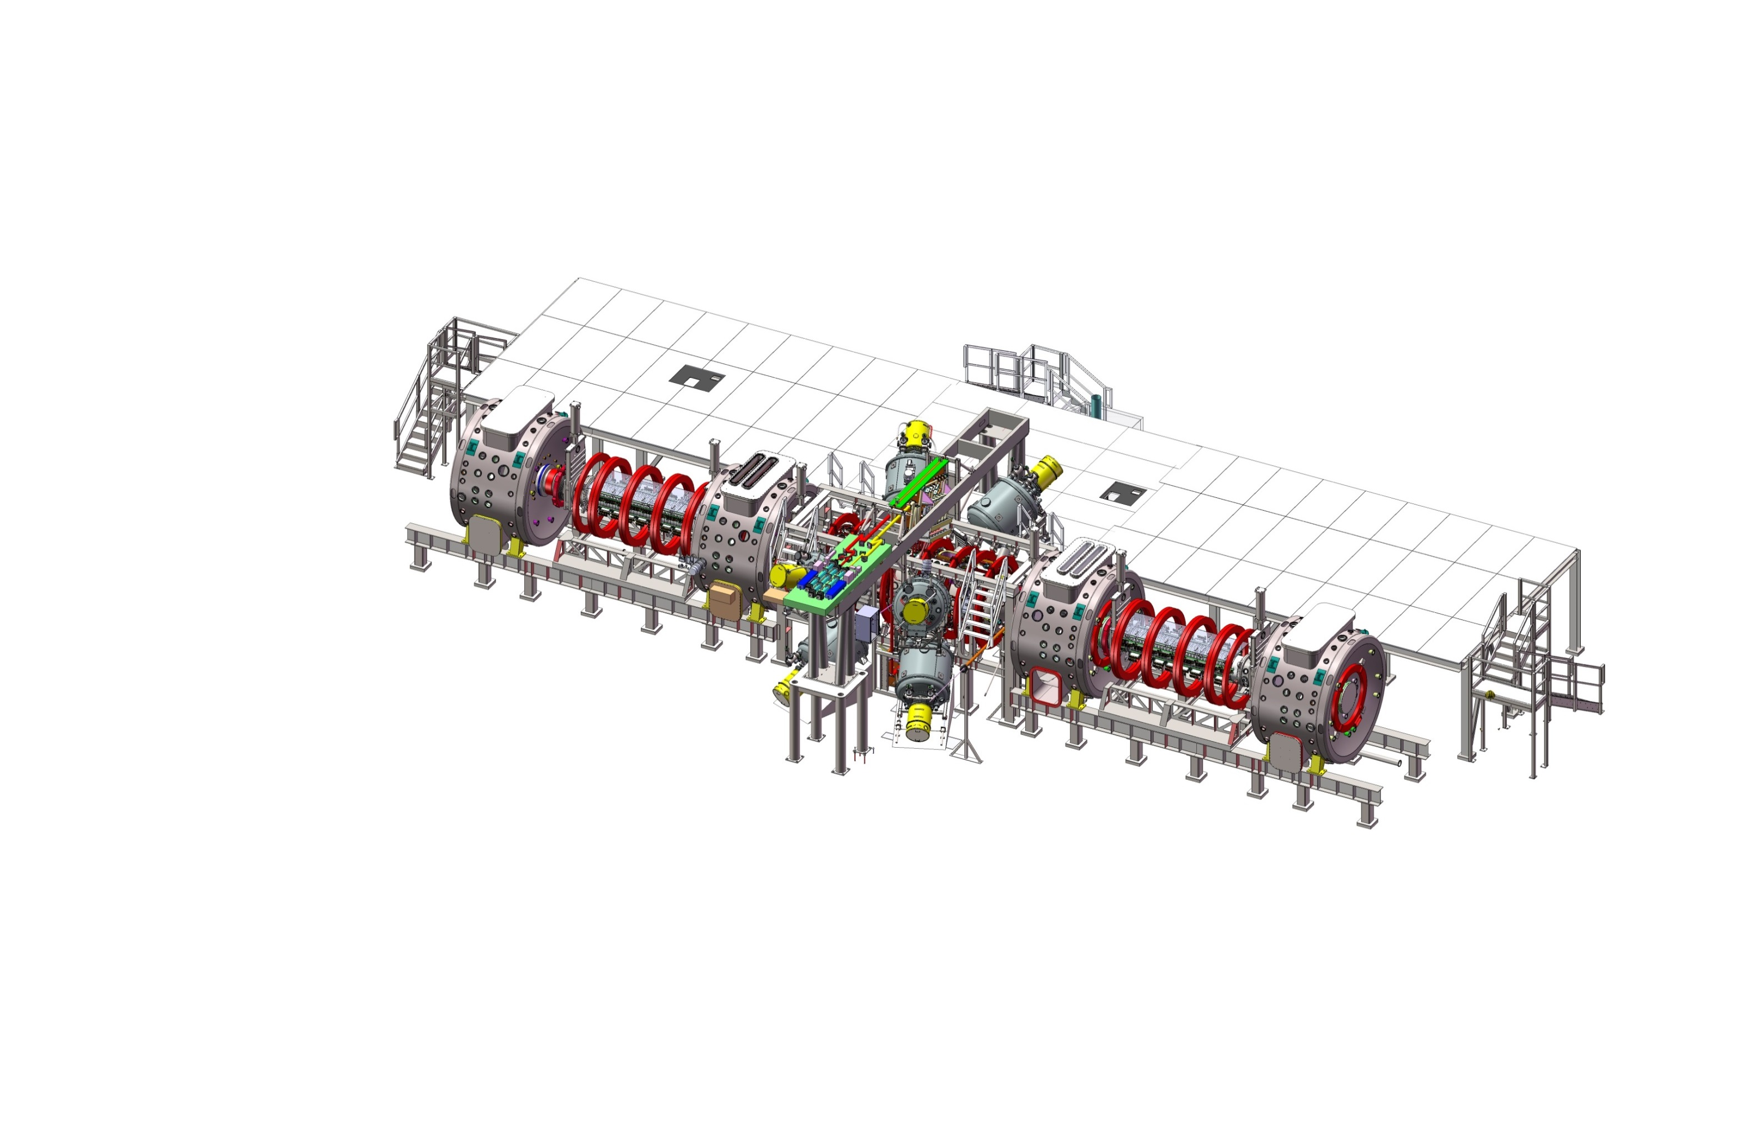
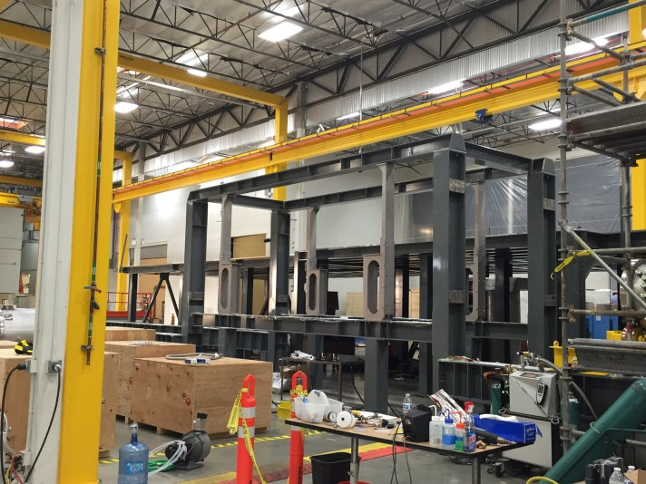
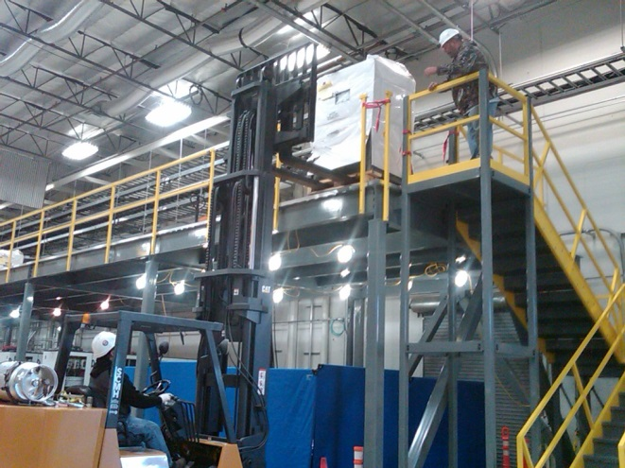
C-2W Structures and Platforms

Slide 16
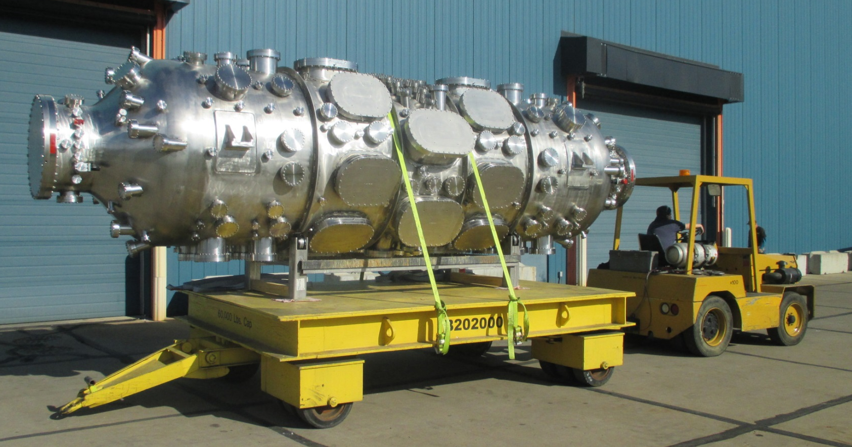
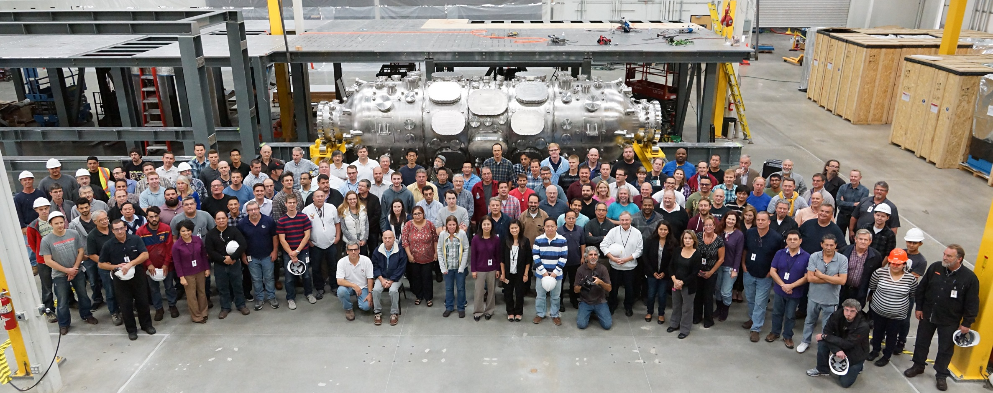
C-2W Confinement Vessel
¼” Inconel 625 vessel
resistive wall time constant < 3ms
339 penetrations and ports

Slide 17
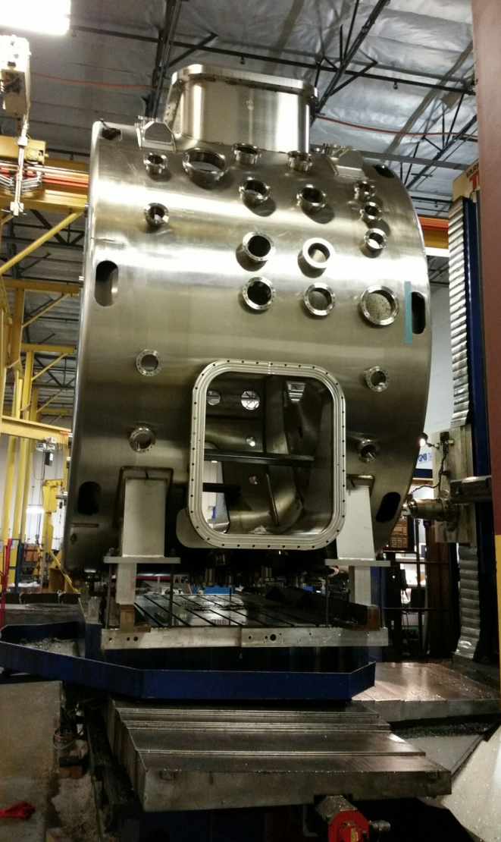
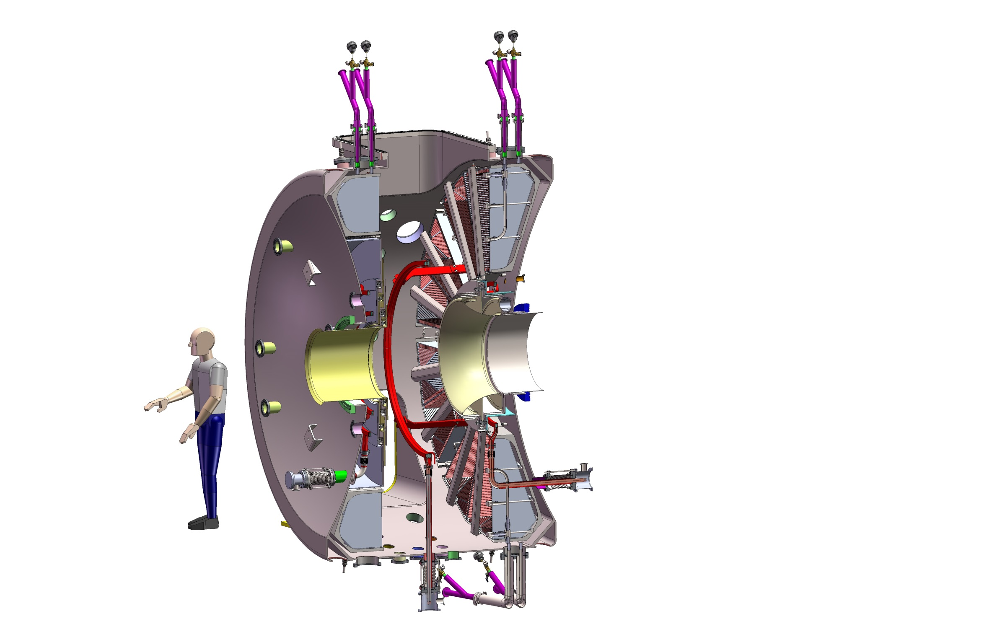
C-2W Divertors
LN2 Supply
Cryopanels
Fast-Switching
Magnet Coils
Funnel Limiters
5’ 10”
Divertor Electrodes
(20 kV voltage standoff, tested in C-2U

Slide 18
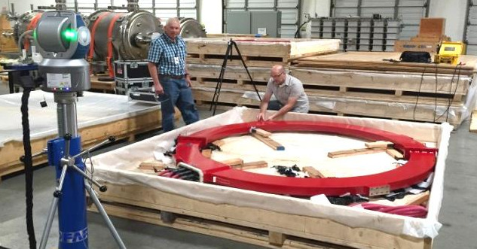
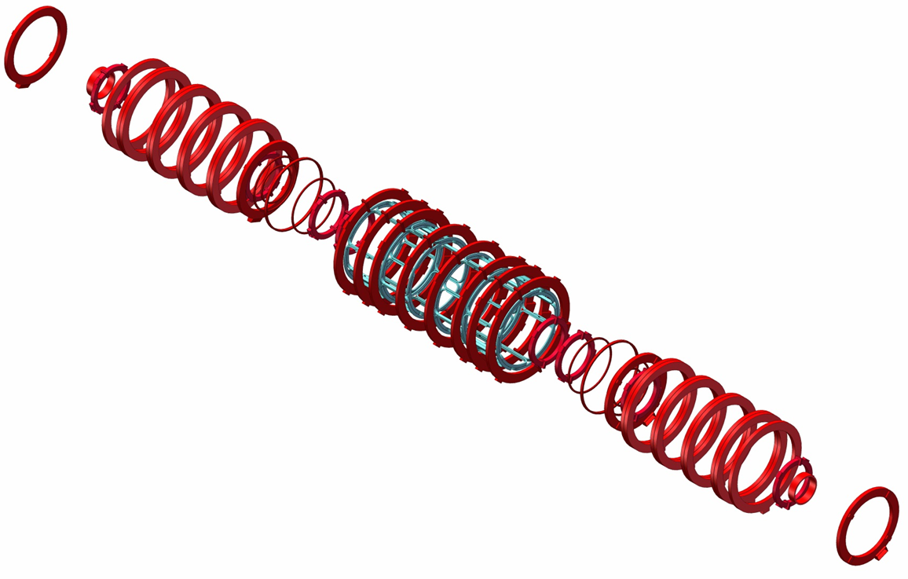
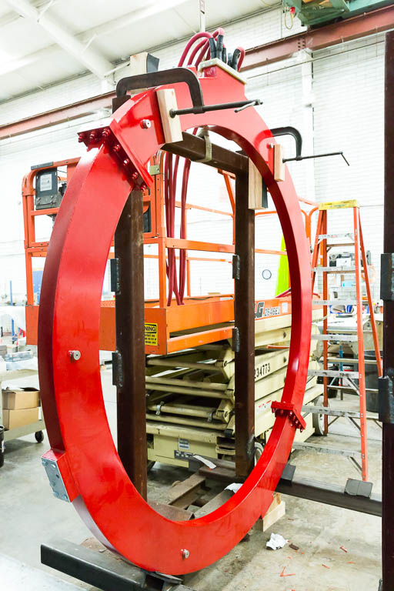
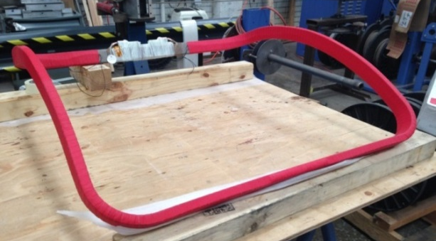
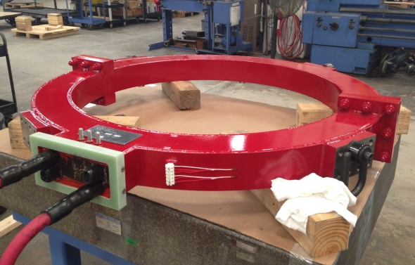
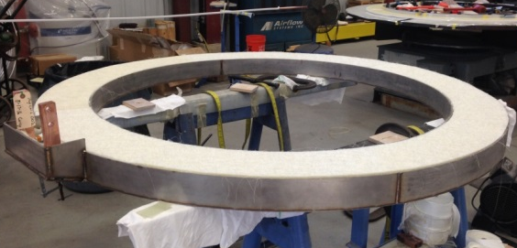
C-2W Magnetic Coils (106 total)
Necking (4)
Equilibrium/
External Trim (8)
DC Formation (18)
Fast Switching (8)
Saddle (32)
16 Active
16 Passive
Mirror
Plug (2)
Mirror (4)
Divertor (4)

Slide 19
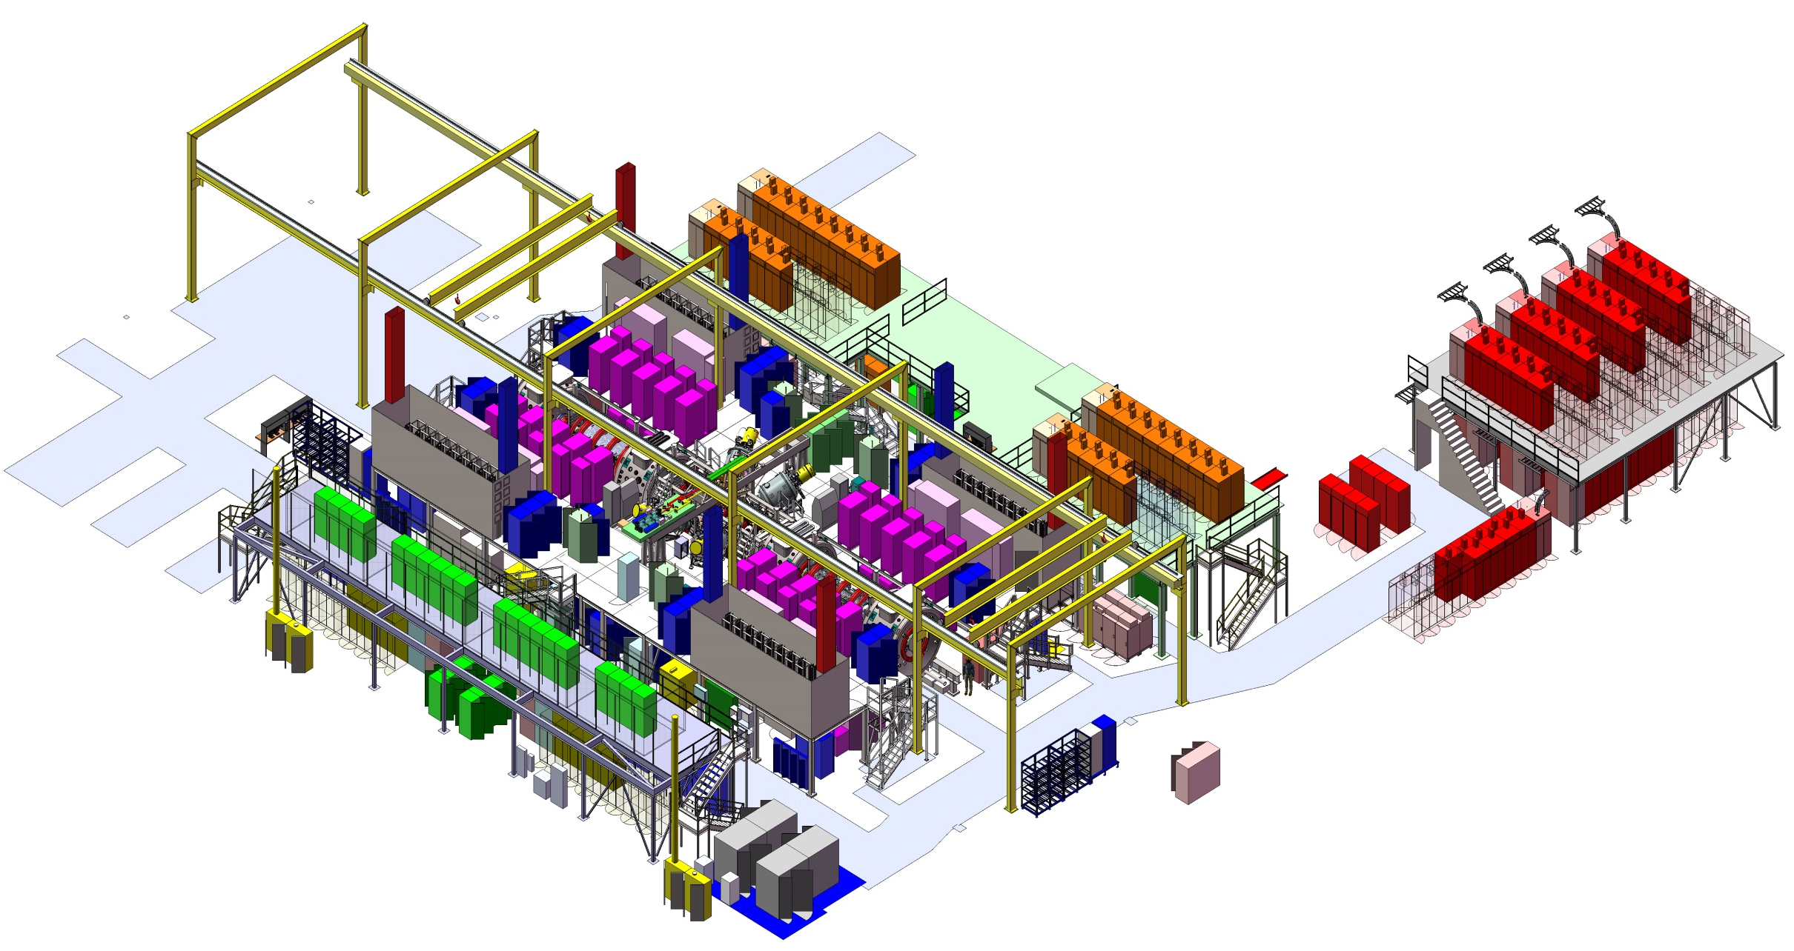
C-2W Power Supplies
> 200 MW on tap for each shot (125 PSUs, 350 cabinets)
Trim PSUs (8)
Equilibrium Magnets PSUs (8)
Mirror PSUs (4)
Saddle PSUs (16)
Neutral Beam PSUs (8)
Other Power Supply Units (PSUs)
Electrode PSUs (2)
Fast Switching PSUs (4)
Mirror Plug PS
Funnel Limiters (optional active))
Getters (multiplexed – 8/PSU)
Flywheel Controls

Slide 20
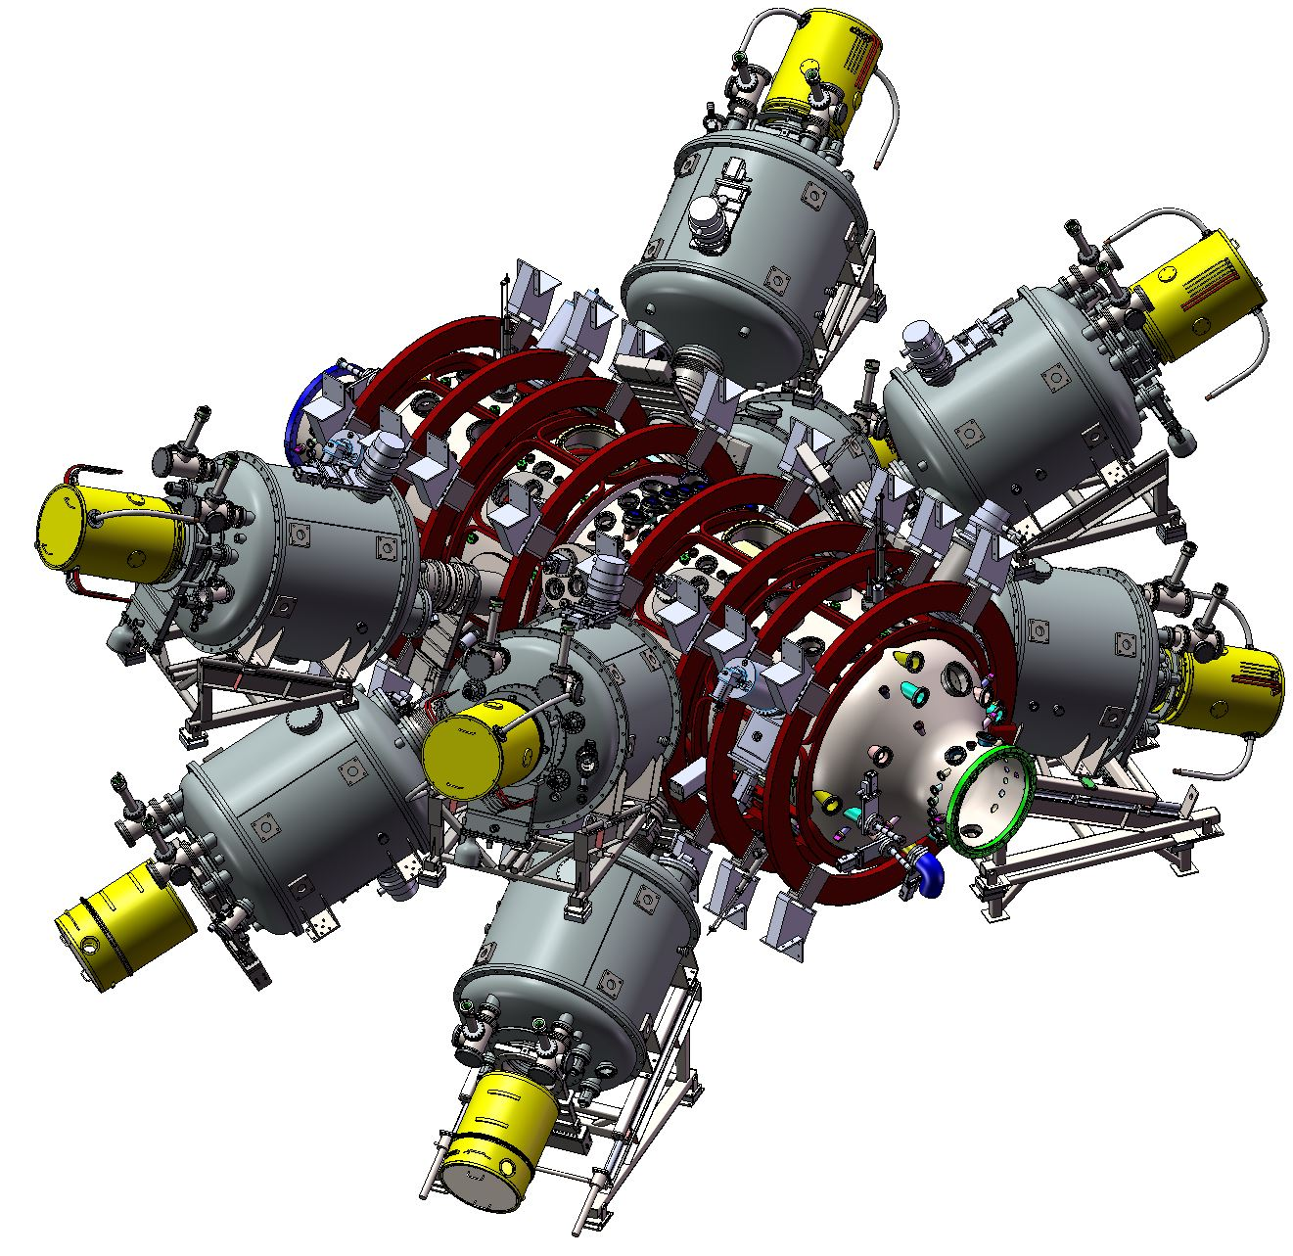
Neutral Beam System
Performance Markers and Design Philosophy
Neutral Beam System Specification
Parameter | Value
Beam energy | 15 / 15-40 keV
Total beam power | 13 / 21 MW
# of injectors | 8, 4+4
Pulse duration | 30 ms
Beam radial e-fold. size | 16 (z), 4.2 (r) cm
Beam divergence | 38 (z), 11(r) mrad
Ion current per source | 130 A
Manufacturing of all components complete
Acceptance testing successful
NBs in final assembly
Tunable energy neutral beams under design (15 keV to 40 keV)

Slide 21
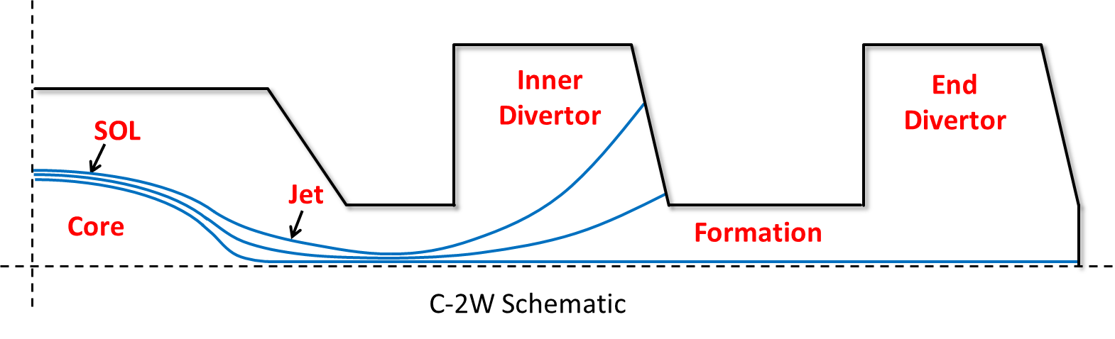
C-2W Diagnostics Zones
Diagnostics requirements and plans are sorted into four regional groups based on the plasma area they focus on
  Core plasma inside the FRC separatrix
  Open-field-line mirror-confined plasma in the scrape-off layer (SOL) and jet
  Rapidly expanding plasma in the inner divertors and/or end divertor

Slide 22
C-2W Diagnostics Suite
Core
SOL / Jet
Divertor
Magnetic Diagnostics
Magnetic Diagnostics
Magnetic Diagnostics
Interferometry
Interferometry
Interferometry
Thomson Scattering
Thomson Scattering
Insertable Electric Probes
Visible Imaging
Visible Imaging
Visible & IR Imaging
Bolometery
Bolometery
End Loss Analyzer
Visible Spectrometry
Visible Spectrometry
Visible Spectrometry
Lyman/Balmer Alpha
Lyman/Balmer Alpha
Lyman/Balmer Alpha
Bremsstrahlung
Bremsstrahlung
Fast Ionization Gauges
Reflectometry
Reflectometry
Residual Gas Analyzer
Neutral Particle Analyzers
Neutral Particle Analyzers
Wall Electric Probes
Diagnostic Neutral Beam
Diagnostic Neutral Beam
VUV Spectrometry
Insertable Electric Probes
Formation
Neutron Detectors
Insertable Bolometer
Proton Detectors
Microwave Radiometry
Opaque Tubes:
Magnetic Diagnostics
Polarimetry

Slide 23
Key C-2W Milestones
1 year construction phase
April 11, 2016 – C-2U Dismantlement/C-2W Construction Start
November 2016 – Confinement Vessel Delivery, initial power supply shipments
December – begin of final beams assembly and commencement of training
January 2017 – Divertor Vessels Delivery Complete
April 2017 – Integrated Subsystems Commissioning Start
Early Summer 2017 – First Plasma
Summer 2017 – Initial Scientific Campaigns

Slide 24
Agenda
  Introduction
    Concept and recent efforts
  C-2/C-2U Project Summary
    Results & achievements
  C-2W Project Preview
    Goals
    Construction progress
    Schedule
  Miscellaneous Initiatives
    Technology spin-offs – BNCT, non-destructive testing
    Whole device modeling

Slide 25
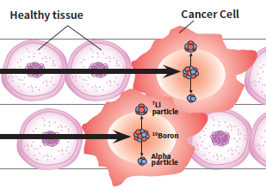
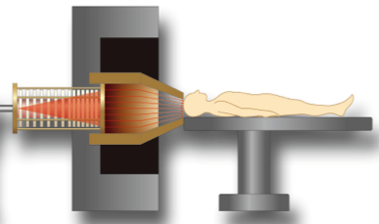
Boron Neutron Capture Therapy (BNCT)
A highly promising targeted cancer therapy
Combined action of vector drugs and neutron radiation selectively kills cancer cells
delivers spectacular increase in survival and quality of life for most severe types of cancer
TAE accelerator technology is ideal neutron delivery method
Clinical BNCT system deployable in 24 months
n
n
Neutron generator
Proton
beam from
accelerator
Neutrons

Slide 26
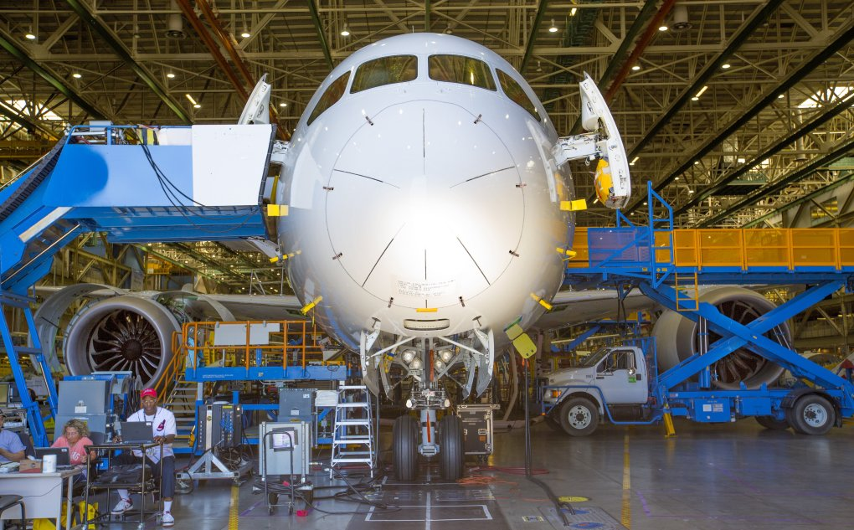
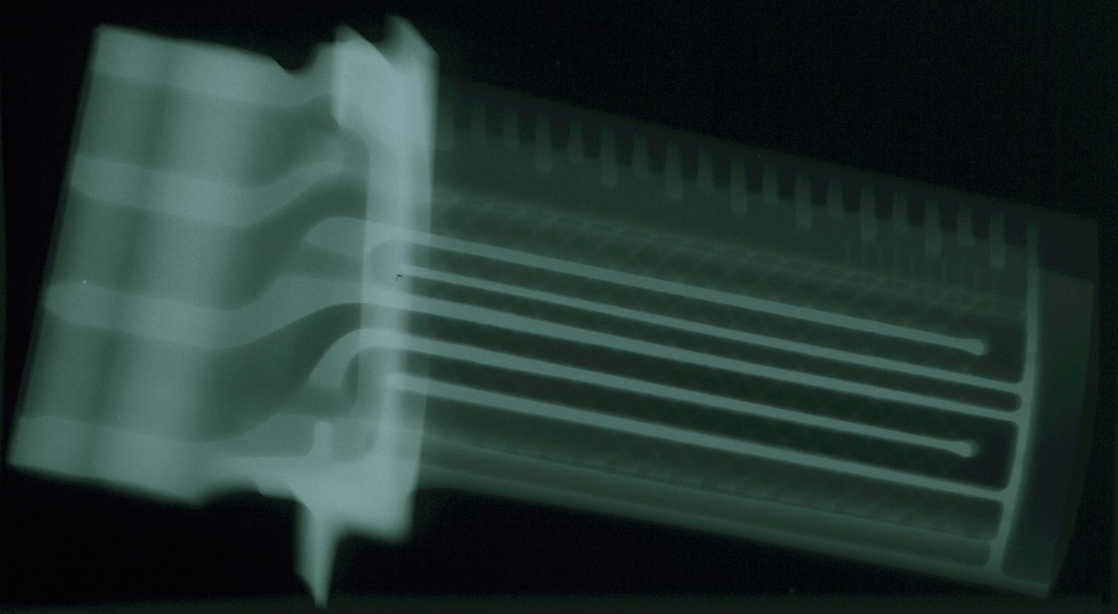
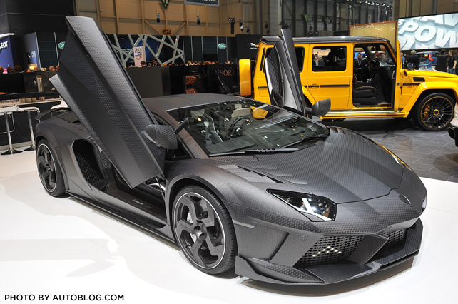
Neutron Imaging
Only viable solution for imaging of composite materials
Large untapped market
  aerospace
  turbine blades
  batteries/Fuel cells
  automotive
  munitions
Access to nuclear reactors limited
TAE high-intensity beam based neutron source provides fast exposure images

Slide 27
Whole Device Modeling of Compact Tori
“Numerical CT” initiative
TAE self-funded, funds some public-private partnerships
    PPPL, LLNL, TUNL, UC Irvine, UCLA, U. Wisconsin, U. Washington, Budker INP, U. Pisa, Nihon U.
TAE seeks to enhance public funding of non-TAE collaborators to serve wider community of high beta physics and deepen collaboration
Motivation & Objectives
    energy confinement times τ_{Ee}~1/ν_{e}* for NSTX and τ_{Ee}~1/ν_{e} for C-2U
    C-2W experiment (under construction) to test ~1/ν_{e} scaling in FRC at high T_{e}
    whole device model for compact tori
      hierarchical set of models; 0D, 1D, 2D reduced models to 3D kinetic 1st principles
      high beta work complementary to main tokamak programs – algorithms and physics, e.g. fully kinetic ion push, non-inductive current drive, electron kinetics in SOL, may assist tokamak
      WDM for CT could act as “high beta extension” to WDM for tokamak
      leverage shared components of WDM, such as PMI, boundary, workflow tools
Participants
    diverse leaders in Simulation
      Z. Lin, UC Irvine; E. Belova, PPPL; W. Horton, IFS; Y. Kishimoto, Kyoto U.; T. Tajima, UC Irvine
    experimental validation of model components and WDM on multiple machines
      M. Yamada, MRX, PPPL; C. Forest, UWisc; T. Asai, NUCTE-III, Nihon U; A. Ivanov, GDT, Budker INP; C-2W, TAE
    validated WDM of CT and model components can act as cross-pollination and validation tool across DOE-sponsored high-beta and CT plasma physics community

Slide 28
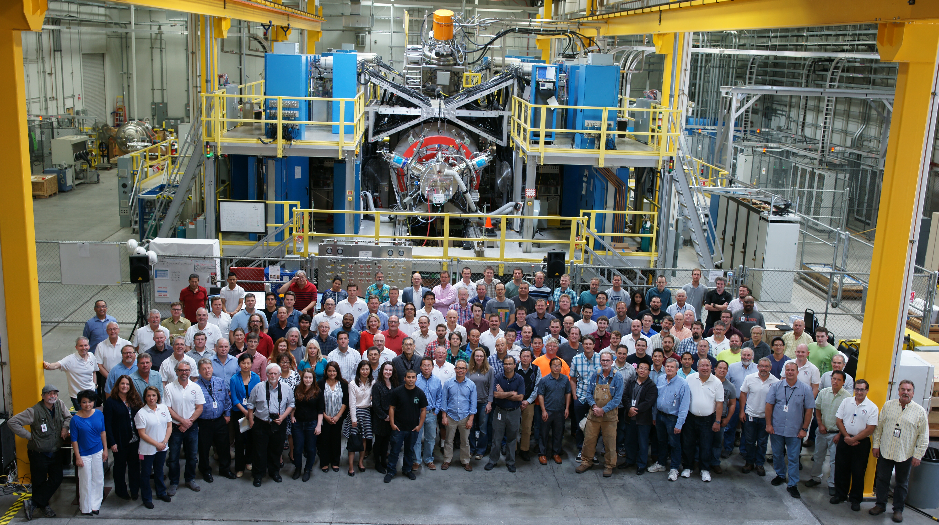
Thank you

