Slide 1



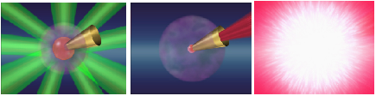
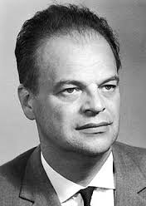
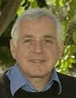

Status and Progress on FIREX
Implosion Heating Ignition
Primitive idea by
T. Yamanaka, int. rep. 83.
N. Basov, J. Sov. Laser Res. 92.
Matured concept by
M. Tabak, PoP 94.
T. Yamanaka
N. Basov
M. Tabak
Hiroshi AZECHI
Director, Institute of Laser Engineering, Osaka University
FPA 37th Meeting and Symposium, 2016. 12. 14
Washington, DC
1
Notes:
Let me talk about The Progress of Fast Ignition Realization Experiment.
In the FI scheme, the fuel is first imploded by irradiating laser light just like the standard fashion.
At the maximum compression timing, a high-intensity short-pulse laser is injected to the core before hydrodynamic disassembly,
If the temperature becomes high enough ignition takes place followed by propagation of burning wave, resulting the high fusion gain.
Primitive concept was first proposed by T. Yamanaka in 1983 followed by concrete proposal by Tabak in 1994.

Slide 2
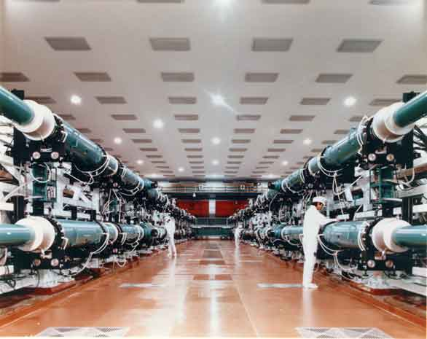
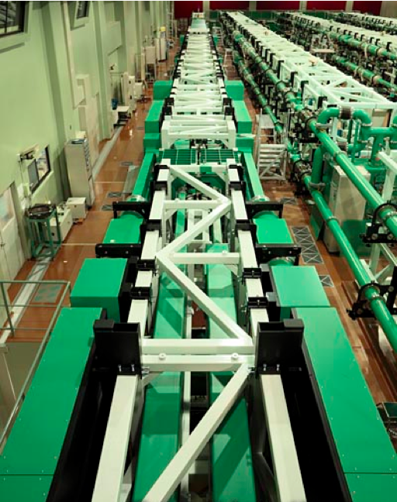
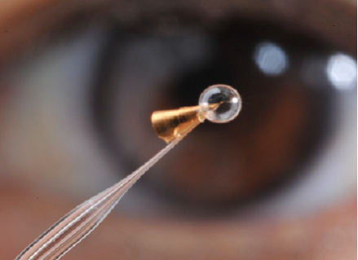
FIREX
Fast Ignition Realization EXperiment
①FIREX-I/5-keV Heating
ρR ~ 0.2 g/cm²
②FIREX-II/Ignition
ρR ~ 1.2 g/cm²
Nanosecond Laser
GEKKO-XII for Implosion
Picosecond Laser
LFEX for Heating
③Reactor/High Gain
ρR > 2.0 g/cm²
No essential difference between
ignitors of FIREX-I and reactor
2
Notes:
One of most advanced FI programs
is Fast Ignition Realization Experiment, FIREX. Nanosecond GEKKO-XII laser implodes the fuel, whereas picosecond LFEX laser heats the compressed fuel.
1. The purpose of FIREX-1st phase is to verify whether one can heat a hot spark without main fuel to the ignition temperature of 5 keV.
2. It is followed by Firex-II to actually demonstrate ignition by adding a main fuel to the hot spark.
3. From FIREX-II to a Reactor, high gain is obtained by simply adding more mass in the main fuel.
It should be worthwhile to note that there is no essential difference between hot sparks of FIREX-I, II and reactor. Therefore the most concerns on the hot spark formation are clarified in FIREX-I phase.
高速点火実証のプロジェクトをＦＩＲＥＸと呼ばれる。ナノ秒の爆縮用レーザー激光で燃料を爆縮させ、ピコ秒の加熱レーザーをコーンの内側から導入して加熱する。このプロジェクトの目標は第一期では５千万度へ加熱することであり、その後の第二期では本当にそれを点火・燃焼させることである。
点火・燃焼から高核融合利得へは、燃料が大きくすることのみで実現する。したがって点火温度への加熱と自己点火の実証が最も大きなハードルとなる。

Slide 3
Summary
Critical issues of fast ignition
    Laser-accelerated Relativistic Electron Beam (REB) is too energetic,
    and
    REB is too divergent to couple with a compressed core.
Cool REB Campaign
    Contrast ratio of heating laser pulse is improved to ten billion.
    Low energy electrons (<few MeV) increased significantly.
Guiding REB Campaign
    Kilo-tesla magnetic-field is generated in free space for the first time.
    Convergence of REB by magnetic-field was demonstrated.
Integration Campaign
    Cool and Guiding REB are simultaneously implemented.
    Temperature of ~3keV is demonstrated at a reduced heating energy.
What Next?
    High energy rep. laser J-EPoCH*
    International cooperation of FIREX-II.
    *Japan Establishment for POwer laser Community Harvest
3
Notes:
In the past ten years
Two unfavorable issues were discovered, First, REB.... Second…. These phenomena were not apparent in the previous low energy and low intensity case.
These problems were overcome in two intensive efforts. One: cool REB campaign i.e. c
According to the two issues, we made two campaigns

Slide 4
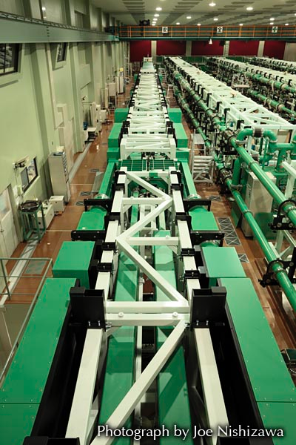
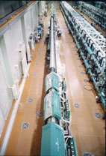
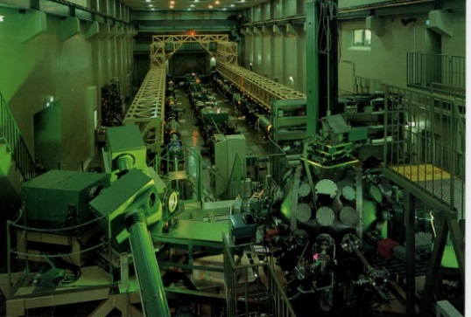
Heating Laser Development
GEKKO-MII-Short Pulse
1989
PetaWatt Mod 1996
PetaWatt 2001
LFEX 1 beam2009
4 beam 2014
30 J / 1 ps
0.5 kJ / 0.5 ps
2-10 kJ /1-10 ps
4
Notes:
Before talking about cool REB campaign,
I would just summarize how high energy short pulse laser increased its energy in the past quarter century starting from GEKKOMII shortpulse at 30 TW through Petawatt and to LFEX.

Slide 5
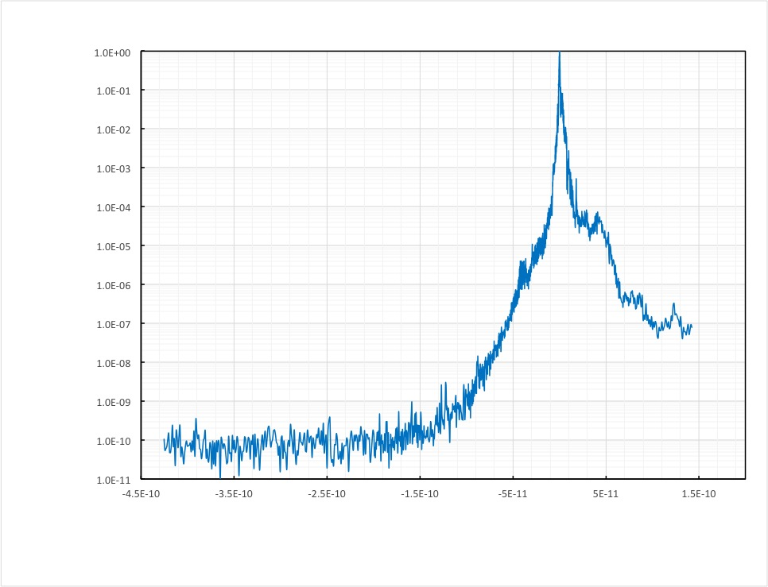

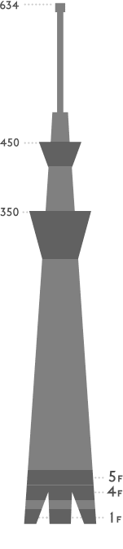
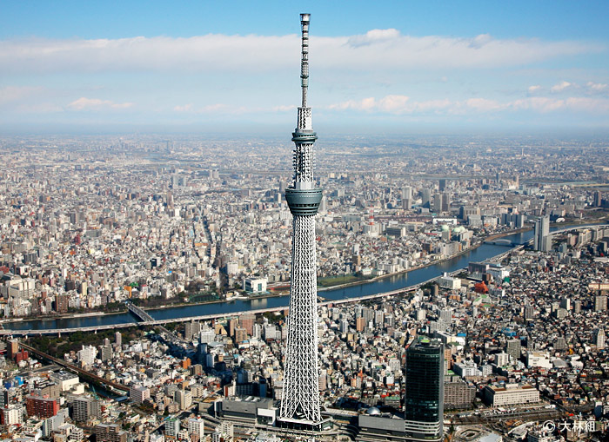
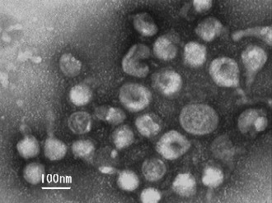
Cool REB Campaign: Highest Contrast
10⁰
10⁻¹
10⁻²
10⁻³
10⁻⁴
10⁻⁵
10⁻⁶
10⁻⁷
10⁻⁸
10⁻⁹
10⁻¹⁰
10⁻¹¹
2 PW
Relative Power
previous
-450 -350 -250 -150 -50 0 50 150
Time (ps)
>10 orders of magnitude
Pedestal : Peak ≈ Virus : Skyscraper
Tokyo Skytree
~ 1000 m
Flu Virus
~100 nm
Notes:
More important issue is how clean the short pulse is. Prepulse creates preplasma that generates too hot electrons that decouple with the core. Here is the observed pulse shape showing that the contrast ratio of 10^10 (ten trillionth), being equivalent to Tokyo skytree with 1000 meter hight vs. Flu Virus of 100 nm.

Slide 6
Cool REB Campaign: Results
With Prepulse
@1.5 ns before main pulse
Prepulse Free
@0.15 ns before main pulse
Fuel core
ele
<3MeV
>>3MeV
decoupling
With Prepulse
Without Prepulse
Low energy component of REB increased dramatically.
Notes:
As a result, prepulse free laser generate cool relativistic electron beam. 80% of hot electrons have energy below 3 MeV at which the core effectively absorb the REB.
２つめに加熱の効率の向上。エネルギーが上がるとプレパルスやフットパルスの強度が増大。プレプラズマをつくる。そこに強度の高いレーザーが入ると航跡場加速により高エネルギーの電子を発生。これを抑制するためにプラズマミラーを導入。プレパルスやフットパルスは無反射コートを施したミラーを透過。メインパルスがやってくるとミラーがプラズマ化して反射する。こうしてプレパルス・フットパルスフリーのパルスができあがる。

Slide 7

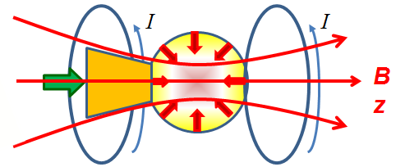
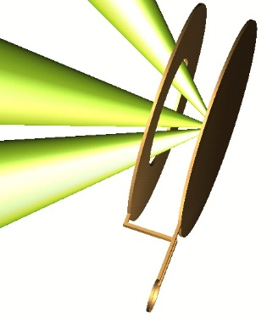
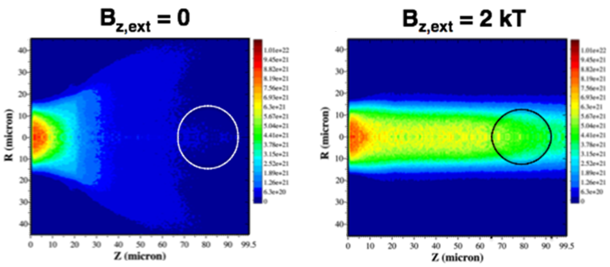
Guiding REB Campaign: Concept
Fast Ignition Target
Nature 2001, 2002
Fast Electron Guiding by B Field
⇒Efficient heating
High B Field
Sci. Report 2013
2.1ps
2.1ps
Heating Laser
Fuel
B
B_{z}
Notes:
Second, guiding REB campaign
Electrons diverge at high laser intensity by filamentation instability. Recent strong magnetic field generation by Fujioka is as following. GEKKO XII is injected one of two metal plate through a hole of another plate, generating multi kT magnetic field. Applying this B field along the hot electron stream well guide the electrons to the compressed core.
２つめに加熱の効率の向上。加熱レーザーから発生する電子はワイベル不安定性のために電子が拡がって十分に燃料に当たらない。最近私どもの若手である藤岡君が新しい強磁場発生の機構を発見。２つの金属板の間をコイルで接続し、レーザーを照射すると電子が飛び出しＭＶの電位差が発生して電流が流れ磁場を発生。磁場の大きさは１０キロテスラに迫る、世界最高共同のものだった。この磁場収束効果を２年後には自信をもって経過報告できると確信。燃料が十分に過熱されれば燃焼することはNIFで行っており、これが実現できれば、核融合点火を目指す次の段階に進むことができる。

Slide 8
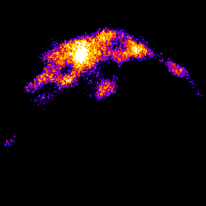

Guiding REB Campaign: Mag Field
Temporal history of B-field measured with B-dot probe
600 T of the peak magnitude and 2 ns of the duration
(Tesla) @one beam
w/ B
39022
39024
39051
Laser driven Capacitor-coil target generated
strong (kilo Tesla) magnetic field
13
Notes:
Magnetic field generation.
About 600 T per beam was generated measured with Bdot probe and proton deflactometry. The maximum field is in very good agreement with proton deflactometry data.
相対論的電子ビームを誘導するためには強磁場が必要。強磁場は二枚の金属板の一方に激光XII号のレーザーを照射し、そこで発生する高温電子が飛び出すことによりMVの電位差を生み、ワンターンコイルをMAの電流が流れることによりキロテスラの磁場を発生させた。１ビームで０．６キロテスラ、３ビームで２キロテスラの磁場が発生。

Slide 9
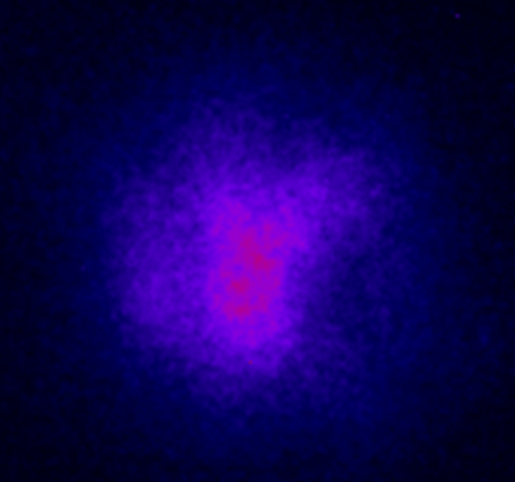
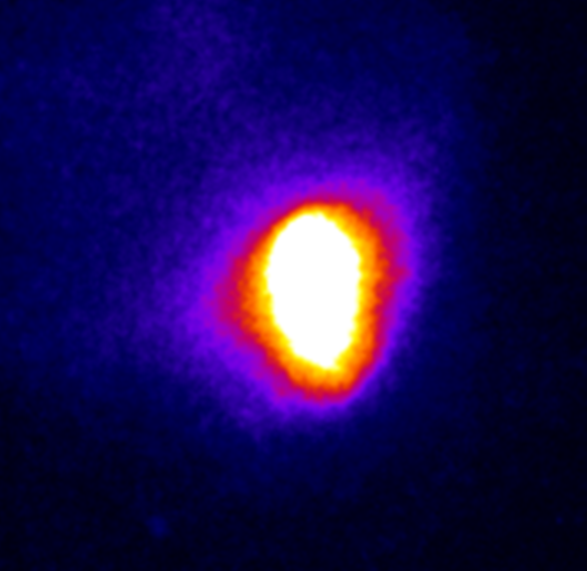
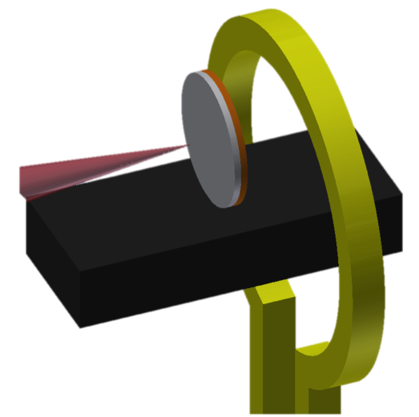

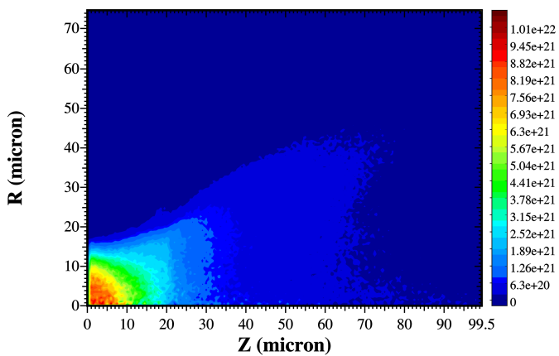
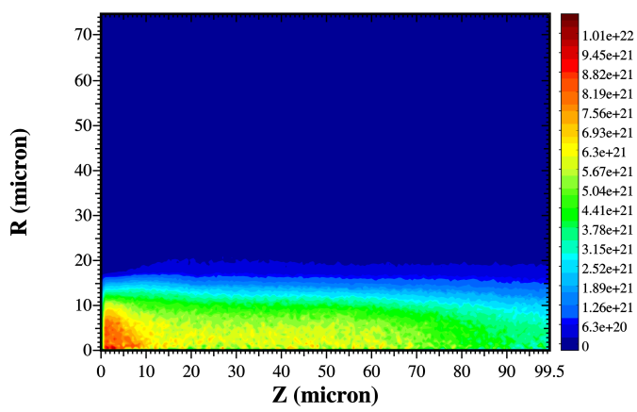
Guiding REB Campaign: Results
Spatial spread of REB after long distance traverse
X1/2 size, X8 intensity
w/o B-field
with B-field
w/o B_{ext}
w/ B_{ext}
10 µm
10um
10um
B_{z}
Kilo Tesla magnetic field guides relativistic electron beam.
14
Notes:
Guiding:
This is the recent demonstration of hot electron guiding by magnetic field, in collaboration with CELIA/LULI. Coherent Transition Radiation at B field shows that the hot electron spot size reduced to ½ and peak intensity increased by a factor of 8, demonstrating good guiding of the hot electrons.
長距離伝播五の構想電子ビームの空間拡がりをターゲット後面から観測。磁場を印可することにより、拡がりはおよそ１／２に強度は８倍に増大。

Slide 10
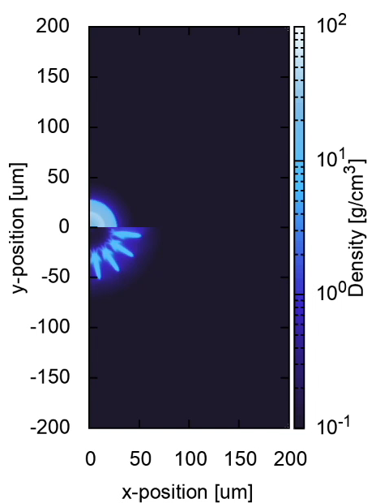
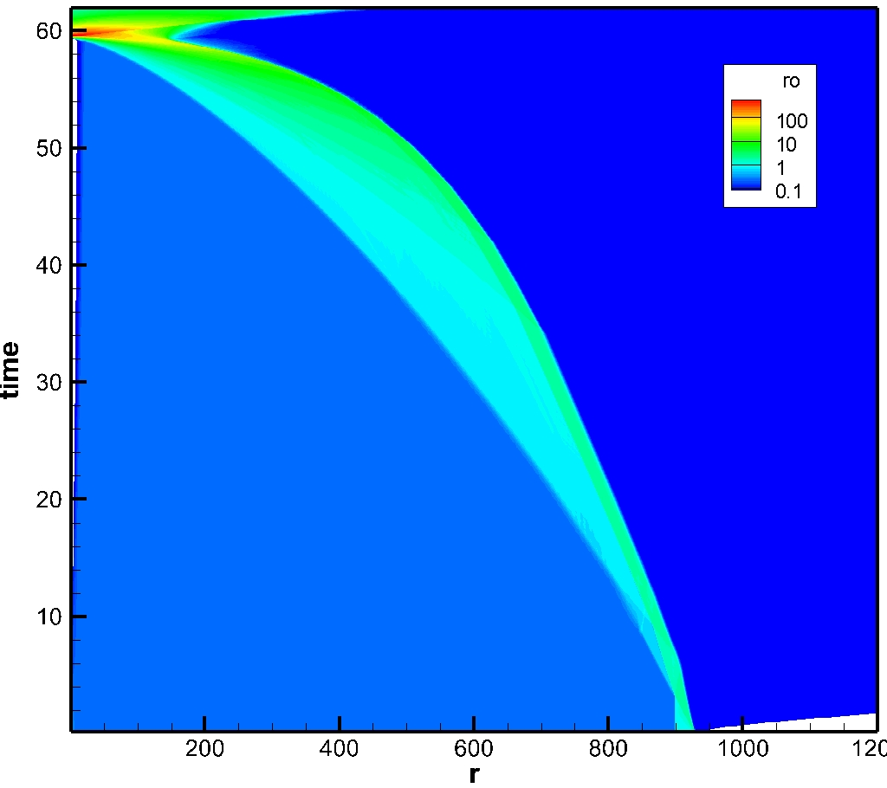
Integration Campaign: Solid Ball Fuel
Learning from Kidder in 1970’s
Growth of surface perturbation
Initiated by non-uniform laser drive
High density compression
with tailored pulse
ρR achieves 2.7 g/cm²
10
Notes:
One more important challenge:
We replaced shell target with solid ball fuel. Historically shell was introduced in 1970’s to create a hot spark at the center. But as illustrated, central hot spark is not necessary. The biggest advantage of solid ball is that there is no RT instability as no acceleration. The only instability that might occur is RM instabiltiy

Slide 11
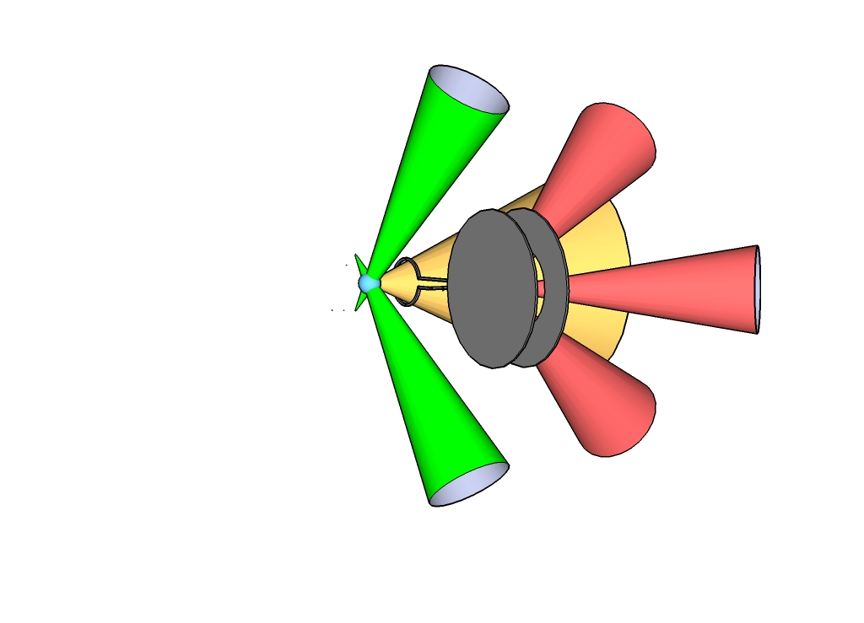
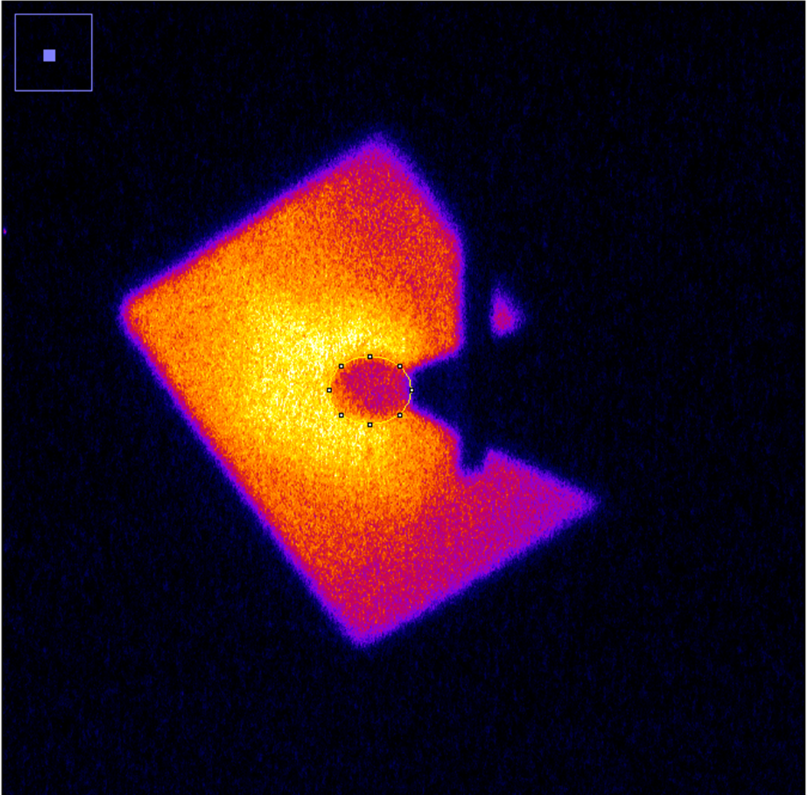
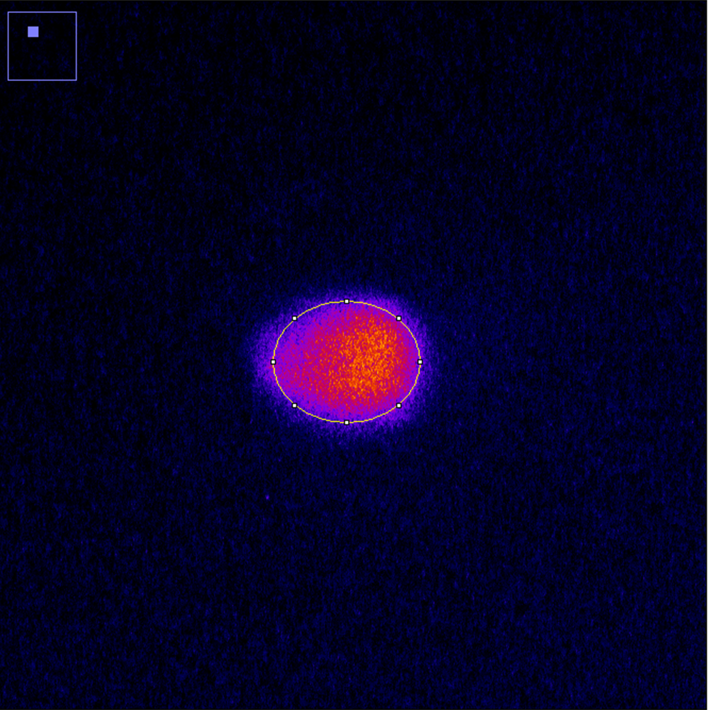
Integration Campaign: Experiment
Target layout
Cu-doped plastic sphere
X-ray shadow
Coil
Cone
Compressed Core
Cu-Kα image
X-ray spectrum
LFEX
Compressed core is well heated to some keV.
Notes:
The capacitor coil target is inserted near the top of the cone. At the top of the cone cu-doped ball is attached. The compression is diagnosed with x-ray shadowgraphy at 5keV. The Cu-Ka imaging depicts that heating region is well within the compressed fuel.

Slide 12
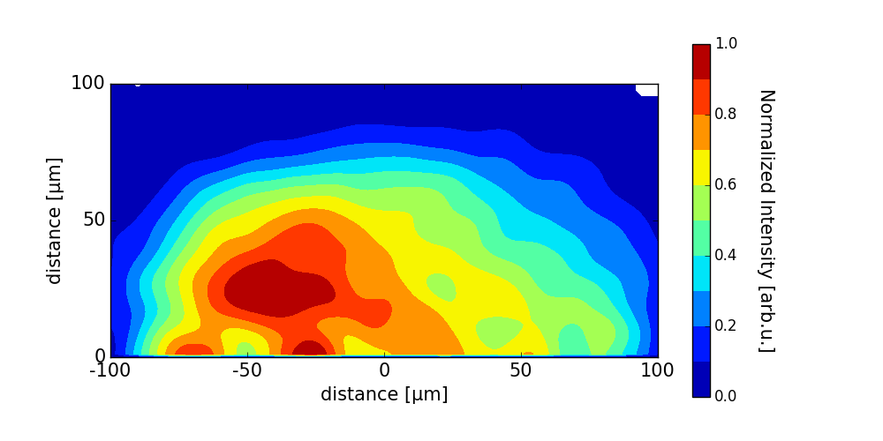
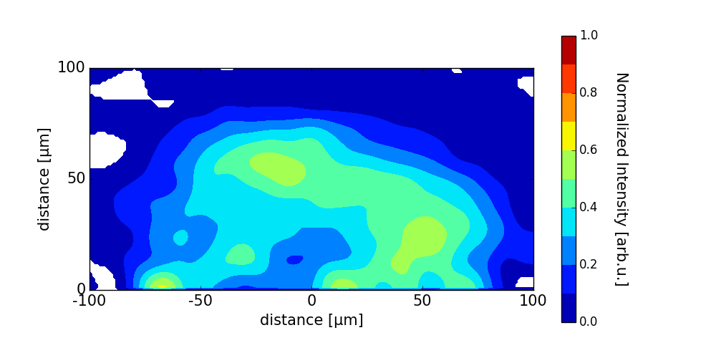
Decrease of cold Kα suggests heating.
a negative proof
Intensity ratio
of w/B over w/o B
Cu-Kα emission
w/o B-field
I_{w/B}/I_{w/oB} = f(ΔT)
LFEX
Cu-Kα image
w/ B-field
LFEX
0
150
(μm)
Heated region
12

Slide 13
Integration Campaign: 3-keV Heating
LFEX Energy = 1.5 kJ
Li-like
Satellites
Heα
Au-cone Lα
8.54 keV
Cold Cu Kα
8.05 keV
w/B
w/o B
1000 eV
ρ = 10 g/cm³
2000 eV
3000 eV
(PRISM-SPECT)
K shell emissions of Cu increase with B field.
Notes:
Three features: One is Ka emission from cold Cu. Second is Li and He-like K-shell emission from hot plasma, Third Gold La emission from cone. With B on, the hot electron which went to gold cone sidewall, is collimated and heat the compressed core, resulting in strong K shell emissions from stripped ions. This is the strong evidence that the fuel is indeed heated up several keV temperature. Atomic model calculation indicate that the heated temperature is most likely 3 keV. Since currently the heating laser energy is half of the operation level, we strongly believe that one can get 5 keV temperature at full operation of the heating laser.

Slide 14
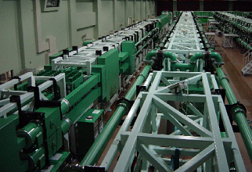
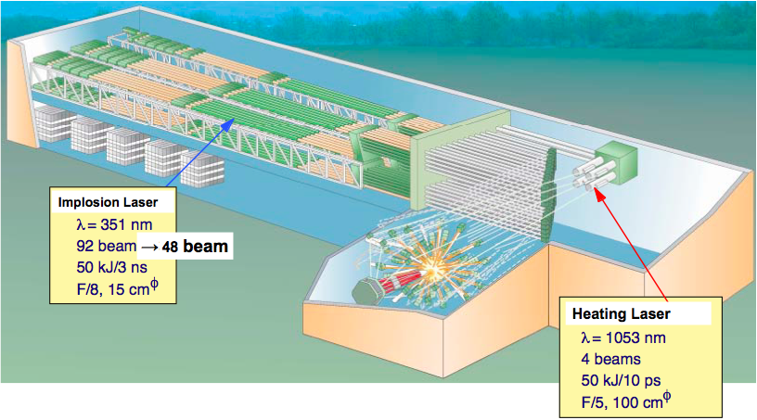
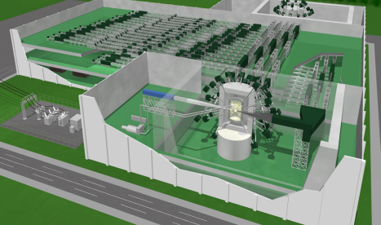
What next? Current Roadmap
〜2016
～2025
FIREX-II
FIREX-I: 5-keV Heating
FIREX-II: Ignition
Atomic Energy Commission of Japan report (Oct. 2005):
“Based on its (FIREX-I) achievement, it will be decided whether the project should advance to its second-phase which will be aimed at realizing of ignition and burning”
〜2040
*Laboratory Inertial Fusion Test
LIFT: Power Generation
14
Notes:
Corresponding to this strategy from FIREX-I to reactor,
roadmap is established here. FIREX-I is current program, FIREX-II needs 10 years, and Power Generation takes 15 more years. Atomic Energy Commission of Japan declared that “Based on its (FIREX-I) achievement, it will be decided whether the project should advance to its second-phase which will be aimed at realizing of ignition and burning”.
エネルギー供給への道のりはどのようなものか。現在高速点火実証実験第一期を実施中．第一期の成果により，点火・燃焼の実現を目指す第二期計画に発展させるか否かの判断を行う．これらは一秒に１０回繰り返す中の１回を実証するもの．２０３０年にはレーザー核融合実験炉により１０万キロワットの発電実証．これをLIFTと呼んでいる．

Slide 15
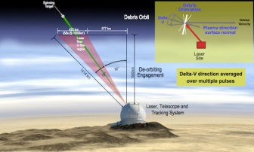
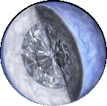
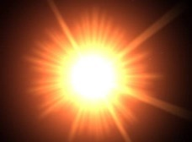
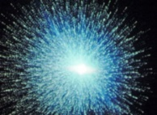
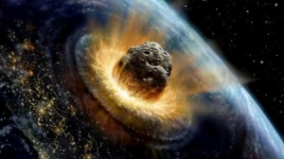
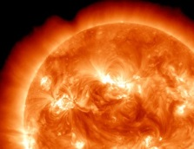
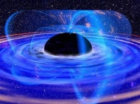
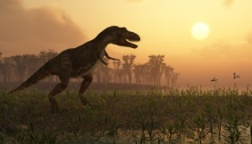
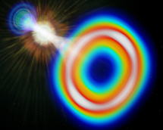
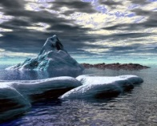



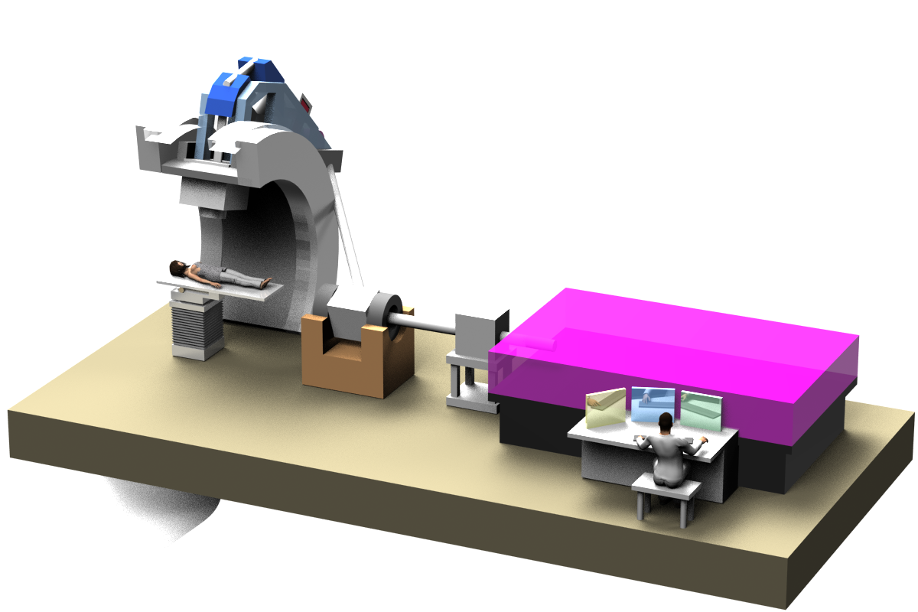




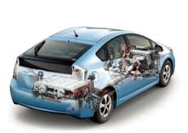
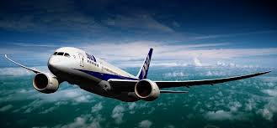
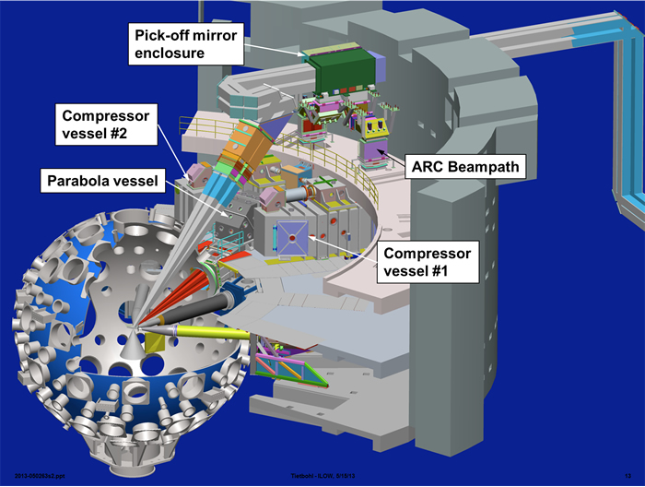
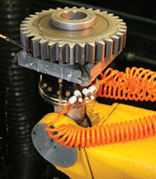
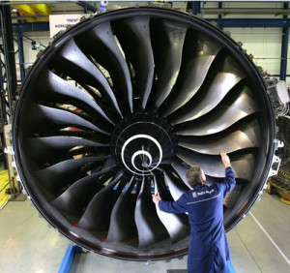
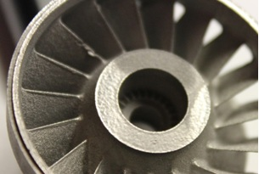
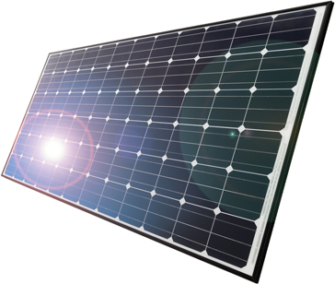
Next Generation Multi-Purpose Facility
Academic Frontiers
Infrastructure
Planetary Science
Astrophysics
Vacuum Quantum
Physics
Space debris elimination
LIFT: Power Generation
Laser Propulsion
Nondestructive inspection
〜2040
Radiation
Therapy
ビーム輸送
Industry
粒子線加速
Semiconductor manuf.
Medical
レーザー装置
臨床部
Diode Pump
Ceramic Crystal
Japan Establishment for POwer laser Community Harvest
Laser Machining
FIREX-I
FIREX-II: Ignition
3D Printing
Gear
Turbine Brads
Material
NIKKEI Newspaper
JAEA
(2011)
Surface process (a-Si)
Perovskite Ceramic
〜2016
〜2025 International
15
Notes:
Here is the strategy to Fusion Power Generation. The high-energy rep-rate laser contribute not only fusion but academic frontiers and Industrial Applications. At the same time ignition demo may be explored as an international cooperation at for instance NIF. Vy good understanding of reactor core together with the ignition demonstration, we may start a experimental reactor for power generation.

Slide 16






Three Innovations for Repetition Laser
From Flush Lamps to Diodes
From Glasses to Ceramics
Laser Glasses
•Large optics
•Low thermal
conductivity
Flash Lamps
Broad spectra
→Inefficienty
Laser Diodes
Emission lines≈
absorption lines
Yb: YAG Cooled Ceramic Crystal
•Large optics
•High thermal
conductivity
60mm
18mm
60mm
X100 efficiency
X100 thermal conductivity
GEMBU Laser 1J, 100Hz
Cooled Ceramic Crystal Laser
developed in ILE becomes
a Global Standard.
Japan Establishment for POwer laser Community Harvest
Notes:
As for the rep-rate lasers, we have made three major breakthroughs in the last 15 years. First, By replacing flash lamps with laser diodes, one may improve 1) efficiency and 2) eliminate excess heat limiting rep-rate operation. Laser Diodes emission line can exactly match to the absorption line so that both efficiency and rep-rate conditions are simultaneously fulfilled. Second, transition from glasses to ceramic.
エネルギー開発が可能かどうかの中心課題は、繰り返しレーザーである。１は白色光のため極めて非効率なフラッシュランプからレーザー作用に必要なラインのみを発光させるレーザーダイオードへの転換。これにより１００倍の効率の向上。２，は熱伝導の悪いガラスレーザー材料から、１０００倍も熱伝導の高い冷却セラミック結晶への転換。 阪大レーザー研の吉田さんが世界初のセラミック結晶レーザーを発振させ、植田先生により製造方法の革新が行われた、わが国発の技術です。両方合わせて１０＾５倍の繰り返し率の向上。これが世界標準となり、イギリス・フランス・チェコのプロジェクトとして採用された。
フラッシュランプ励起レーザーは，１９６０年のレーザーの発明以来半世紀の間使われているが，レーザー媒質の吸収線に対して，励起光が非常に広いスペクトルを有するため，ほとんど熱損失となり，効率が悪く，かつ高い繰り返し動作ができない．これに対しレーザーダイオードは媒質の吸収線に合致した発光波長を選ぶことができるので，効率と繰り返しという２つの要請を満足することができる．これが実際に使われているレーザーダイオードでその一つは２５層になって一層から１００Wが出力されます．大変明るい光源であることがおわかりいただけるかと思います．レーザーダイオード励起のレーザーには２つ問題があり，その１つは価格です．現在はワットあたり３００円を１０円／Wにまで下がる必要があります．ちなみに現状の価格は同重量の金の価格の１００倍以上しています．

Slide 17








繰り返しハイパワーレーザーのブレークスルー：スプリットディスク
Split Disk : a New Breakthrough
in Rep-rate High Power Laser
Nd:Glass or
Ceramic Nd:Cr:YAG (Nd: 0.8at% Cr: 0.1at%)
10l/min (0.5m/sec), 800J, 10Hz, 100pulse
Interference fringe
of water
0s 5s 10s 15s 30s 40s
excitation
X100 heat removal
17
Notes:
The third technology is heat removal. By replacing coolant from gas to liquid, we could increase heat removal efficiency by a factor of 100. In all together, we expect 1 million times rep rate of the current 10^-4. glass laser.

Slide 18
Summary
Critical issues of fast ignition
    Laser-accelerated Relativistic Electron Beam (REB) is too energetic,
    and
    REB is too divergent to couple with a compressed core.
Cool REB Campaign
    Contrast ratio of heating laser pulse is improved to ten billion.
    Low energy electrons (<few MeV) increased significantly.
Guiding REB Campaign
    Kilo-tesla magnetic-field is generated in free space for the first time.
    Convergence of REB by magnetic-field was demonstrated.
Integration Campaign
    Cool and Guiding REB are simultaneously implemented.
    Temperature of ~3keV is demonstrated at a reduced heating energy.
What Next?
    High energy rep. laser J-EPoCH*
    International cooperation of FIREX-II.
    *Japan Establishment for POwer laser Community Harvest
18
Notes:
In the past ten years
Two unfavorable issues were revealed, First, REB.... Second…. These phenomena were not apparent in the previous low energy and low intensity case.
These problems were overcome in two intensive efforts. One: cool REB campaign i.e. c
According to the two issues, we made two campaigns

Slide 19


Draw Dragon Dot Eyes

Slide 20
Get together at IFSA in Saint-Malo
We hope to see you soon in Saint Malo!
10-15 September 2017
20

