Slide 1
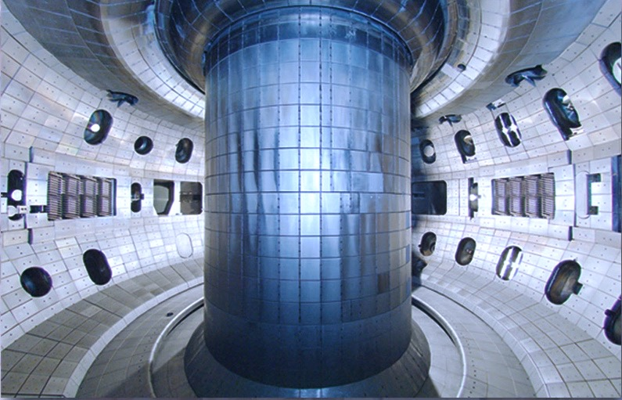
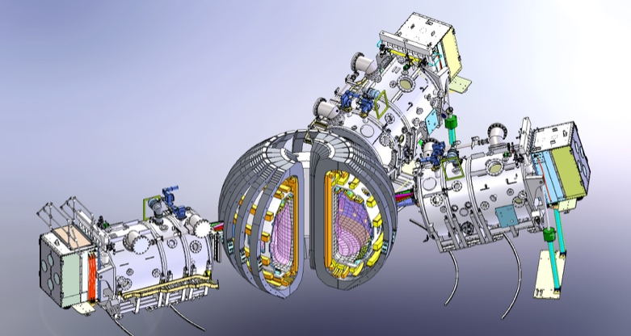
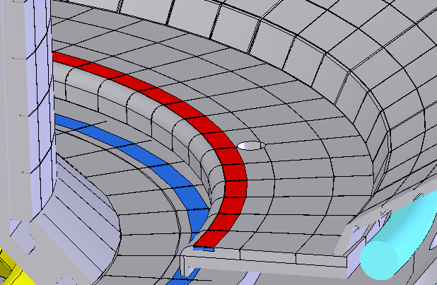
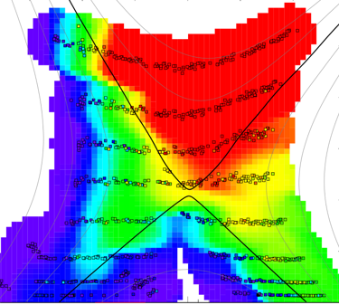
Progress and Plans for the DIII-D Program
by
D.N. Hill
Presented at the
Fusion Power Associates Annual Symposium
Washington, D.C.
December 13, 2016

Slide 2
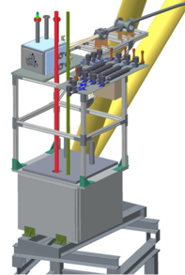
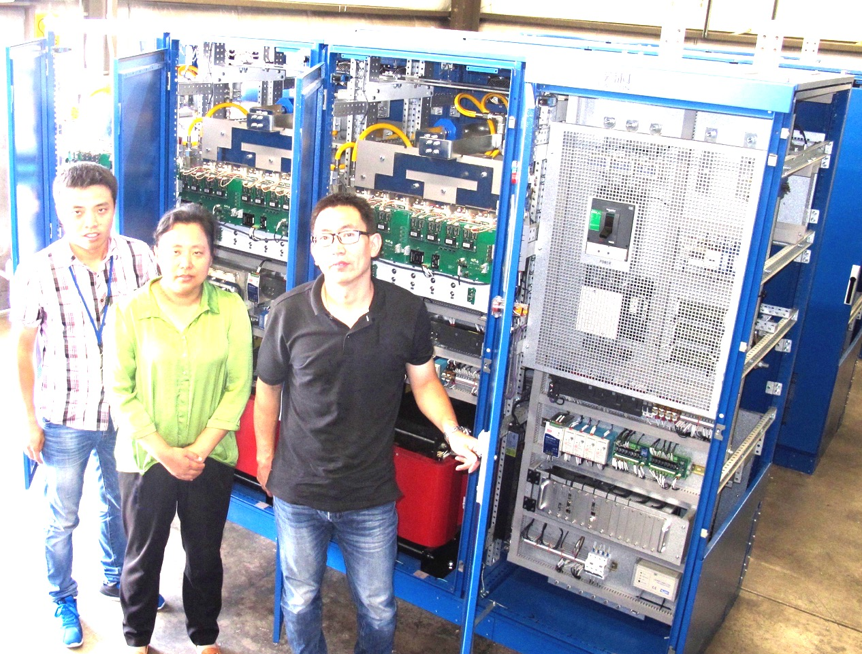
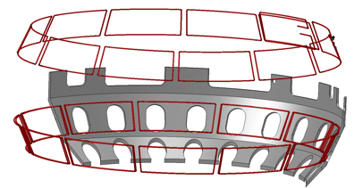
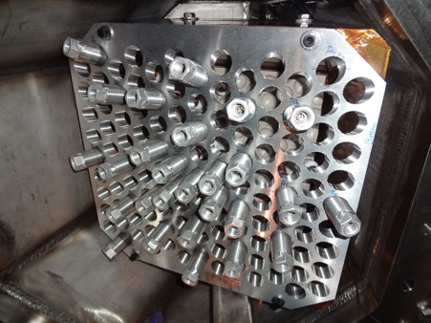
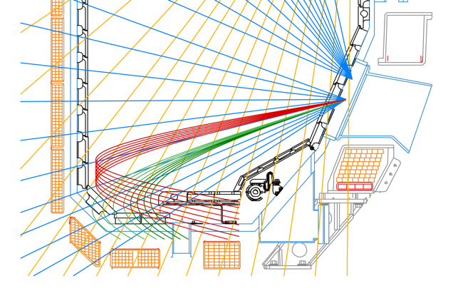
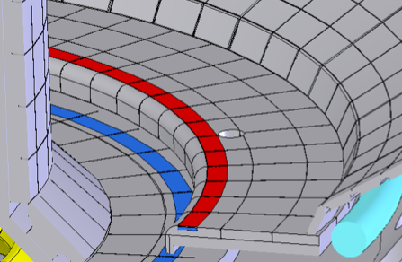
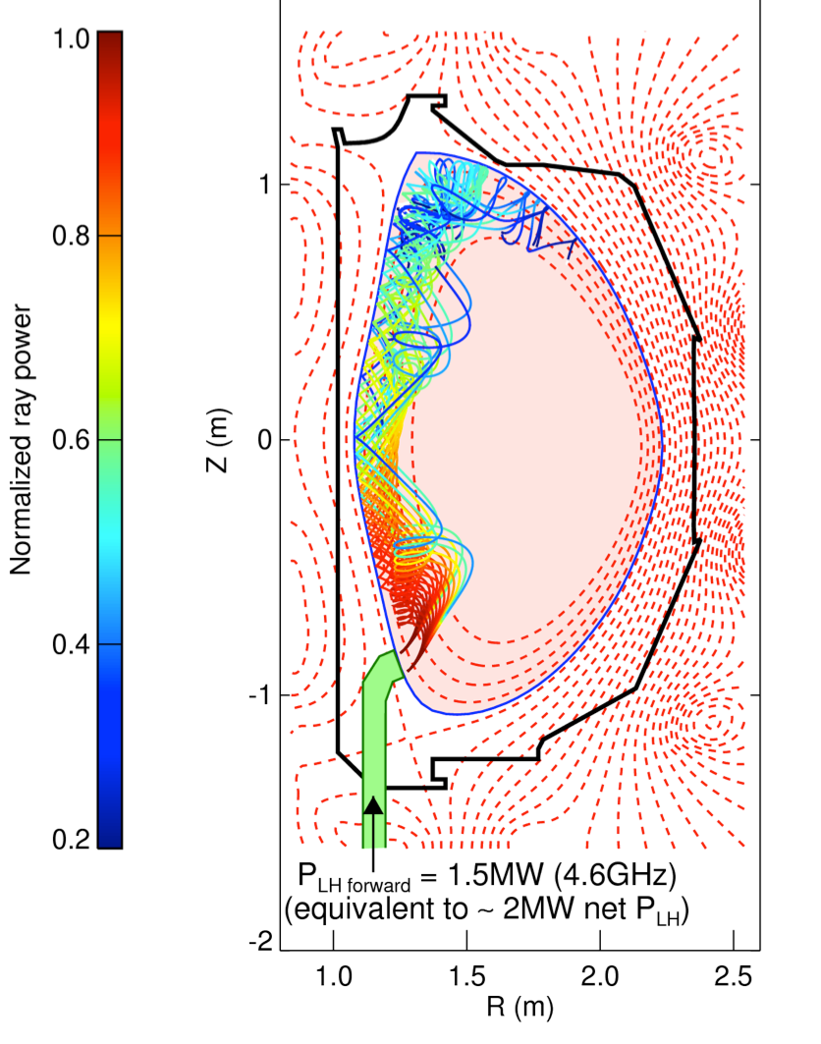
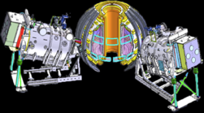

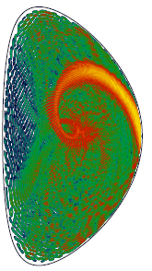
The DIII-D National Fusion Program Advances Fusion Energy Development By Focusing on Four Research Elements
DIII-D Research Elements | Enabled by DIII-D Enhancements
Control Transient Behavior
Strengthen the Scientific Basis for Fusion Energy
Develop Relevant Boundary Solutions
Determine Path to Steady-State
Improved
3D control
2nd SPI
Improved diagnostics
Bolometer upgrades
Tungstencoated rings
Divertor closure modifications
Helicon
HFS LHCD?
Increased co-current,
off-axis current drive
Increased electron
Heating/current drive

Slide 3
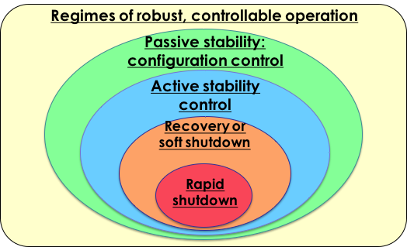
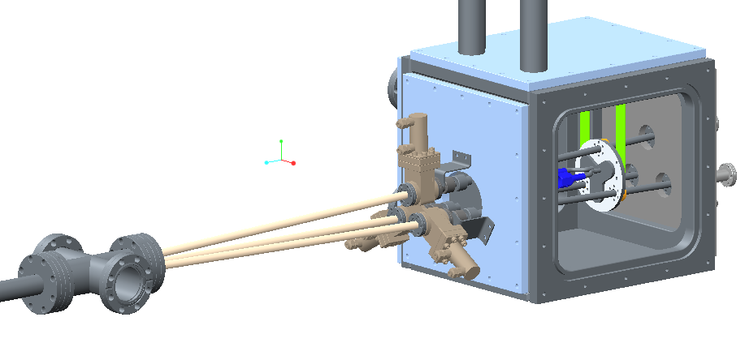
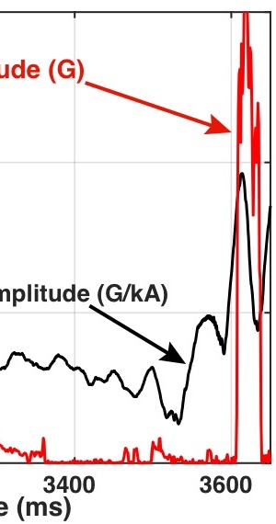
DIII-D Goal: Establish the Physics Basis for Avoiding Transient Events Due to Disruptions (Integrated Strategy)
High performance steady-state regimes offer improved stability
Real-time warning of approach to stability limits enables corrective action
→ Localized current profile control
(ECCD) and 3D fields
Ensure disruption mitigation works as last line of defense
ITER-prototype
2nd SPI
Tearing mode amplitude
Response

Slide 4
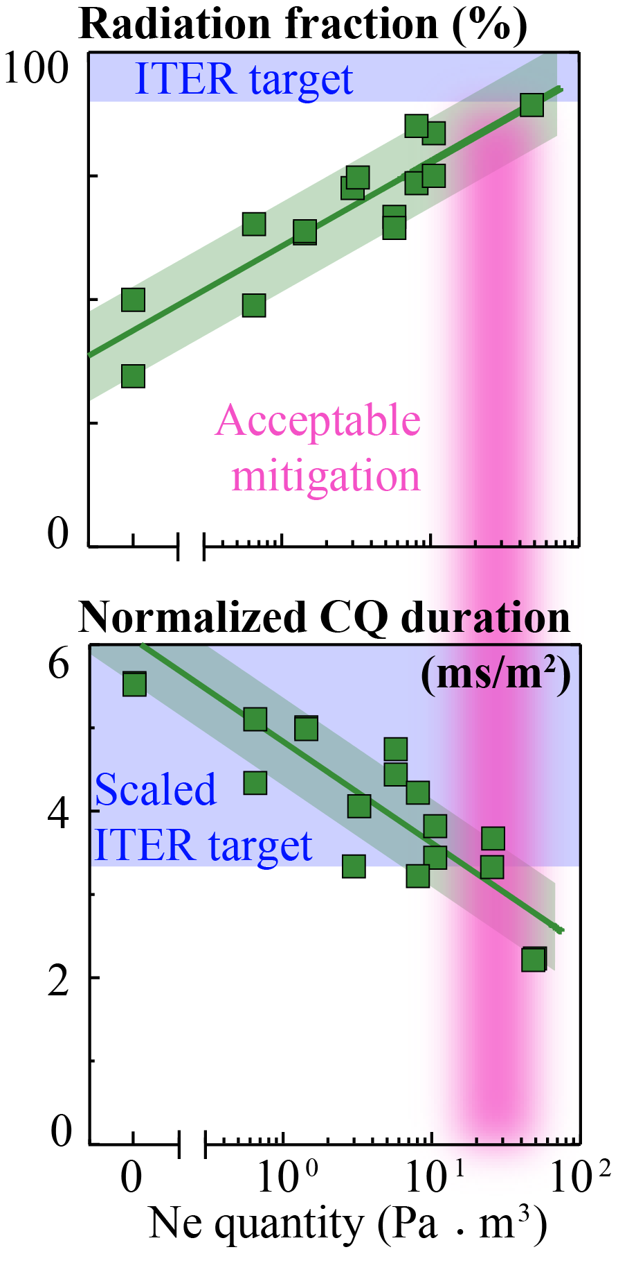
Encouraging Results For Disruption Mitigation With Shattered Pellet Injection (Adopted by ITER)
Large cryogenic pellet shattered in guide tube provides pulse of tiny solid shards
Varying deuterium / neon mix provides control of disruption characteristics
Achieved first demonstration of runaway electron plateau dissipation with SPI
Installing 2nd SPI (ITER prototype) to study asymmetries
Increases confidence that SPI will be an effective disruption mitigation tool for ITER

Slide 5
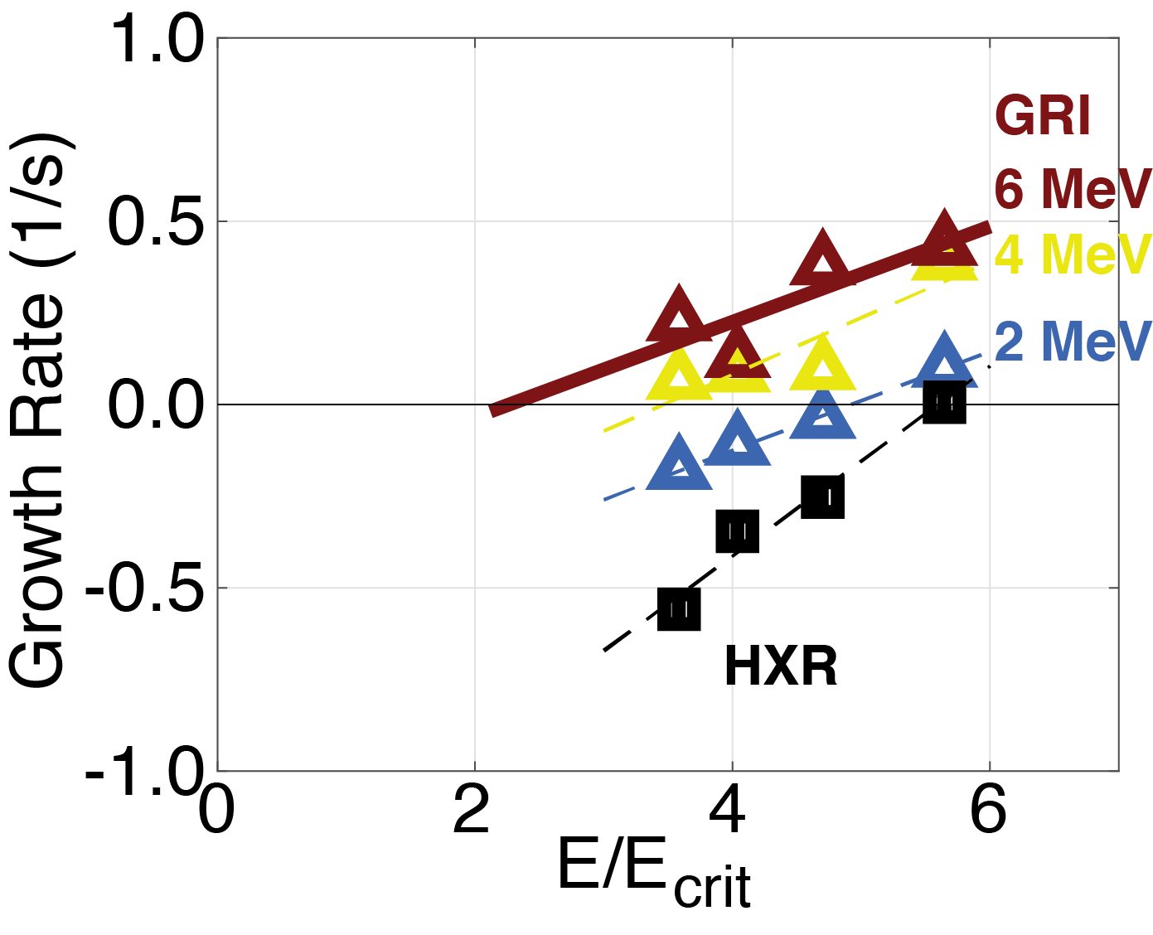
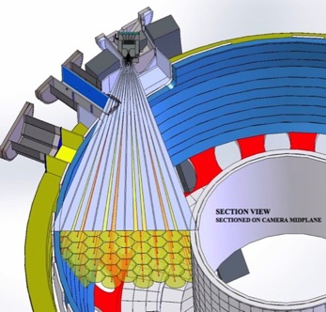
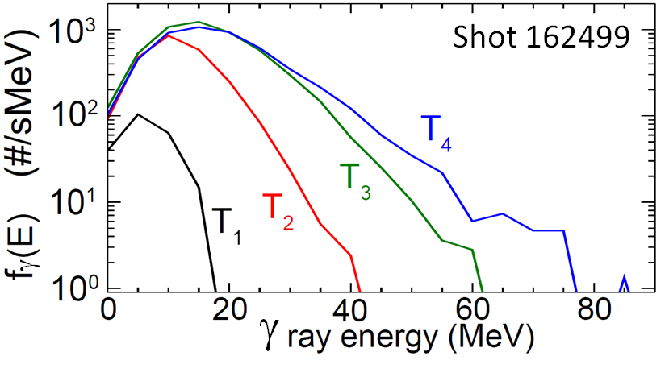
Gamma Ray Spectroscopy Reveals Growth of High Energy Runaway Electrons (REs) Is Matching Theory
Gamma ray imaging camera
High energy REs grow with electric fields E/E_{crit}~2
  Theory predicts growth at E/E_{crit}~1.6
  Lower energy RE growth at higher E/E_{crit}~5
High energy REs are more difficult to dissipate
→ better to prevent initial growth

Slide 6
DIII-D/ASDEX–U RMP-ELM Experiments Represent An Important Milestone for ELM Transient Control
DIII-D experiments identified key elements in AUG compatible shape
  Low ν* & triangularity important
  (enhance plasma response)
AUG established ELM suppression
  Raised δ increased performance
Excellent confinement &
effective tungsten exhaust
RMP-ELM suppression proven with metal wall
Notes:
OVERLAY RMP? CONTEXT SLIDE…

Slide 7
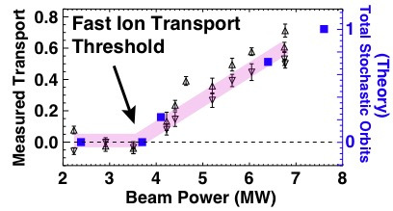
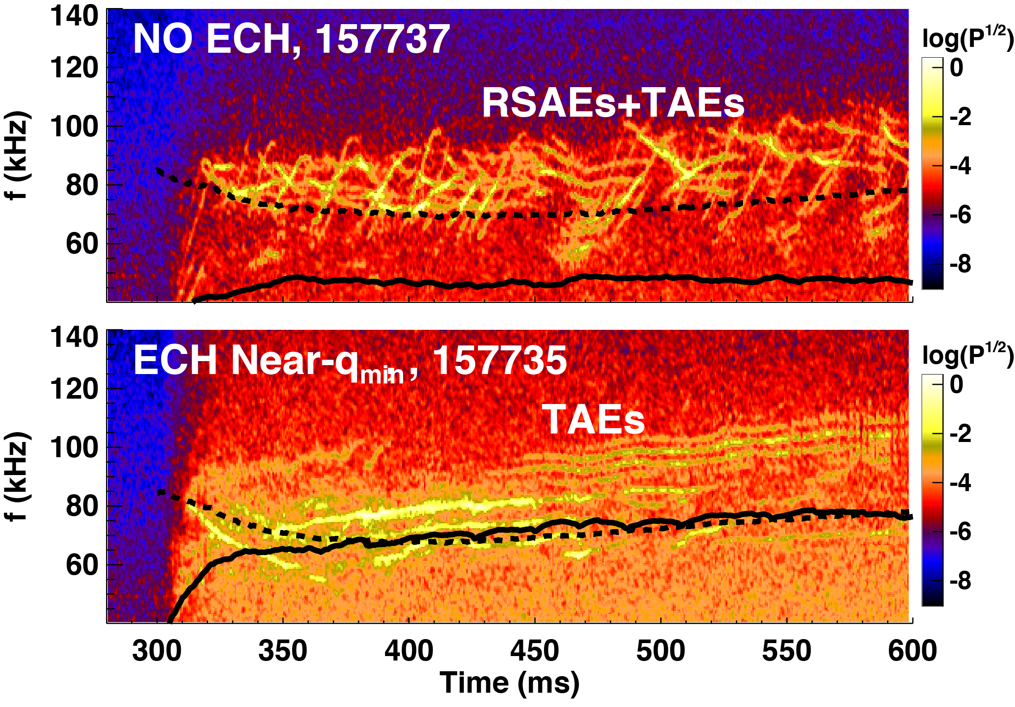

Significant Fast Ion Transport & Losses Result From Interplay of Energetic Particle Driven Modes
Multiple Interacting RSAEs in DIII-D
f_{TAE}
f_{RSAE-min}
DIII-D: enhanced transport when
modes overlap

Slide 8
Significant Fast Ion Transport & Losses Result From Interplay of Energetic Particle Driven Modes
ECH modification of RSAEs in DIII-D
f_{TAE}
f_{RSAE-min}
f_{TAE}
DIII-D: enhanced transport when
modes overlap
ECH changes temperature
gradient, removing mode overlap
Simulation now predicts existence
and evolution of RSAEs
f_{RSAE-min}

Slide 9
Significant Fast Ion Transport & Losses Result From Interplay of Energetic Particle Driven Modes
ECH modification of RSAEs in DIII-D
f_{TAE}
f_{RSAE-min}
f_{TAE}
DIII-D: enhanced transport when
modes overlap
ECH changes temperature
gradient, removing mode overlap
Simulation now predicts existence
and evolution of RSAEs
f_{RSAE-min}
Experiments and simulation are improving predictive capability for ITER

Slide 10
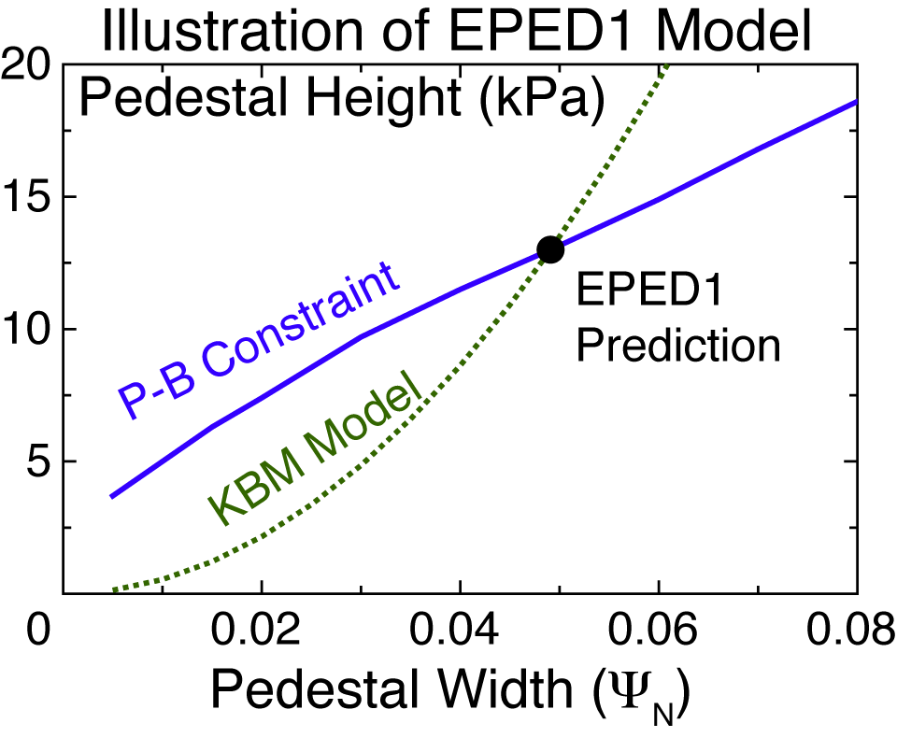
EPED Model Is Providing a Framework for Optimizing the Edge Pedestal to Avoid ELMs and Increase Confinement
Increasing pedestal stability supports higher core plasma performance

Slide 11
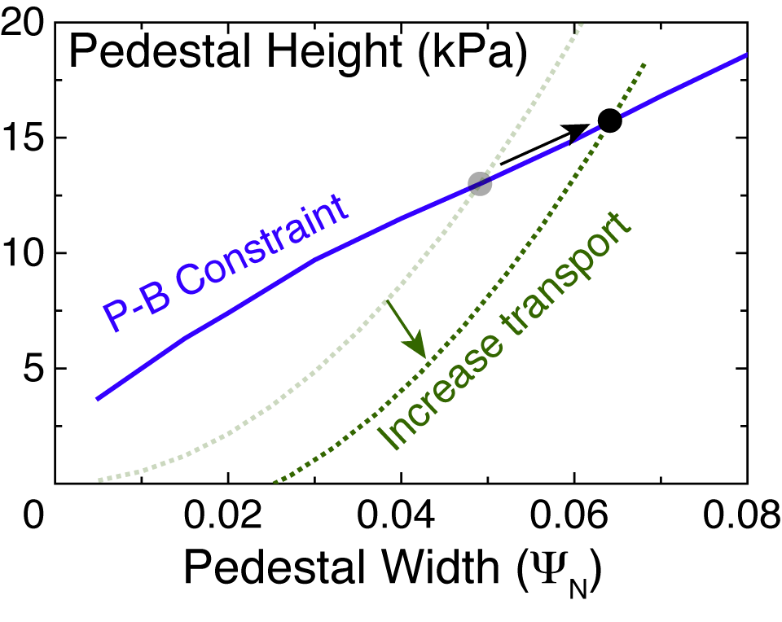
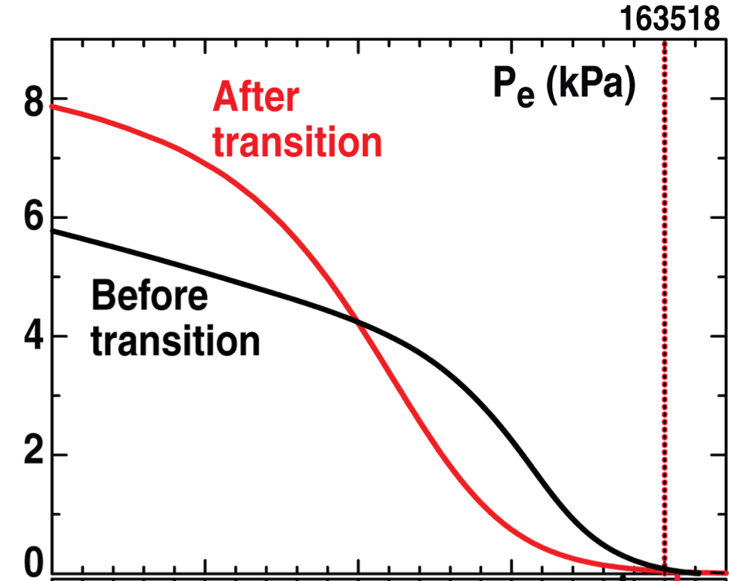
EPED Model Is Providing a Framework for Optimizing the Edge Pedestal to Avoid ELMs and Increase Confinement
Low-torque
Wide pedestal
QH mode
•
Previous
high torque QH-mode
0.85
0.90
0.95
1.00
ρ
Increasing pedestal stability supports higher core plasma performance
QH-mode maintains high pedestal without exceeding ELM threshold

Slide 12
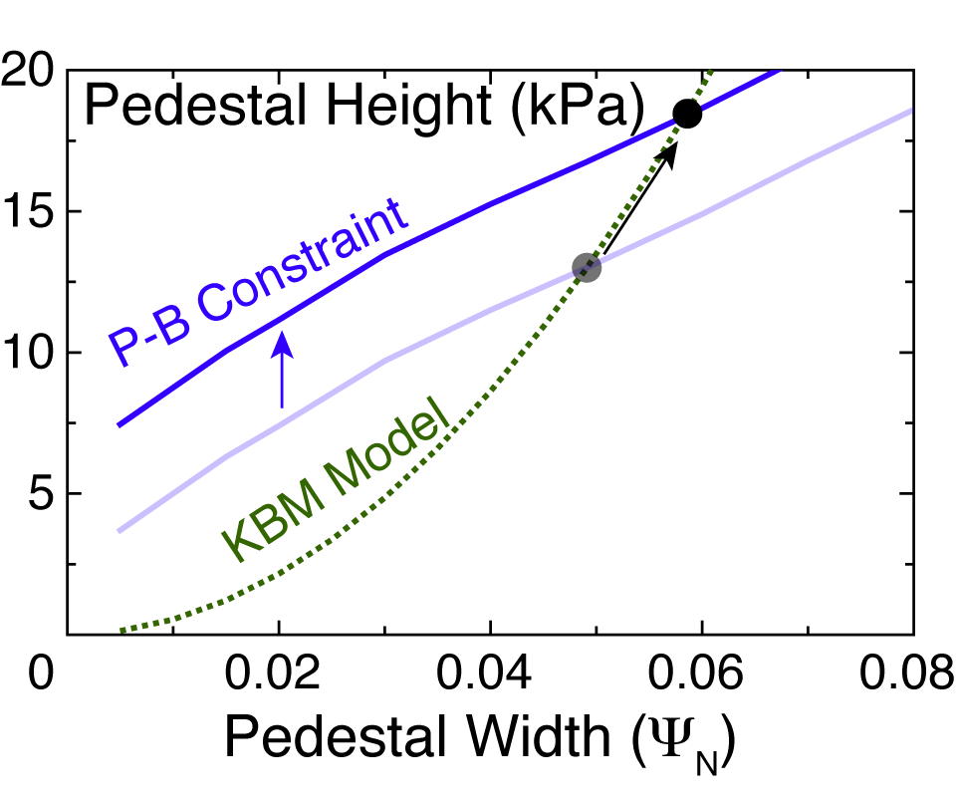
EPED Model Is Providing a Framework for Optimizing the Edge Pedestal to Avoid ELMs and Increase Performance
Low-torque
Wide pedestal
QH mode
•
Previous
high torque QH-mode
0.85
0.90
0.95
1.00
ρ
Increasing pedestal stability supports higher core plasma performance
QH-mode maintains high pedestal without exceeding ELM threshold
Extending Super H-mode may yield further increases in performance

Slide 13
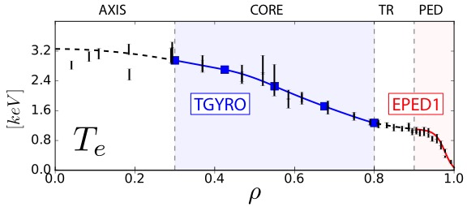
Theory-Experiment Validation Has Increased Confidence in ITER Achieving its Q=10 mission
Self-consistent coupling of core & pedestal theoretical models
  No free or fit parameters
Whole profile iteration converges
to unique solution
  Predicts β_{N} to ~15% in
  200 DIII-D cases
Enables prediction and optimization of ITER fusion gain: Q~12 possible
New computing frontier: Multi-scale turbulence simulations
(TGLF+NEO)
Results reported at IAEA FEC 2016

Slide 14
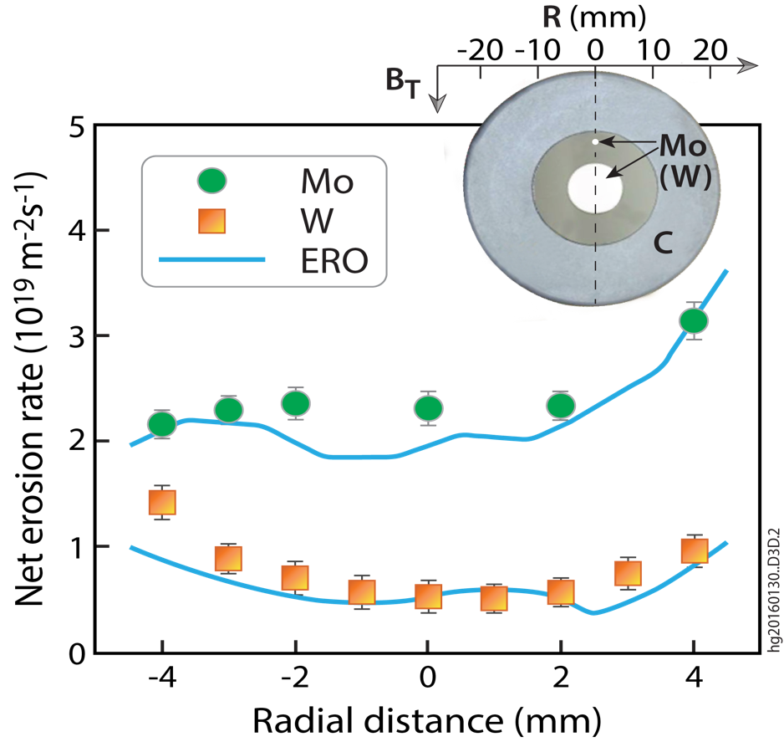
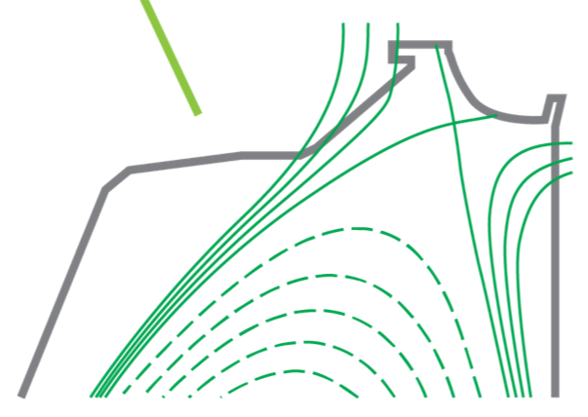
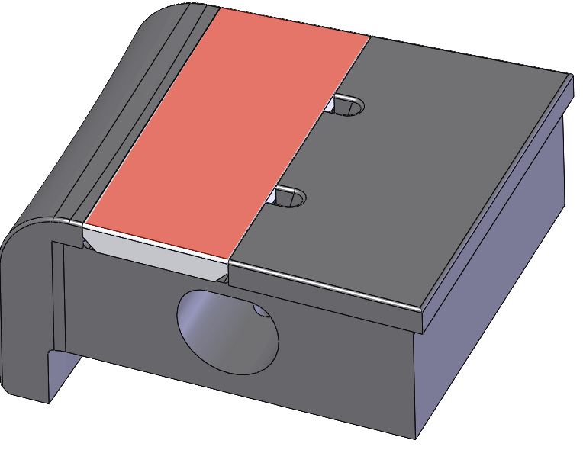
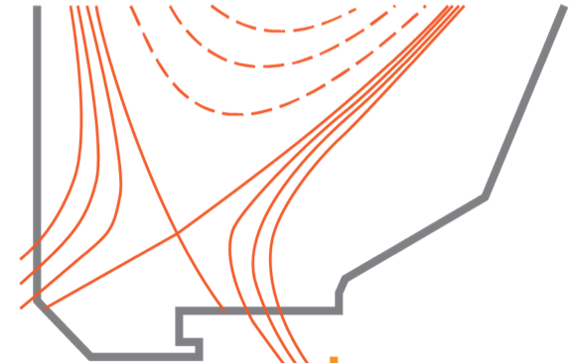
DIII-D Boundary/PMI Center Is Developing the Scientific Basis for Advanced Divertor Solutions
Research Goals
Use enhanced diagnostics to identify
physics and validate models
Vary geometry and configuration:
to test predictive capability
Work with materials community
to assess candidate materials
Model Validation: Helium Detachment
Measured
P_{rad}
SOLPS P_{rad}
Divertor Erosion and Migration
Divertor Closure Experiments
Tungsten
W¹⁸²
DiMES

Slide 15
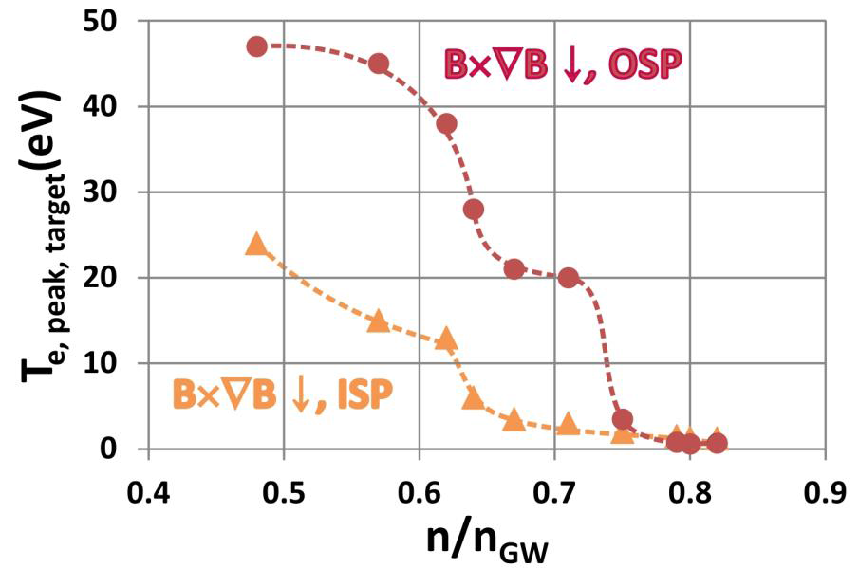
Ion Drifts Produce Strong Divertor Asymmetries in Particle Flux and Detachment Threshold Density
∇B drift into divertor: Asymmetric T_{e}, n_{e} and detachment
Divertor Thomson Scattering Data

Slide 16
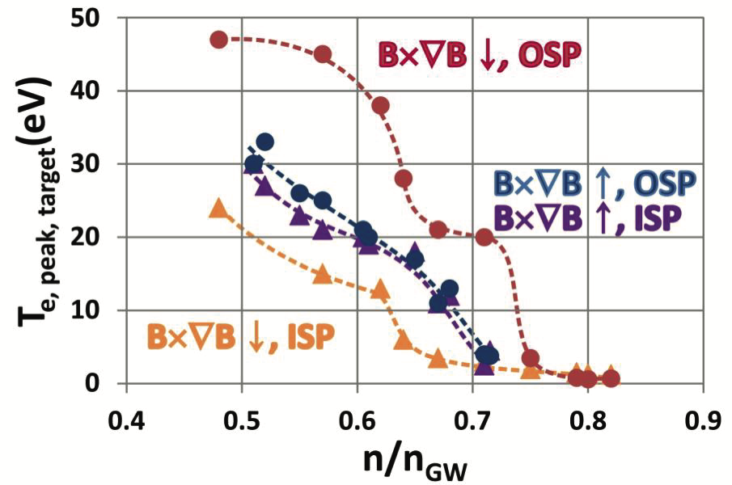
Ion Drifts Produce Strong Divertor Asymmetries in Particle Flux and Detachment Threshold Density
∇B drift into divertor: Asymmetric T_{e}, n_{e} and detachment
∇B drift out of divertor: Symmetric T_{e}, n_{e} and detachment
Divertor Thomson Scattering Data
Including drifts in models reproduces major features

Slide 17
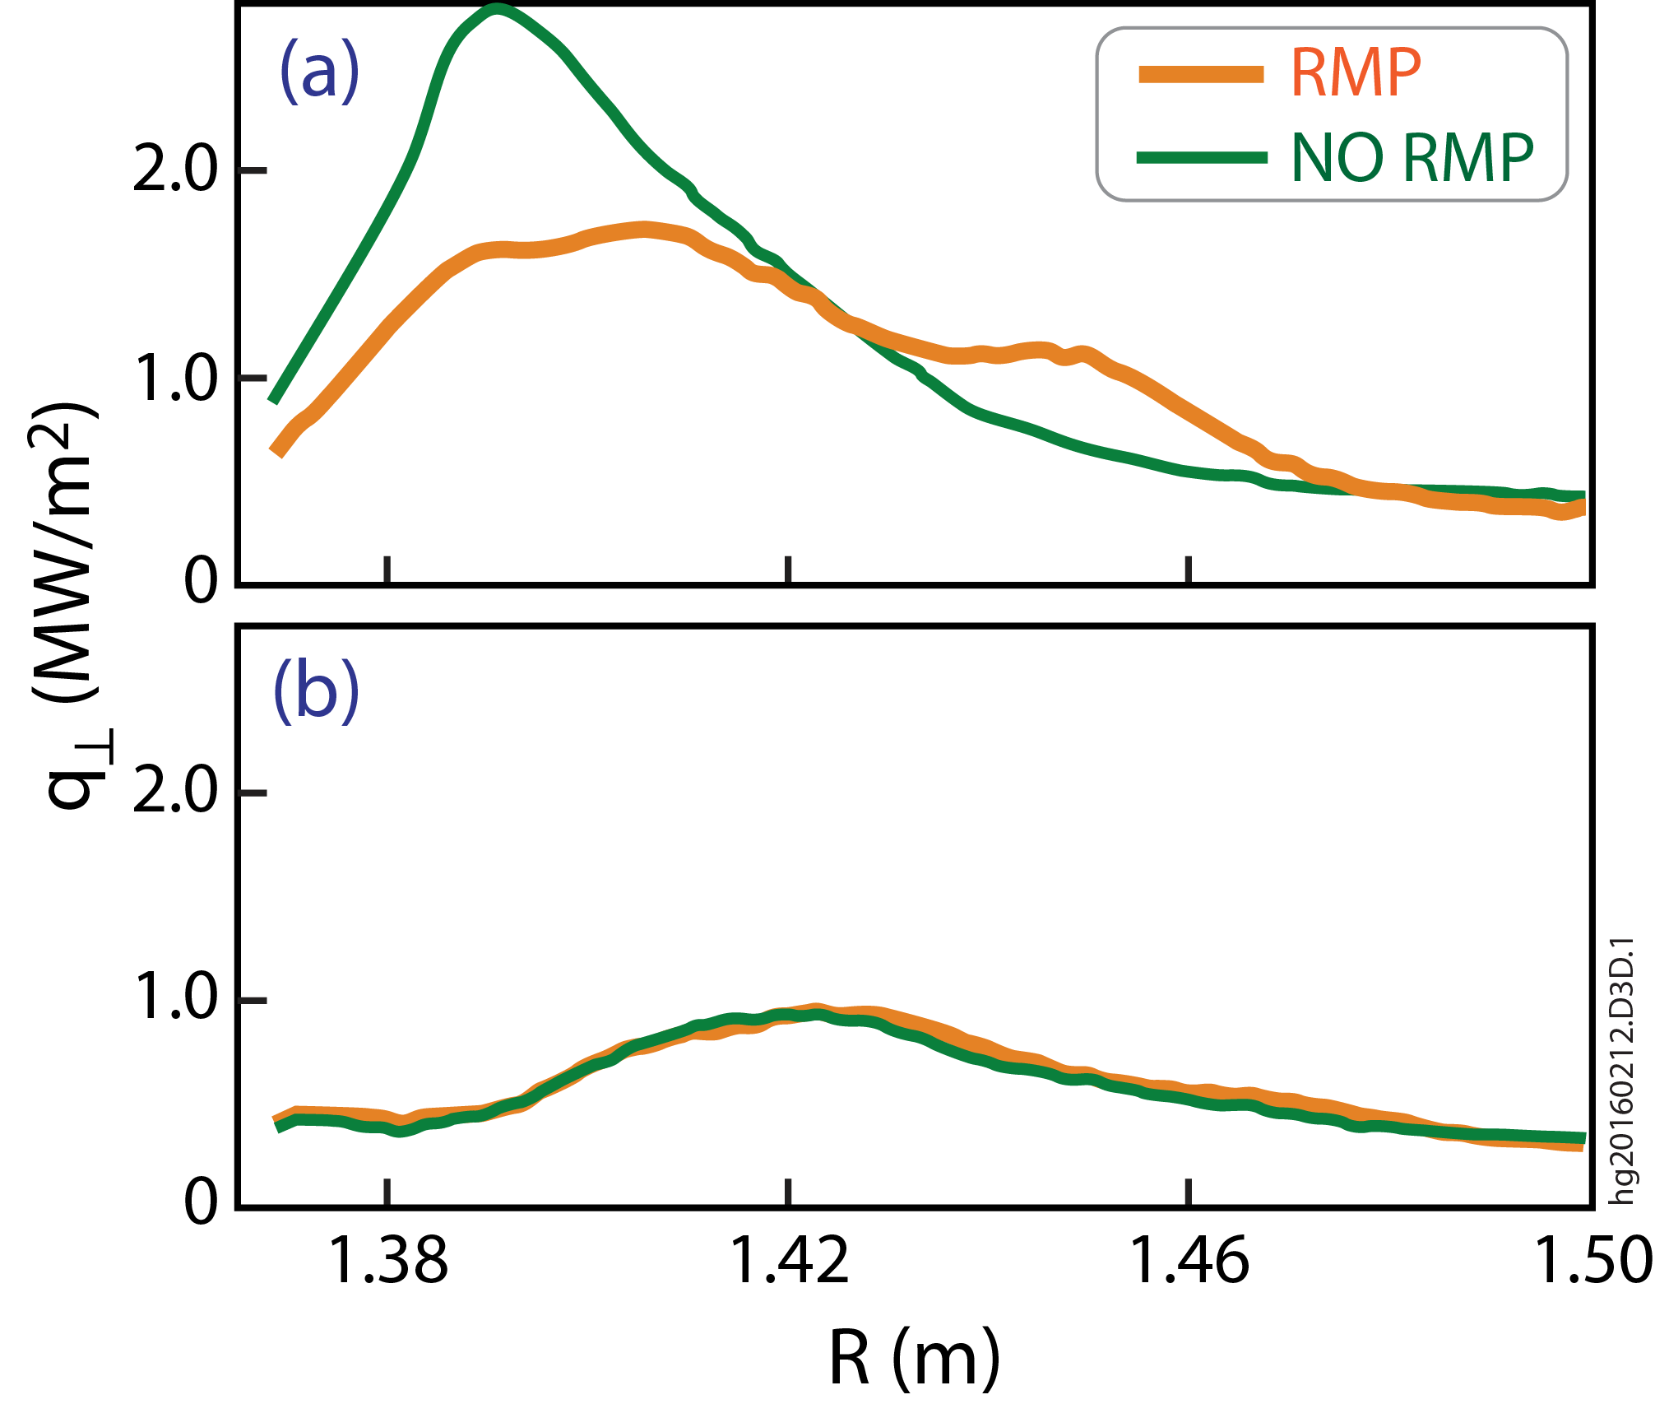
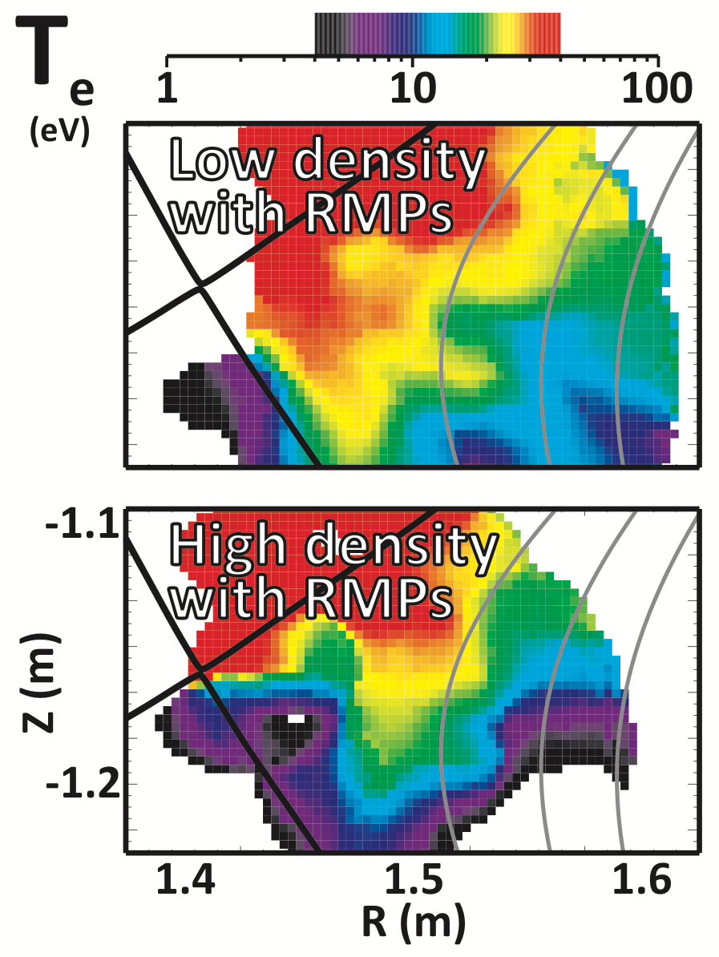
Obtained First Evidence that Non-Axisymmetric Inter-ELM Heat Flux Is Eliminated During Detachment
Heat flux (MW/m²)
2
1
Low density
0
2
High density, detached
1
0
1.38
1.42
1.46
1.50
R(m)
Heat flux profile is broadened with RMP, exhibiting a structure indicative of non-axisymmetric striations, also seen in T_{e} profile
3D heat flux striations between ELMs are eliminated at high density
  Before partial detachment and continuing through to detachment
Suggests ITER should not see divertor asymmetries from RMP ELM suppression

Slide 18
AT Operation With Tungsten Divertor Target Achieved Similar Performance As With Carbon (With Caveats)
Best results with on-axis ECH
Accumulation highly sensitive to profiles
Tungsten radiation sensitive to T_{e} profile and time history
  P_{rad} sensitive to T_{e} =3-4keV
  Recombination slower than ionization

Slide 19
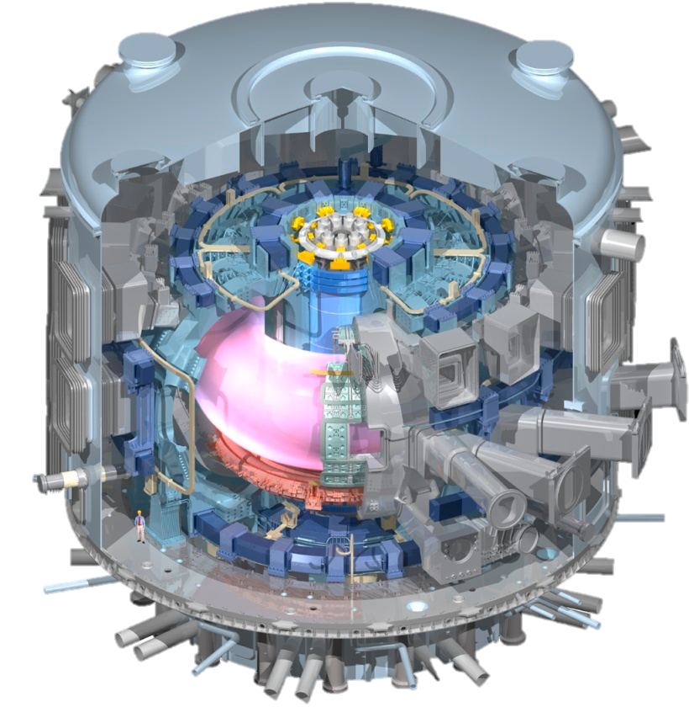
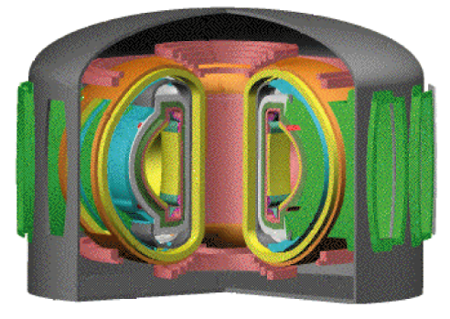
DIII-D Targets Key Priorities in Fusion Development
ITER success
  Operational basis for rapid progress to Q=10
  Resolve (few) remaining design issues
  Scientific basis for confident projection
  and exploitation of ITER
Path to Fusion Energy
  High β Advanced Tokamak
  Power handling: divertor & materials
Address through focus on underlying physics & exploration

Slide 20

Profile Flexibility Will Enable DIII-D to Study the Physics of High β_{N} Operation For Attractive Reactor Solutions
Research will explore key profile
dependencies in high β regime
  Stability above the no-wall limit
  Turbulence modification by magnetic shear
  Fast ion redistribution physics
Enabled by increased off-axis current drive and electron heating:
  One-year shutdown to add 2nd
  off-axis beam for current drive
  Increased ECH (1.5MW 117Ghz) for H&CD and mode control
Peaked
Broad
Peaked
Broad
Current Profile
Current Profile
LTO3: 2nd
OANBI
Co-cntr
Flexible profile tools:
J||
Will determine scientific foundations and existence proofs for viable steady state
Off axis
beam
On axis
beam
ECCD
0
Normalized radius
1

Slide 21
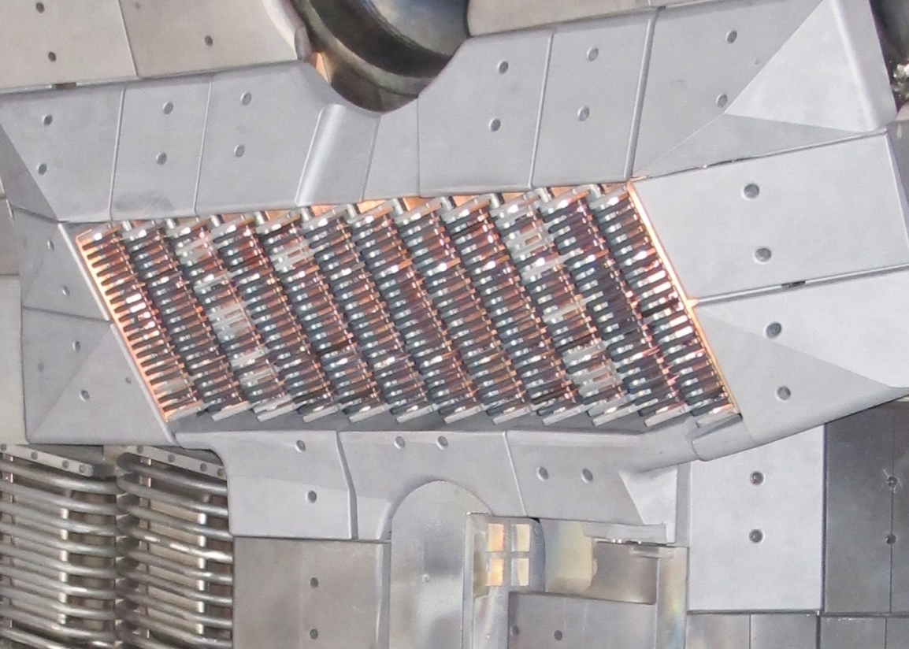
Actively Investigating Alternative Approaches to
Potentially Reactor-Relevant Off-axis Current Drive
Helicon Wave Current Drive
High-field Side LHCD (MIT)
Low power test antenna
High efficiency at high density
Challenge: adequate coupling
Low power test: good loading in high beta AT plasma
Planning for 1 MW test
High efficiency, proven technology
Quiescent inner SOL should allow smaller gaps, good coupling
Evaluating possible launcher locations and waveguide routing, using C-Mod hardware
Notes:
with 12-element phased-array antenna at < 0.4 kW (476 MHz)

Slide 22

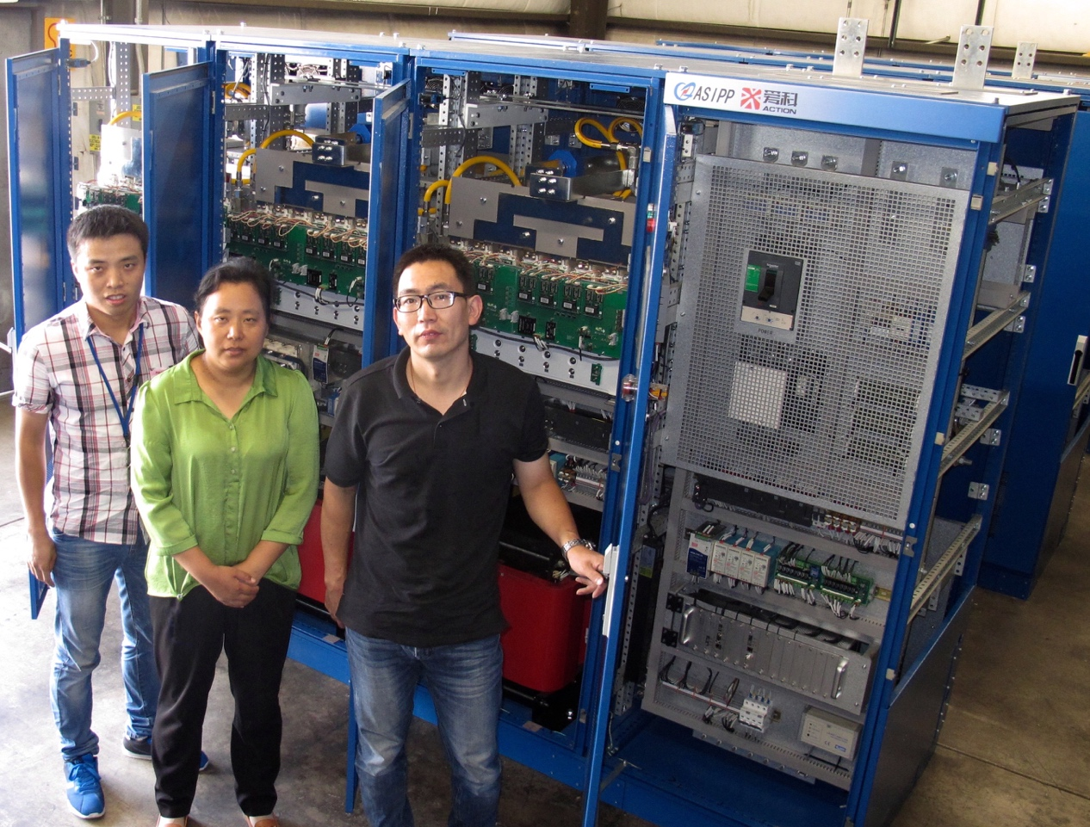
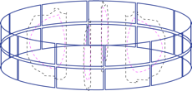
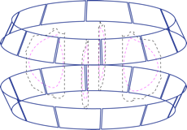
EAST Collaboration Provides New Power Supplies to Advance Physics of 3D Fields
ASIPP poloidal field AC power supply increases shaping flexibility and capability for high-current, multi-mode 3D fields
New physics & control includes
  Multiple-n excitation of plasma modes
  Actuator sharing for ELM control, error field correction, MHD spectroscopy, etc.
New Coils will advance physics & control
  Broader n-spectrum: n → 6
  Greater selectivity in m-spectrum
  for Torque control, ELM control, …
Further 3D coil sets are being considered
Possible New Coil Sets

Slide 23
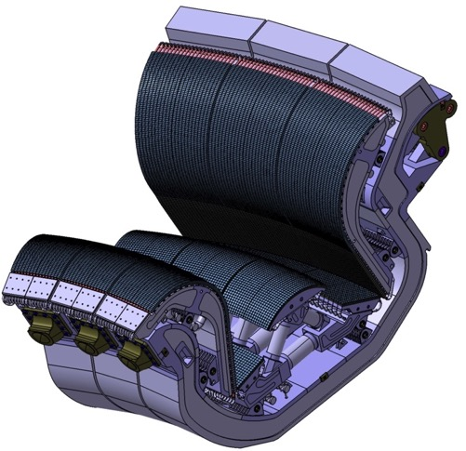
Advanced Divertors Should Minimize and Simplify the Volume Needed for Reliable Dissipation of Plasma Losses
Improve physics understanding to
develop improved divertor concepts
  Enhanced measurements to isolate physics
  Systematic divertor modifications to
  determine key dependencies
  Compare against state-of-the art
  numerical simulation
Test Advanced Materials for fusion
  Evaluate erosion, migration and re-deposition
  on a variety of scales
  Assess impact and mitigate impacts on core plasma
Assess compatibility with high performance core
ITER
divertor module
Validated models are essential for extrapolating to
future devices and to design optimized divertors

Slide 24
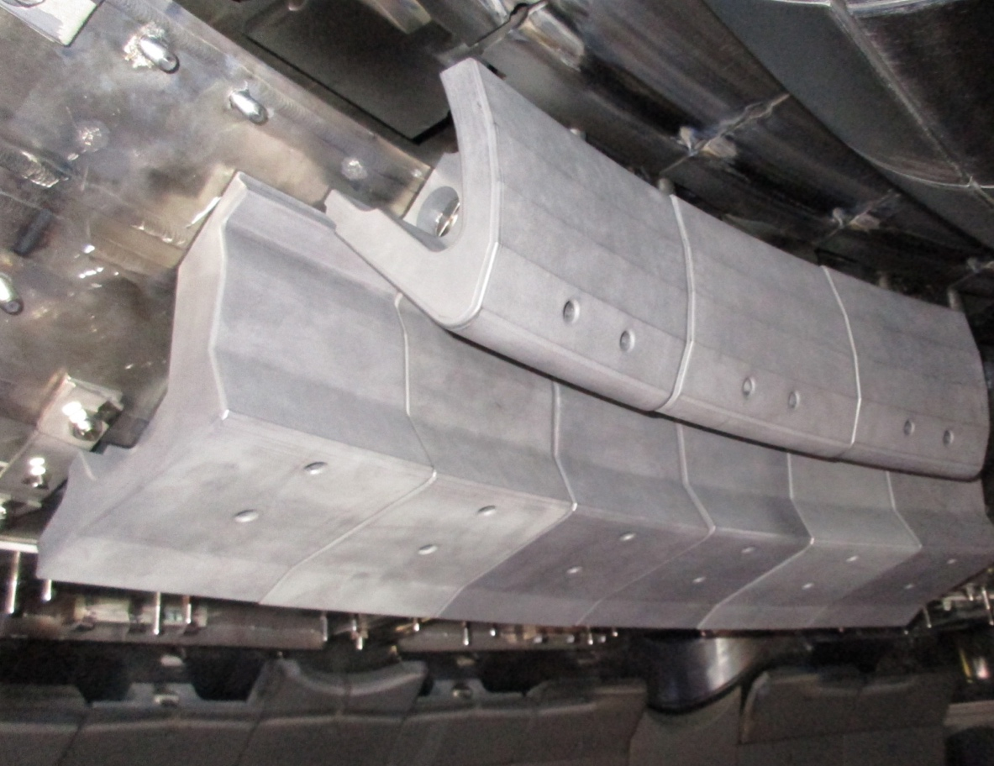
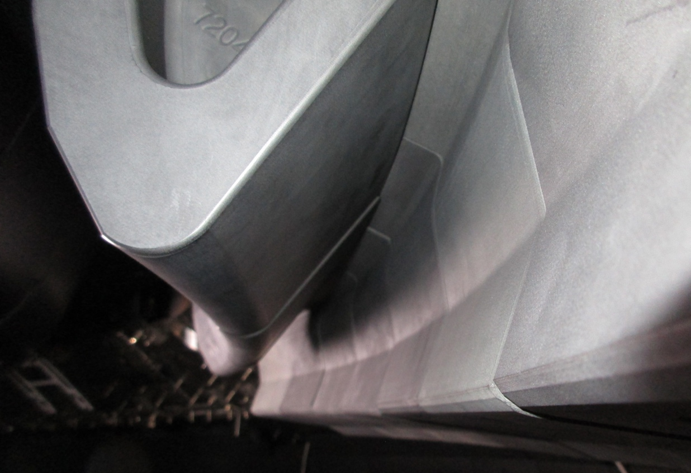
  New Divertor Is Being Installed for FY17 Experiments to Increase Operating Window for Divertor Detachment
Phase IA (FY16-17): SAS prototype test
  Reshape the upper divertor tiles to
  increase divertor closure (SOLPS)
  Essential diagnostics (Langmuir Probes, TC, spectroscopy, DTS)
  Compatible with AT shaping

Slide 25
  New Divertor Is Being Installed for FY17 Experiments to Increase Operating Window for Divertor Detachment
Phase IA (FY16-17): SAS prototype test
  Reshape the upper divertor tiles to
  increase divertor closure (SOLPS)
  Essential diagnostics (Langmuir Probes, TC, spectroscopy, DTS)
  Compatible with AT shaping
Phase IB (LTO3): Validation of SAS physics basis
  Complete significant diagnostic
  enhancements
  Improve tile shaping if needed
Phase II (FY19): Improved divertor
  Demonstrate improved
  detachment with Pumping
  Test compatibility with AT

Slide 26
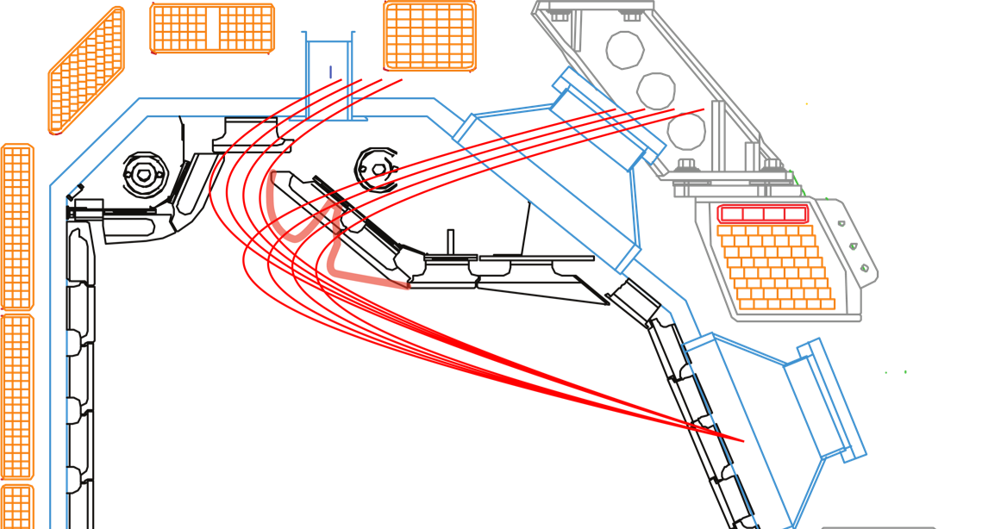
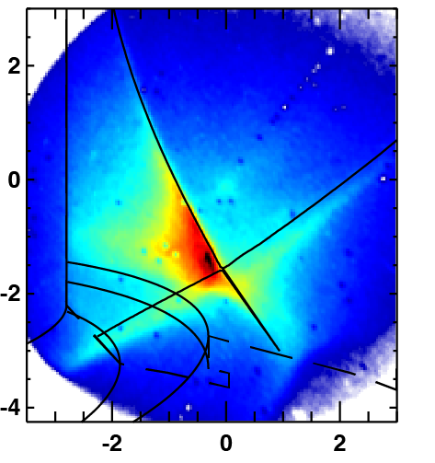
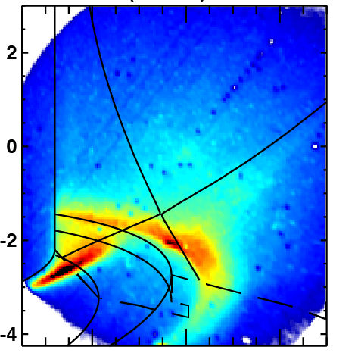
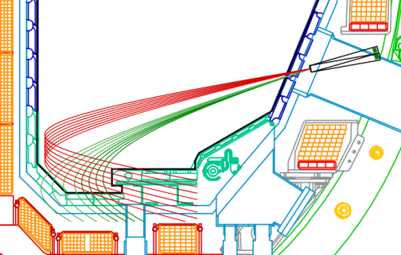
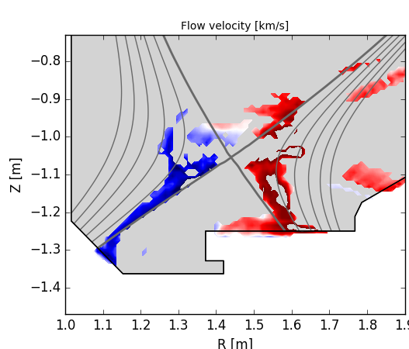
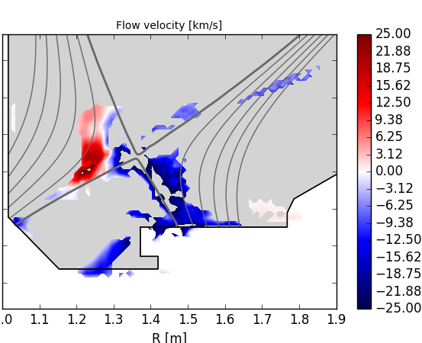
New Boundary Diagnostics Target Key Parameters for Boundary Model Validation Studies
New VUV Spectrometer
Lyman-alpha imaging
Detached
Attached
160380.3180
160380.1680
New bolometer view chords
New Divertor Thomson Chords
Divertor Flow Imaging
Rev Btor
Fwd Btor

Slide 27

DIII-D Expects To Operate 14+3 Weeks in FY17 (Depending on Funding)
Vessel is open now for upper-divertor modifications, diagnostic improvements, and system refurbishments.
Near-term operating schedule (FY17-18) awaits budget and DOE guidance (present guidance is 14 weeks)
Working toward year-long torus opening (LTO3) starting Aug. 2017 to modify a beam-line for Co-counter Off-Axis injection
Now developing plans for two special research campaigns:
  NSTX-U National Campaign (39 proposals for 2 operating weeks)
  Frontier Science Evaluation Campaign (fundamental plasma physics)
    Engage university programs for non-fusion plasma research
    Small working group now evaluating ideas for 1 additional run week.
Now starting preparation of the research plan for FY 2019-2024
  Evaluating research emphases and potential facility upgrades
  Will discuss at a Program Advisory Committee meeting in March 2017

Slide 28












DIII-D Program Will Continue Working With World Tokamak Programs to Prepare for ITER and Future Next-step Devices
JET
MAST-U
ITER
ASDEX-U
JT-60SA
Develop physics basis for controlled high performance scenarios
Develop and evaluate new materials and boundary solutions
Extend to long-pulse operation on superconducting devices
DIII-D
NSTX-U
TCV
SST-1
EAST
KSTAR
International Collaboration Accelerates Fusion Energy Development

