Slide 1
The path to delivering nuclear fusion power
Ian Chapman

Slide 2
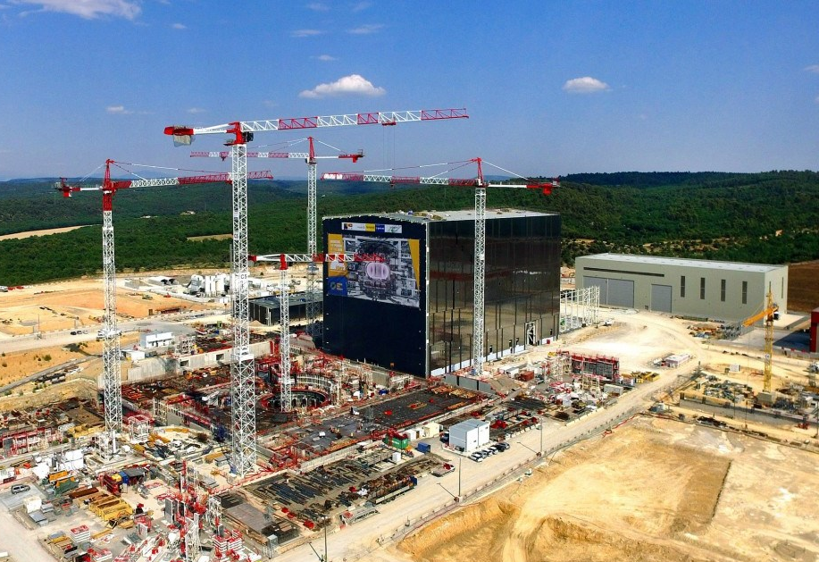
Now entering the ‘delivery era’
Must ensure we deliver!

Slide 3
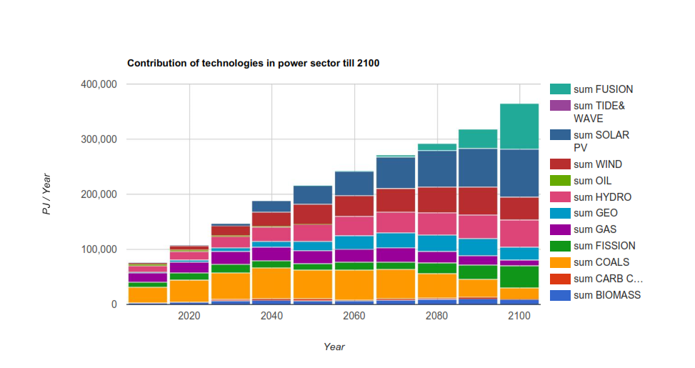
Why do we need fusion?
Assume a goal is to deploy fusion power to a level that
“replaces” a higher carbon source
provides back-up for renewable fluctuations
i.e. primarily strategic drive rather than pure COE competition
Globally implies that we need ~1 TW(e) capacity by early next century ~10% of global demand. 1000 reliable fusion power plants?!
Average growth of ~10-15%/year implied when in industrial phase after DEMO (tritium economy, other resources: e.g. superconductor strand)
COE needs to be reasonably competitive by then
Fusion

Slide 4
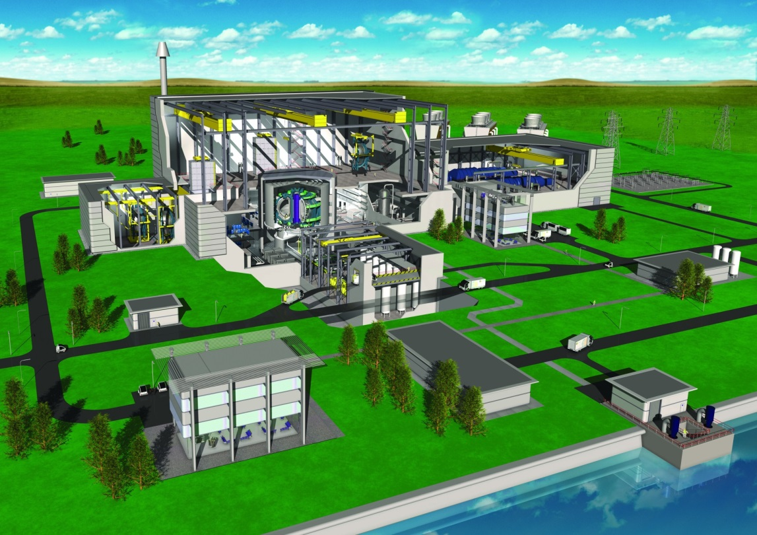
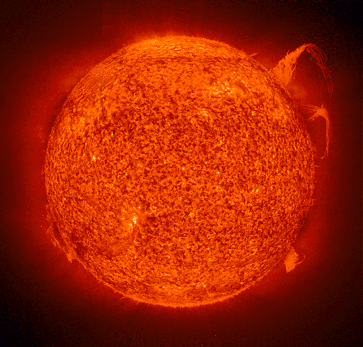
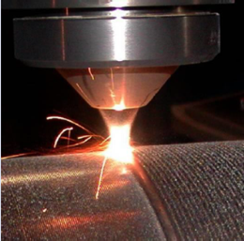
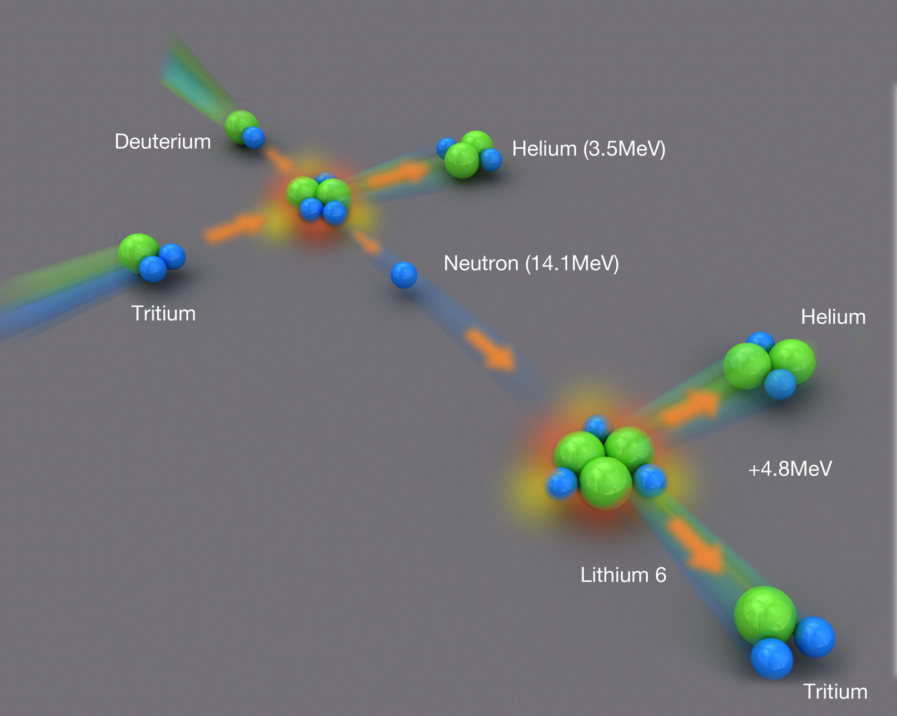
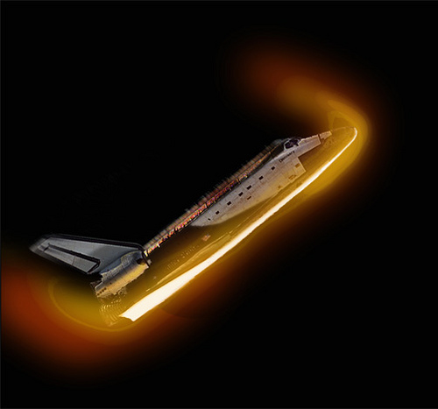
Fusion requires integrated solutions
Robotics
Plasma Science
Exhaust and High Heat Flux
Technology
Tritium
Materials Science

Slide 5
What Determines the Economics of a Future Fusion Power Station?
Cost of the power station – not cost of fuel which is very small
Power output – depends on developments in plasma physics, materials, technology and engineering, as well as maximum tolerable for grid.
Availability – what fraction of time the plant is running, depends on design, reliability, component lifetime and maintenance schemes.
What is the point of considering this during R&D phase?
Identifying the main levers for improving economics helps to guide the fusion programme.

Slide 6
Cost of plant

Slide 7
What Empirical Data on Costs Exists?
At GW scale predicts few $/W_{th} (2000$)
These are one off experimental devices not including power conversion equipment

Slide 8
ITER Costs
In the earlier studies, power plant costs of around 2€/W_{f} were typical with cost per W_{e} depending on technology
But ITER looks to be costing closer to 30€/W_{f.} Why?
Economies of Scale. Expect ITER specific cost to be a factor of around 3 higher.
Technological learning. Expect ITER cost higher by factor of around 2.
Inflation in power sector. Expect cost increase of factor of around 2.
Project structure. Expect cost increase of factor P (value unknown to me).
Overall, expect ITER specific cost to be a factor of 12P higher than earlier powerplant estimates, and P >>1.25!

Slide 9
Is there Evidence of Technological Learning?
Can only look to analogues. MRI scanner magnets approximately halved in price in 5 years as production ramped up

Slide 10
Where do Costs Lie?
PROCESS is really set up for power-producing plants, unlike ITER, but where the systems are similar the costs appear to be similar. Cost estimate using PROCESS was 3.5B$ direct cost, 5.5 B$ total cost (1989$). Using normal costing approach, inflation (CPI) would have increased this to a total of 9.5 B$ (2009).

Slide 11
Disruptive R&D - I
Modularised Magnets
The inability to repair a damaged TF coil once in operation is an inherent weakness of current designs
>25% ITER cost is magnets, FPP cost being a barrier to realisation
Modularised construction will reduce total installed cost
Removable magnets may facilitate remote handling
Cheaper nuclear concrete
Many $Bns in ITER concrete and buildings
Big issue for fission new-build too
Should we have a nuclear concrete R&D programme?!

Slide 12
Power output

Slide 13
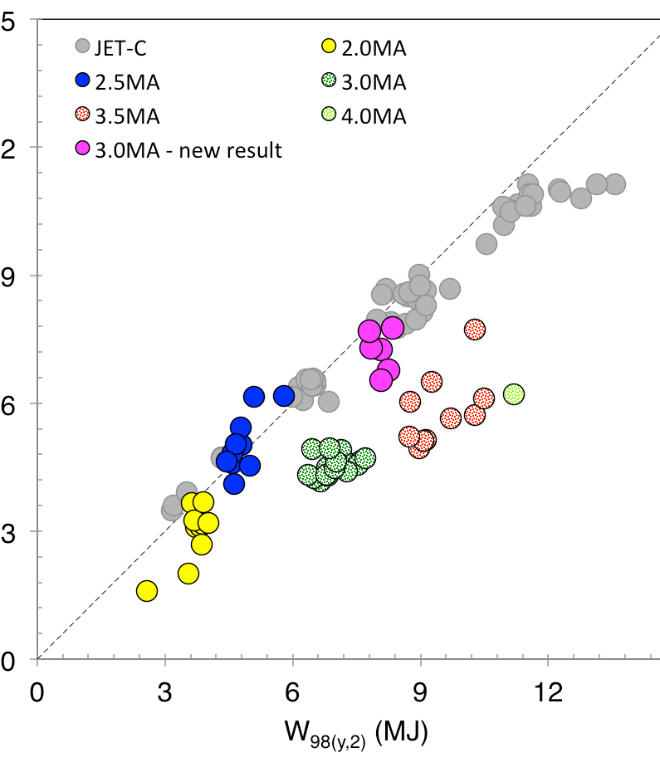
Developing JET scenarios for ITER
JET plasmas being re-optimised to meet metal wall constraints
Recent experiments have extended domain of good confinement (at or above scaling developed for ITER) to higher plasma current
Set new records in stored energy & neutron rate since ITER-like wall installed
15
12
W_{measured} (MJ)
15
Litaudon et al IAEA-FEC 2016

Slide 14
Disruptive R&D - II
Disruption free plasmas
Experience tells us: Tokamak plasmas will always disrupt
Large disruptions in DEMO damage the blankets, resulting in unacceptable availability
Engineering design is hampered by assuming crippling disruption loads in normal operation
Prioritise advances in stable scenario development
Divertor solution
Erosion rate of current solid divertor targets is availability sapping
20MW/m² may be the limit for conventional divertor target materials within current constraints
Can we relax constraints on materials by better configurations?

Slide 15
Disruptive R&D - III
Advanced design methodology
Currently developing single design point optimisation over years based on short process code runs
Need simultaneous design point optimisation with faster iteration
Multi-physics modelling is central pillar, with closely coupled models allowing plug-ins to iterate designs quickly
Configuration is controlled with good visibility of reference

Slide 16
Availability

Slide 17
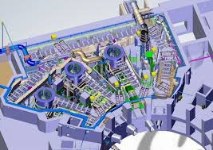
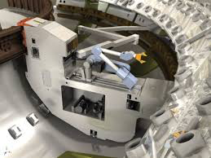
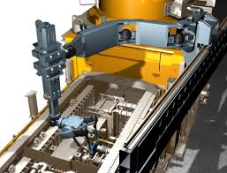
ITER: Massive industrial robot solutions
Divertor RHS
Neutral Beam RHS
Cask and Plug

Slide 18
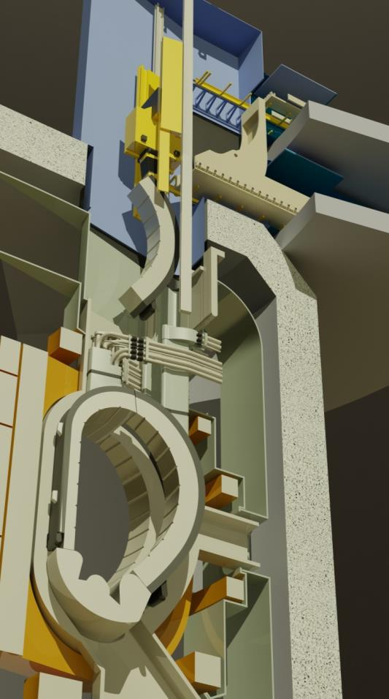
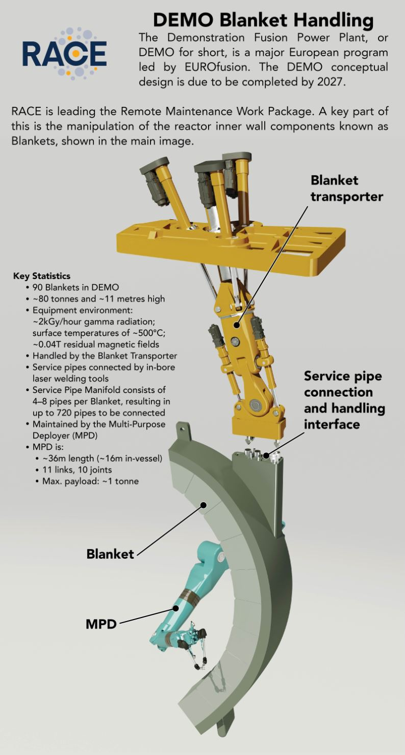
DEMO blanket handling

Slide 19
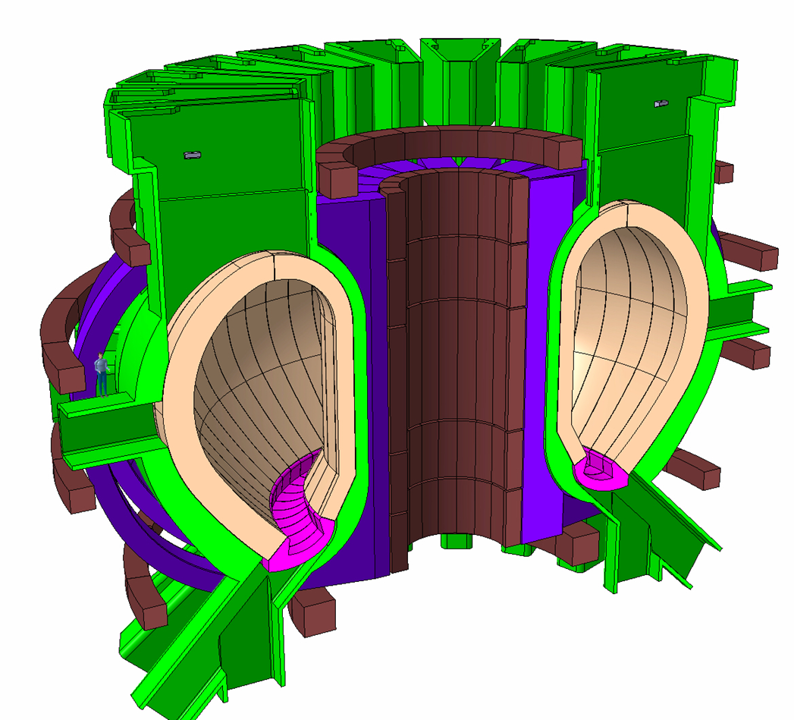
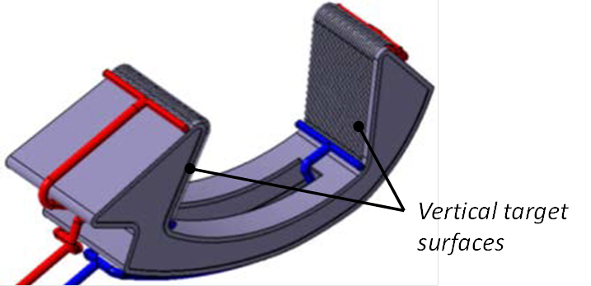
Example: Divertor Monoblock
Vertical targets made from rows of cooled tungsten monoblocks

Slide 20
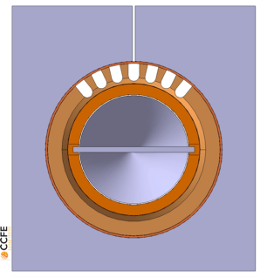
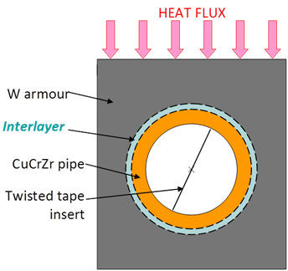
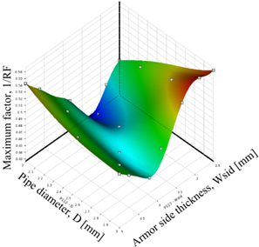
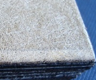
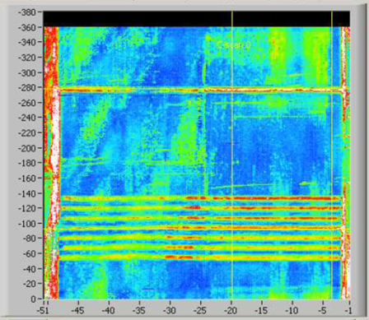
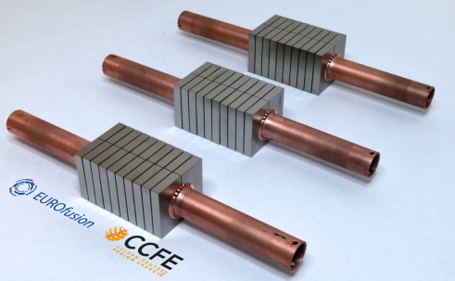
Prototyping Cycle
Final design pipe, break embedded in W monoblock
Various options tested for manufacturability
Problem: reduce stress on pipe
Design Search Optimisation -“Thermal Break” solution
X-ray tomography of manufacture component shows flaws in contact
Revised Manufacturing Process
Virtual Prototyping of as-built component
Test pieces manufactured
Testing
Ultrasonic - bond integrity
SATIR thermographic testing
HHF-GLADIS/FE200/HIVE
Debonded FEM
Ideal FEM

Slide 21
Disruptive R&D - IV
Better remote maintenance solutions
Availability has strongest exponent for cost of electricity
Maintenance schemes are usually added as after thought, but are actually device defining drivers
Can we make more space, more robust, cheaper robots?
Can we benefit from massive robotics industry (transport, petrochem…)?
Developing and fabricating better materials
Dealing with combined loads of extreme heat, neutrons and helium
Again, can we benefit from refractory metals and advanced manufacturing for other sectors?

Slide 22
Implications for fusion programme

Slide 23
What should fusion community do?
Four distinct goals
Make ITER a success, and soon!
Earnest integrated fusion power plant design (to the standards of nuclear industry)
Innovation to improve performance & make reactors cheaper (and/or smaller, faster, easier, safer….)
Exploitation of synergies with other sectors to reach critical mass of industrial engagement and benefit from best practice and tools

Slide 24
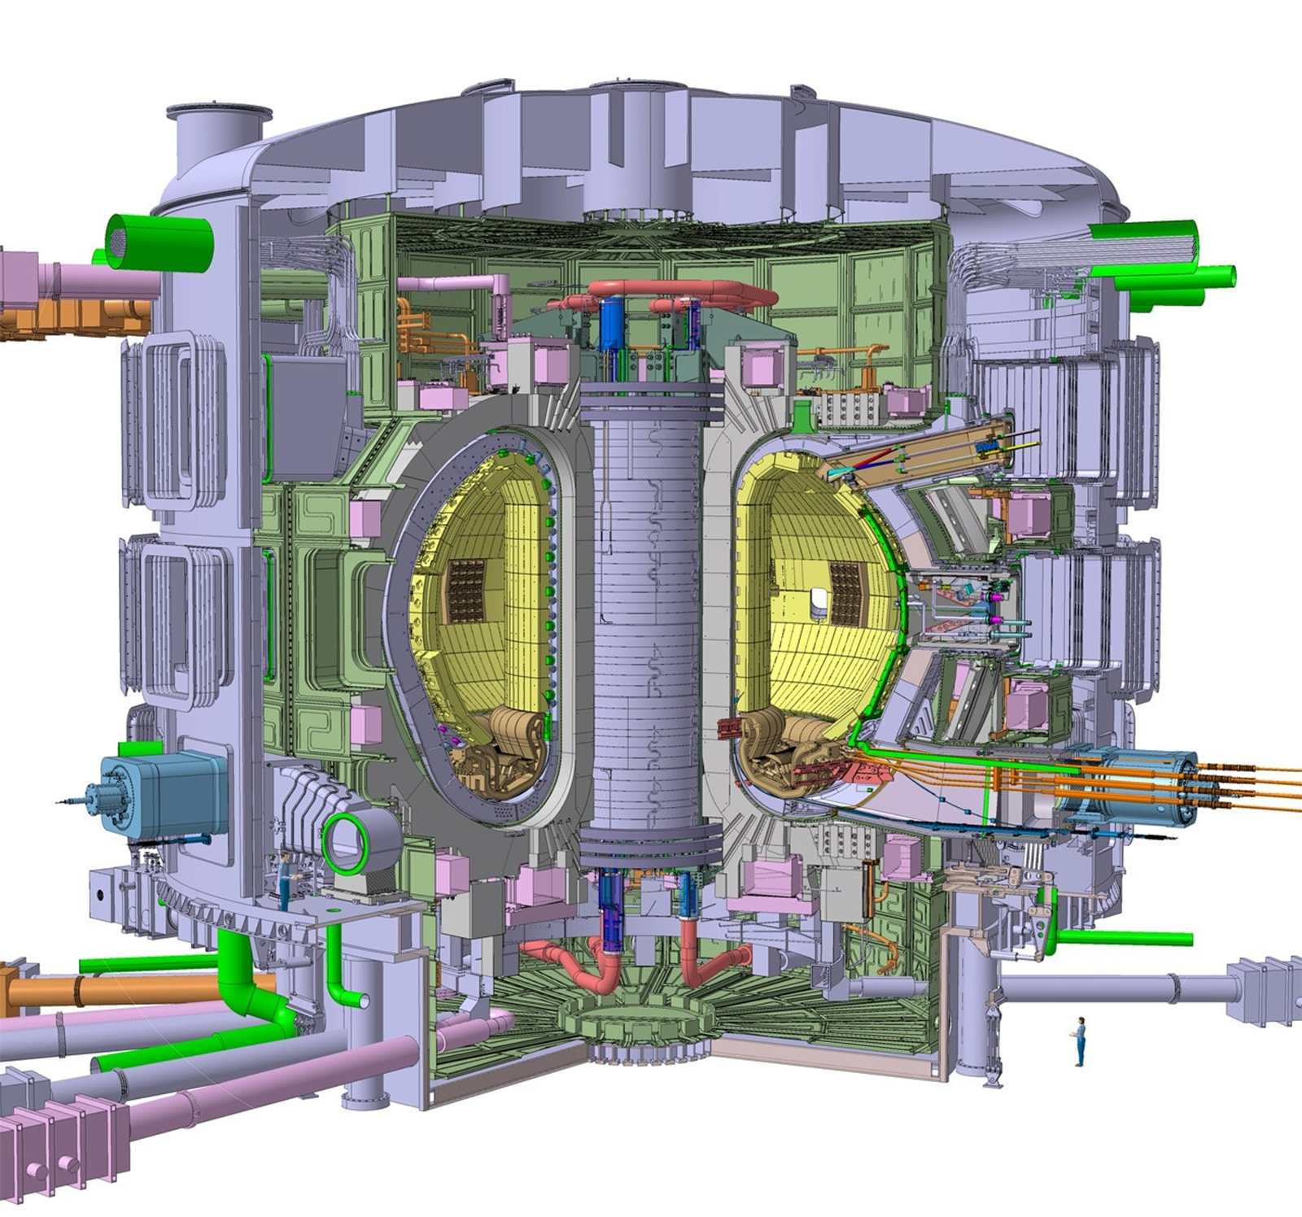
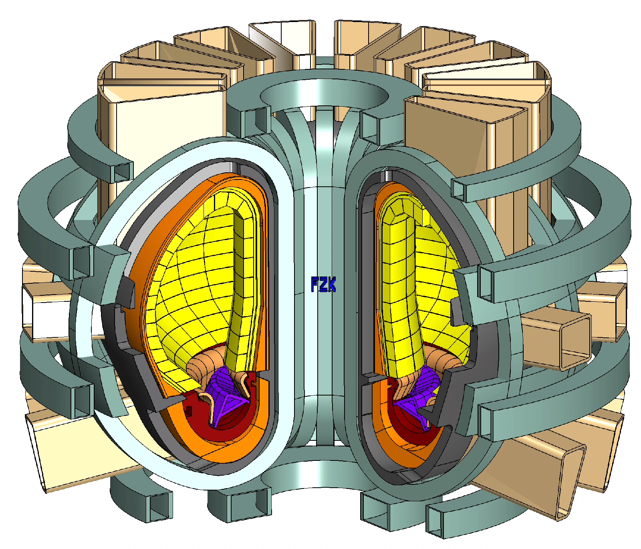
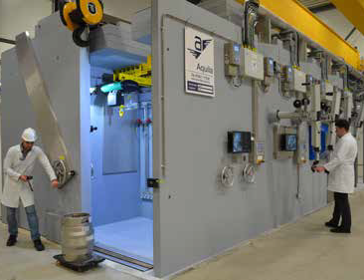
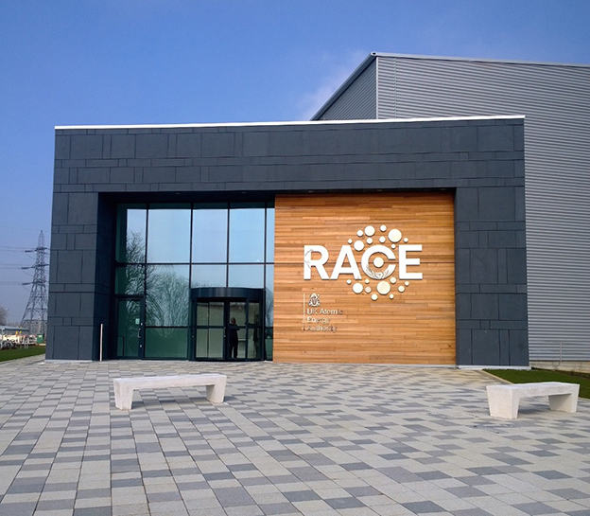
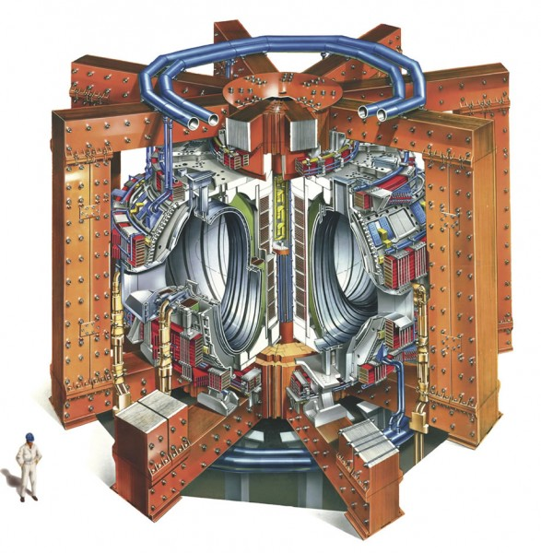
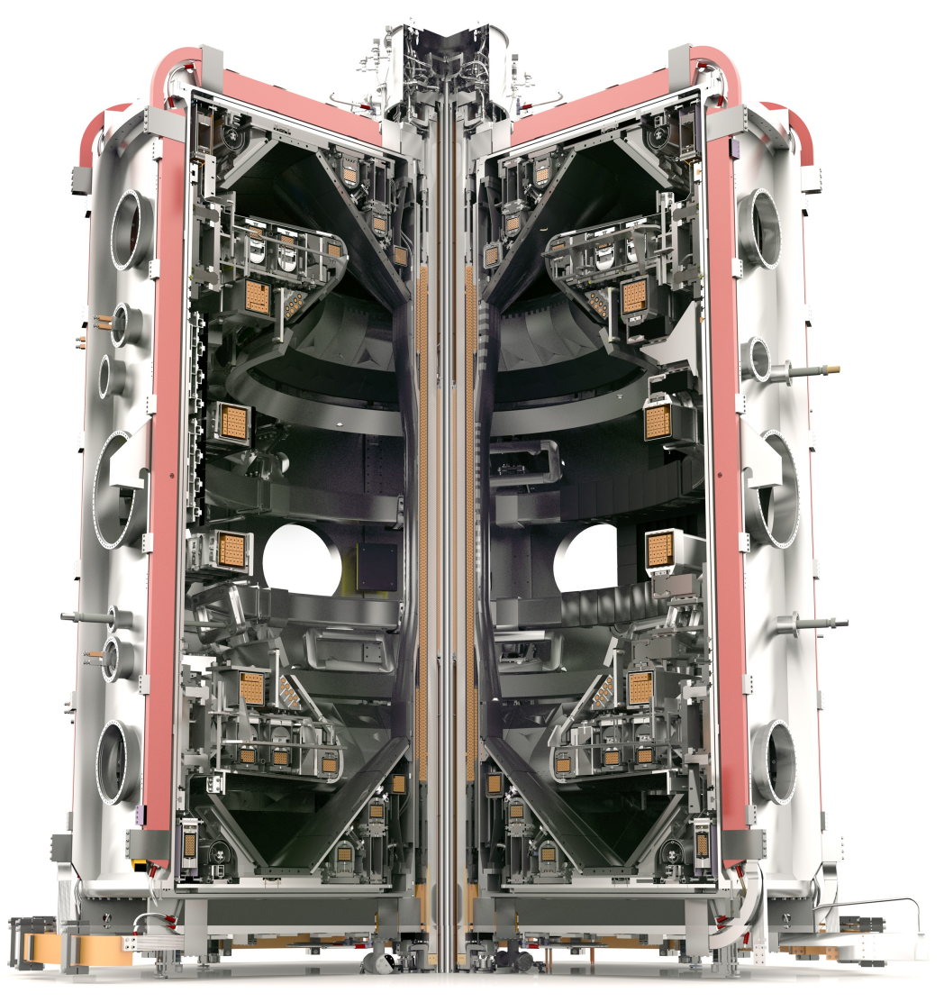
UKAEA is focussed on delivering fusion
DEMO
ITER
1. Understanding key physics issues for ITER
JET
2. DEMO & reactor design
4. Innovation to improve reactors or make smaller
and/or cheaper
3. Advancing fusion materials and technology
MAST-U

Slide 25
Role of industry
We are simply too small a community to be credible in building 1000 power plants this century
Need to upskill and transfer knowledge to industry
Can mutually benefit in many ways:
Critical mass – huge pools of skills and manpower
Experience with qualification and regulatory frameworks
State-of-the-art design and systems engineering tools
Rigour, quality and safety standards
We need to engage and encourage participation much more than we do today. ITER is helping

Slide 26
Conclusions
At the same time as working together on ITER, there is increasing inhomogeneity in powerplant design. Diversity is good, but lack of clarity (and more importantly) design credibility is damaging fusion
There are big gaps to close on path to commercial power: in scale, integration, control, combined loads etc
How do we convince nuclear regulators without empirical qualification?
How much can we use virtual engineering? Now? In 20 years?
Programme priorities should be set by factors affecting commercialisation

Slide 27
Final thoughts

Slide 28
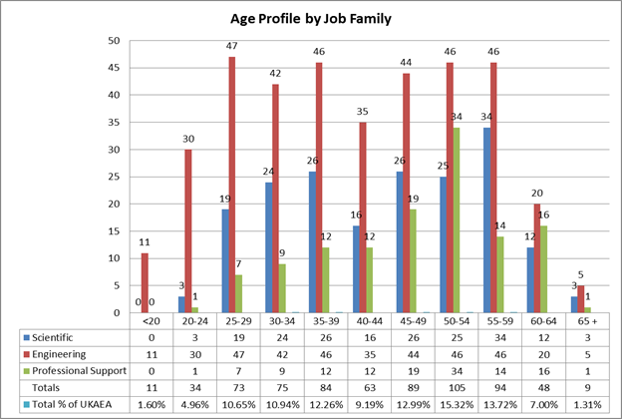
Training
UKAEA age profile healthier than was, but still much to do in order to develop next generation
Also need to make transition from “operations” to sophisticated systems engineering design

Slide 30
Implications for the R&D Programme
Increase power density but not at the cost of overloading power handling systems. (MAST-U is designed to contribute to this area).
Increase technology work (this is a key strategy at Culham).
Increase potential plant availability by materials and Maintenance R&D. (Culham recently opened new facilities on both of these areas which also have synergies with fission).
Follow but do not lead the development of magnet technologies as fusion is too small to impact magnet R&D. (Engage with University and industry experience)

