Slide 1
Construction perspective on the future of the stellarator approach to fusion power
Lutz Wegener on behalf of the Wendelstein 7-X team

Slide 2
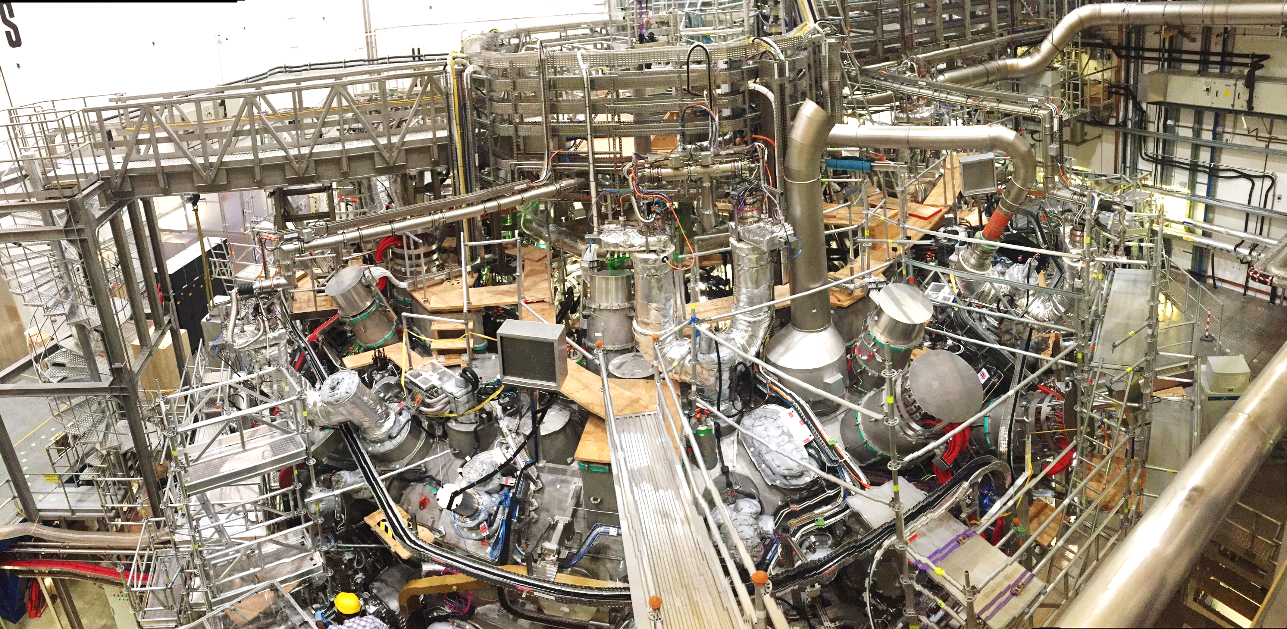
Overview
Overview of the main components of the Stellarator Wendelstein 7-X
Challenges in the construction of W7-X
Remarks to challenges in the construction of comparable but larger stellarator approaches like HELIAS 5-B

Slide 3
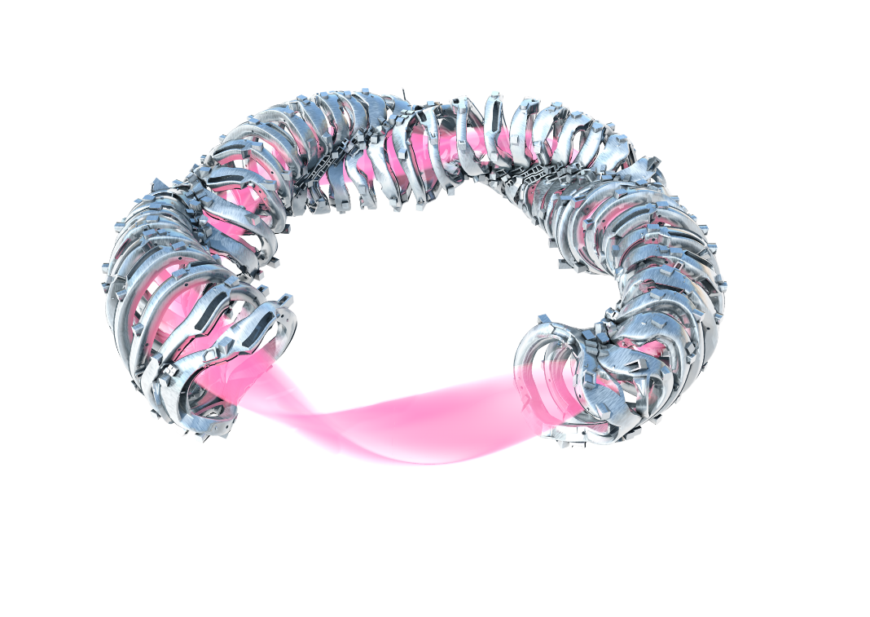
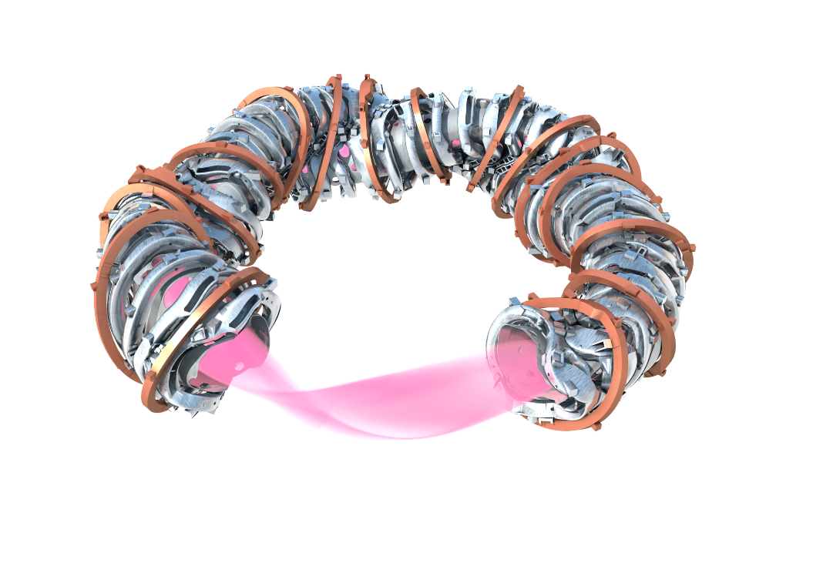
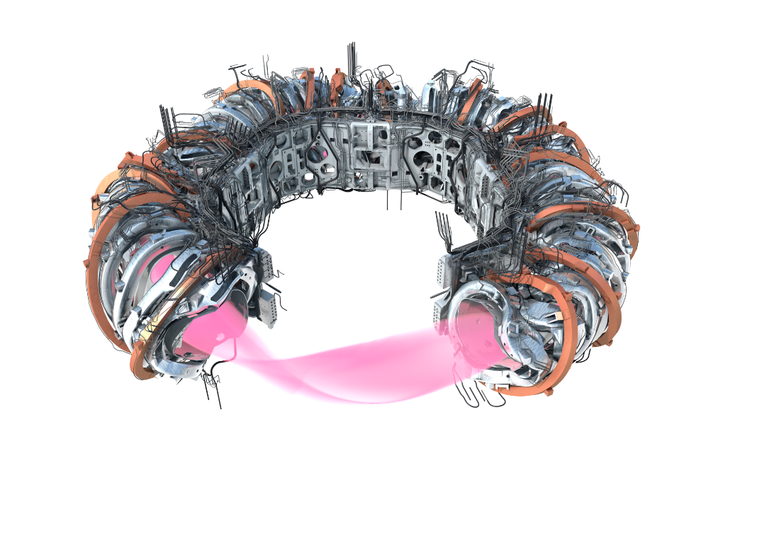
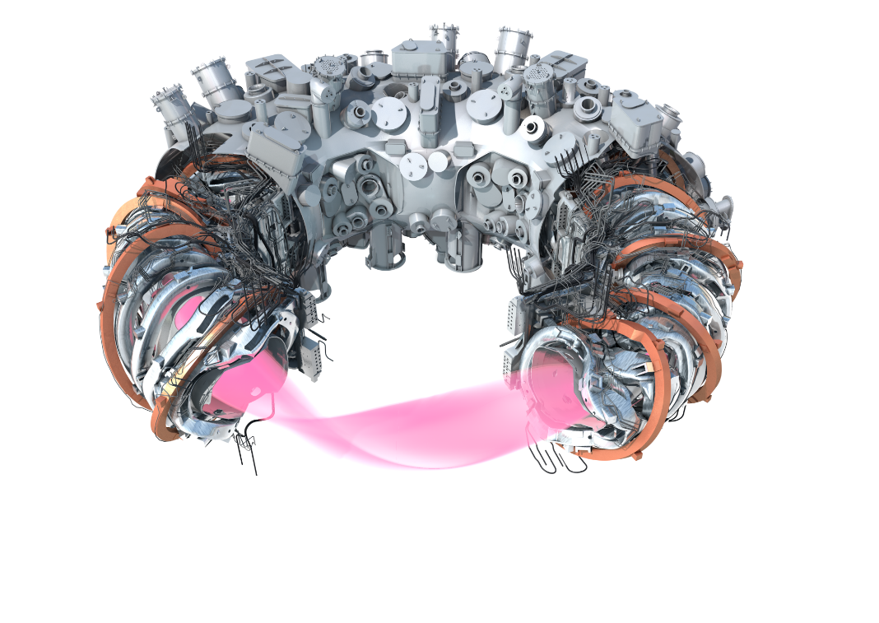
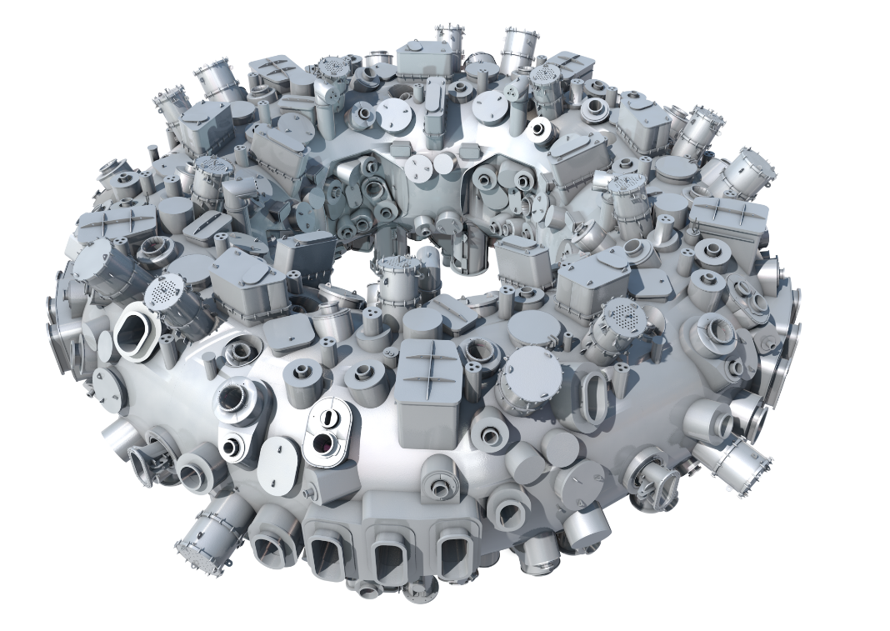
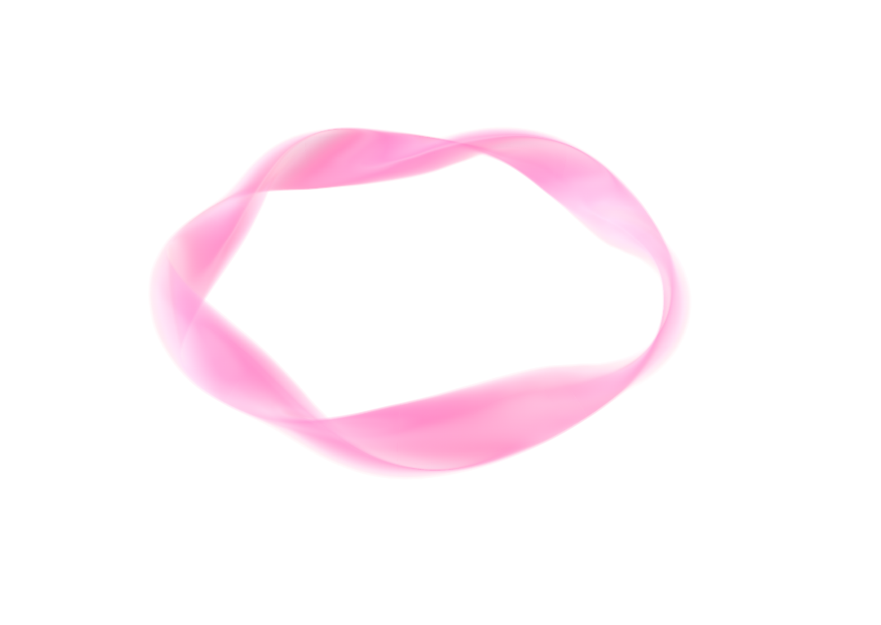
The optimized stellarator Wendelstein 7-X
optimized plasma confinement
50 non-planar sc magnets 15 kA
3.4 K
20 planar sc magnets 10 kA
central support ring sc bus bar system, He pipe work
cryostat + thermal insulation
vessel with 500 openings
16 m outer diameter
1000 t total weight

Slide 4
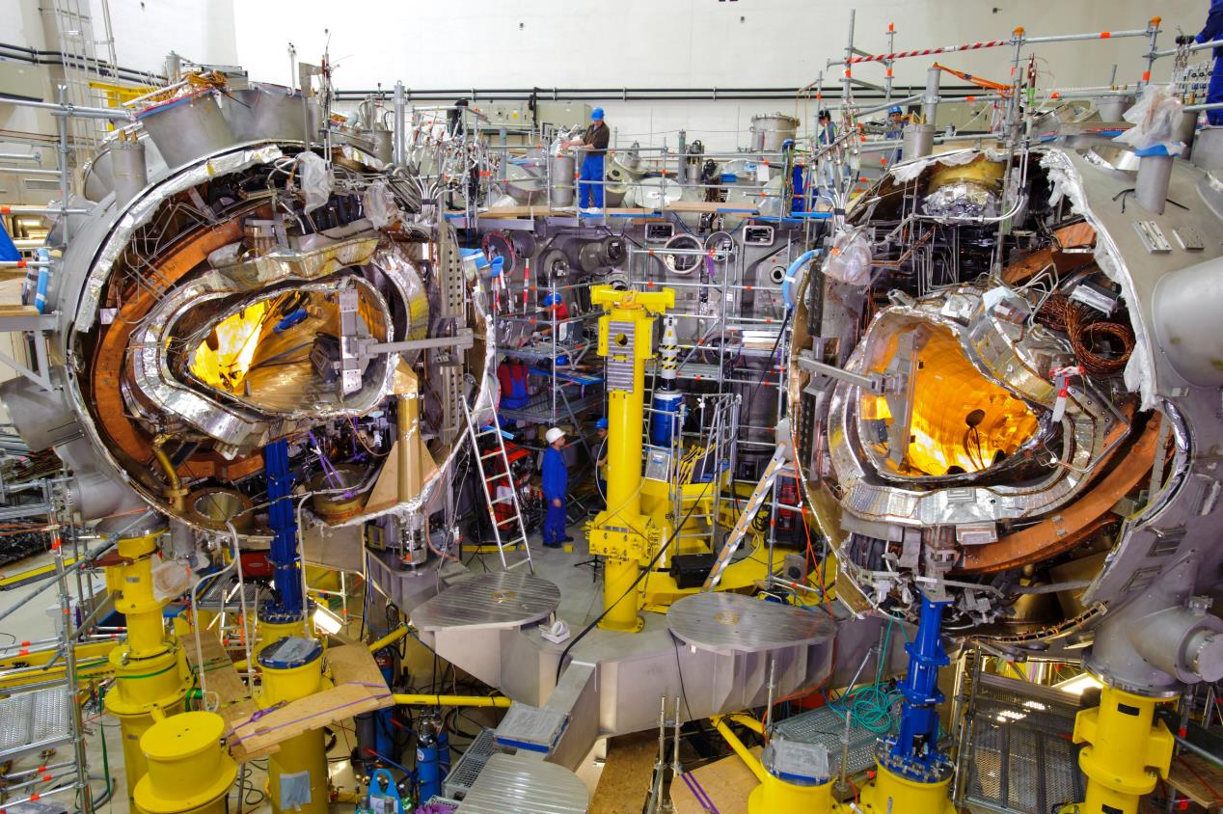
W7-X Construction Challenges
5 modules (~150t each)
7 coil-type groups á 10 coils
10 semi magnet-modules
20 PV-segments
15 PV-pendulum supports
5 horizontal PV-supports
20 cryo-feet per module with self-centering system
2 x 5 cryostat-shells
250 ports (100kg…1.5t)
14 current leads
121 bus-bars, ~240 joints
Field deviation target: <10⁻⁴
Flexible coil support (deflection <10mm when energized)

Slide 5
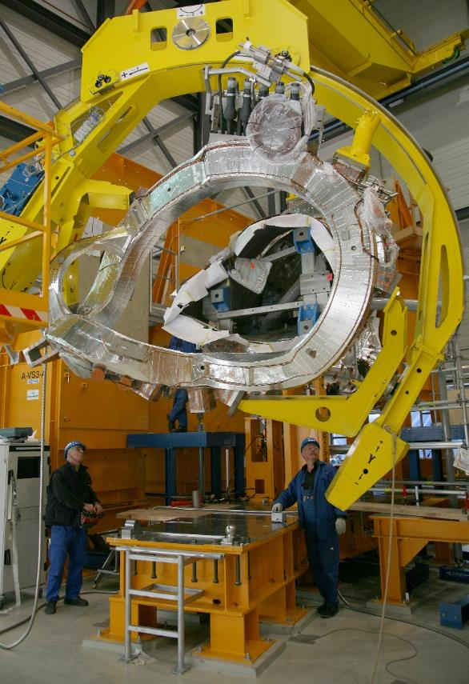
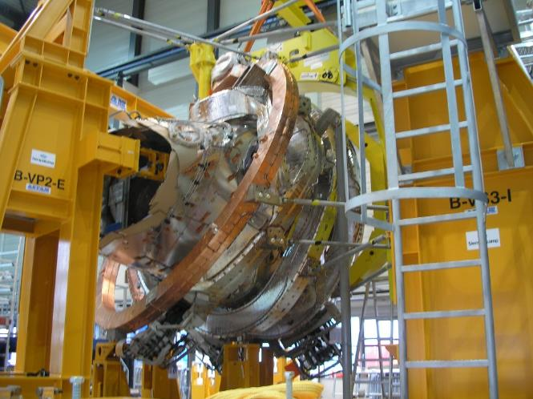
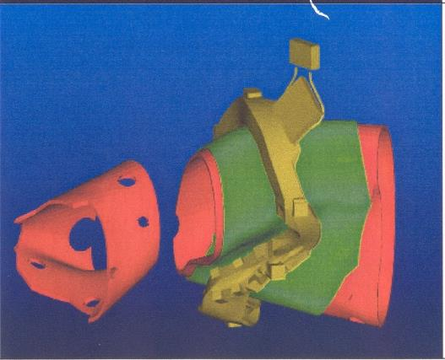
Construction Challenges – threading of Coils
Coil weigh: ~6t
Tool weigh: ~6t
Deformation (x, y, z) due to dead-weight yet negligible
Positioning failure compared to CAD <1.5mm (ø ~4m)
Optimization of threading path = minimization of vessel segmentation (-> 10 segments)

Slide 6
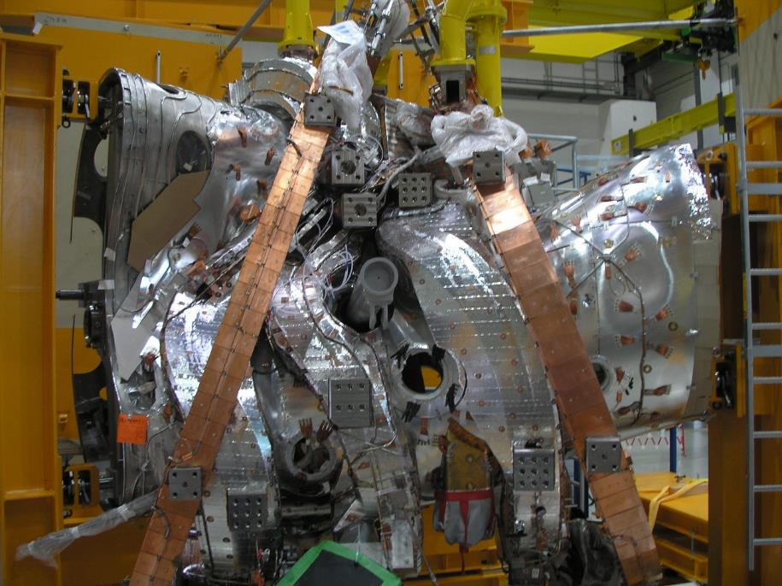
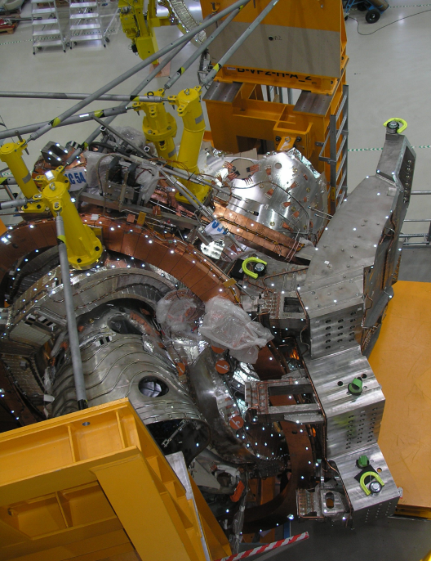
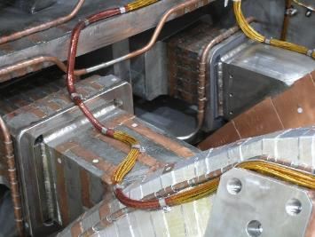
Construction Challenges – Central Support
7 coils x 2 supports
Simultaneous fit of 14 supports
Super-bolt arrays 3x3; single bolts up to M90
Precision table enables several movements of the central support ring-segment
Welded wedge-shims at four sides of every support

Slide 7
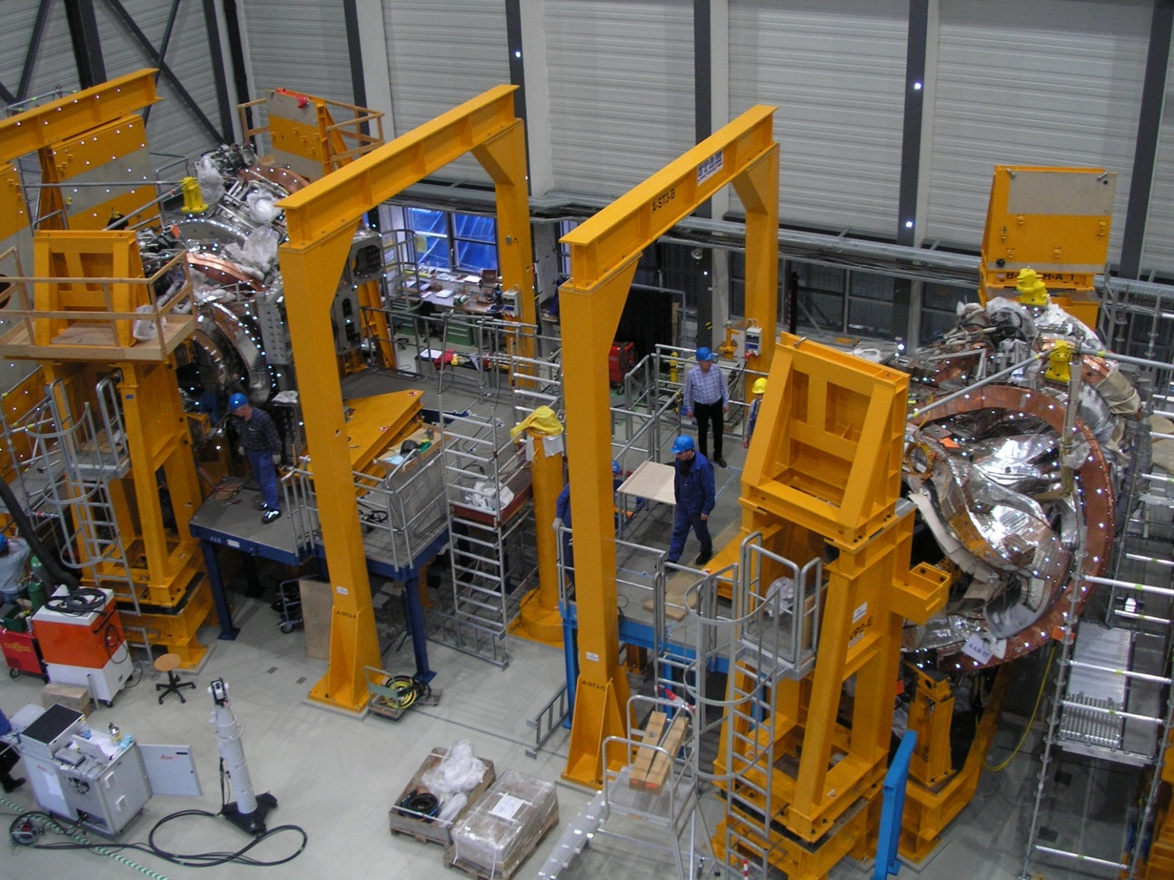
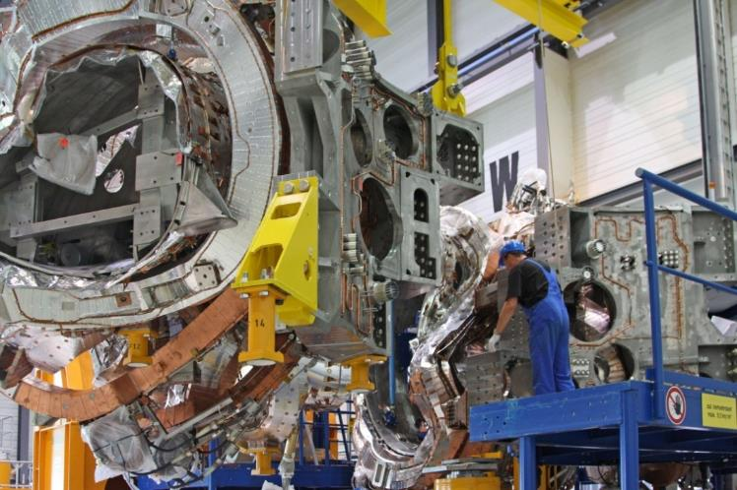
Construction Challenges – Connection of Semi-Modules
Connection of two flip-symmetric semi-modules
Inconel-screws and superbolt-nuts connect both stairs-shaped flanges with each other.
Vessel segments are aligned and welded (from inside, shielding gas, He-leak-tests).

Slide 8
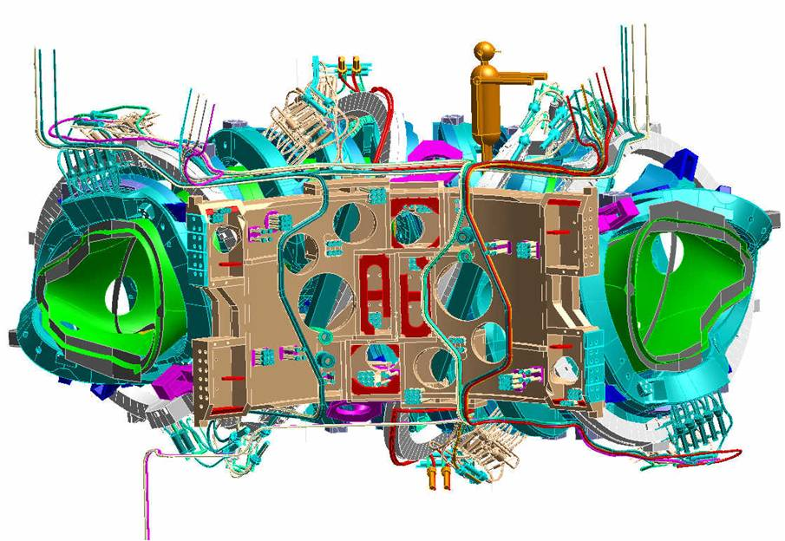
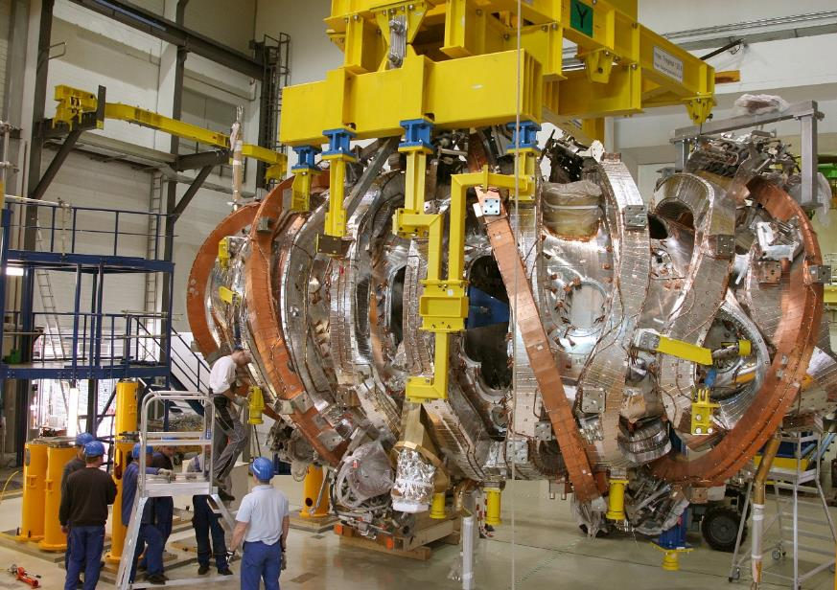
Construction Challenges – Bus-Bars and Helium-Pipes
Transportation of Magnet-Modules
Completion with Bus-bars and Joints
Disadvantage: alternating between top and down
Better: coil termination always down (doubles coil types)

Slide 9
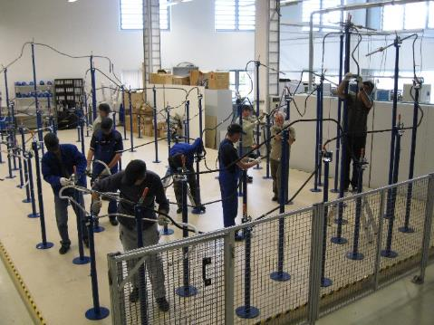
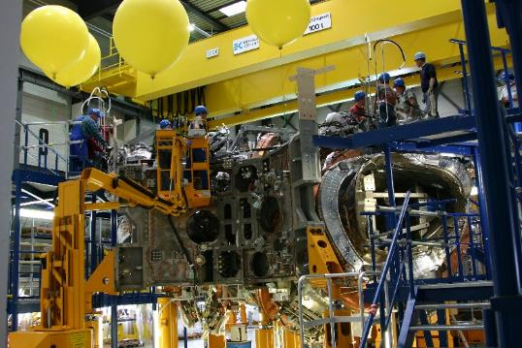
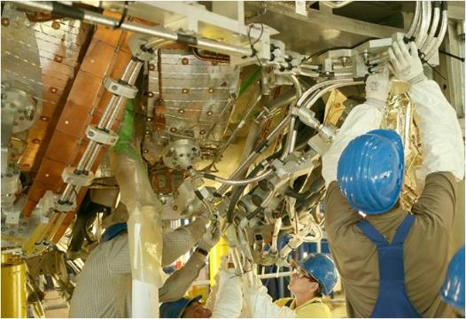
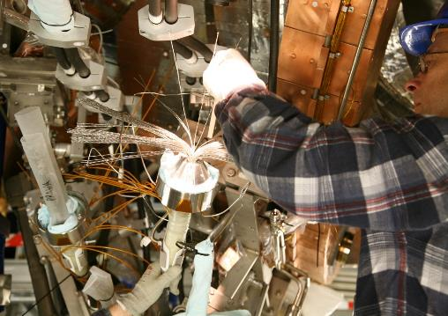
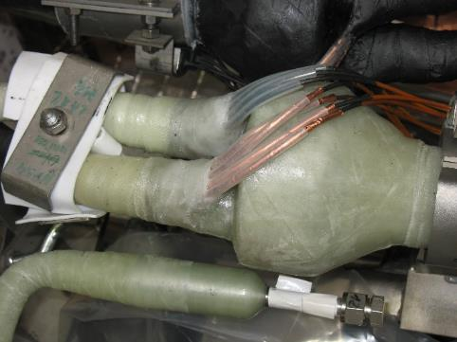
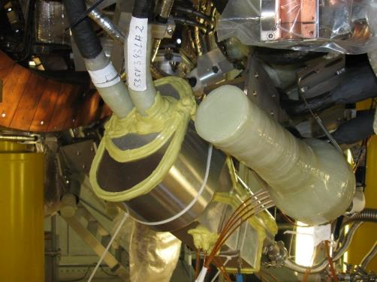
Construction Challenges – Bus-Bars and Joints
Bus-Bar Preparation
Bus-Bar Installation
Bus-Bar Clamps and Holders
Joint – Strand Connection (<5nOhm)
Joint – Isolation
Joint Isolation – Paschen test

Slide 10
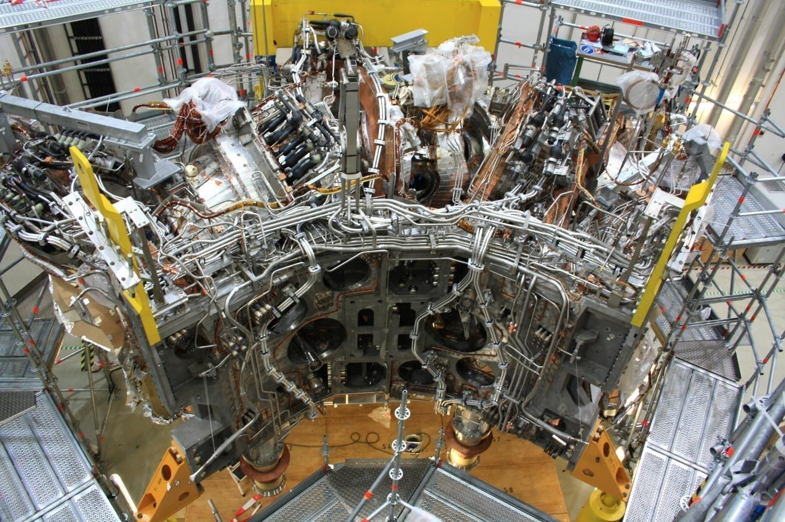
Construction – completed Magnet Module (MM)

Slide 11
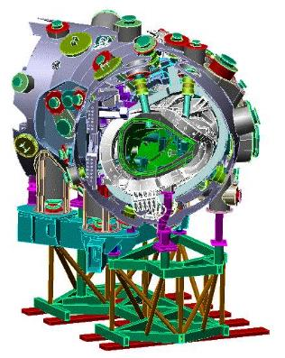
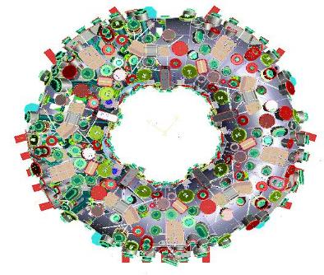
Construction Challenges – Cryostat and positioning of MM
Central Question: Module assembly/alignment in parallel (star-like) or in series
Original Concept (2000) - parallel
Realized Concept (2003) - serial
Movable module
Star-like Torus Assembly
+ Even load distribution on floor and support-system
+ Central alignment promises best possible accuracy
- Too late (services and in-vessel have to wait)
- Instability of movable support; blockage of lower ports
- No space
+ 3D-measurements ensure accuracy
+ Fast (services and in-vessel in parallel at all modules)
+ Highest stability through robust Machine Base
+ Unrestricted port-installation
+ Effective use of available space

Slide 12
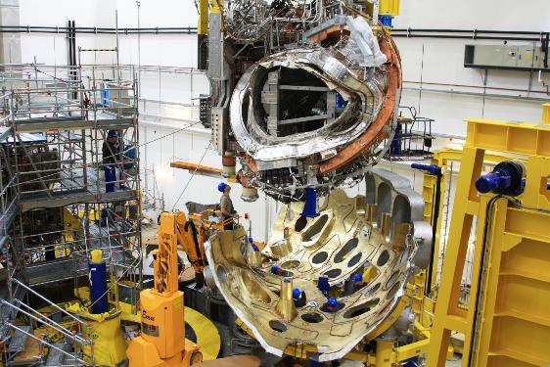
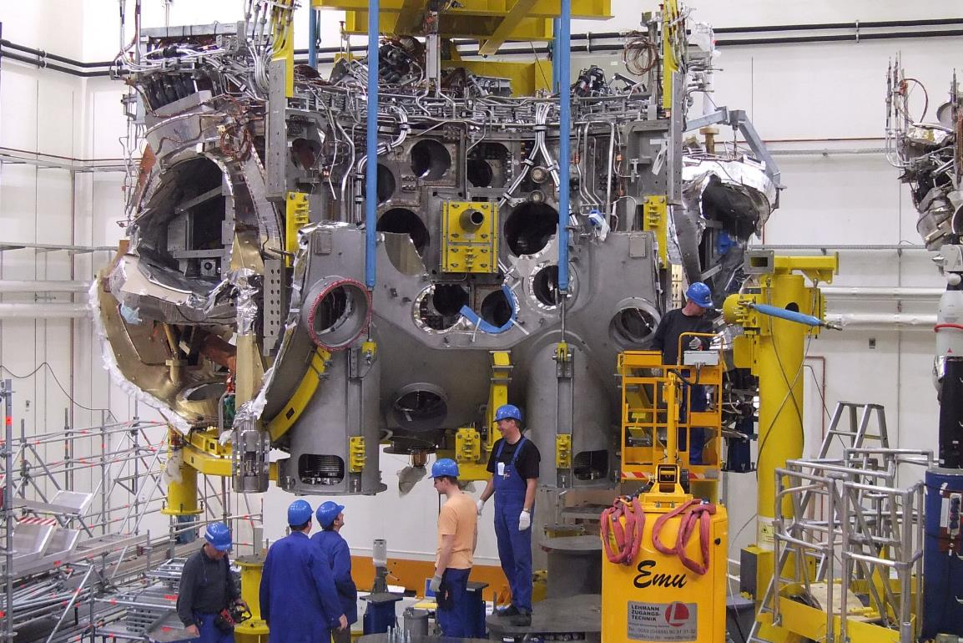
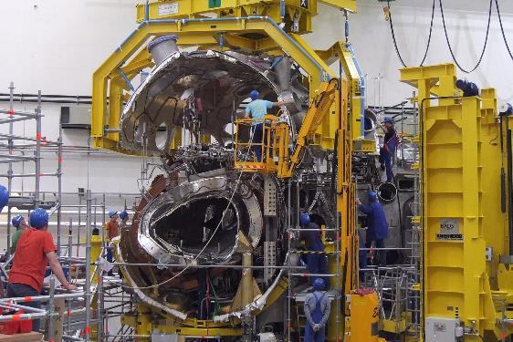
Construction Challenges – Cryostat and positioning of MM
First module - lowered in bottom shell
Second module positioned to the side of the first one
Robust temporary fastening – flexibly adjustable
Third module - top shell

Slide 13
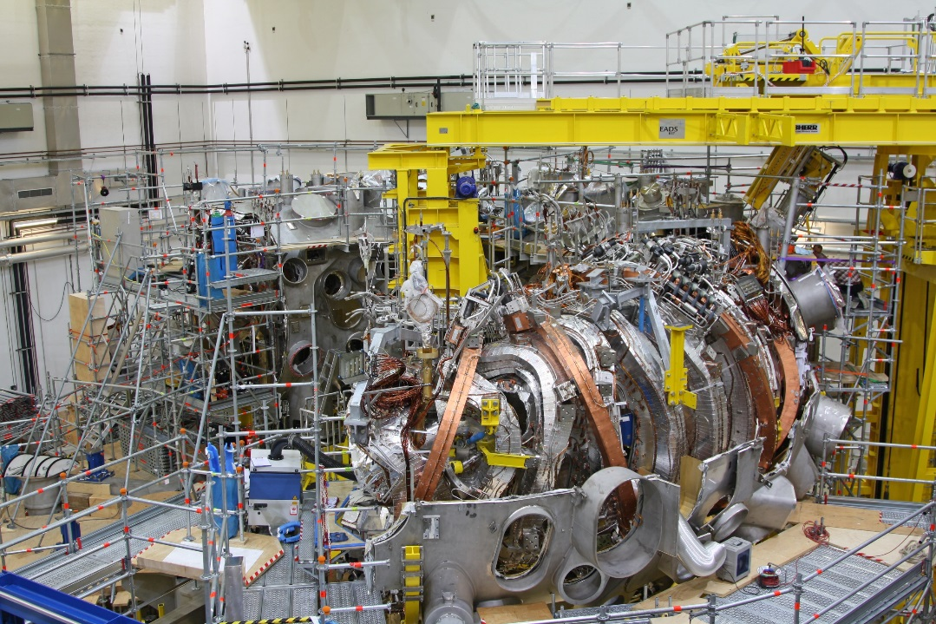
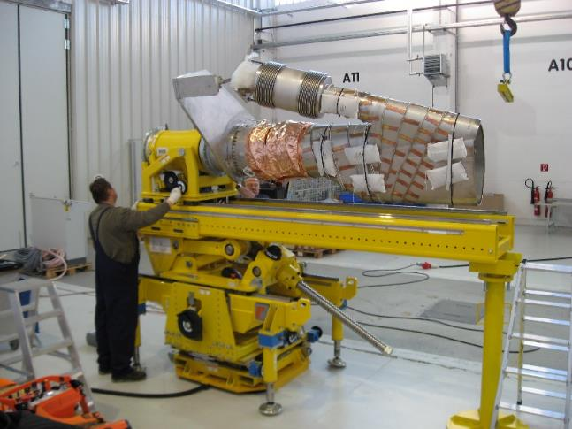
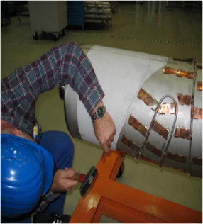
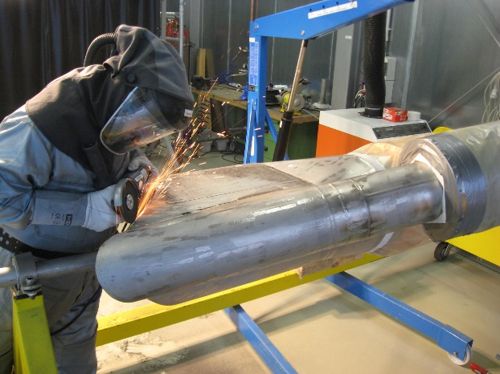
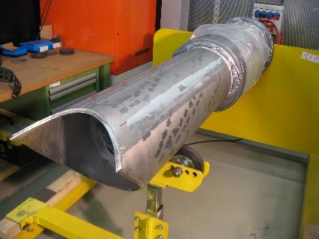
Construction Challenges – Port installation
Ports positioning tools: Bridge and Ramps
Ports are cut to length and shape (as built)
Contour deduced from scanning data of as-built PV-opening (reverse engineering)

Slide 14
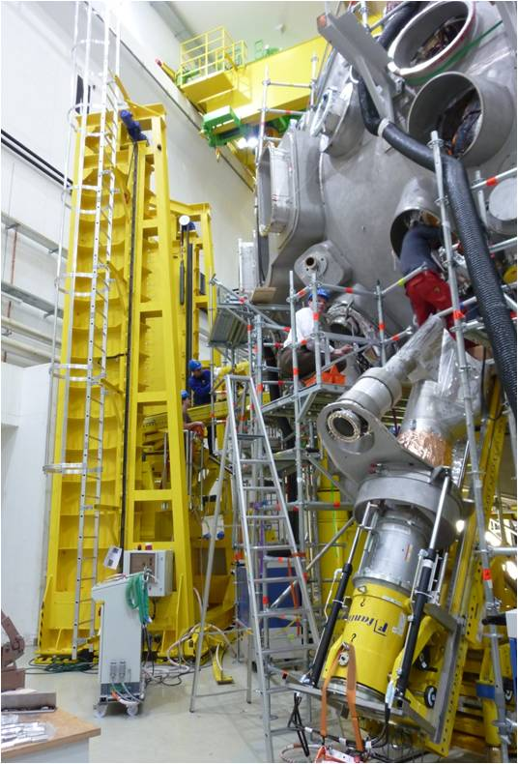
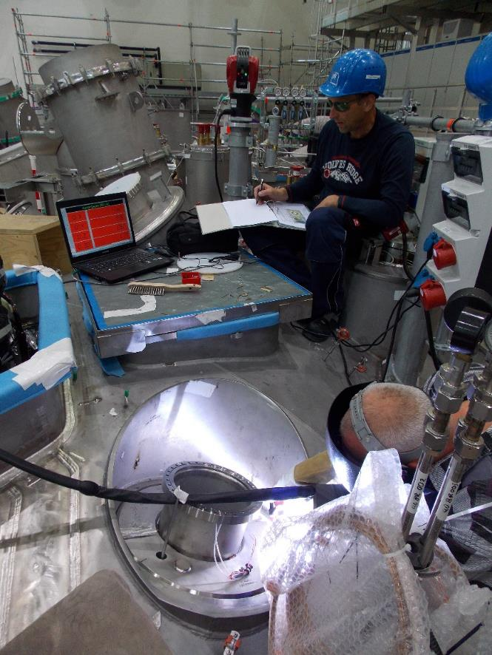
Construction Challenges – Port installation
Port installation and positioning
Laser controlled Port welding
1st PV weld (from inside)
2nd Cryostat weld
Shielding gas
Leak testing
Accuracy ~4mm

Slide 15
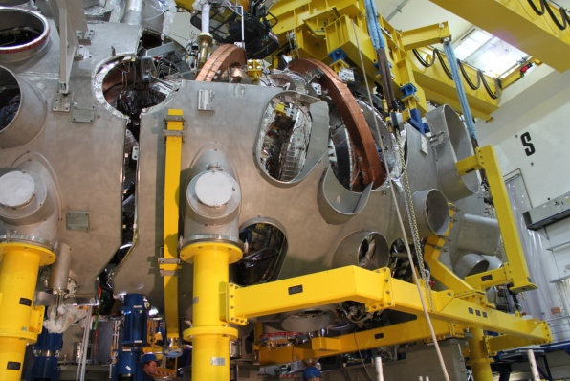
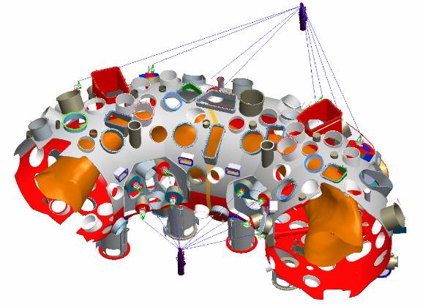
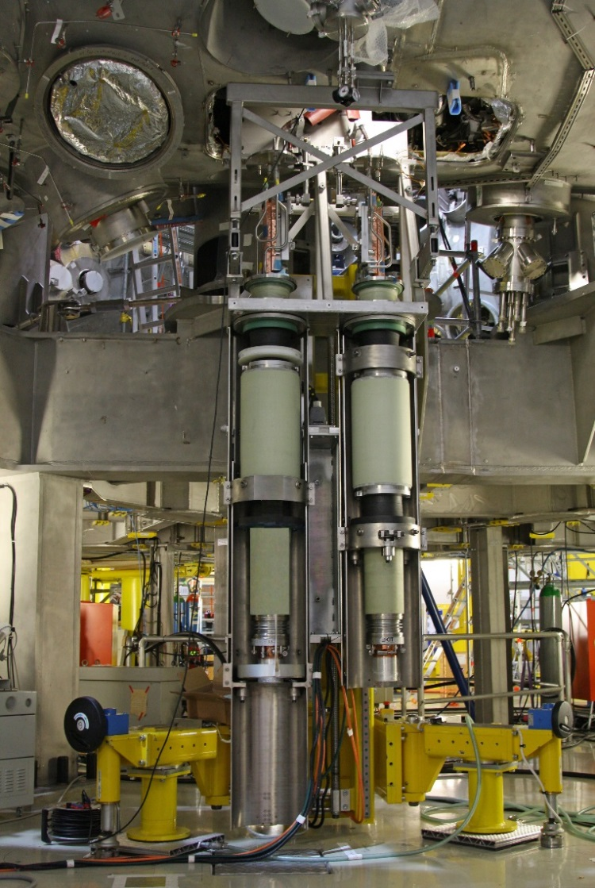
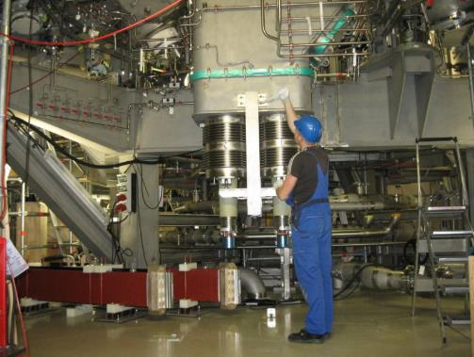
Construction Challenges – Module connection, Current Leads
Current Lead installation
Installation technology: IPP/ORNL
PV and Cryostat pushed apart (4…6mm)
Splice plates inserted and simultaneously welded
Shrinkage moves modules back
Insertion of Fit Keys between coils

Slide 16
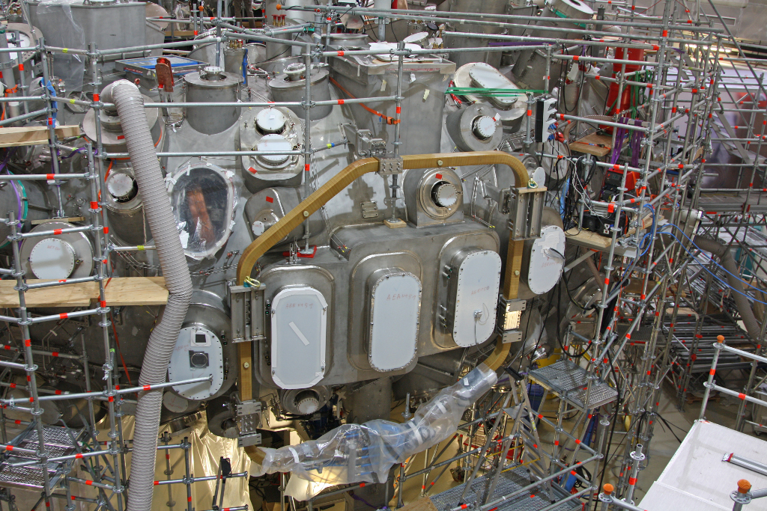
Construction Challenges – Trim Coils
Five Trim coils provided by PPPL
Correction of expected field errors due to deviation in manufacturing and assembly of TF coils
Steel bearings with rubber inserts fastened to the cryostat
Glued friction foils at winding body
Determination of bolt-torque (long-term stability vs. rubber overloading)

Slide 17
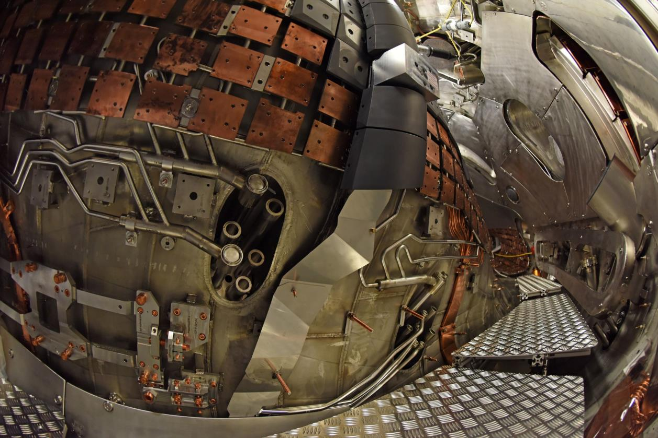
Construction Challenges - First Plasma in-vessel components
Few Carbon Tiles
Limiter
T-piece connection (inner orbital weld)
TDU Support Frame

Slide 18
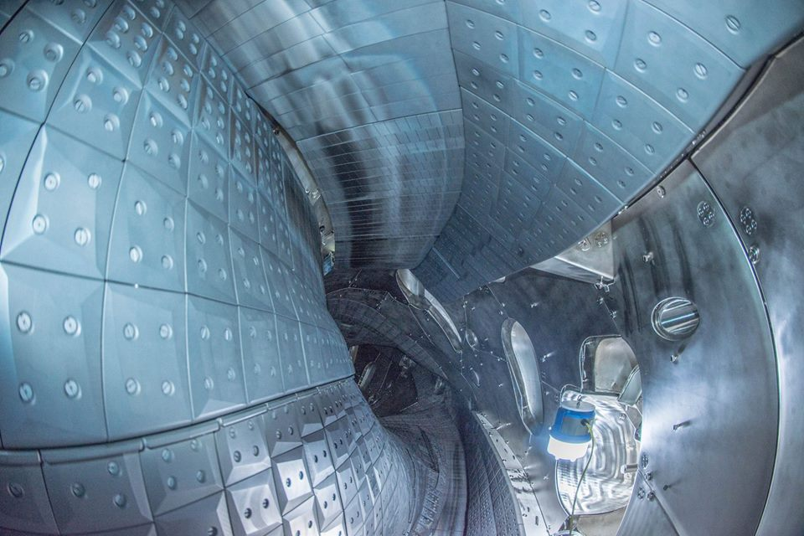
Construction Challenges – Test Divertor Unit
divertor target plate
divertor baffle
divertor baffle
wall panels
port opening
heat shield

Slide 19
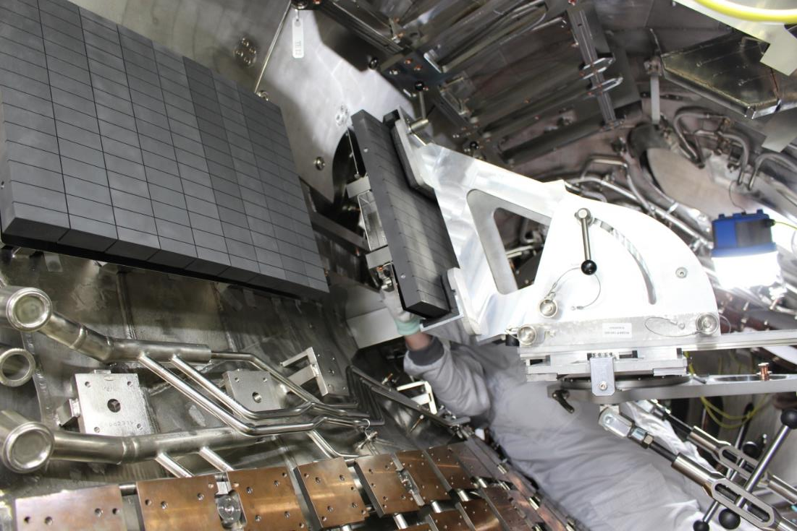
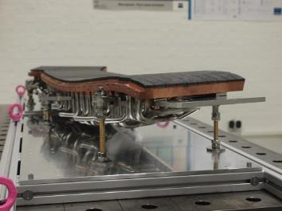
Construction Challenges - HHF-Divertor
Installation of Divertor Modules (overhead position)
Vertical Divertor Modules
Divertor support frames for horizontal modules
Positioning device
HHF Module (70kg)

Slide 20
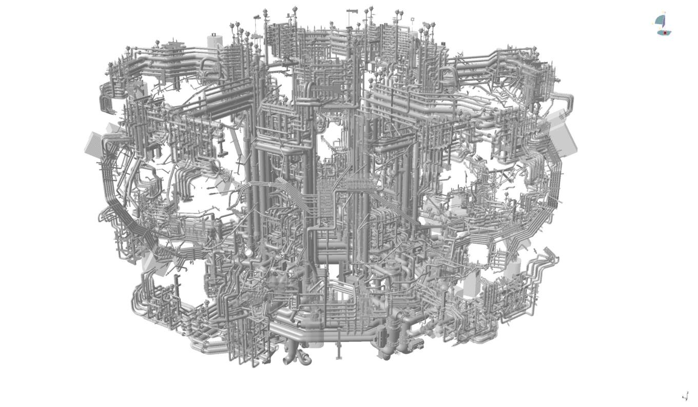
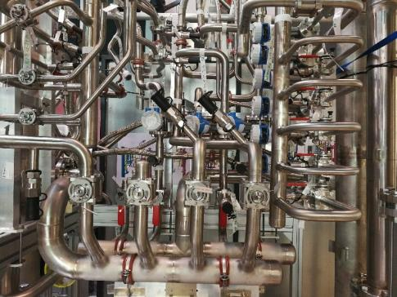
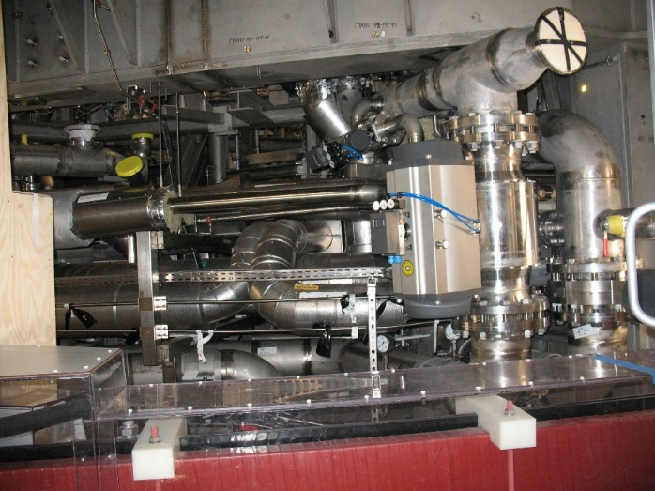
Challenges of the HHF-Divertor – Cooling Circuits
Wendelstein 7-X is now transformed into a fully water-cooled device
Trial assembly of one manifold-unit (out of 40)
5 main Divertor feedings
Pipework accuracy +/-5mm (otherwise clashes possible)

Slide 21
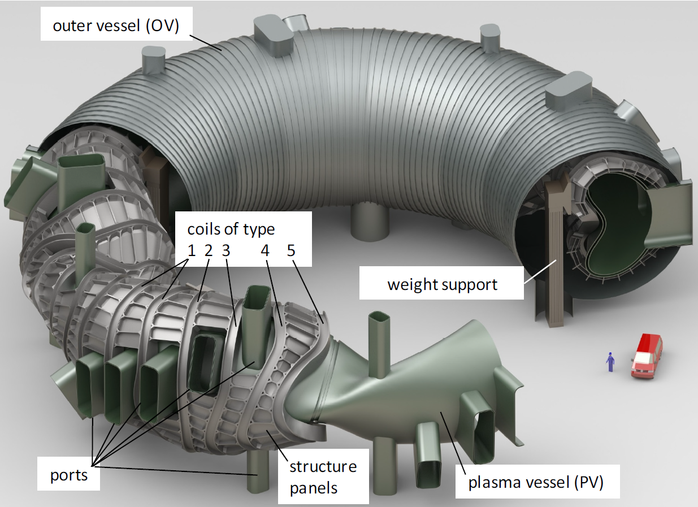
Size comparison W7-X with Helias-5B (4 times)
Coils:
5t <-> ~200t
4m <-> ~20m
Magnet-modules:
150t <-> 2000t
PV-wall thickness:
17mm <-> >70mm?
(shrinkage control in helically shaped contours)
250 ports <-> only “few” large ports at the outside ✓
Cryostat shells?
Divertor, maintenance concept?
Repair/Redundancy concept for coils?

Slide 22
Thank You!

Slide 23
Construction – Schedule and Organization
Start | End | Activity | Person hours* | Notes
March 2005 | March 2015 | Main Assembly to First Plasma | 925Th | 1y contingency, overlap commissioning/assembly
Dec 2015 | March 2016 | Operation Phase 1.1 |  | First Plasma
March 2016 | May 2017 | 1st Completion Phase Test Divertor Unit | 95Th | 8 weeks contingency
May 2017 | Dec 2017 | Operation Phase 1.2a
Feb 2018 | April 2018 | 2nd Completion Phase Scraper Elements (SE) | ~5Th
April 2018 | Nov 2018 | Operation Phase 1.2b
Nov 2018 | July 2021 | 3rd Completion Phase HHF Divertor | 220Th | 13 weeks contingency
Aug 2021 |  | Commissioning and operation OP2.x |  | 10MW ECRH, 1800 sec
*Direct person hours on-site
Construction Department
OSC
Work preparation/ scheduling
9000 CWPs/IWPs
4-week planning
Weekly planning
Engineering/ Technology
1200 EWPs
Spec. Tools
Mockups
Construction Management 2 shifts/6 days
All construction work
Maintenance
Shift-service/Scaffolds
Periphery
Cable
Pipes
Platforms
Structures
Special Techniques
Metrology
Leak Testing
Welding

