Slide 1
Jonathan Carling
Tokamak Energy
Perspectives,
Progress & Plans

Slide 2
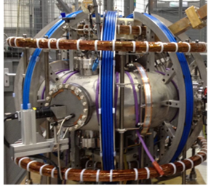
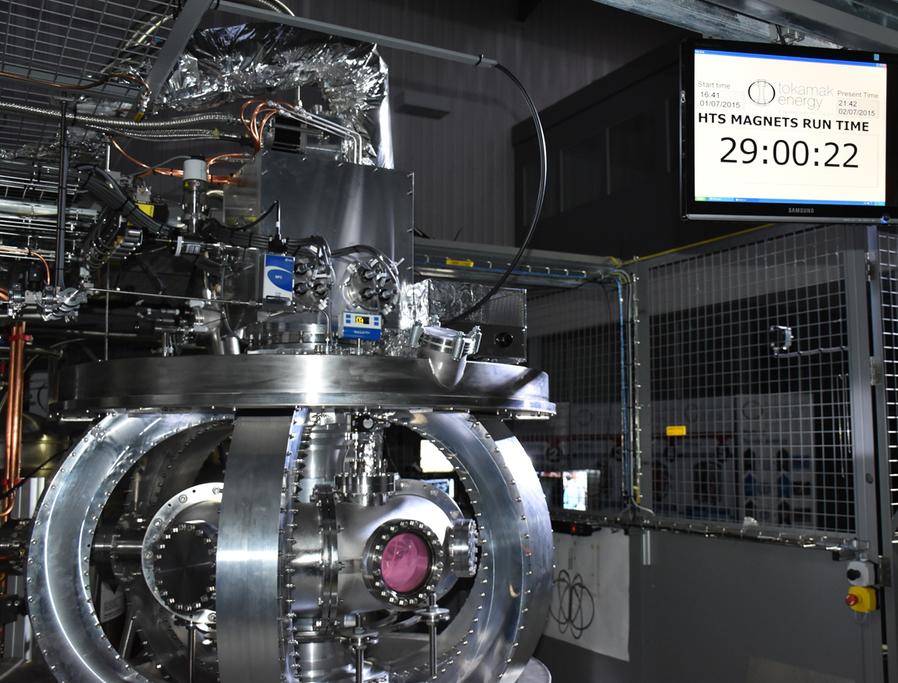
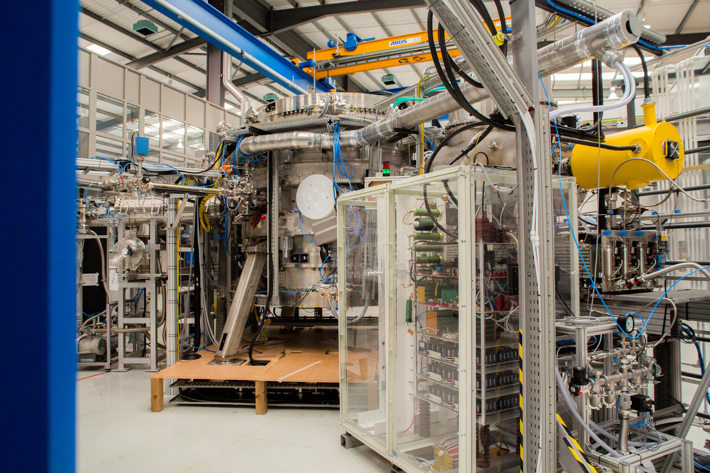
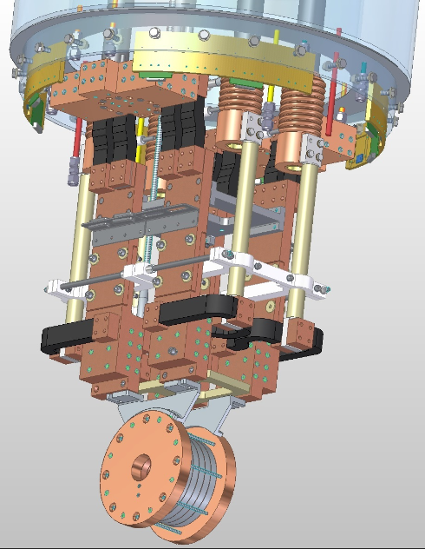
Tokamak Energy
Established in 2009
Private company
Engineering centre in Milton Park, Oxfordshire, UK
Team of over 100 technicians, scientists, and engineers
Designed, built and tested 3 prototype tokamaks since 2012
World leading high temperature superconducting magnet laboratory

Slide 3

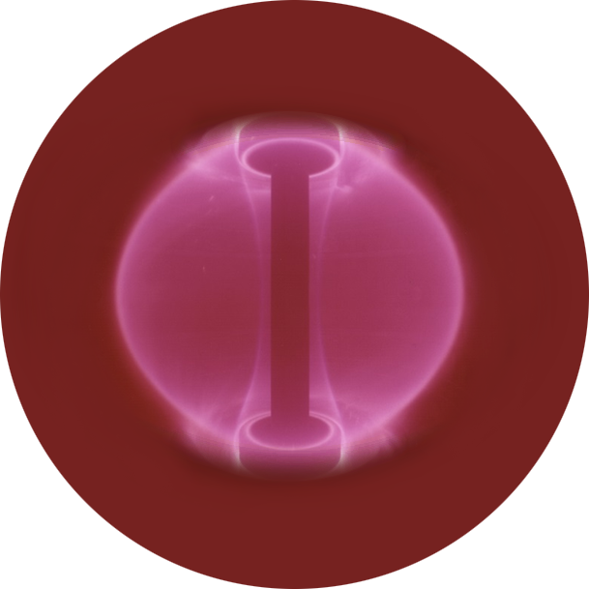

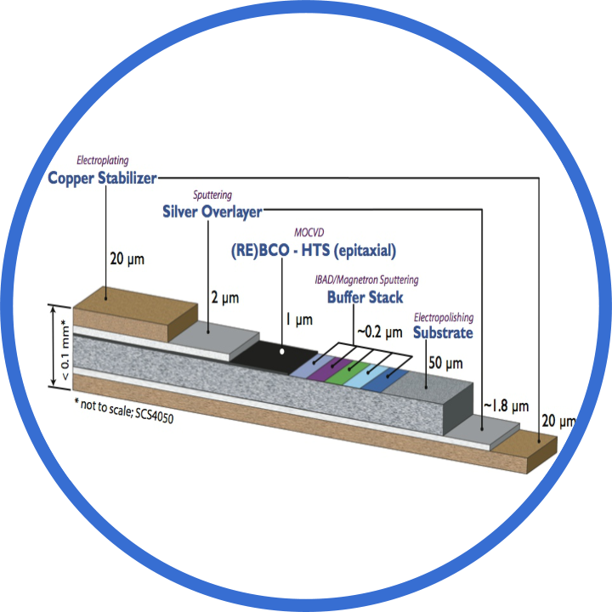

Promising physics and emerging technologies
Spherical
Tokamak
High Temperature
Superconductors (HTS)
Improved geometry, highly efficient
High current at high field
FUSION POWER
Smaller, cheaper, faster...... with distinct competitive advantage
Notes:
Promising physics and improved efficiency of ST
Combined with high field magnets made using high temp…
To produce a compact and cost effective route to fusion power

Slide 4

One Perspective
Two years in, I’m still new to fusion ….
... but my career fusion experience doubled since last year !!

Slide 5
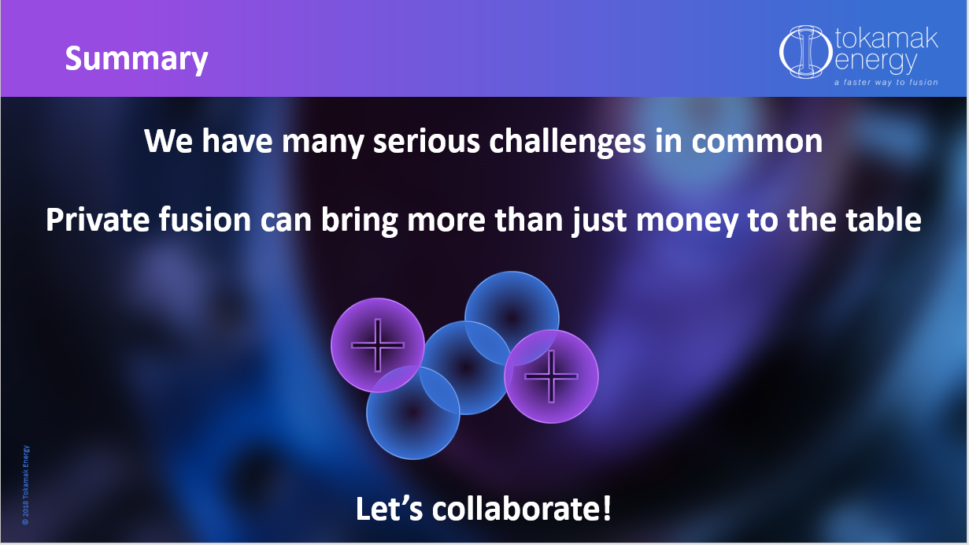

One year ago at FPS year we said …

Slide 6
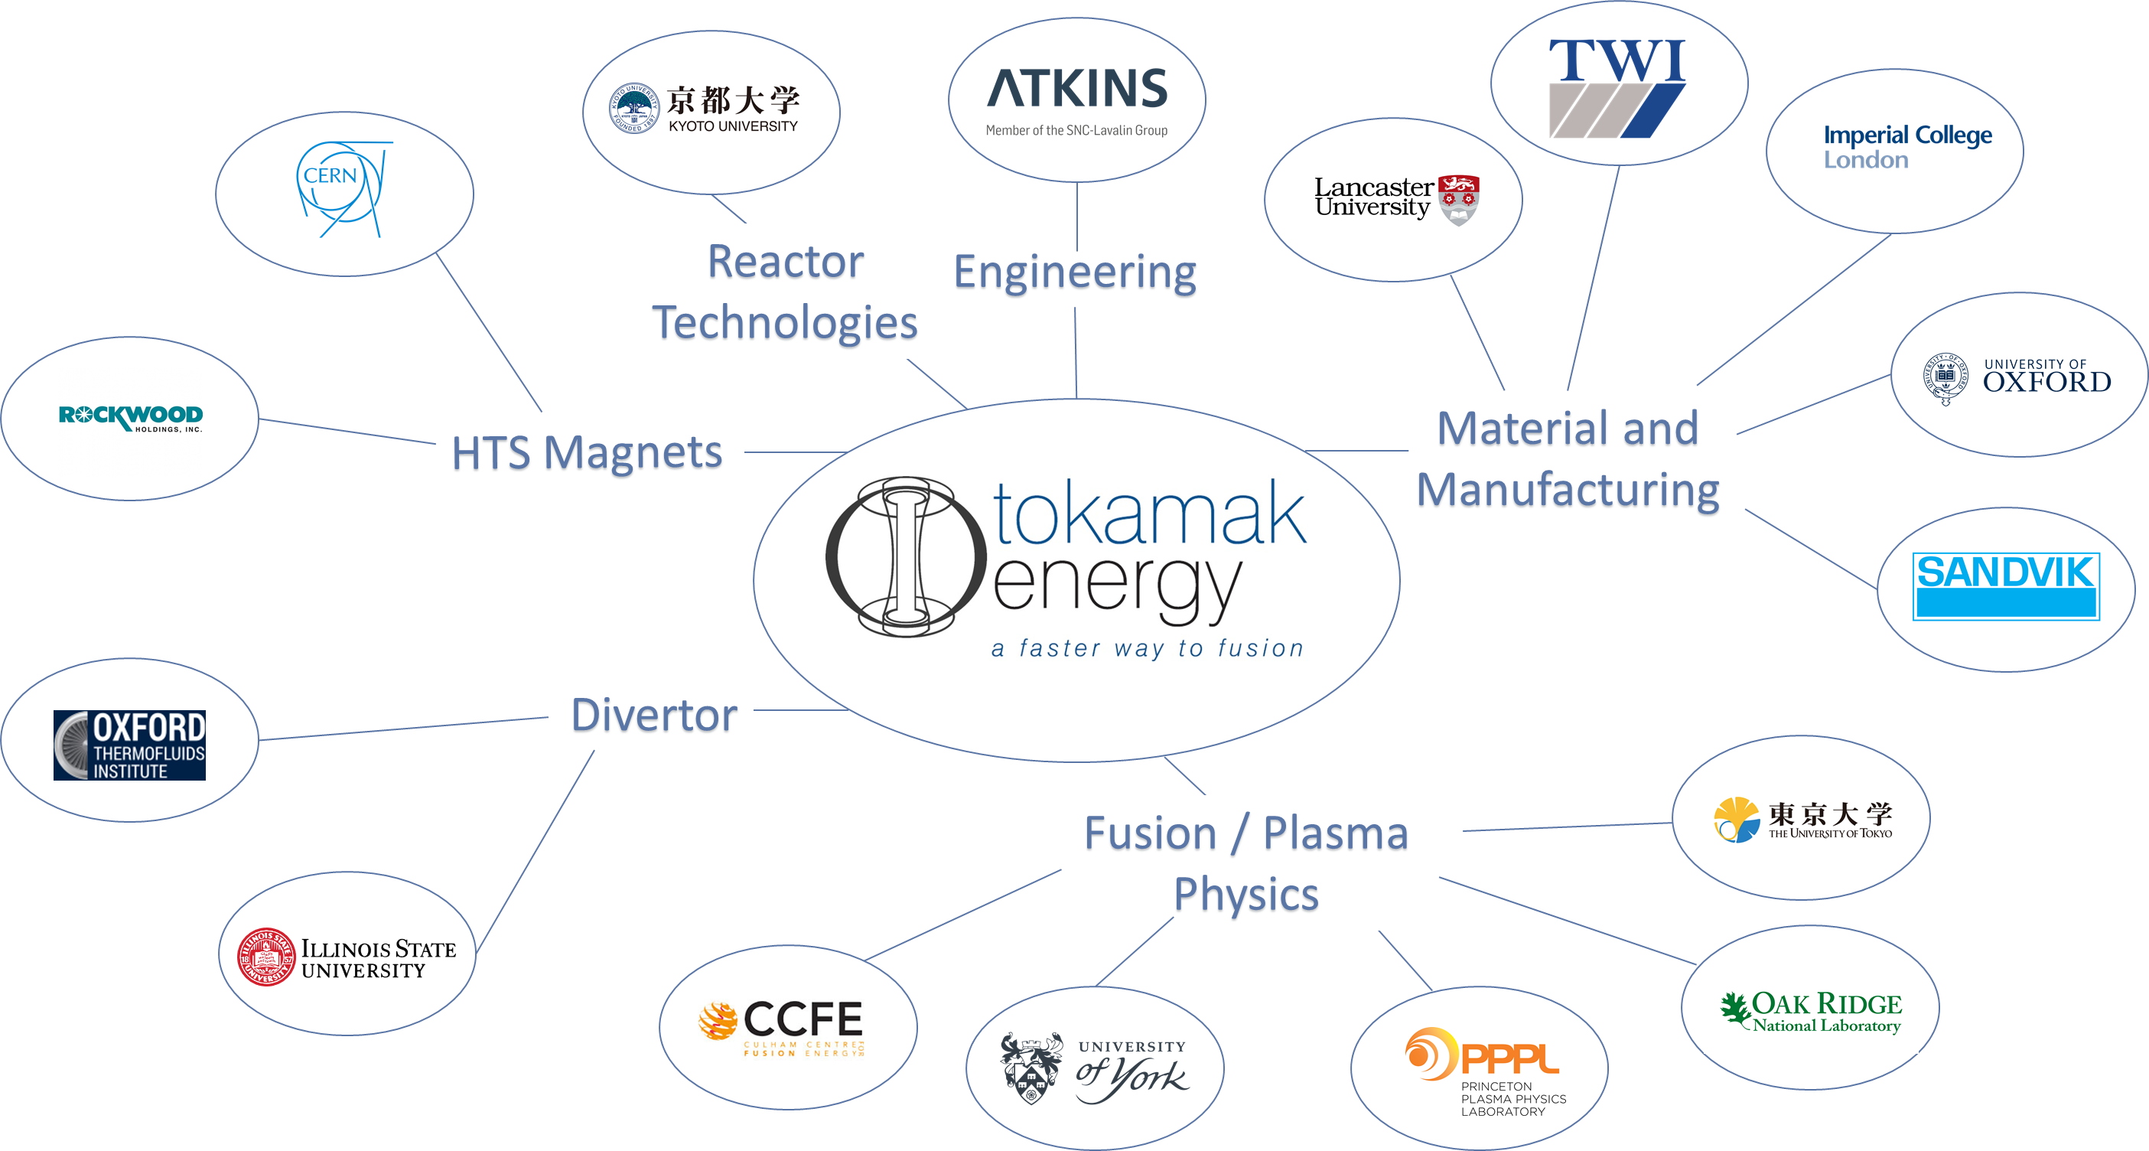

Main Collaborations
NAMRC

Slide 7

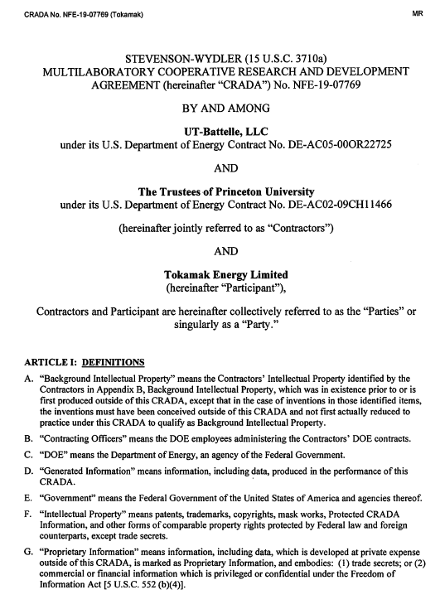
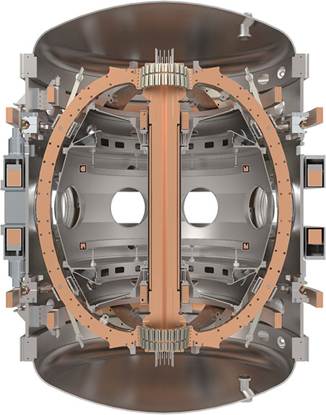



A first-of-a-kind collaboration
ORNL, PPPL, and Tokamak Energy signed a CRADA covering a ~ 3 year collaborative research program
FES awarded a total of $3.9M to ORNL and PPPL to carry out open public research on ST40
The collaborative research intends to study world leading high toroidal magnetic field (up to 3T) spherical tokamak plasmas to explore:
  ST energy confinement scaling's w.r.t. high B_{T} & I_{P}
  λ_{q} at B_{pol} nearly 2 x greater than NSTX-U and MAST-U
  Maximum achievable ST pedestal pressures by temporarily relocating the NSTX-U Thomson pulse-burst laser system to ST40
  And more! (RF, T-CHI, MHD, fast particles …)
Notes:
This month we signed a Corporative Research & Development Agreement with PPPL and ORNL to support these research activities

Slide 8



Liquid metal development
Tokamak Energy have partnered with three leading laboratories … so far:
Theoretical modelling of flowing liquid lithium
Developing ‘true’ free surface models
Developing the flowing liquid lithium divertor plate for ST40
Developing a diagnostic to measure the depth of the flowing liquid lithium

Slide 9

Interesting Areas for Collaboration
We are active in these areas and want to collaborate more …
Spherical Tokamak modelling & experimentation
Divertor development
Plasma facing components and coatings
Heating & Current Drive
Start-up methods
Diagnostics
Advanced plasma control
Advanced machine and plant design
If you are interested - please contact us.

Slide 10

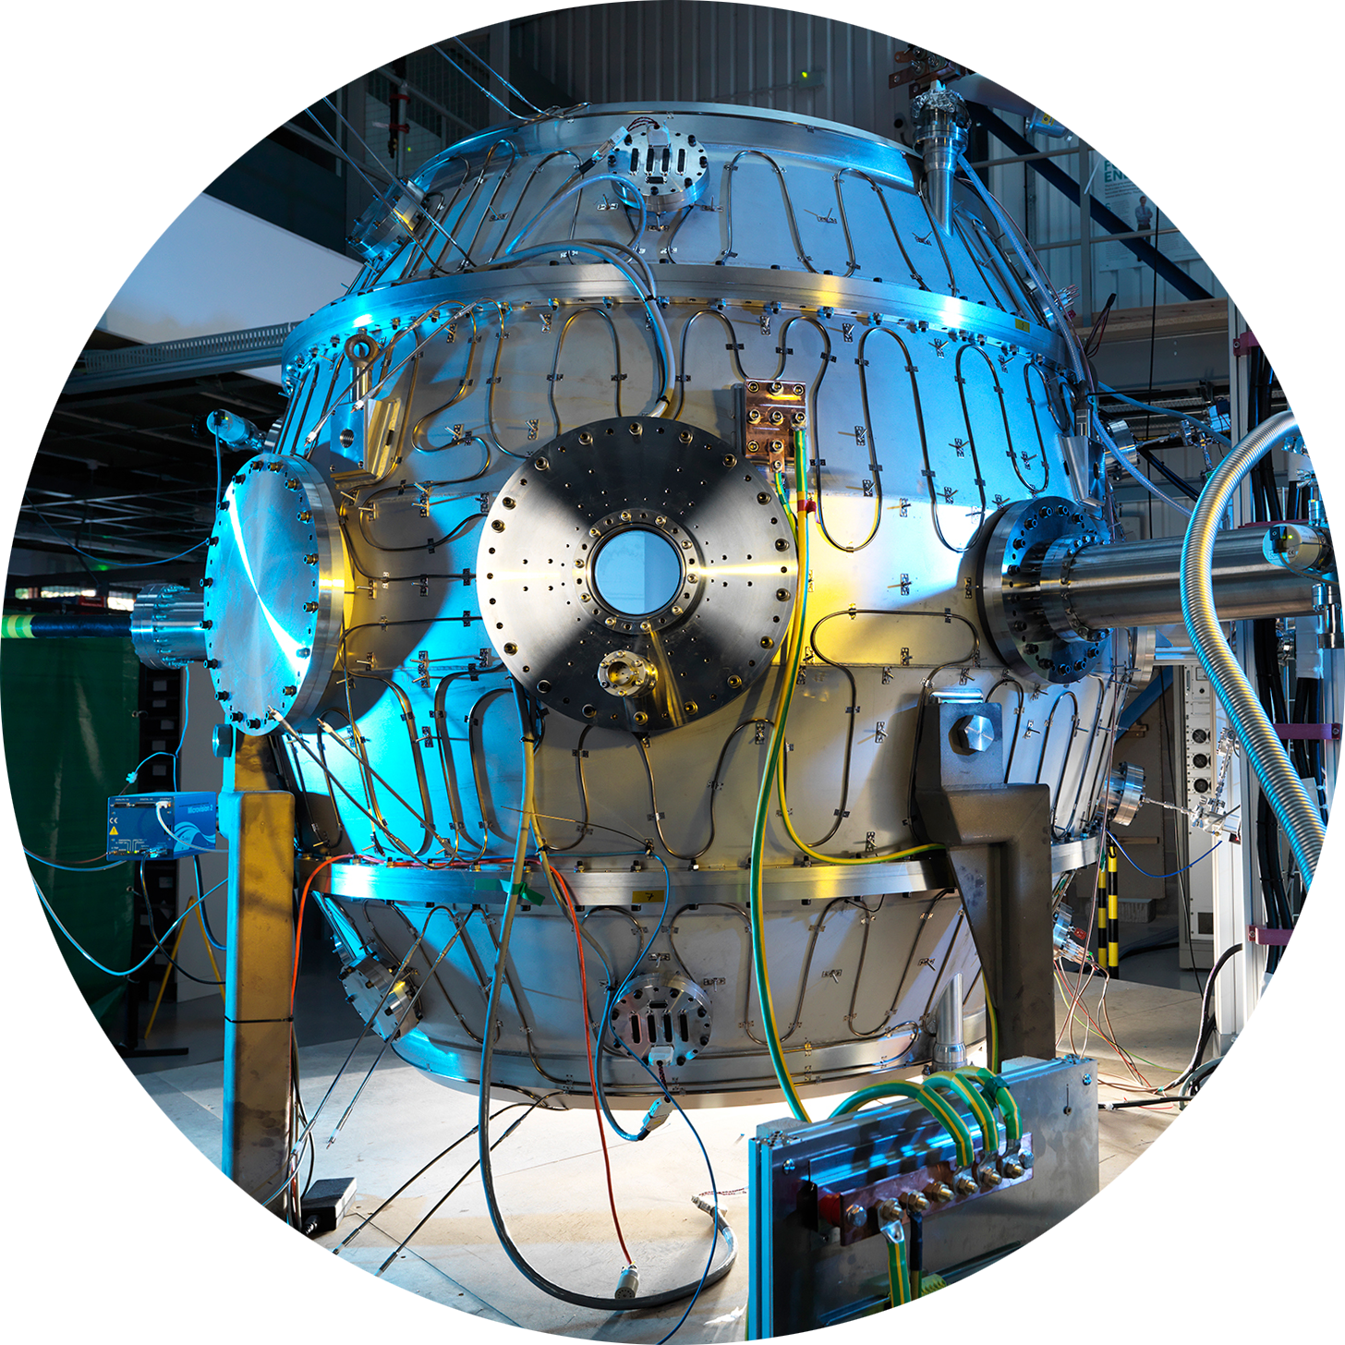
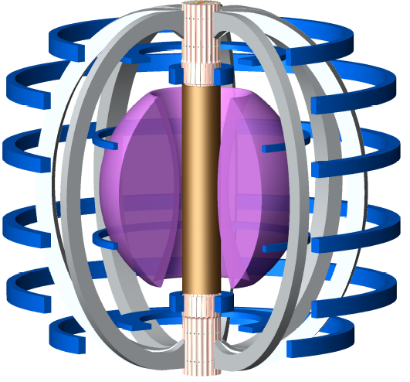

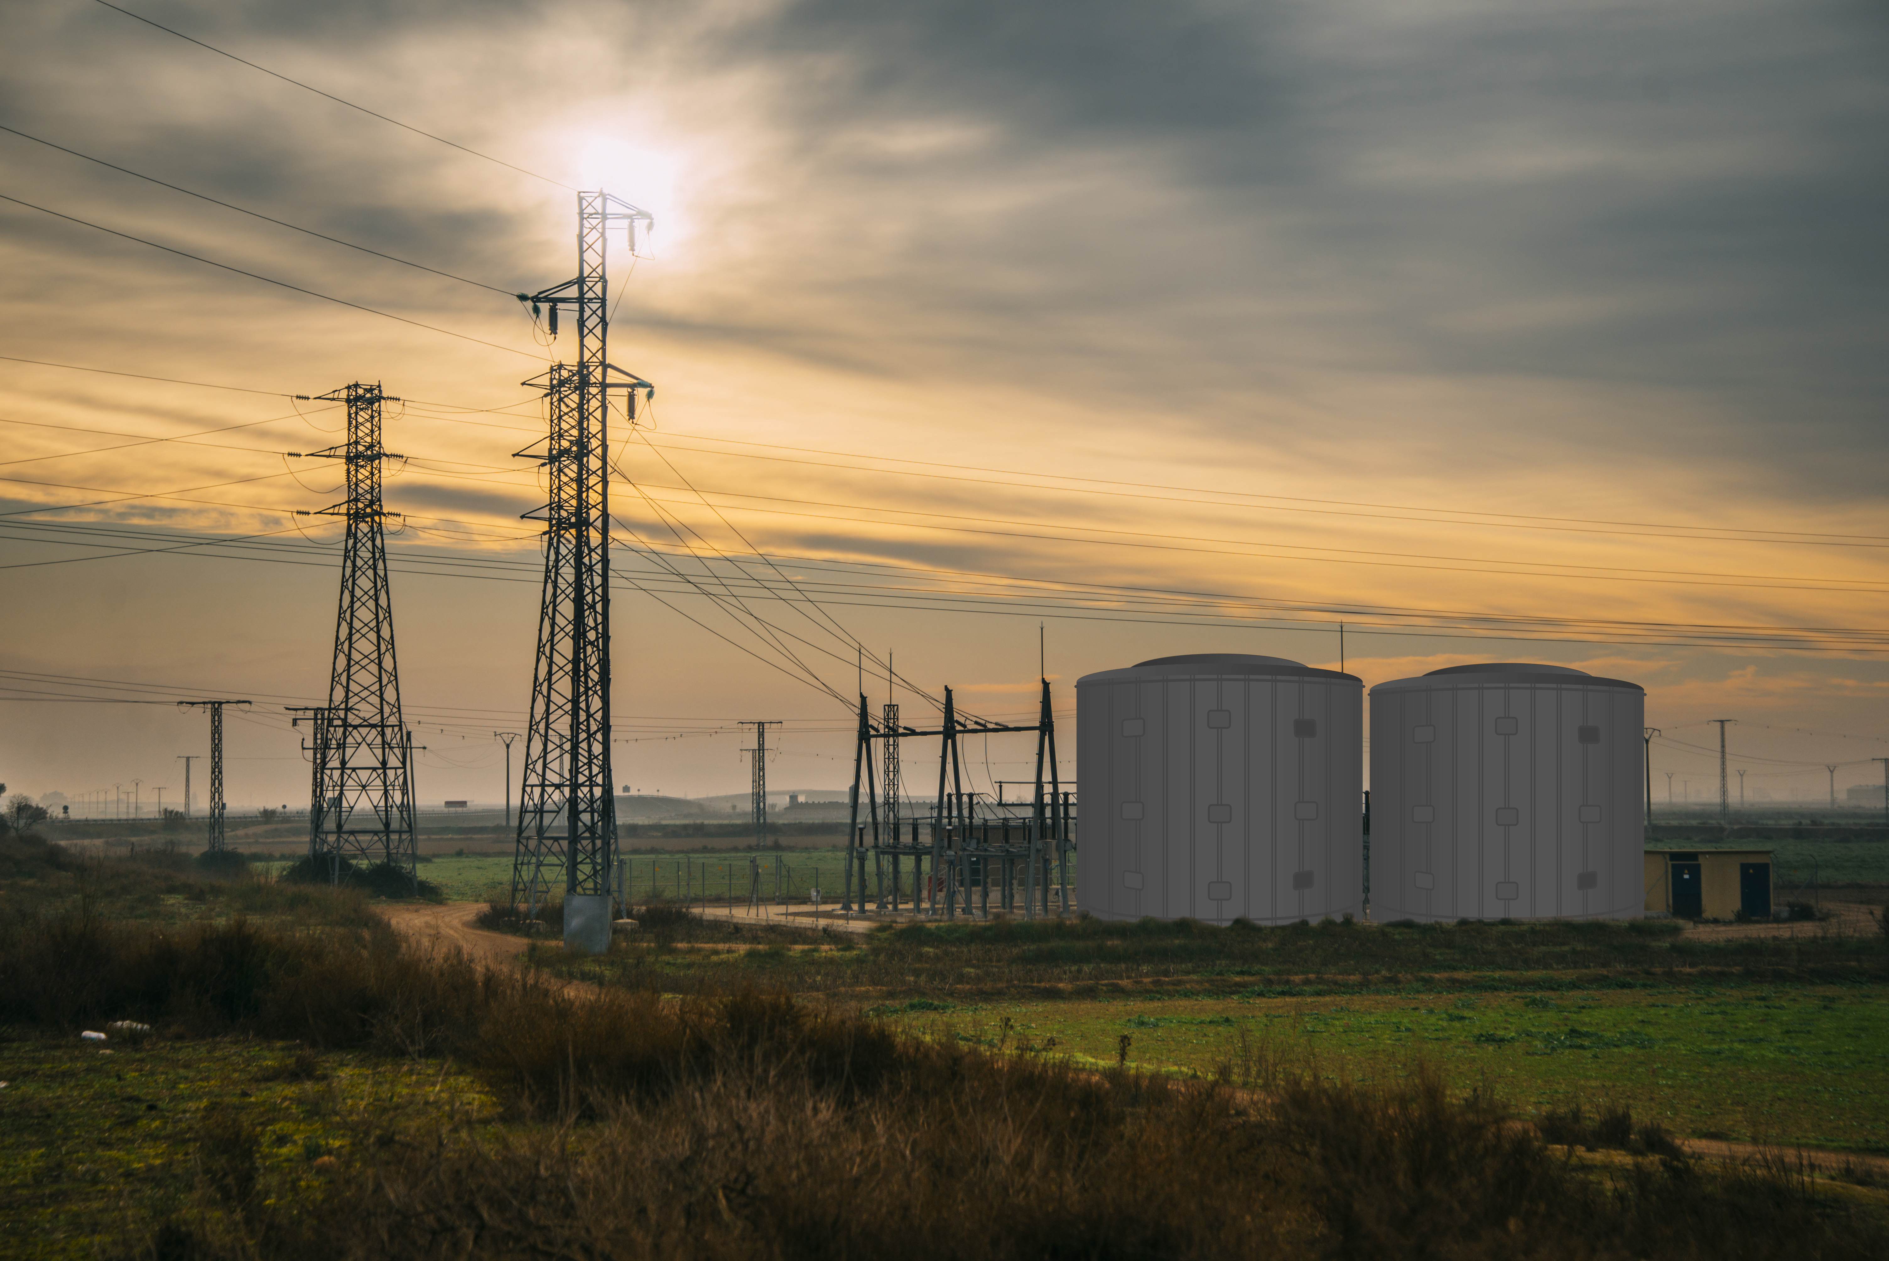
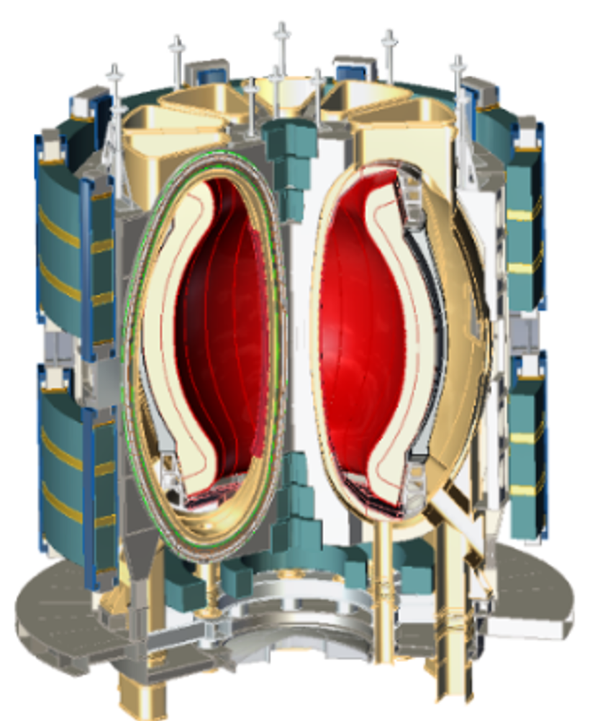
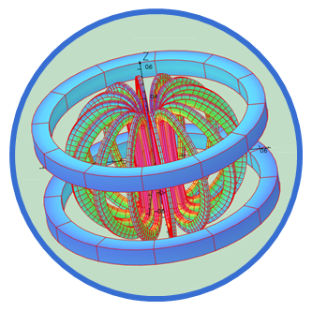
Our plans have not changed
Research & Development
Engineering & Demonstration
Power Plant
Our Focus
Verify the high field ST approach
Energy gain conditions
ST-F1
ST-E1
HTS Magnet Demo
Fusion Power Demonstration
All HTS Magnets
Industrial scale heat production
Commercial scale module
Electricity production
(to the grid)
Large scale HTS magnet
Magnet design and construction
Notes:
STF1
Mission to demonstrate viability of this high field ST with HTs magnets at significant scale
scoping studies have identified a range of designs and potential operating points. Being assessed with plan to start concept design next year

Slide 11
Programme 1
Programme 2
Programme 3
Programme 4
Completed October 2019
In progress, ending early 2020
Starting late 2020
2022 - …
System & diagnostic commissioning
1st Plasma 28NOV19
Upgraded vacuum vessel and in-vessel components
Liquid metal divertor upgrade
Ohmic plasmas
Neutral beam heated plasmas
RF heated plasmas
Solenoid free start-up: merging compression
Solenoid free start-up: EBW/ECRH
Confinement and transport studies
SOL and divertor characterisation

Slide 12


Slide 13
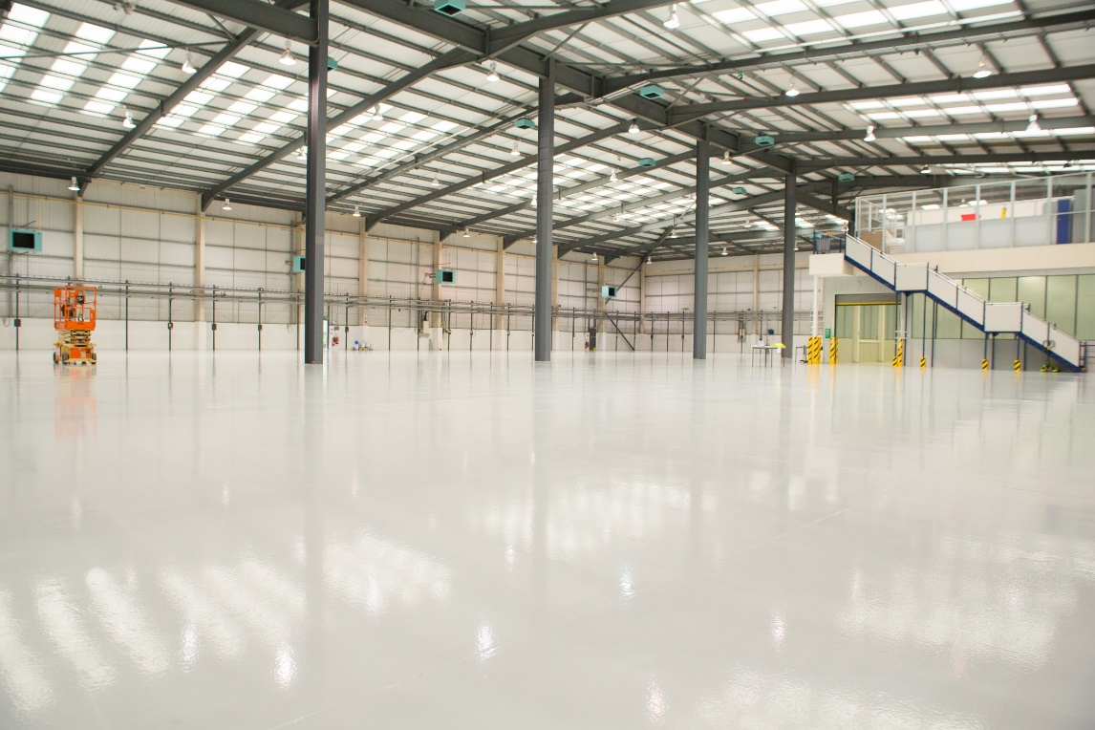

Slide 15
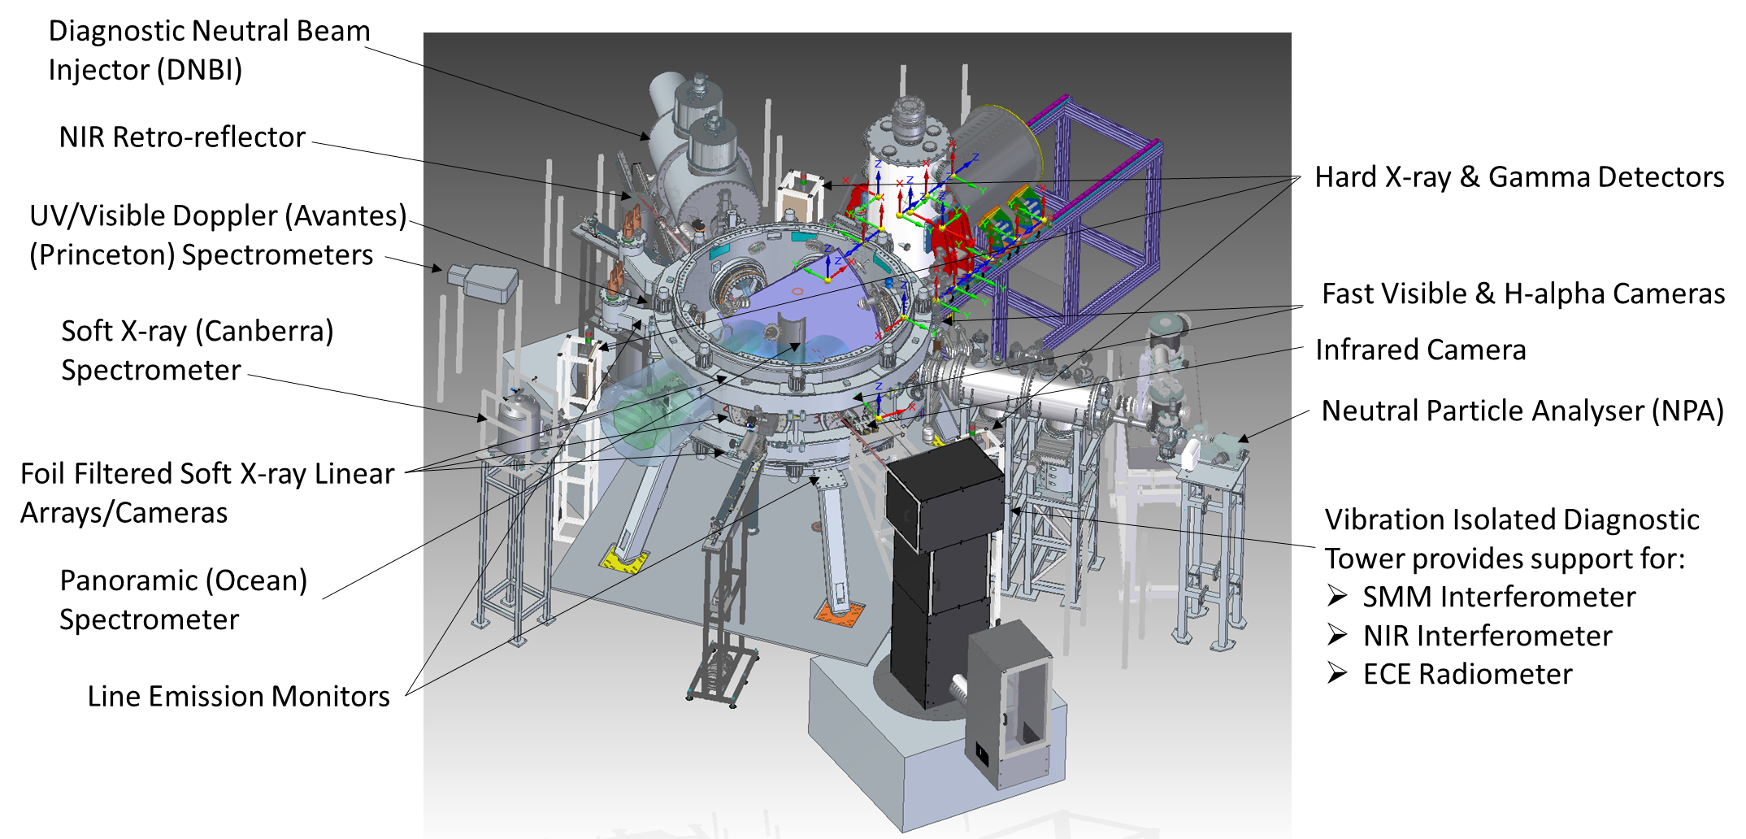
ST40: P1 & P2 Diagnostics

Slide 16
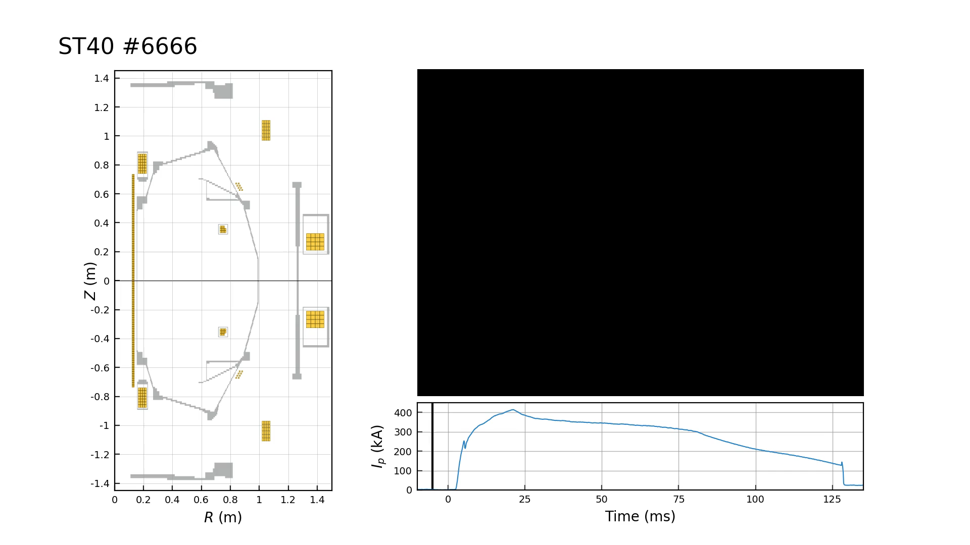
ST40: Programme 1

Slide 17
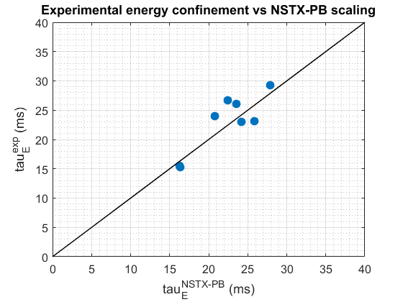

Slide 18
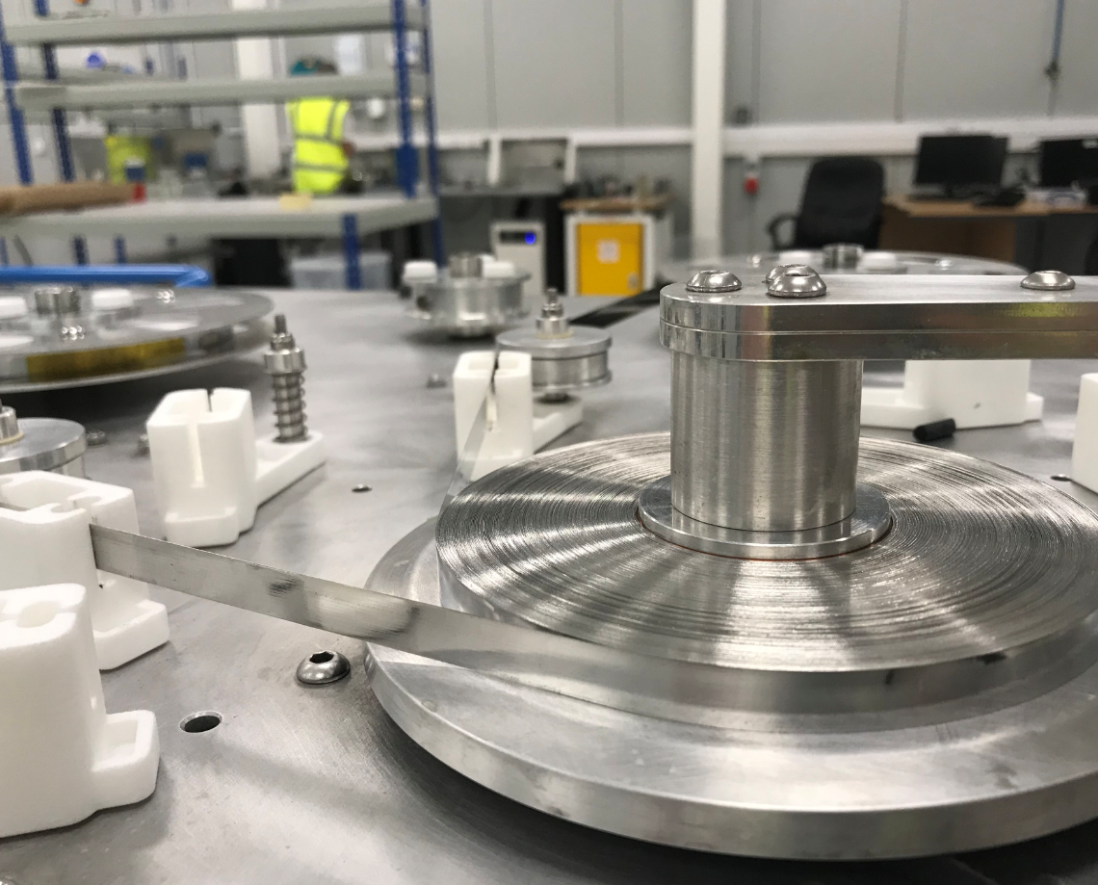
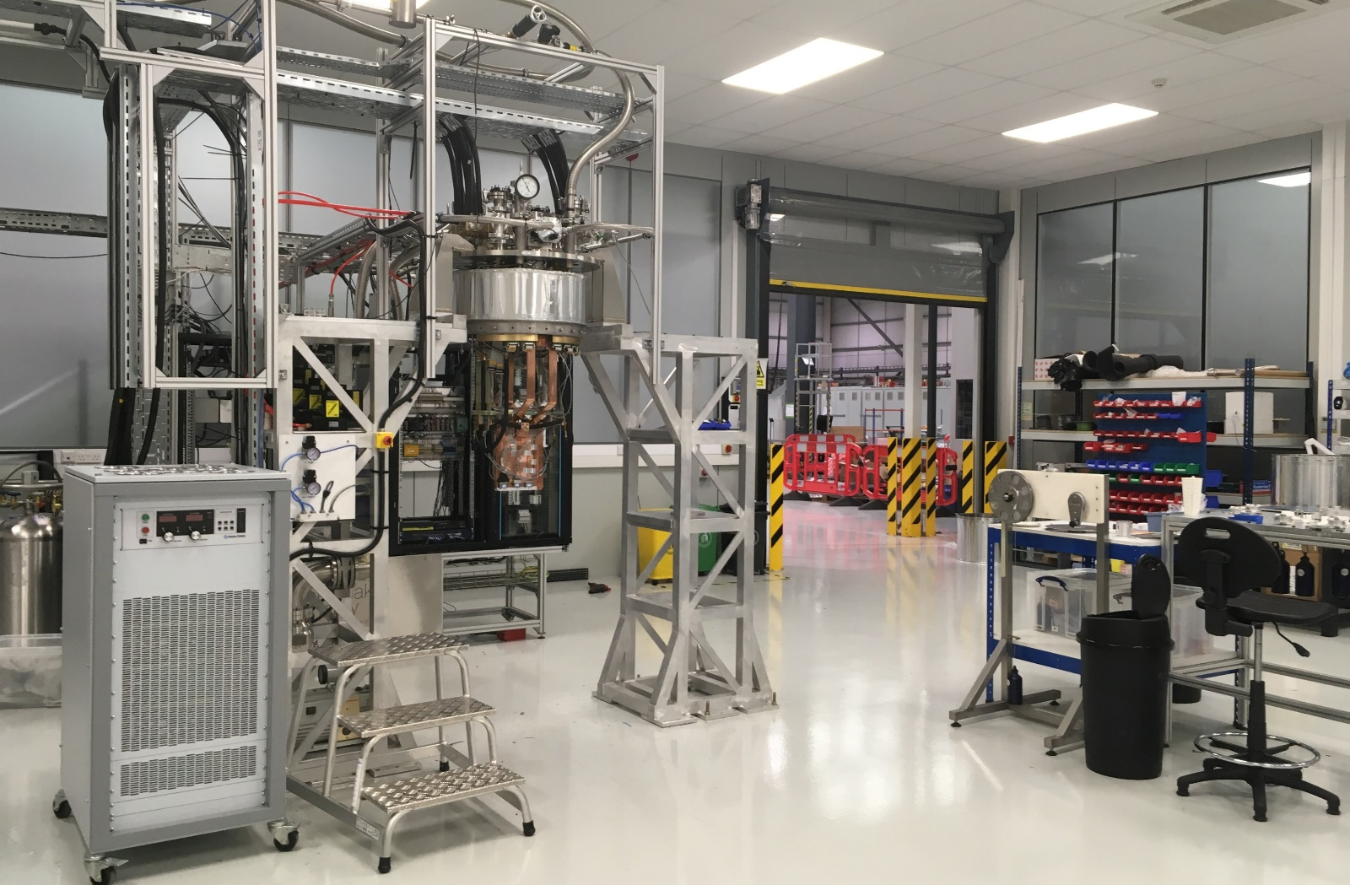
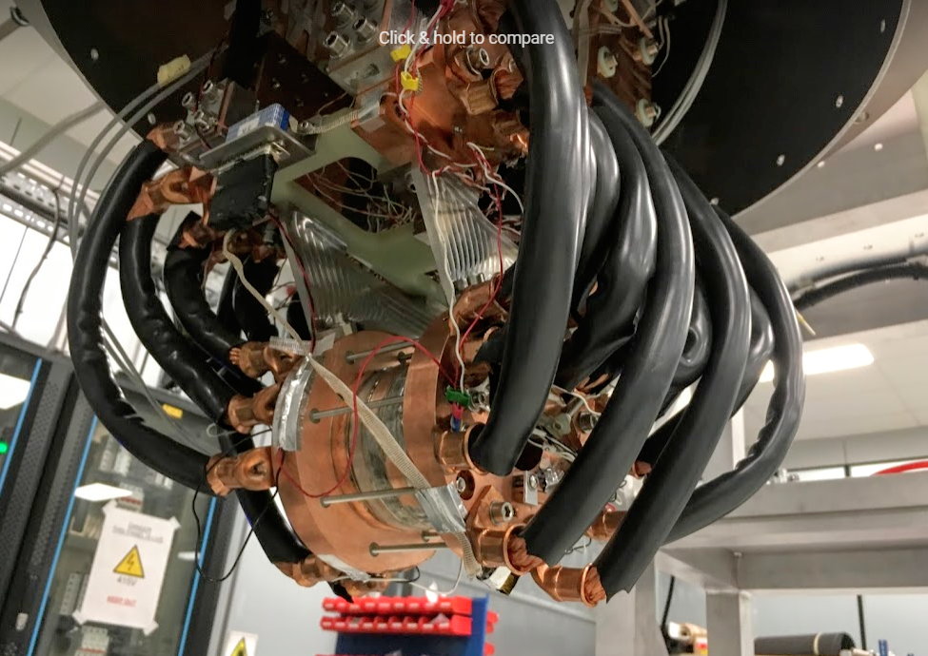
HTS magnet laboratory built

Slide 19
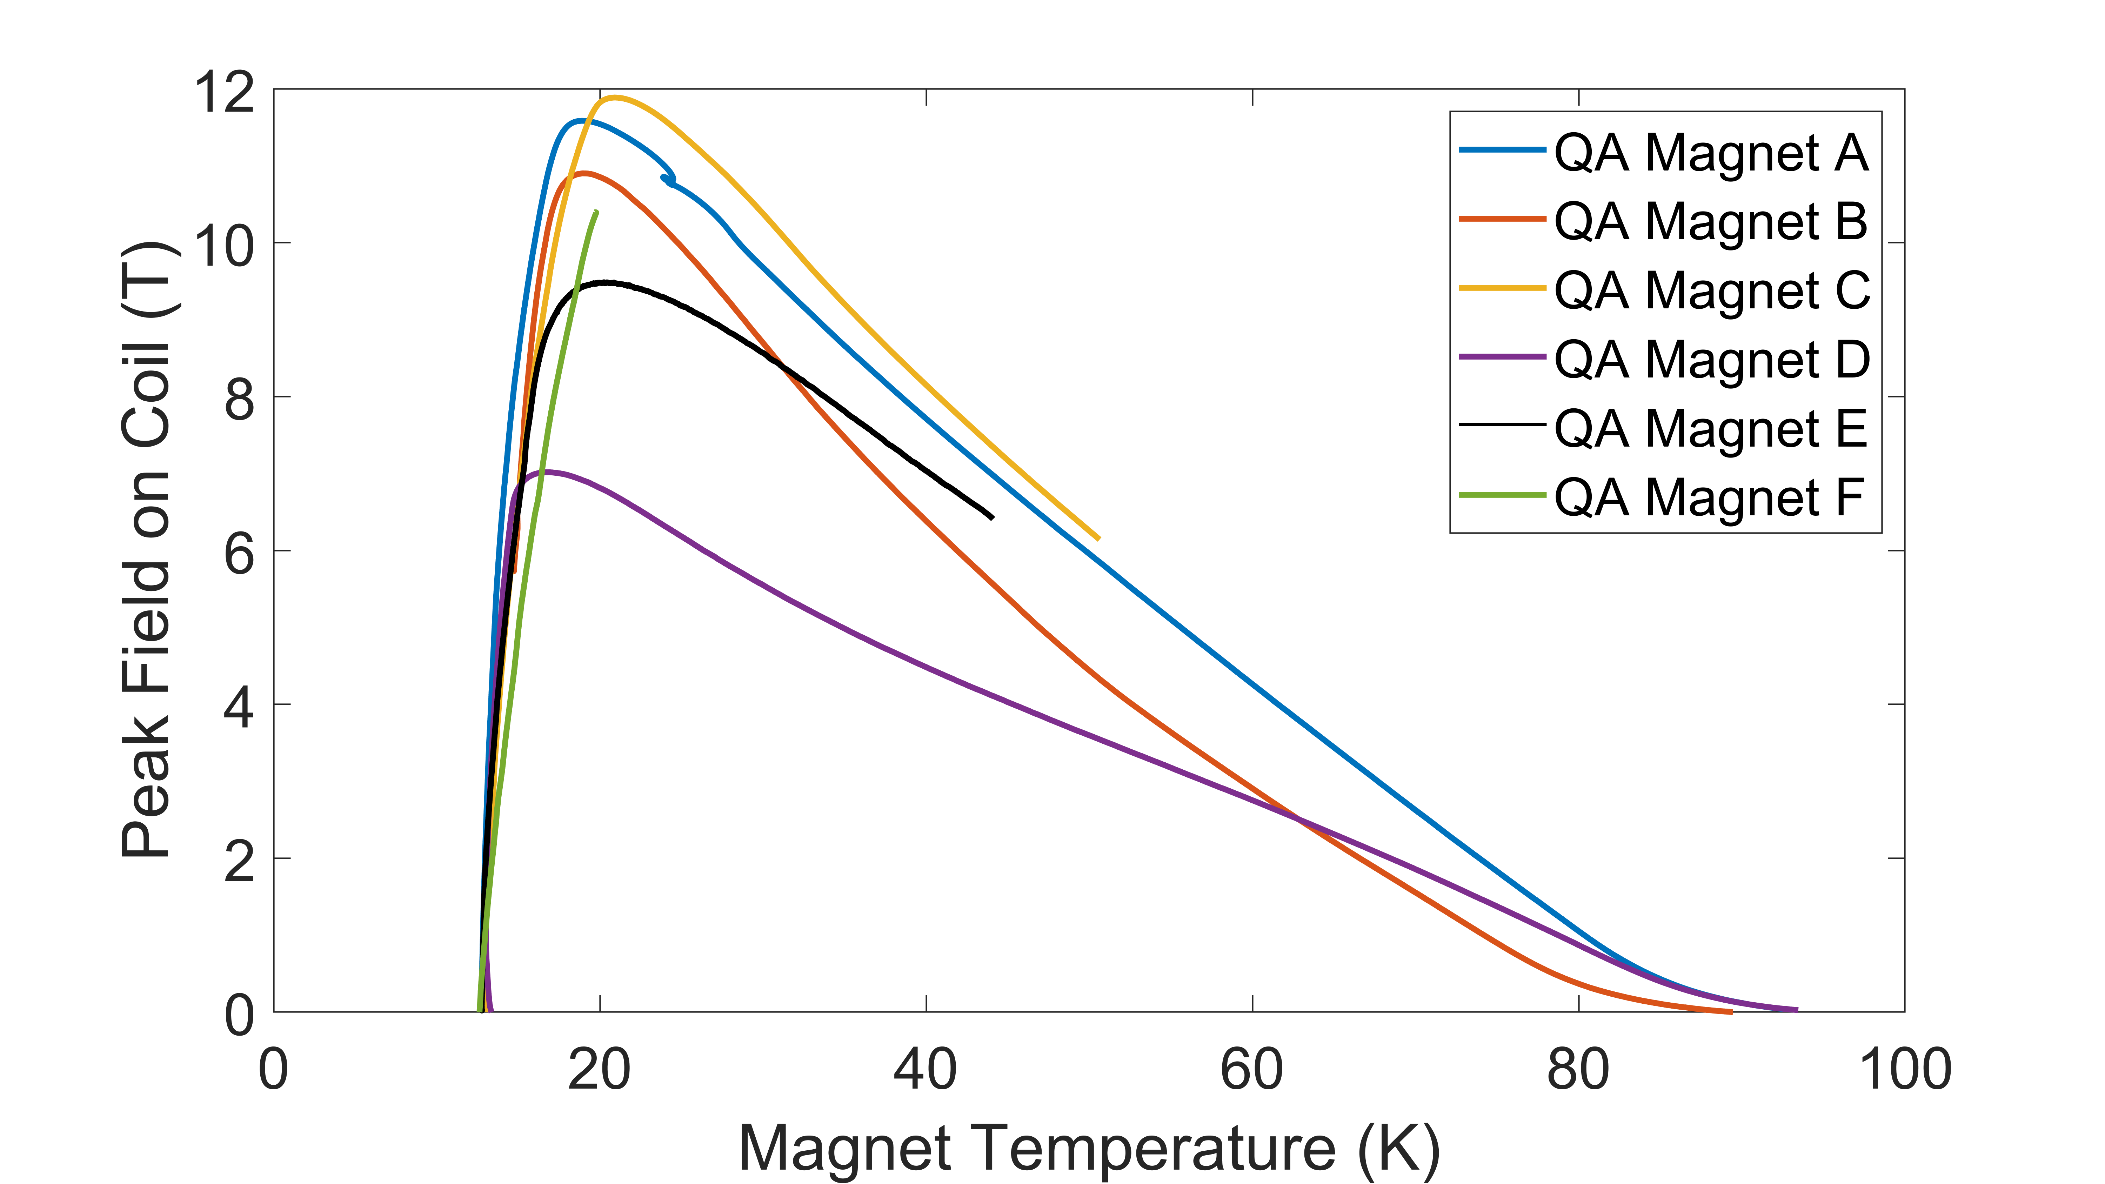
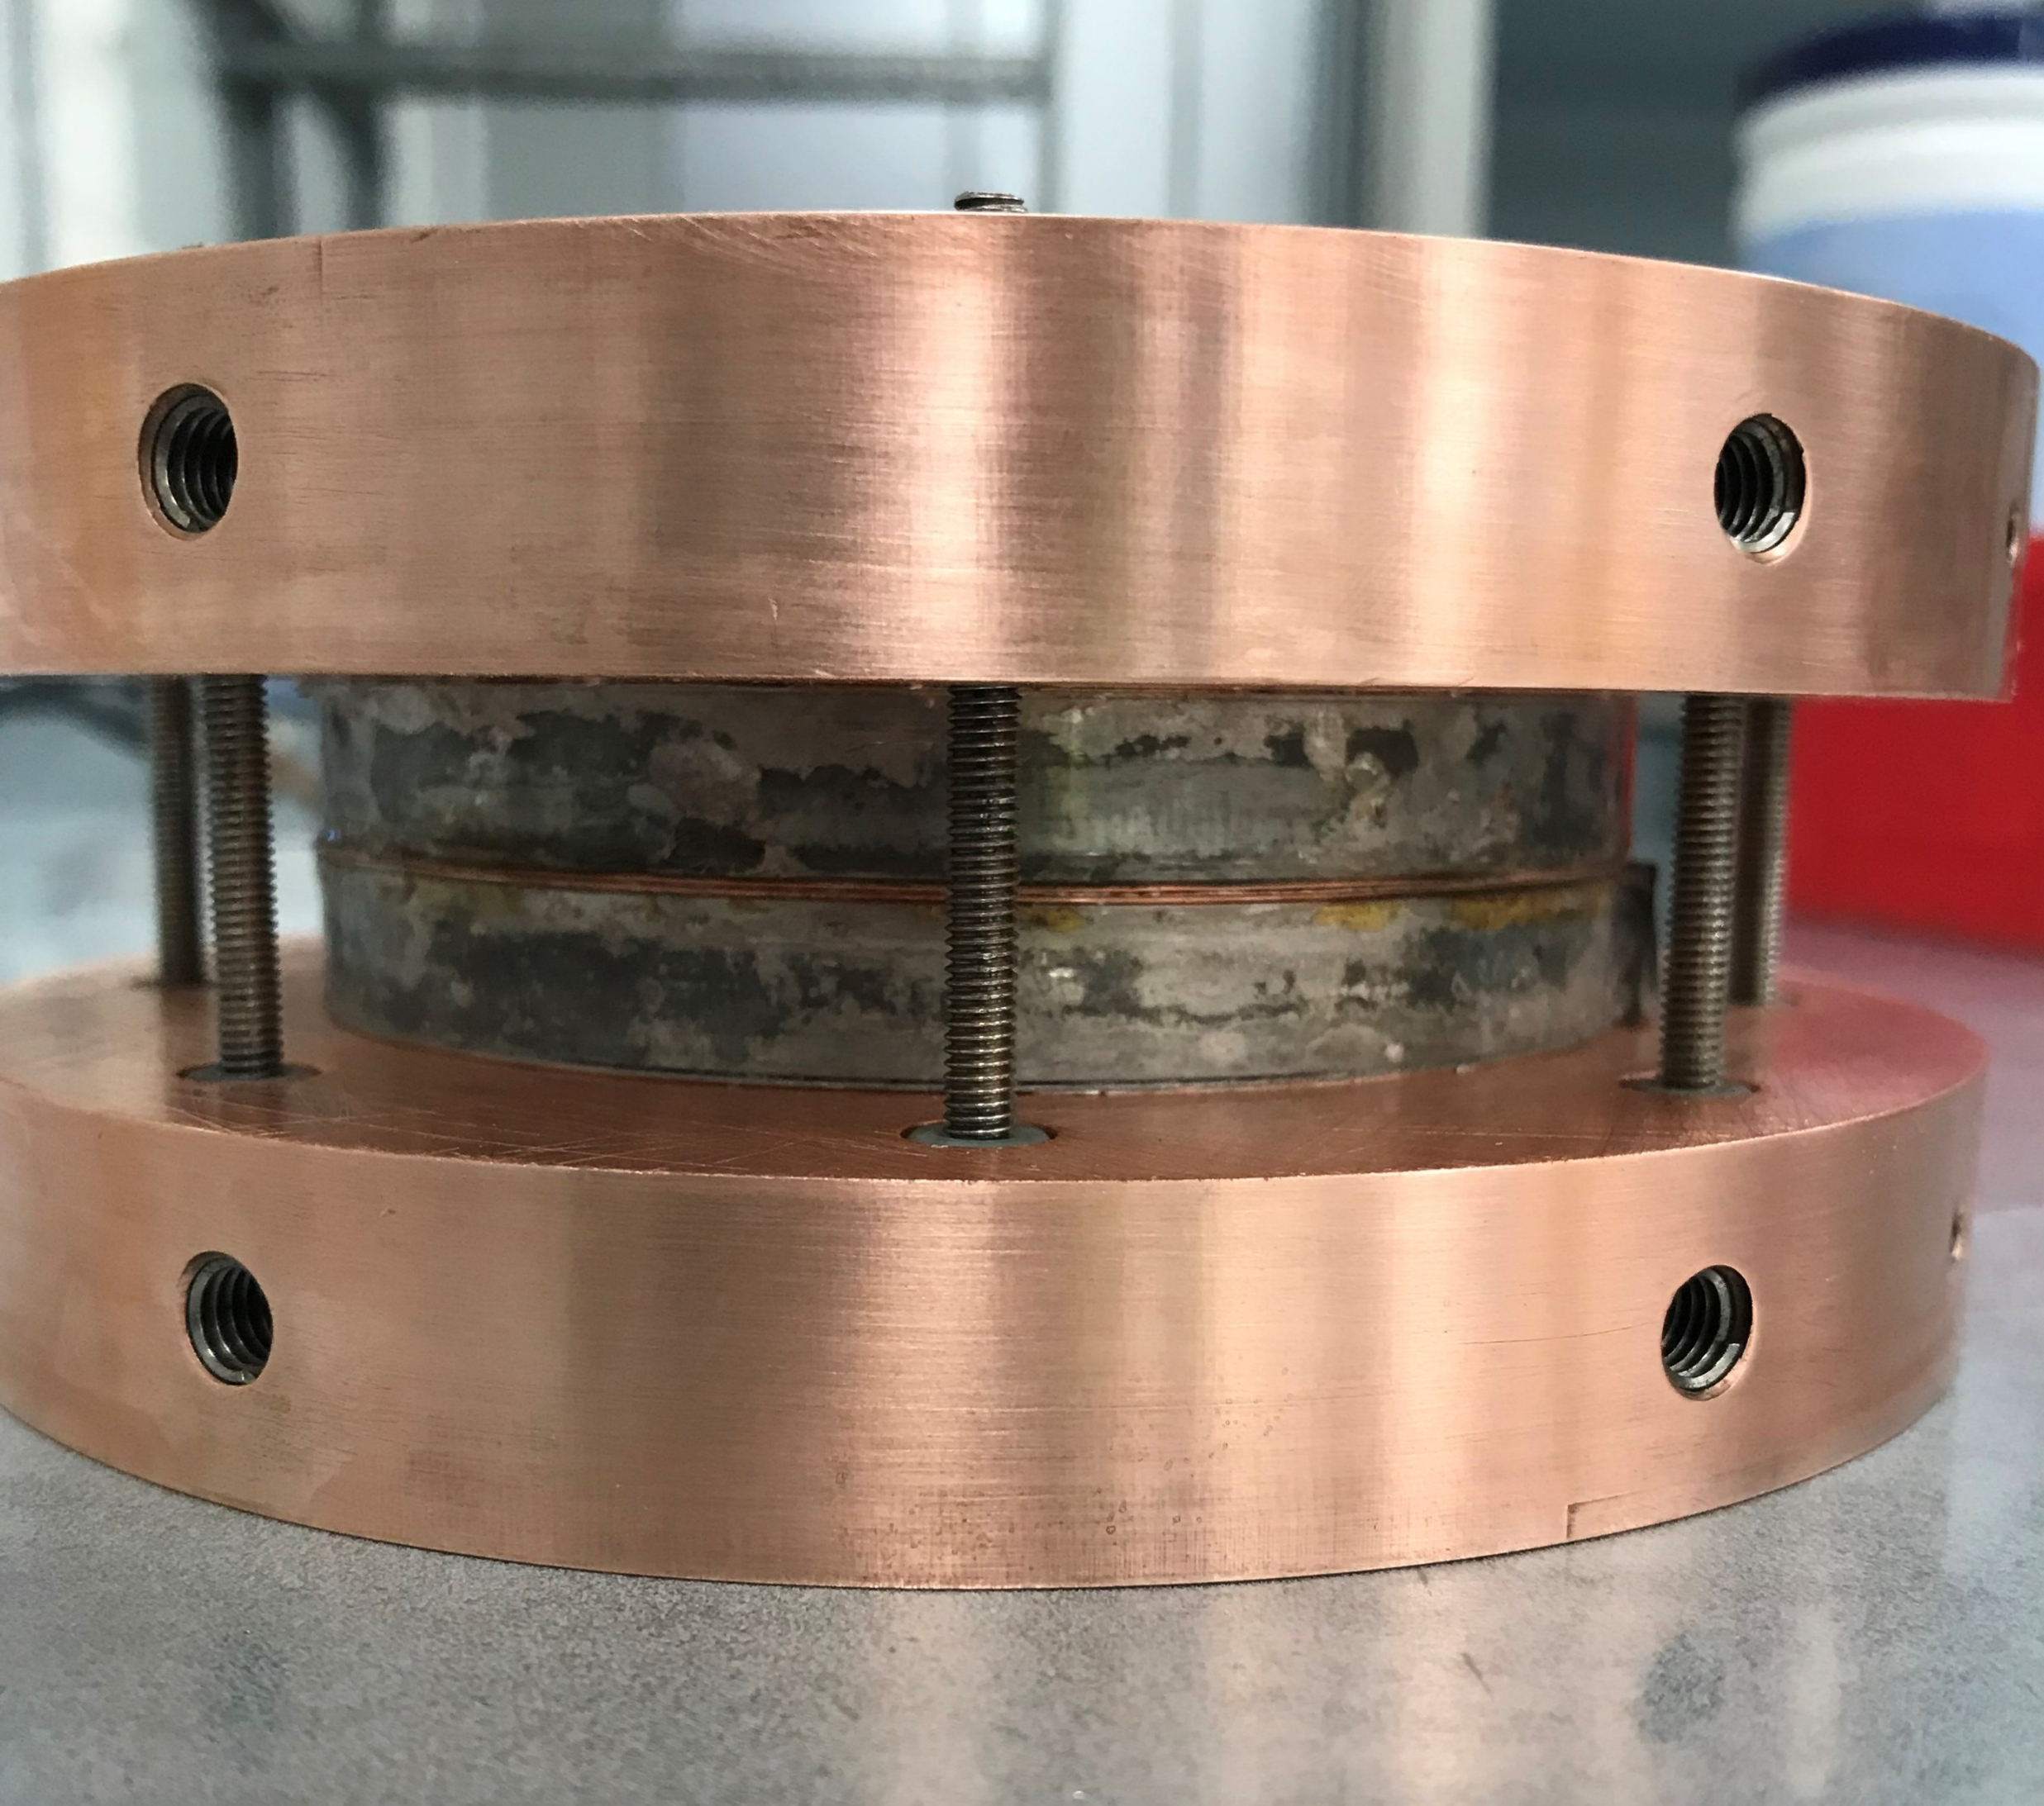
Characterisation and technology development
Novel HTS magnet design
  Soldered, non-insulated
  Electro-Thermal Interface (ETI) plates for current injection
“QA” magnets
  Compared tape I_{C}(B,T,θ) from six different HTS suppliers
  Characterised tape performance in a magnet as opposed to short sample
Results used to verify magnet models

Slide 20
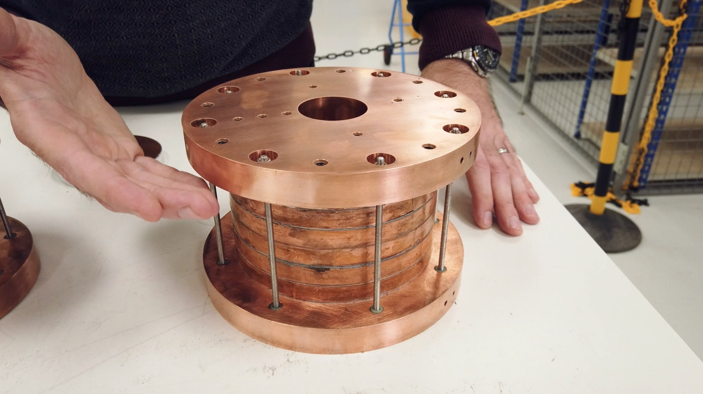
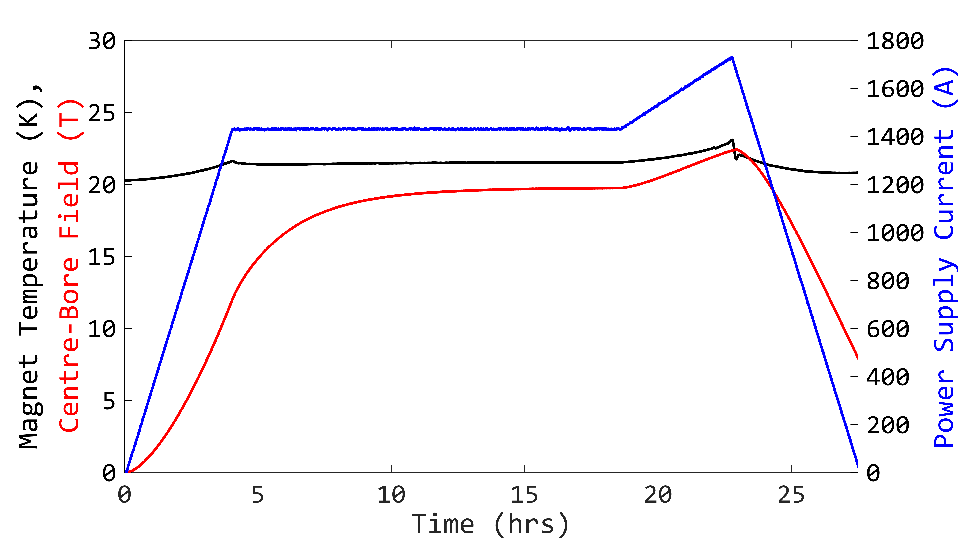
24.4T at 21K in all-REBCO Solenoid
All-REBCO magnet, conduction cooled to 21K
Six pancake stack
  ID-50mm, OD-140mm
  735m of 12mm HTS tape
24.4T peak field on coil
Operated at >20T for 10s hours
~700 A/mm² current density
22.2 T

Slide 21
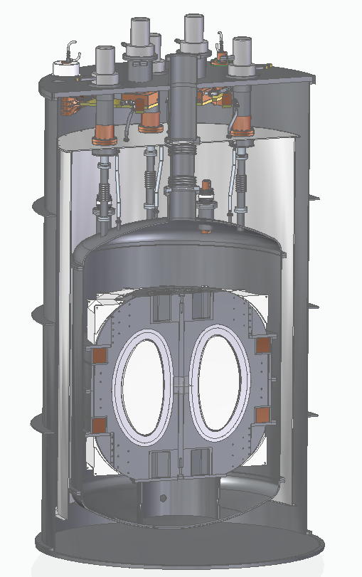
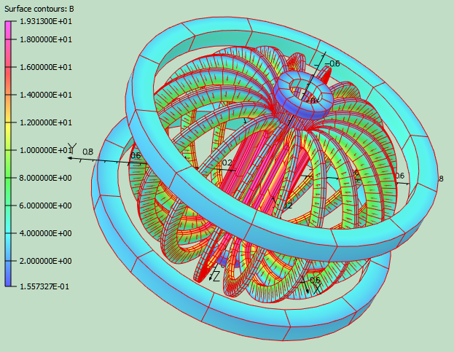
High field HTS magnet demonstrator
Demo4 – a mid-scale tokamak type magnet to develop and demonstrate HTS technology and manufacturing methods
Approach conditions expected in a reactor:
  Exceed 20T on HTS surface
  Exceed 250MPa compressive stress is centre column
  Simulate fusion heat loads
Demonstrate scalable quench protection
Test PF/TF interaction
Notes:
* Previous coils have all been “small bore”

Slide 22
ST-F1 and beyond
F1 Hot Topics
Recruitment – Tokamak Energy staffing now over 100 … plus partnerships
Design work
Supply chain and long-lead ordering
Site down-selection
Total cost optimisation

Slide 23
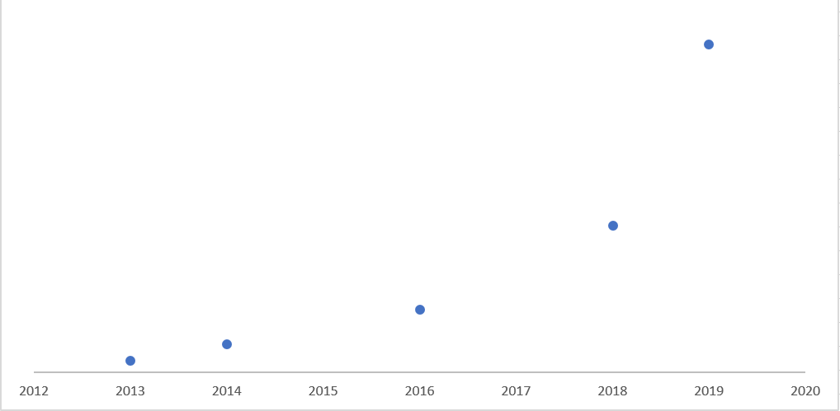
Funding going well – announcement in January
Drives Progress, Underpins partnerships

Slide 24




Let’s collaborate!

Slide 25
Public fusion programmes
JET
GLOBUS-M
St Petersburg, RF
Oxford, UK
COMPASS
KTM
Alcator C-Mod⁽³⁾
Prague, CZ
T15-M⁽¹⁾
Moscow
Kurchatov, KZ
STOR-M
Cambridge, MA
MAST
Saskatoon, SK
Oxford, UK
ASDEX
KSTAR
ITER⁽¹⁾⁽²⁾ / WEST
Garching, DE
Daejeon, KR
LTX / NSTX
Cadarache, FR
FTU
HL-2
DIII-D
Pegasus
Princeton, NJ
Frascati, IT
Chengdu, CN
QUEST
JT-60SA⁽¹⁾
San Diego, CA
Madison, WI
ISTTOK
TCV
Kasuga, JP
Naka, JP
Lisbon, PT
Lausanne, CH
SST-1 / ADITY
EAST
Gandhinagar, IN
Hefei, CN
Conventional Tokamak
Spherical Tokamak
Note: Tokamaks are operating unless indicated otherwise.
Under construction.
The International Thermonuclear Experimental Reactor (“ITER”) megaproject is supported by China, the European Union, India, Japan, Korea, Russia and the United States.
No longer in use.

Slide 26






Private fusion
Cambridge, MA
Vancouver, BC
Langfang, PRC
Los Angeles, CA
Orange County, CA
Oxford, UK
Oxford, UK
Conventional Tokamak
Spherical Tokamak
Non-Tokamak Technology

Slide 27
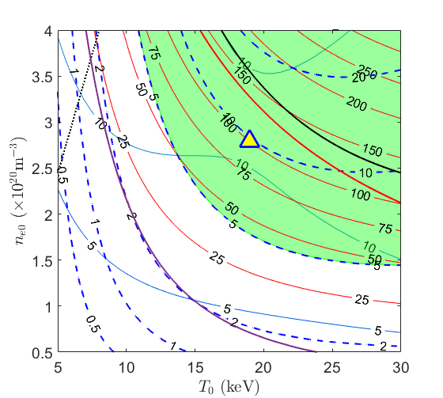
ST-F1
Prove viability of our approach to fusion power
Demonstrate high field HTS magnets and other fusion technologies at scale
Scoping studies have identified a range of device options current under review
Watch this space!

Slide 28
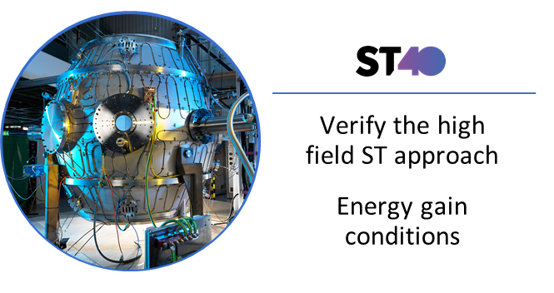
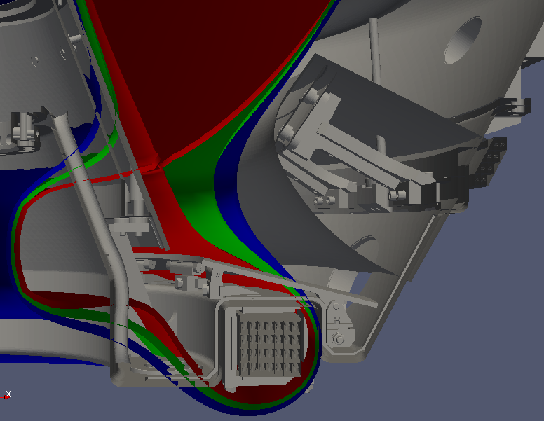
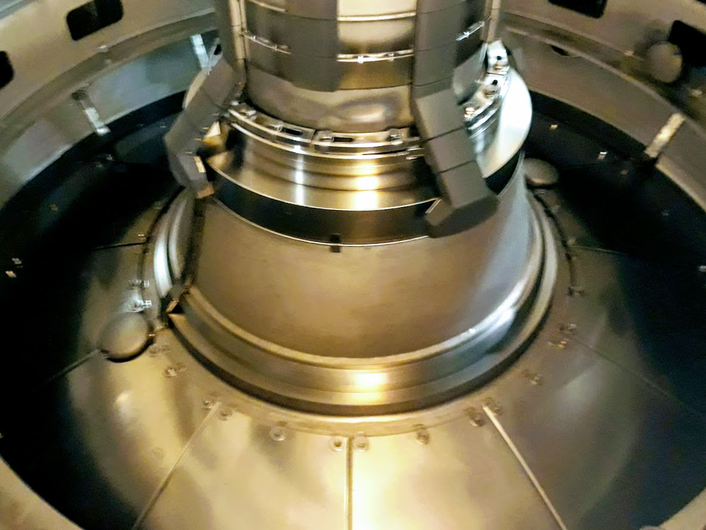
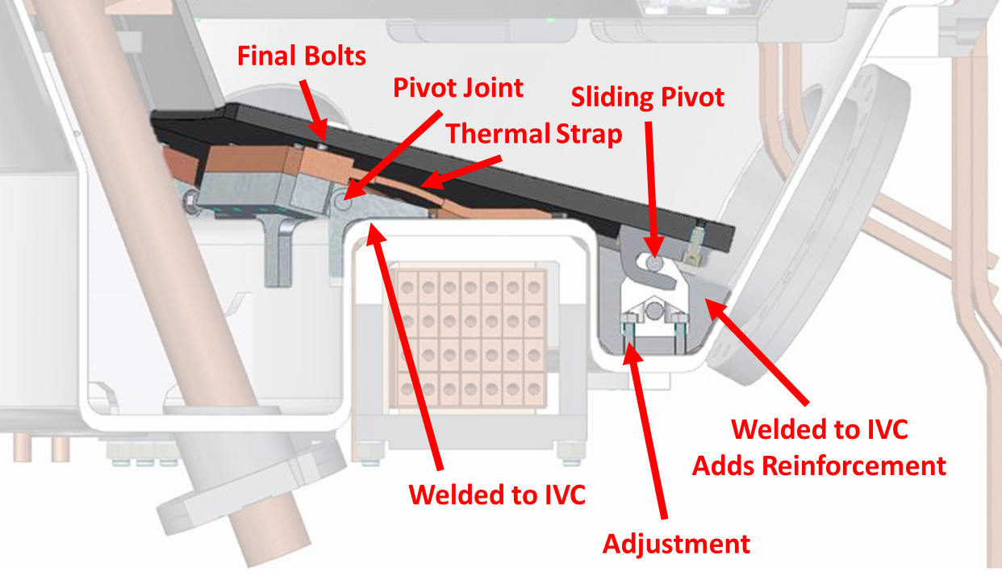
ST40 divertor upgrade
Planned Programme 3 divertor upgrade
Present ST40 molybdenum divertor
Notes:
Divertor will be partially closed; with a narrow ‘throat’

Slide 29
Liquid metal development
Tokamak Energy have partnered with three leading laboratories:
Theoretical modelling of flowing liquid lithium
Developing ‘true’ free surface models
Developing the flowing liquid lithium divertor plate for ST40
Developing a diagnostic to measure the depth of the flowing liquid lithium

Slide 30
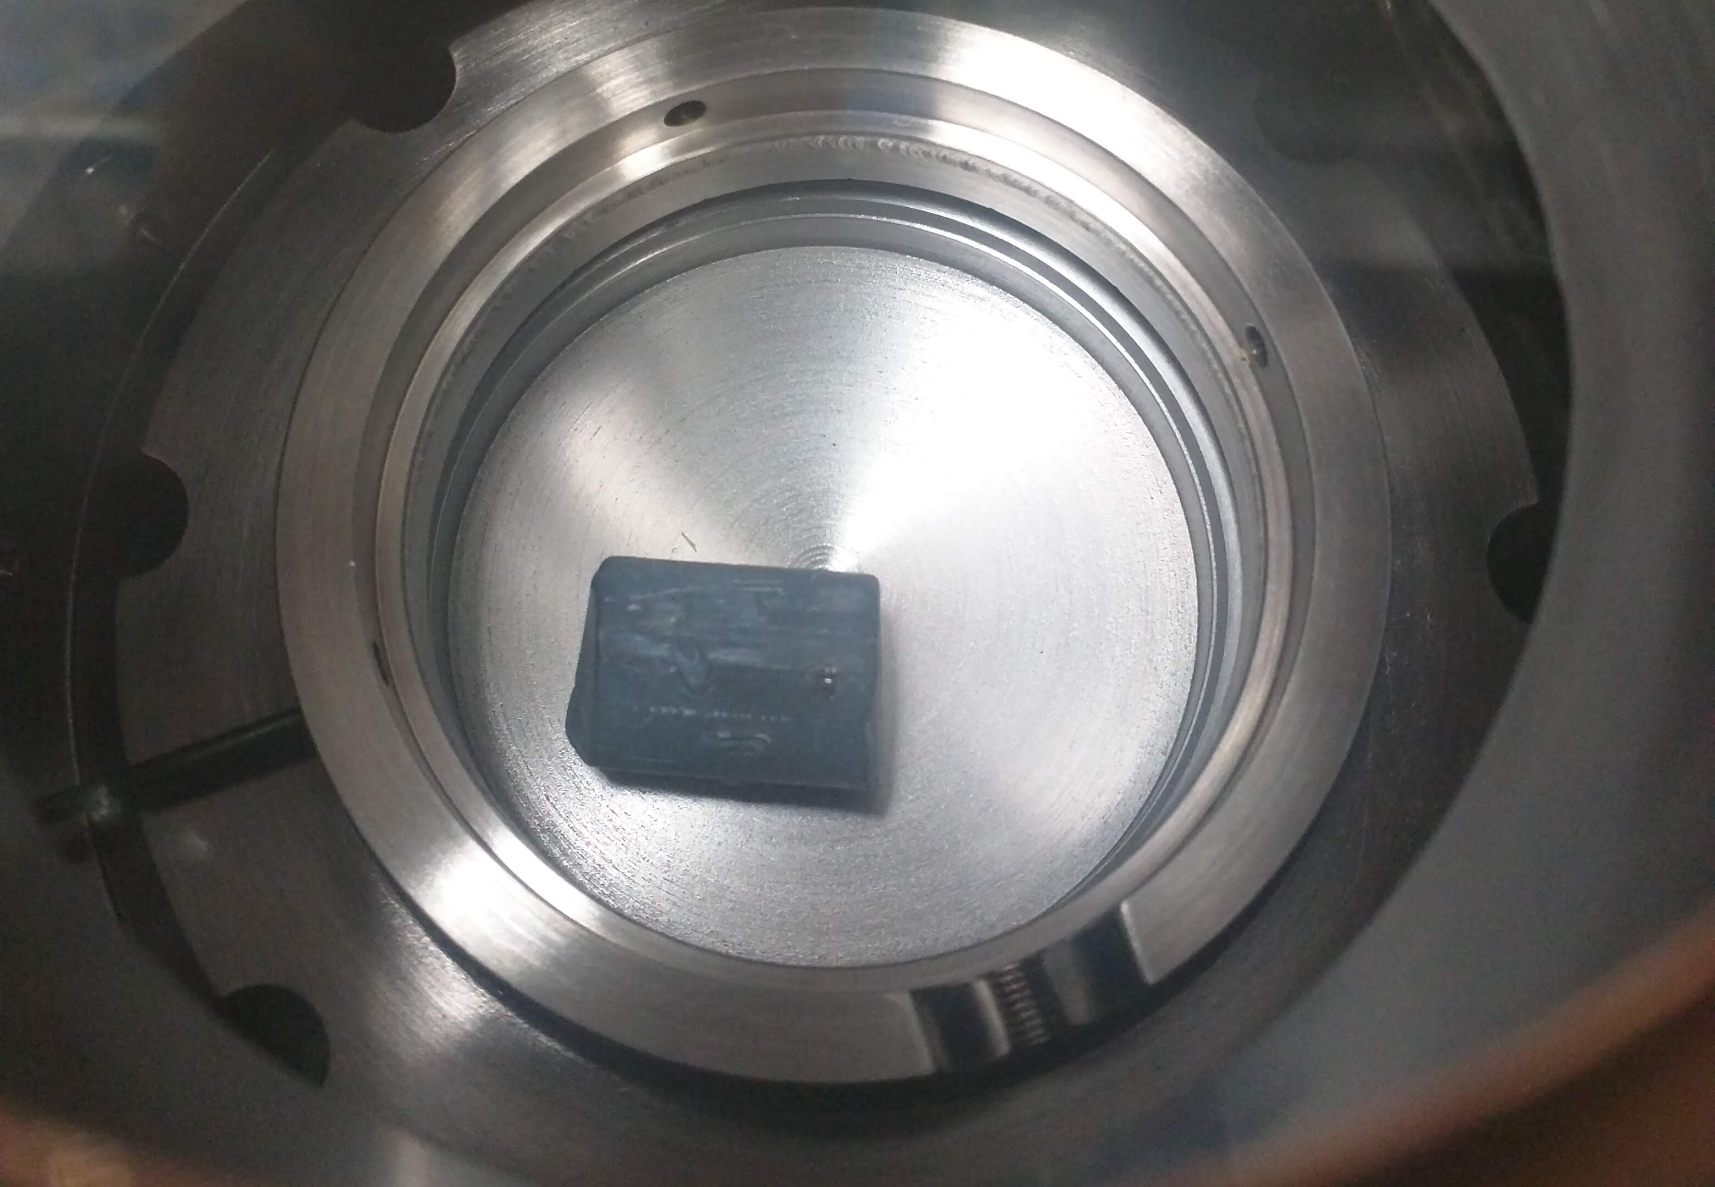
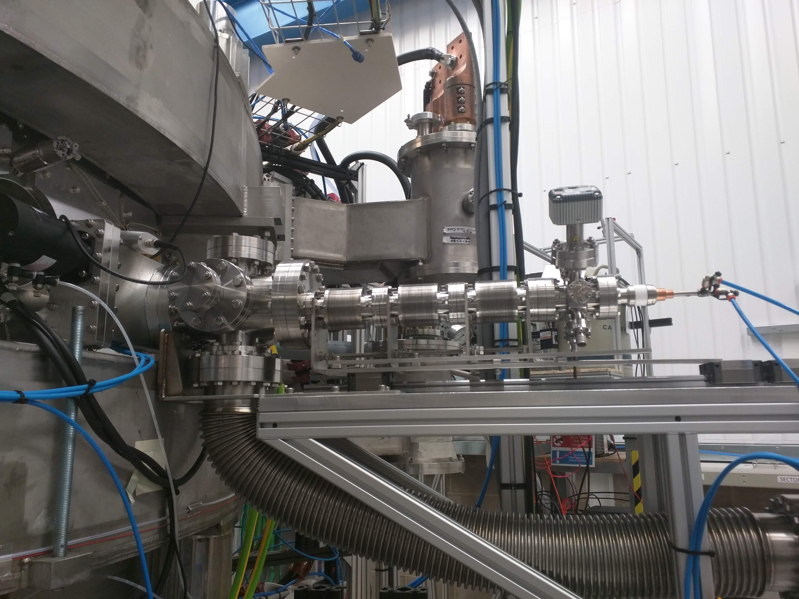
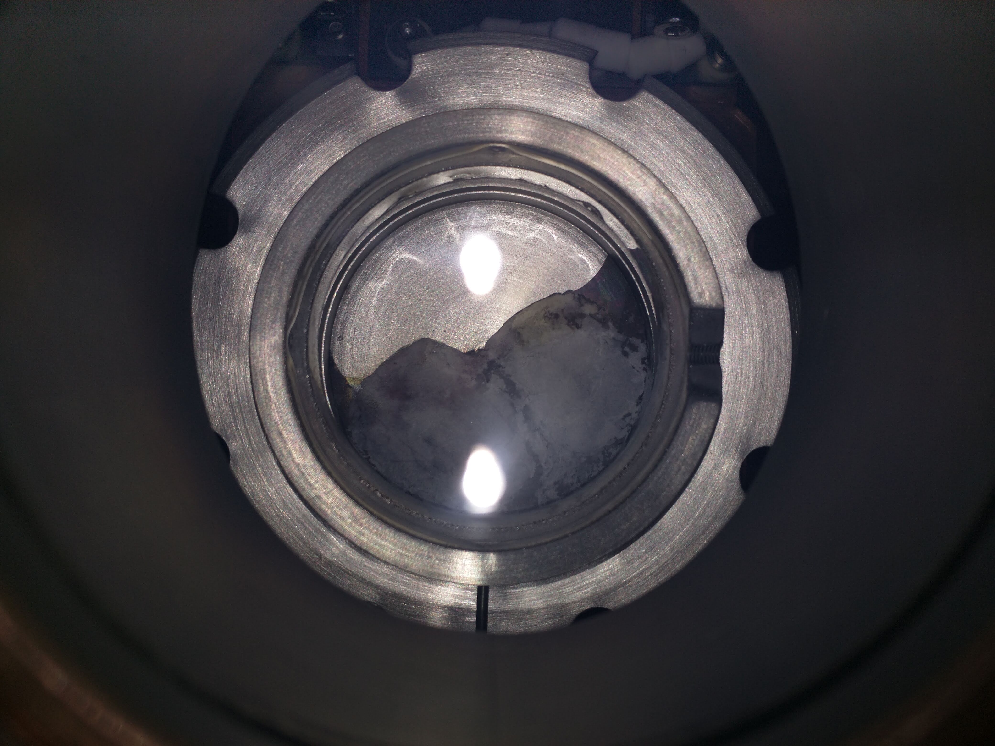
ST40 lithium conditioning

Slide 31
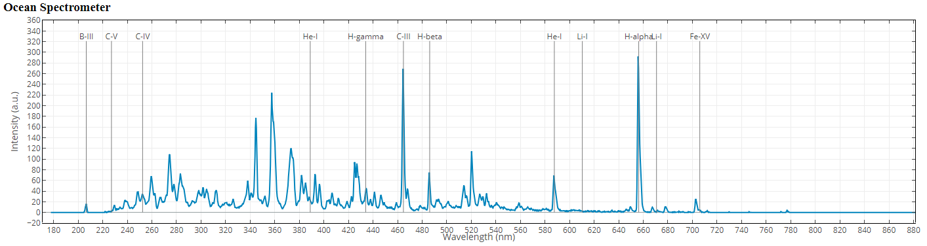
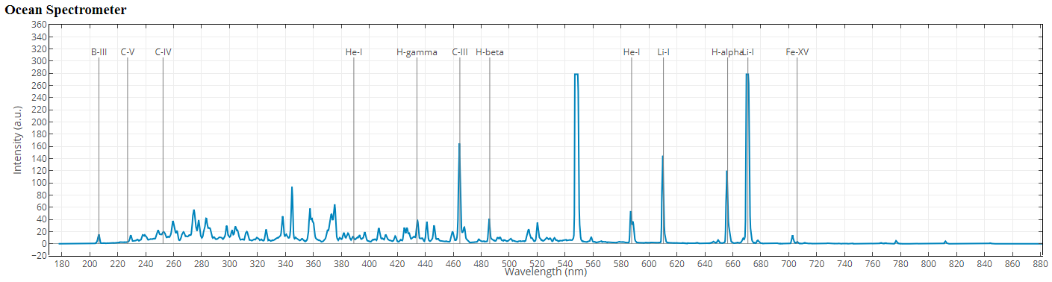
ST40 – first experience with lithium
Significant reduction in impurities observed
Lithium
Notes:
Without any lithium conditioning: 10^-8 milibar = 0.75 x10^-8 torr

Slide 32
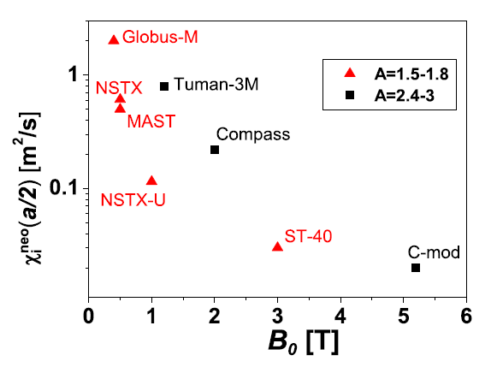
ST40: Performance Potential
Dnestrovskij, A. Y, J. W. Connor, & M. P. Gryaznevich. "On the confinement modeling of a high field spherical tokamak ST40." PPCF 61(5) (2019)

Slide 33
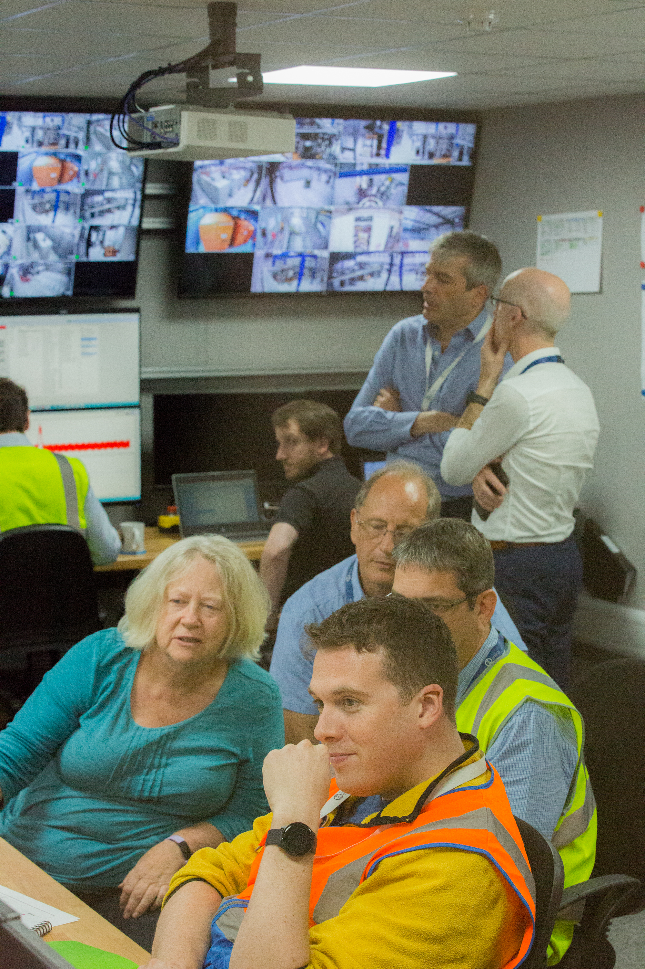
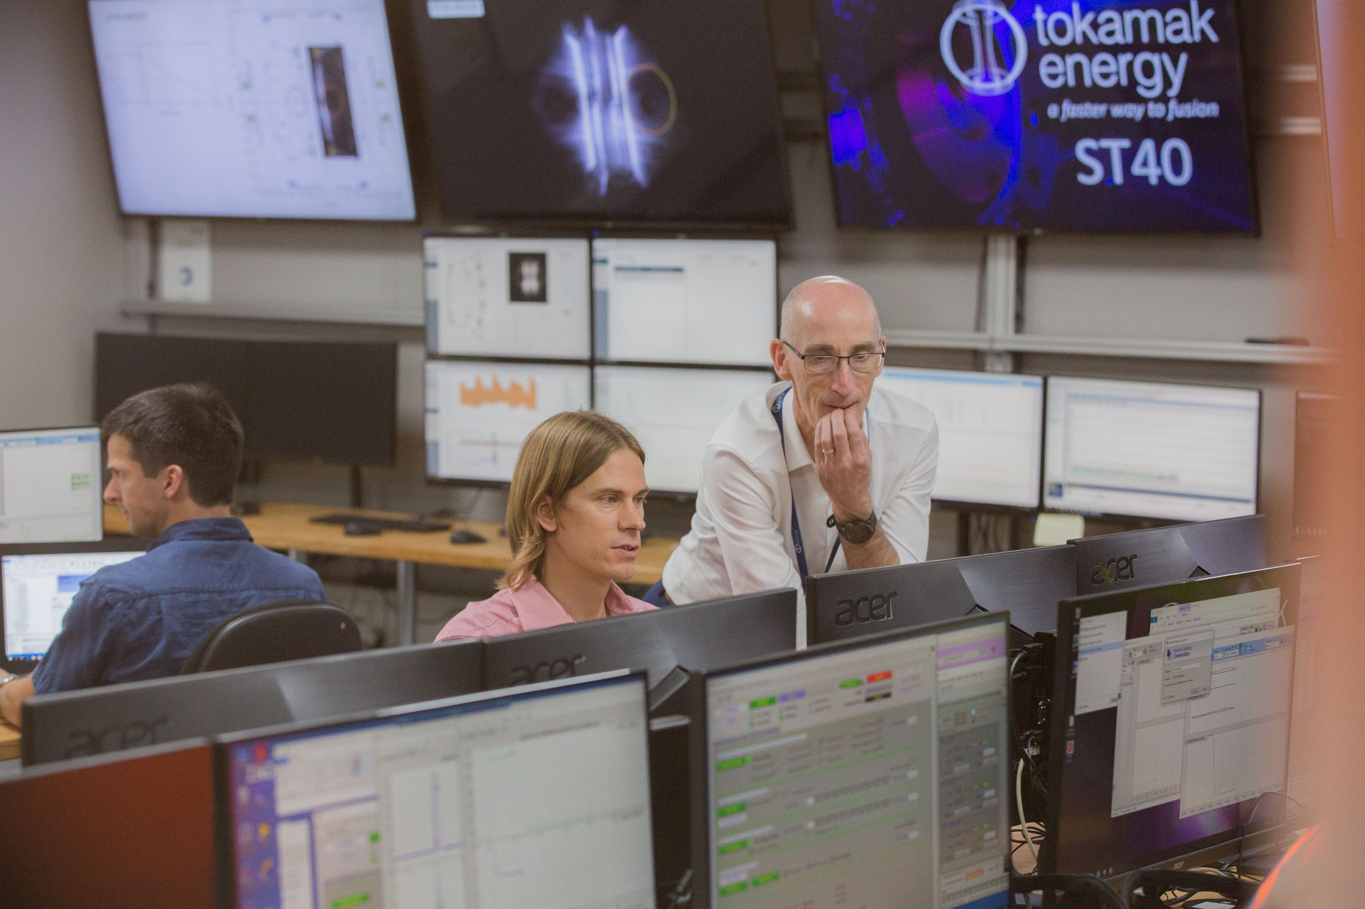
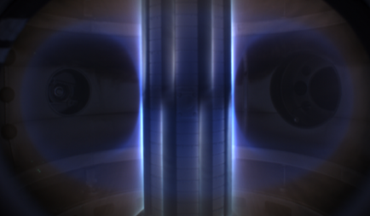
Tokamak Energy
Notes:
Established in 2009 with a mission to develop a faster way to fusion energy
Private company with over £50M investment
Engineering centre in Milton Park, Oxfordshire
Team of over 80 scientists, engineers and technicians
Designed, built and tested 3 prototype tokamaks since 2012
World leading superconducting magnet laboratory

