Slide 1
ORNL Fusion Energy Program: Perspectives and Planning
Presented at:
Fusion Power Associates 40th Annual Meeting
John Canik
December 4, 2019

Slide 2
Fusion is at a critical moment
ITER operation is on the horizon
  Mainline approach to a burning plasma; focus of our present efforts
Fusion industry is rising in US pursuing alternate routes in parallel
  High risk, high reward, with highly compressed timelines
Climate change is pressing the urgency of fusion energy
  The 2030’s will be a key in fusion—(multiple?) high-Q plasma achieved, nearing time of required growth in clean energy
  Will we be ready to advance the full array of required elements to realize fusion energy in time to meet energy demand? If we don’t, other sources will
It is essential for us to
  Leverage all opportunities for rapid fusion energy development—both ITER and industry
  Build up fusion nuclear materials and technology program so we are ready when ITER (and industry) are successful in demonstrating fusion plasmas

Slide 3
Realization of fusion energy requires solutions to multiple physics and technology challenges
Working more closely with industry
Creating a predictable burning plasma
  Disruption control
  Predictive integrated modeling
Taming the plasma material interface
  Power exhaust and particle control
  Unraveling the science of plasma wall interactions
Harnessing fusion power
  Fusion structural materials
  Closing the fusion fuel cycle

Slide 4
Realization of fusion energy requires solutions to multiple physics and technology challenges
Working more closely with industry
Creating a predictable burning plasma
  Disruption control
  Predictive integrated modeling
Taming the plasma material interface
  Power exhaust and particle control
  Unraveling the science of plasma wall interactions
Harnessing fusion power
  Fusion structural materials
  Closing the fusion fuel cycle

Slide 5
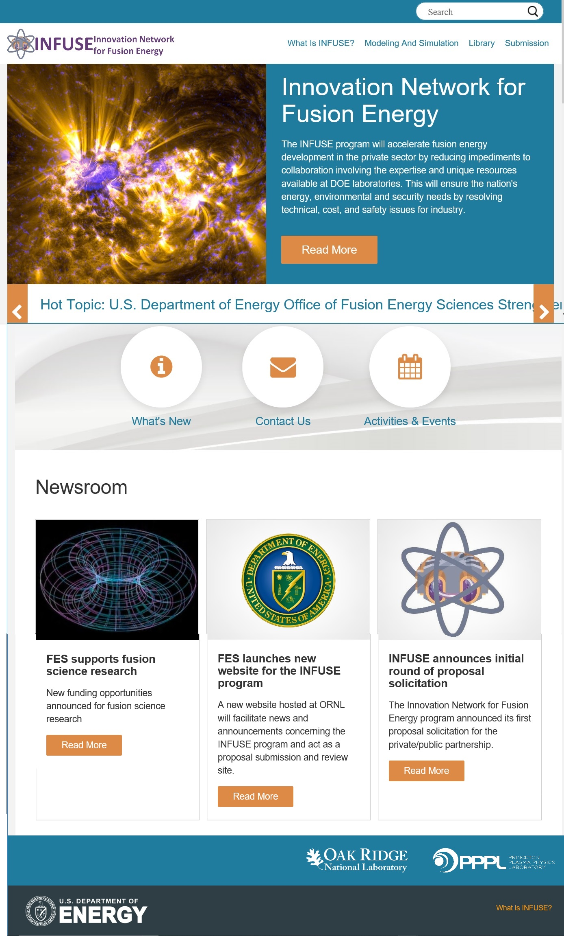




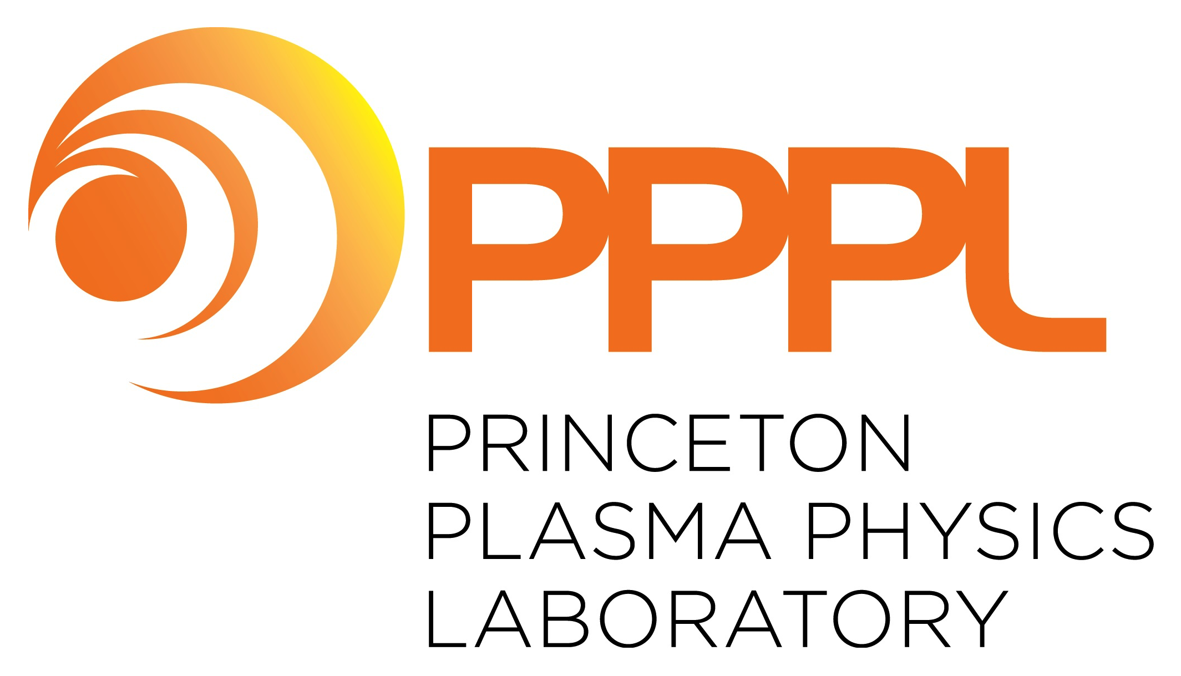
FES established INFUSE program to aid private/public partnerships in Fusion
ORNL and PPPL selected to manage INFUSE program for FES
ORNL launched a new INFUSE website for submissions and reviews
Two RFA calls are planned for FY2020
12 FY2019 awards announced in October, funding release in December
1st annual INFUSE workshop occurred Nov. 22-23 in Knoxville, TN
10 Participating laboratories:
Topical areas:
BNL, INL, LBNL, LLNL, LANL,
ORNL, PNNL, PPPL, SNL, SRNL
https://infuse.ornl.gov/
Enabling Technologies including magnets
Materials Science
Plasma Diagnostics
Theory and Simulation
Magnetic Fusion Experimental Capabilities
Dennis Youchison-ORNL, INFUSE Director
Ahmed Diallo-PPPL INFUSE Deputy Director

Slide 6
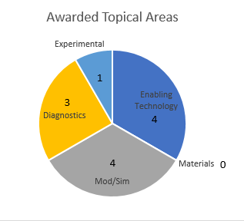
2019 INFUSE Awards and Changes for 2020
AWARDS
12 projects from 22 applications received 2019 awards totaling $1.72 M
The 12 awards went to 6 U.S. companies and involved 6 national labs
Detailed list: https://infuse.ornl.gov/2019-infuse-awards-2/
PLANNED CHANGES (subject to final approval by FES)
Eligibility: In 2020 US companies with a majority foreign ownership can now participate
All must show economic advantage to US economy, must accept CRADA terms and export control restrictions (DOE POLICY 485.1 and 2CFR910.124)
Two labs added to INFUSE program: SNL and SRNL for expertise in tritium and fuel cycle.
Max. number of proposals per company is 5, but no longer restricted to one from each topical area.
Maximum award values likely to increase pending final budget breakdown.
Two RFA calls anticipated. One in ~January, the second in ~June. Dates yet to be finalized.
Six-month window established to execute CRADAs or award is rescinded.
Annual workshop added to improve communication and showcase projects.

Slide 7
Realization of fusion energy requires solutions to multiple physics and technology challenges
Working more closely with industry
Creating a predictable burning plasma
  Disruption control
  Predictive integrated modeling
Taming the plasma material interface
  Power exhaust and particle control
  Unraveling the science of plasma wall interactions
Harnessing fusion power
  Fusion structural materials
  Closing the fusion fuel cycle

Slide 8
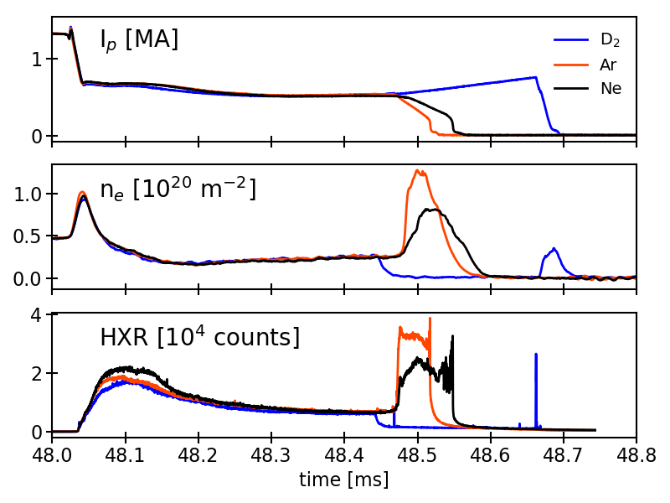
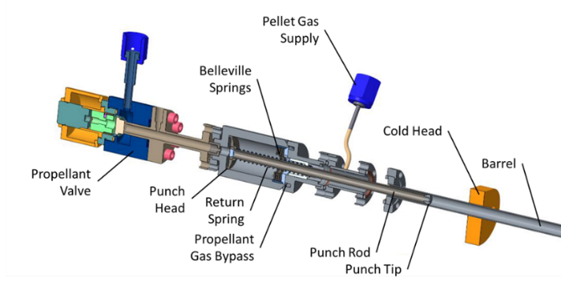

Argon SPI into a Runaway Electron Beam on
JET Shows Rapid Dissipation of the RE Current
Argon, Neon and Deuterium pellets from the ORNL SPI have been injected into a RE beam on JET for the first time.
Ar and Ne show the ability to collisionally dissipate the 600 kA RE current on a 30-50 ms time scale. D₂ SPI reduces impurities in the beam and actually increases the RE current as observed on DIII-D.
The main physics question to be answered is the scaling of the dissipation rate to ITER. Modeling is underway.
The mechanical punch required for this work was developed for the DIII-D and JET SPIs.
Argon gas injection triggers disruption and forms RE beam
Ar and Ne SPI Dissipate the REs
SPI
Time (s)
Hard X-rays show RE losses

Slide 9
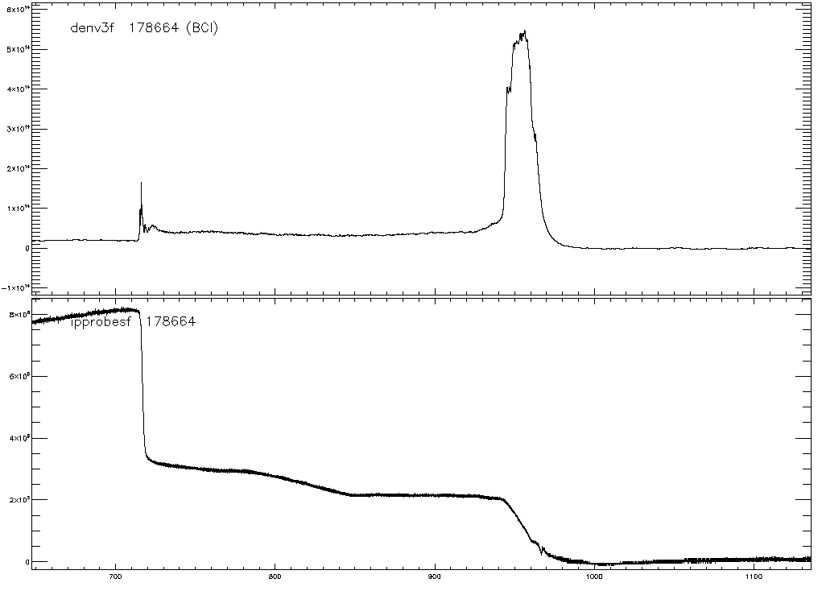
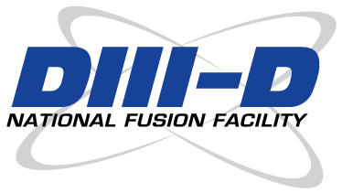
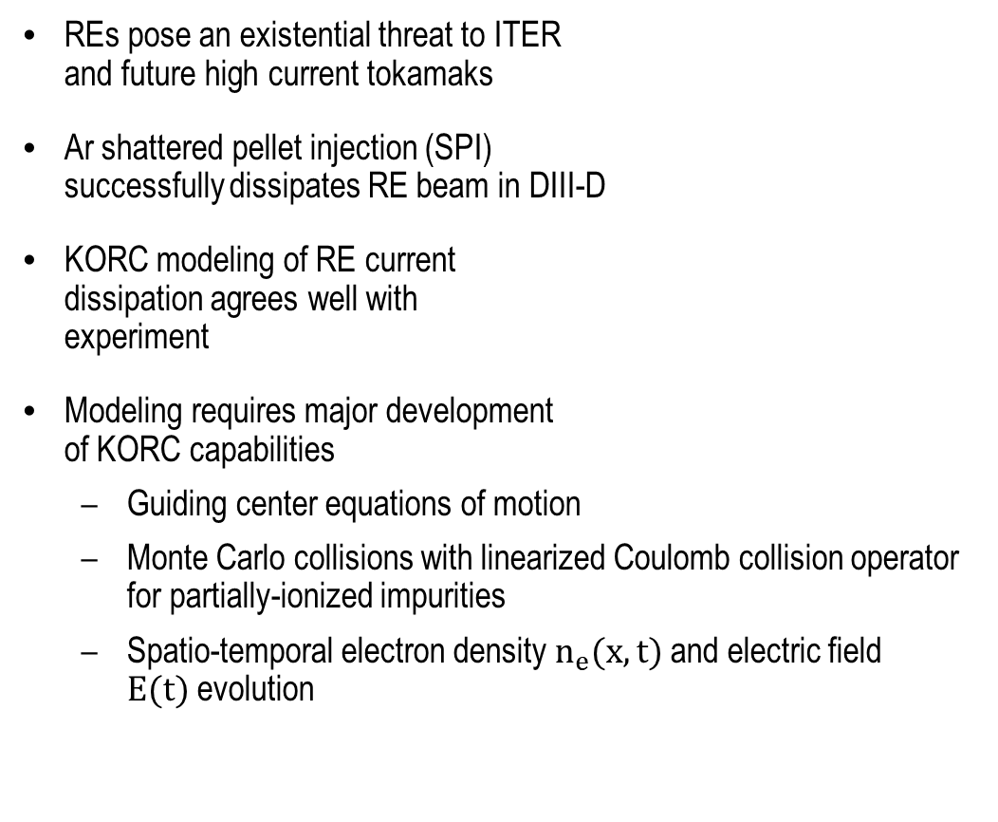
Modeling and Simulation of Runaway Electron (RE) Dissipation by Impurity Injection Using KORC
REs pose an existential threat to ITER
and future high current tokamaks
Ar shattered pellet injection (SPI)
successfully dissipates RE beam in DIII-D
KORC modeling of RE current
dissipation agrees well with
experiment
Modeling requires major development
of KORC capabilities
  Guiding center equations of motion
  Monte Carlo collisions with linearized Coulomb collision operator for partially-ionized impurities
  Spatio-temporal electron density $n_{e}(x,t)$and electric field $E(t)$evolution
6 x10¹⁹
8.5mm
Ar SPI
4 x10¹⁹
3mm Ar
Pellet
Density (m⁻³)
2 x10¹⁹
0
0.8
Rapid Dissipation of RE Current
0.6
RE Plateau
200 kA
Current (MA)
0.4
0.2
0
700
800
900
1000
1100
Time (ms)
M.T. Beidler, D. del-Castillo-Negrete, D.A. Spong, L. Baylor, and D. Shiraki, APS-DPP Poster PP10.00047, (2019)

Slide 10
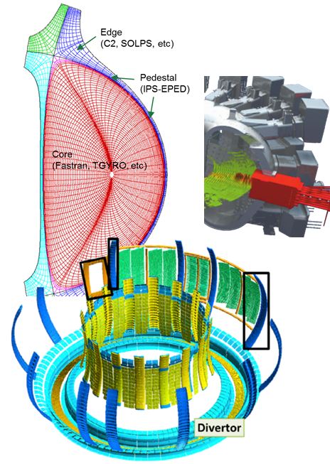
Integrated, predictive, validated modeling is key to efficient fusion development
R&D areas within ORNL theory and modeling program
  MHD Equilibrium
  RF Heating and current drive
  Energetic-particle physics
  (Edge) plasma transport and plasma-material interactions
Present efforts: working within Theory and SciDAC programs to develop pieces needed for the plasma and wall surface
  Addressing key gaps in Boundary and PMI, Transients
  Leveraging advances in HPC capabilities
Medium-term plan: take advantage of strengths & experience in the fission world to add key capabilities
  Neutronics, thermal hydraulics, siting, materials, chemistry,…
Long-term goal: nuclear facility integrated design capability
  HPC enabled integration of plasma, neutronics, and components.

Slide 11
Realization of fusion energy requires solutions to multiple physics and technology challenges
Working more closely with industry
Creating a predictable burning plasma
  Disruption control
  Predictive integrated modeling
Taming the plasma material interface
  Power exhaust and particle control
  Unraveling the science of plasma wall interactions
Harnessing fusion power
  Fusion structural materials
  Closing the fusion fuel cycle

Slide 12
Power exhaust and particle control
ITER baseline divertor scenario is not expected to be sufficient for DEMO-class tokamaks
Elements of a strategy to develop a divertor solution for tokamaks beyond ITER
  Develop predictive physics basis for heat flux and detachment
  Develop high-performance core scenarios that lessen the demand on the divertor
  Study divertor-pedestal integration at-scale through next step near-reactor plasma experiments
  Advance the TRL of alternative divertor configurations as risk mitigation beyond ITER

Slide 13

Challenges to Integrating Radiative Exhaust in I-Mode Demonstrated on US/Intl. Tokamaks
M.L. Reinke, et al Nucl. Fusion 59, 046018 (2019)
Research Details
The Alcator C-Mod tokmak (US) has led the study of the “I-mode” regime which features an edge that keeps heat in but lets impurities out, avoiding ash build-up in reactor scenarios
ORNL-led experiments in 2015-2016 on C-Mod failed to integrate a dissipative, detached divertor while maintaining the I-mode pedestal
Findings published in March 2019 summarized investigations and characterized multiple features of an unexplained mechanism that is linked to loss of I-mode following weak N₂ seeding
Follow-up experiments in March 2019 on ASDEX-U (EU) relied on active US participation (ORNL,MIT)
Early results appear to confirm C-Mod observations
I/L
delay
p₀ (div)
pedestal T_{e}
Main Chamber D_{α}
SHOT-A
SHOT-B
Significance
Tokamaks have yet to widely demonstrate operating scenarios that maintain high core energy confinement while avoiding transients (ELMs) and sustaining a low-heat flux, low-erosion divertor.
The I-mode is an attractive core regime, but results show a need to explore use of advanced divertors
Results highlight a capability gap for studying core/edge integration in compact, high-field devices
Divertor N II
C-Mod data showing sensitivity to external N₂ puffing, confirmed by moving gas injection time (A vs. B). Small delay between gas arriving and T_{e} collapse prevents establishing a detached divertor
Sponsor: DOE SC/FES
Contact: Matthew L. Reinke (Fusion Energy Division)

Slide 14
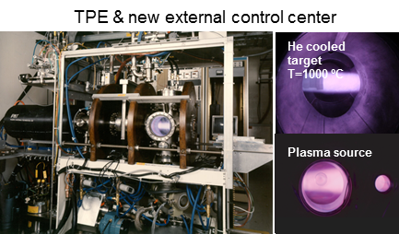
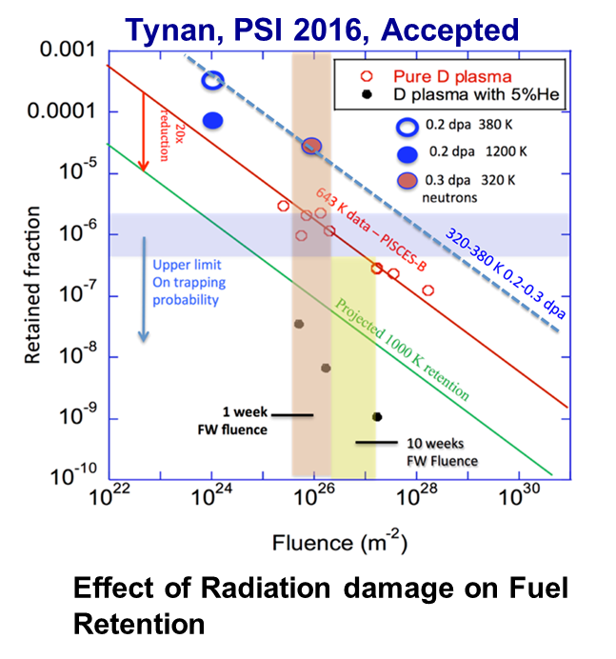
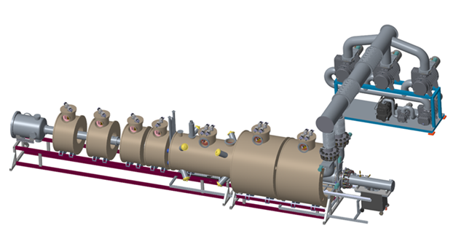
Three PMI facilities will position the US uniquely to address challenges
TPE (INL) addresses tritium retention in damaged samples
PISCES (UCSD) is a high fluence facility with beryllium capabilities to address ITER challenges
MPEX (ORNL) will be a DEMO-level fluence device with tilted target & neutron irradiated capabilities
MPEX with magnets shown

Slide 15
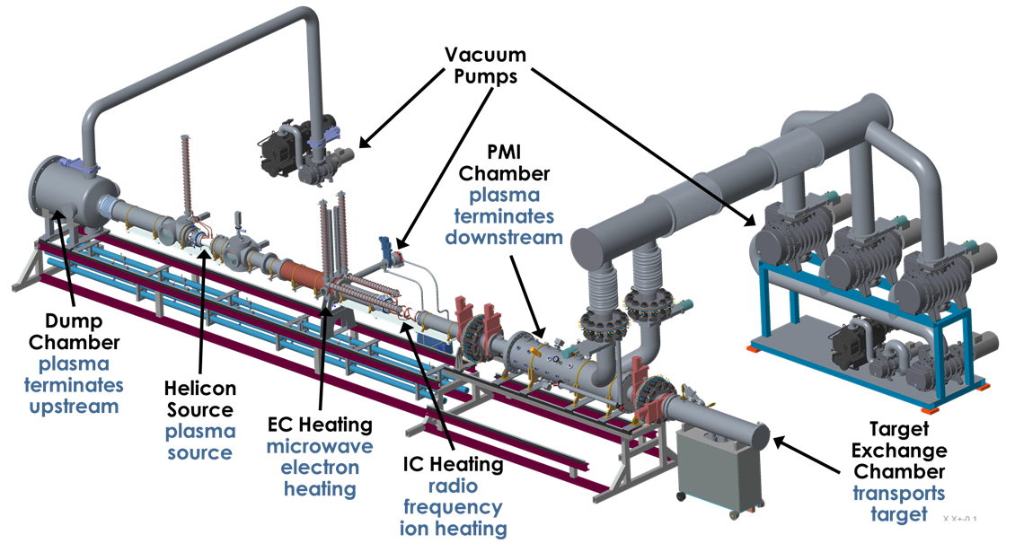
MPEX is moving towards CD-1 and beyond
An Independent Project Review (IPR) was successfully completed October 16-18, 2019
  “The Committee assessed that … the selected alternative is appropriate. The design is mature…the project is ready for CD-1 approval.”
An Independent Cost Review (ICR) was successfully completed November 5-7, 2019
A meeting with the Energy Systems Acquisition Advisory Board is tentatively scheduled for January 9, 2020
CD-3a is the next step, where long-lead procurements for the magnets and gyrotrons will be approved

Slide 16
Realization of fusion energy requires solutions to multiple physics and technology challenges
Working more closely with industry
Creating a predictable burning plasma
  Disruption control
  Predictive integrated modeling
Taming the plasma material interface
  Power exhaust and particle control
  Unraveling the science of plasma wall interactions
Harnessing fusion power
  Fusion structural materials
  Closing the fusion fuel cycle

Slide 17
US fusion materials program is productive, with many opportunities for innovation
The US is a leader among the international fusion materials program
  US-Japan collaboration is more than three decades strong, and continues to make key contributions (currently the FRONTIER collaboration)
  US is executing a structural materials irradiation and PIE for the EUROfusion program
Resources are limited
  Within existing budget, prime focus is structural materials and existing materials
  Not much effort on blanket materials or materials development
  Even PMI science is not a large program in the US…yet
Opportunities include:
  Advanced manufacturing, PMI, fusion relevant neutron source, and modeling & simulation

Slide 18
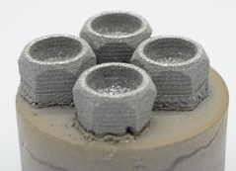
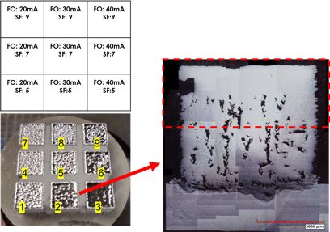
Additive manufacturing has been used to produce full density tungsten tiles
ORNL is exploring two AM methodologies that have the potential to revolutionize
production of divertor components
Electron Beam Melting (EBM)
Initial parameter search of print settings for tungsten has shown:
Ability to contour correct divertor tile geometry
Build plate adhesion
Ability to print at full density
Exploratory tiles show EBM ability to properly contour W
Binder Jetting (BJ)
Densification is being investigated through WF₆ chemical vapor infiltration of print body
Avoids shrinkage/cracking/warping/high temps associated with traditional sintering process
More study needs to be performed on temperature/flow to optimize final density
Parameter search for EBM printing W on Ti resulted in full density W – see full density beginning in the area near top of the red box

Slide 19
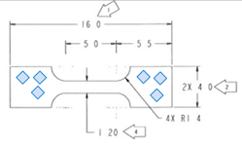

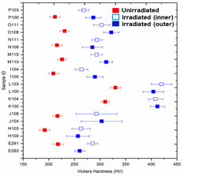
Initial PIE of Eurofer Steel Variants Show Significant Differences in Properties, but Small Differences in Changes Due to Neutron Irradiation
Alloys based on Fe-9Cr-2W are candidates for fusion first wall, blanket and PFC component structures
Ten Eurofer 97 steel variants were neutron irradiated in HFIR to ~2.5 dpa at ~300°C
  Using small tensile and bend bar specimens
  Specimens recovered and hot cell tests underway
Irradiation temperature evaluation and hardness measurements are complete
  SiC passive temperature monitors showed irradiation temperatures were in the range 190 to 330°C
  Vickers hardness was temperature invariant over this narrow temperature range
  While hardness of the variants showed significant differences, the hardness increment due to irradiation was similar for all ten steels
  These differences show the potential for property improvement by manipulating composition and processing
SS-J3 tensile specimen with 6 indents per specimen (mm)
Microhardness vs Irradiation temperature
Is invariant for all 10 steels for T< 350°C
[Error bars both figures show min/max values]
Bend bar showing 4 indents per fracture position
Irradiation increased the
microhardness of all variants
X. Chen et al, “Mechanical properties and microstructure characterization of Eurofer97 steel variants in EUROfusion program,” Fus Eng & Design 2019, doi.org/ 10.1016/fusengdes 2019.03.158
ORNL - X. Chen, A. Bhattacharaya, Y. Kato KIT - M. Rieth,, T. Graening

Slide 20
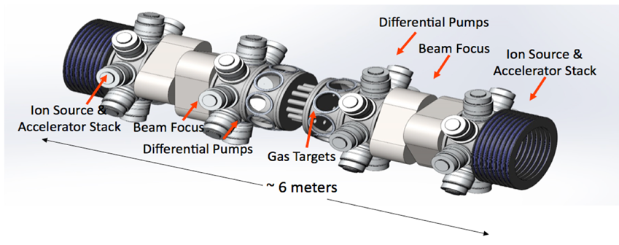
A fusion relevant neutron source is an international need, and a US opportunity
High displacement rate irradiations have been carried out in HFIR for decades
A neutron source with the correct energy spectrum, producing gas synergistically with displacements, is needed for basic scientific understanding as well as materials qualification
IFMIF has been discussed for decades, and should be built
DONES is the latest version, with reduced scope but still costing hundreds of millions of dollars
It is time to consider nearer term, lower cost options with reduced performance
  A precursor to DONES/AFNS
  Phoenix Nuclear Labs has a proposal for a DT neutron generator
  Spallation sources can provide near term data
  A Gas Dynamic Trap proposal has also been discussed
Phoenix Nuclear Labs neutron generator concept

Slide 21
Fusion Prototypic Neutron Source
The Virtual Laboratory for Technology (VLT) helped FES organize a workshop around the topic
33 members of the US fusion materials community, the VLT, and private industry met August 20-22, 2018, and discussed the possibility of the US developing a Fusion Prototypic Neutron Source (FPNS)
Initial discussion indicated that the source would be a potential intermediate step to IFMIF/DONES/AFNS
  The goal is to advance the scientific understanding of fusion neutron damage in prospective structural and blanket materials
  May provide useful information for the design of DONES/AFNS
Three options are currently being scoped for the ability to meet the performance requirements as well as cost & schedule

Slide 22
Closing the fuel cycle is a critical part of fusion energy
Analysis shows there is likely enough tritium for ITER and possibly one DEMO (startup=5-15 kg)
  Control of production and consumption is largely outside of fusion community control
  Without a closed fuel cycle, we need tritium production from fission power plants
    Why have additional complexity of fusion power plants if fission plants are required?
  We must close the fuel cycle for any fusion energy system
    Must actually do better than that to start additional plants in the future
CFETR
Scenario A:
- Romania does not extract their T
- All HWRs finish their lives ~30y and some HWRs are refurbished +25y
Scenario B:
- Romania extracts their T
- Several refurbishments
Scenario C:
- All known refurbishments go ahead and then some more!
- Romania builds two new CANDUs in the mid-2020s (and refurbishes them)

Slide 23



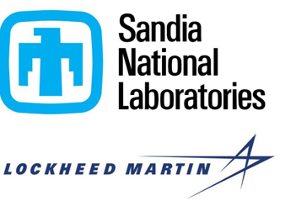


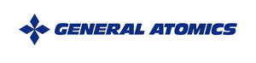
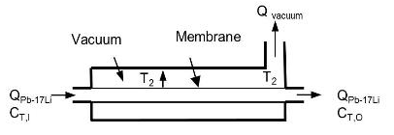
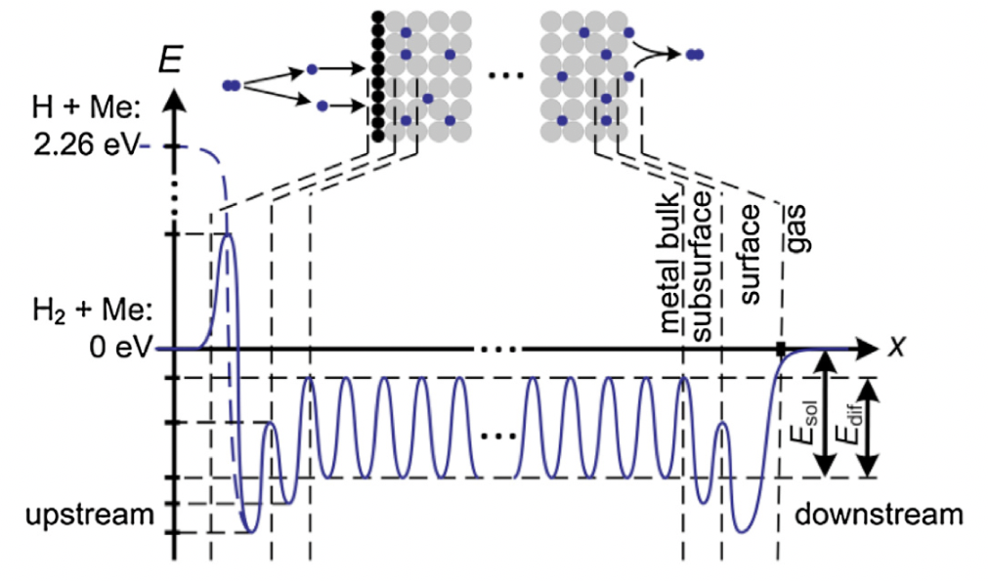
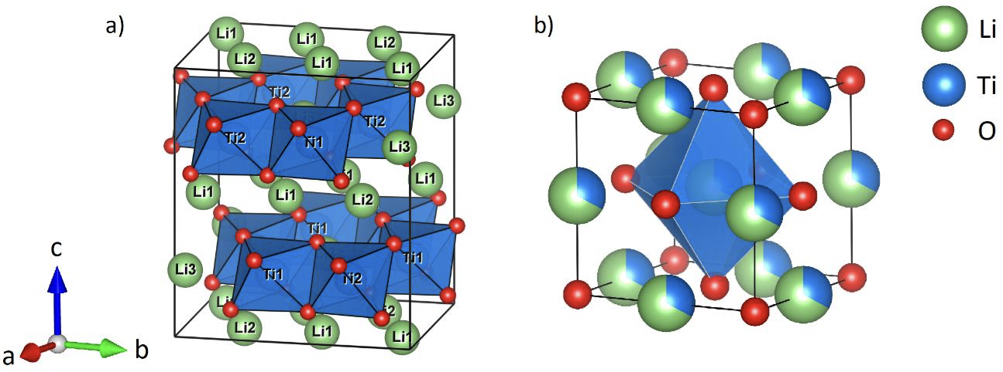
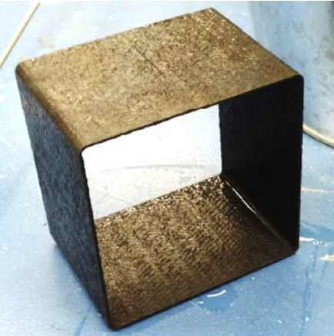
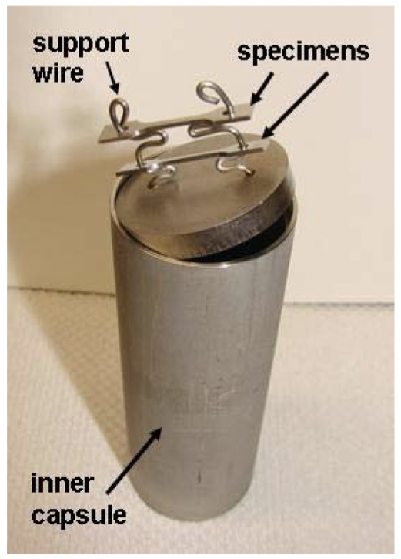
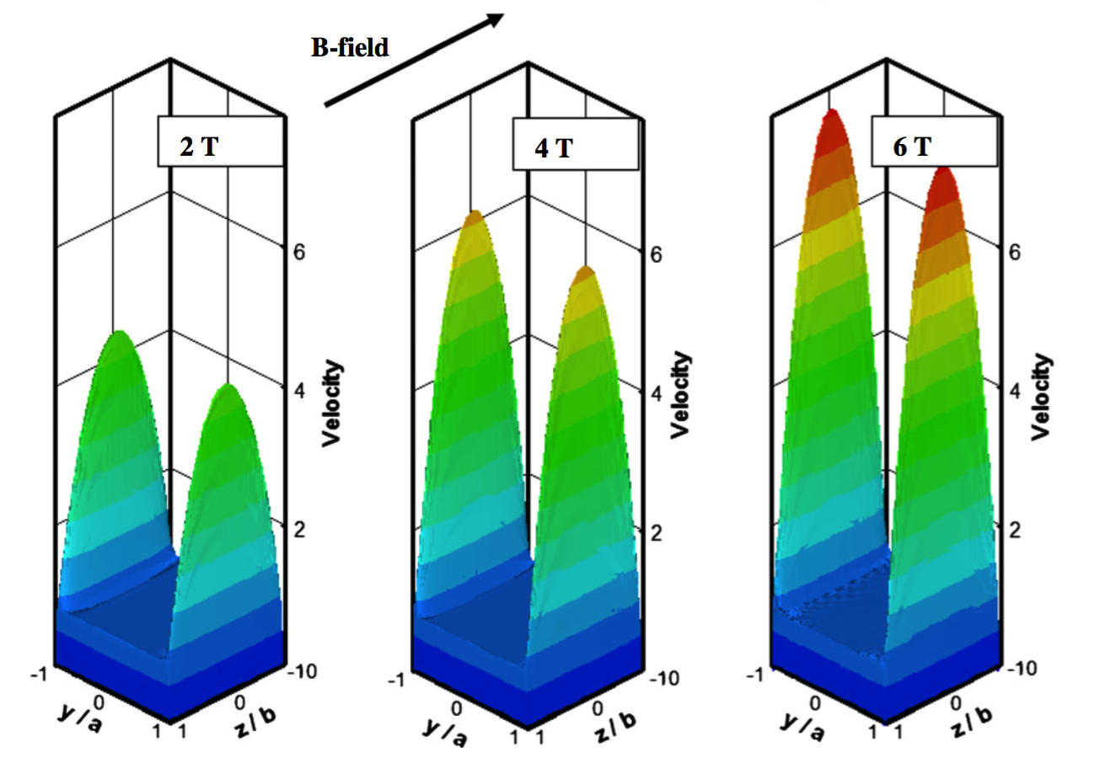
Attacking Critical Issues in the Blanket and Tritium Fuel Cycle
Tritium Extraction from PbLi and He with Vacuum Permeator Window….window material and configuration optimization
Hydrogen Separation of Plasma Exhaust with Super Permeable Membrane….multiple approaches, material optimization, and impact on tritium fuel cycle
Solid Breeder Material and Structure Exploration and Optimization….irradiation response, microscopic material and tritium behavior, advanced manufacturing
PbLi Compatibility with RAFM Steels and SiC-composite Flow Channel Inserts….high temperature, FeCrAl, SiC interactions
PbLi Breeder Thermofluids Simulations in Support of Blanket and Systems Studies….complex geometry, corrosion loops, 3D effects, blanket concepts
Hydrogen permeation energy field in membrane
Li₂TiO₃ solid breeder structure
Static corrosion cell
Flow channel insert made of SiC-c
PbLi liquid metal flow velocity in conduit with magnetic field

Slide 24
Summary
ORNL Fusion Energy Program is pursuing solutions to several S&T challenges
  Disruption control
  Predictive integrated modeling
  Power exhaust and particle control
  Plasma wall interactions
  Fusion structural materials
  Closing the fusion fuel cycle
Full array of elements are essential for the deployment of fusion as an energy source

Slide 25
Backup slides

Slide 26
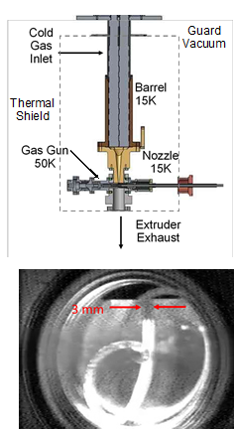

W7-X Continuous Pellet Fueling making great progress
Low-speed batch pellet fueling (OP1.2) of W7-X was very successful
  n > 10²⁰ m⁻³, T ~ 4 keV, improved confinement
Extend to ~30 min (OP 2) using continuous pellets
  Developed by ORNL for ITER
  Twin-screw extruder + gas gun
  V ~ 500-1250 m/s, ~3 mm dia., f ~ 10 Hz
Real-time parameter variation
  Profile control → turbulence + confinement
ITER fueling technology deployment well in advance of ITER
3 mm D2 Extrusion
Joint project: ORNL/IPP/PPPL/NIFS
Prototype extruder testing underway → final design/fabrication 2020
Integration with profile diagnostics and CODAC to allow real-time control

