Slide 1

Peter Seidl and Thomas Schenkel
Accelerator Technology and Applied Physics Division
Lawrence Berkeley National Laboratory
Fusion Power Associates, December 4, 2019
Fusion Energy Sciences at LBNL –
Status and Directions

Slide 2
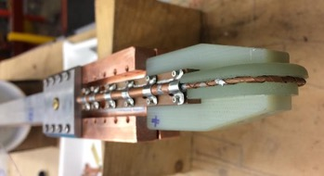
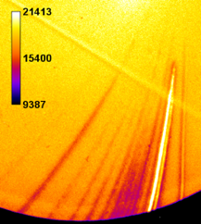
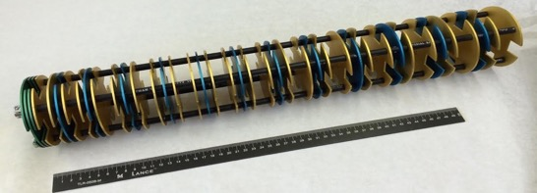
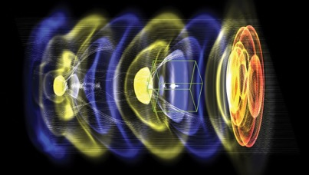
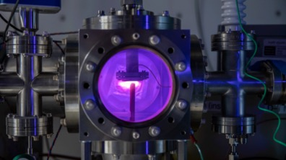
Our R&D portfolio to advance fusion energy sciences at LBNL
High Tc superconducting magnets for high-field tokamaks
High Energy Density Physics with laser and particle beams at the BELLA Center, LaserNetUS, and NDCX-II
MEMS-based accelerators for plasma heating
Modeling and Simulations of plasmas
Exploratory studies
New ideas for Inertial Fusion Energy
Notes:
Our RD portfolio is comprised of six elements. Some have been

Slide 3
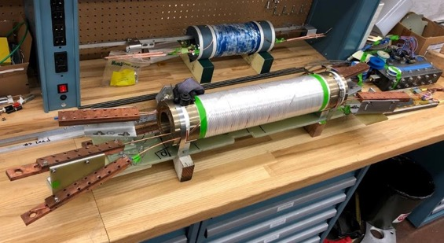
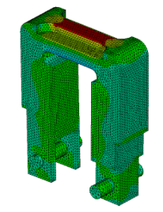
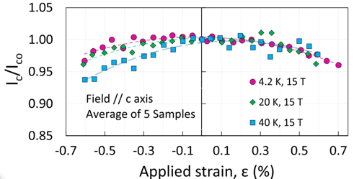

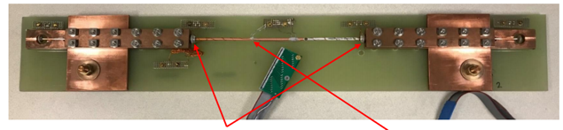

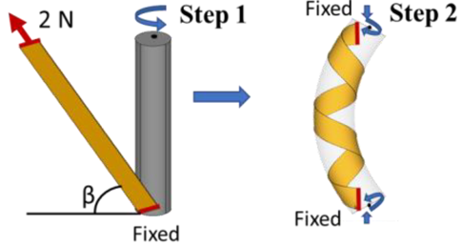
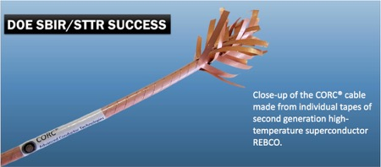
1. High-T superconducting magnets for fusion: Fundamental conductor characterization leads to robust cables. Pushing novel quench protection.
High Temperature Superconducting Magnets for Fusion
Conductor characterization
High-field REBCO magnet technology
Reproducible development of coil voltage – potential to avoid quenches in HTS fusion magnets.
The strain measurements on commercial REBCO tapes provide first data set critical for developing stable, high-current fusion conductors
Toward enhanced quench protection: Use acoustic sensors to detect hot spots in HTS conductors – strong potential for fusion environment with strong EM interference.
F. Pierro, et al, “Measurements of the Strain Dependence of Critical Current of Commercial REBCO Tapes at 15 T between 4.2 and 40 K for High Field Magnets”, IEEE Trans. Appl. Supercond. V. 29, #5, 8401305 (2019)
Development of optimal geometry to manage strain in REBCO cables and magnets
ρ(T) @ various O₂ flow rates
Piezo transducers HTS
VO_{x} coating on short REBCO tapes
using cathodic arc plasma deposition.
Hall effect measurements: Resistivity of V₂O₃ films at room temperature was 3 orders of magnitude lower than at 77 K. Negligible change of tape I_{c} after coating.
X. Wang et al, “Strain Distribution in REBCO Coated Conductors Bent with the Constant-Perimeter Geometry”, IEEE Trans. Appl. Supercond., 6604010, 2017. https://doi.org/10.1109/TASC.2017.2766132
Z. Yang, et al, “Cathodic arc deposition of VOx films and their application in quench protection of high-temperature superconducting magnets”, in preparation.
Contact: S. Prestemon
soprestemon@lbl.gov
Notes:
REBCO = Rare-earth barium copper oxide
ReBCO are Hi Tc superconductors. ReBCO superconductors have the potential to sustain stronger magnetic fields than other superconductors materials. Due to their stronger magnetic field and their relatively high superconducting critical temperature these materials have been proposed for future magnetic confinement fusion reactors such as the ARC reactor, allowing a more compact and economical construction.^{[3]}
Any rare earth can be used in a ReBCO; popular choices include yttrium (YBCO), lanthanum (LBCO), samarium, neodymium, and gadolinium. (W)

Slide 4
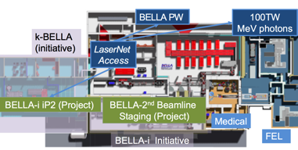
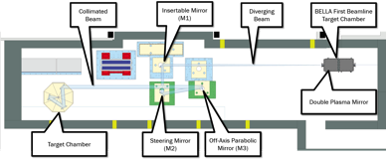
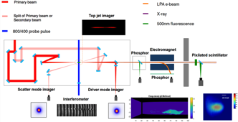
2. High Energy Density Physics with laser and particle beams at the BELLA Center, LaserNetUS, and at NDCX-II
BELLA PW, long focal length beamline
  Electron acceleration to 8 GeV
  1 Hz, 40J, ≥30 fs, 210¹⁹ W/cm²
  Available now for high energy density science, ion acceleration, …
2. BELLA PW, short focal length beamline
  >10²¹ W/cm² at 1 Hz available in 2020
3. BELLA PW, 2nd beamline
  Electron acceleration in two stages (starting in 2020)
  Possible future multi-beam experiments
4. 100 TW laser
  Electron acceleration, Thomson scattering, …
  1 to 5 Hz, 2.4 J primary + 0.6 J 2nd beam, ≥40 fs
  Available now for high energy density science, …
  HEDLP, laser-plasma interactions, electron & ion acceleration, photon and neutron secondary beams at relatively high repetition rates
  Context of LBNL User Facilities: The Molecular Foundry, ALS, NERSC
  Collaboration areas: HEDLP, targets, diagnostics, simulations,…
PW Short Focal Length Beamline
100 TW experiments
http://bella.lbl.gov
https://www.lasernetus.org/facility/berkeley-lab-laser-accelerator-bella-center
Thomas Schenkel, t_schenkel@lbl.gov

Slide 5
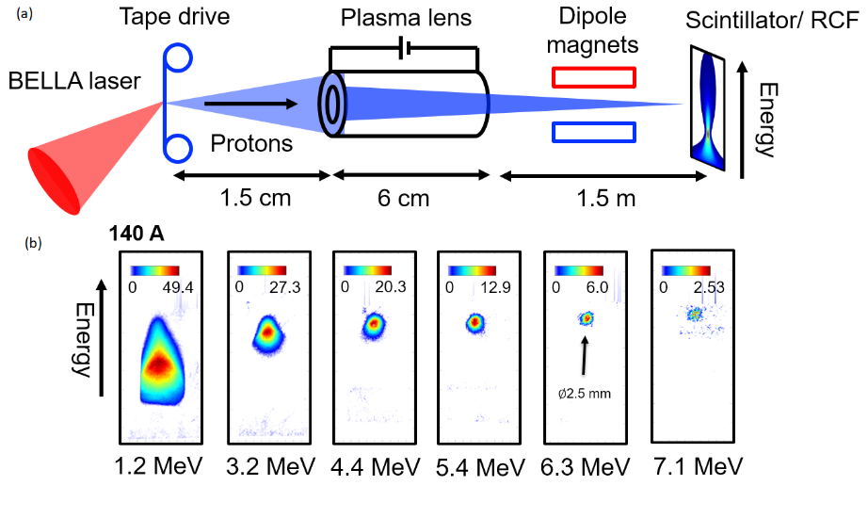
Transport and focusing of laser driven ions and electrons
Experiments with >1000 petawatt shots per day enable tuning, alignment, parametric studies
The BELLA Center is part of LaserNetUS, https://www.lasernetus.org/, funded by DOE - FES, coordinated with HEP
Dose rate effects and defect dynamics in (fusion) materials, FLASH radiation biology, …
Sven Steinke, Jianhui Bin, et al., in preparation •J. van Tilborg, et al. PRL 115, 184802 (2015)
J. H. Bin, et al., Rev. Sci. Instr. 90, 053301(2019)

Slide 6
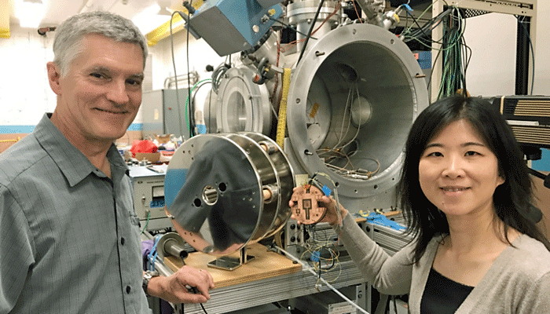
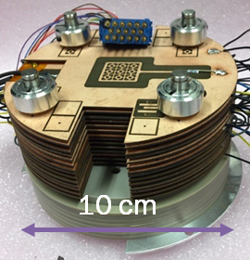
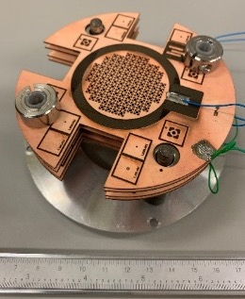

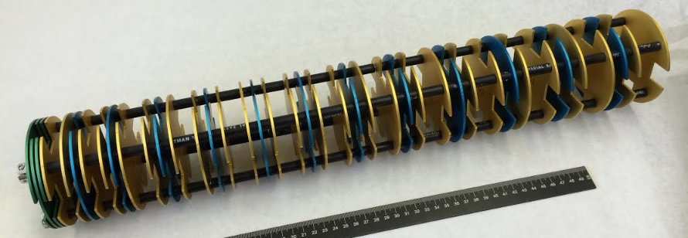


3. MEMS-based accelerators for (nuclear) materials and plasma heating.
Can we build particle accelerators at much lower cost?
10 cm
9 beams
112-beams
Model of ~300 keV, >10 mA, ~ 1 MV/m
Multi-beam particle accelerators made from low cost wafers
Development of rad hard materials, towards plasma heating
Funded by ArpaE
P. A. Seidl, et al., Rev. Sci. Instr. 89, 053302 (2018)
V. Kumar, et al., J. Appl. Phys. 125, 194901 (2019)

Slide 7
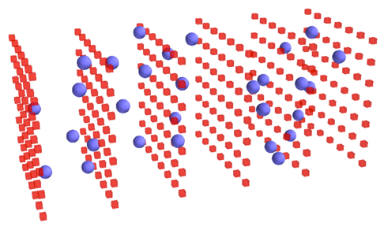

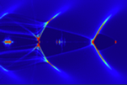
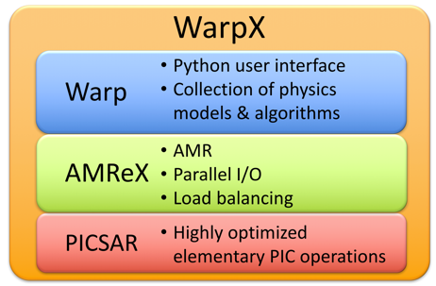



4. Modeling and Simulations: relativistic plasma science and collisional interaction modules in WarpX for Fusion Research
WarpX is a Particle-In-Cell code for ab initio simulations of interaction between plasma particles and electromagnetic fields
.
WarpX running on CPUs and GPUs.
30x faster on GPUs
Summit @ ORNL
  J.-L. Vay, et al, Nucl. Inst. Meth. A 909, 486-479 (2018), contact: JLVay@LBL.gov
Notes:
WarpX is massively parallel, optimized on DOE supercomputers; supported by the DoE Exascale project
Red and blue dots: cartoon of PIC simulation.
Lower right with boxes: illustrative cartoon of mesh refinement.
Examples of fusion relevant applications:
Interaction between intense lasers, intense beams and dense targets for inertial fusion, fast ignition
Interpenetration of high-energy plasmas, Weibel instability, …
Kinetic effects in heating processes inside plasmas, heating by RF fields or neutral beams in tokamaks, laser heating, …
Some applications may require developing new modules in WarpX, esp. collisional interactions

Slide 8
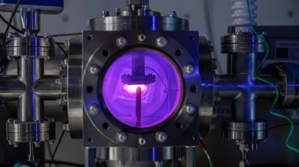
5. Exploratory topics
Fusion reactions at low energies are important for nuclear astrophysics
Experiments are challenging due to very low fusion yields
Table top plasma discharges enable exploratory basic fusion science studies at relatively low ion energies due to relatively high ion currents
We observe that solid state environments can strongly affect fusion rates at relatively low energies
Underlying mechanisms are not known
  electron screening?
  plasma-ion energy distribution, target loading?
  can we correlate materials phases with fusion yields?
  can we use well known fusion reactions as probes of materials properties?
Funded by GOOGLE LLC
T. Schenkel, et al., J. Appl. Phys., 126, 203302 (2019)
C. P. Berlinguette, et al., Nature (2019)
Notes:
Caveats:
1- IEDF not constrained by direct measurement. Only plasma power. If the IEDF is less peaked, then the low-energy yield enhancement is greater.
2- Target loading/unloading dependence on discharge voltage and plasma power

Slide 9
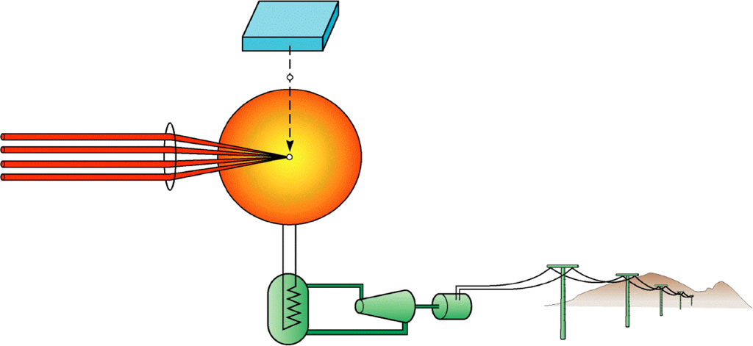
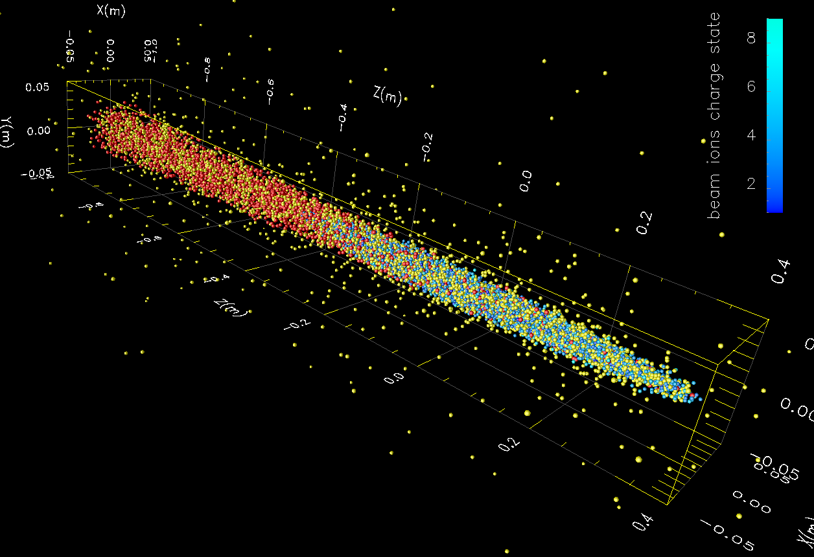
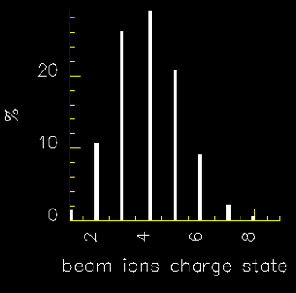
6. Inertial Fusion Energy science should be part of the DOE Fusion portfolio. A modest program in IFE driver development and scaled experiments would maintain US leadership.
1. Target, fuel, recycling
Accelerators are efficient, high rep-rate, compatible with liquid reactor walls, beam optics can protected from fusion radiation and debris
New accelerator developments and opportunities to advance beam-plasma and beam-target physics
3. Driver
2. Reactor
Separable components
Heavy ion beam-plasma physics in the reactor chamber
4. Balance of plant
beam ions Flibe ions electrons
Our vision is in APS-DPP-CPP white papers, also jointly with Laser IFE community:
Inertial Fusion Energy Drive Technology (LLE, LLNL, LBNL) NAS 2020 Decadal Assessment
Low-Cost, Scalable Power Plants Based on Heavy Ion Fusion, (LBNL, LLNL) APS-DPP CPP.
https://sites.google.com/pppl.gov/dpp-cpp/home/input-and-feedback
Also to ArpaE RFI.
target
Sharp (LLNL), Vay (LBNL) (2010)
10 GeV, 210 AMU, 3.125 kA, 5x10¹³/cm³ BeF₂
Notes:
Link to topic 3.
Different driver technologies have unique benefits and challenges
We propose to establish a lower cost development path.
Low-Cost, Scalable Power Plants Based on Heavy Ion Fusion, APS-DPP CPP
Low Capacity Power Plants Based on Heavy Ion Fusion, AE-RFI
Capabilities needed:
Small/medium scale facilities that are diverse/flexible
High data return (= rep rate, reproducibility)
Innovative diagnostics and analysis routines
More efficient algorithms, architectures, and exascale
Advances in driver technology
Definition for success:
Predict beam-plasma interactions
Reduce uncertainty in key scientific questions critical to IFE
6-10 years

Slide 10
At LBNL, we are advancing these key areas of fusion energy sciences
High T_{c} superconducting magnets for high-field tokamaks
High Energy Density Physics with laser and particle beams at the BELLA Center, LaserNetUS, and NDCX-II
MEMS-based accelerators for plasma heating
Modeling and Simulations of plasmas
Exploratory studies
New ideas for Inertial Fusion Energy

Slide 11



Acknowledgments
High Tc superconducting magnets for high-field tokamaks
High Energy Density Physics with laser and particle beams at the BELLA Center, LaserNetUS, and NDCX-II
MEMS-based accelerators for plasma heating
Modeling and Simulations of plasmas
Exploratory studies
New ideas for Inertial Fusion Energy
DOE Office of Science
Fusion Energy Sciences
DOE Office of Science
Fusion Energy Sciences
DOE Office of Science
Fusion Energy Sciences
http://atap.lbl.gov/

Slide 12
Extras

Slide 13















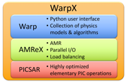

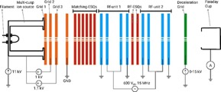
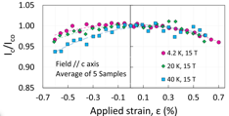

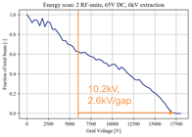
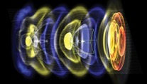


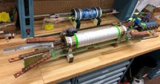


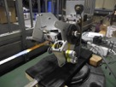

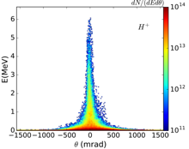





Beams, magnets and modeling to advance the quest for fusion energy at Berkeley Lab
Thomas Schenkel
Lawrence Berkeley National Laboratory, Berkeley, CA 94720
1. Compact multi-beam ion accelerators for plasma heating
2. High Temperature Superconducting Magnets for Fusion Reactors
3. Collisional interaction modules in WarpX for Fusion Research
T. Schenkel Q. Ji A. Persaud P. Seidl M. Garske G. Giesbercht
A. Lal K. K. Afridi D. Ni S. Sinha
S. Prestemon X. Wang G. L. Sabbi M. Martchevskii F. Pierro
J. L. Vay R. Lehe M. Thevenet A. Huebl
LBNL
Cornell University
WarpX is a Particle-In-Cell code: ab initio simulations of interaction between plasma particles and electromagnetic fields
Ion beams are widely used in many applications, and they are attractive for fusion plasma heating.
We are developing compact, low cost multi-beam ion accelerators that can be scaled to high beam power.
We are working on the exploration, development, and application of HTS for Fusion
  on conductor characterization and initial feedback to cabling
  investigating novel diagnostics for quench detection/protection
The strain measurements on commercial REBCO tapes provide first data set critical to develop robust high-current fusion conductors
Schematic with focusing and acceleration wafers.
Ref. F. Pierro et al, “Measurements of the Strain Dependence of Critical Current of Commercial REBCO Tapes at 15 T between 4.2 and 40 K for High Field Magnets”, IEEE Trans. Appl. Supercond. Vol. 29, No. 5, 8401305( 2019)
WarpX is massively parallel, optimized on DOE supercomputers; supported by the DoE Exascale project
Examples of fusion relevant applications:
  Interaction between intense lasers, intense beams and dense targets for inertial fusion, fast ignition
  Interpenetration of high-energy plasmas, Weibel instability, …
  Kinetic effects in heating processes inside plasmas, heating by RF fields or neutral beams in tokamaks, laser heating, …
  Some applications may require developing new modules in WarpX, esp. collisional interactions
  J.-L. Vay, et al, Nucl. Inst. Meth. A 909, 486-479 (2018)
Development of optimal cable and magnet geometry to manage strain in REBCO cables and magnets
High-field REBCO magnet technology relevant for HTS fusion
Images of parallel
ion beams for a series of electrostatic quadrupole (ESQ) settings demonstrating focusing.
Multi-beamlet Ar⁺ ion current vs. retarding grid bias showing ion acceleration with 2.6 kV/gap.
  We have demonstrated the concept of multi-beam ion accelerators made from stacks of low cost wafers.
  The next step is scaling to high beam power.
A helical winding used in CORC® cable
A bending mode relevant
for stacked cable
Ref: X. Wang et al, “Strain Distribution in REBCO Coated Conductors Bent with the Constant-Perimeter Geometry”, IEEE Trans. Appl. Supercond., 6604010, 2017. https://doi.org/10.1109/TASC.2017.2766132
Multi-beamlet RF accelerator unit with 112 beamlet array (1 mm apertures,
3 mm spacing).
Compact RF power supply from Airity Tech, LLC, designed for
10 kV/gap at 13.56MHz
The world-class cabling facility and expertise at LBNL can contribute to the development of HTS fusion cables
4. Fundamental studies of fusion processes with high impact potential
15.5cm
8cm
Fusion rates are determined by tunneling through the Coulomb barrier.
Can we discover new ways to enhance tunneling rates?
Electron screening in dense plasmas is a known-unknown. Let’s hack it!
10 cm
4cm
We demonstrated VO_{x} coating on short REBCO tapes using cathodic arc plasma deposition as a first step to enhance protection capability for REBCO cables and magnets
High power, multi-beam RF accelerators can advance plasma heating in MFE (neutral beam injectors), MTF (liner formation and compression and IFE/HIF
ρ(T) with various O₂ flow rates
Low cost components and fabrication based on MEMS technology
Q. Ji X. Wang Z. Yang A. A. Martinez A. Anders
Scalability to high ion current (>1 Ampere) and high kinetic energy (>1 MeV) in a modular approach. Left: model of a 300 keV module.
Exploratory; opportunities to advance basic understanding and master new control vectors to enhance fusion rates. Theory, simulations and fusion experiments with ion pulses, lasers, plasmas, …
10x higher system current density than single beam accelerators
Mid term goal is 1 MeV in 1 m, higher gradients in progress
Safe – no need to stand-off high voltages due to sequential acceleration, no x-ray hazard
US Patent 2019/0159331 A1, May 23, 2019.
A. Persaud, et al. Rev. Sci. Instrum. 88, 063304 (2017)
P. A. Seidl et al., Rev. Sci. Instrum. 89, 053302 (2018).
Hall effect measurements indicated that the resistivity of the V₂O₃ films at room temperature was at least 3 orders of magnitude lower than at 77 K.
Change of the critical current of the REBCO tape before and after coating is negligible.
J. H. Bin, et al., Rev. Sci. Instrum. 90, 053301 (2019)
T. Schenkel, et al., https://arxiv.org/abs/1905.03400
C. P. Berlinguette, et al., Nature 570, 45 (2019)
funded in part by GOOGLE LLC through a Crada with LBNL
Ref: Z. Yang et al, “Cathodic arc deposition of VOx films and their application in quench protection of high-temperature superconducting magnets”, in preparation.
This work was supported by the Director, Office of Science, Offices of HEP and FES, and by ARPA-E, U.S. Department of Energy, under Contract No. DE-AC-02­05CH11231 (LBNL).

