Slide 1



The Nuclear Physics Long Range Plan Process
FESAC Meeting, 12 March 2019

Slide 2
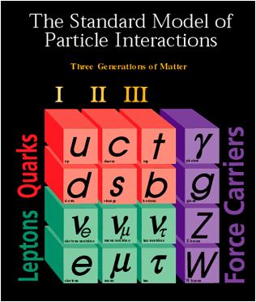
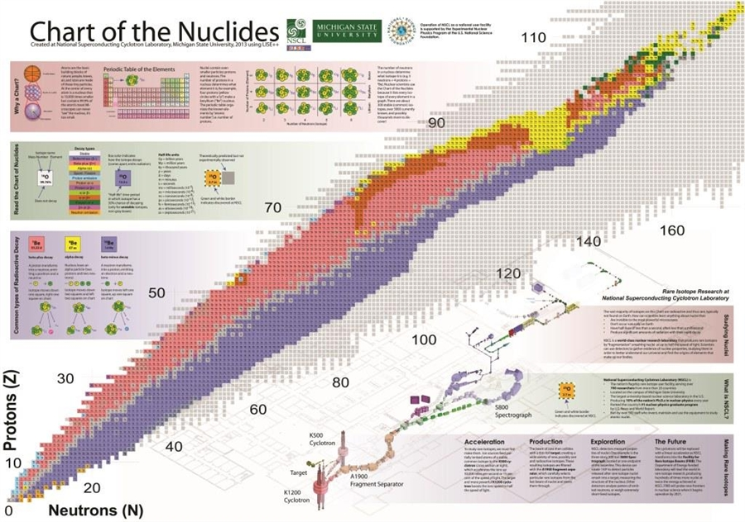
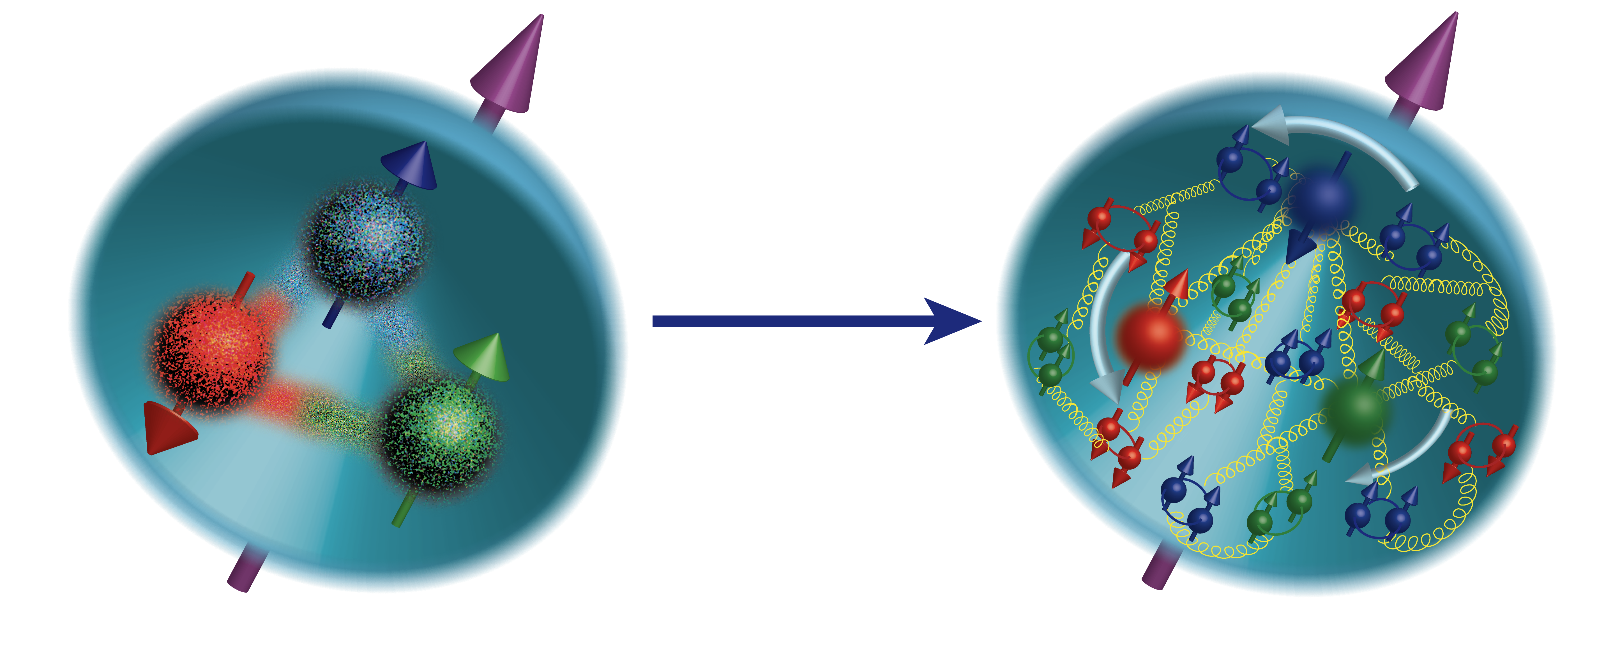
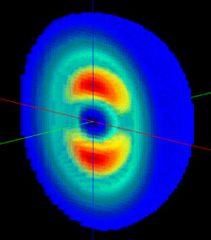
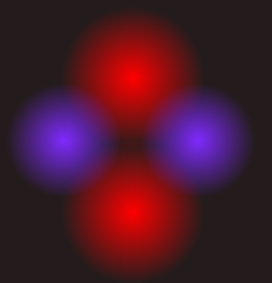
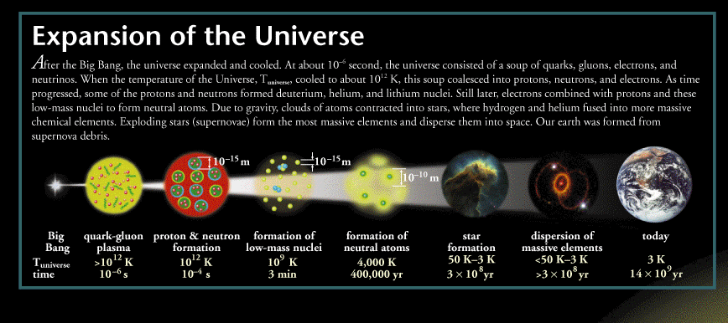
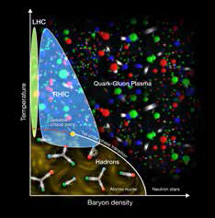
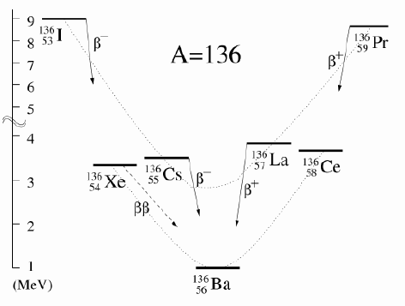
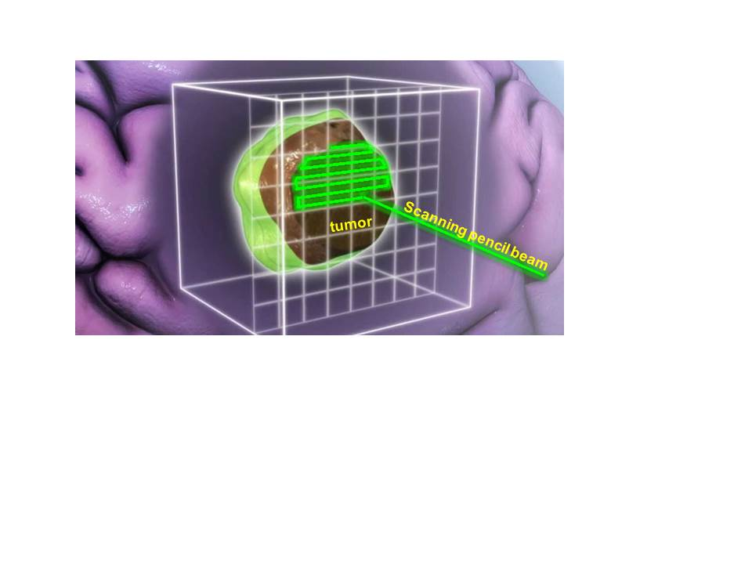

Will
21st Century Nuclear Science:
Probing nuclear matter in all Its forms & exploring their potential for applications
Where in the universe, and how, were the heavy elements formed? How do supernovae explode?
How are the properties of protons and neutrons, and the force between them, built up from quarks, antiquarks and gluons? What is the mechanism by which these fundamental particles materialize as hadrons?
Where are the limits of nuclear existence, and what is the structure of nuclei near those limits?
What is the nature of the different phases of nuclear matter through which the universe has evolved?
Do nucleons and all nuclei, viewed at near light speed, appear as walls of gluons with universal properties?
How can the properties of nuclei be used to reveal the fundamental processes that produced an imbalance between matter and antimatter in our universe?
How are the nuclear building blocks manifested in the internal structure of compact stellar objects, like neutron stars?
How can technologies developed for basic nuclear physics research be adapted to address society’s needs?

Slide 3
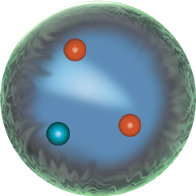
Nuclear Science is at a Launching Point in Reaching for the Horizon
JLAB 12 GeV Upgrade – Valence 3D Imaging and Valence Glue
Valence quarks and gluons
RHIC – Low Energy Search for critical point
Exploit jets and high mass probes
Quark Gluon Plasma
The most perfect liquid
FRIB – Twice the number of
nuclei available
NSCL, ATLAS and
University Facilities
The Structure and Limits of Nuclei
The Origin of Nuclei
Unique Nuclear Probes of Physics beyond the Standard Model
Neutrinoless Double Beta Decay, Electric Dipole Moments and other nuclear tests of the Standard Model
Understanding the Glue that binds us all
A future Electron Ion Collider

Slide 4
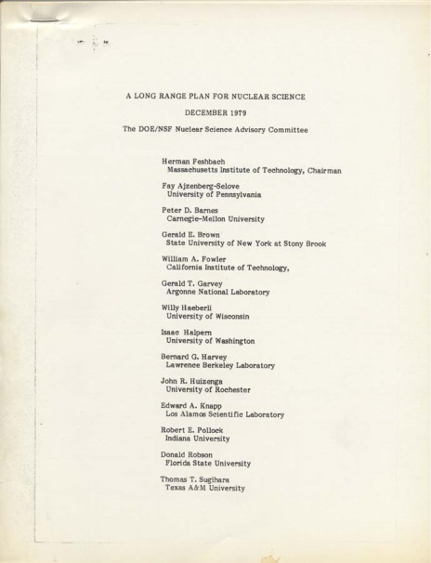
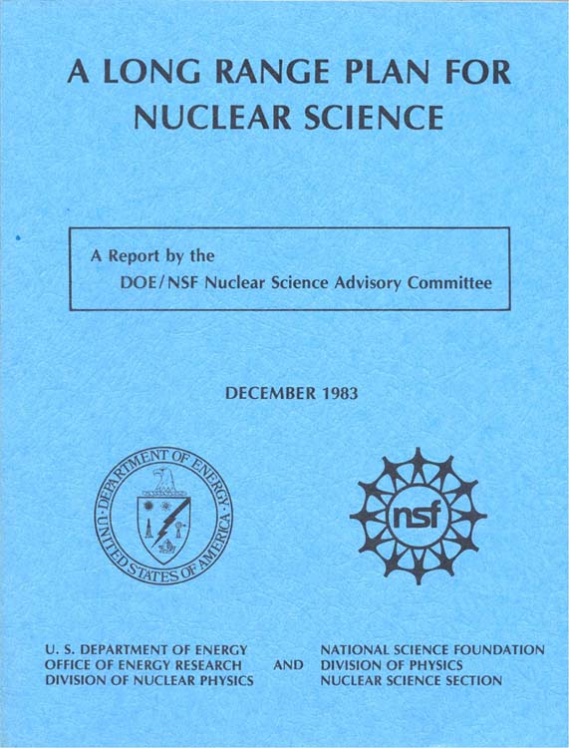
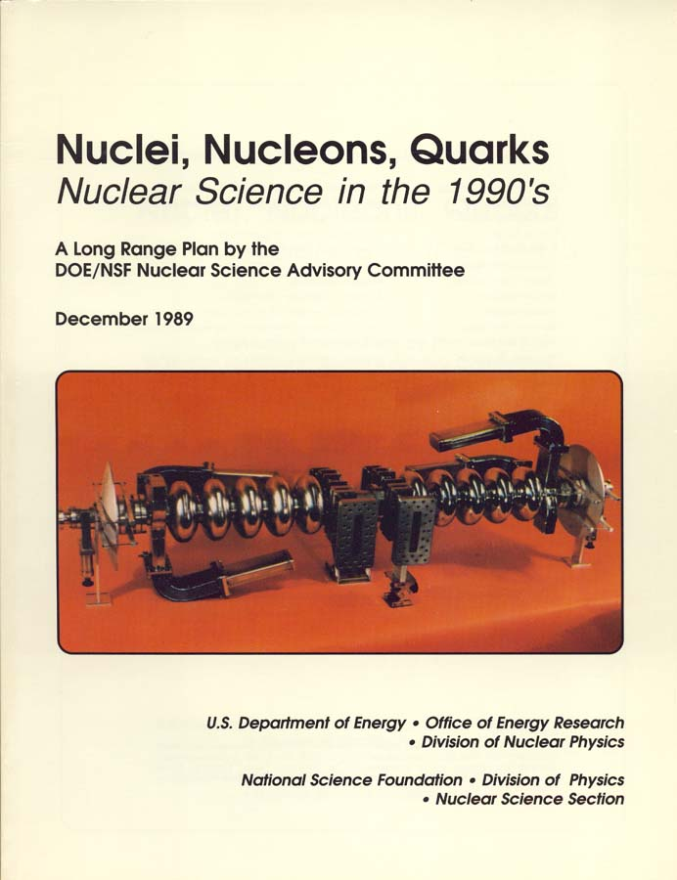
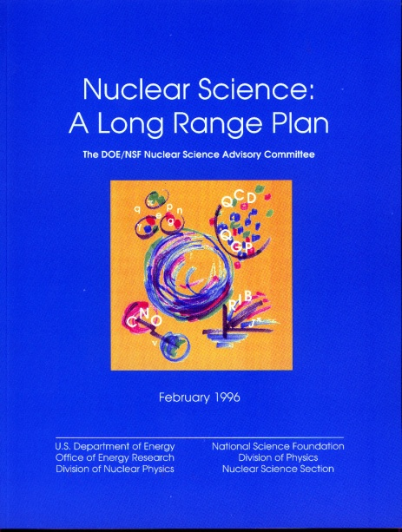
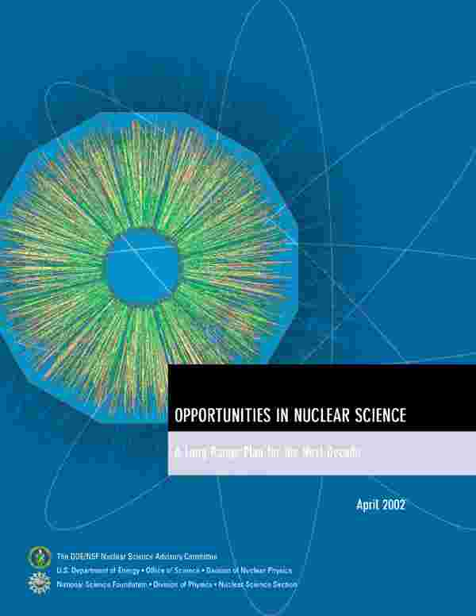
Nuclear Science in the U.S. has been guided by the NSAC Long Range Plans
For large projects ~15 years between recommendation and first operation
1979
1983
Two Rare
Isotopes Facilities
–in-flight, ISOL
1989
1996
RIA (Descoped)
JLAB 12 GeV
2002
FRIB
RHIC Upgrade
CW Electron
Accelerator
2007
RHIC
Recommendations that did not
happen, typically recommendation #3-4,
but one was #1
10% budget increase
KAON
LISS
DUSEL

Slide 5


Our Charge is from Two Funding Agencies
Department of Energy
Office of Science
Nuclear Physics
National Science Foundation
Mathematical and Physical Sciences
Directorate
Division of Physics

Slide 6
The process has evolved
- NSAC smoke filled room
1983- Working group of ~50 members including younger scientists. I was a member at age 33.
1989- NSAC organized community town meetings
1995- NSAC and DNP together organized community meetings
2001- DNP by itself organized community town meetings
2007-
2015-

Slide 7
Fundamentals- Trust
We can see the the program office has listened to the Long Range Plans and helped deliver major initiatives.
The fundamental recommendations are about capabilities to do science, not a particular machine or experiment. This differs from the HEP P5 charge. We trust the DOE and NSF to optimize the science delivery.
Under budget pressures, the scope that can go forward may be reduced, if the science still can be done.
To be effective the entire community must support the plan. We cannot circle the wagons and shoot inward.
If we start something, finishing it is a priority.
Budget constraints are real. This means low-ball estimates of project costs are dangerous.
It must address the international context.
Obviously great care must be taken in selection of the subcommittee members to avoid the perception of bias.

Slide 8
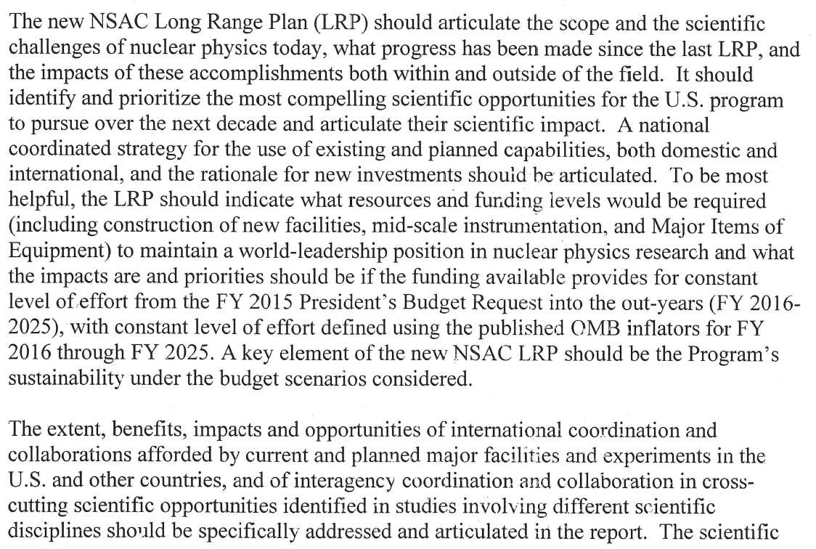
Charge to NSAC to Develop a New Long Range Plan

Slide 9
Charge to NSAC to Develop a New Long Range Plan
“a framework of coordinated advancement of the Nation’s nuclear science research programs over the next decade”
“articulate the scope and scientific challenges”
“what progress has been made and the impact of these accomplishments both within and outside the field”
“identify and prioritize the most compelling scientific opportunities”
“coordinated strategy for the use of existing and planned capabilities, both domestic and foreign”
“what resources and funding levels would be required … to maintain a world-leadership position in nuclear physics research”
“what the impacts are and priorities should be if funding provides for constant level of effort.”
“key element should be the Program’s sustainability under the budget scenarios considered”

Slide 10
LRP Schedule
Charge delivered at 24 April 2014 NSAC Meeting
LRP Working Group formed in early June ~ 60 members
  Observers from nuclear physics associations in Europe and Asia
Community organization summer 2014
DNP town meetings in the July/September 2014
Joint APS-DNP-Japanese Physical Society Meeting Oct 7-11, 2014
Working Group organizational meeting Nov 16, 2014
White papers submitted by end of January
Cost review of EIC – Report at April 3 NSAC meeting
Most of text of report assembled by April 10
Resolution meeting of Long Range Plan working group April 16-20, 2015 in Kitty Hawk, NC. The wordings of the recommendations were frozen.
Second draft of full report by May 18
Draft report reviewed by external wise women and men
  Balantekin, Jacak, Redwine, Seestrom, Symons, Tribble,
LRP final report October 2015 – NSAC Meeting and Public Presentation
18 months in 2014-15. Some were done in 6 months.

Slide 11
Special Thanks to the Organizers and Participants in the Town Meetings
Education and Innovation: Michael Thoennessen and Graham Peaslee
Nuclear Structure: Mark Riley and Charlotte Elster
Nuclear Astrophysics: Hendrik Schatz and Michael Wiescher
Hadron QCD: Haiyan Gao and Craig Roberts
Heavy Ion QCD: Paul Sorensen and Ulrich Heinz
Fundamental Symmetries, Neutrinos and the Relevant Nuclear Astrophysics:
Hamish Robertson and Michael Ramsey-Musolf
High Performance Computing: A. Burrows, J Carlson, W. Detmold, R. Edwards, R, Furnstahl, W, Haxton, W, Hix, F. Karsch, W. Nazarewicz, P. Petreczky, D, Richards and M. Savage. This was an ad-hoc meeting.

Slide 12
Town Meetings
I gave no direction to DNP or the town meeting organizers because they were familiar with the process.
One major goal is to help make the physics case. Text from the white papers of the town meetings were freely adapted for the science discussion in the LRP.
It is difficult for an open community to set priorities. If they can, that is great and has an impact with the LRP working group. If not, that is also useful information.
Ad hoc town meetings that do not spring from the DNP organization are also useful. They must be open to the broad community and let everyone have a chance to speak.
Listing every project as a separate recommendation is not particularly useful.

Slide 13
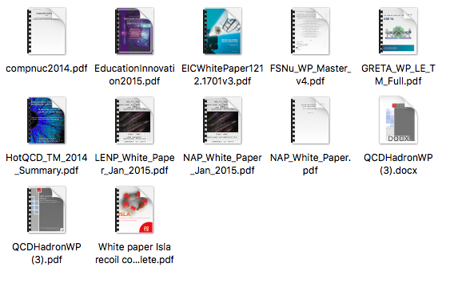
White Papers
These were public documents from the community
7 from town meetings
1 from proposed major facility
2 major instrumentation projects
2 copies in other formats

Slide 14
FY07 LRP Recommendations are being implemented!
These were made after a period, 2001-2006, of little major construction.
Complete JLAB 12 GeV - almost complete in FY15
Build FRIB - now well underway
Targeted program in fundamental symmetries
- underway
Upgrade RHIC - completed at 1/7 the anticipated
cost
Resources for R&D for EIC – steps forward
Initiatives in theory, gamma-ray tracking and Accelerator R&D - major progress, theory topical collaborations, GRETINA

Slide 15
2015 Recommendations from the Town Meetings
These flow into LRP recommendations
Run JLAB12
Run RHIC RHI
Run RHIC Spin
and other existing facilities
Run ATLAS and NSCL
Participation in LHC
Not
Priority
Ordered
Here!
Finish and run FRIB
Recommendation of both low energy
and astrophysics meetings
Lead NLDBD
$250M
<$1500M
Build EIC
Recommendation of both hadron and hot qcd meetings
Increase Instrumentation and MIE
Requests
JLAB $75M
LE $116M
RHI $31M
ASTRO $25M
OTHER FS&N $116M
TOTAL $363M
Increase theory and theory computing
Increase experimental research
in Astro, FS&N

Slide 16
How were recommendations and priorities set in the Long Range Plan?
The recommendations were developed by consensus in the context of illustrative budget scenarios. Having sample budgets to work through was very important. It was understood that hard choices had to be made or the budgets would be completely unrealistic. The only votes were on details of word choice.
In earlier LRP there have been working group votes on relative priorities of different initiatives.

Slide 17
RECOMMENDATION I
The progress achieved under the guidance of the 2007 Long Range Plan has reinforced U.S. world leadership in nuclear science. The highest priority in this 2015 Plan is to capitalize on the investments made.
With the imminent completion of the CEBAF 12-GeV Upgrade, its forefront program of using electrons to unfold the quark and gluon structure of hadrons and nuclei and to probe the Standard Model must be realized.
Expeditiously completing the Facility for Rare Isotope Beams (FRIB) construction is essential. Initiating its scientific program will revolutionize our understanding of nuclei and their role in the cosmos.
The targeted program of fundamental symmetries and neutrino research that opens new doors to physics beyond the Standard Model must be sustained.
The upgraded RHIC facility provides unique capabilities that must be utilized to explore the properties and phases of quark and gluon matter in the high temperatures of the early universe and to explore the spin structure of the proton.
Realizing world-leading nuclear science also requires robust support of experimental and theoretical research at universities and national laboratories and operating our two low-energy national user facilities —ATLAS and NSCL— each with their unique capabilities and scientific instrumentation.
The ordering of these four bullets follows the priority ordering of the 2007 plan.

Slide 18
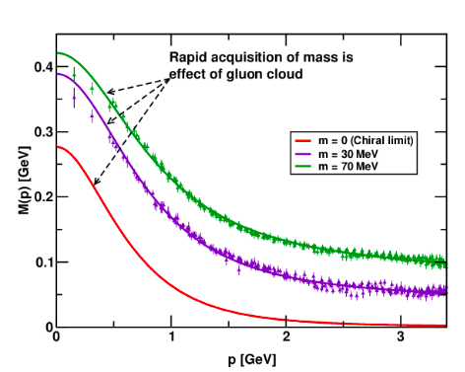
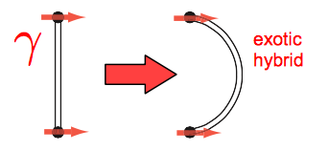
The CEBAF 12 GeV Era
The upgraded CEBAF has the ideal beam properties to learn about the dynamics of the valence quarks that determine the quantum numbers of strongly interacting particles.
We have learned this dynamics is strongly influenced by the mechanism that develops mass in QCD, dynamical chiral symmetry breaking.
We have a firm theoretical framework to measure the correlations between quark momentum and transverse position, 3D imaging.
We will search for particles where the glue helps determine the quantum numbers.

Slide 19
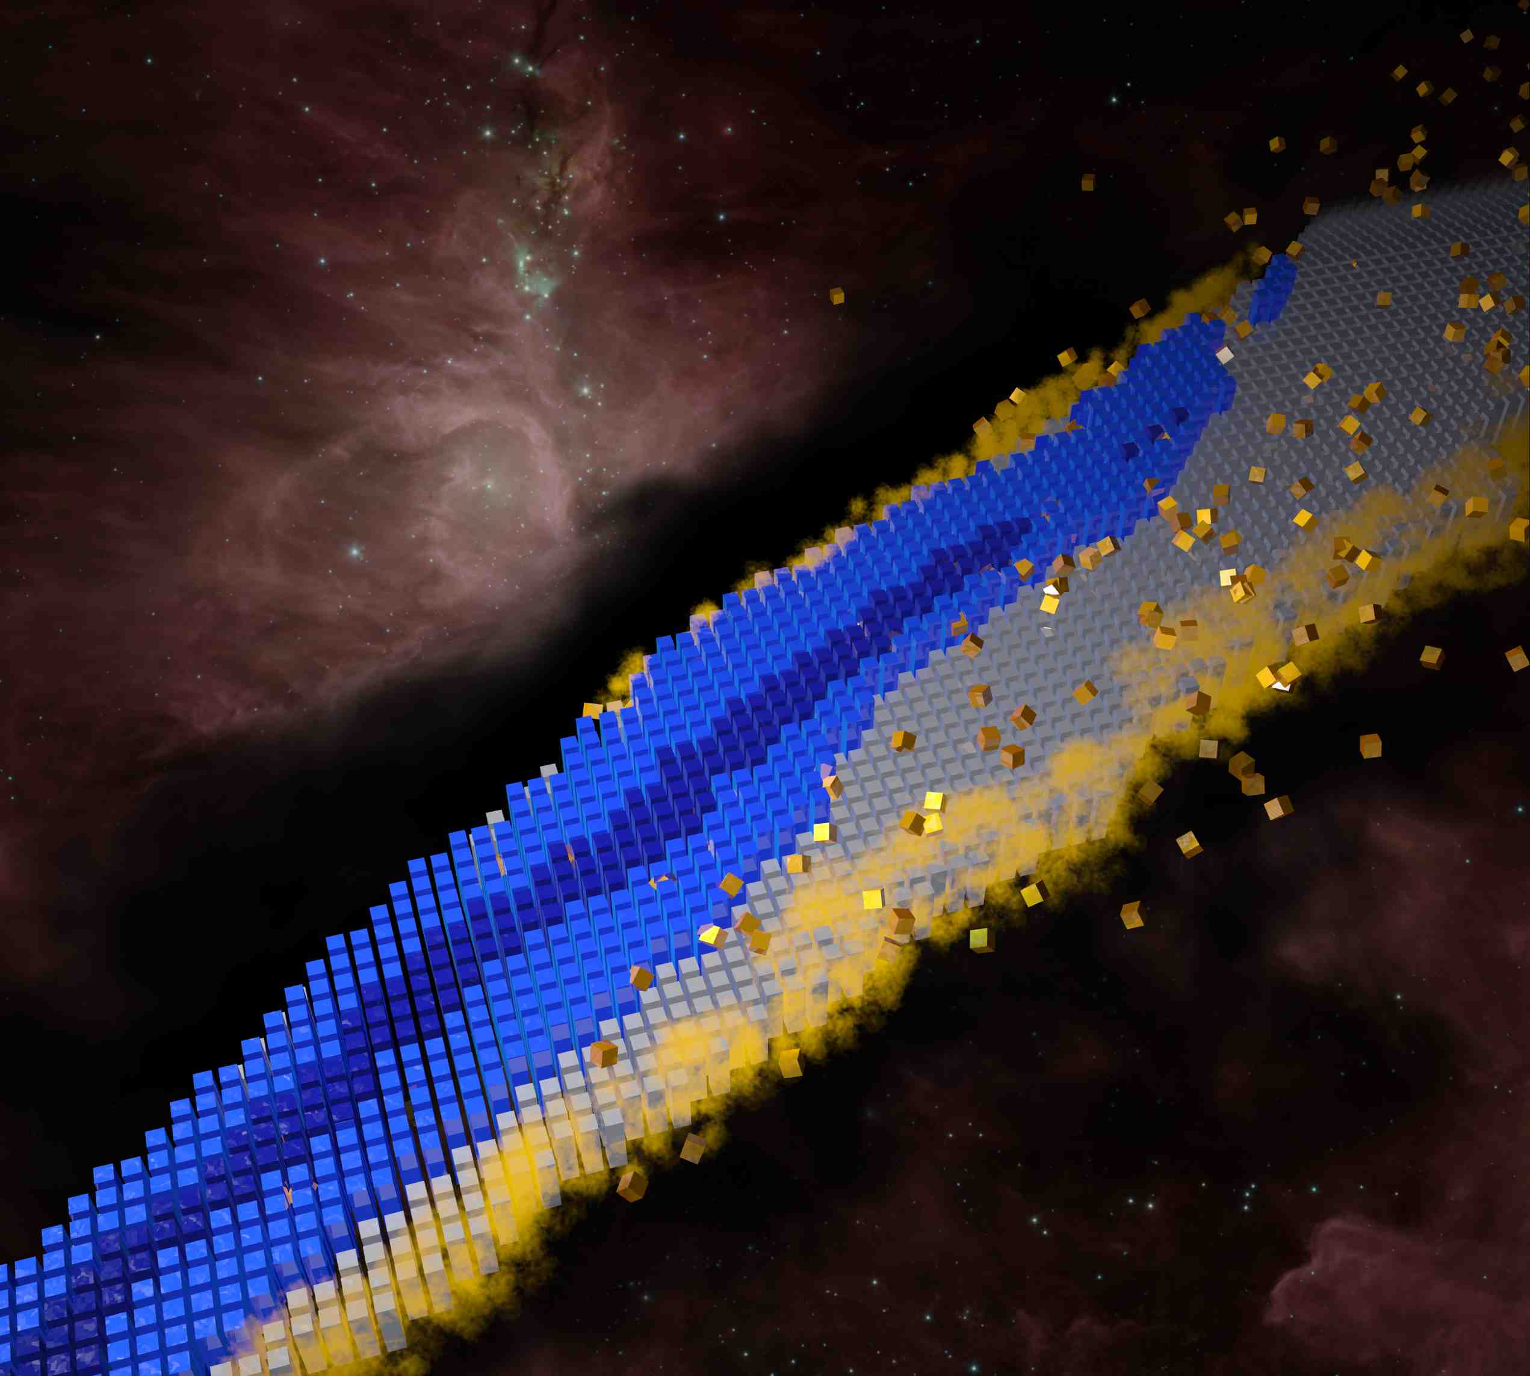
The FRIB ERA
The Nuclear Landscape and the Big Questions
Where do nuclei and elements come from?
How are nuclei organized?
What are practical and scientific uses of nuclei?
BOTTOM LINE
Revolution due to major advances in accelerator technology, experimental techniques, analytic theory, and computing. This has led to a shift from phenomenological picture to nuclear theory grounded in the Standard Model. Today, we are constructing a roadmap that will lead to a predictive theory of nuclei.
To Understand, Predict, and Use…
Notes:
http://www.astro.ucla.edu/~wright/BBNS.html

Slide 20
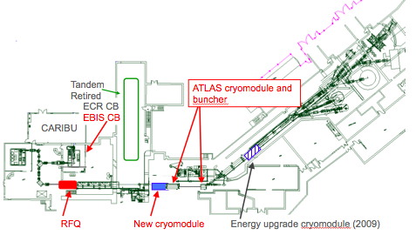
Roles in 2024
Two DOE user facilities needed to accommodate the physics goals of the low-energy nuclear physics community in the US, down from four low-energy user facilities in 2001.
  FRIB: the radioactive beam facility with the furthest reach from stability
  ATLAS: unique high-intensity stable beam facility for low cross section and high precision experiments closer to stability
Connecting the physics far from stability to that observed near or at stability requires these two world-leading facilities
ATLAS

Slide 21
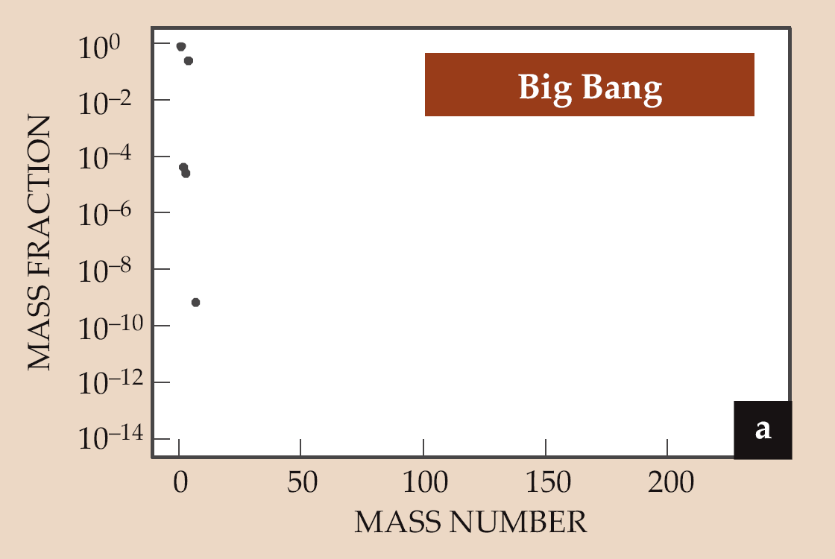
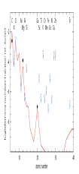
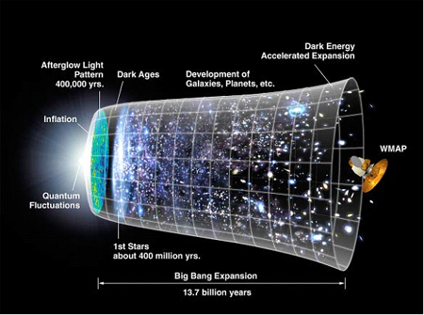

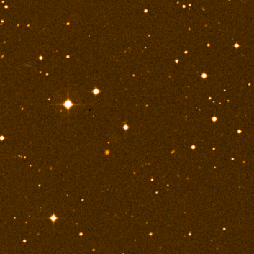
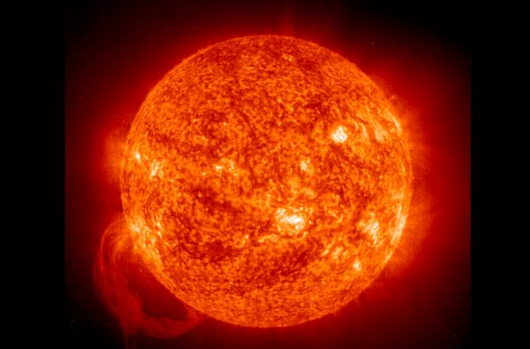
Nuclear Astrophysics
Compelling Open Questions
What is the origin of the elements?
  What nuclear processes contribute to the origin of elements
  How did the chemical composition of the universe evolve?
2nd Generation star
Very old star
Sr
Big Bang – Li Problem – what is primordial abundance?
Early Stars – dynamic nucleosynthesis – how are C and O formed?
Quiescent burning and seed material – what are burning and ignition conditions
r-process, s-process, p-process, i-process and the origin of the heavy materials
Weak interaction and neutrino physics in Big Bang, core collapse, and dense objects
21

Slide 22
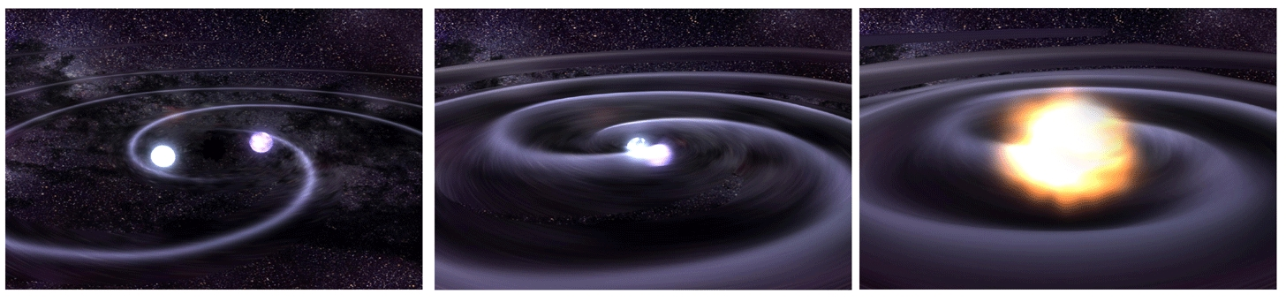
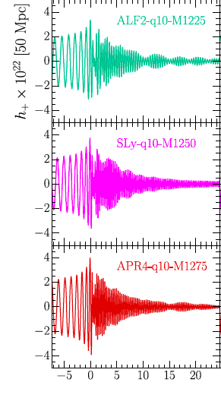
Nuclear Physics in Gravitational Waves
One of the best signals for the NSF’s Advanced LIGO is the merger of two neutron stars
This will immediately tell us the rate of neutron star mergers. Are there enough to create the heavy elements through the r-process?
The waveform is sensitive to the nuclear equation of state for neutron stars

Slide 23
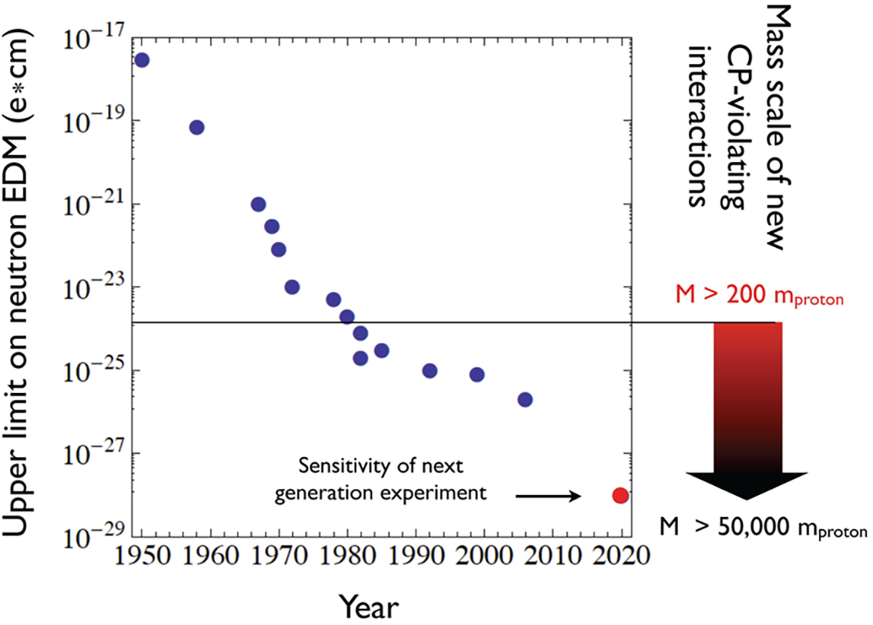
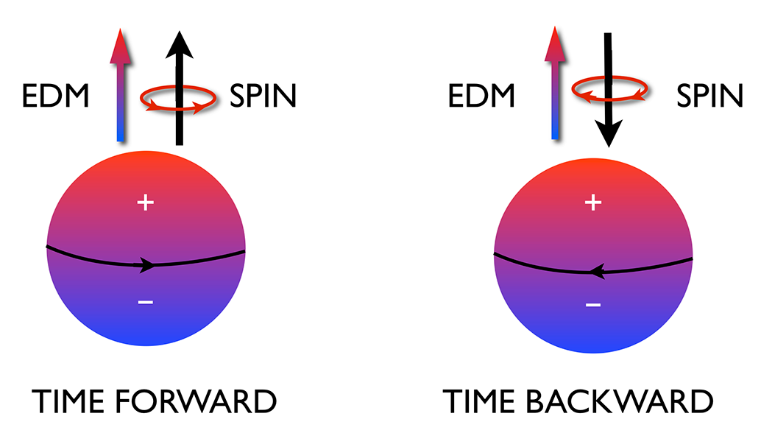
Fundamental Symmetries - Example
Search for CP Violation in Electric Dipole Moments
There is a full court press searching for new mechanisms for CP violation to explain the matter/antimatter asymmetry of the universe. A measurement of an electric dipole moment of the neutron is one of the most sensitive of these searches. The U.S. effort is jointly funded by NSF and DOE and will use the fundamental physics neutron beam line at the SNS.
Reversing time reverses the relative direction of the spin and EDM. By the CPT theorem, this is CP violating

Slide 24
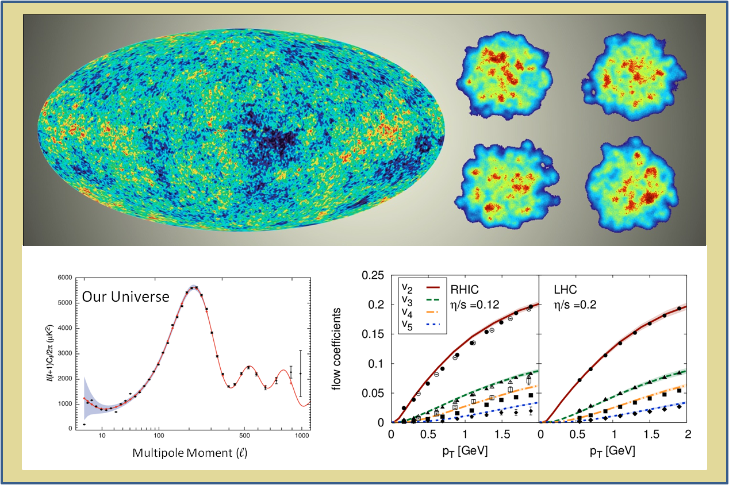
RHIC and the LHC
The Big Bang vs Lots of Little Bangs
In both cases the measurements at later time reveal the fluctuations in the initial conditions which are remarkably preserved during the expansion.

Slide 25
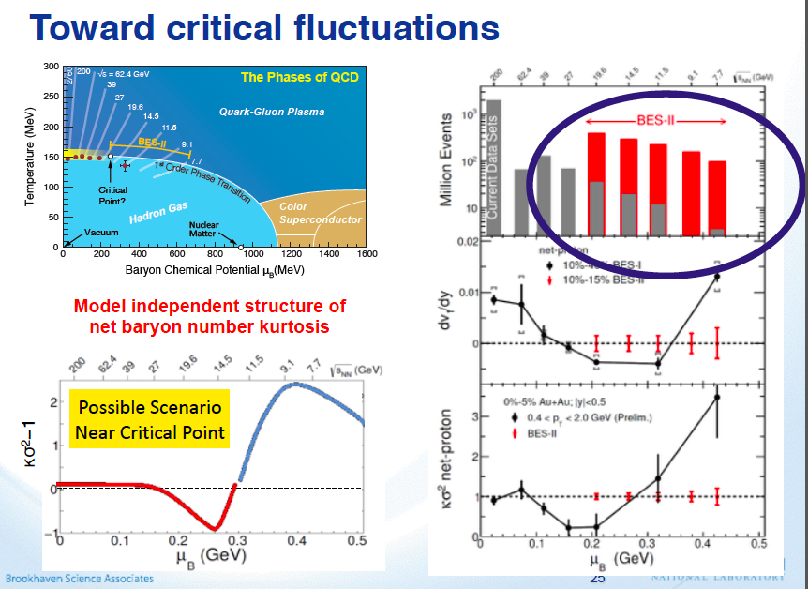

Slide 26
RECOMMENDATION II
The excess of matter over antimatter in the universe is one of the most compelling mysteries in all of science. The observation of neutrinoless double beta decay in nuclei would immediately demonstrate that neutrinos are their own antiparticles and would have profound implications for our understanding of the matter-antimatter mystery.
We recommend the timely development and deployment of a U.S.-led ton-scale neutrinoless double beta decay experiment.
A ton-scale instrument designed to search for this as-yet unseen nuclear decay will provide the most powerful test of the particle-antiparticle nature of neutrinos ever performed. With recent experimental breakthroughs pioneered by U.S. physicists and the availability of deep underground laboratories, we are poised to make a major discovery.
This recommendation flows out of the targeted investments of the third bullet in Recommendation I. It must be part of a broader program that includes U.S. participation in complementary experimental efforts leveraging international investments together with enhanced theoretical efforts to enable full realization of this opportunity.

Slide 27
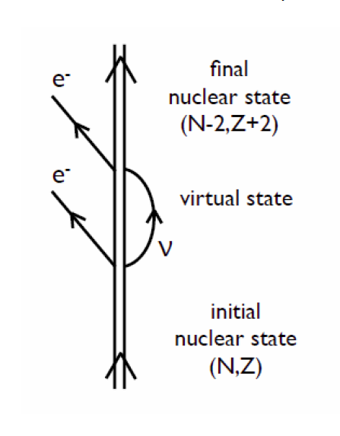
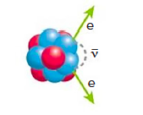
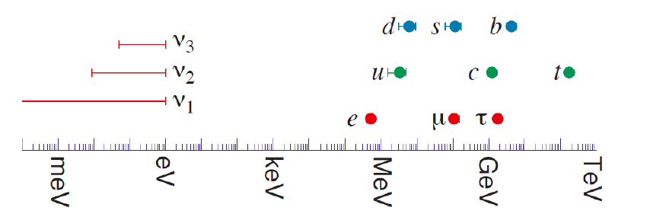
Neutrinoless Double Beta Decay
Observation of Neutrinoless
Double Beta Decay would
Demonstrate the lepton number is not conserved
Prove that a neutrino is an elementary Majorana particle, that is, its own antiparticle.
Suggest that a new mechanism for mass generation, not the Higgs mechanism, is at work.
Provide evidence for one of the key ingredients that could explain the preponderance of matter over antimatter in the universe, leptogenesis.

Slide 28
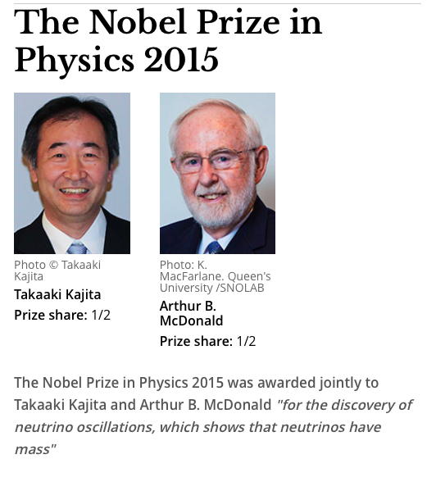
This work sets a minimum mass for the heaviest of the three neutrinos of
58 meV.
This prize follows the 2002 Nobel prize winning work of Davis and Koshiba for detecting cosmic neutrinos.

Slide 29
RECOMMENDATION III
Gluons, the carriers of the strong force, bind the quarks together inside nucleons and nuclei and generate nearly all of the visible mass in the universe. Despite their importance, fundamental questions remain about the role of gluons in nucleons and nuclei. These questions can only be answered with a powerful new Electron Ion Collider (EIC), providing unprecedented precision and versatility. The realization of this instrument is enabled by recent advances in accelerator technology.
We recommend a high-energy high-luminosity polarized Electron Ion Collider as the highest priority for new facility construction following the completion of FRIB.
The EIC will, for the first time, precisely image gluons in nucleons and nuclei. It will definitively reveal the origin of the nucleon spin and will explore a new Quantum Chromodynamics (QCD) frontier of ultra-dense gluon fields, with the potential to discover a new form of gluon matter predicted to be common to all nuclei. This science will be made possible by the EIC’s unique capabilities for collisions of polarized electrons with polarized protons, polarized light ions, and heavy nuclei at high luminosity.

Slide 30
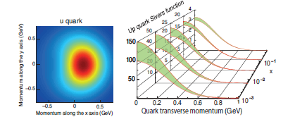
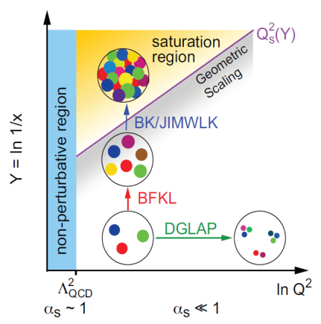
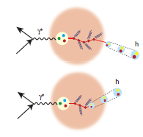
The Science Questions for the EIC as laid out by the community
How are the sea quarks and gluons, and their spins, distributed in space and momentum inside the nucleon? How are these quark and gluon distributions correlated with overall nucleon properties, such as spin direction? What is the role of the orbital motion of sea quarks and gluons in building the nucleon spin?
Where does the saturation of gluon densities set in? Is there a simple boundary that separates this region from that of more dilute quark-gluon matter? If so, how do the distributions of quarks and gluons change as one crosses the boundary. Does this saturation produce matter of universal properties in the nucleon and all nuclei viewed at nearly the speed of light?
How does the nuclear environment affect the distribution of quarks and gluons and their interactions in nuclei? How does the transverse spatial distribution of gluons compare to that in the nucleon? How does nuclear matter respond to a fast moving color charge passing through it? Is this response different for light and heavy quarks?
Quark propagation

Slide 31
RECOMMENDATION IV
We recommend increasing investment in small-scale and mid-scale projects and initiatives that enable forefront research at universities and laboratories.
Innovative research and initiatives in instrumentation, computation, and theory play a major role in U.S. leadership in nuclear science and are crucial to capitalize on recent investments. The NSF competitive instrumentation funding mechanisms, such as the Major Research Instrumentation (MRI) program and the Mathematical & Physical Sciences mid-scale research initiative, are essential to enable university researchers to respond nimbly to opportunities for scientific discovery. Similarly, DOE-supported research and development (R&D) and Major Items of Equipment (MIE) at universities and national laboratories are vital to maximize the potential for discovery as opportunities emerge.
The context was that DOE major capital equipment funding had been very low in 2014 and 2015 and NSF wanted to introduce mid-scale instrumentation funding.

Slide 32
The Role of the NSAC Long Range Plan in Projects
NSAC is asked to identify scientific opportunities and a level of resources necessary to achieve these. The recommendations express priorities. But, except for the largest-scale facilities, projects named in this report are given as examples to carry out the science. The funding agencies have well-established procedures to evaluate the scientific value and the cost and technical effectiveness of individual projects. There is a long-standing basis of trust that if NSAC identifies the opportunities, the agencies will do their best to address these, even under the constraints of budget challenges.
In this way our charge is different than that of the HEP Particle Physics Prioritization Panel which considers individual projects.

Slide 33
A: Theory Initiative
Advances in theory underpin the goal that we truly understand how nuclei and strongly interacting matter in all its forms behave and can predict their behavior in new settings.
To meet the challenges and realize the full scientific potential of current and future experiments, we require new investments in theoretical and computational nuclear physics.
We recommend new investments in computational nuclear theory that exploit the U.S. leadership in high-performance computing. These investments include a timely enhancement of the nuclear physics contribution to the Scientific Discovery through Advanced Computing program and complementary efforts as well as the deployment of the necessary capacity computing.
We recommend the establishment of a national FRIB theory alliance. This alliance will enhance the field through the national FRIB theory fellow program and tenure-track bridge positions at universities and national laboratories across the U.S.
We recommend the expansion of the successful Topical Collaborations initiative to a steady-state level of five Topical Collaborations, each selected by a competitive peer-review process.

Slide 34
B: Initiative for Detector and Accelerator Research and Development
U.S. leadership in nuclear physics requires tools and techniques that are state-of-the-art or beyond. Targeted detector and accelerator R&D for the search for neutrinoless double beta decay and for the Electron Ion Collider is critical to ensure that these exciting scientific opportunities can be fully realized.
We recommend vigorous detector and accelerator R&D in support of the neutrinoless double beta decay program and the Electron Ion Collider.

Slide 35
Workforce, Education, and Outreach
A workforce trained in cutting-edge nuclear science is a vital resource for the Nation.
Our Nation needs a highly trained workforce in nuclear science to pursue research, develop technology, and ensure national security. Meeting this need relies critically on recruiting and educating early career scientists.
We recommend that the NSF and DOE take the following steps.
Enhance programs, such as the NSF-supported Research Experience for Undergraduates (REU) program, the DOE-supported Science Undergraduate Laboratory Internships (SULI), and the DOE-supported Summer School in Nuclear and Radiochemistry, that introduce undergraduate students to career opportunities in nuclear science.
Support educational initiatives and advanced summer schools, such as the National Nuclear Physics Summer School, designed to enhance graduate student and postdoctoral instruction.
Support the creation of a prestigious fellowship program designed to enhance the visibility of outstanding postdoctoral researchers across the field of nuclear science.

Slide 36
International Context- We rely on off-shore facilities
Higher energy relativistic heavy ions – LHC
Multi-GeV energy hadron beams – J-PARC, FAIR, CERN
Higher energy radioactive beams – RIBF, GSI, FAIR
ISOL radioactive beams – TRIUMF, ISOLDE
To a large part, neutrons and neutrinos from reactors
Lower energy electron beams – Mainz
High resolution transfer reactions with stable beams - RCNP
In some cases, U.S. scientists are users of these facilities. In others, we count on experiments at these facilities to provide complementary information.

Slide 37
Budgets
It is well recognized that resources are always limited, and hard choices have been made concerning parts of the program that could not go forward in a realistic budget scenario. For example, the 2013 NSAC report Implementing the 2007 Long Range Plan responded to a more constrained budget picture than was originally expected. The resulting focused plan has been widely supported by the community, the Administration and the Congress. The 2015 Long Range Plan also involved hard choices to go forward with constrained budget scenarios.

Slide 38
Project Sequencing
FY15-18 as in 2013 Implementation Plan and consistent with the FY16 President’s budget request
Ton-scale neutrinoless double beta decay starts near end of the decade after FRIB peak.
  Need for demonstration projects to show what they can do and need for more R&D
  A standing NSAC subcommittee is providing advice.
EIC construction after completion of FRIB construction.
  Time scale set, in part, by exciting physics at current facilities, by R&D required, and, in part, to avoid the need for large sudden budget increase.
  Significant redirection from existing facilities when construction begins

Slide 39
Other Budget Priorities
Increased small-scale and mid-scale projects including theory computing. This was temporarily sacrificed in 2013 implementation plan to start construction program.
Increased research funding. It has fallen over the past few years to less than 30% of total in 2015 in DOE-NP.

Slide 40
Major NP Facilities Have Been Closed
Bevalac
LAMPF
M.I.T. Bates Electron Accelerator
Holifield Radioactive Ion Beam Facility
but so far no long range plan has recommended this. Ad-hoc NSAC subcommittees responding to specific charges have recommended closures under specific budget guidance.

Slide 41
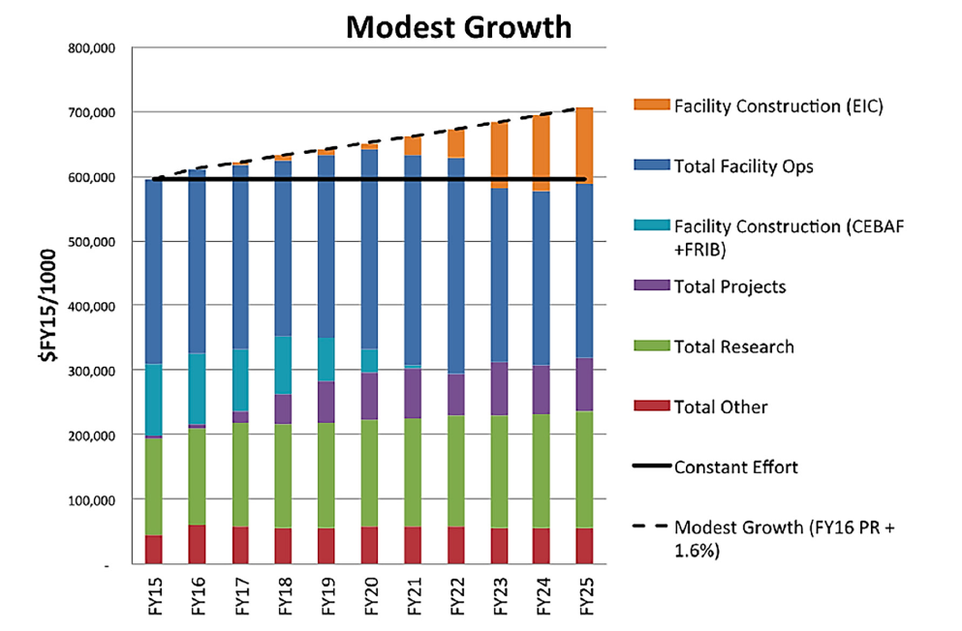
DOE Budget Projections
This is comparable to NP budget growth from 2007 to 2015

Slide 42
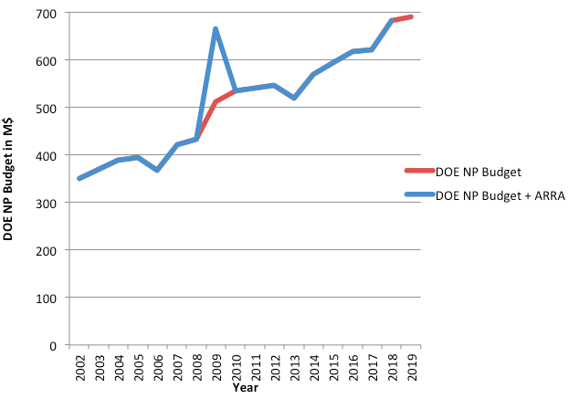
Is This Realistic?
DOE NP Budget history Since the 2007 LRP
Since 2007, the real growth has been larger than this!

Slide 43
NSF Nuclear Physics Budget
FRIB begins operation at the mid-point of this LRP and NSCL transitions from NSF stewardship. Before the transition , NSCL will remain the premier national user facility for rare isotope research in the U.S., with unique rare isotope reacceleration capabilities following fast beam fragmentation.
We project increasing mid-scale funding at NSF and believe NP can compete well across the Physics Division for new initiatives. This is essential to ensure NSF-supported scientists have the resources to lead significant initiatives. We did not specifically associate any one initiative with NSF except as significant partners/leaders in neutrinoless double beta decay and neutron EDM where they already play important roles.
We project a total NSF nuclear physics funding increasing slightly each year in line with the modest growth scenario.

Slide 44
Impacts of Constant Effort Budget
Under a budget that represents constant effort at the level of the appropriated FY 2015 budget, the decisions become more difficult. Promising opportunities will be lost. The technology choices for some of the major projects may become driven more by cost rather than by optimizing the science reach. This could affect the international competitiveness of the ton-scale neutrinoless double beta decay experiment. While the FRIB facility operations can be maintained, completion of experimental equipment needed to fully utilize FRIB beams would be stretched out in time. There would be less scope to follow up new discoveries at FRIB, CEBAF, and RHIC. The EIC must begin more slowly. U.S. leadership would be maintained in some areas but would be given up in others.
The most difficult choices would occur at or beyond the mid-point of time window of this LRP.
Nonetheless, a constant effort budget can fund a sustainable program for nuclear science, one of the elements of the charge.

Slide 45
Thoughts from afar on P5 and FESAC Plans
HEP does an even more comprehensive job now than NP in organizing the community to contribute to the planning process.
Previous HEPAP LRP’s suffered from the focus on the elephant in the room, the ILC. They required huge budget increases to implement recommendations. (ghost of the SSC). The 2014 P5 report responded to budget scenarios. The fusion community may have a similar issue with ITER.
P5 dealt with concrete projects.
P5 did a great job and I think you will learn a lot from Andy’s presentation tomorrow.
How do you build the trust in each other and the funding agencies?

Slide 46
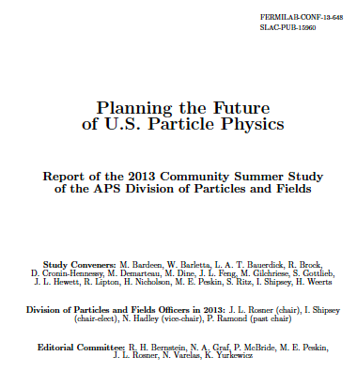

Slide 47
NSAC LRP and NAS Decadal Survey
In NP, the LRP is accepted as the base planning document.
If the LRP and Decadal Surveys offer differing priorities, I don’t know how you convince Congress to move forward.
In your case I understand they are going forward at the same time. This requires close coordination.

Slide 48
Summary
The NSAC LRP process has produced an exciting and sustainable world-leading science program
There are broader impacts to technology and medicine as well as other sciences such as astrophysics, HEP, material science and chemistry.
New powerful world leading tools are coming on-line and being constructed
We see important major initiatives for the future.
The recommendations were developed by consensus. There was unanimous agreement among the working group for the recommendations and the report. The community did unite to support this vision of the future.
It is built on trust within the community and with the funding agencies.

